Slide 1

Covid 19 Predictions with Data Science
#DataScienceJourneyWithANR

Slide 2

Our Business Approach
Look at the big picture.
Get the data.
Discover and visualize the data to gain insights.
Prepare the data for Machine Learning algorithms.
Select a model and train it.
Fine-tune your model.
Present your solution.
Launch, monitor, and maintain your system.

Slide 3
Big Picture
Epidemiologists are teaming up with data scientists to stem the spread of the novel coronavirus by tapping big data, machine learning and other digital tools.
The goal is to get real-time forecasts and other critical information to front-line health-care workers and public policy makers as the outbreak unfolds.
Known as outbreak analytics, the approach attempts to go beyond confirmed cases and fatalities to gauge the total number of people who are likely to be infected by a virus—
whether or not they show any symptoms.

Slide 4
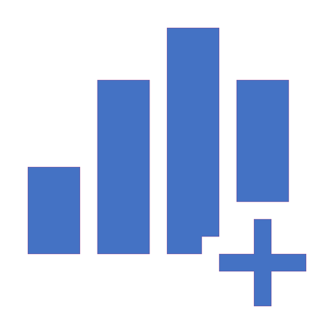
Get the Data
Source : https://github.com/CSSEGISandData/COVID-19/tree/master/csse_covid_19_data/csse_covid_19_time_series
1. Where is the data?
2. Do you need to change the data?
3. How will you connect the data?
4. Do you need to further consolidate the data?
5. How will you import the data?
6. How will you verify the results?
Start analysing!

Slide 5
Time Series Analysis
Time series analysis is a statistical technique that deals with time series data, or trend analysis.
Time series data means that data is in a series of particular time periods or intervals.
The data is considered in three types:
Time series data: A set of observations on the values that a variable takes at different times.
Cross-sectional data: Data of one or more variables, collected at the same point in time.
Pooled data: A combination of time series data and cross-sectional data.

Slide 6
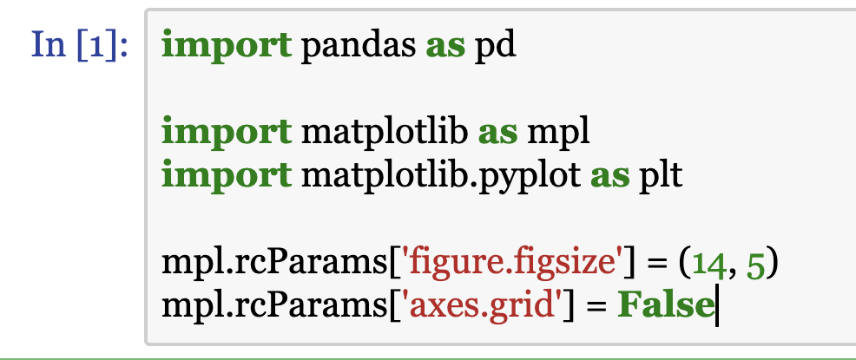
Importing Libraries & Get to know them
matplotlib.pyplot.figure
https://matplotlib.org/3.1.0/api/_as_gen/matplotlib.pyplot.figure.html
https://matplotlib.org/3.1.1/api/_as_gen/matplotlib.axes.Axes.grid.html

Slide 7
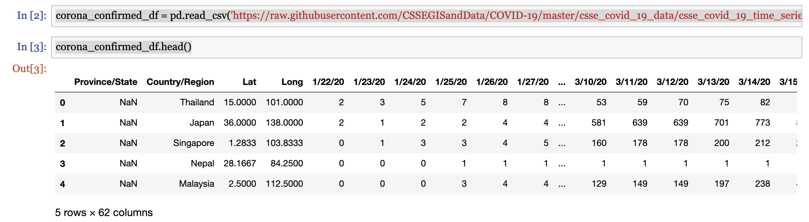
Loading the data into a DataFrame and Analyzing
First, lets Analyze the Confirmed cases and get to know the data points

Slide 8
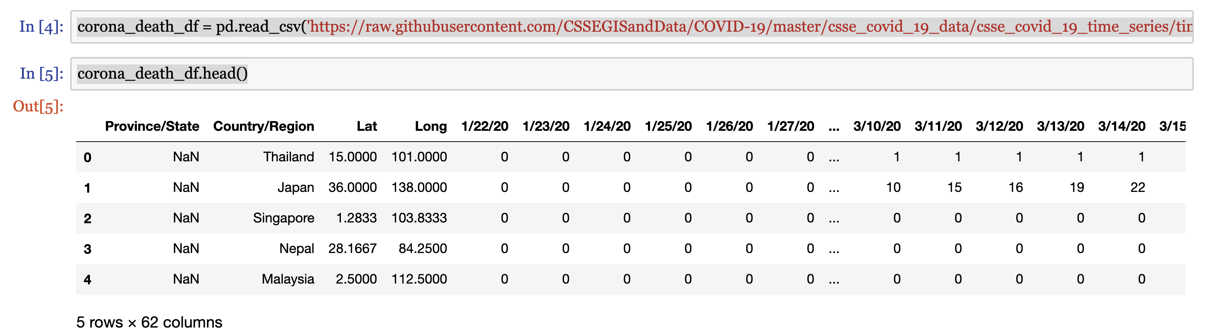
Loading the data into a DataFrame and Analyzing - Cont
Second, lets Analyze the Death cases and get to know the data points

Slide 9
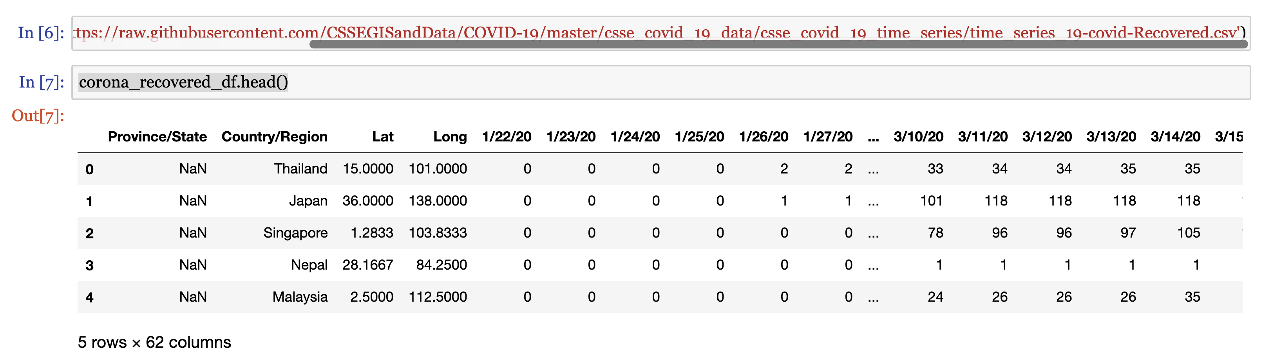
Loading the data into a DataFrame and Analyzing - Cont
Third , lets Analyze the Recovered cases and get to know the data points

Slide 10
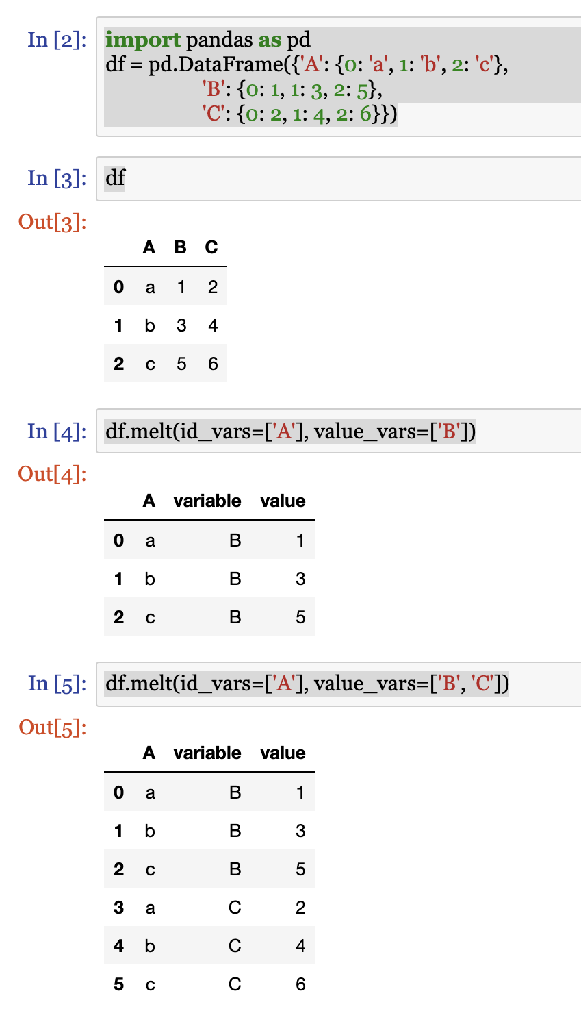
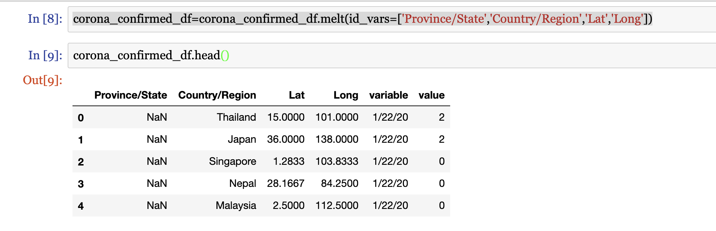
pandas.melt
This function is useful to massage a DataFrame into a format where one or more columns are identifier variables (id_vars), while all other columns, considered measured variables

Slide 11
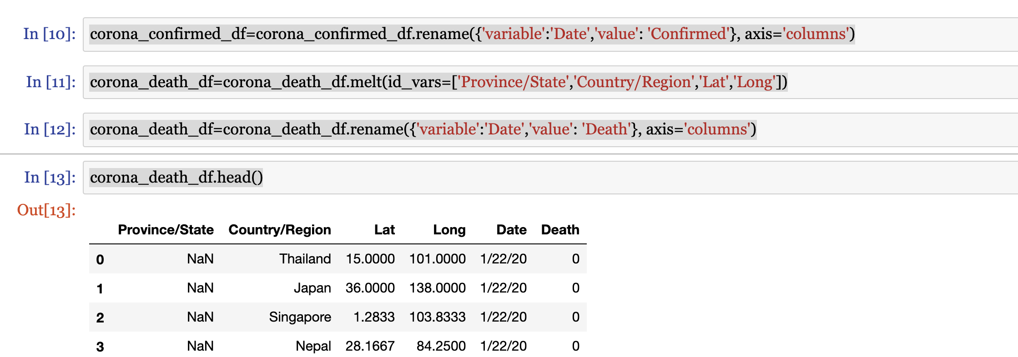
DataFrame rename for convenience
I have renamed the variable to date and value to confirmed for my ease.

Slide 12
pandas.DataFrame.set_index
Set the DataFrame index using existing columns.
Set the DataFrame index (row labels) using one or more existing columns or arrays (of the correct length). The index can replace the existing index or expand on it.
DataFrame.reset_index : Opposite of set_index.
DataFrame.reindex : Change to new indices or expand indices.
DataFrame.reindex_like : Change to same indices as other DataFrame.

Slide 13
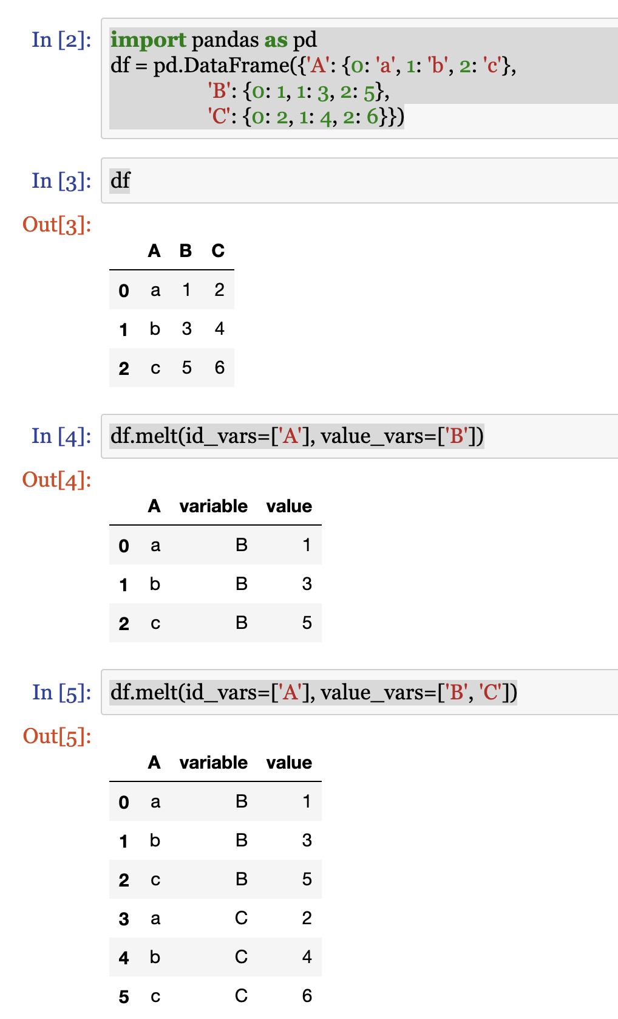
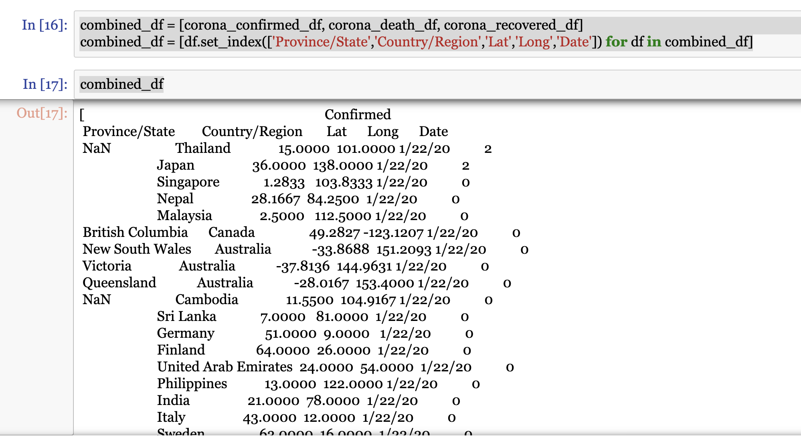
Implementing pandas melt & set_index

Slide 14
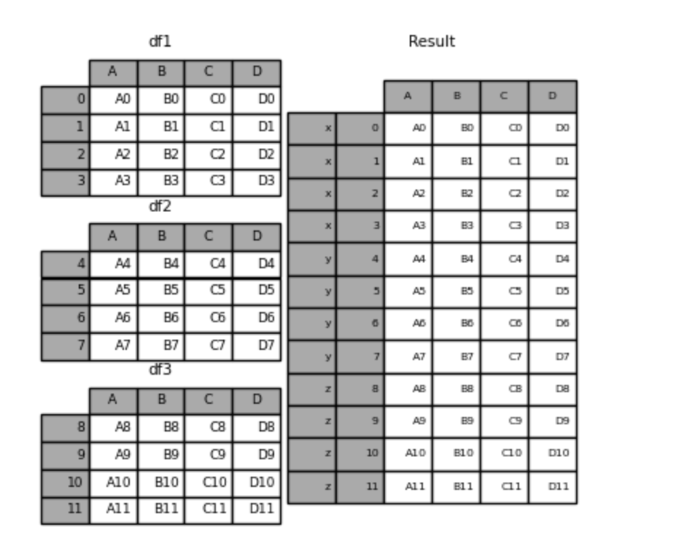
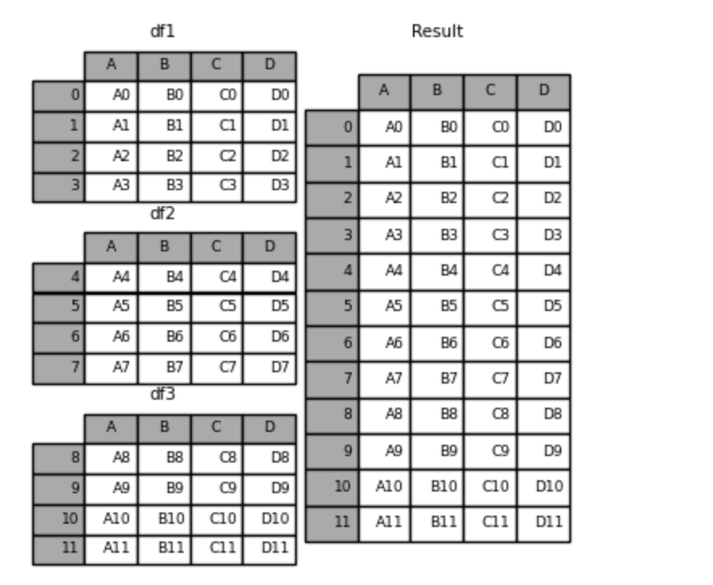
pandas.DataFrame.combine
Perform column-wise combine with another DataFrame.
Combines a DataFrame with other DataFrame using func to element-wise combine columns.
The row and column indexes of the resulting DataFrame will be the union of the two.

Slide 15
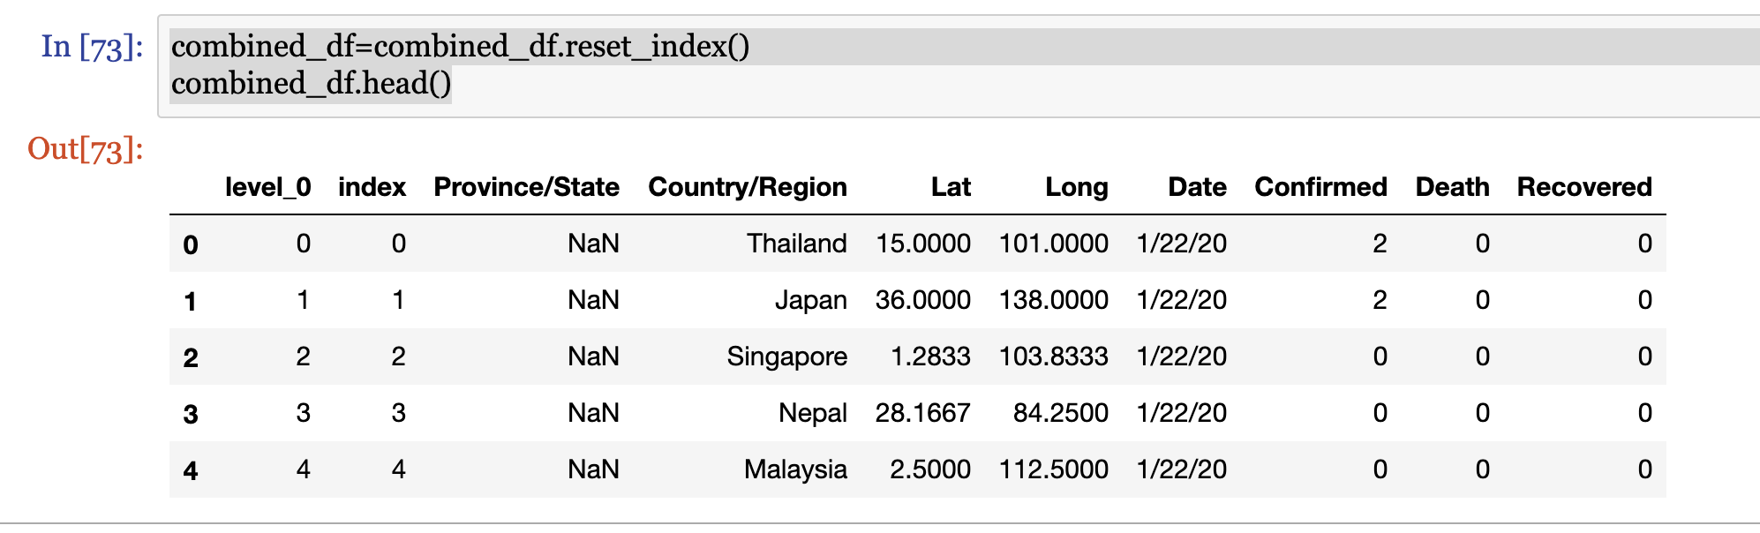
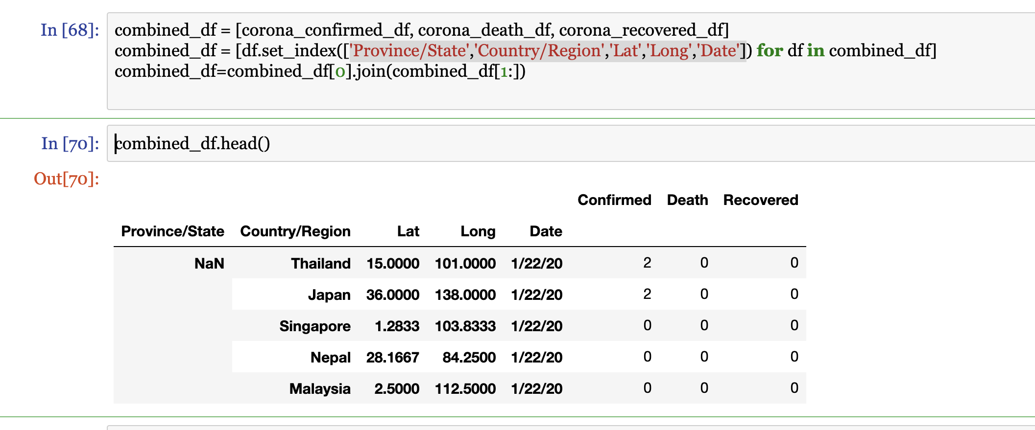
Observe the difference :

Slide 16
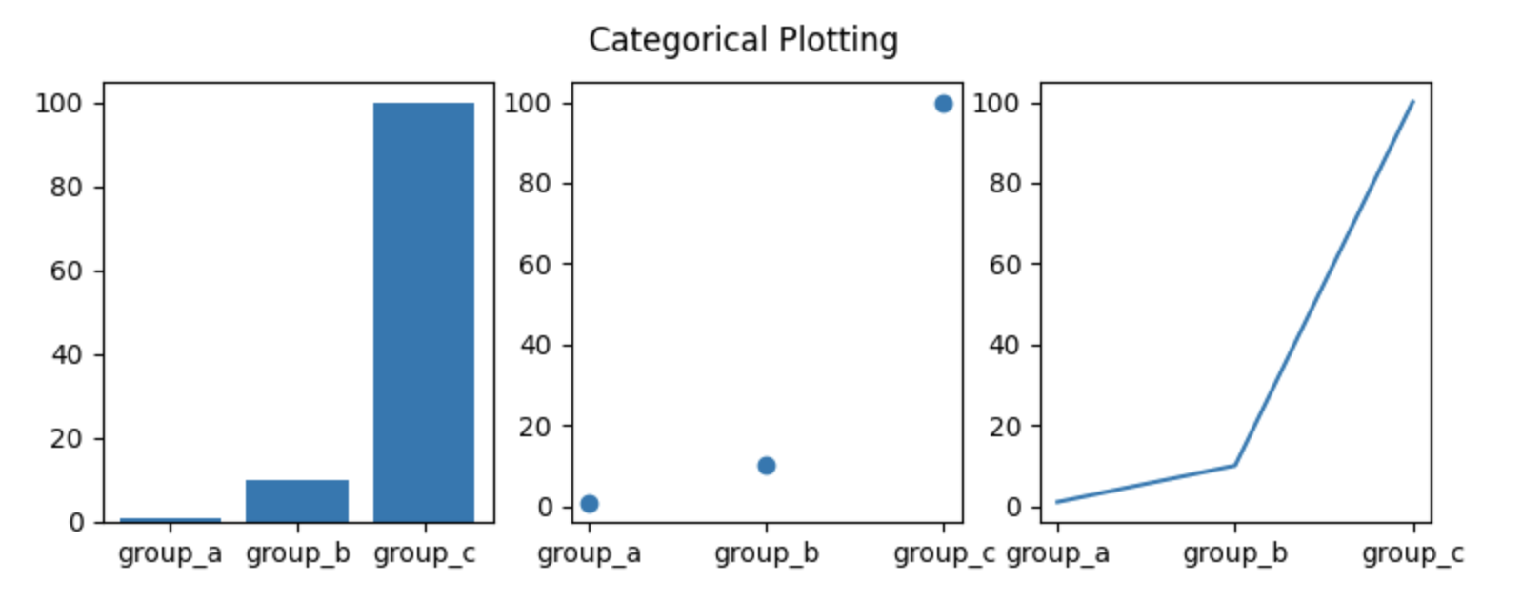
pandas.DataFrame.plot
Make plots of Series or DataFrame.
Parameters :
dataSeries or DataFrame
The object for which the method is called.
X : label or position, default,
NoneOnly used if data is a DataFrame.
Y : label, position or list of label, positions, default
NoneAllows plotting of one column versus another.
Only used if data is a DataFrame.

Slide 17
& Now Part II - Exponential & Logistic Modelling

Slide 18
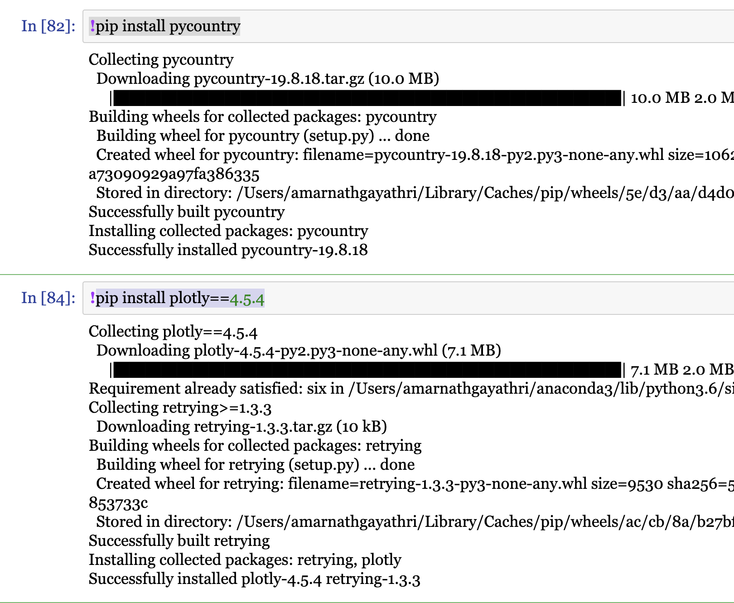
pip install pycountry & pip install plotly
Ploty - An open-source, interactive graphing library for Python
Pycountry - provides the ISO databases for the standards
Countries are accessible through a database object that is already configured upon import of pycountry

Slide 19

plotly.graph_objs
https://plot.ly/python/bar-charts/ -
With px.bar, each row of the DataFrame is represented as a rectangular mark.
https://plot.ly/python/line-charts/ -
How to make line charts in Python with Plotly. Examples on creating and styling line charts in Python with Plotly.

Slide 20
Prophet – Facebook API
Prophet follows the sklearn model API. We create an instance of the Prophet class and then call its fit and predict methods.
The input to Prophet is always a dataframe with two columns: ds and y.
The ds (datestamp) column should be of a format expected by Pandas, ideally YYYY-MM-DD for a date or YYYY-MM-DD HH:MM:SS for a timestamp.
The y column must be numeric and represents the measurement we wish to forecast.
Prophet is a procedure for forecasting time series data based on an additive model where non-linear trends are fit with yearly, weekly, and daily seasonality, plus holiday effects.
It works best with time series that have strong seasonal effects and several seasons of historical data.
Prophet is robust to missing data and shifts in the trend, and typically handles outliers well.

Slide 21
The Prophet Forecasting Model
The Prophet uses a decomposable time series model with three main model components:
trend, seasonality, and holidays
They are combined in the following equation:
y(t)= g(t) + s(t) + h(t) + εt
g(t): piecewise linear or logistic growth curve for modeling non-periodic changes in time series
s(t): periodic changes (e.g. weekly/yearly seasonality)
h(t): effects of holidays (user provided) with irregular schedules
εt: error term accounts for any unusual changes not accommodated by the model
Reference : https://towardsdatascience.com/a-quick-start-of-time-series-forecasting-with-a-practical-example-using-fb-prophet-31c4447a2274
https://www.analyticsvidhya.com/blog/2018/05/generate-accurate-forecasts-facebook-prophet-python-r/

