Slide 1
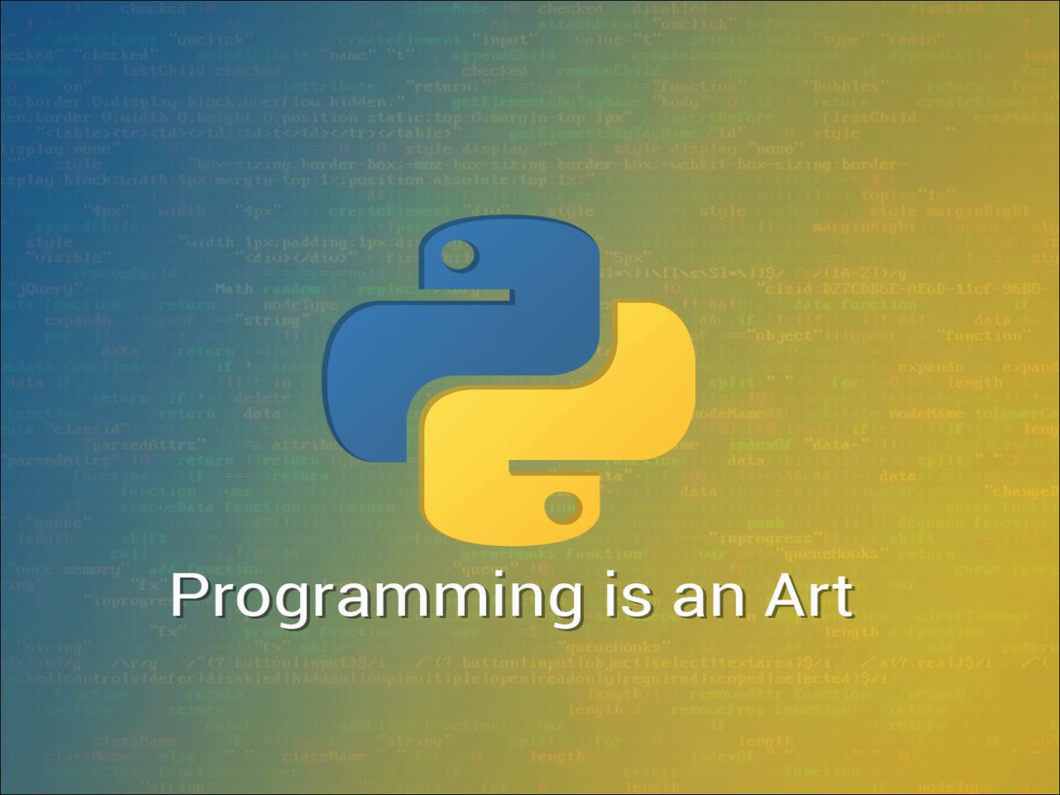

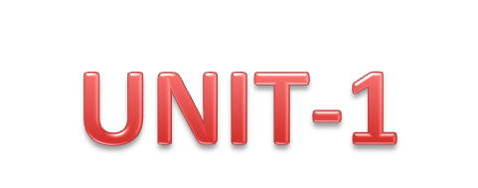

Slide 2
Data Types
Python has seven standard data types:
  Numbers
  Boolean
  String
  List
  Tuple
  Set
  Dictionary

Slide 3
Numbers
Python supports four different numerical types:
  int (signed integers)
  long (long integers, they can also be represented in octal and hexadecimal)
  float (floating point real values)
  complex (complex numbers)

Slide 4
Numbers
Program:
a = 3
b = 2.65
c = 98657412345L
d = 2+5j
print "int is",a
print "float is",b
print "long is",c
print "complex is",d
Output:
int is 3
float is 2.65
long is 98657412345
complex is (2+5j)

Slide 5
Boolean
Booleans are identified by True or False.
Program:
a = True
b = False
print a
print b
Output:
True
False

Slide 6
Strings
Strings in Python are identified as a contiguous set of characters represented in the quotation marks.
Python allows for either pairs of single or double quotes.
Subsets of strings can be taken using the slice operator ([ ] and [:] ) with indexes starting at 0 in the beginning of the string and working their way from -1 at the end.

Slide 7
Strings
Program:
str ="WELCOME"
print str
print str[0]
print str[2:5]
print str[2:]
print str * 2
print str + "CSE"
Output:
WELCOME
W
LCO
LCOME
WELCOMEWELCOME
WELCOMECSE

Slide 8
Strings Methods
capitalize()
  str1=“hello"
  print str1.capitalize() # Hello
Center(width, fillchar)
  str1="welcome“
  print str1.center(15,"*") # ****welcome****
len(string)
  str1="welcome"
  print len(str1) # 7

Slide 9
Strings Methods
count(str, beg= 0, end=len(string))
  str1="welcome"
  print str1.count('e',0,len(str1)) # 2
endswith(suffix, beg=0, end=len(string))
  str1="welcome"
  print str1.endswith('me',0,len(str1)) # True
startswith(str, beg=0, end=len(string))
  str1="welcome"
  print str1.startswith('me',0,len(str1)) # False

Slide 10
Strings Methods
replace(old, new)
  str5="welcome to java“
  print str5.replace("java", "python“)
  #welcome to python
find(str, beg=0, end=len(string))
  str1="welcome“
  print str1.find('e',0,len(str1)) # 1

Slide 11
Strings Methods
isalnum()
  str2="welcome2017"
  print str2.isalnum() # True
isalpha()
  str2="welcome2017“
  print str2.isalpha() # False

Slide 12
Strings Methods
islower()
  str2="welcome2017"
  print str2.islower() # True
isupper()
  str2="welcome2017"
  print str2.isupper() # False

Slide 13
DataType Conversion
Sometimes, you may need to perform conversions between the built-in types. To convert between types, you simply use the type name as a function.
  int(x)-Converts x to an integer.
  float(x) -Converts x to float.
  str(x) -Converts x to string.
  tuple(s)-Converts s to tuple.
  hex(x)-Converts an integer to a hexa decimal string.

Slide 14
Python Operators
Arithmetic Operators
Comparison (Relational) Operators
Assignment Operators
Logical Operators
Bitwise Operators
Membership Operators
Identity Operators

Slide 15
Arithmetic Operators
Operator | Description | Example
+ Addition | Adds values on either side of the operator. | a + b = 30
- Subtraction | Subtracts right hand operand from left hand operand. | a – b = -10
* Multiplication | Multiplies values on either side of the operator | a * b = 200
/ Division | Divides left hand operand by right hand operand | b / a = 2
% Modulus | Divides left hand operand by right hand operand and returns remainder | b % a = 0
** Exponent | Performs exponential (power) calculation on operators | a**b =10 to the power 20
// Floor Division | The division of operands where the result is the quotient in which the digits after the decimal point are removed. | 9//2 = 4 and 9.0//2.0 = 4.0

Slide 16
Comparison (Relational) Operators
Operator | Description | Example
= = | If the values of two operands are equal, then the condition becomes true. | (a == b) is not true.
!= | If values of two operands are not equal, then condition becomes true. | (a != b) is true.
< > | If values of two operands are not equal, then condition becomes true. | (a <> b) is true. This is similar to != operator.
> | If the value of left operand is greater than the value of right operand, then condition becomes true. | (a > b) is not true.
< | If the value of left operand is less than the value of right operand, then condition becomes true. | (a < b) is true.
> = | If the value of left operand is greater than or equal to the value of right operand, then condition becomes true. | (a >= b) is not true.
< = | If the value of left operand is less than or equal to the value of right operand, then condition becomes true. | (a <= b) is true.

Slide 17
Assignment Operators
Operator | Description | Example
= | Assigns values from right side operands to left side operand | c = a + b assigns value of a + b into c
+= Add AND | It adds right operand to the left operand and assign the result to left operand | c += a is equivalent to c = c + a
-= Subtract AND | It subtracts right operand from the left operand and assign the result to left operand | c -= a is equivalent to c = c - a
*= Multiply AND | It multiplies right operand with the left operand and assign the result to left operand | c *= a is equivalent to c = c * a
/= Divide AND | It divides left operand with the right operand and assign the result to left operand | c /= a is equivalent to c = c / a
%= Modulus AND | It takes modulus using two operands and assign the result to left operand | c %= a is equivalent to c = c % a
**= Exponent AND | Performs exponential (power) calculation on operators and assign value to the left operand | c **= a is equivalent to c = c ** a
//= Floor Division | It performs floor division on operators and assign value to the left operand | c //= a is equivalent to c = c // a

Slide 18
Logical Operators
Operator | Description | Example
And Logical AND | If both the operands are true then condition becomes true. | (a and b) is true.
Or Logical OR | If any of the two operands are non-zero then condition becomes true. | (a or b) is true.
not Logical NOT | Used to reverse the logical state of its operand. | Not (a and b) is false.

Slide 19
Bitwise Operators
Operator | Description | Example
& Binary AND | Operator copies a bit to the result if it exists in both operands. | (a & b) = 12 (means 0000 1100)
| Binary OR | It copies a bit if it exists in either operand. | (a | b) = 61 (means 0011 1101)
^ Binary XOR | It copies the bit if it is set in one operand but not both. | (a ^ b) = 49 (means 0011 0001)
~ Binary Ones Complement | It is unary and has the effect of 'flipping' bits. | (~a ) = -61 (means 1100 0011 in 2's complement form due to a signed binary number.
<< Binary Left Shift | The left operands value is moved left by the number of bits specified by the right operand. | a << 2 = 240 (means 1111 0000)
>> Binary Right Shift | The left operands value is moved right by the number of bits specified by the right operand. | a >> 2 = 15 (means 0000 1111)

Slide 20
Membership Operators
Operator | Description | Example
in | Evaluates to true if it finds a variable in the specified sequence and false otherwise. | x in y, here in results in a 1 if x is a member of sequence y.
not in | Evaluates to true if it does not finds a variable in the specified sequence and false otherwise. | x not in y, here not in results in a 1 if x is not a member of sequence y.

Slide 21
Identity Operators
Operator | Description | Example
is | Evaluates to true if the variables on either side of the operator point to the same object and false otherwise. | x is y, here is results in 1 if id(x) equals id(y).
is not | Evaluates to false if the variables on either side of the operator point to the same object and true otherwise. | x is not y, here is not results in 1 if id(x) is not equal to id(y).

Slide 22
Python Operator Precedence
Operator | Description
( ) | Parenthesis
** | Exponentiation (raise to the power)
~ x, +x, -x | Complement, unary plus and minus
* / % // | Multiply, divide, modulo and floor division
+ - | Addition and subtraction
>> << | Right and left bitwise shift
& | Bitwise 'AND'
^ | | Bitwise exclusive `OR' and regular `OR'
<= < > >= | Comparison operators
<> == != | Equality operators
= %= /= //= -= += *= **= | Assignment operators
is is not | Identity operators
in not in | Membership operators
not or and | Logical operators

Slide 23
Expression
An expression is a combination of variables constants and operators written according to the syntax of Python language.
In Python every expression evaluates to a value i.e., every expression results in some value of a certain type that can be assigned to a variable.
Example:
    A*b-c
    (m+n)*(x+y)
    3*x*x+2*x+1
    x / y + c

Slide 24
Evaluation of Expression
The expression is evaluated first and then replaces the previous value of the variable on the left hand side.
The Expression can be evaluated based operator precedence.

Slide 25
Decision Making
Decision making is anticipation of conditions occurring while execution of the program and specifying actions taken according to the conditions.
Decision structures evaluate multiple expressions which produce True or False as outcome.
Statement | Description
if statements | if statement consists of a boolean expression followed by one or more statements.
if...else statements | if statement can be followed by an optional else statement, which executes when the boolean expression is FALSE.
nested if statements | You can use one if or else if statement inside another if or else if statement(s).

Slide 26
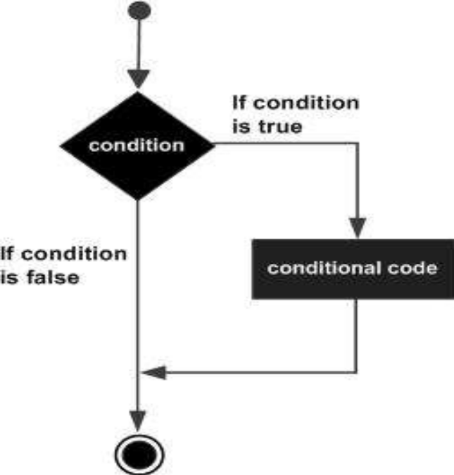
if Statement
The if statement contains a logical expression using which data is compared and a decision is made based on the result of the comparison.
The condition is tested. If the condition is True, then the statements given after colon (:) are executed.
Syntax:
if Condition:
  Statements

Slide 27
if Statement
Program:
a=10
b=15
if a < b :
  print "b is Big“
  print "The value is", b
Output:
B is Big
The value is 15

Slide 28
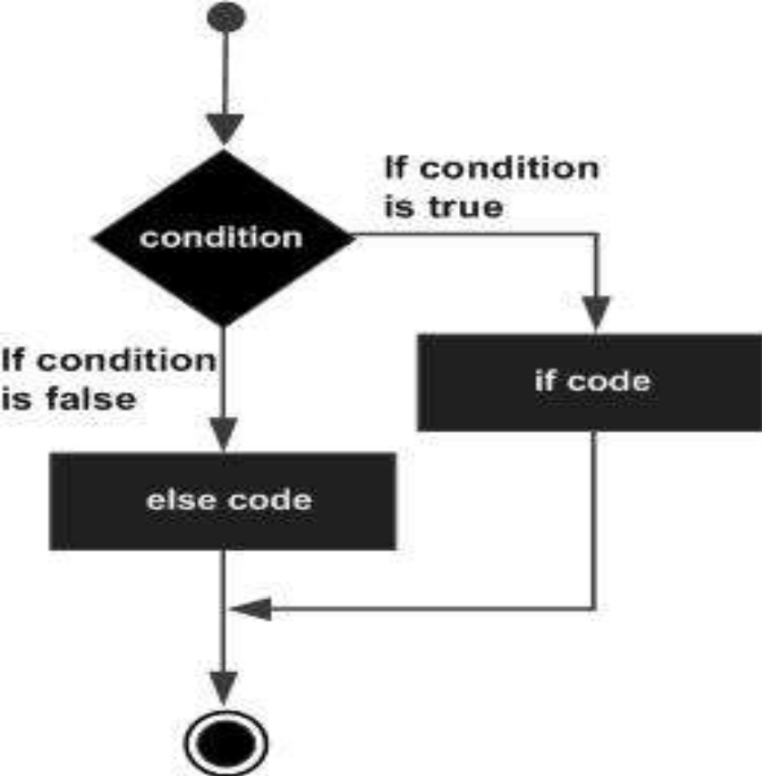
if….else Statement
An else statement contains the block of code that executes if the conditional expression in the if statement resolves to 0 or a FALSE value.
Syntax:
if Condition:
  Statements
  else:
  Statements

Slide 29
if Statement
Program:
a=48
b=34
if a < b:
print "b is big“
print "b value is", b
else:
print "a is big "
print "a value is", a
print "END"
Output:
a is big
a value is 48
END

Slide 30
elif Statement
The elif statement allows you to check multiple expressions for True and execute a block of code as soon as one of the conditions evaluates to True.
Syntax:
if Condition1:
  Statements
elif Condition2:
  Statements
  else:
  Statements

Slide 31
elif Statement
Program:
a=20
b=10
c=30
if a >= b and a >= c:
print "a is big"
elif b >= a and b >= c:
print "b is big"
else:
print "c is big"
Output:
c is big

Slide 32
Iteration Statements
In general, statements are executed sequentially: The first statement in a function is executed first, followed by the second, and so on. There may be a situation when you need to execute a block of code several number of times.
A loop statement allows us to execute a statement or group of statements multiple times.
Loop Type | Description
while loop | Repeats a statement or group of statements while a given condition is TRUE. It tests the condition before executing the loop body.
for loop | Executes a sequence of statements multiple times and abbreviates the code that manages the loop variable.
nested loops | You can use one or more loop inside any another while, for loop.

Slide 33
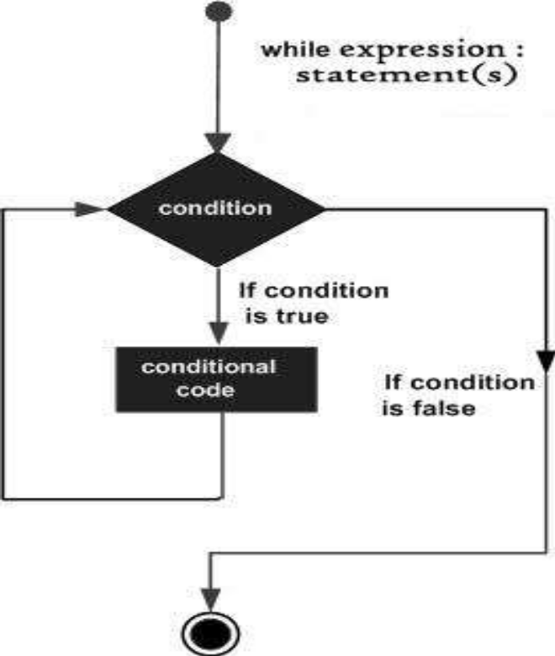
while Loop
A while loop statement in Python programming language repeatedly executes a target statement as long as a given condition is True.
Syntax:
while Condition:
  Statements

Slide 34
while Loop
Program:
i=1
while i <= 3 :
print i
i+=1
print "END"
Program:
i=1
while i <= 3 :
print i
i+=1
print "END"
Output:
1
END
2
END
3
END
Output:
1
2
3
END

Slide 35
for Loop
The for loop is useful to iterate over the elements of a sequence.
It means, the for loop can be used to execute a group of statements repeatedly depending upon the number of elements in the sequence.
The for loop can work with sequence like string, list, tuple, range etc.
Syntax:
for variable in sequence:
  Statements

Slide 36
for Loop
Program:
for i in range(1,4):
print i
print "END"
Program:
for i in range(1,4):
print i
print "END"
Output:
1
END
2
END
3
END
Output:
1
2
3
END

Slide 37
Nested Loops
It is possible to write one loop inside another loop.
For example, we can write a for loop inside a while loop or a for loop inside another for loop.

Slide 38
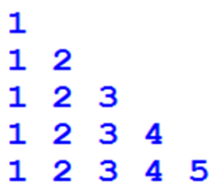
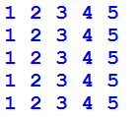
Nested Loops
Program:
for i in range(1,6):
for j in range(1,i+1):
print j,
print ""
Program:
for i in range(1,6):
for j in range(1,6):
print j,
print ""

Slide 39
Jump Statements
There are Three jump statements,
  break
  continue
  pass

Slide 40
break statement
The break statement provides you with the opportunity to exit out of a loop when an external condition is triggered.
Program:
n=input("Enter the n value")
count=0
for i in range(2,n):
if n%i==0:
count=count+1
break
if count==0:
print "Prime Number"
else:
print "Not Prime Number"
Output:
Enter the n value: 7
Prime Number

Slide 41
continue statement
The continue statement gives you the option to skip over the part of a loop where an external condition is triggered, but to go on to complete the rest of the loop.
Program:
for number in range(1,7):
if number == 4:
continue
print 'Number is ' + str(number)
Output:
Number is 1 Number is 2 Number is 3 Number is 5 Number is 6

Slide 42
pass statement
When an external condition is triggered, the pass statement allows you to handle the condition without the loop being impacted in any way.
Program:
for number in range(1,7):
if number == 4:
pass
print 'Number is ' + str(number)
Output:
Number is 1 Number is 2 Number is 3
Number is 4 Number is 5 Number is 6

