Slide 1
Unit-1
Python Basics
Python Objects
Standard Types
Other Built-in Types
Internal Types
Standard Type Operators
Standard Type Built-in Functions
Categorizing the Standard Types

Slide 2
Unsupported Types
Numbers - Introduction to Numbers
Integers, Floating Point Real Numbers
Complex Numbers
Operators
Built-in Functions
Related Modules
Sequences - Strings, Lists and Tuples,
Mapping and Set Types

Slide 3
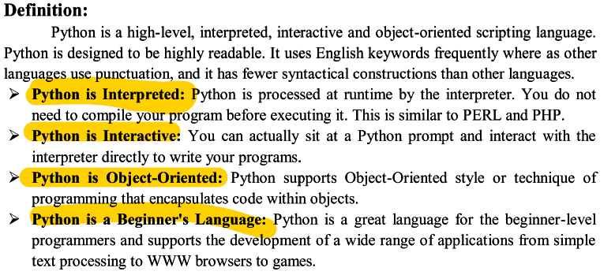
Python

Slide 4
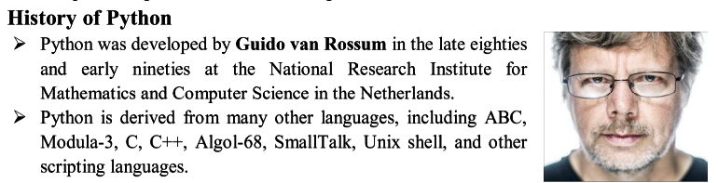
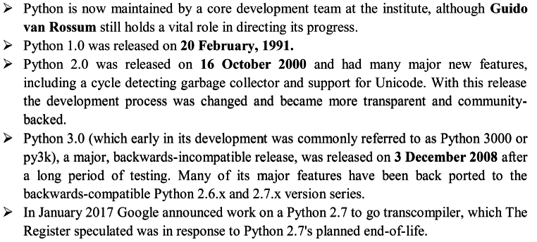

Slide 5
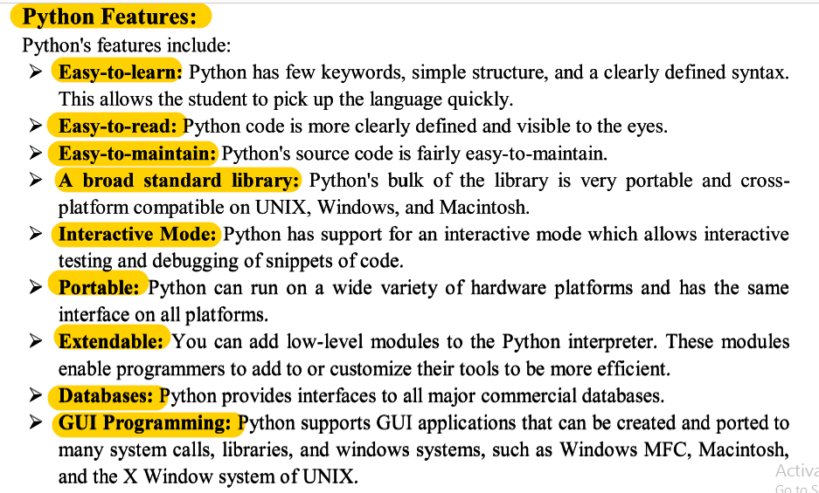

Slide 6


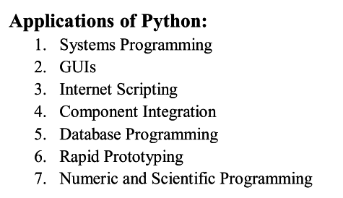
Need for python:
Portable
Open Source Soft ware

Slide 7
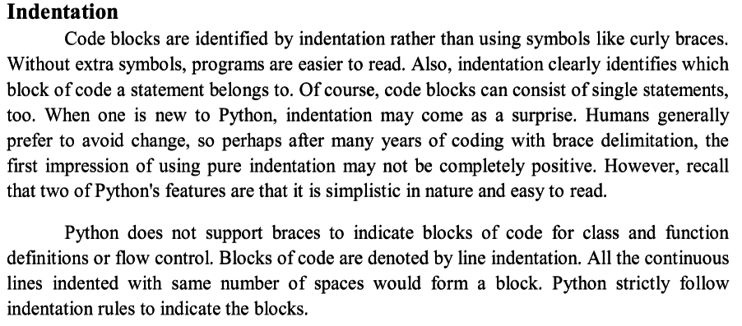

Slide 8
Python Objects
Python uses the object model abstraction for data storage.
Any construct that contains any type of value is an object.
Python is an "object-oriented programming (OOP) language.

Slide 9
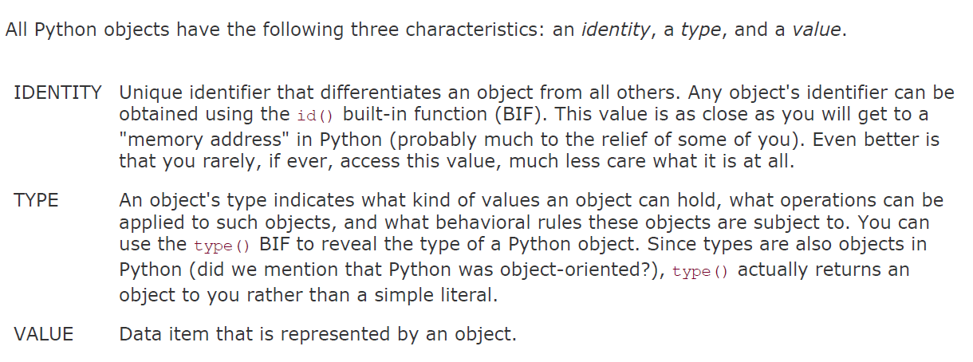
Id() method return the address of the object
Type() method return the type of the object
Value return the data in the object

Slide 10
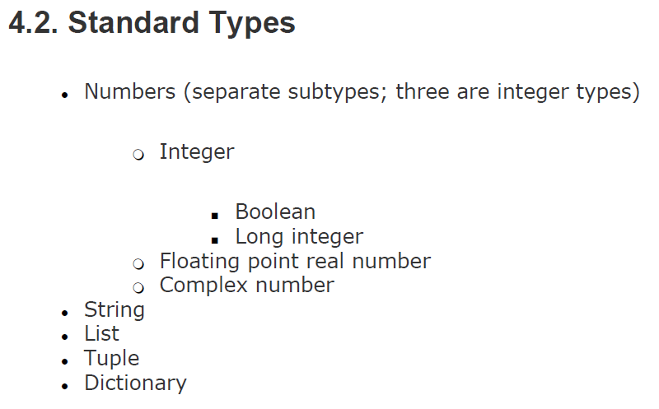
as "primitive data types"

Slide 11
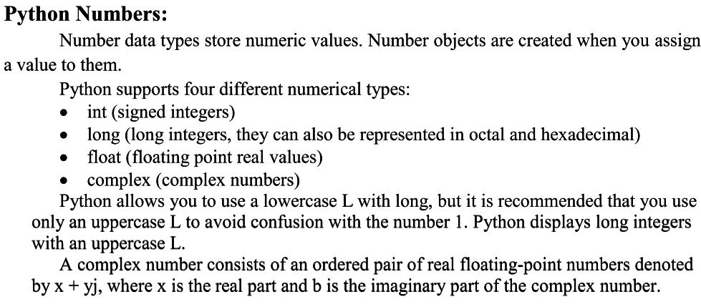

Slide 12
Python Numbers
There are three numeric types in Python:
Int:integer, is a whole number, positive or negative, without decimals, of unlimited length.
float: "floating point number" is a number, positive or negative, containing one or more decimals.
complex: Complex numbers are written with a "j" as the imaginary part
Example
x = 1 # int y = 2.8 # float z = 1j # complex
‘’’To verify the type of any object in Python, use the type() function:’’’
print(type(x)) print(type(y)) print(type(z))
x = 3+5j y = 5j z = -5j print(type(x)) print(type(y)) print(type(z))

Slide 13
Type Conversion:
You can convert from one type to another with the int(), float(), and complex() methods.
Example: Convert from one type to another
x = 1 # int y = 2.8 # float z = 1j # complex #convert from int to float: a = float(x) #convert from float to int: b = int(y) #convert from int to complex: c = complex(x) print(a) print(b) print(c) print(type(a)) print(type(b)) print(type(c))

Slide 14
Python Boolean:
Boolean represent one of two values: True or False.
You can evaluate any expression in Python, and get one of two answers, True or False.
When you compare two values, the expression is evaluated and Python returns the Boolean answer
Example1:
print(10 > 9) print(10 == 9) print(10 < 9)
Example2:
a = 200 b = 33 if b > a: print("b is greater than a") else: print("b is not greater than a")

Slide 15
Evaluate Values and Variables:
The bool() function allows you to evaluate any value, and give you True or False in return
Example1
#Evaluate a string and a number
print(bool("Hello")) print(bool(15))
Example2
#Evaluate two variables:
x = "Hello" y = 15 print(bool(x)) print(bool(y))
Most Values are True
Almost any value is evaluated to True if it has some sort of content.
Any string is True, except empty strings.
Any number is True, except 0.
Any list, tuple, set, and dictionary are True, except empty ones.
bool("abc") bool(123) bool(["apple", "cherry", "banana"])

Slide 16
Some Values are False
There are not many values that evaluate to False, except empty values, such as (), [], {}, "", the number 0, and the value None. And of course the value False evaluates to False.
Example:
bool(False) bool(None) bool(0) bool("") bool(()) bool([]) bool({})

Slide 17
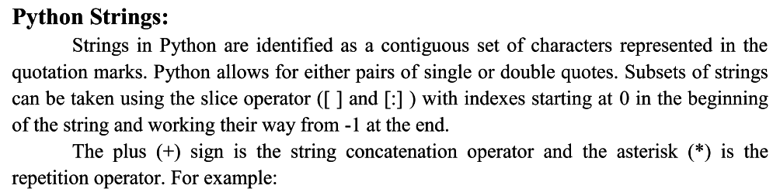

Slide 18
String
Strings in python are surrounded by either single quotation marks, or double quotation marks.
'hello' is the same as "hello".
You can display a string literal with the print() function:
Example:
print("Hello") print('Hello’)
Assign String to a Variable:
Assigning a string to a variable is done with the variable name followed by an equal sign and the string:
Example:
a = "Hello" print(a)
Multiline Strings
You can assign a multiline string to a variable by using three quotes:
Example:
a = """It may seem unusual to regard types themselves as objects since we are attempting to just describe all
of Python's types." print(a)

Slide 19
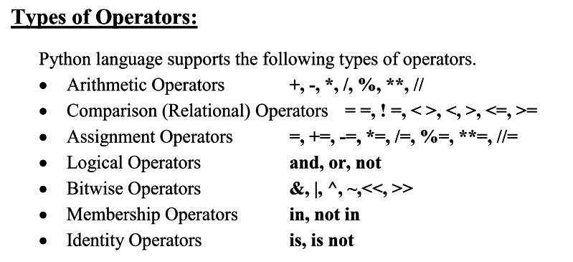
Operators are used to perform operations on variables and values.

Slide 20
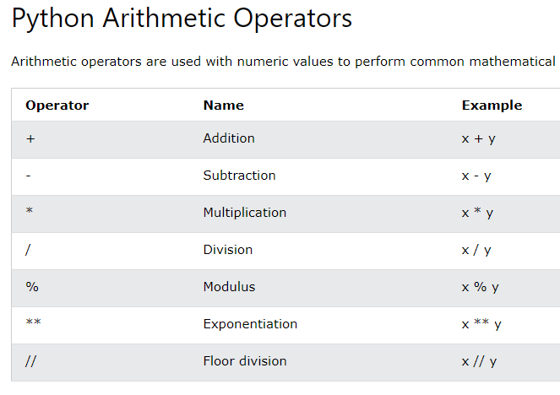

Slide 21
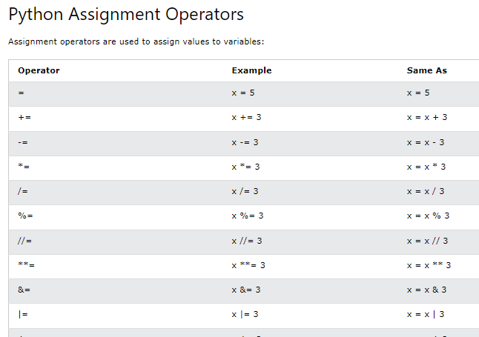

Slide 22
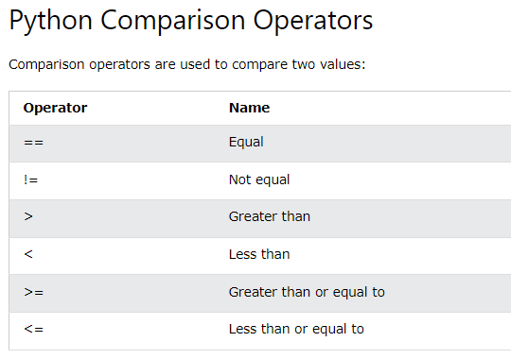

Slide 23
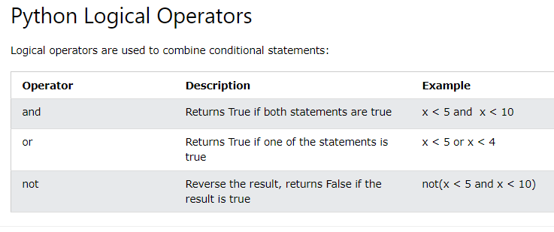

Slide 24
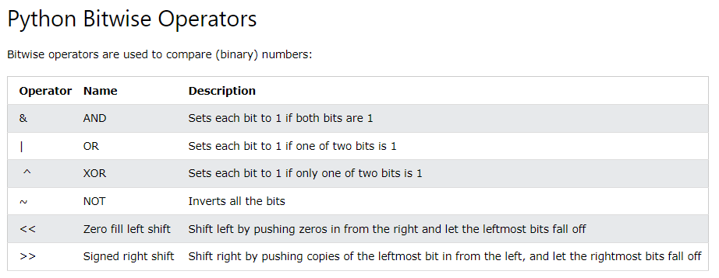

Slide 25
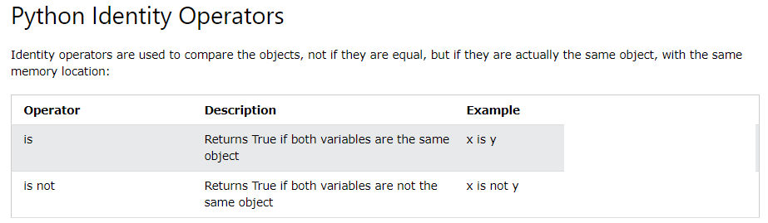

Slide 26
x = ["apple", "banana"]
y = ["apple", "banana"]
z = x
print(x is z)
# returns True because z is the same object as x
print(x is y)
# returns False because x is not the same object as y, even if they have the same content
print(x == y)
# to demonstrate the difference betweeen "is" and "==": this comparison returns True because x is equal to y

Slide 27
x = ["apple", "banana"]
y = ["apple", "banana"]
z = x
print(x is not z)
# returns False because z is the same object as x
print(x is not y)
# returns True because x is not the same object as y, even if they have the same #content
print(x != y)
# to demonstrate the difference betweeen "is not" and "!=": this comparison #returns False because x is equal to y

Slide 28
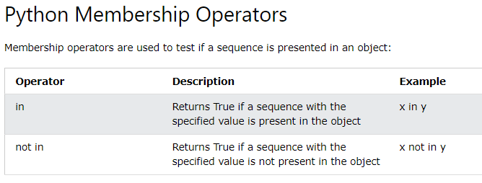
x = ["apple", "banana"]
print("banana" in x)
# returns True because a sequence
with the value "banana" is in the list
x = ["apple", "banana"]
print("pineapple" not in x)
# returns True because a sequence with the value "pineapple" is not in the list

Slide 29
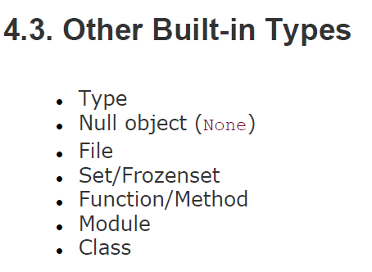

Slide 30
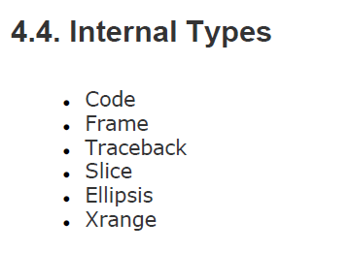

Slide 31
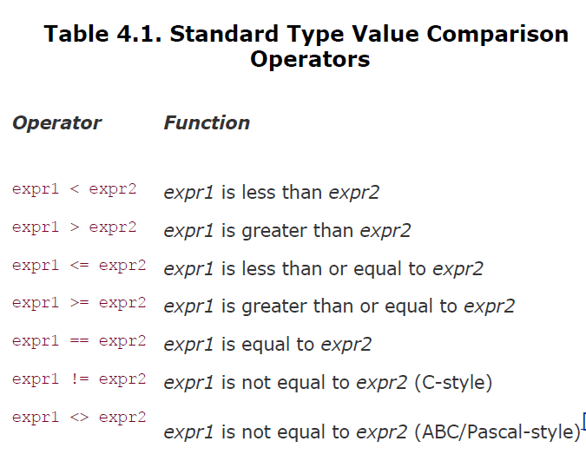

Slide 32
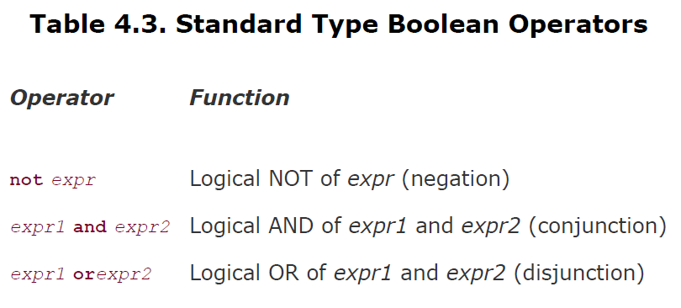

Slide 33
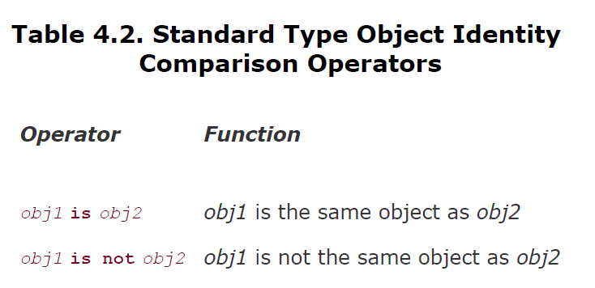

Slide 34
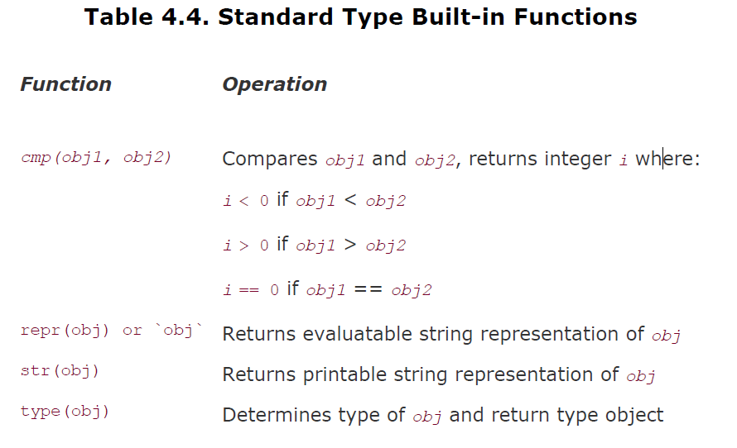

Slide 35
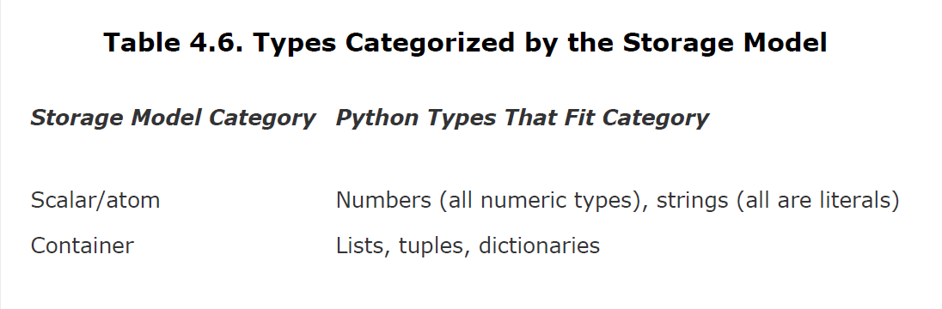

Slide 36
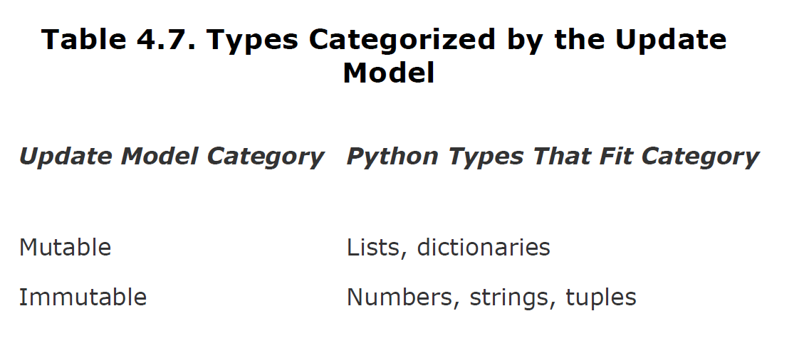

Slide 37
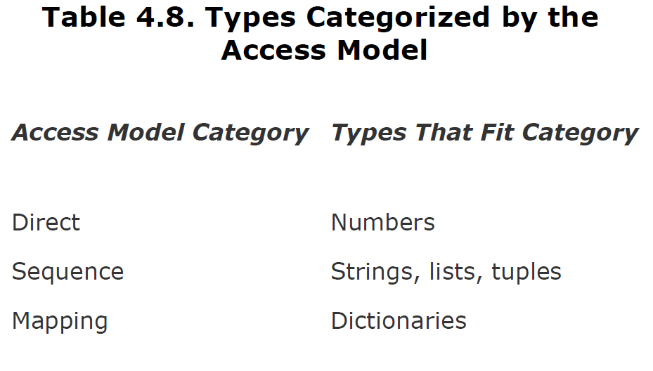

Slide 38
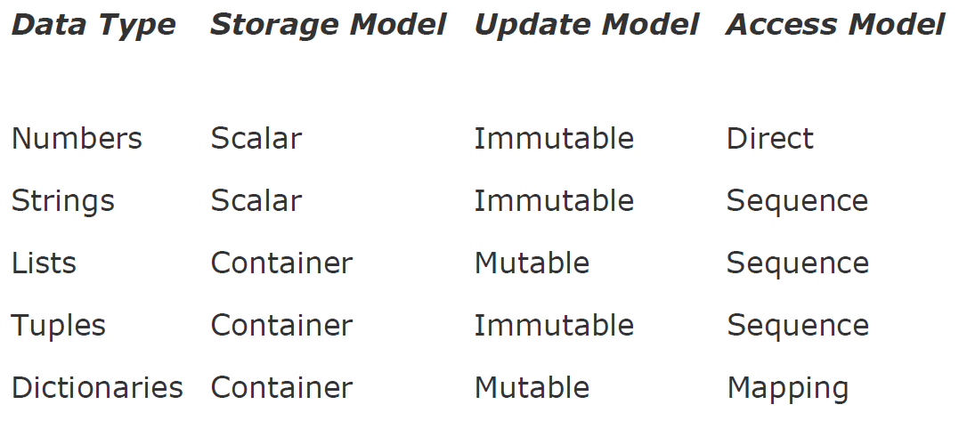

Slide 39
Unsupported Types
list of types that are not supported by Python.
char or byte
int versus short versus long
float versus double

Slide 40
Numbers - Introduction to Numbers Integers, Floating Point Real Numbers ,Complex Numbers

Slide 41
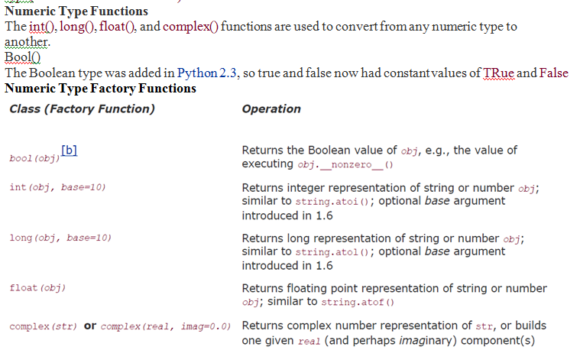

Slide 42
Examples on Numbers::
Example for integers:
a=90;
b=2;
C=a>>2;
Print(c)
Print(type(c))
***
Example double numbers:
a=9.0;
B=4.7
C=a/b
Print(c)
Print(type(c))
**
Example1 on Complex number:
a=7+8j
Print(a)
Print(type(a))
Example2 on Complex number:
a=complex("3+2j")
print (a)
print("a is",a)

Slide 44
Standard Type Functions
cmp(-6, 2)
str(0xFF)
str(55.3e2)
type(0xFF)
type(98765432109876543210L)

Slide 45
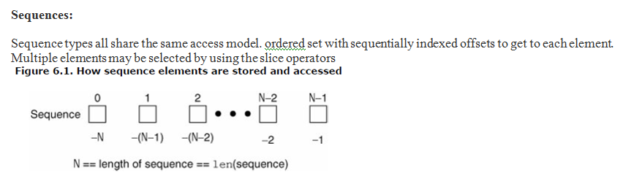

Slide 49
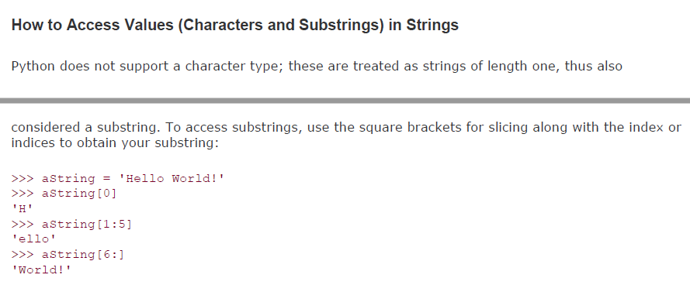
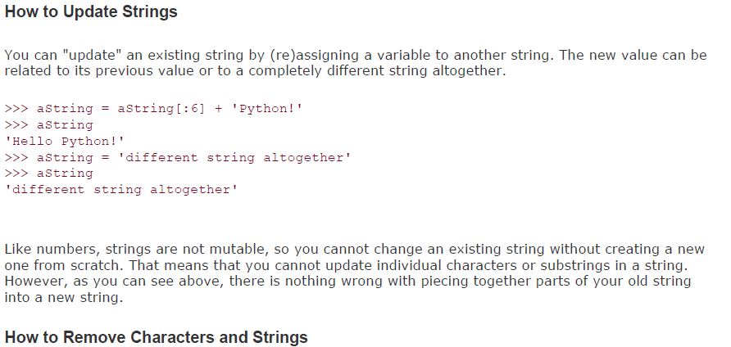

Slide 50
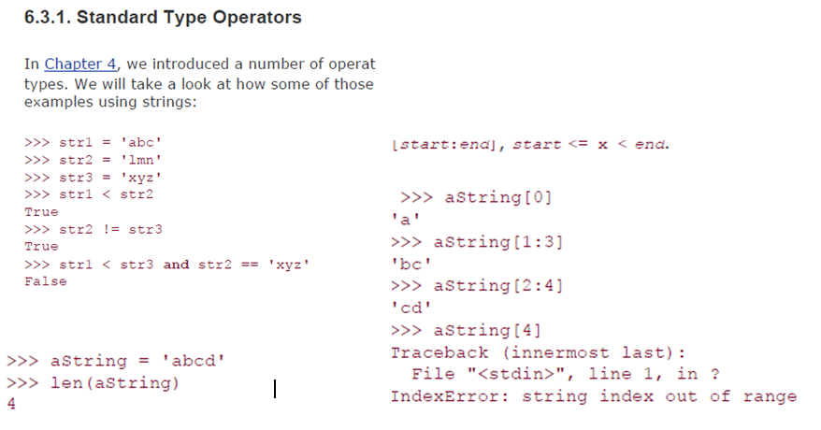

Slide 51
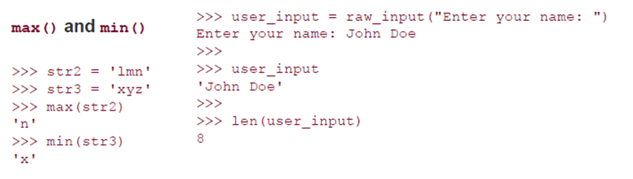

Slide 53
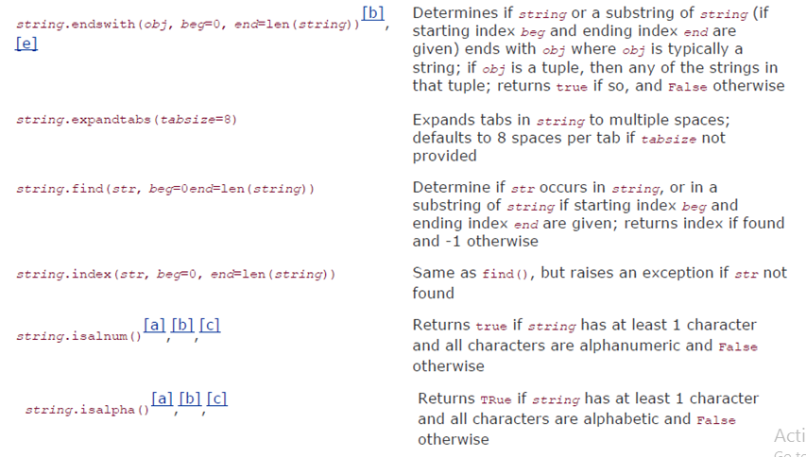
Built in Methods on Strings cont..

Slide 54
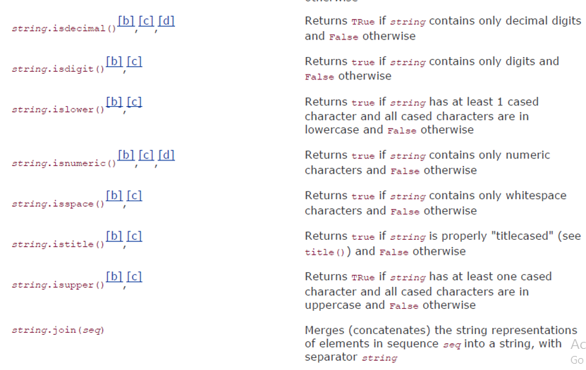
Built in Methods on Strings cont..

Slide 55
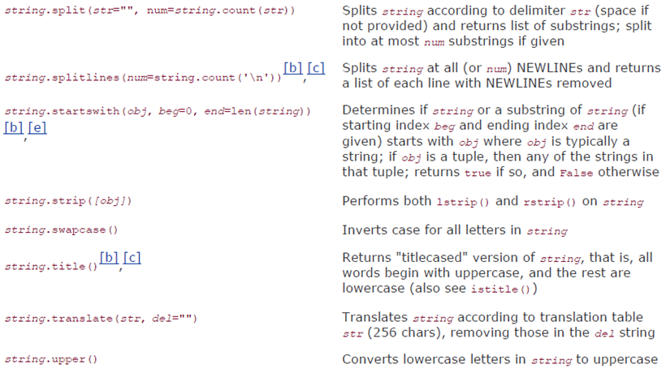
Built in Methods on Strings cont..

Slide 56
Sequence
A sequence is a data type that represents a group of elements.
The purpose of any sequence is to store and process group elements.
In python, strings, lists, tuples and dictionaries are very important sequence data types.

Slide 57
Sequence
Sequence types all share the same access model: ordered set with sequentially indexed offsets to get to each element.
Multiple elements may be selected by using the slice operators.
The numbering scheme used starts from zero (0) and ends with one less than the length of the sequence( 0 to n-1 ).

Slide 58
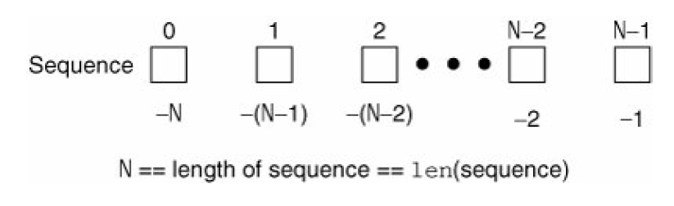
How sequence elements are stored and accessed

Slide 59
List
A list is similar to an array that consists of a group of elements or items.
The Difference is ……… An array can store only one type of elements whereas a list can store different types of elements.
To create a List as putting different comma-separated values between square brackets [ ].

Slide 60
List
Lists are used to store multiple items in a single variable.
List items are ordered, changeable, and allow duplicate values.
ordered: items have a defined order, and that order will not change.
Changeable: We can change, add, and remove items in a list after it has been created.
duplicate values: lists are indexed, lists can have items with the same value.
MyList = ["apple", "banana", "cherry", "apple", "cherry"]

Slide 61
List
Lists are dynamic because they can contain as many variables and handle various data types at a time.
List items can be of any data type:
(String, int and boolean data types)
list1 = ["apple", "banana", "cherry"]
list2 = [1, 5, 7, 9, 3]
list3 = [True, False, False]

Slide 62
A list can contain different data types:
list1 = ["abc", 34, True, 40, "male"]

Slide 63
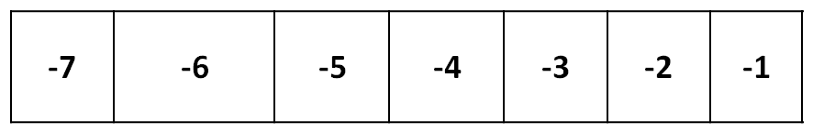
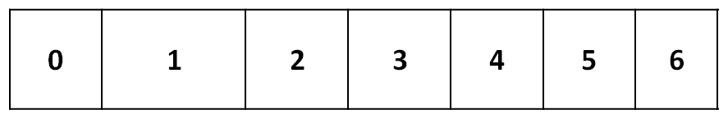
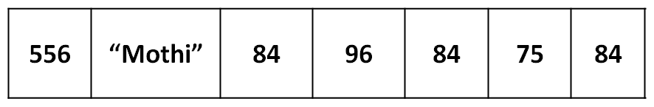
List
Accessing values in List:
use the square brackets for slicing along with the index or indices to obtain value available at that index.
negative Indexing
Positive Indexing
Student

Slide 64
How to Create and Assign Lists
In Python programming, to create a list, place any number of items (elements) inside a square bracket [and], separated by commas, and they may be of the same type or different type.
MyList = [ ] # empty list
MyList = [100, 101, 102, 103] # list of integers
MyList = [ 'India', 'Canada', 'UK'] # list of string
MyList = [100, "India", 103] #list with mixed data types
MyList = ["UK", [100, 200, 300]] # nested list

Slide 65
List
Output:
[556, "Mothi", 84, 96, 84, 75, 84]
556
[556, "MOTHI"]
[84, 96, 84, 75, 84]
[556, "MOTHI", 84]
[556, "MOTHI", 84, 96, 84, 75, 84]
84
[84, 75, 84, 96, 84, "MOTHI"]
Program:
student = [556, “Mothi”, 84, 96, 84, 75, 84 ]
print(student)
print(student[0])
print(student[0:2])
print(student[2: ])
print(student[ :3])
print(student[ : ])
print(student[-1])
print(student[-1:-7:-1])

Slide 67
range() function
range() function used to print list of integer values.
Syntax:
range(start, end [, step])

Slide 68
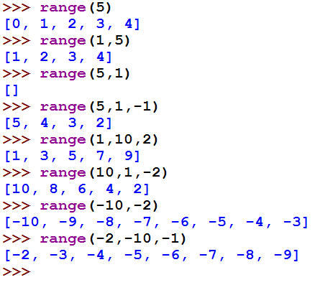
range() function
Example:

Slide 69
List
Creating List using range() function:
numbers=range(0,9)
print numbers #[0,1,2,3,4,5,6,7,8]
numbers=range(0,9,2)
print numbers #[0,2,4,6,8]

Slide 70
List
Looping over List:
numbers=[1,2,3,4,5]
for i in numbers:
print i,
Output:
1 2 3 4 5

Slide 71
List
Updating and Deleting List:
Lists are mutable.
It means we can modify the contents of a list.
We can append, update or delete the elements of a list depending upon our requirements.

Slide 72
List
Program:
a = [4, 7, 6, 8, 9]
print a
a[2] = 45
print a
a[2:5] = 10, 11, 12
print a
Output:
[4, 7, 6, 8, 9]
[4, 7, 45, 8, 9]
[4, 7, 10, 11, 12]

Slide 73
List
Program:
a = [4, 7, 6, 8, 9]
print a
del a[3]
print a
Output:
[4, 7, 6, 8, 9]
[4, 7, 6, 9]

Slide 74
List
Concatenation of Two lists
We can simply use ‘+’ operator on two lists to join them.
Program:
a = [4, 7, 6, 8, 9]
b = [1, 2, 3]
print a+b
Output:
[4, 7, 6, 8, 9, 1, 2, 3]

Slide 75
List
Repetition of Two lists
We can repeat the elements of a list ‘n’ number of times using ‘ * ’ operator.
Program:
a = [4, 7, 6, 8, 9]
print a*2
Output:
[4, 7, 6, 8, 4, 7, 6, 8]

Slide 76
List
Membership in lists
We can check if an element is a member of a list by using ‘in’ and ‘not in’ operator.
Program:
a = [4, 7, 6, 8, 9]
x = 7
print x in a
y = 10
print y not in a
Output:
True
True

Slide 77
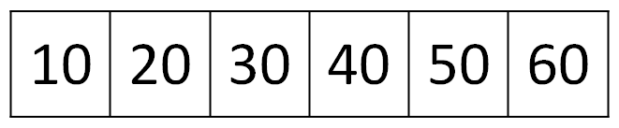
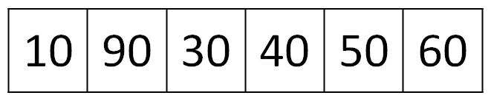
List
Aliasing lists
Giving a new name to an existing list is called ‘aliasing’.
To provide a new name to this list, we can simply use assignment operator (=).
X
y
Before Modifications
X
y
After Modifications

Slide 78
List
Program:
a = [10, 20, 30, 40, 50, 60]
x = a
Print(a)
print(x)
a[1]= 90
Print(a)
print(x)
Output:
[10, 20, 30, 40, 50, 60]
[10, 20, 30, 40, 50, 60]
[10, 90, 30, 40, 50, 60]
[10, 90, 30, 40, 50, 60]

Slide 79
List
Cloning lists
Obtaining exact copy of an existing object (or list) is called ‘cloning’.
To Clone a list, we can take help of the slicing operation [:].

Slide 80
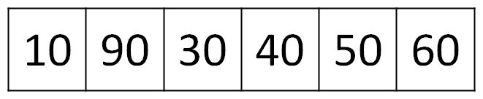
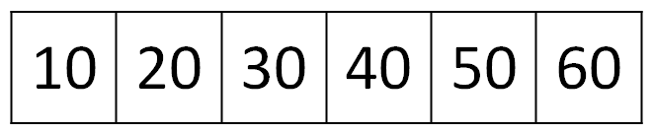
List
X
y
Before Modifications
X
y
After Modifications

Slide 81
List
Program:
a = [10, 20, 30, 40, 50, 60]
x = a[ : ]
print a
print x
a[1]= 90
print a
print x
Output:
[10, 20, 30, 40, 50, 60]
[10, 20, 30, 40, 50, 60]
[10, 90, 30, 40, 50, 60]
[10, 20, 30, 40, 50, 60]

Slide 82
List
Method | Description
lst.index(x) | Returns the first occurrence of x in the list.
lst.append(x) | Appends x at the end of the list.
lst.insert(i,x) | Inserts x to the list in the position specified by i.
lst.copy() | Copies all the list elements into a new list and returns it.
lst.extend(lst2) | Appends lst2 to list.
lst.count(x) | Returns number of occurrences of x in the list.
lst.remove(x) | Removes x from the list.
lst.pop() | Removes the ending element from the list.
lst.sort() | Sorts the elements of list into ascending order.
lst.reverse() | Reverses the sequence of elements in the list.
lst.clear() | Deletes all elements from the list.
max(lst) | Returns biggest element in the list.
min(lst) | Returns smallest element in the list.

Slide 83
List
Nested List:
A list within another list is called a nested list.
Program:
a = [[1, 2],[3,4],[5,6]]
print a[1]
print a[2][1]
for i in a[2]:
print i,
Output:
[1,2]
6
5 6

Slide 84
List
List Comprehensions:
List comprehensions represent creation of new lists from an iterable object that satisfy a given condition.
squares=[ ]
for i in range(1,11):
squares.append(i**2)
Can be rewritten as………..
squares=[x**2 for x in range(1,11)]

Slide 85
Tuple
A Tuple is a python sequence which stores a group of elements or items.
Tuples are similar to lists but the main difference is tuples are immutable whereas lists are mutable.
Once we create a tuple we cannot modify its elements.
Tuples are generally used to store data which should not be modified and retrieve that data on demand.

Slide 86
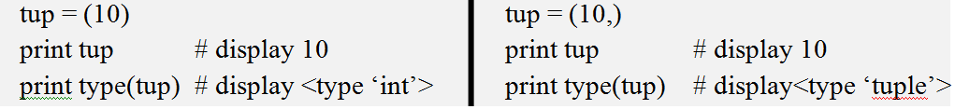
How to Create and Assign a Tuple
Creating a tuple by writing elements separated by commas inside parentheses ( ).
tup = (10, 556, 22.3, “Mothi”)
To create a tuple with only one element, we can, mention that element in parenthesis and after that a comma is needed.

Slide 87
Access elements of a tuple
You can access individual elements of a tuple using indexing and a range of elements using slicing. In Python tuples, index starts from 0 and keeps increasing by 1 with every element in the tuple. This is called Positive Indexing(or indexing from the beginning). If there are n elements in a tuple, the 1st element will have index of 0 and the last element will have index n-1.
Python also allows negative indexing of tuples(indexing from the end). If there are n elements in a list, the last element will have index of -1 and the first element will have index -n.

Slide 88
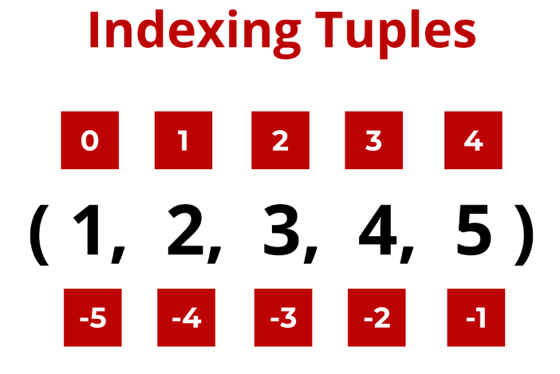
Positive Indexing
Negative Indexing

Slide 89
Slicing of Tuples
you can access a range of elements from a tuple using slicing.
Basically, you have to specify the starting index and the end index, separated by a colon(:), to return a range of elements from the tuple.

Slide 90
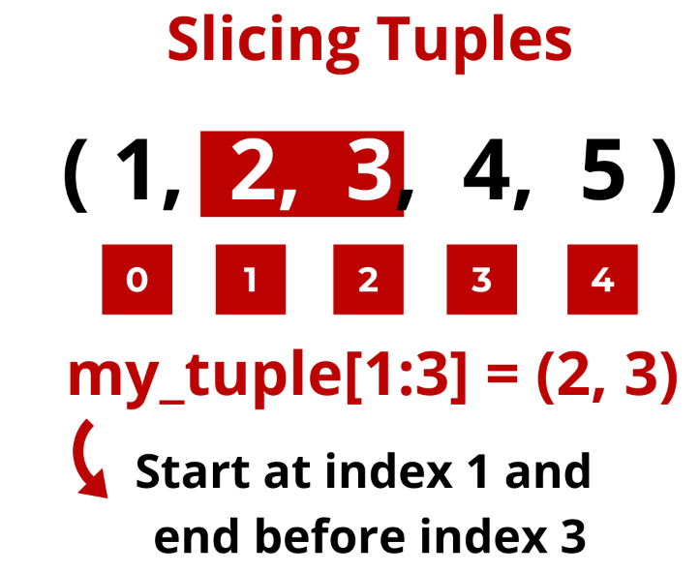
Slicing Tuples with Positive Index

Slide 91
tuple = (50,60,70,80,90)
print(tuple[:])
print(tuple[1:])
print(tuple[1:3])
print(tuple[:3])
(50, 60, 70, 80, 90)
(60, 70, 80, 90)
(60, 70)
(50, 60, 70)

Slide 92
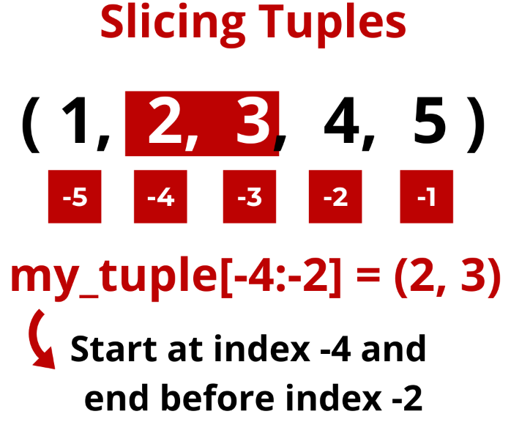
Slicing Tuple with Negative Index

Slide 93


Slide 94
Tuple
Accessing values in Tuple:
Accessing the elements from a tuple can be done using indexing or slicing.
The index must be an integer.
tuple = (50,60,70,80,90)
print(tuple[0]) # 50
print(tuple[1:4]) # (60,70,80)
print(tuple[-1]) # 90
print(tuple[-1:-4:-1]) # (90,80,70)
print(tuple[-4:-1]) # (60,70,80)

Slide 95

Tuple
Updating and deleting in Tuple:
Tuples are immutable which means you cannot update, change or delete the values of tuple elements.

Slide 96

Tuple
Because tuples are immutable, you cannot delete specific elements of a tuple

Slide 97
Tuple
Operation | Description
len(t) | Return the length of tuple.
tup1+tup2 | Concatenation of two tuples.
tup*n | Repetition of tuple values in n number of times.
x in tup | Return True if x is found in tuple otherwise returns False.
cmp(tup1,tup2) | Compare elements of both tuples
max(tup) | Returns the maximum value in tuple.
min(tup) | Returns the minimum value in tuple.
tuple(list) | Convert list into tuple.
tup.count(x) | Returns how many times the element ‘x’ is found in tuple.
tup.index(x) | Returns the first occurrence of the element ‘x’ in tuple. Raises ValueError if ‘x’ is not found in the tuple.
sorted(tup) | Sorts the elements of tuple into ascending order. sorted(tup,reverse=True) will sort in reverse order.

Slide 98
Tuple
Nested Tuple:
A list within another list is called a nested list.
Program:
students=(("RAVI", "CSE", 92.00), ("RAMU", "ECE", 93.00),
("RAJA", "EEE", 87.00))
for i in students:
print i
Output:
("RAVI", "CSE", 92.00)
("RAMU", "ECE", 93.00)
("RAJA", "EEE", 87.00)

Slide 99
Set
Set is another data structure supported by python.
Basically, sets are same as lists but with a difference that sets are lists with no duplicate entries.
Technically a set is a mutable and an unordered collection of items. This means that we can easily add or remove items from it.

Slide 100
Set
Creating a set:
A set is created by placing all the elements inside curly brackets { }.
s={1, 2.5, "abc" }
print s
Output:
set([1, 2.5, "abc" ])

Slide 101
Set
Converting list into a set:
A set can have any number of items and they may be of different data types. set() function is used to converting list into set.
s=set([1, 2.5, "abc"])
print s
Output:
set([1, 2.5, "abc" ])

Slide 102
Set
Operation | Description
len(s) | number of elements in set s (cardinality)
s.issubset(t) (or) s <= t | test whether every element in s is in t
s.issuperset(t) (or) s >= t | test whether every element in t is in s
s.union(t) (or) s|t | new set with elements from both s and t
s.intersection(t) (or) s & t | new set with elements common to s and t
s.copy() | new set with a shallow copy of s
s.update(t) | return set s with elements added from t

Slide 103
Dictionary
A dictionary represents a group of elements arranged in the form of key-value pairs. The first element is considered as ‘key’ and the immediate next element is taken as its ‘value’.
The key and its value are separated by a colon (:). All the key-value pairs in a dictionary are inserted in curly braces { }.

Slide 104
Dictionary
Program:
d= { 'Regd.No': 556, 'Name':'Mothi', 'Branch': 'CSE' }
print d['Regd.No'] # 556
print d['Name'] # Mothi
print d['Branch'] # CSE

Slide 105
Dictionary
Program:
d={'Regd.No':556,'Name':'Mothi','Branch':'CSE'}
print d
d['Gender']="Male"
print d
Output:
{'Regd.No':556,'Name':'Mothi','Branch':'CSE'}
{'Gender': 'Male', 'Branch': 'CSE', 'Name': 'Mothi', 'Regd.No': 556}

Slide 106
Dictionary
Method | Description
d.clear() | Removes all key-value pairs from dictionary‘d’.
d2=d.copy() | Copies all elements from‘d’ into a new dictionary d2.
d.fromkeys(s [,v] ) | Create a new dictionary with keys from sequence‘s’ and values all set to ‘v’.
d.get(k [,v] ) | Returns the value associated with key ‘k’. If key is not found, it returns ‘v’.
d.items() | Returns an object that contains key-value pairs of‘d’. The pairs are stored as tuples in the object.
d.keys() | Returns a sequence of keys from the dictionary‘d’.
d.values() | Returns a sequence of values from the dictionary‘d’.
d.update(x) | Adds all elements from dictionary ‘x’ to‘d’.
d.pop(k [,v] ) | Removes the key ‘k’ and its value from‘d’ and returns the value. If key is not found, then the value ‘v’ is returned. If key is not found and ‘v’ is not mentioned then ‘KeyError’ is raised.
d.setdefault(k [,v] ) | If key ‘k’ is found, its value is returned. If key is not found, then the k, v pair is stored into the dictionary‘d’.

