Slide 1


Benefits of social media in education

Slide 2

OVERVIEW
Introduction on Benefits of social media in Education.
Different social media and their uses in Education.
Facebook
Twitter
Pinterest
Instagram
Blogs
Linke din
Conclusion

Slide 3
Introduction
Social media and technology are integral parts of daily life, and integrating the use of these into the classroom is more natural than before, given how acclimated many students are to them.
Sharing announcements to holding live lectures, and so much more.
First, social media provides a smoother, more direct communication tool.
Social media allows for more e-learning opportunities as well.
It’s important to understand the impact of social media in education before using it, but we’re of the firm belief that it will help advance students in technology.

Slide 4
Facebook
Use a Facebook Page to broadcast updates and alerts.
Use a Facebook Group to stream live lectures and host discussions.
Create interest-based Facebook Groups.

Slide 5
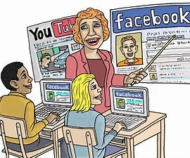
Twitter
The 280 character limit makes students think critically on communicating concisely and effectively, a beneficial skill to develop.
Instagram
Blogs
Use Twitter as a class message board.
Use Instagram for photo essays.
Create a class blog for discussions.
Assign blog posts as essays.

Slide 6

Create
Create a class-specific Pinterest board.
Include
Include social media links on your school website.
Share
Share school events and photos.
Create
Create a social media crisis strategy.
Manage
Manage your accounts all under one roof.

Slide 7

Are you ready to try these tips for using social media for education settings? There are many different uses for social media in the classroom and in education marketing, and it’s time to embrace them!

Slide 8
THANK YOU

