Slide 1
SYNTARS
AMAR
THARUN
BHARGAVI
RAJITHA

Slide 2
Problem statement
Intelligent Answer Script Evaluation System

Slide 3
Why we choose this problem statement..?
The primary goal is to conduct online exams for students,
automatically checking all answers, finding errors, and ensuring they match faculty standards.Additionally,addressing plagiarism is crucial, and by using NLP techniques,we can provide accurate scores to students, promoting constant and continuous learning.

Slide 4
What is approach...!
We created dashboards for faculty to upload questions, which automatically appear on the student's interface. Submitted answers are checked for grammar mistakes, errors, and
plagiarism using NLP. This analysis is faculty-only for comprehensive review of student performance..

Slide 5
THE IMPACT

Slide 6
This project will benefit both faculty and students. It aims to turn theoretical knowledge into practical understanding through self-learning. Student answers will closely match faculty standards,
ensuring quality. The plagiarism check helps faculty analyze
performance and provide targeted feedback.

Slide 7
User Interface (UI)
Streamlit App
Data Storage NLP Services Plagiarism
(Local Files) (spaCy) Check (Fuzzy Wuzzy)

Slide 8
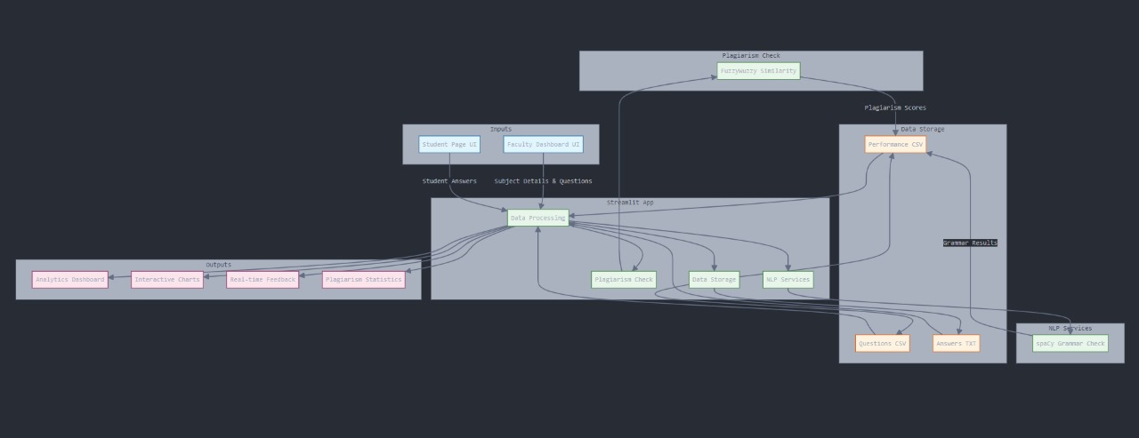

Slide 9
Thank you

