Slide 1
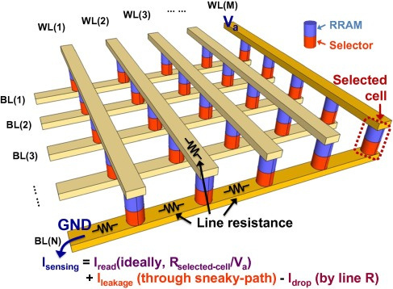
ANALOG IN-MEMORY COMPUTING
ACA × BitNet b1.58
A hybrid ternary-weight design for analog crossbar arrays
16 × 16 SPICE study
2T2R vs. 1T1R with a reference column
Amarouche Nafaa
College presentation

Slide 2
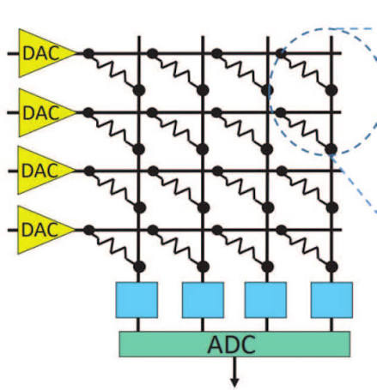
FOUNDATION
Analog Crossbar Arrays
Definition
An analog crossbar array is a grid-based hardware architecture that performs in-memory computing—specifically executing parallel vector-matrix multiplications (VMM) and multiply-accumulate (MAC) operations directly within the memory cells.
How the physics performs VMM
1. Row voltages encode the input vector.
2. Each cell produces current I = V × G.
3. Column currents sum by Kirchhoff’s current law.
4. The output current becomes the dot product Σ(VᵢGᵢⱼ).
Crossbar geometry and selected-cell concept
Computation occurs in parallel across all columns.
02

Slide 3
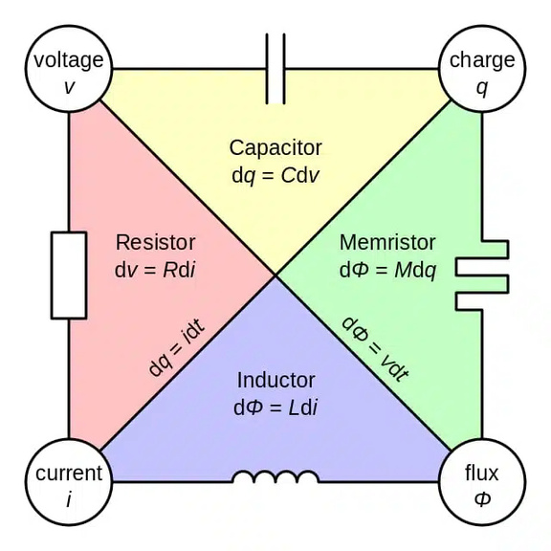
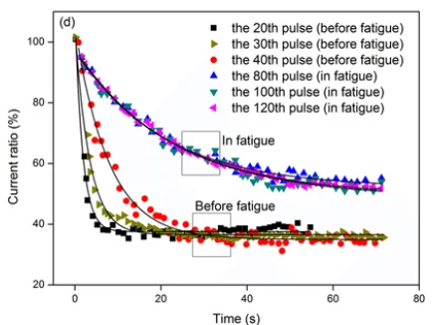
DEVICE LEVEL
What is a Memristor?
Definition
A memristor is a fundamental non-volatile electronic component whose electrical resistance changes depending on the history of the current that has flowed through it. Within a memory crossbar array, this property allows the memristor to act as a programmable resistor, effectively storing synaptic weights directly at the junction points for in-memory computing.
Programming and read
The programming process involves applying carefully controlled voltage or current pulses to alter the device's internal physical state, often by forming or rupturing a conductive filament. Reading the stored state is accomplished using a smaller voltage pulse that measures the resistance without disturbing the filament, while writing requires a larger, specific pulse to permanently adjust the resistance level.
03

Slide 4
MOTIVATION
The Problem and the Ternary Solution
Practical hurdles
Programming precision
Exact analog conductance targets are difficult to reach.
TERNARY WEIGHTS
−1 0 +1
Leakage current
HRS devices still pass a small current during readout.
Drift and degradation
Repeated switching can move the stored conductance over time.
Three intended conductance states reduce programming complexity and lower the precision burden on peripheral converters.
Converter overhead
Fine-grained weights require more ADC/DAC resolution at the periphery.
Solution
Adopting ternary weights (-1, 0, 1) drastically simplifies the architecture. With only three distinct levels to manage, the memristors become significantly easier to program and are much less susceptible to the effects of drift and degradation. Additionally, the strict precision requirements for peripheral circuitry are relaxed, greatly reducing the size and complexity of the required ADCs and DACs.
But what structure should we use?
04

Slide 5
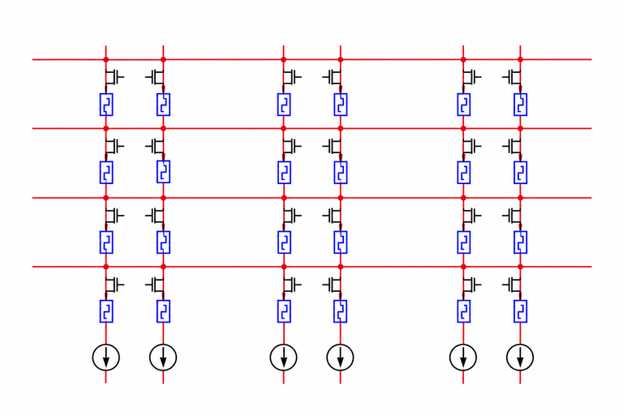
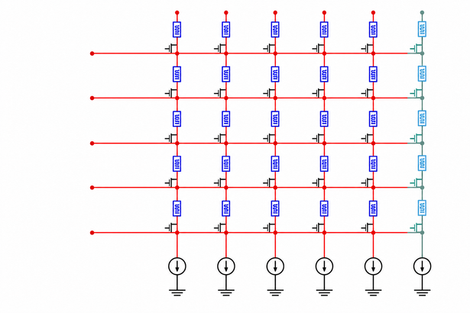
ARCHITECTURE COMPARISON
Two Ternary Crossbar Architectures
2T2R crossbar array
  Advantages :
Each logical weight uses a positive and negative 1T1R cell. +1 maps to (LRS, HRS), 0 to (HRS, HRS), and −1 to (HRS, LRS). Differential readout supports signed weights, a stable near-zero state, and common-mode error cancellation.
  Disadvantages :
The cost is density: every weight consumes two devices and two bitlines, and necessitates double the wiring complexity.
Differential 2T2R
Gᴘ − Gɴ readout
1T1R with a reference column
  Advantages :
A shared reference column current provides the comparison point outside the array. It cuts the required surface area in half, minimizes the number of memristors to be programmed, and dramatically improves scalability and structural simplicity.
  Disadvantages :
it ntroduces minor computational errors at the zero state, it requires tuning the memristor resistances to specific intermediate values instead of relying on simple one-shot binary switching
1T1R + reference column
Iᴄᴏʟ − Iʀᴇꜰ
05

Slide 6
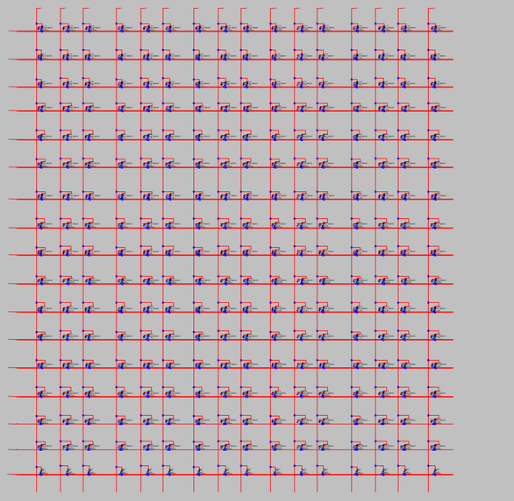
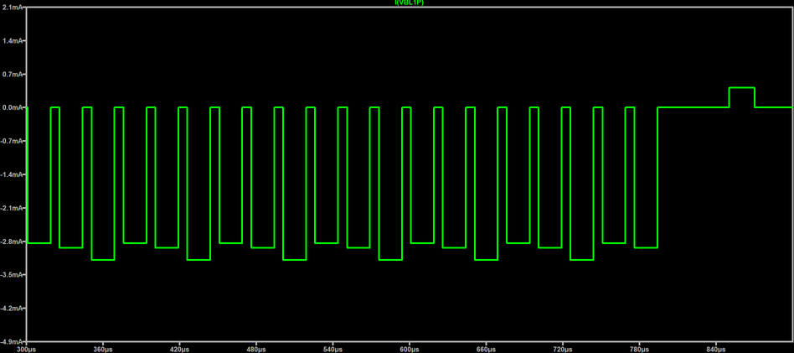
VALIDATION
Simulation Results
Testbench
16 × 16 arrays were simulated in SPICE using the Yakopcic memristor model. An alternating ternary matrix and sub-threshold read vector exercised the two architectures.
Modelled error sources
Leakage current and imperfect conductance programming
Observed trade-off
16 × 16 simulation schematic
85%
80%
45%
2T2R accuracy
1T1R accuracy
less area for 1T1R
Result
Despite a minor reduction in precision , the 1T1R reference bitline architecture
proved to be the superior choice for its overwhelming advantages in memory
density and power efficiency
Bitline current waveform during the transient simulation
06

Slide 7
ACA × BITNET b1.58
Thank you
Questions and discussion
Amarouche Nafaa
Analog crossbar arrays · ternary weights · memristor simulation

