Slide 1
Reducing Emotional Biases in Investment Portfolio Management
A Thesis Defense Presentation
Executive Master of Business Administration – SBS Swiss Business School
Aliaksei Malashonak
Student ID 19795, Matriculation 24891798
Mentor: Dr. Stefano Canossa
September 2026

Slide 2
Topic and Motivation
The study evaluates whether a structured decision-support indicator, the Shock Score, can reduce emotional biases in equity portfolio management.
Behavioral finance: there are systematic, emotionally driven decision errors during external information shocks.
Existing decision-support systems: analytics rather than ex-ante bias mitigation
The topic is grounded in professional risk-management practice, where this gap is persistently observed.

Slide 3
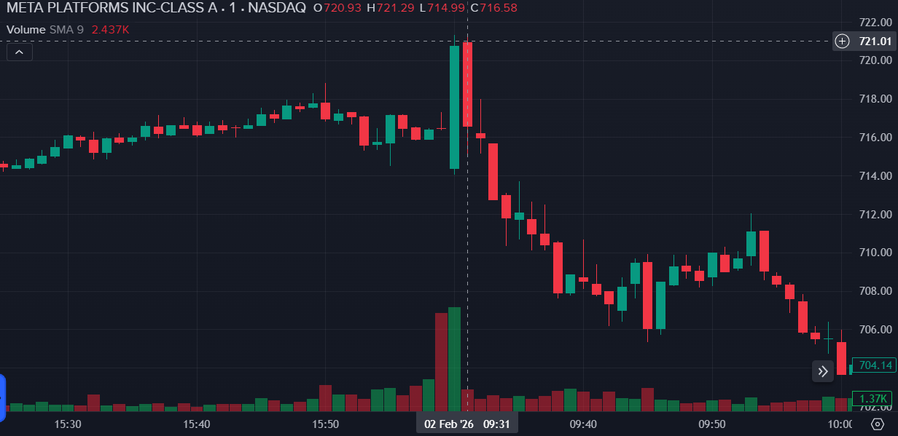
Example: Informational Shock
Intraday Price Movement of Meta Platforms Inc. on 2 February 2026 Following the Release of Quarterly Earnings Results followed by announcement about Capex increase, Illustrating a Short-Horizon Market Reaction to an External Information Shock.

Slide 4
Research Question and Hypotheses
Research question: can a structured decision-support indicator moderate behavioral bias in professional equity portfolio management?
H1: Shock Score intensity has a statistically significant effect on managers' Net Risk Stance.
H2: Exposure to the Shock Score dashboard has a statistically significant effect on portfolio risk – return outcomes.

Slide 5
Method and Design
Within-subject quasi-experimental scenario survey of professional equity portfolio managers.
24 real-market scenarios across three blocks; the treatment condition displays the Shock Score dashboard.
Sample of 53 respondents yielding 424 scenario-level observations.
Primary estimator: two-way cluster-robust OLS regression with respondent fixed effects.

Slide 6
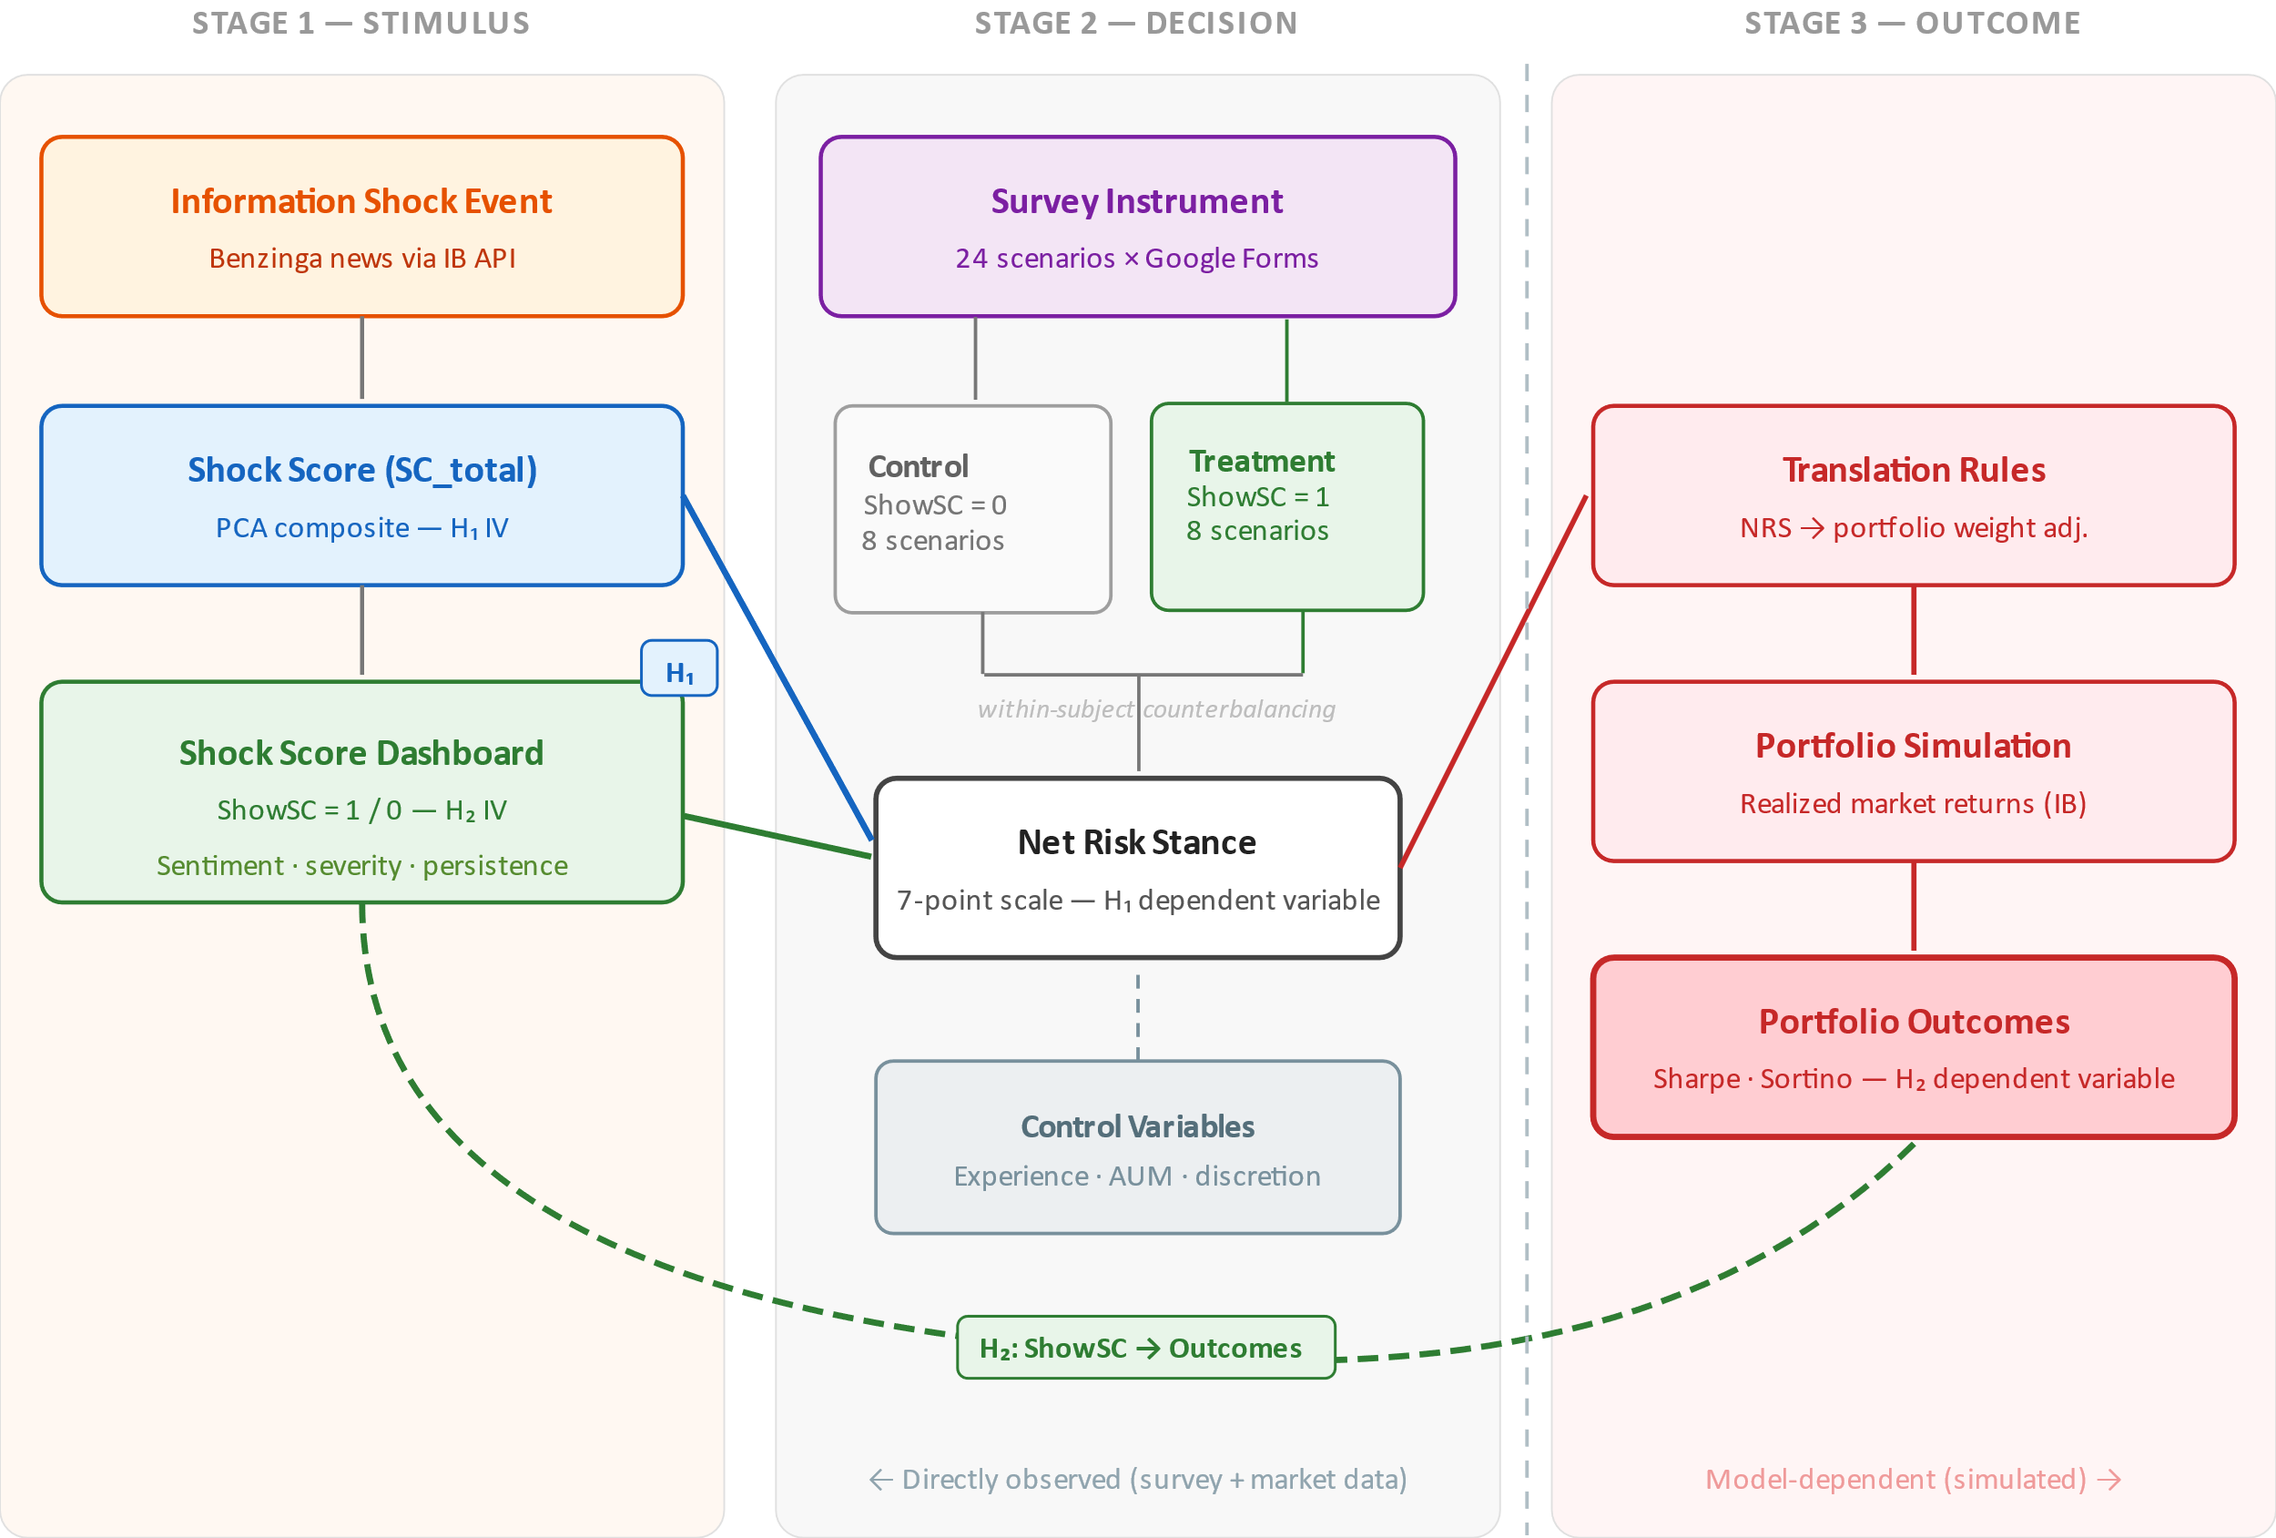
Research Framework

Slide 7
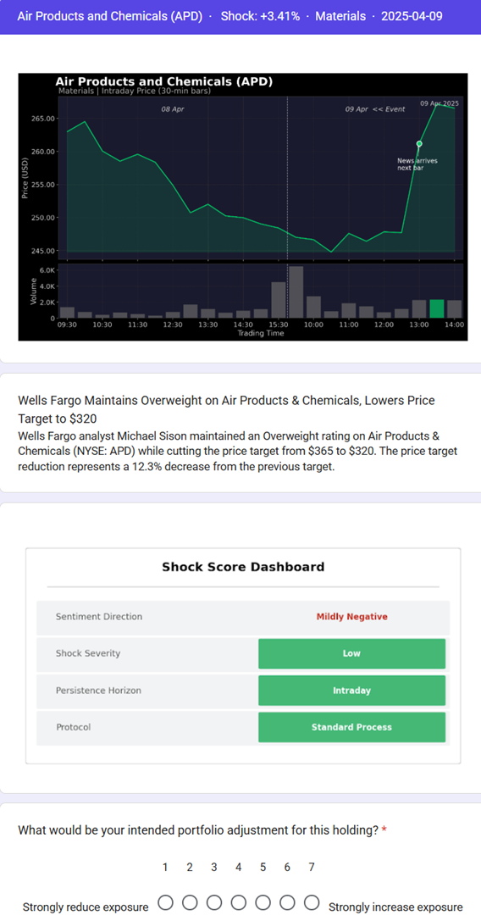
Scenario and Shock Dashboard example

Slide 8
Finding 1: H1 Supported
The null hypothesis H1 is rejected at the 5 percent significance level.
Shock Score coefficient = -0.4874 (p = 0.0015), a statistically significant negative effect.
Higher shock intensity is systematically associated with a risk-reducing shift in Net Risk Stance.
The result is consistent with behavioral finance theory.

Slide 9
Finding 2: H2 Not Supported
The null hypothesis H2 is not rejected in the current sample.
Dashboard treatment effect = -0.1584 (p = 0.7428), not statistically significant.
The estimate is directionally consistent with the hypothesized moderation mechanism.
The non-significant result is attributed primarily to limited statistical power, not to an absence of effect.

Slide 10
Conclusions and Recommendations
External information shocks are associated with measurable, systematic changes in professional managers' risk stance.
The Shock Score demonstrates construct validity and directional alignment with the hypothesized mechanism.
Replication on a larger sample is recommended to evaluate H2 with adequate statistical power.
Behavioral indicators can support risk-governance frameworks and structured pre-commitment protocols.

Slide 11
Ethical Implications
Decision-support indicators should augment, not replace, professional judgment and accountability.
Over-reliance on a single composite score risks automation bias and a false sense of precision.
Transparency and interpretability of the indicator are prerequisites for responsible deployment.
Behavioral monitoring must respect the professional autonomy and discretion of portfolio managers.

Slide 12
Personal Lessons Learned
A rigorous, pre-specified design protects the credibility of findings more than any single result.
A non-significant result is a legitimate and informative scientific contribution.
Statistical power must be planned at the design stage, not diagnosed afterwards.
Translating behavioral theory into a practitioner tool requires disciplined simplification.

Slide 13
References
Yang, Y., UY, M. C. S., & Huang, A. (2020). FinBERT: A pretrained language model for financial communications [Preprint]. arXiv. https://doi.org/10.48550/arXiv.2006.08097

Slide 14
Thank You
Aliaksei Malashonak – Executive Master of Business Administration.
SBS Swiss Business School.
Questions and discussion are welcome.

Slide 15
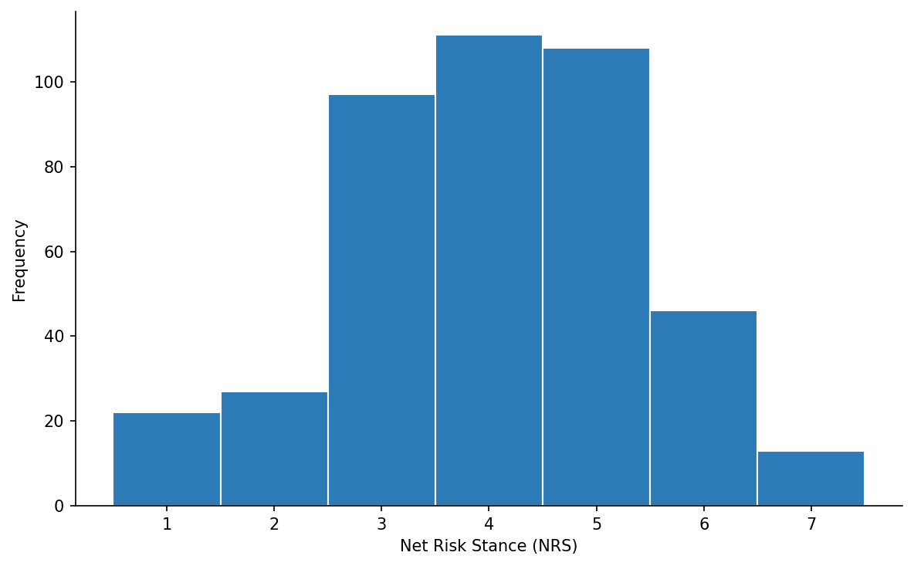
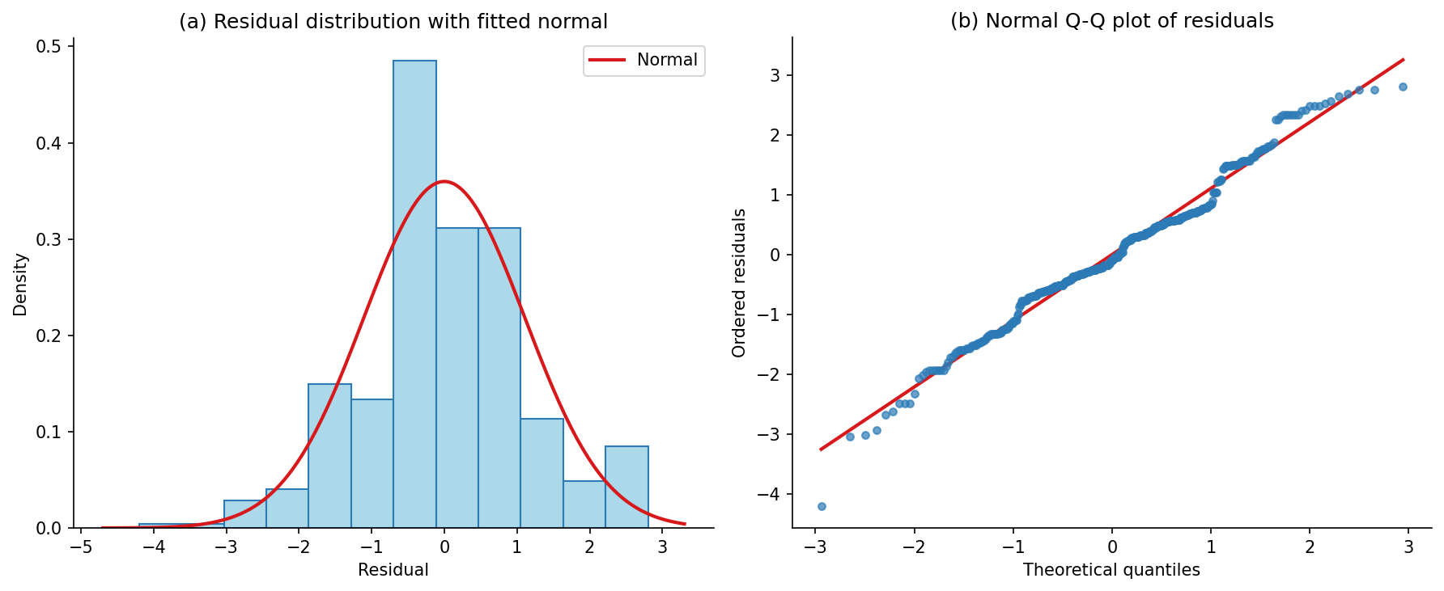
Appendix 1 – Normality of Key Responses and Method Justification
Net Risk Stance is a seven-point ordinal scale -- cannot follow an exact normal distribution by construction
The response is approximately symmetric with all seven categories well populated, and skewness and excess kurtosis are low.
OLS requires approximately normal errors, not a normal dependent variable; the residuals are near-symmetric and close to normal (W = 0.9849), and with 424 observations the central limit theorem applies.
Shapiro-Wilk rejects strict normality for both series; at n = 424 the test detects trivial departures, so the high W values and small skewness and kurtosis are the more informative evidence. The H1 conclusion does not depend on a normality assumption.
Net Risk Stance (NRS), n = 424. Skewness = −0.1846; excess kurtosis = −0.2561; Shapiro-Wilk W = 0.9455, p < 0.0001. Approximately symmetric and unimodal; all seven categories materially populated.
Primary H1 residuals, n = 424. Skewness = 0.0205; excess kurtosis = 0.5096; Shapiro-Wilk W = 0.9849, p = 0.0002. Approximately symmetric and centred on zero; Q-Q plot tracks the reference line with mild tail deviation.

Slide 16
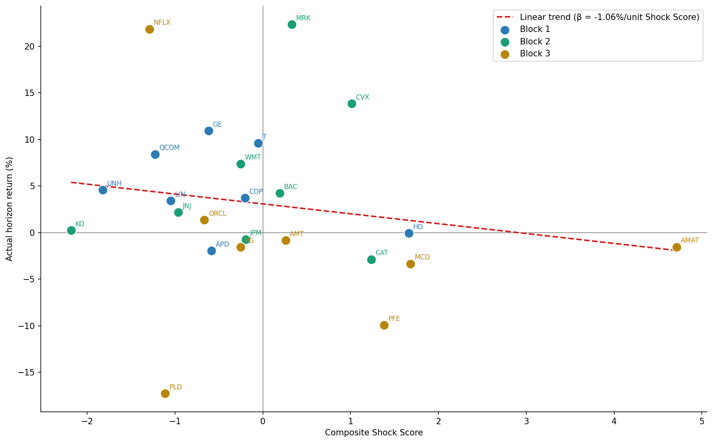
Appendix 2 – Does shock score predict return?

Slide 17
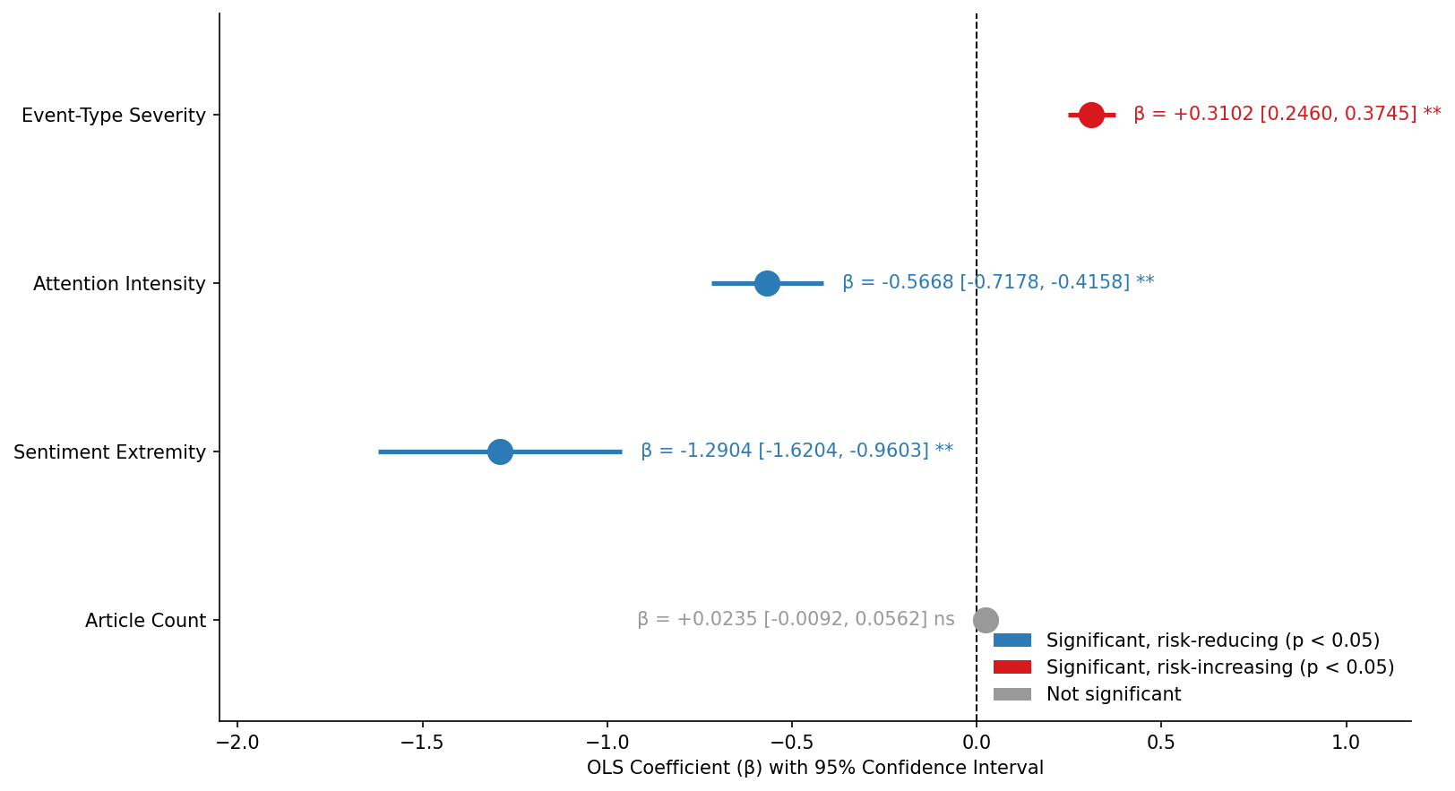
Appendix 3 – Shock Score decomposition.

