Slide 1
Reducing Emotional Biases in Investment Portfolio Management
A Thesis Defense Presentation
Executive Master of Business Administration – SBS Swiss Business School
Aliaksei Malashonak
Student ID 19795, Matriculation 24891798
Mentor: Dr. Stefano Canossa
September 2, 2026

Slide 2
Topic and Motivation
Information shock
news, events, attention
Manager’s decision
Net Risk Stance
Portfolio outcome
risk–return ratio
H1 – shock intensity affects
managers’ Net Risk Stance
H2 – showing the Shock Score affects the portfolio risk–return ratio
Shock Score dashboard
Why it matters
Information shocks – news, events, publications – trigger emotional biases.
Those biases sit outside the strategy and add risk and cost.
What this study asks
Can a Shock Score indicator approximate systematic emotional biases?
Can a decision-support tool reduce those biases in practice?
What we already know
Behavioural finance: errors cluster around information shocks.
Analytics work; ex-ante bias mitigation does not.
The gap persists in professional risk management.

Slide 3
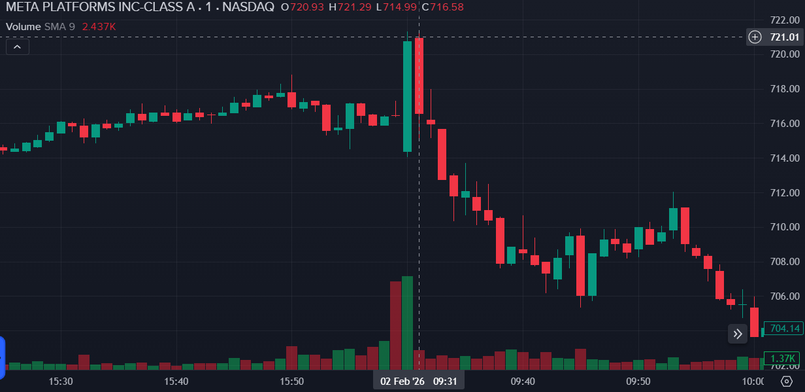
Example: Short Term market Reaction to Informational Shock
One day of trading of META stock (February 2nd,2026): Quarterly earnings release followed by announcement about Capex increase.

Slide 4
Research Questions
Goal 1: predict & measure the bias
Info Shock
Biased Decision
Goal 2: remove the bias
RQ1
Do bigger shocks move risk decisions?
Is the intensity of external financial information shocks associated with statistically significant differences in managers’ immediate Net Risk Stance?
Tested as H1 — 424 scenario responses
RQ2
Does the Shock Score change decisions?
Is providing the Shock Score associated with changes in Net Risk Stance and, through them, in portfolio risk–return outcomes, versus no score?
Tested as H2 — within-subject design

Slide 5




Method and Design
METHOD
Positivist, deductive, quasi-experimental within-subject survey
DESIGN
Primary: within-subject quasi-experimental scenario survey with the treatment condition.
Secondary: information-shock scenarios for US Equities.
PARTICIPANTS
Professional equity portfolio managers who take real allocation decisions
ANALYSIS
Two-way cluster-robust OLS regression with respondent fixed effects
53
Portfolio managers surveyed
424
Scenario-level observations
24
Real-market scenarios, 3 blocks
Each manager judges every scenario with and without the Shock Score — the design isolates the effect of the dashboard itself.

Slide 6
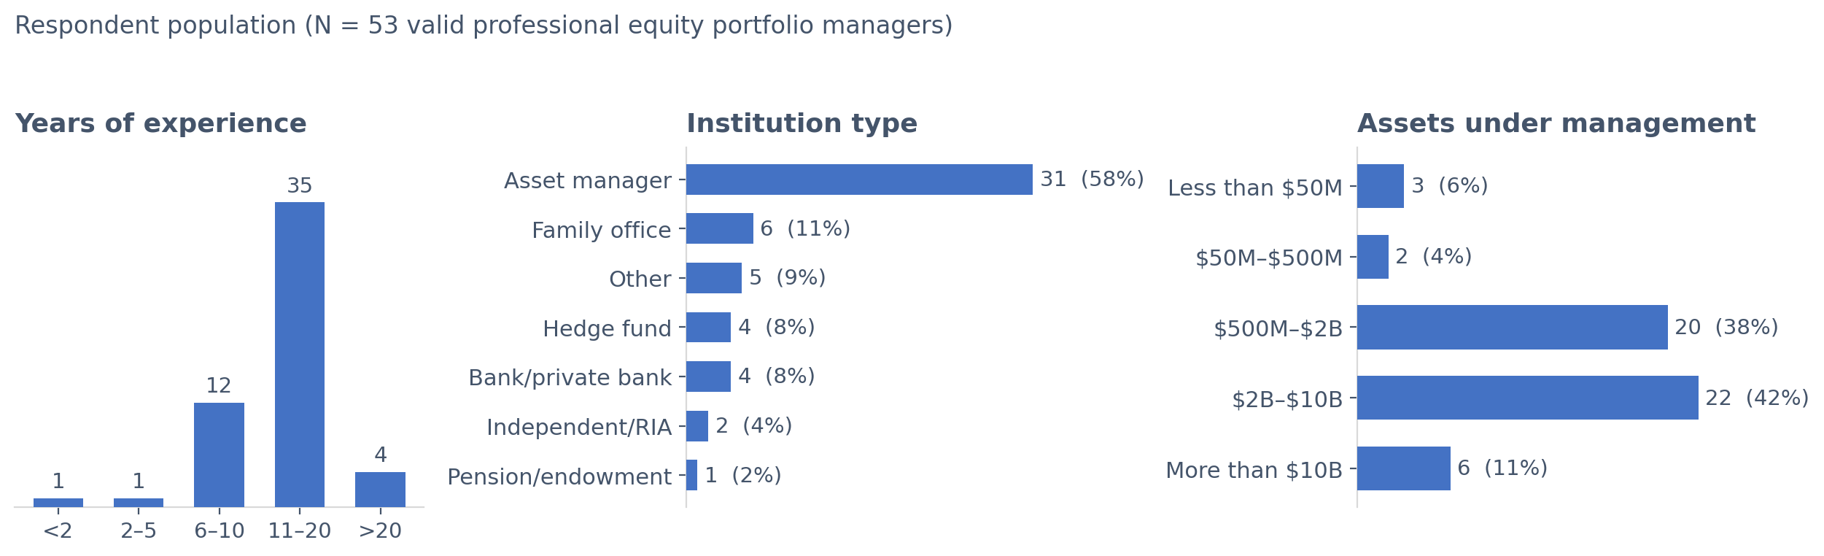
Respondent Profile
Note. Original figures created for this study (2026).

Slide 7
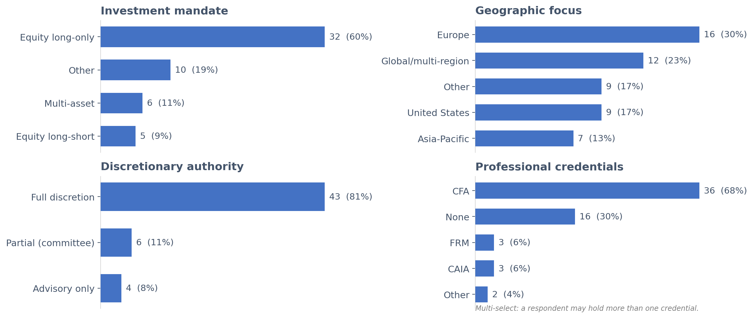
Respondent Profile(cont.)
Note. Original figures created for this study (2026).

Slide 8
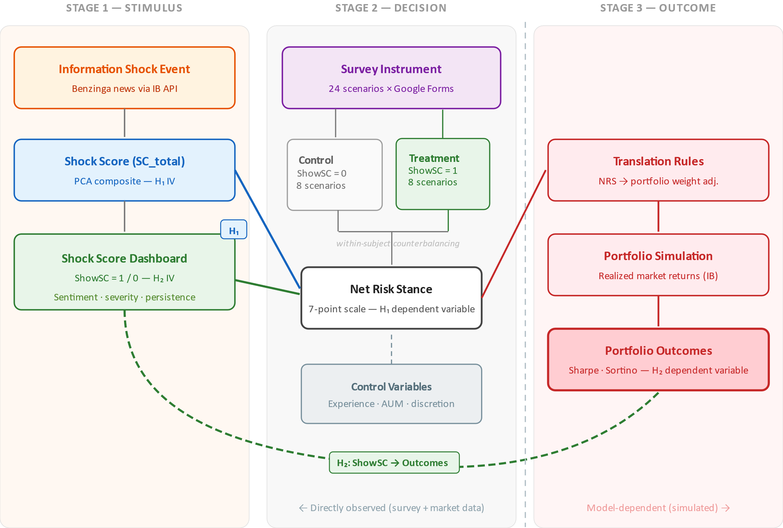
Research Framework
Note. Original figures created for this study (2026).

Slide 9
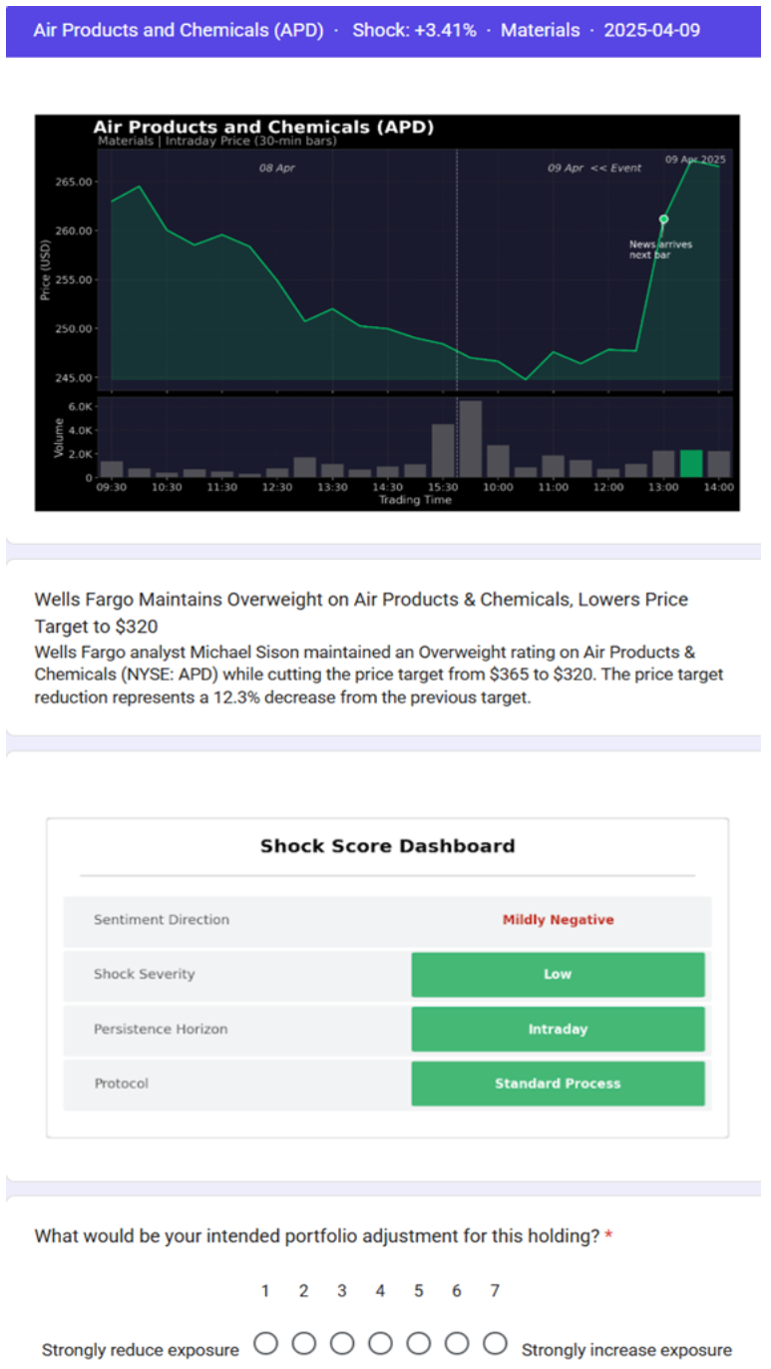
Scenario and Shock Dashboard example
Market events are selected randomly across different industries/companies/topics with counter-balancing algorithm.
Top companies (my market cap) are excluded to avoid framing bias.
Interviewer gets Shock Score decomposed into main components together with Treatment Protocol.
Response section proposes options to change portfolio weights.

Slide 10
Hypothesis H1 Null: Rejected
Hypothesis H1—Influence of Information Shocks on Decisions
H1₀: The intensity of external financial information shocks has no statistically significant effect on managers’ Net Risk Stance responses.
H1ₐ: The intensity of external financial information shocks has a statistically significant effect on managers’ Net Risk Stance responses.
The Null H1 is rejected at the 5 percent significance level.
Shock Score coefficient = -0.4874 (p = 0.0015), a statistically significant negative effect.
Higher shock intensity is systematically associated with a risk-reducing shift in Net Risk Stance.
The result is consistent with behavioral finance theory (Huber et al., 2021; March & Shapira, 1987).

Slide 11
Finding 2 H2 Null: Fail to Reject
Hypothesis H2—Value Added of the Shock Score
H2₀: Introducing the Shock Score for investment decision-making has no statistically significant effect on the risk–return ratio of the portfolio.
H2ₐ: Introducing the Shock Score for investment decision-making has a statistically significant effect on the risk–return ratio of the portfolio.
The null H2 is not rejected:
Dashboard treatment effect = -0.1584 (p = 0.7428), not statistically significant.
The estimate is directionally consistent with the expected moderation mechanism (Bianchi & Briere, 2021; Lim, 2026; Statman, 2019).
The non-significant result is attributed primarily to limited statistical power, not to an absence of effect.

Slide 12
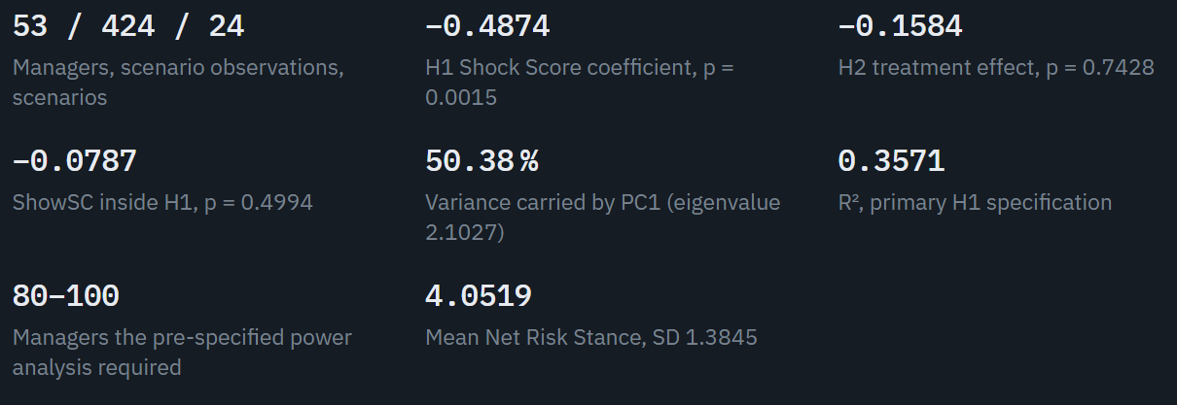
Key Figures

Slide 13


Conclusions and Recommendations
Findings
Recommendations
Info Shocks move behaviour
Professional managers shift their Net Risk Stance measurably and systematically when an external information shock lands.
Replicate at scale
A larger sample is needed to test H2 with adequate statistical power.
The Shock Score predicts behavior
It behaves consistently as a construct and points in the direction the expected mechanism predicts.
Put it into governance
Behavioural indicators can feed risk-governance frameworks and structured pre-commitment protocols.
Shock-driven behaviour is measurable — and what can be measured can be governed.

Slide 14
Ethical and legal Implications
Decision-support indicators should augment, not replace, professional judgment and accountability.
Over-reliance on a single composite score risks automation bias and a false sense of precision.
Transparency and interpretability of the indicator are prerequisites for responsible deployment.
Behavioral monitoring must respect the professional autonomy and discretion of portfolio managers.
Legal implication – the line is not crossed (see Annex)

Slide 15
Personal Lessons Learned
A rigorous, pre-specified design protects the credibility of findings more than any single result.
A non-significant result is a legitimate and informative scientific contribution.
Statistical power must be planned at the design stage, not diagnosed afterwards.
Translating behavioral theory into a practitioner tool requires disciplined simplification.

Slide 16
References
Bianchi, M., & Brière, M. (2021). Robo-advising: Less AI and more XAI? SSRN Electronic Journal.
Huber, C., Huber, J., & Kirchler, M. (2021). Market shocks and professionals' investment behavior: Evidence from the COVID-19 crash. Journal of Banking & Finance, 133, Article 106247.
Lim, T. (2026). Emotion-aware decision support system for real-time financial sentiment and behavior-based trading risk advisory. Journal of Behavioral Finance, 1–24.
March, J. G., & Shapira, Z. (1987). Managerial perspectives on risk and risk taking. Management Science, 33(11), 1404–1418
Statman, M. (2019). Behavioral finance: The second generation. SSRN Electronic Journal.
Yang, Y., UY, M. C. S., & Huang, A. (2020). FinBERT: A pretrained language model for financial communications [Preprint]. arXiv.

Slide 17
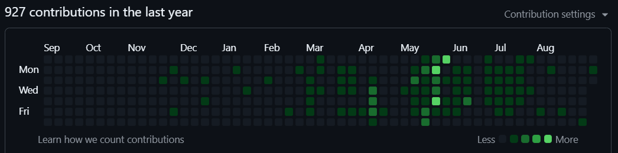
Thank You
Aliaksei Malashonak – Executive Master of Business Administration.
SBS Swiss Business School.
Questions and discussion are welcome.
Repo: https://github.com/Amarows/thesis

Slide 18
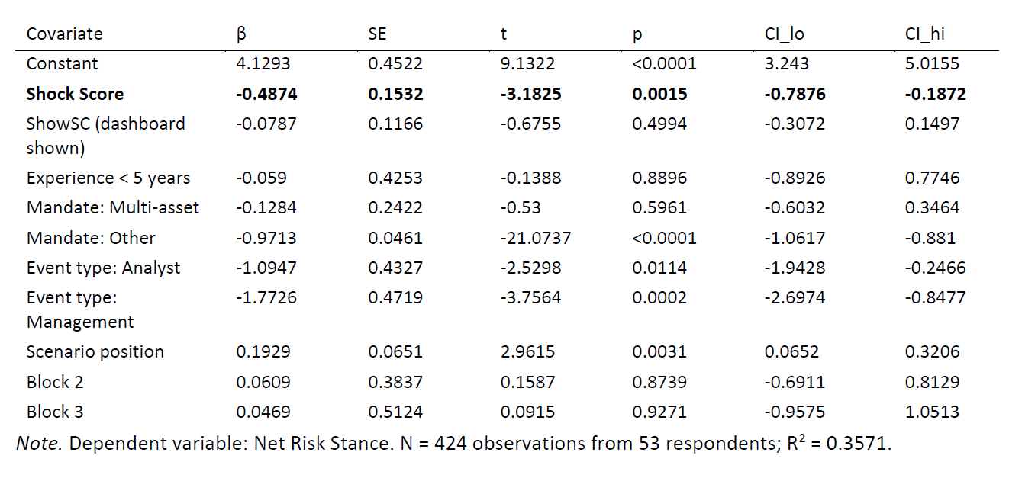
Appendix 1: H1 regression results
Hypothesis H1—Influence of Information Shocks on Decisions
H1₀: The intensity of external financial information shocks has no statistically significant effect on managers’ Net Risk Stance responses.
H1ₐ: The intensity of external financial information shocks has a statistically significant effect on managers’ Net Risk Stance responses.

Slide 19
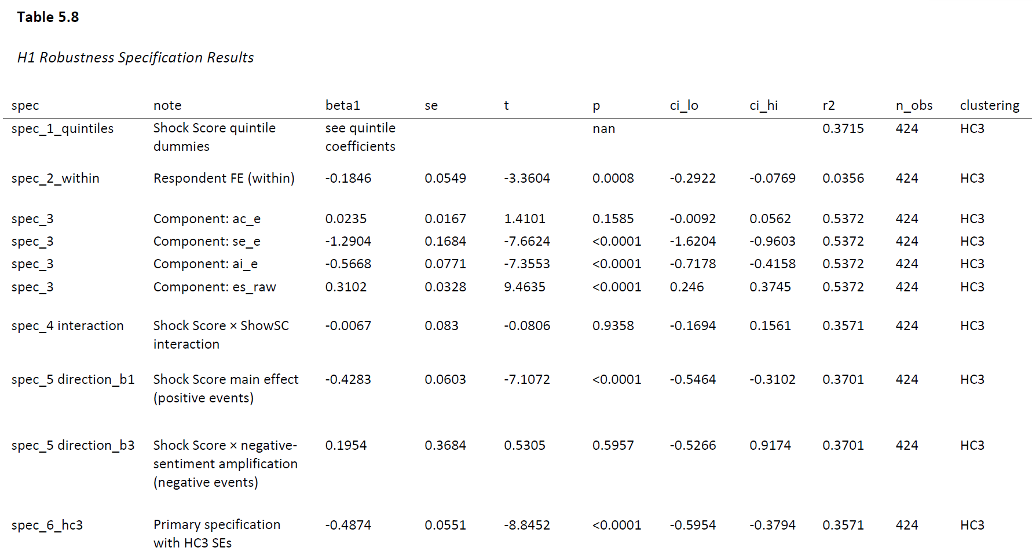
Appendix 1 (cont.): Robustness Spec

Slide 20
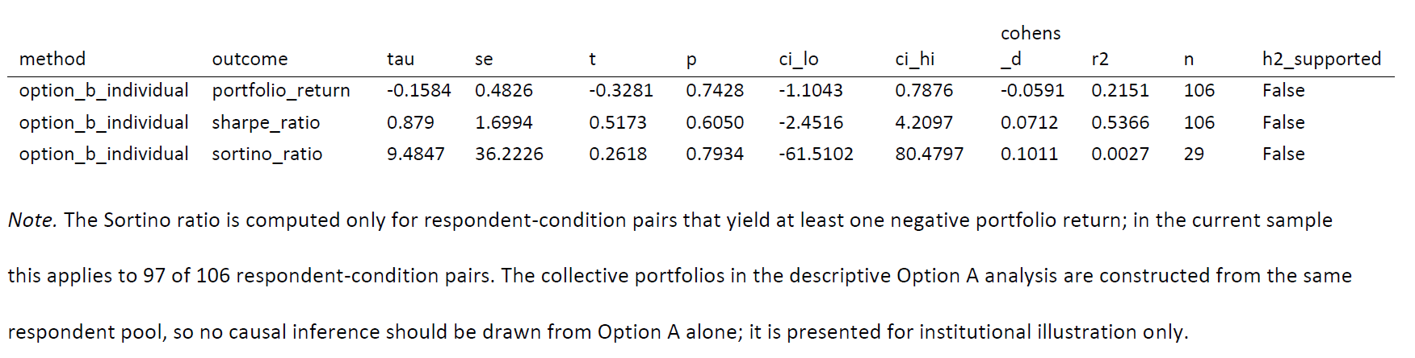
Appendix 2: H2 regression results
Hypothesis H2—Value Added of the Shock Score
H2₀: Introducing the Shock Score for investment decision-making has no statistically significant effect on the risk–return ratio of the portfolio.
H2ₐ: Introducing the Shock Score for investment decision-making has a statistically significant effect on the risk–return ratio of the portfolio.

Slide 21

Appendix 3: Regression Method Explained
Two-way cluster-robust OLS regression with respondent fixed effects
OLS regression — measures how much the allocation decision changes when the Shock Score is displayed, holding the other scenario features constant.
Respondent fixed effects — every manager is compared with himself, so personal risk appetite, seniority and house style drop out of the estimate.
Two-way clustering (respondent and scenario) — one person answers many scenarios and one scenario is judged by many people; clustering corrects the standard errors for both, so significance is not overstated.
The effect is measured within-person and is deliberately conservative: it reflects the dashboard itself, not who answered or which market event was shown.

Slide 22
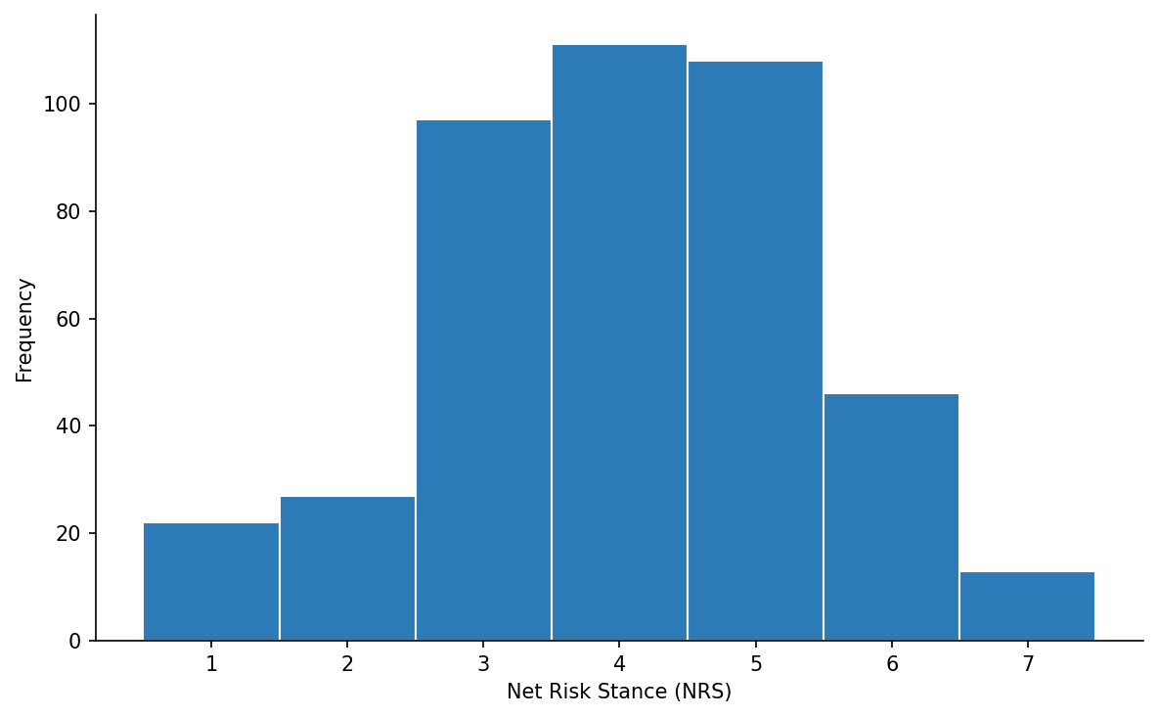
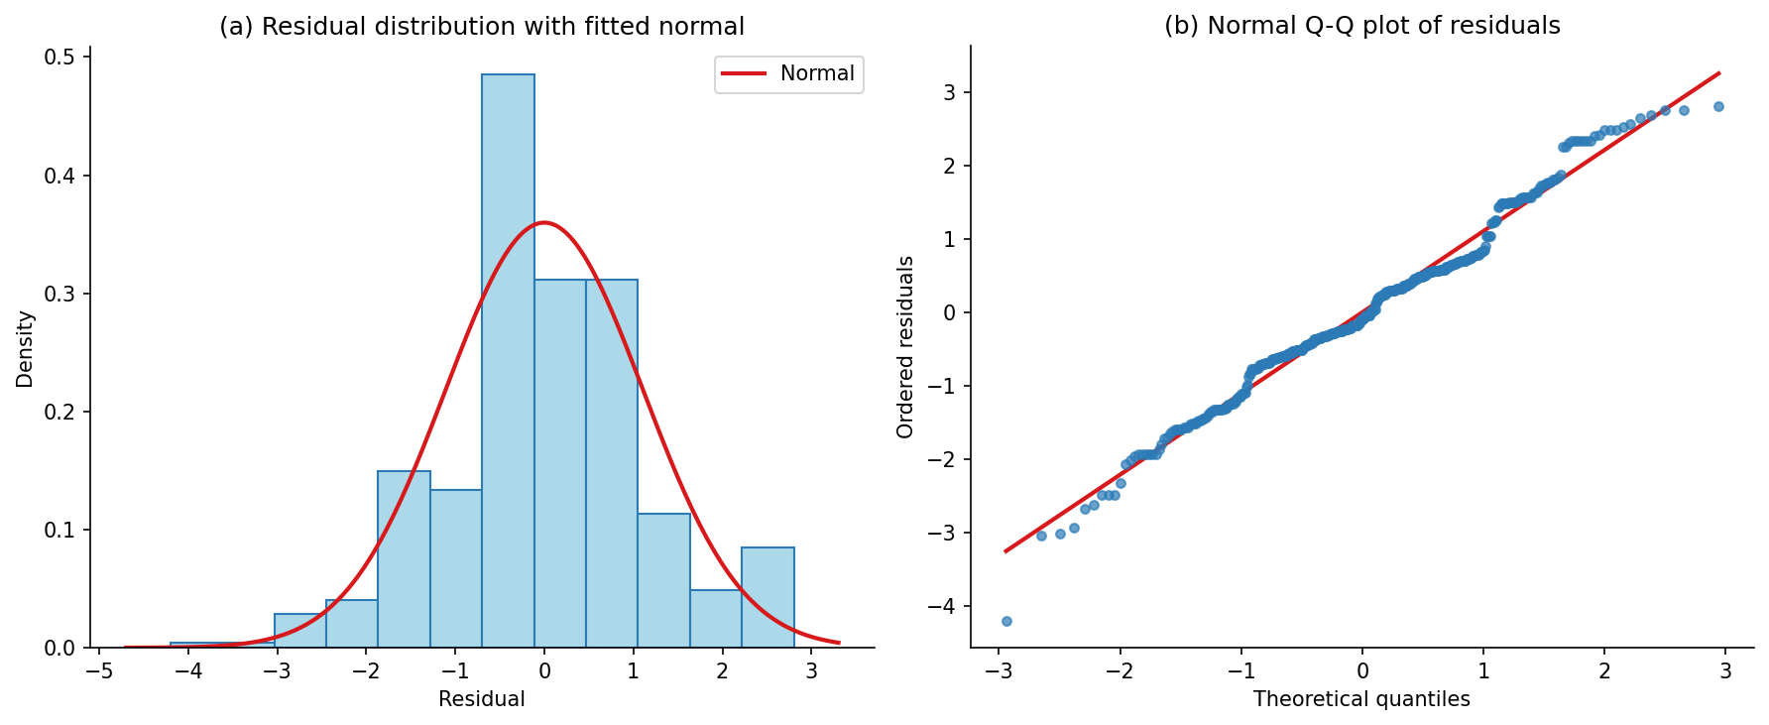
Appendix 4: Normality of Key Responses and Method Justification
Net Risk Stance is a seven-point ordinal scale -- cannot follow an exact normal distribution by construction
The response is approximately symmetric with all seven categories well populated, and skewness and excess kurtosis are low.
OLS requires approximately normal errors, not a normal dependent variable; the residuals are near-symmetric and close to normal (W = 0.9849), and with 424 observations the central limit theorem applies.
Shapiro-Wilk rejects strict normality for both series; at n = 424 the test detects trivial departures, so the high W values and small skewness and kurtosis are the more informative evidence.
The H1 conclusion does not depend on a normality assumption.
Net Risk Stance (NRS), n = 424. Skewness = −0.1846; excess kurtosis = −0.2561; Shapiro-Wilk W = 0.9455, p < 0.0001. Approximately symmetric and unimodal; all seven categories materially populated.
Primary H1 residuals, n = 424. Skewness = 0.0205; excess kurtosis = 0.5096; Shapiro-Wilk W = 0.9849, p = 0.0002. Approximately symmetric and centred on zero; Q-Q plot tracks the reference line with mild tail deviation.
Note. Original figures created for this study (2026).

Slide 23
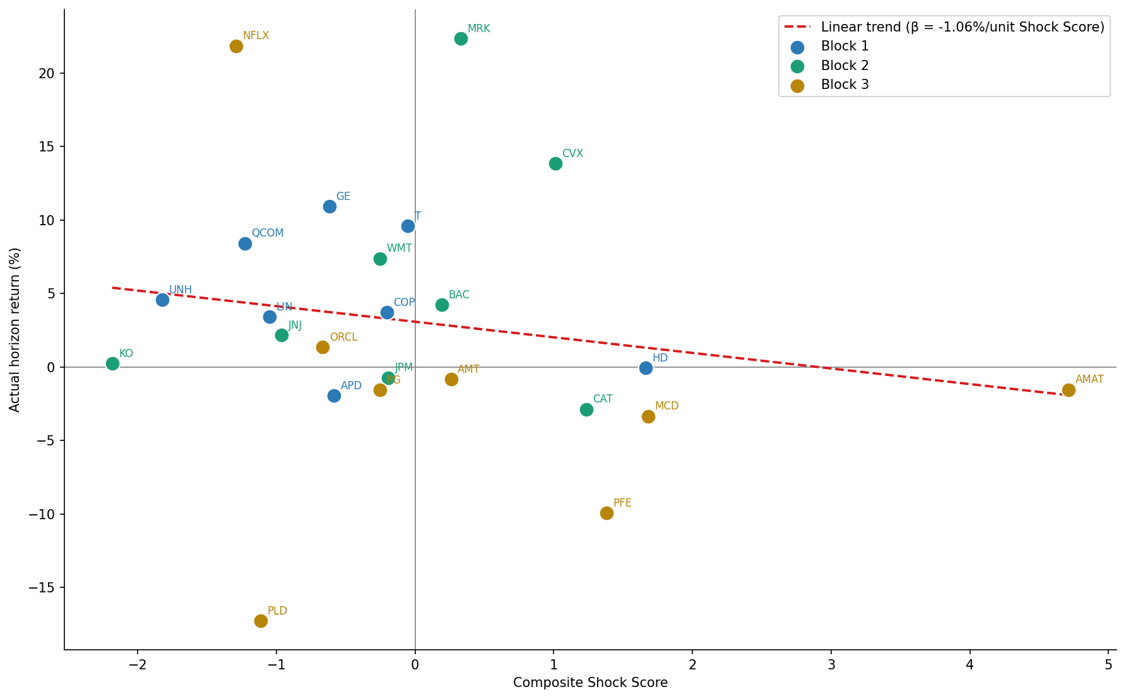
Appendix 5: Does shock score predict return?
Note. Original figures created for this study (2026).

Slide 24
Appendix 5: Building the Shock Score
Article Count
AC_e
Number of news headlines in the shock window.
Sentiment Extremity
SE_e
Largest absolute FinBERT sentiment in the 30-min shock bar.
Attention Intensity
AI_e
Shock-bar volume ÷ 60-day average 30-min volume.
Event-Type Severity
ES_e
Event-category volatility vs overall
(σ_k ÷ σ_all).
Standardise
Each component z-scored across all events.
Combine (PCA)
First principal component (PC1) sets the weights.
SC_total
Composite shock-intensity score (higher = more intense shock).
Inputs: Interactive Brokers 30-minute price bars · Benzinga headlines · FinBERT sentiment.
All four are event-level components (subscript e). PCA combines them into a single ex-ante measure available at the point of decision.

Slide 25
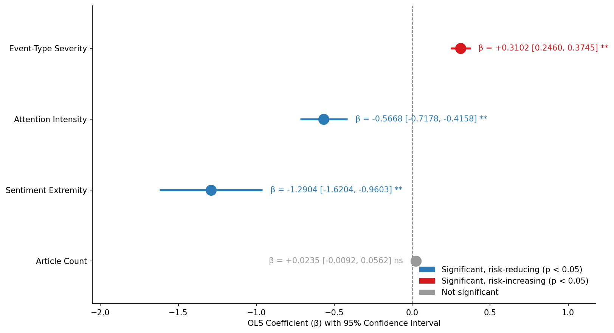
Appendix 7: Shock Score decomposition.
Note. Original figures created for this study (2026).

Slide 26
Appendix 8: Decision Protocols
HALT
Above 85th percentile
Intense shock: prompt pre-commitment and a pause before acting.
REVIEW
60th – 85th percentile
Elevated shock: prompt a deliberate reassessment of the position.
MONITOR
Below 60th percentile
Routine conditions: no action prompted.
Bands are percentile cut-offs on the scenario SC_total distribution.
The dashboard surfaces the band at the moment of decision (ex-ante). Displaying it is the intervention tested in H2 (ShowSC).

Slide 27
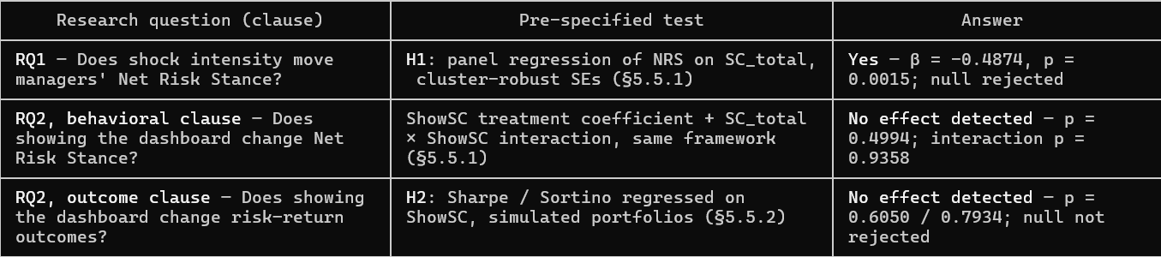
Appendix 9: Paradigm -- How the Design Answers the Research Questions
Research Paradigm – What each term means (Saunders et al., 2019):
Positivist — knowledge comes only from observable, measurable facts, independent of the researcher's beliefs. In this study: structured seven-point survey responses and market data — no interpretation of what managers "meant.“
Deductive — reasoning runs from theory to data, never the reverse: behavioral finance theory → testable hypotheses → measurement → statistical test. (Opposite: inductive — building theory out of observations.)
Theory-testing — the study does not create new theory from the data; it checks whether predictions of existing theory hold in a professional sample.
Falsification logic (Popper) — hypotheses are stated as null statements that data could reject. Nothing is ever "proven": a claim stands only while the evidence fails to reject it at the pre-set threshold (α = 0.05).
Under falsification logic, a null result is a complete answer, not a failure: the research question is answered by running the test, not by the direction of its outcome. The H2 null is reported as informative and bounded by statistical power (§5.8.2).
Notes:
The paradigm answers the research questions by construction. Positivist means I only use measurable data; deductive and theory-testing mean I derived hypotheses from behavioral finance theory before collecting data; falsification means each question was converted into a null hypothesis a statistical test could reject. Both questions were fully answered: shock intensity significantly predicts risk stance — the null was rejected — and the dashboard showed no detectable effect on behavior or outcomes, which under this paradigm is an equally valid, informative answer.

Slide 28
Appendix 10: Regulatory Context
Regulatory position:
EU AI Act emotion-recognition ban (Art. 5(1)(f)) — not applicable: requires biometric data on natural persons; SC scores events from news text and volume
Social scoring (Art. 5(1)(c)) — not applicable: no person is classified or ranked
Research artefact exempt under Art. 2(6) (scientific R&D)
If method is deployed: minimal-risk tier (not Annex III); Art. 4 AI-literacy duty applies GDPR / revFADP (2023) govern survey data — consent, minimisation, anonymised reporting
Switzerland has no AI act: sector-specific approach confirmed 12 Feb 2025; CoE Framework Convention ratification, consultation bill due end-2026 → FINMA Guidance 08/2024 is the operative standard
Human-in-the-loop by design keeps the tool outside MiFID II Art. 17 algorithmic trading
⚠️ Line not crossed: profiling individual managers would trigger Annex III(4) high-risk
Sources:
Article 3: Definitions | EU Artificial Intelligence Act
Article 5: Prohibited AI Practices | EU Artificial Intelligence Act
Red Lines under EU AI Act: Unpacking the prohibition of emotion recognition in the workplace and education institutions (FPF)
AI regulation: Federal Council to ratify Council of Europe Convention (admin.ch)- Switzerland Sets Its Course on AI Legislation (Pestalozzi)
FINMA guidance on governance and risk management when using artificial intelligence

