Slide 1
Communication: any-to-any
vnet1
10.0.1.0/24
vnet2
10.0.2.0/24
vm1-pubIP
nsg-vm1
vm2-pubIP
nsg-vm2
vm1
vm2
subnet1
10.0.1.0/25
subnet1
10.0.2.0/25
hub1
10.10.0.0/23
hub1_S2SvpnGW
AS: 65515
vnet-branch1
192.168.1.0/24
S2S VPN
vpnGtw1
AS: 65020
tunnel1
vpn-pubIP1
vm-branch
tunnel2
192.168.1.228
192.168.1.229
vpn-pubIP2
GatewaySubnet
192.168.1.224/27
192.168.1.0/25

Slide 2
Communication: any-to-any
vnet1
10.0.1.0/24
vnet2
10.0.2.0/24
vm1-pubIP
nsg-vm1
vm2-pubIP
nsg-vm2
vm1
vm2
subnet1
10.0.1.0/25
subnet1
10.0.2.0/25
hub1
10.10.0.0/23
hub1_S2SvpnGW
AS: 65515
vnet-branch1
192.168.1.0/24
tunnel1
S2S VPN
52.237.173.111
vpnGtw1
AS: 65020
vm-branch
tunnel2
192.168.1.228
192.168.1.229
52.237.173.100
$vpnGateway = Get-AzVpnGateway -ResourceGroupName $rgName -Name hub1_S2SvpnGW
$vpnGateway.IpConfigurations.PublicIpAddress[0]
$vpnGateway.IpConfigurations.PublicIpAddress[1]
$vpnGateway.BgpSettings.BgpPeeringAddresses[0].DefaultBgpIpAddresses
$vpnGateway.BgpSettings.BgpPeeringAddresses[1].DefaultBgpIpAddresses
GatewaySubnet
192.168.1.224/27
192.168.1.0/25
$vpnGtwBranch = Get-AzVirtualNetworkGateway -ResourceGroupName $rgName -Name $vpnGtwBranchName
$vpnGtwBranch.BgpSettings.BgpPeeringAddresses[0].TunnelIpAddresses
$vpnGtwBranch.BgpSettings.BgpPeeringAddresses[1].TunnelIpAddresses
$vpnGtwBranch.BgpSettings.BgpPeeringAddresses[0].DefaultBgpIpAddresses
$vpnGtwBranch.BgpSettings.BgpPeeringAddresses[1].DefaultBgpIpAddresses

Slide 3
Effective routes: vm2-nic
vnet2
10.0.2.0/24
Source | State | Address Prefixes | Next Hop Type | Next Hop IP Address | User Defined Route Name
Default | Active | 10.0.2.0/24 | Virtual network | - | -
Default | Active | 10.10.0.0/24 | VNet peering | - | -
Virtual network gateway | Active | 192.168.1.0/24 | Virtual network gateway | 10.10.0.12 | -
Virtual network gateway | Active | 192.168.1.0/24 | Virtual network gateway | 10.10.0.13 | -
Virtual network gateway | Active | 10.0.1.0/24 | Virtual network gateway | 52.162.181.145 | -
Default | Active | 0.0.0.0/0 | Internet | - | -
subnet1
10.0.2.0/25
vm2
vnet1
10.0.2.0/24
Microsoft.Network/virtualHubs/hub1/hubVirtualNetworkConnections/vnet1_conn
subnet1
10.0.1.0/25
vm2
Microsoft.Network/virtualHubs/hub1/hubVirtualNetworkConnections/vnet2_conn
Routing Configuration of vnet1 connection
associatedRouteTable | id: defaultRouteTable
propagatedRouteTable | {id: hub1 ->defaultRourte Table}
Routing Configuration of vnet2 connections
associatedRouteTable | id: defaultRouteTable
propagatedRouteTable | {id: hub1 ->defaultRoute Table}
hub1
10.10.0.0/23
Route Table: defaultRouteTable
vnet-branch1
192.168.1.0/24
Prefix | Next Hop Type | Next Hop | Origin | AS path
192.168.1.0/24 | VPN_S2S_Gateway | hub1_S2SvpnGW | hub1_S2SvpnGW | 65020
10.0.1.0/24 | Virtual Network Connection | vnet1_conn | vnet1_conn
10.0.2.0/24 | Virtual Network Connection | vnet2_conn | vnet2_conn
hub1_S2SvpnGW
AS: 65515
tunnel1
S2S VPN
vpn-pubIP1
52.237.173.111
vpnGtw1
AS: 65020
vm-branch
tunnel2
192.168.1.228
192.168.1.229
vpn-pubIP2
52.237.173.100
sites
GatewaySubnet
192.168.1.224/27
192.168.1.0/25
Site | Site Provisioning Status | Hub | Location | Link IP Address / FQDN
vwan-branch1 | Provisioned | 1 hubs-Connected | North Central US | 2 links
 |  |  |  | 52.237.173.111
 |  |  |  | 52.237.173.100

Slide 4
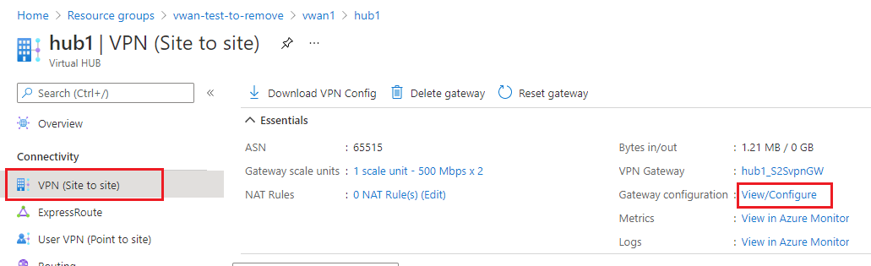
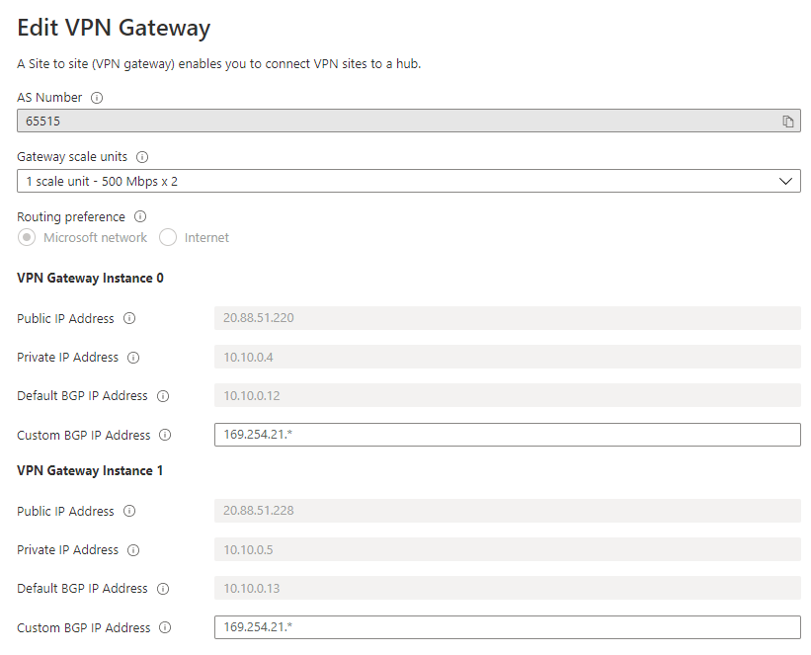
Get the VPN GW
BGP
20.88.51.220
10.10.0.12
20.88.51.228
10.10.0.13

Slide 5
How to get the site-to-site VPN GW IPs
BGP
20.88.51.220
10.10.0.12
20.88.51.228
10.10.0.13

