Slide 1


VISVESVARAYA TECHNOLOGICAL UNIVERSITY
Belagavi - 590 018
BCD586 – Mini Project
VERDICT
A Legal Judgment Digestor using LLMs
and
RAG (Retrieval-Augmented Generation)
Under the Guidance of
Mr. Abhijith S
Assistant Professor
CSE(DS)
Presented By:
Thammappa Gari Amarthya 1AY23CD066
Rishik Raj G 1AY23CD051
Vishal Raj T 1AY23CD070
Thammisetty Premsagar 1AY23CD067
November 17, 2025
Department of COMPUTER SCIENCE ENGINEERING (DATA SCIENCE)
Acharya Institute of technology

Slide 2
Content
SN | Title
1 | Abstract
2 | Introduction
3 | Literature Survey
4 | Flow Diagram
5 | System Architecture
6 | Methodology
7 | System Testing
8 | Result &Discussion
9 | Demonstration of Prototype
10 | Future Works
11 | Conclusion
November 17, 2025
Department of COMPUTER SCIENCE ENGINEERING (DATA SCIENCE)
Acharya Institute of technology

Slide 3
Abstract
Legal judgments are long, complex, and difficult to interpret quickly.
Traditional summarizers and standard LLMs produce unreliable or hallucinated outputs.
The proposed Legal Judgment Digestor uses LLMs + RAG to generate accurate, structured, and citation-faithful summaries.
Uses transformer models, hybrid retrieval, structure-aware preprocessing, and adaptive summarization.
Provides two summary modes: Lawyer Mode (detailed) and Citizen Mode (Future-work).
Improves legal accessibility, reduces workload, and enhances trustworthy AI-driven legal assistance.
November 17, 2025
Department of COMPUTER SCIENCE ENGINEERING (DATA SCIENCE)
Acharya Institute of technology

Slide 4
Introduction
Indian legal documents are extremely verbose, with complex reasoning and domain- specific terminology.
Lawyers, students, and citizens struggle to analyze long judgments effectively.
Standard LLMs hallucinate, lack up-to-date knowledge, and fail to preserve legal structure.
RAG helps ground LLM responses in real legal sources but needs domain-aware optimization.
Proposed solution integrates structure-aware preprocessing, hybrid retrieval, and verifiable summarization.
Offers tailored summaries for expert and non-expert audiences
November 17, 2025
Department of COMPUTER SCIENCE ENGINEERING (DATA SCIENCE)
Acharya Institute of technology

Slide 5
Literature Survey
Sl. No | Citation(Reference IEEE Format) | Methodology | Limitation
1 | [1] All for Law and Law for All: Adaptive RAG Pipeline for Legal Research F. Keisha, P. Singh, Pallavi, D. Fernandes, A. Manivannan, I. Wicaksono, and F. Ahmad, “All for Law and Law for All: Adaptive RAG Pipeline for Legal Research,” 2025. | RAG pipeline that automatically adjusts retrieval methods based on the type of legal query. | computationally expensive because several retrieval components run in parallel.
2 | [2]HyPA-RAG: Hybrid Parameter Adaptive Retrieval-Augmented GenerationR. Kalra, Z. Wu, A. Gulley, A. Hilliard, X. Guan, A. Koshiyama, and P. Treleaven,“HyPA-RAG: Hybrid Parameter Adaptive Retrieval-Augmented Generation,” 2025. | HyPA-RAG combines dense and sparse retrieval methods while automatically adjusting parameters based on query difficulty. | The system is difficult to tune because many adaptive mechanisms operate at the same time.
3 | [3] The Hidden Structure: Improving Legal Document Understanding Through Explicit Text Formatting C. Braun, A. Lilienbeck, and D. Mentjukov,“The Hidden Structure: Improving Legal Document Understanding Through Explicit Text Formatting,” 2025. | This paper understanding by adding explicit structural formatting such as issue labels, argument tags, and reasoning markers | The method requires significant manual or semi-automatic effort to label and format legal documents.
November 17, 2025
Department of COMPUTER SCIENCE ENGINEERING (DATA SCIENCE)
Acharya Institute of technology

Slide 6
Literature Survey
Sl. No | Citation(Reference IEEE Format) | Methodology | Limitation
4 | [4]LexRAGBenchmarkingRetrieval-Augmented Generation in Multi-Turn Legal Consultation ConversationH. Li, Y . Chen, Y . Hu, Q. Ai, J. Chen, X. Yang, J. Yang, Y . Wu, Z. Liu, and Y . Liu, “LexRAG: Benchmarking Retrieval-Augmented Generation in Multi-Turn Legal Consultation Conversation,” 2025. | LexRAG evaluates different RAG systems in multi-turn legal consultation settings where the model must track conversation history. | Ensuring factual correctness becomes difficult when multiple turns introduce conflicting or vague information
5 | [5] Legal Chunking: Evaluating Methods for Effective Legal Text Retrieval A. F. Ferraris, D. Audrito, G. Siragusa, and A. Piovano,“Legal Chunking: Evaluating Methods for Effective Legal Text Retrieval,” 2024 | This work analyzes various chunking strategies to break long legal documents into manageable sections for retrieval. | The ideal chunk size varies across different document types, making standardization difficult.
6 | [6] C. Cao, H. Zhu, J. Ji, Q. Sun, Z. Zhu, Y . Wu, J. Dai, Y . Yang, S. Han, and Y . Guo, “SafeLawBench: Towards Safe Alignment of Large Language Models,” 2025. | The paper introduces SafeLawBench, a benchmark designed to evaluate how safely large language models behave in legal settings | The benchmark focuses mainly on safety and does not evaluate retrieval quality or legal reasoning depth
November 17, 2025
Department of COMPUTER SCIENCE ENGINEERING (DATA SCIENCE)
Acharya Institute of technology

Slide 7
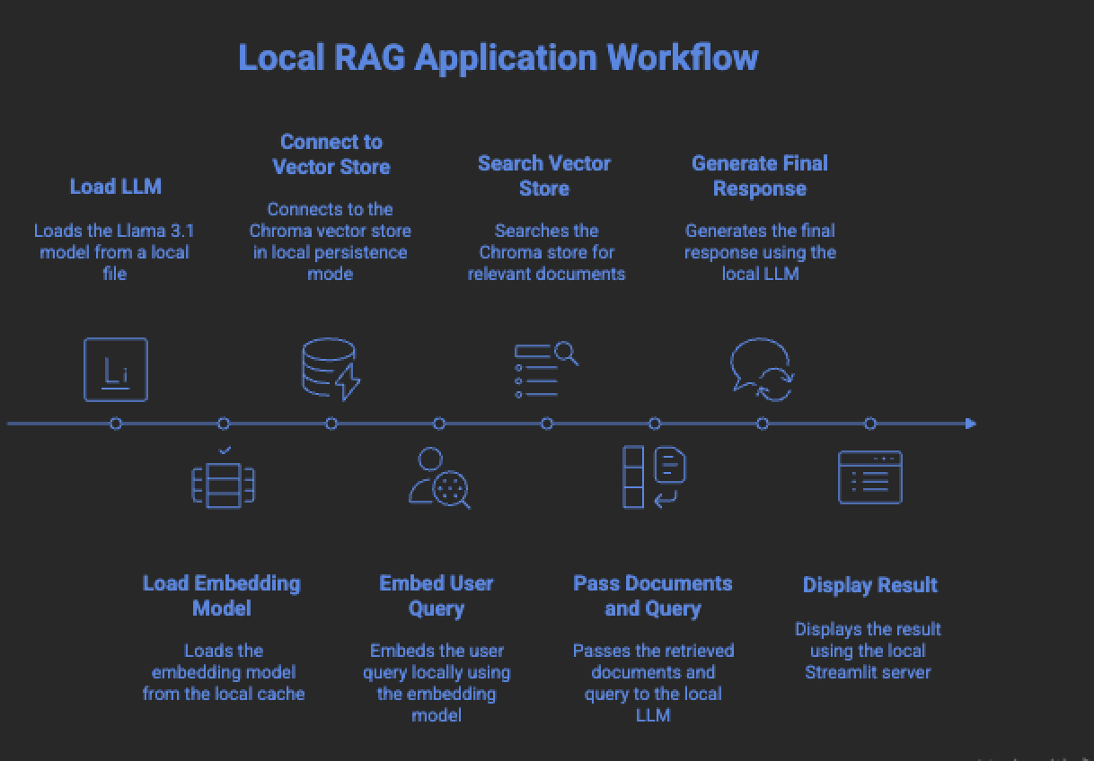
Flow Diagram
Fig.1: Local RAG Application Workflow
November 17, 2025
Department of COMPUTER SCIENCE ENGINEERING (DATA SCIENCE)
Acharya Institute of technology

Slide 8
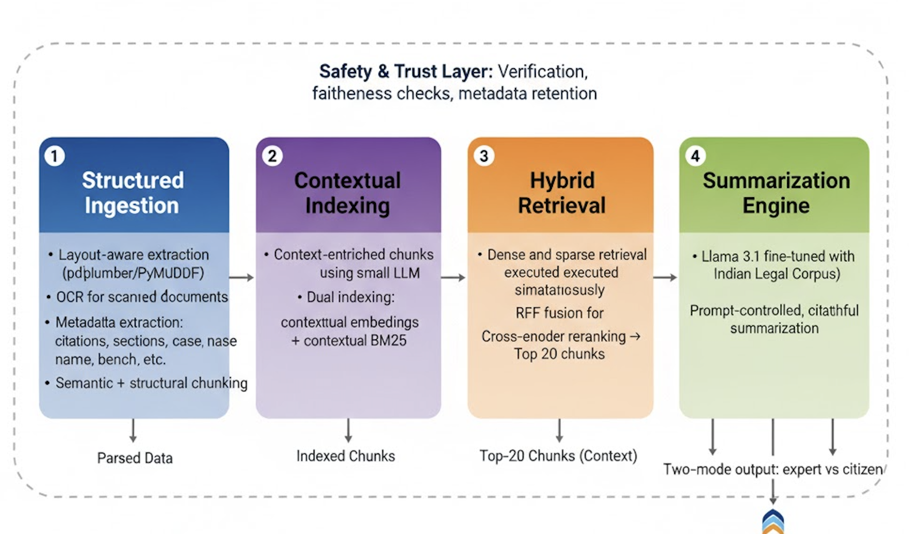
System Architecture
Fig.2: safety & trust Layer
November 17, 2025
Department of COMPUTER SCIENCE ENGINEERING (DATA SCIENCE)
Acharya Institute of technology

Slide 9
System Architecture
Detailed Implementation (Short):
Frontend: Takes user input and displays final summarisation results.
Backend: Streamlit sends query to RAG pipeline.
Engine: llama 3.1
Database/SNP File: Chroma BD(vector database).
Output Module: Summarization of the query
November 17, 2025
Department of COMPUTER SCIENCE ENGINEERING (DATA SCIENCE)
Acharya Institute of technology

Slide 10
System Architecture
Internal Architecture
Streamlit UI → Query Embedded → RAG pipeline → Similarity Search(Chroma DB) → llama 3.1 → Summarised output.
RAG pipeline uses Chroma DB(vector Database) to search for similar chunks.
November 17, 2025
Department of COMPUTER SCIENCE ENGINEERING (DATA SCIENCE)
Acharya Institute of technology

Slide 11
Methodology
Steps Followed
Parse legal PDFs with layout-aware tools to preserve headings and structure.
Extract semantic metadata before chunking to prevent loss of semantic hierarchy.
Apply hybrid chunking ( contextual + semantic ) to maintain coherent legal meaning.
Build dual indexes (dense + sparse) to capture semantic and lexical relevance.
Implement hybrid retrieval + reranking for high-precision evidence selection.
Feed top-ranked chunks to Llama 3.1, fine-tuned on the Indian Legal Corpus.
Produce structured summaries with paragraph-level citations.
Generate two versions of summary depending on user expertise
November 17, 2025
Department of COMPUTER SCIENCE ENGINEERING (DATA SCIENCE)
Acharya Institute of technology

Slide 12
Methodology
Model Used
llama 3.1 Model
Tools
Python, Streamlit, VS Code, GitHub
Data handling/testing tools: Hugging Face, Google Colab, GitHub
November 17, 2025
Department of COMPUTER SCIENCE ENGINEERING (DATA SCIENCE)
Acharya Institute of technology

Slide 13
Methodology
Libraries
NLP/LLM: Transformers, LangChain, Sentence Transformers, LlamaIndex
Streamlit – frontend and backend interface.
Frameworks
Streamlit and python for backend processing
Streamlit for frontend UI
November 17, 2025
Department of COMPUTER SCIENCE ENGINEERING (DATA SCIENCE)
Acharya Institute of technology

Slide 14
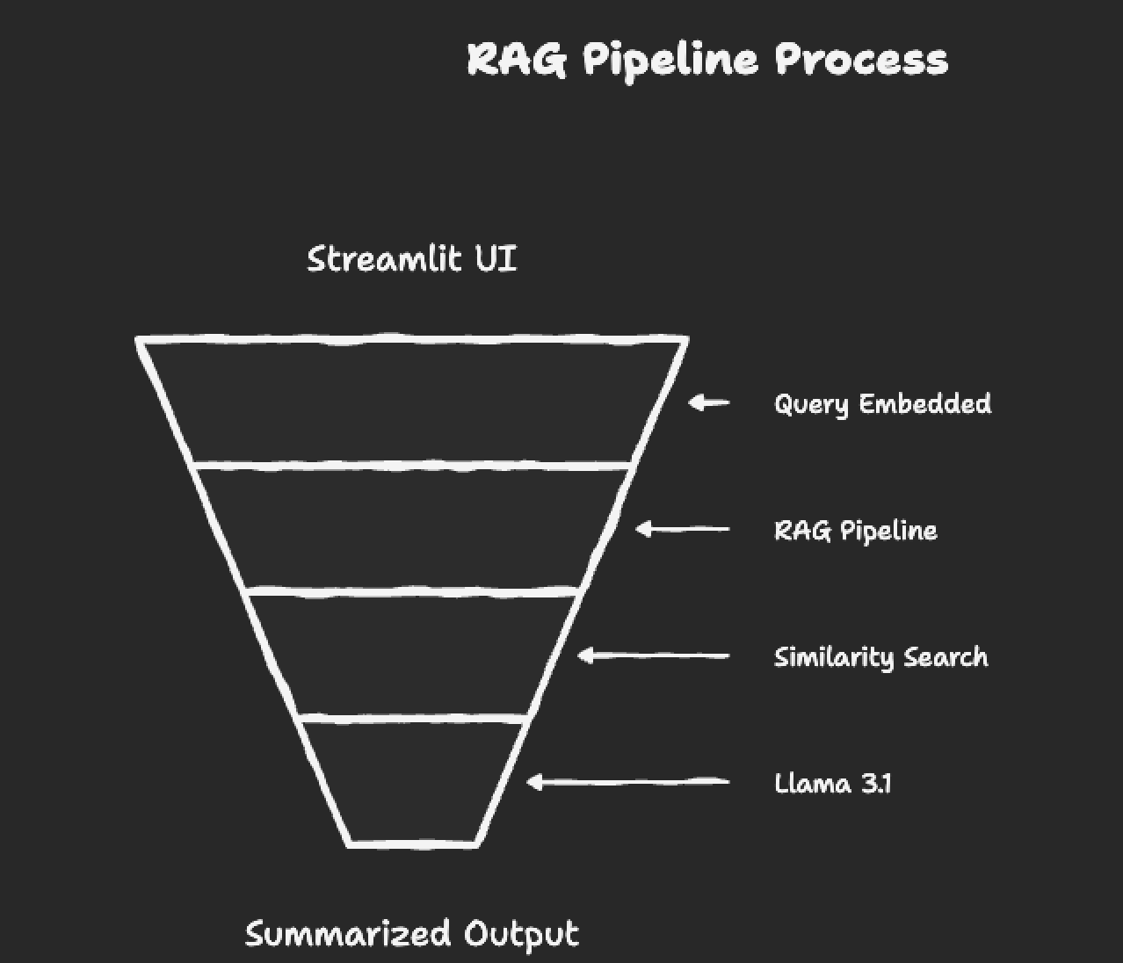
Methodology
Fig.3: Pipeline process
November 17, 2025
Department of COMPUTER SCIENCE ENGINEERING (DATA SCIENCE)
Acharya Institute of technology

Slide 15
System Testing
Processing Query: Summarize the Adv. Ritesh Varma vs Ministry of Digital Affairs (2029) involving constitutional challenge to algorithmic blacklisting of citizens.Retrieve all real cases related to:
•algorithmic transparency
•blacklisting rules
• Article 14 non-arbitrariness
• audi alteram partem
[LLM RESPONSE]
[FICTIONAL ANALYSIS: ]
Scenario Status: Hypothetical Scenario - Not a Real Precedent.
Scenario Issues:
Constitutional challenge to algorithmic blacklisting of citizens;
Algorithmic transparency and fairness in decision-making processes;
Compliance with Article 14 (non-arbitrariness) and audi alteram partem principles;
November 17, 2025
Department of COMPUTER SCIENCE ENGINEERING (DATA SCIENCE)
Acharya Institute of technology

Slide 16
System Testing
Factual Matrix:
The scenario involves Adv. Ritesh Varma, a citizen who was blacklisted by the Ministry of Digital Affairs using an algorithm that purportedly assessed his digital footprint and deemed him a potential threat to national security. The algorithmic system did not provide any human oversight or review before making its decision, leading to a lack of transparency and accountability.
Applied Legal Principles:
In this hypothetical scenario, the Court would apply the principles of Article 14 (non-arbitrariness) by examining whether the algorithmic blacklisting was arbitrary, unreasonable, or unfair. The Court would also consider the audi alteram partem principle, requiring that the decision-maker hear the other side and provide an opportunity for the citizen to respond before making a decision.
To determine whether the algorithmic blacklisting was unconstitutional, the Court would evaluate the following factors:
1. Whether the algorithmic system was designed to provide transparency and accountability in its decision-making process;
2. Whether the algorithmic system provided opportunities for human oversight and review of its decisions;
3. Whether the algorithmic system was biased towards certain individuals or groups based on irrelevant factors such as race, gender, or socioeconomic status.
November 17, 2025
Department of COMPUTER SCIENCE ENGINEERING (DATA SCIENCE)
Acharya Institute of technology

Slide 17
System Testing
Plausible Ratio Decidendi:
In this hypothetical scenario, the Court might hold that an algorithmic blacklisting system must provide transparency and accountability in its decision-making process by ensuring human oversight and review of its decisions. The Court might also emphasize that any decision-making process must be guided by clear and objective criteria that are free from bias and arbitrary discretion.
Ultimately, the Court would likely strike down the algorithmic blacklisting system as unconstitutional if it fails to provide transparency, accountability, or fair procedures for citizens to challenge and appeal the decisions made by the algorithm.
November 17, 2025
Department of COMPUTER SCIENCE ENGINEERING (DATA SCIENCE)
Acharya Institute of technology

Slide 18
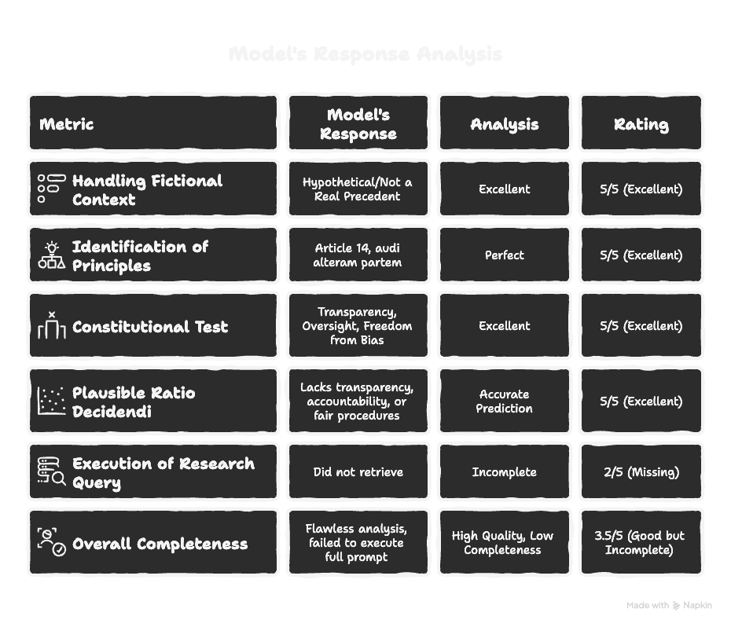
System Testing
November 17, 2025
Department of COMPUTER SCIENCE ENGINEERING (DATA SCIENCE)
Acharya Institute of technology
14

Slide 19
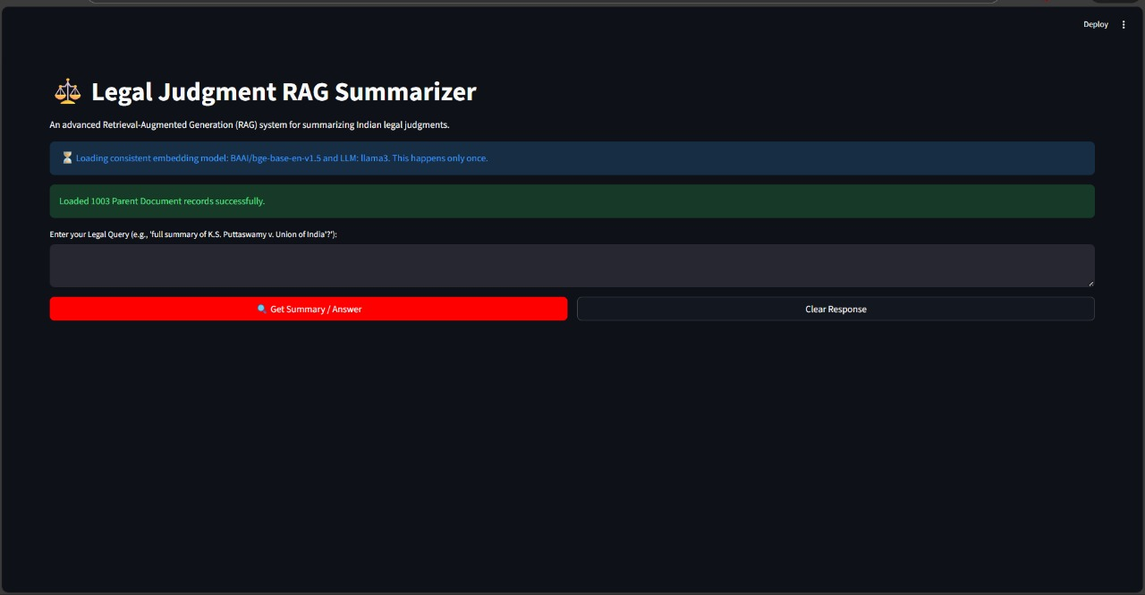

Demonstration of Prototype
UI/UX Images
Fig.4: user interface
Fig.5: Response interface
November 17, 2025
Department of COMPUTER SCIENCE ENGINEERING (DATA SCIENCE)
Acharya Institute of technology

Slide 20
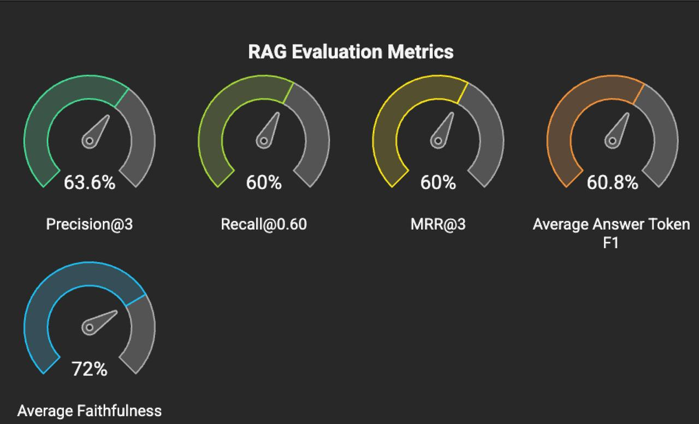
Results & Discussion
Performance Metrics & Evaluation
Fig.6:RAG evaluation metrics
November 17, 2025
Department of COMPUTER SCIENCE ENGINEERING (DATA SCIENCE)
Acharya Institute of technology

Slide 21
Results & Discussion
Discussion of Findings: Metrics & Utility
1. System Performance Metrics
Accuracy of Case Identification:
The model correctly differentiates between real and fictional cases using fuzzy matching, LLM-assisted extraction, and semantic validation.
Hallucination Prevention:
High reliability due to strict acceptance thresholds, fallback case listing, and refusal to fabricate non-existent precedents.
Retrieval Quality:
Parent–Child RAG ensures complete aggregation of all judgment chunks, improving context coverage and summary quality.
November 17, 2025
Department of COMPUTER SCIENCE ENGINEERING (DATA SCIENCE)
Acharya Institute of technology
19

Slide 22
Results & Discussion
Discussion of Findings: Metrics & Utility
2. Utility for the Project
Trustworthy Legal Summaries:
Produces accurate, structured summaries following judicial formats (Issues, Facts, Ratio, Holding, etc.).
Safe Fictional Analysis Mode:
Prevents hallucination by switching to a controlled mode when detecting hypothetical or future-year cases.
Strong Constitutional Interpretation:
Automatically references doctrines like Article 14, natural justice principles, proportionality, etc.
Scalable for Large Databases:
Efficient vector retrieval and chunking allow handling 1000+ judgments smoothly.
November 17, 2025
Department of COMPUTER SCIENCE ENGINEERING (DATA SCIENCE)
Acharya Institute of technology
19

Slide 23
Future Works
Expand knowledge base to include:
High Courts
International jurisdictions
Statutory documents
Introduce multi-turn conversational legal research.
Build a citation graph for tracking precedents automatically.
Use rationale-driven retrieval instead of fixed top-k.
Add multimodal support (PDFs, scanned documents, handwritten notes).
Integrate real-time legal updates and precedent monitoring
November 17, 2025
Department of COMPUTER SCIENCE ENGINEERING (DATA SCIENCE)
Acharya Institute of technology

Slide 24
Conclusion
Legal Judgment Digestor provides a domain-aware, trustworthy pipeline for summarizing complex legal judgments.
Goes beyond standard RAG by combining structure-awareness, hybrid retrieval, and citation-faithful generation.
Produces accurate, adaptive summaries suitable for both legal professionals and the public.
Addresses the core challenges of hallucinations, verbosity, and complexity in legal documents.
Sets foundation for future large-scale deployment in legal research and justice accessibility.
November 17, 2025
Department of COMPUTER SCIENCE ENGINEERING (DATA SCIENCE)
Acharya Institute of technology

Slide 25
References
[1] All for Law and Law for All: Adaptive RAG Pipeline for Legal Research F. Keisha, P. Singh, Pallavi, D. Fernandes, A. Manivannan, I. Wicaksono, and F. Ahmad, “All for Law and Law for All: Adaptive RAG Pipeline for Legal Research,” 2025.
[2]HyPA-RAG: Hybrid Parameter Adaptive Retrieval-Augmented GenerationR. Kalra, Z. Wu, A. Gulley, A. Hilliard, X. Guan, A. Koshiyama, and P. Treleaven,“HyPA-RAG: Hybrid Parameter Adaptive Retrieval-Augmented Generation,” 2025.
[3] The Hidden Structure: Improving Legal Document Understanding Through Explicit Text Formatting C. Braun, A. Lilienbeck, and D. Mentjukov,“The Hidden Structure: Improving Legal Document Understanding Through Explicit Text Formatting,” 2025.
November 17, 2025
Department of COMPUTER SCIENCE ENGINEERING (DATA SCIENCE)
Acharya Institute of technology

Slide 26
References
[4]LexRAGBenchmarkingRetrieval-Augmented Generation in Multi-Turn Legal Consultation ConversationH. Li, Y . Chen, Y . Hu, Q. Ai, J. Chen, X. Yang, J. Yang, Y . Wu, Z. Liu, and Y . Liu, “LexRAG: Benchmarking Retrieval-Augmented Generation in Multi-Turn Legal Consultation Conversation,” 2025.
5] Legal Chunking: Evaluating Methods for Effective Legal Text Retrieval A. F. Ferraris, D. Audrito, G. Siragusa, and A. Piovano,“Legal Chunking: Evaluating Methods for Effective Legal Text Retrieval,” 2024.
[6] C. Cao, H. Zhu, J. Ji, Q. Sun, Z. Zhu, Y . Wu, J. Dai, Y . Yang, S. Han, and Y . Guo, “SafeLawBench: Towards Safe Alignment of Large Language Models,” 2025.
November 17, 2025
Department of COMPUTER SCIENCE ENGINEERING (DATA SCIENCE)
Acharya Institute of technology

Slide 27
References
[7] F. Faisal and U. Yousaf, “LEGAL-UQA: A Low-Resource Urdu-English Dataset for Legal Question Answering,” 2024.
[8] J. Cui, M. Ning, Z. Li, B. Chen, Y . Yan, H. Li, B. Ling, Y . Tian, and L. Yuan, “Chatlaw: A Multi-Agent Collaborative Legal Assistant,” 2023
[9] (Article from Artificial Intelligence and Law), “Enhancing legal question answering with data generation and knowledge distillation
(Ace-Attorney),” 2025.
November 17, 2025
Department of COMPUTER SCIENCE ENGINEERING (DATA SCIENCE)
Acharya Institute of technology

Slide 28
References
[10] arXiv Authors, “LegalBench-RAG: A Benchmark for Retrieval-Augmented Generation in the Legal Domain,” 2024.5] Legal Chunking: Evaluating Methods for Effective Legal Text Retrieval A. F. Ferraris, D. Audrito, G. Siragusa, and A. Piovano,“Legal Chunking: Evaluating Methods for Effective Legal Text Retrieval,” 2024.
[11] V . Vishnuprabha, M. D. Viswanathan, R.Rajesh, and V . A. Pillai,“Augmented Question-guided Retrieval (AQgR) of indian Case Law with LLM, RAG, and Structured Summaries,” 2025.
[12] M. Zhang, N. Zhao, J. Qin, Q. Xu, K. Pan, andT. Luo, “An Integrated Framework of Prompt Engineering and Multidimensional Knowledge Graphs for Legal. Dispute Analysis,” 2025.
November 17, 2025
Department of COMPUTER SCIENCE ENGINEERING (DATA SCIENCE)
Acharya Institute of technology

Slide 29
References
[13] H. Zhong, C. Xiao, C. Tu, T. Zhang, Z. Liu, and M. Sun, “JEC-QA: A Legal-Domain Question Answering Dataset,” 2020.
[14] Author(s) not specified, “cLegal-QA: Chinese Legal QA via NLG Methods,” 2024/2025.
[15] B. Liu, Z. Zhu, Q. Ai, Y . Liu, and Y . Wu, “LeDQA: Chinese Legal Case Document QA Dataset,” 2024.
[16] Chen et al., “EQUALS: Legal QA via Reading Chinese Laws,” 2023.
[17] R. Kalra, Z. Wu, and A. Gulley, “HyPA-RAG: Hybrid Parameter Adaptive RAG for AI Legal/Policy,” 2024.
November 17, 2025
Department of COMPUTER SCIENCE ENGINEERING (DATA SCIENCE)
Acharya Institute of technology

Slide 30

November 17, 2025
Department of COMPUTER SCIENCE ENGINEERING (DATA SCIENCE)
Acharya Institute of technology

Slide 31
Thank you
November 17, 2025
Department of COMPUTER SCIENCE ENGINEERING (DATA SCIENCE)
Acharya Institute of technology

