Slide 1
2-DOF PLANAR ROBOTIC REACHING
PROJECT REVIEW II
PPO • Human Reward • Eureka Reward Discovery • RAPP • Shifted Domain Randomization • PINN Physics Observer
Task
Reward search
PPO policy
Physics variation
PINN observer
Future adaptive DR / Sim-to-Real
23BRS1309 Amartya Ranjan, 23BRS1356 Aditya Kumar Singh, 23BRS1171 Rajarshi Somvanshi
Guide: Dr. Saranya M

Slide 2
1. Research question and experimental logic
The controlled variable is the reward objective, not PPO.
Natural-language task
Eureka / LLM
Candidate reward
Isaac Lab + PPO
Policy
Human reward path
Eureka path
Dense distance shaping
Exponential proximity
Same robot • same observations • same action interface • same evaluation metrics
5 cm success bonus
+100 success bonus
Action regularization
Velocity + time penalties
Interpretation: Eureka is an outer reward-engineering loop around PPO, not a replacement for PPO.
Project Review II | 2-DOF Planar Robotic Reaching
2

Slide 3
2. Platform and task definition
Deliberately simplified 2-link planar reaching benchmark.
• Two revolute joints about world Z; motion in XY.
• Torque control: τ = 20 a, a ∈ [−1,1]²; ±5 rad/s velocity limit.
• 10 s episodes; 120 Hz physics, 30 Hz policy control.
• 4,096 parallel environments; target resampled every reset.
random target
r ∈ [0.20, 0.85] m
End-effector
m₁ = 1.0 kg
m₂ = 0.5 kg
2 × 0.5 m links
Project Review II | 2-DOF Planar Robotic Reaching
3

Slide 4
3. Mathematical model
Eight mathematical objects connect the policy, physics, RAPP and PINN.
State
Physics vector
sₜ = [q₁,q₂,q̇₁,q̇₂,xₜ,yₜ,xₜ−xₑₑ,yₜ−yₑₑ] ∈ ℝ⁸
ξ = [m₁,m₂,f₁,f₂,b₁,b₂,α₁,α₂] ∈ ℝ⁸
Actuation
RAPP
aₜ ∈ [−1,1]²,
τ_cmd = 20aₜ,
τ_applied = 20(α ⊙ aₜ)
S(π,ξ) = P(d_T < 0.05 | π,ξ)
C_RAPP = ∏ᵢ [lᵢ,hᵢ], α = 0.9
Dynamics
PINN observer
M(q;ξ)q̈ + C(q,q̇;ξ) + F(q̇;ξ) = α ⊙ τ_cmd
fφ : {(q,q̇,τ,q̈)}ₜ₋₆₃:ₜ → (ξ̂,Σ̂)
Current status
Adaptive DR update is deliberately NOT implemented yet.
Project Review II | 2-DOF Planar Robotic Reaching
4

Slide 5
4. Simulation → policy → physics loop
Low-level torque control is explicit; PhysX performs the numerical integration.
Observation sₜ
PPO policy πθ
Normalized action aₜ
Torque 20·α⊙aₜ
PhysX dynamics
qₜ₊₁ → sₜ₊₁
Control frequency
Rollout scale
Episode
Observation design
Δt_phys = 1/120 s
control decimation = 4
policy rate = 30 Hz
4,096 envs × 24 collected steps
= 98,304 transitions / PPO rollout
10 s
≈ 300 policy decisions
≈ 1,200 physics steps
Absolute target + Cartesian error + joint state.
Joint angles wrapped to [−π,π] for observations.
Project Review II | 2-DOF Planar Robotic Reaching
5

Slide 6
5. PPO configuration
The policy optimizer remains fixed across reward variants.
Backbone
8 → 256 → 128 → 64, ELU
Clip ε
0.2
Actor
Gaussian over 2 normalized torque actions
Entropy / value coeff.
0.005 / 1.0
Critic
V(s)
KL target / grad norm
0.01 / 1.0
Learning rate
1×10⁻³
Epochs / minibatches
8 / 4
γ / GAE λ
0.99 / 0.95
Initial action σ
1.0
Scientific control: changing the reward changes PPO's optimization target while the optimizer and environment remain otherwise fixed.
Project Review II | 2-DOF Planar Robotic Reaching
6

Slide 7
6. Reward engineering: human vs Eureka
The discovered objective changes the incentive landscape.
Human-designed reward
Eureka-generated reward
R_vanilla = −d + 5·1[d<0.05] − 0.005||a||²
R_Eureka = e^(−10d) + 100·1[d<0.05]
− 0.01||q̇||² − 0.1
• Dense Cartesian distance shaping
• 5 cm success bonus
• Quadratic normalized-action penalty
• Keeps improving after entering the 5 cm region
• Nonlinear proximity term
• Success bonus is 20× larger
• Physical joint-velocity penalty
• Explicit per-step time penalty
Key mechanism: once d < 5 cm, +100 dominates the ~0–1 exponential proximity term.
Project Review II | 2-DOF Planar Robotic Reaching
7

Slide 8
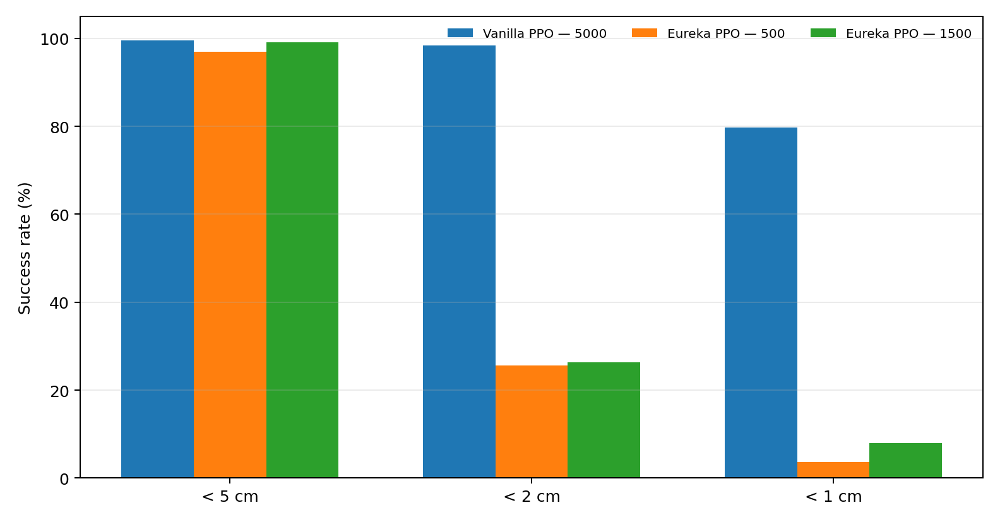
7. Head-to-head policy results
Latest exact evaluation files; same 4,096-env evaluation protocol.
Metric | Vanilla 5000 | Eureka 500 | Eureka 1500
<5 cm | 93.04% | 96.97% | 99.05%
<2 cm | 13.28% | 25.56% | 26.37%
<1 cm | 2.22% | 3.59% | 7.91%
Mean error | 101.9 mm | 46.4 mm | 38.6 mm
Mean velocity | 1.53 rad/s | 3.40 rad/s | 2.52 rad/s
Control effort | 0.514 | 1.436 | 1.073
The coarse 5 cm metric can look strong while finer thresholds remain low.
Project Review II | 2-DOF Planar Robotic Reaching
8

Slide 9
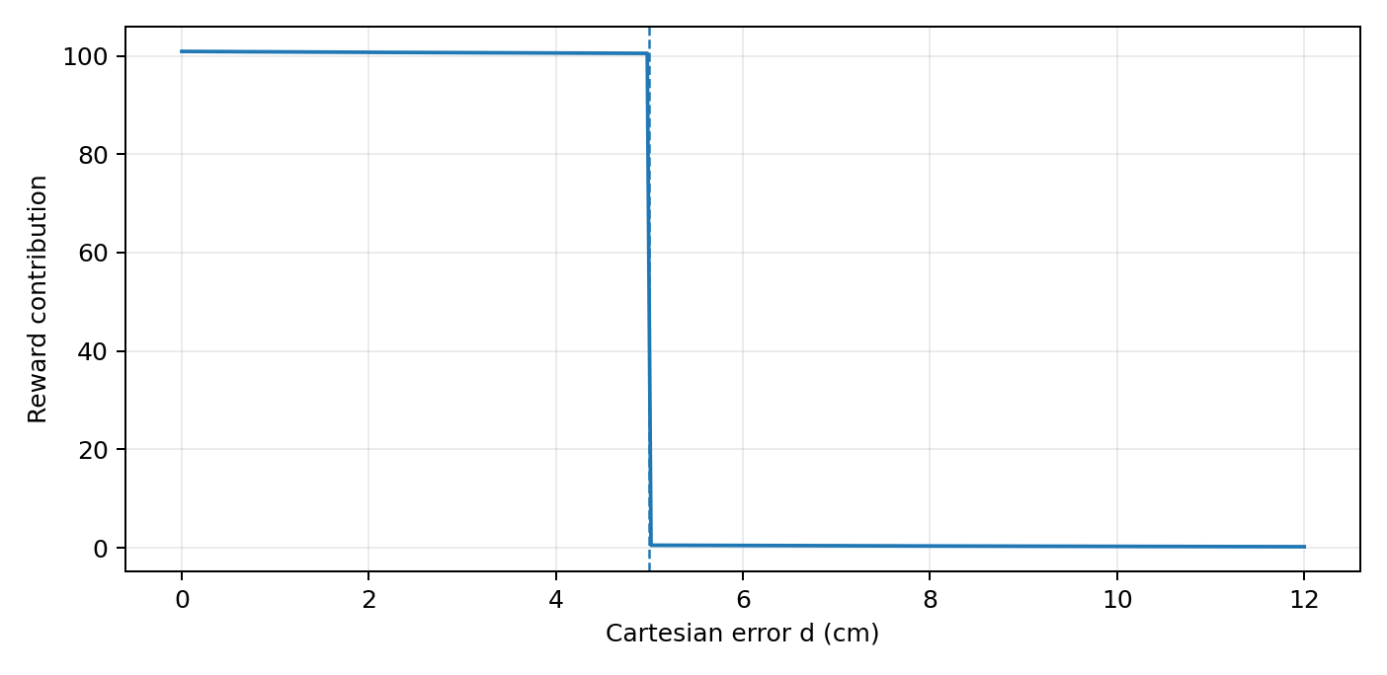
8. Why Eureka plateaus at coarse precision
The failure is primarily an objective-design issue, not simply insufficient PPO iterations.
• At 4.9 cm, 1 cm and 1 mm, the same +100 success bonus is received.
• The exponential term changes only from ~0 to 1, tiny relative to +100.
• Time penalty creates urgency to cross the threshold rather than settle precisely.
• 1,500-iteration rerun did not remove the coarse objective: success stayed concentrated around the 5 cm criterion.
• The human reward's −d term continues to economically reward smaller final error.
Documented implication: refine the task/reward specification before assuming longer PPO training will fix precision.
Project Review II | 2-DOF Planar Robotic Reaching
9

Slide 10
9. IK + PD reference exposed an environment issue
A scripted controller demonstrates that millimetre precision is physically reachable when the joint-limit trap is removed.
Closed-form IK
±π limits → wrap-around trap
cos q₂ = (r² − l₁² − l₂²)/(2l₁l₂)
q₁ = atan2(y,x) − atan2(l₂ sin q₂, l₁+l₂ cos q₂)
31.4% failures with ±π limits;
all such failures ended at a limit.
PD control
τ = Kp(q* − q) − Kd q̇
Kp = 12, Kd = 1.2
Widened limits → 100% success < 1 mm
2048 episodes • mean terminal error ≈ 2.31 μm
mean settling time ≈ 0.77 s
This is a diagnostic/reference controller, not a learned-policy comparison.
Project Review II | 2-DOF Planar Robotic Reaching
10

Slide 11
10. Domain randomization: what was actually implemented
Per-environment physics variation is sampled once at reset.
m₁, m₂
f₁, f₂
ξ sampled per env
at reset
PhysX dynamics
Policy behavior
b₁, b₂
α₁, α₂
Stage-2 status
DR was used for evaluation-time robustness tests. PPO training itself remained nominal (domain_rand.enabled=False). Training-time DR is future work.
Project Review II | 2-DOF Planar Robotic Reaching
11

Slide 12
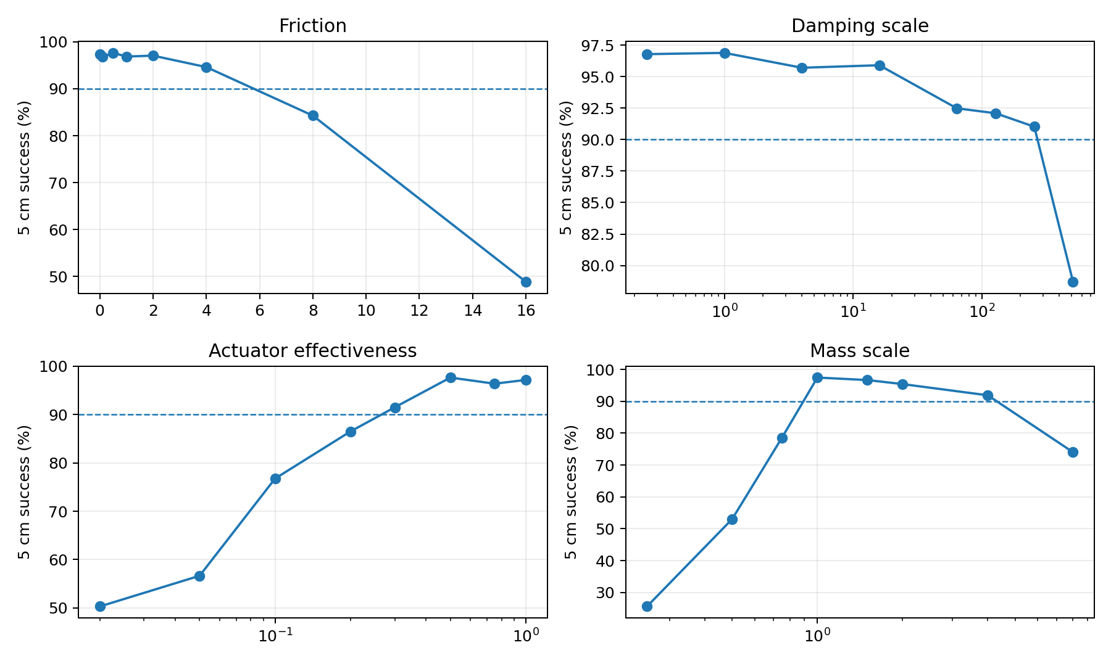
11. RAPP: measured feasible physics envelope
Fixed Eureka@500 policy; α = 0.9 feasibility criterion; 1 parameter swept at a time.
Measured C_RAPP
friction: [0, 4]
damping scale: [0.25, 256]
effectiveness: [0.3, 1.0]
mass scale: [1, 4]
• Friction and damping remain feasible across very wide ranges.
• Actuator effectiveness has a lower feasible boundary near 0.3.
• Mass is the sharpest feasibility boundary: below 1× becomes infeasible; 4× remains feasible.
• The sweep is one-dimensional per parameter, so it does not establish the full joint feasible volume.
Project Review II | 2-DOF Planar Robotic Reaching
12

Slide 13
12. Shifted-DR robustness experiment
Evaluation distributions are inside / outside the RAPP envelope; policies were not trained on these variations.
Physics | DR-train distribution | Shifted / unseen
Friction | 0–0.25 | 0.25–0.50
Damping scale | 0.5–4 | 4–8
Effectiveness | 0.5–1.0 | 0.3–0.5
Mass scale | 1.0–1.5 | 1.5–2.5
Experimental interpretation
• DR-train ranges sit inside C_RAPP.
• Shifted ranges are harder on every axis and overlap the harder edge of C_RAPP.
• Both vanilla and Eureka checkpoints were evaluated without retraining.
• Metrics include thresholded success, mean/median error, velocity, effort, settling time and overshoot.
Purpose: separate in-distribution robustness from generalization to a shifted physics distribution.
Project Review II | 2-DOF Planar Robotic Reaching
13

Slide 14
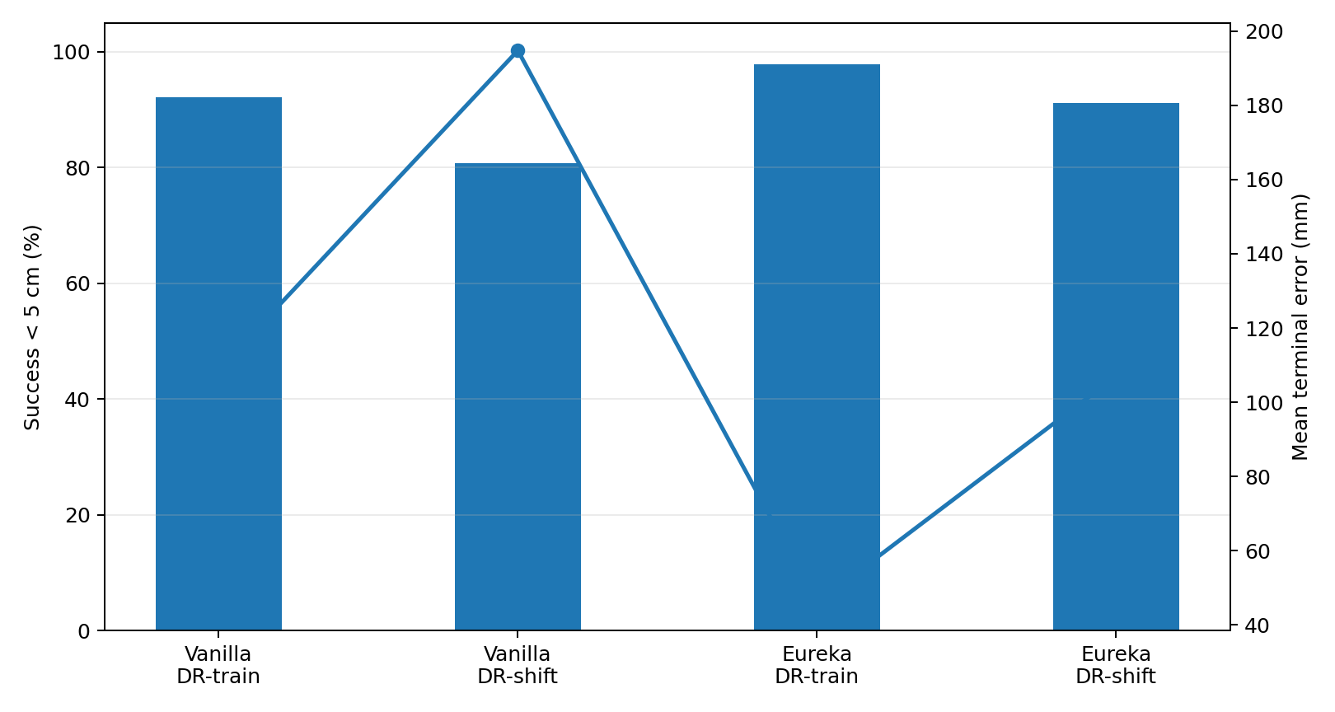
13. Shifted-DR results
Evaluation-time physics shift changes both success and control behavior.
Run | <5 cm | <2 cm | Mean error | Settling
Vanilla DR-train | 92.14% | 12.99% | 108.8 mm | 1.70 s
Vanilla DR-shift | 80.69% | 13.18% | 194.8 mm | 3.28 s
Eureka DR-train | 97.88% | 34.89% | 45.9 mm | 1.52 s
Eureka DR-shift | 91.14% | 42.36% | 107.0 mm | 2.53 s
Observed pattern
The shifted distribution increases terminal error and settling time for both policies. The finer-threshold metrics remain distinct from the 5 cm success statistic.
Project Review II | 2-DOF Planar Robotic Reaching
14

Slide 15
14. Physics-performance map: what the data says
The current map reports P(d < 1 cm) in 8 bins for selected physics dimensions.
Current implementation
Conceptual sensitivity map
• M(ξ) = P₁cm(ξ ∈ bin), with sample counts per bin.
• Currently embedded for friction_j1 and effectiveness_j1 in DR evaluation JSONs.
• Full roadmap vector — [P₅cm, P₂cm, P₁cm, E_d, E_q̇, E_τ, T_settle] — is not yet implemented.
Research implication
• RAPP suggests large flat regions for friction/damping.
• Mass has the clearest sharp feasibility boundary.
• Adaptive DR should therefore be driven by measured sensitivity, not by blindly maximizing uncertainty.
flat region
sharp boundary
Not a new measurement — schematic of how the measured RAPP map can guide future sampling.
Project Review II | 2-DOF Planar Robotic Reaching
15

Slide 16
15. PINN / physics observer architecture
Stage-2 adds explicit physics inference from short transition windows.
64 transitions
(q,q̇,τ,q̈)
Per-transition
8→256→256→128
Mean + max
pooling
256-D
representation
MLP → ξ̂,
log σ²
Ensemble K = 5
Output physics vector
ξ̂ = [m₁,m₂,f₁,f₂,b₁,b₂,α₁,α₂]
Uncertainty
Σ_epistemic = variance across ensemble members (diagonal only).
Important: the observer is a set encoder, not a sequence model; transitions are pooled because the dynamics model is instantaneous.
Project Review II | 2-DOF Planar Robotic Reaching
16

Slide 17
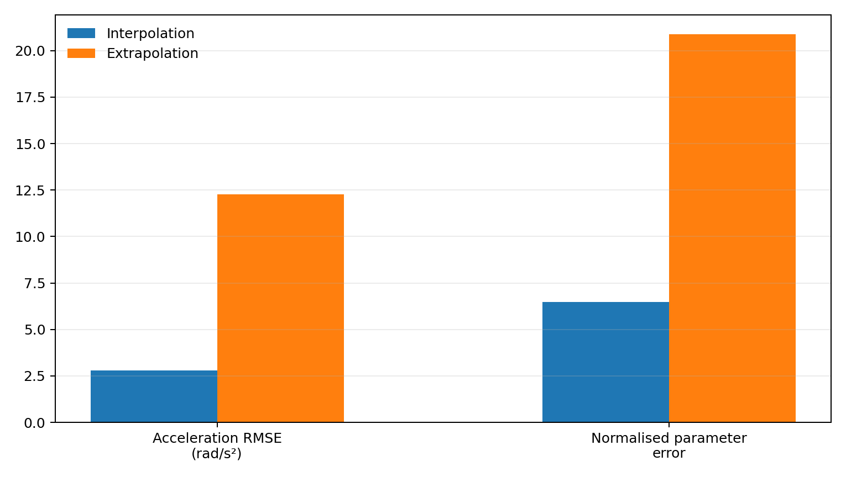
16. PINN loss and measured performance
Physics consistency is included explicitly, but current uncertainty is not yet reliable enough for adaptive DR.
Loss
L = 1.0 L_data + 0.01 L_phys + 1.0 L_sup
• L_data: acceleration prediction fit
• L_phys: EOM residual Mq̈ + C + F − ατ
• L_sup: heteroscedastic NLL against ground-truth ξ
Uncertainty rank correlation with actual parameter error: +0.114 (interpolation), +0.097 (extrapolation) → nearly uninformative.
Validation
Interpolation: acceleration RMSE 2.79 rad/s²; normalised parameter error 0.0648.
Extrapolation: 12.28 rad/s²; 0.2088.
Project Review II | 2-DOF Planar Robotic Reaching
17

Slide 18
17. Validation, reproducibility and implementation discipline
The Stage-2 work added explicit checks that caught environment and data defects.
Environment FK
analytic FK vs simulator EE: max error 0.000 mm
Reward equivalence
vanilla/Eureka code matches equations: max deviation 0.00
DR injection
per-environment physics reaches simulator; friction std 0.059
Actuator effectiveness
coupled-dynamics test: 3.99% mean relative deviation
Dynamics model
analytic vs simulator acceleration: 2.27% mean relative error
Inverse dynamics
recovered torque mean absolute error: 0.036 Nm
Critical defect fixes documented
Mass-write-skip bug fixed; joint-limit trap identified; PINN label handling corrected; damping override checked.
Project Review II | 2-DOF Planar Robotic Reaching
18

Slide 19
18. What is established vs. what remains open
Today's review separates demonstrated results from future research claims.
Established in Stage 1 + Stage 2
Open / next
• Controlled human-vs-Eureka reward experiment.
• Exact reward-induced precision tradeoff documented.
• IK+PD reference proves mm-scale reachability when limits are corrected.
• RAPP feasibility envelope measured for four physics dimensions.
• Shifted-DR robustness evaluation completed for both checkpoints.
• PINN physics observer implemented, trained and quantitatively evaluated.
• Validation scripts provide reproducible checks for key environment assumptions.
• Do not build adaptive DR until sensitivity / identifiability are better understood.
• Improve physics identifiability: m and actuator effectiveness can be confounded.
• Consider richer excitation regimes and/or non-diagonal uncertainty.
• Extend the physics-performance map to the full metric vector.
• Train PPO with DR and test sim-to-real robustness.
• Use PINN-informed adaptation only after uncertainty becomes decision-useful.
• Future: physics-informed sim-to-real transfer to physical hardware.
Project Review II | 2-DOF Planar Robotic Reaching
19

Slide 20
19. Reproduction baseline beyond the 2-DOF arm
LEAP Hand track B establishes a separate rung-1 reference from the supplied results.
LEAP_500
Interpretation
Isaac-Reorient-Cube-Leap
500 PPO iterations • 4,096 train envs • 512 eval envs
600 control steps • 20 s / env
• This is a stock upstream-config reproduction baseline.
• No adaptive DR and no PINN were used in this track.
• The documented number is a benchmark rung to exceed in future domain-randomized / physics-informed experiments.
≈ 7.52 rotations / 20 s / hand
Mean joint velocity: 1.86 rad/s
Mean control effort / joint: 0.696
Mean |action|: 0.776
Source environment: LEAP Hand Isaac Lab track B result file supplied in the Stage-2 compilation.
Project Review II | 2-DOF Planar Robotic Reaching
20

Slide 21
20. Final research roadmap
A staged path from reward engineering → robustness → physics inference → sim-to-real.
1
Reward diagnosis
Precision-aware objective / better task specification
2
RAPP + sensitivity
Map feasible physics and identify sharp dimensions
3
PINN observer
Estimate ξ and calibrate useful uncertainty
4
Training-time DR
Expose PPO to controlled physics variation
5
Adaptive DR
Sample toward measured sensitivity / uncertainty only when justified
6
Sim-to-real
Validate on physical arm; close the reality gap
Core scientific principle
Keep the causal chain explicit: reward → policy behavior → physics sensitivity → robustness → transfer.
Project Review II | 2-DOF Planar Robotic Reaching
21

