Slide 1

INSTITUTIONAL-GRADE AI · PRODUCTION-READY PIPELINE
Socrates AI: Autonomous Quantitative Research Engine
Institutional-Grade AI Inference & Data Engineering Pipeline
Socrates AI is a fully autonomous, production-ready data engineering and AI inference pipeline synthesizing structured quantitative stock intelligence at sub-second latencies. Built to meet the rigorous demands of institutional research — not retail dashboards — every architectural decision prioritizes fault tolerance, asynchronous orchestration, and deterministic JSON output suitable for downstream algorithmic consumption. This is not a prototype. This is enterprise-grade infrastructure engineered for scale.

Slide 2



ARCHITECTURE RATIONALE
Overcoming Retail Quant Architecture Failures
Most retail-facing quantitative platforms fail under institutional load not because of poor intent, but because of fundamental architectural brittleness. Socrates AI was designed from first principles to eliminate the three most catastrophic failure modes in production quant pipelines.
⚠ Traditional System Failures
✓ Socrates AI Solutions
API Brittleness
Fail-Fast Cascades
Cloud servers face aggressive IP bans and WAF throttling under concurrent request patterns. Single-point API dependencies collapse entire pipelines without graceful degradation.
A 5-layer valuation cascade with strict abort gates instantly halts the pipeline upon detecting $0.00 prices or empty matrices — preserving API quota and preventing garbage output.
Synthetic Valuation Errors
Async FastAPI Orchestration
Live market caps computed via delayed SEC shares outstanding data introduce mathematical inconsistencies. A stale share count multiplied against a live price produces a fundamentally broken valuation matrix.
All heavy computation — vectorization, embedding generation, LLM inference — executes in FastAPI BackgroundTasks, decoupled from the main async event loop. Zero blocking, zero 504s.
UX Timeouts (HTTP 504)
Immortal Next.js Terminal Polling
Deep RAG vectorization on 10-K documents is computationally intensive. Synchronous frontend architectures block the main event loop, triggering gateway timeouts and destroying user trust.
A persistent WebSocket-backed terminal UI streams live backend execution logs with race-condition immunity, replacing opaque spinners with real-time telemetry.

Slide 3
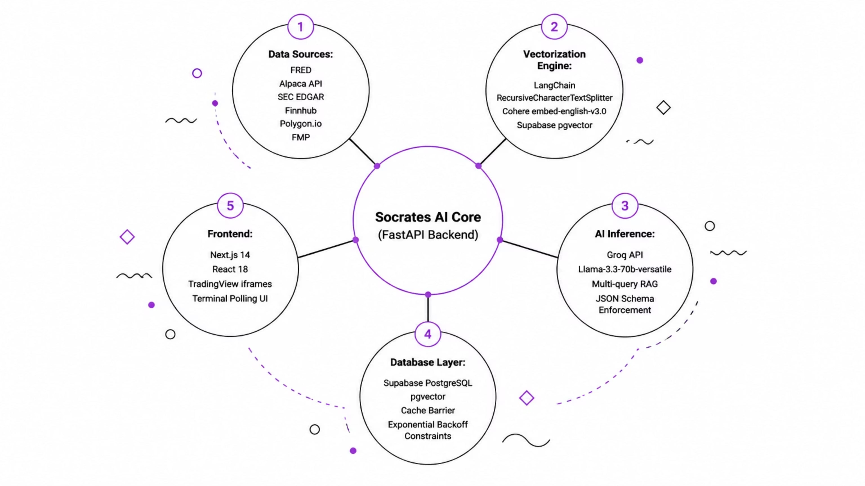
SYSTEM TOPOLOGY
Full-Stack Enterprise Topology
Socrates AI's architecture spans five distinct operational layers, each engineered for independent scalability and fault isolation. The system ingests from multiple external financial APIs, vectorizes unstructured SEC filings, performs multi-query RAG inference against a 70B-parameter LLM, and renders results through a Bloomberg Terminal-inspired Next.js frontend — all orchestrated through asynchronous, non-blocking patterns.
Data Sourcing Layer
Resilience Architecture
Multithreaded ingestion from FRED, Alpaca, and SEC EDGAR ensures continuous data freshness. Each source operates within its own async task group, preventing cascade failures from propagating upstream.
Exponential backoff retry logic with jitter is applied at every API boundary. Strict PostgreSQL constraint barriers (UNIQUE, CHECK, FOREIGN KEY) act as the final data integrity gate before any result reaches the inference layer.

Slide 4






BACKEND · VALUATION ENGINE
Defeating WAFs & API IP Bans: The 5-Layer Fail-Fast Cascade
Financial APIs aggressively throttle and ban IPs under concurrent load. Socrates AI implements a descending 5-tier waterfall cascade — each layer serves as both a primary data source and a fallback for the layer above. Critically, a strict Fail-Fast abort gate instantly terminates the entire pipeline if any layer returns a $0.00 price or empty matrix, preventing API quota burn on corrupted data.
⚠ Fail-Fast Abort Gate
Instantly aborts and halts the entire pipeline if an API explicitly returns $0.00 price or empty matrix. Zero API limit burn on garbage data.
Layer D — Mathematical Derivation
Computes implied market cap via 30-day float averages / 5-day close price. Used only when all external APIs fail simultaneously.
Layer C — Polygon.io Emergency Cascade
Activated when primary authenticated gateways return errors. Polygon.io serves as the emergency liquidity data fallback with separate API credentials.
Layer B — FMP & Finnhub Authenticated Gateways
Secondary authenticated API layer with rate-limit-aware request queuing. Provides redundancy when Alpaca returns incomplete share matrices.
Layer A — Live Alpaca × SEC Shares Outstanding
Primary valuation layer. Multiplies real-time Alpaca price against SEC-verified shares outstanding for mathematically sound market cap computation.
The Fail-Fast gate is not a retry mechanism — it is an architectural kill-switch. If Layer A returns $0.00, the system does not attempt Layer B. It aborts immediately, logs the failure event, and surfaces the error to the terminal UI. This design prevents silent data corruption.

Slide 5
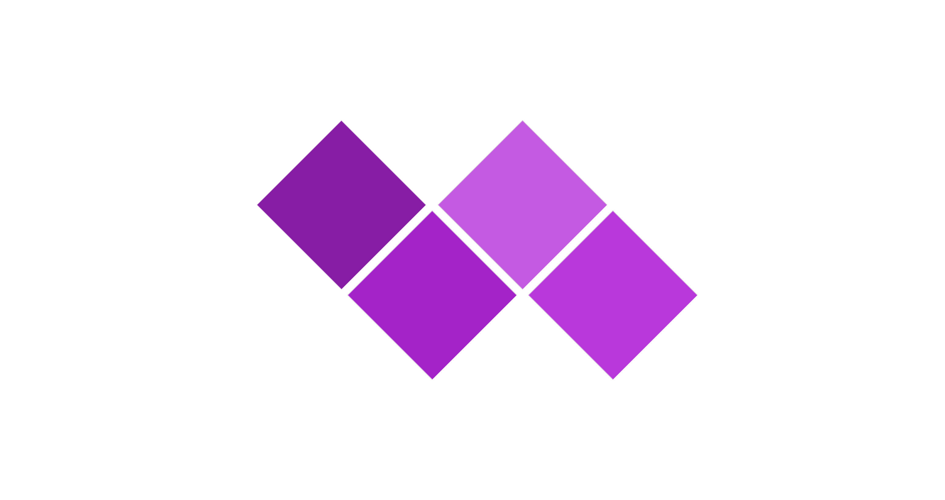
BACKEND · RAG PIPELINE
Autonomous SEC EDGAR Ingestion & Vectorization Engine
The SEC RAG vectorization engine is the computational heart of Socrates AI's qualitative intelligence layer. It autonomously ingests 10-K and 20-F filings, semantically slices them into retrievable chunks, generates high-dimensional embeddings via Cohere's cloud API, and injects them directly into PostgreSQL's pgvector extension — all without blocking the main FastAPI event loop.
Text Splitting
Batch Embedding
RecursiveCharacterTextSplitter: 1500 chars, 200 overlap.
Cohere embed-english-v3.0 used for vectorizing batches.
Document Fetch
Vector Insert
Async HTTP pull of SEC 10-K/20-F filings.
Supabase pgvector bulk async insert into DB.
Each stage of this pipeline operates asynchronously. The splitter, embedder, and database writer are decoupled FastAPI BackgroundTasks, meaning the frontend never waits for a 200-page 10-K to be fully vectorized before responding to the user.
Semantic Slicing Strategy
Non-Blocking Orchestration
LangChain's RecursiveCharacterTextSplitter is configured with a 1,500-character chunk size and 200-character overlap. The overlap is critical: it preserves semantic continuity across chunk boundaries, ensuring that risk factors spanning two chunks are not lost during retrieval. Splitter priorities follow SEC document hierarchy — Item 1A (Risk Factors) and Item 7 (MD&A) receive higher chunk density.
FastAPI's BackgroundTasks dependency injection system ensures that vectorization executes entirely outside the main async event loop. When a user queries a ticker whose 10-K has not yet been vectorized, the system returns an HTTP 400 with a structured vectorization_in_progress flag — the frontend intercepts this and streams live chunking logs to the terminal UI while the backend continues processing.

Slide 6

AI PIPELINE · INFERENCE LAYER
High-Speed Inference & Cost Optimization: The Cache Barrier
The AI inference layer is where Socrates AI differentiates itself from naive RAG implementations. A PostgreSQL-backed Cache Barrier intercepts identical daily queries before they ever reach the LLM, reducing average latency to under 0.5 seconds for repeated ticker lookups. When a cache miss occurs, a multi-query RAG ensemble executes against Groq's Llama-3.3-70B, producing conflict-free, institutional-grade trading thesis JSON.
The Cache Barrier Architecture
Multi-Query RAG Ensemble
Before any LLM call is made, PostgreSQL queries the inference_cache table with a composite key of (ticker_symbol, query_date, query_type). If a valid record exists (TTL: 24 hours), the cached JSON is returned directly — bypassing Groq entirely. This single architectural decision reduces LLM compute costs by an estimated 60–70% for frequently accessed tickers while delivering sub-500ms response times.
On a cache miss, Groq's API executes Llama-3.3-70b-versatile across three parallel semantic vector queries simultaneously:
Risks Query
Retrieves top-k chunks from Item 1A Risk Factors and Legal Proceedings sections, weighted by cosine similarity to the user's query embedding.
Cache Hit Path
Cache Miss Path
PostgreSQL → Cached JSON → Frontend. Latency: <0.5s. Cost: $0.
RAG Ensemble → Groq LLM → JSON Validation → Cache Write → Frontend.
Growth Query
Targets MD&A, Forward-Looking Statements, and Revenue Recognition sections to construct a quantitative growth thesis.
Financials Query
Extracts balance sheet metrics, cash flow data, and key ratios from structured filing tables, cross-referenced with live Alpaca price data.
All three query results are merged, deduplicated, and validated against a strict Pydantic JSON schema before being returned. Output is guaranteed to be conflict-free and machine-parseable.

Slide 7
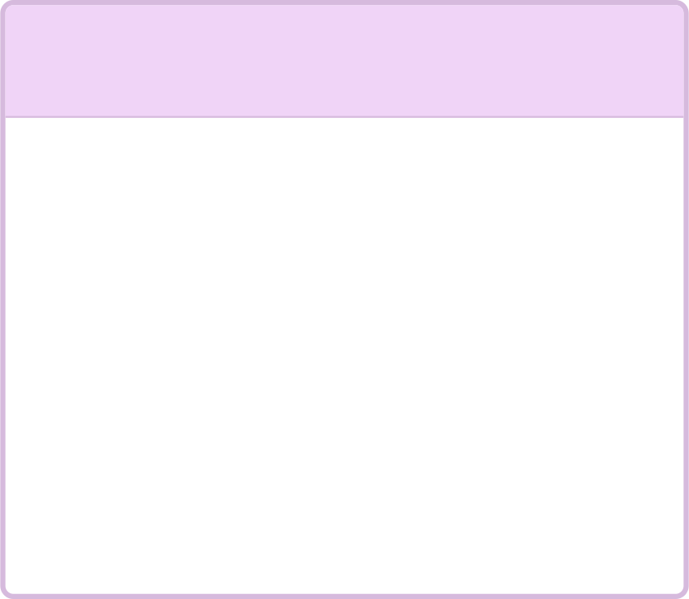



FRONTEND · UI ARCHITECTURE
Institutional Research Terminal UI
The Socrates AI frontend is engineered to replicate the information density, speed, and aesthetic of a Bloomberg Terminal — built on modern React 18 and Next.js 14. The layout is governed by a strict 12-column CSS Grid system, ensuring pixel-perfect alignment across all viewport sizes while maintaining the dense data presentation that institutional researchers require.
Grid Architecture
Performance & Rendering Strategy
The UI is divided into two primary zones within a 12-column grid:
Next.js 14's App Router with React Server Components (RSC) is used for initial data fetching, while React 18's concurrent features (useTransition, useOptimistic) ensure the UI remains responsive during heavy computation. Tailwind CSS provides atomic styling with zero runtime overhead. Critical rendering paths are optimized to achieve First Contentful Paint under 1.2 seconds on standard broadband.
1
2
4-Column Sticky Telemetry Sidebar
8-Column Main Dashboard
Renders the primary research output: Sentiment analysis matrices, Bull/Bear case summaries, Risk/Growth factor tables, and live price charts. Dynamically resizes based on content density.
Sub-Second FCP
Persistent across all routes. Displays live backend execution logs, API status indicators, vectorization progress bars, and system health metrics. Never unmounts during active RAG queries.
Server-side rendering + edge caching via Vercel ensures institutional-grade load times.
12-Column CSS Grid
Strict grid system ensures Bloomberg Terminal-level information density without visual clutter.
Dark Theme Aesthetic
Charcoal backgrounds with emerald and cyan accent glows replicate professional trading terminal aesthetics.

Slide 8
FRONTEND · REAL-TIME TELEMETRY
The "Immortal" Terminal: Real-Time Execution Telemetry
Traditional loading spinners are unacceptable in an institutional research context. Socrates AI replaces them with a live-streaming terminal UI that displays real-time backend execution logs — giving users full visibility into the inference pipeline's state. The terminal is "immortal": it never unmounts prematurely, even during rapid ticker switches or cache-hit scenarios.
Optimized React State Management
Terminal State Flow
Log state is managed through functional state updates with strict array capping:
01
setLogs(prev => [...prev.slice(-(MAX_LOGS - 1)), newLog])
User Submits Ticker Query
Next.js API route initiates async validation. Terminal UI immediately renders "Initializing inference pipeline…" log entry.
MAX_LOGS = 50 prevents memory bloat and DOM churn during extended sessions. The .slice() operation ensures the array never exceeds the cap, and functional updates guarantee no stale closure references.
Race-Condition Immunity
02
The terminal implements a synchronous log-fetch immediately upon main API resolution. This captures sub-second cache hits that would otherwise be missed if the component unmounted before the log stream completed. The fetch is forced synchronously — not queued — ensuring zero log loss.
Cache Barrier Check
PostgreSQL queried for cached result. If hit: log shows "Cache HIT — bypassing LLM compute" and JSON renders in <500ms.
03
RAG Vectorization (Cache Miss)
Terminal streams live chunking logs: "Splitting 10-K into 147 chunks…", "Embedding batch 12/15…", "Injecting into pgvector…"
04
LLM Inference & JSON Output
Groq API call logged with token count and latency. Final JSON validated against Pydantic schema before render.
05
Synchronous Log Capture
Forced sync log-fetch on API resolution captures any sub-second events before component unmount. Terminal state preserved.

Slide 9


FRONTEND · ASYNC UX
Seamless UX During Heavy Computation
The most challenging frontend engineering problem in Socrates AI is maintaining a responsive, information-rich UI while the backend performs computationally intensive RAG vectorization. The solution is a layered async architecture that intelligently intercepts in-progress states, decouples heavy integrations, and ensures zero UI freezing during peak inference loads.
Intelligent HTTP 400 Intercepts
Async Third-Party Integrations
When a user queries a ticker whose SEC filing is still being vectorized, the backend returns a structured HTTP 400 with a vectorization_in_progress error code. The frontend intercepts this response, cleanly detaches the main inference request from the UI thread, and switches the terminal to "streaming mode" — displaying live chunking and embedding logs in real-time while the user continues to interact with the rest of the dashboard.
Two critical third-party integrations are architected to never block or unmount during active RAG queries:
TradingView HTML5 Iframes
Dynamic US Macro Headers
Embedded TradingView Advanced Chart widgets are loaded in isolated iframe contexts with loading="lazy" and persistent ref management. They refuse to unmount during active RAG queries — users can analyze price charts while the backend vectorizes a 300-page 10-K.
Live CPI, GDP, and Treasury yield widgets load independently via separate async data fetching. They are decoupled from the main ticker inference pipeline, ensuring macro context is always available regardless of RAG pipeline state.
Detached Request Pattern
Recursive Log Streaming
The main inference request is decoupled from the UI render cycle. A separate useEffect hook polls the vectorization status endpoint every 2 seconds without blocking the main thread.
As each chunk is processed, the backend pushes a log entry via Server-Sent Events (SSE). The terminal UI appends these in real-time, providing full transparency into the vectorization pipeline.
The dual-dashboard architecture — trading charts on the left, live terminal on the right — was specifically designed to mirror the workflow of a quantitative analyst who needs to correlate fundamental research with real-time price action simultaneously.

Slide 10
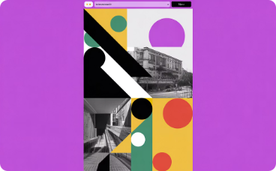

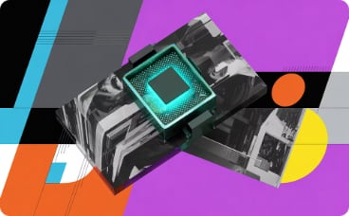

PRODUCTION DEPLOYMENT
Engineered for Enterprise Scale: Tech Stack & Deployment Architecture
Socrates AI's technology stack was selected based on three criteria: production maturity at scale, async-native architecture, and institutional-grade reliability. Every component has been validated in high-throughput environments. The deployment architecture is fully stateless, enabling horizontal scaling via Docker containers on any cloud provider.
Backend Stack
Database Layer
AI Inference Layer
Frontend Stack
Python 3.10+ · FastAPI 0.111.0 (async-native, OpenAPI auto-docs) · Uvicorn (ASGI server) · Pydantic v2 (strict JSON schema validation). Every endpoint is type-annotated and validated at runtime.
Supabase (managed PostgreSQL) · pgvector extension (HNSW index for cosine similarity search) · Row-level security policies · Automated daily backups. Vector similarity queries execute in under 10ms at 1M+ embeddings.
Groq API (Llama-3.3-70B at 500+ tokens/sec) · Cohere (embed-english-v3.0, 1024-dim vectors) · LangChain (orchestration, splitters, retrievers). Groq's LPU architecture eliminates GPU queue latency.
Next.js 14 (App Router, RSC) · React 18 (concurrent features) · Tailwind CSS (atomic utility classes) · TypeScript (strict mode). Deployed on Vercel Edge Network with sub-50ms global latency.
Stateless Deployment Architecture
Scalability Guarantees
Socrates AI is designed for containerized deployment. The backend runs as a stateless FastAPI service behind Uvicorn workers, with all state persisted in Supabase PostgreSQL. This enables horizontal scaling via Docker Swarm or Kubernetes without session affinity requirements. Vercel handles frontend edge deployment with automatic CDN caching.
500+
Tokens/sec
Groq LPU inference throughput for Llama-3.3-70B
10ms
Vector Search
pgvector HNSW cosine similarity at 1M+ embeddings
50
Max Log Buffer
Capped terminal log array preventing memory bloat
0.5s
Cache Hit Latency
PostgreSQL cache barrier bypass for repeated queries

