Slide 1
Team A
Project 6X6 Tic Tac Toe Game
By Ibra, Eddie, Jason, Carrie, Alexis, Alfonso

Slide 2
Job of each member
Ibra : | Team lead and architecture of the GUI interface
Eddie Aguilar: | Sub team lead and architecture of the single player mode (PvsP)
Alfonso Euclides: | Tester
Carrie Dumit: | Secretary and Tester
Jason Jensen: | Developer and architecture of the AI
Alexis Franciosi: | Secretary

Slide 3
Introduction
Tic Tac Toe is a game that is played with two players, X and O, who take turns marking spaces usually in a 3X3 grid.
For this project the game will be change from its most common size 3x3 to a 6x6 with 4 squares require to win rather than 3.
In conclusion it will be 6X6X4 version of the classic Tic Tac Toe game.

Slide 4
Application Domain
Environment for software to operate- Windows , Mac , and Linux
Game should be played in offline and accessible to public
Player can play as guest or registered user
Game should allow players to view their history
Game should keep track of players turns and display who is playing with who
Games should be not have a downtime

Slide 5
Project approach
For this project, we decided to use Microsoft C# which is one of many tools we can use to complete this project
Using MySQL for database in order to keep players history and can be viewed if requested
For source control, we are using GitHub and Dropbox to keep track of all of our files.

Slide 6
Non Functional Requirements
According to our client, the requirements are as follow:
  Users should be able to play the game offline
  Users should be able to sign up
  Users should be able to play as guest
  Users should be able to reset their password

Slide 7
Non-Functional Requirements Continued
Cost Effective :
        -Constrains:
        No monetary cost constrains
        Team effort & time constrains
        -Set reasonable deadlines
        -Manage time effectively
-Risks:
      Possible loss of member team
      Getting the architecture right
    -Reliability
      Games should be not have a downtime

Slide 8
Const Effective Description
For financing the project, it will not cost us nothing because it is a school/academic project.
Not any of our developers will be paid therefore, enjoy the free game

Slide 9
Constrains Descriptions
Our quality of assurance is to deliver the product on time.
In case it is not possible, we will release the beta version with minor bugs and publish an updated version after the deadline
The risk for this is to have a low grade which we are not intending to do so

Slide 10
Constrains Descriptions
Our quality of assurance is to deliver the product on time.
In case it is not possible, we will release the beta version with minor bugs and publish an updated version after the deadline
The risk for this is to have a low grade which we are not intending to do so

Slide 11
Non-Functional Requirement
Reliability Specifications
We assure that our team is reliable and can deliver the project on time.
This is proven by our expected dates and phases chosen to accomplishment milestones.
There are a total of 16 weeks which we took as 4 weeks for doing requirement, analysis, and design.
Week 5, we will do implementation and test on each sub-stone.
By week 12, we will have it nearly completed and use week 13-16 for debugging and finalizing.

Slide 12
Functional Requirements
The functional requirements will be determined through multiple use cases:
  Register a player
  Login as an existing player or a guest
  Player vs Player (PvsP)
  Single player vs AI

Slide 13
Functional Requirements
Use Cases
Case 1:Play as guest or registered user | User is given the option to sign in or play as guest
Case2: Forgot password | User is given the option to recover password or reset password.
Case3: User creates new account | User choses username and password to create his new account
Case4:User computer or user against player | User choses to play against the computer or against another player
Case5: Level of difficulty | User is given 3 options for levels of difficulty: easy, medium, difficult.

Slide 14
Use Cases Continuation
Case 6: Quit game | User is given the option to terminate the game before a winer is determined
Case 7: Check Score | Updated score will be displayed to the user
Case8: Select player | User is given the option to begin game or let the other player begin
Case9: Make a move | User is indicated to make a move to keep playing
Case10: Determine Winner | Check for the number of connected squares

Slide 15
Use Cases Continuation
Case 10 : Player vs. Player | User is given the option to play with another player
Case11: Player vs. EI | User plays against the computer
Case12: Update Winner | Display current winner
Case13: Replay game | User is given the option to start another game session
Case14: Exit game | User is given the option to terminate the game

Slide 16
Registering a Player Use Case Description
User selects the option to register
Registration screen is Displayed
User create username and password
Registration is processed
Registration is successful
New user is created

Slide 17
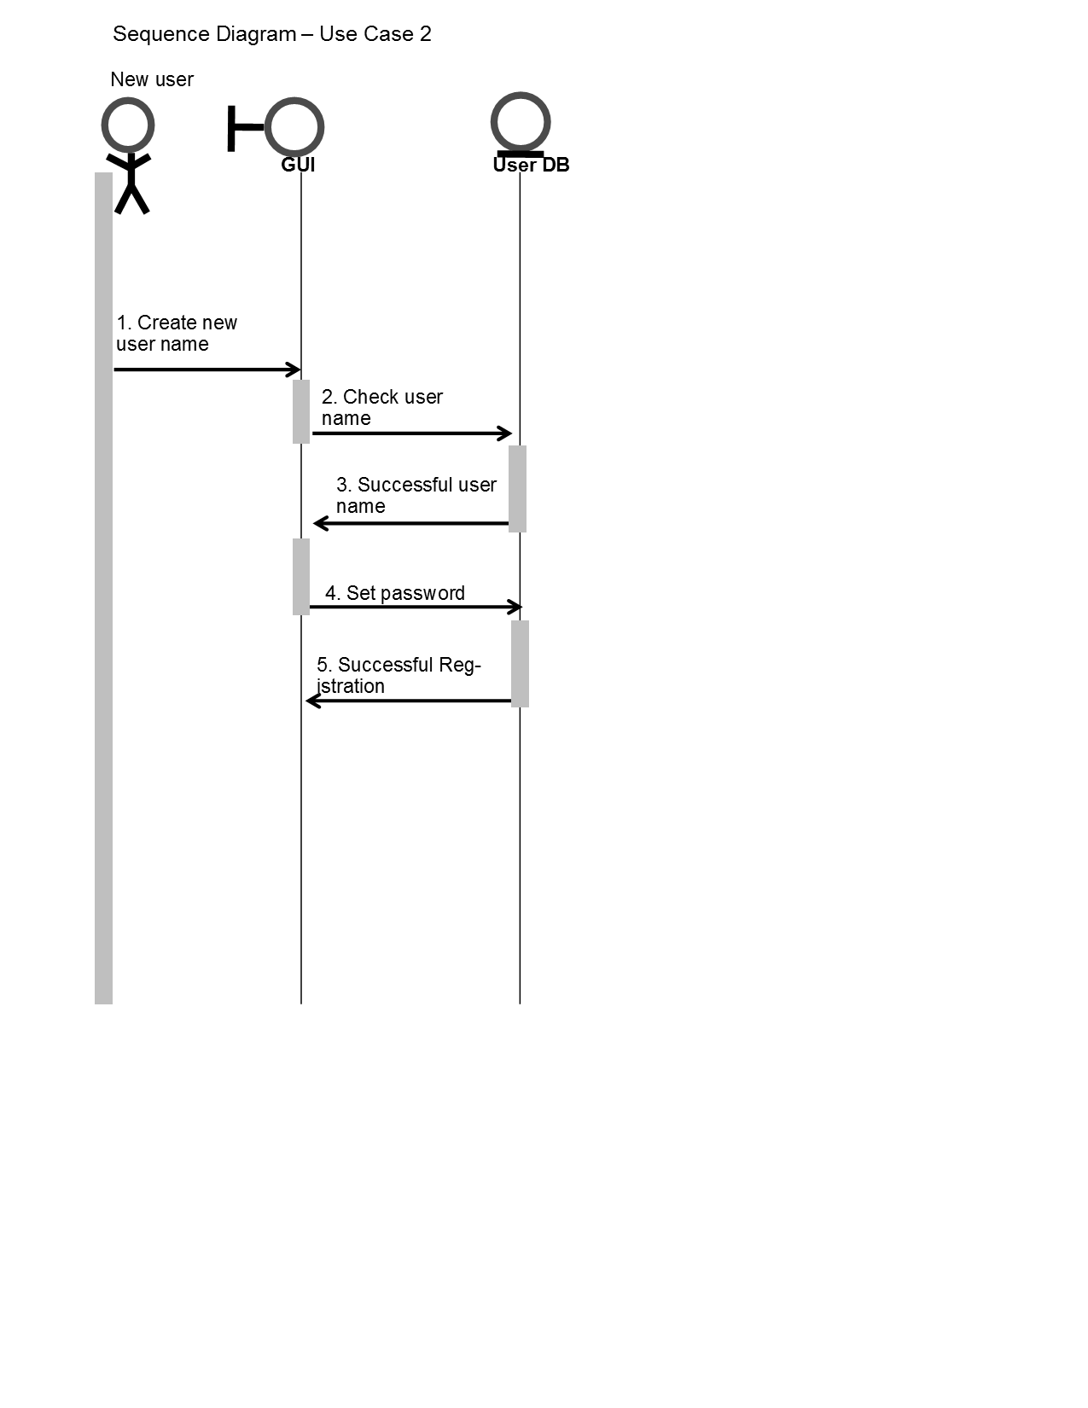
Registering a player Use Case Sequence Diagram

Slide 18
User Plays as Guest Case Description
User selects the guest option
Game guest mode is set
Screen to begin game as a guest is displayed
Guest player is successful
Play guest is completed

Slide 19
User Plays as Guest Diagram

Slide 20
Player vs Player Use Case Description
Player vs Player is mode allows the player to player against another person.
This concepts goes as:
  Start of the game, an initial option will be given to which player goes first
  Then each player will take turns
  The one with the most squares connect will win.

Slide 21
Player vs. Player Use Case Diagram

Slide 22
Login Use Case Description
For a user to login, these steps are require:
  Enter username
  Enter password
  Database checks if user exist
    If user exist, it will allow them to log in
    Displays error message “wrong username or password”
    Keep asking until the user enters the correct information

Slide 23
Login Diagram

Slide 24
Determining winners Case Description
The way the game determine who is the winner:
After all squares has been filled
Game performs a search algorithm to check for connected square:
  Vertically
  Horizontally
  diagonally

Slide 25
Determine Winner Use Case Diagram

Slide 26
Quitting the Game User Case Description
If the player decided to quit the without the game ending:
  That rounded will count against
  Players score will be updated on the record
  And also give the option to play again or quit the application

Slide 27
Quitting the Game Diagram

Slide 28
Update Score Case Description
The player with the most connected 4 squares wins the game.
Score gets updated on the database
Player is given option to play again or quit.

Slide 29
Update Score Diagram

Slide 30
Player vs Player Use Case Description
Player vs Player is mode allows the player to player against another person.
This concepts goes as:
  Start of the game, an initial option will be given to which player goes first
  Then each player will take turns
  The one with the most squares connect will win.

Slide 31
Player vs player diagram

Slide 32
Player vs AI Use Case Scenario
The player vs AI mode is going against the artificial intelligence.
This mode will go as described:
  Player will be given option to go first or AI
  They take turns until the end
  Player with the most connected squares wins
  Score updated and menu will be presented to quit or play again

Slide 33
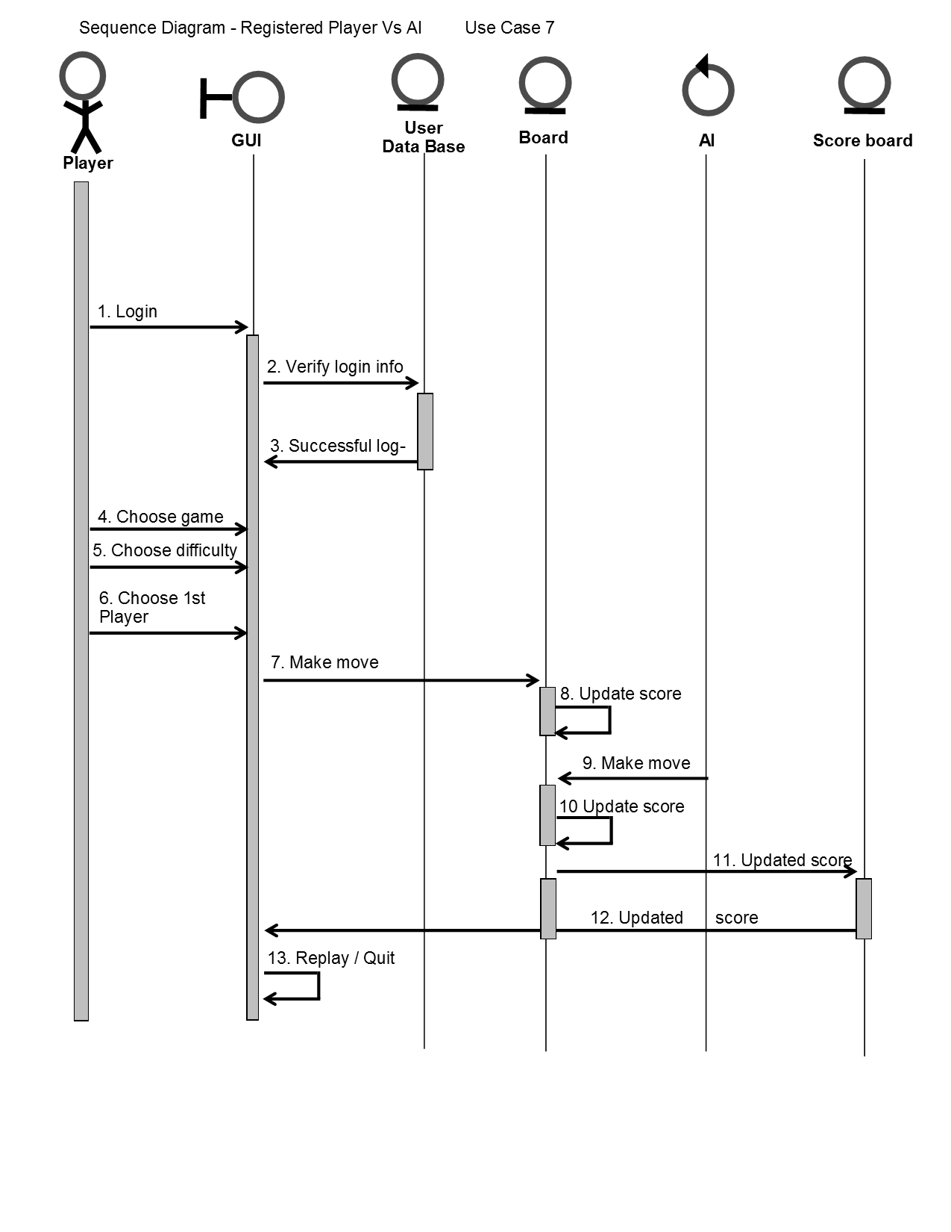
Player vs ai diagram

Slide 34
Mode of Ai Specifications
Beware of the AI because it has different levels:
Each level will be more challenging:
  Easy mode will be towards 25% chance of winning
  Medium mode will be %10 - 7% chance of winning
  HARD mode will be less than 4% winning chances.

Slide 35
Class Diagram
UML

