Slide 1
Team A
Project 6X6 Tic Tac Toe Game
By Ibra, Eddie, Jason, Carrie, Alexis, Alfonso

Slide 2
Job of each member
Ibra : | Team lead and architect of the GUI interface.
Eddie Aguilar: | Sub team lead and architect of the single player mode (PvP).
Alfonso Euclides: | Tester.
Carrie Dumit: | Secretary and Tester.
Jason Jensen: | Developer and architect of the AI.
Alexis Franciosi: | Secretary.

Slide 3
Introduction
Tic-Tac-Toe is a two-player game, played on a 3x3 square, where the winner is the first player to connect three in a row.
For this project we will be developing an enhanced version of the game utilizing a 6x6 square and in which the winner is the player with the most 4 in a row squares once the entire board is filled.
In conclusion it will be 6X6X4 version of the classic Tic Tac Toe game.

Slide 4
Application Domain
Environment for software to operate - Windows , Mac, and Linux.
Game should be played offline and accessible to the public.
Player can play as guest or a registered user.
Game should allow players to view their history.
Game should keep track of players turns and display player user names.
Games should be not have a downtime.

Slide 5
Project approach
For this project, we decided to use C++ with the QT environment.
We are using MySQL to create a database to store player histories, and which can be viewed if requested.
For source control, we are using GitHub and Dropbox to keep track of all of our files.

Slide 6
Non Functional Requirements
According to our client, the requirements are as follow:
  Users should be able to play the game offline.
  Users should be able to sign up.
  Users should be able to play as guest.
  Users should be able to reset their password.

Slide 7
Non-Functional
Requirements Continued
        -Cost Constraints:
        No monetary cost constrains.
        Team effort & time constrains.
        Set reasonable deadlines.
        Manage time effectively.
        -Risks:
        Possible loss of member team.
        Getting the architecture incorrect.
        -Reliability:
        Games should not have downtime.

Slide 8
Cost Constraints Description
There is no budgetary requirements for this project since it is a school/academic project.
We can, however, measure time spent, quality of work, effort applied, etc.
None of our developers will be paid therefore, enjoy the free game

Slide 9
Risks Descriptions
Our quality of assurance is to deliver the product on time.
In case this is not possible, we will release the beta version with minor bugs and publish an updated version after the deadline
The risk for this is to have a low grade which we are not intending to do so

Slide 10
Reliability Specifications
We assure that our team is reliable and can deliver the project on time.
This is proven by our expected dates and phases chosen to accomplishment milestones.
There are a total of 16 weeks which we took as 4 weeks for doing requirement, analysis, and design.
Week 5, we will do implementation and test on each sub-stone.
By week 12, we will have it nearly completed and use week 13-16 for debugging and finalizing.

Slide 11
Requirements and Object Oriented Analysis 2/23 | Preliminary Software Project Management Present risks and constrains Specify Configuration Control Present preliminary use cases
Complete all first phases and present first prototype 3/29 | Complete Requirements and Product Specifications Present first prototype Complete management plan
Present Demo and Source Code 4/26 | Complete Details on Design Test completed plan
Competition 4/28 | Test for reusability and portability Team members evaluation

Slide 12
Functional Requirements
The functional requirements will be determined through multiple use cases:
  Register a player
  Login as an existing player or a guest
  Player vs Player (PvsP)
  Single player vs AI

Slide 13
Functional Requirements
Use Cases
Case 1: Register new account. | Set up user name and password for new user to log into the game.
Case 2: Log in as existing user. | Enter the user name and password to log into the game.
Case 3: Play as guest. | Start a new game without logging in.
Case 4: Reset Password. | User resets account password.
Case 5: View play statistics. | Displays user Win/Loss record.

Slide 14
Use Cases Continuation
Case 6: Clear statistics. | Reset Win/Loss record.
Case 7: Select game mode. | Choose to play the game against another player or against the AI.
Case 8: Difficulty level. | Adjust the AI difficulty level.
Case 9: Select stone color. | Choose the color for the two players.
Case 10: Select first player. | Choose which color will go first.

Slide 15
Use Cases Continuation
Case 11: Make a move. | Place a stone of the users color on an empty square.
Case 12: Replay game. | Starts a new game after the previous game has ended
Case 13: Logout. | Log user out so another user can log in or to allow playing as guest.
Case 14: Quit | Exits the application

Slide 16
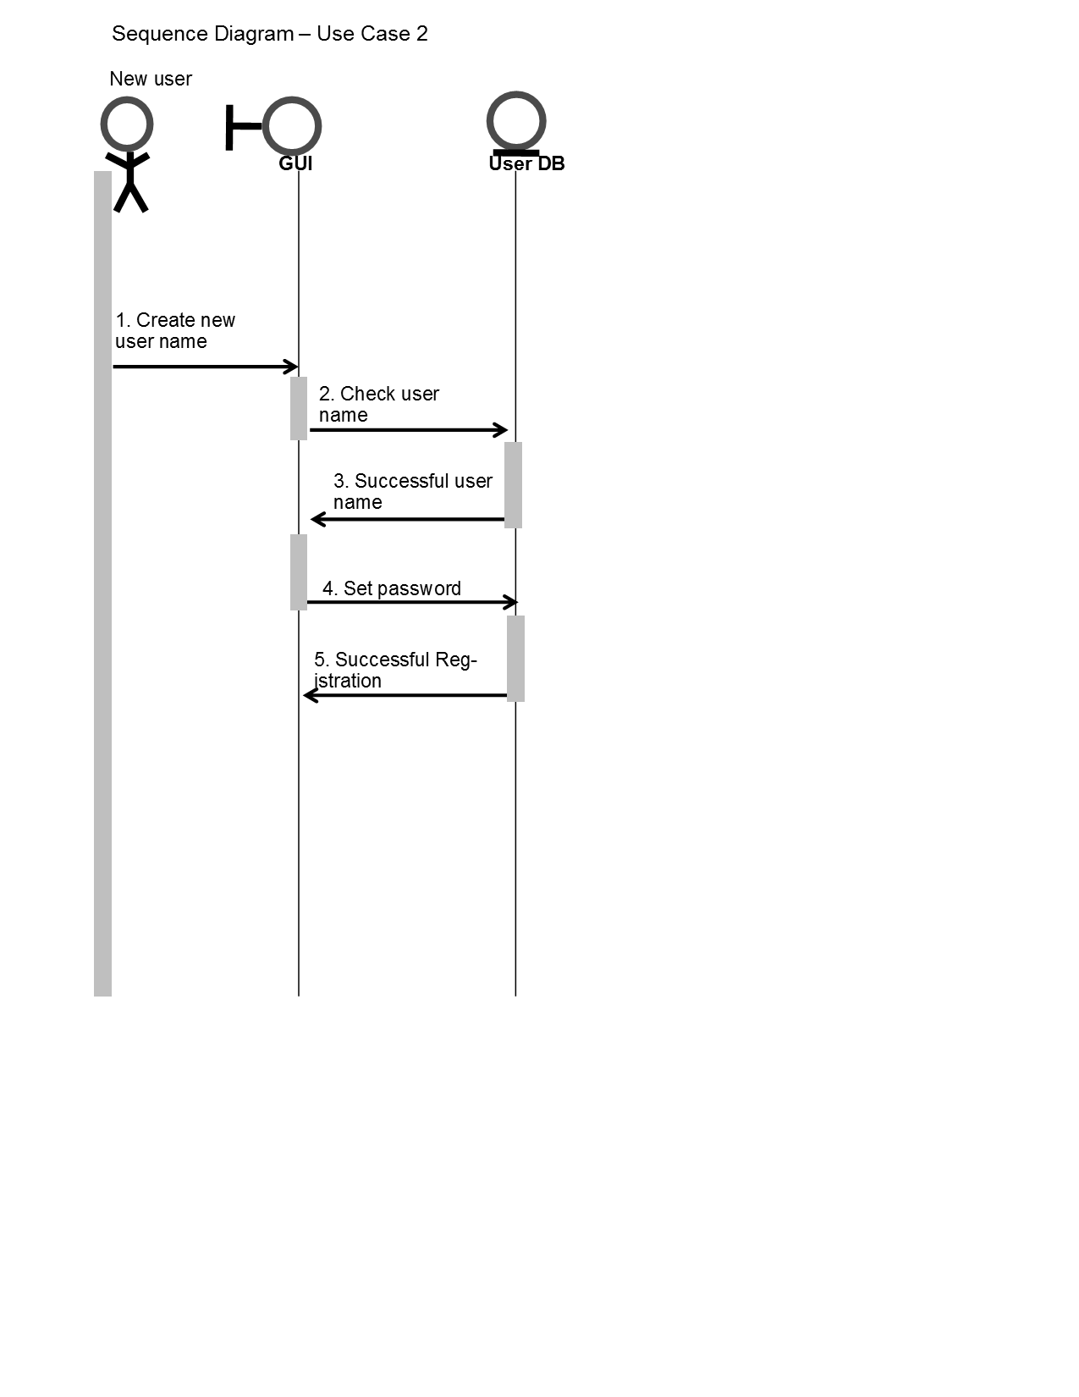
Case 1: Register new account.

Slide 17
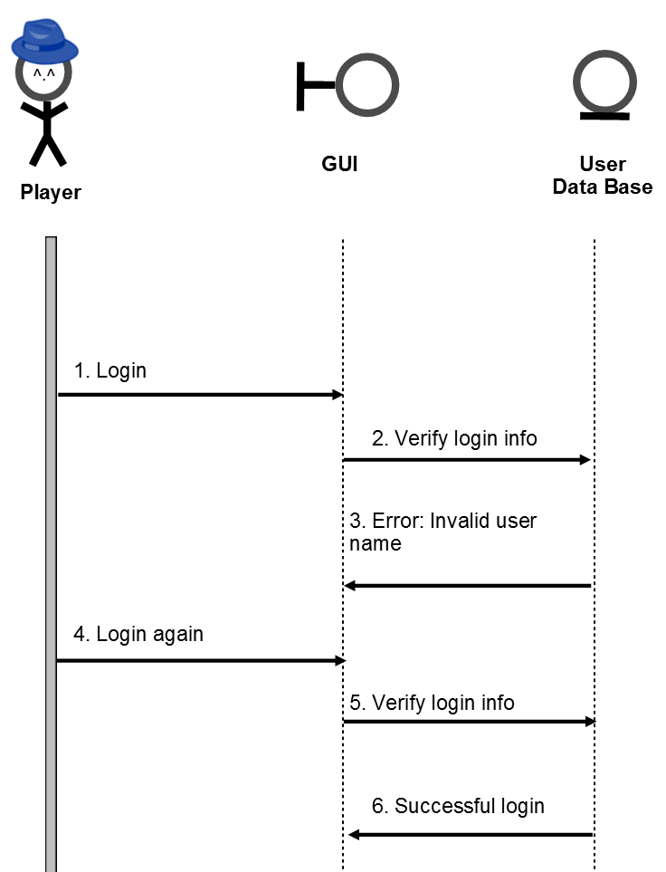
Case 2: Log in as existing user.

Slide 18
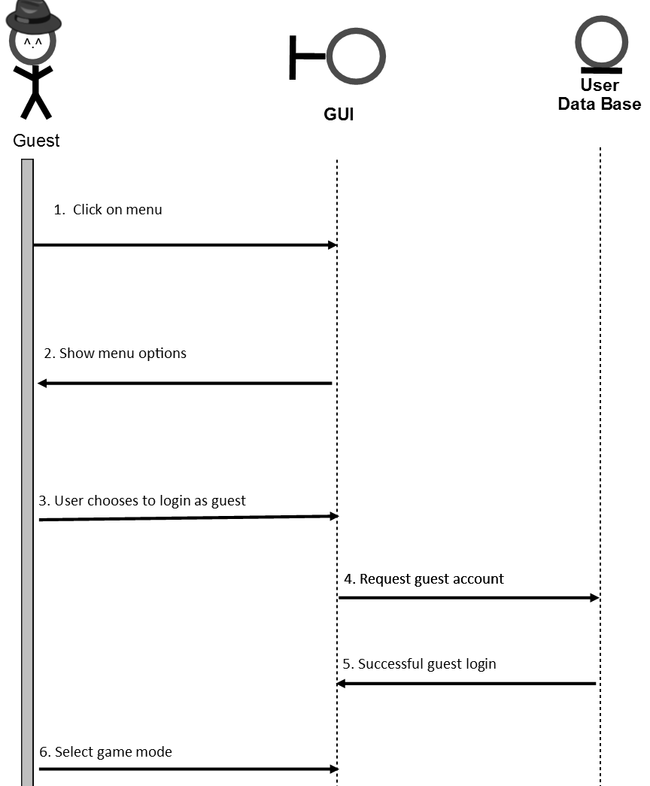
Case 3: Play as guest.

Slide 19
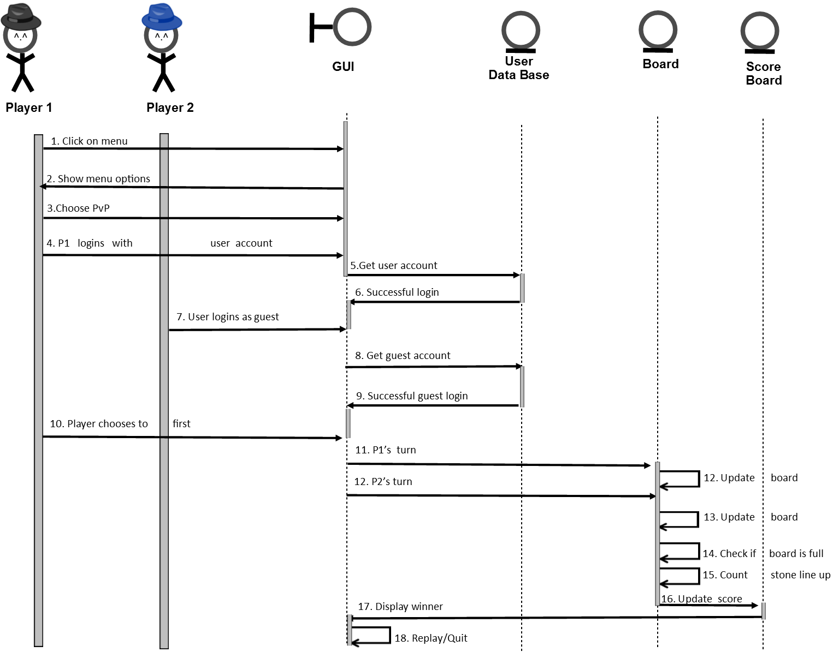
Player vs. Player Use Case Diagram

Slide 20
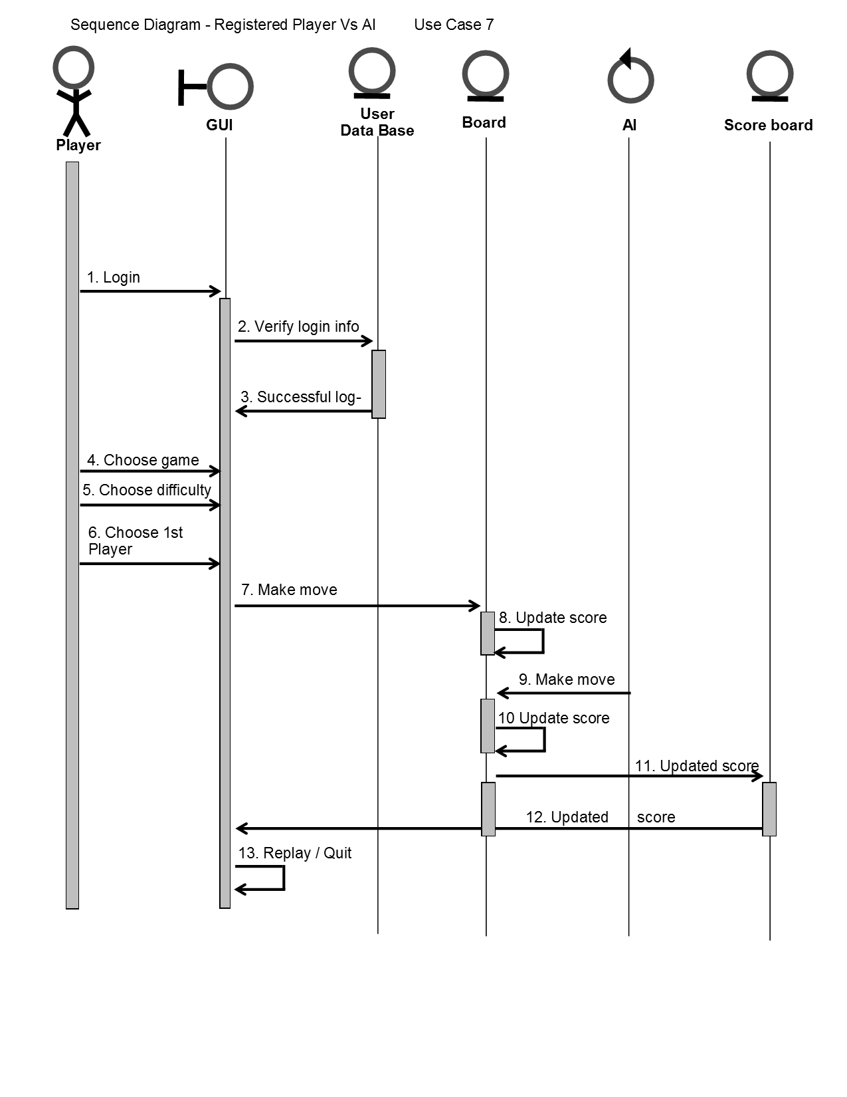
Player vs AI

Slide 21
