Slide 1
CS209-210 Mini-Project: Paper Piano
By Aadit Sharma (2101AI02) and Archit Sharma (2101AI05)

Slide 2
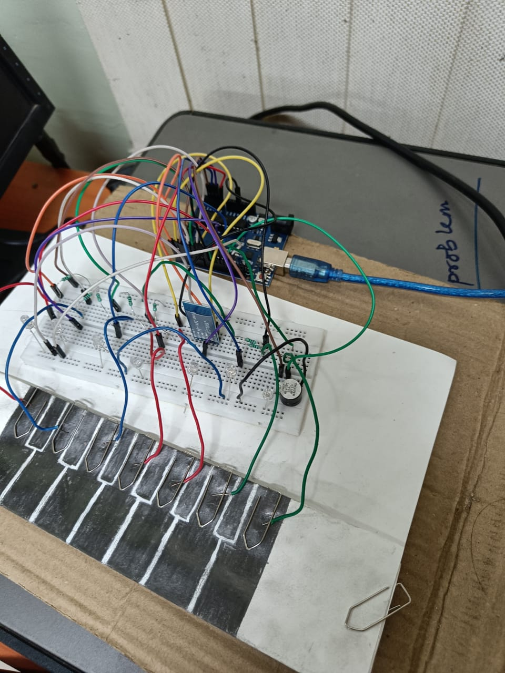
Overview
We designed a paper piano with keys working on the principle of capacitive touch.
LEDs have been connected to indicate the current key pressed or the future key to press.
A piezo-buzzer is connected to play the piano notes at the frequency specified.
The piano has a HC-05 Bluetooth module to communicate with Android App designed for this task.

Slide 3
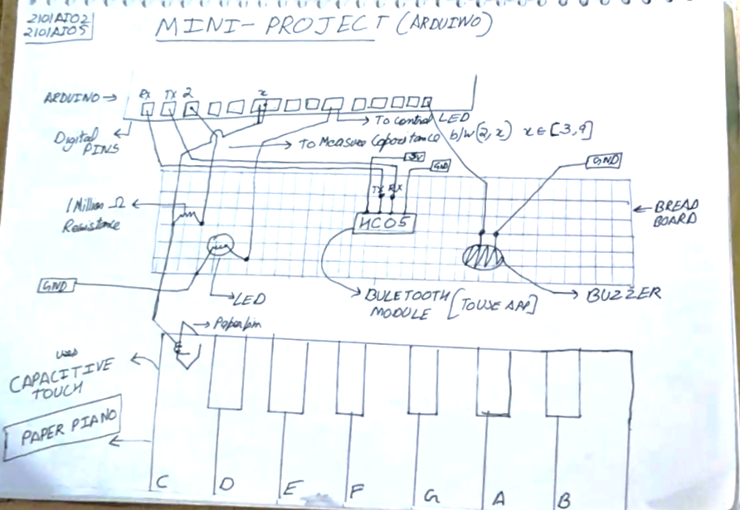
Schematic Representing connections done in the circuit

Slide 4
Circuit Components
•HC05 Bluetooth Module- The RX pin of HC05 is connected to TX pin of Arduino and the TX pin of Arduino is connected to RX pin of Arduino. The VCC of the pin is connected to 5V and ground is connected to Arduino’s ground. The module communicates with the Arduino at 9600 bits/second and it is capable of receiving only 8-bit characters. We use it to send a character to the Arduino where further processing is done.
•LEDs- LEDs are connected from Digital pin 10 to 12 and Analog pin A0 to A3, these light up to indicate the current or future note to play.
•Resistors- One Million Ohm Resistors are connected with the capacitive touch sensors to decrease the sensitivity of the sensor.
•Capacitive Touch- The sensor is made of a paper covered with graphite. When a human touch is sensed, it gives a higher reading than usual and this is exploited for triggering various function calls. A high value resistor is used to decrease the sensitivity of the sensor. The adjoining diagram explains its functioning. The receive pin is connected to digital pin 3 to pin 9 for the 7 sensors, while the send pin of all the 7 sensors are connected to Pin 2.
•Piezo buzzer- This is connected to digital pin 13 and is used to play tones at specified frequencies. The Arduino sends a square wave to pin 13 to produce sound of the specified frequency. Since we have control only over sound, the result is not well produced.

Slide 5
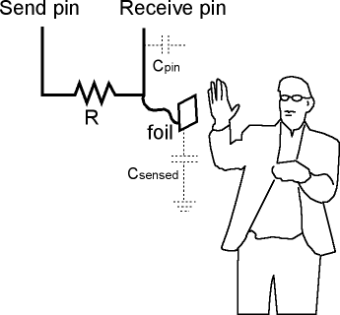
Capacitive Touch and CapacitiveSensor Library
For the keys capacitive touch sensor was created using paper and graphite pencil. When the human touch is detected, there is a change in the RC period and this change can be detected by the Capacitive Sensor objects in Capacitive Sensor Library for Arduino.
The capacitive sensor’s sensitivity is reduced by attaching a 1M ohm resistor. The exact level at which the key is to be pressed is empirically determined and it varies with humidity, temperature and most importantly with the surface on which it is kept.

Slide 6
Android App: Piano_Copilot
In this section we will explain the functioning of Android App and how it communicates with the Arduino board.

Slide 7
The Three Modes
Free Play- This is the default state of the piano. When the user selects this mode, the app asks the user for an octave and when an octave is selected, the app directs the Arduino to play the note in the selected octave corresponding to the key pressed by the user. In this mode the paper piano acts as a ‘vanilla’ piano.
Learn to Play- This is an interactive tutorial mode, which allows the user to learn to play some tunes and song on paper piano. Currently, 5 songs have been implemented, when a song is selected, the piano sends a character from ‘A’ to ‘E’ corresponding to each song to the HC-05 module
Auto Play- This mode sets the ‘Arduino’ to play the songs on its own. Here the app sends a character, ‘a’ to ‘e’ via Bluetooth to the HC-05 module. All the 5 tutorial songs have been implemented for this mode

Slide 8
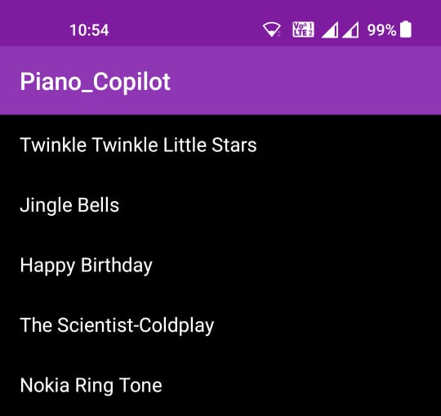
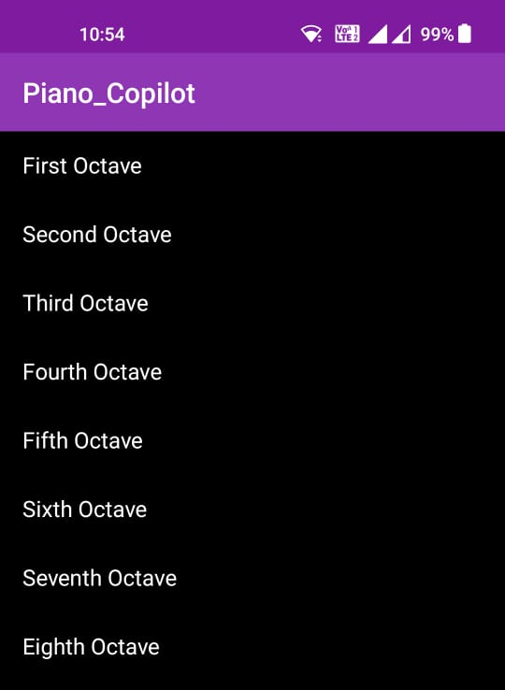
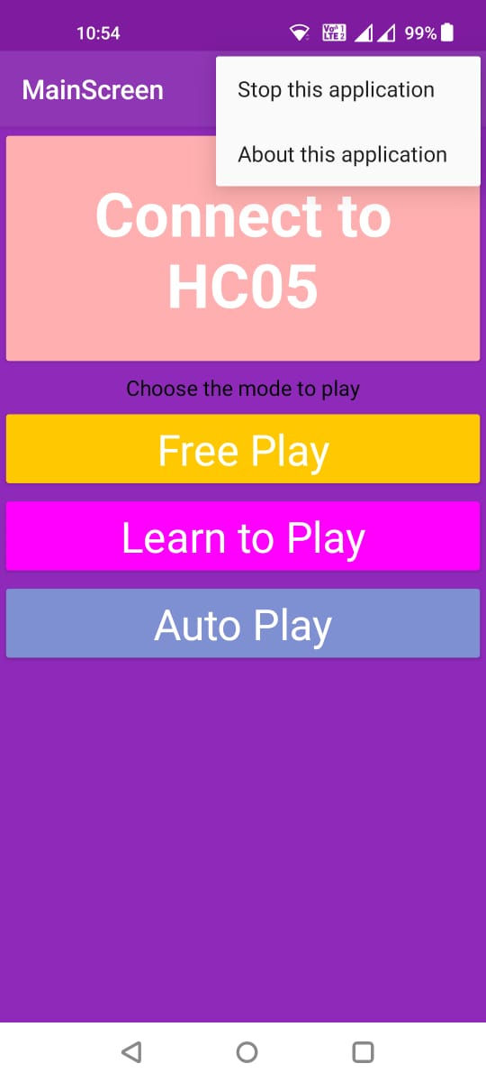
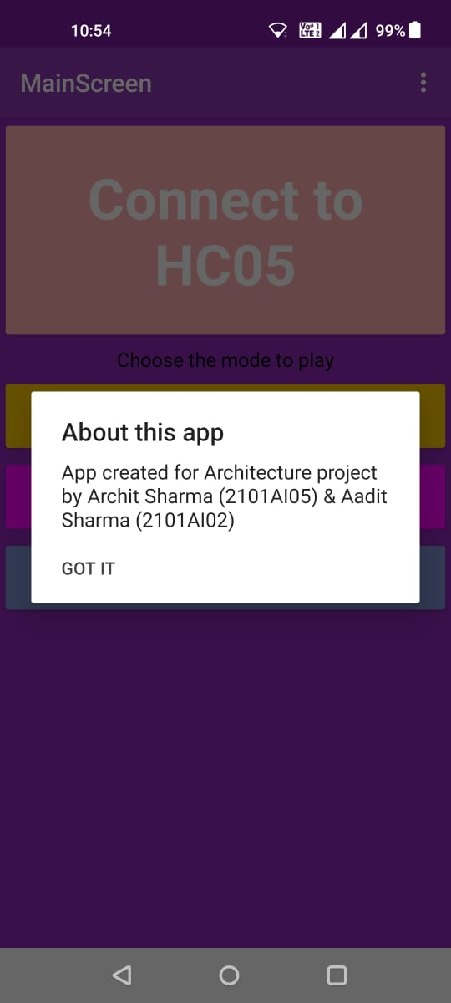

Song Selection Screen for Learn to Play Mode
Octave selection Screen for FreePlay Mode
Song Selection Screen for Auto Play Mode
The MainScreen with open
menu
‘About this application’ section of App

Slide 9
Arduino Code
This section of the report explains the functioning of the Arduino code.

Slide 10
Initialization
The following global values were initialized-
• Speaker pin was initialized as pin 13.
• 7 capacitive sensor objects were initialized measuring capacitance between pin 2 and pin connected to key.
• 7 led pins were initialized- 3 digital pins 10 to 12 and also 4 analog pins acting as digital pins from A0 to A3 as we had exhausted all the digital pins.
• A 2d 8 by 7 integer array was initialized with the name frequency which contained frequency corresponding to each of the 7 notes and each of the 8 octaves

Slide 11
Setup Function
The default octave was initialized as 0 and each of the LEDs and speaker were initialized in output mode. The Serial bit rate was initialized at 9600 bits/second.

Slide 12
Loop Function
The loop is the function which keeps on repeating throughout the time the Arduino is switched on. The Bluetooth Module writes its input on the Serial of the Arduino. The loop reads this in ‘data’ variable and subtracts character ‘1’ to obtain the corresponding octave index for the frequency array. If data was equal to ‘A’ to ‘E’, the code calls corresponding functions to play song in tutorial mode or if the data was a character from ‘a’ to ‘e’, the code calls function to play the song on its own. Otherwise, the Arduino stays in default Free play mode and obtains the capacitance value from the capacitive sensors and prints the read values on the Serial for the purpose of debugging. If the capacitive values for any of the sensor is more than 600 than the Arduino plays the frequency for 300ms.

Slide 13
findKeyPressed()
This function is called to return the key currently pressed by the user by reading the capacitive sensors’ values. When the value of capacitive sensor is detected to be more than 600, than that key is returned as a character.
This function will be called upon in tutorialMode to confirm if the correct key is pressed.

Slide 14
lightLed and turnoffLed
This function takes in character of note pressed and sets the relevant LED to the correct state. This function is called upon in Auto Play and Tutorial mode to light up and switch off the LEDs.

Slide 15
autoPlay
These functions takes in character of note to play the sound, the octave to play the note at and the delay in milliseconds after which to stop the sound. This is called upon by aiPlaySong{x} methods to play the correct notes on the buzzer.

Slide 16
aiPlaySong{x}
The sequence of notes to play have been added as character array in the program. When such a function is called, the CPU loops through the relevant loop and plays the relevant sound by calling auto play function, switches the relevant LED on and off by invoking lightLed and turnoffLed function. After the loop is terminated, the program returns to default state of free play.

Slide 17
song_{x}
This function is called to play song ‘x’ in tutorial mode, since the correct sequence of notes is known, the function loops through relevant loops lighting up LEDs corresponding to the note and if the same key is pressed, the board then reads the next note and so on until the array is exhausted at which point, the program returns to default state of free play. If an incorrect key is pressed, the piano stays in that loop.

