Slide 1

Long-term time-series forecasting
Gas consumption
Members:
Francesco Amato
Filippo Maria Rognoni
Francesco Minaglia
05/2021

Slide 2
ROADMAP
Introduction
Process visualization
Plotting 2D
Spectral analysis
Plotting 3D
Model identification
Polynomial regression
Neural network
Harmonic regression
Compare different models
Prediction function
Link to our project repository (GitHub)
Conclusion

Slide 3
1. Introduction
DATASET
Dataset which represent gas consumption in Italy, during two different years ( in function of day of the week and day of the year).
AIMS
Identify a model which represent yearly trend, for long-term time-series forecast.
Write a function whose aim is predicting gas consumption once you put in, as parameters, the day of the week and the day of the year).

Slide 4
2. Process visualization
Before starting identifying the best model, it is useful to have some ideas on the process function characteristics, plotting it in three different ways:
2D: Gas consumption in function of the day of the year;
Spectral analysis: Allowing us to see what are the repetition that characterize our signal;
3D: Gas consumption in function of the day of the year, and the day of the week.

Slide 5
2.1 Plotting 2D
Observations:
Gas consumption decreases in the hottest months of the year ;
During weekend the gas consumption is lower ;
Stationary process ;
Discrete time process ;
Ergodic process;
Autocovariance function shows some kind of relationship between first days of the year and last days of the year ;

Slide 6
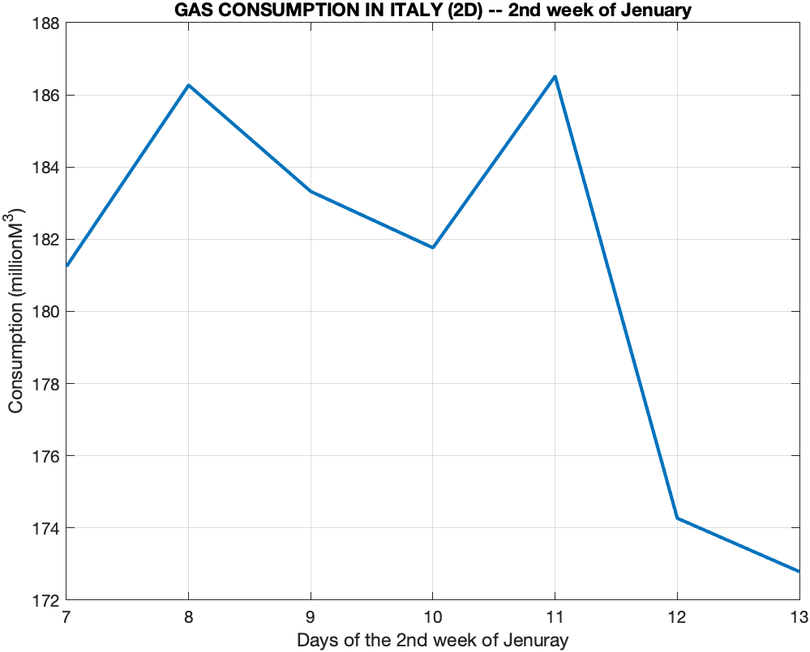
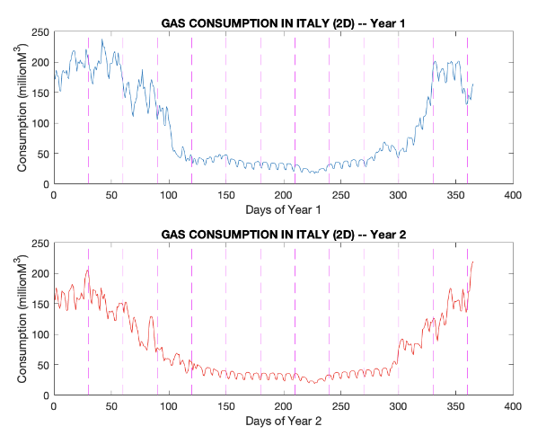
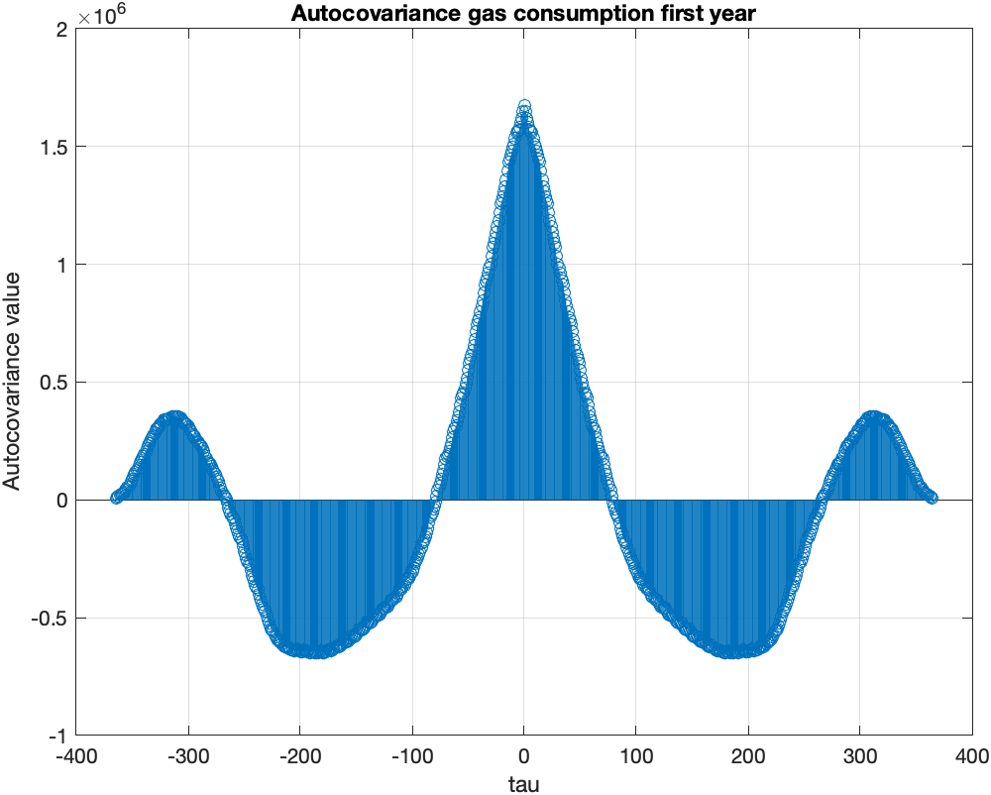
2.1 Plotting 2D
2nd week of January trend
Plot 2D
Autocovariance first year

Slide 7
2.2 Spectral analysis
Another process visualization that allows to notice different signal characteristics, is relative to the frequency domain.
This domain can be very useful to understand and highlight signal repetitions.
The gas consumption of the two years was chained.
Important frequencies in signal spectrum:
Frequency in 0 mean gas consumption in both years;
Frequency in 2 yearly seasonality;
Frequency in 4 semestral seasonality;
Frequency in 104 weekly periodicity;
Frequency in 8 three-months seasonality;
Frequency in 209 four days periodicity;
Frequency in 313 two days periodicity.

Slide 8
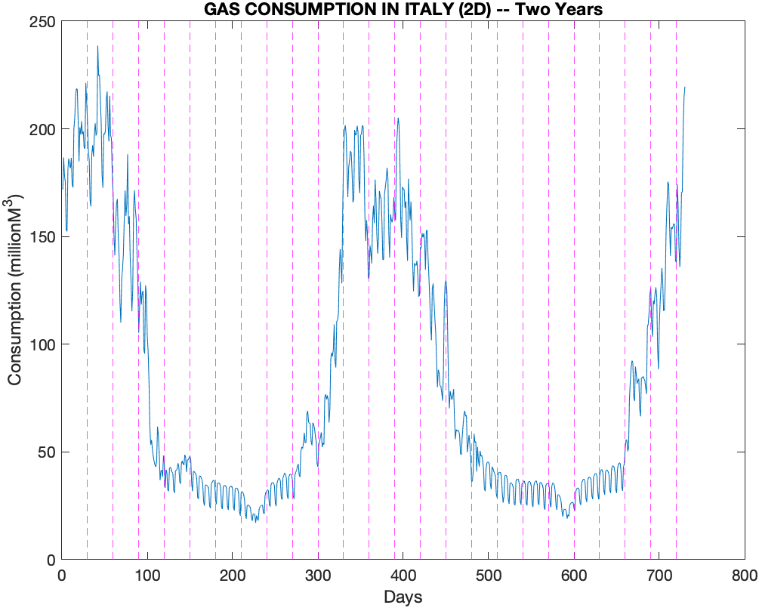
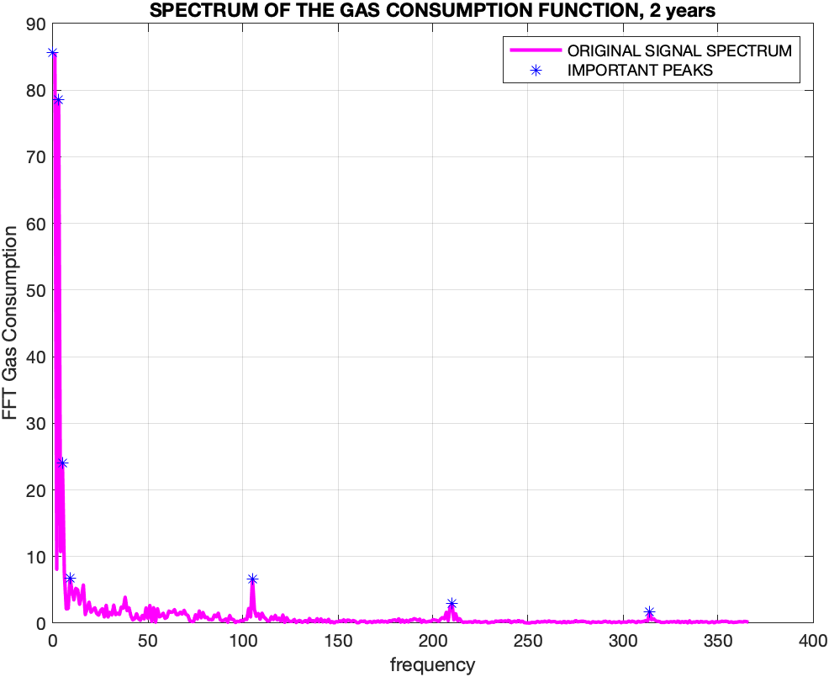
2.2 Spectral analysis
Two years 2D trend
Spectrum of our signal

Slide 9
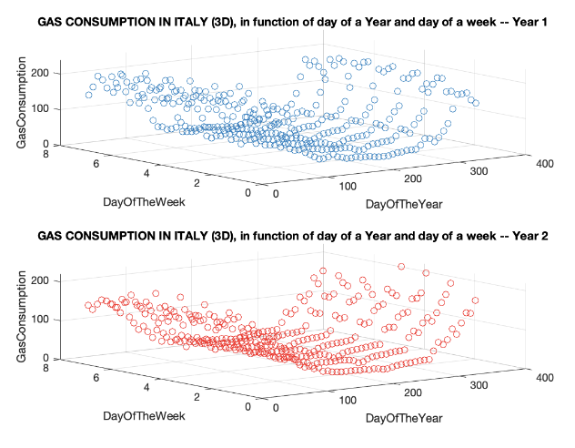
2.3 Plotting 3D
For completeness we show the 3D plot of our process, depending on our two variables (day of year and day of the week)
Plot 3D

Slide 10
3. Model identification
Since we can identify the model through different methodologies, we chose some techniques to do this:
Polynomial regression
Neural network
Harmonic regression
As a criterion for the selection of the method that produces the final model, we chose the one that provides better results than the others (3.4 section).

Slide 11
3.1 Polynomial regression
Creating different polynomial models and plotting them on graphs
Starting from a second degree polynomial model (gas consumption trend is not constant, nor plane).
It seems like all the models are quite good, but how can we decide which is the best model?
SSR (not a good idea) More complex model always wins
Figures of merit:
Subjective criterion (Test F) 4th wins
Objective criteria ( AIC, MDL, FPE ) 4th wins
Cross-validation ( first year gas consumption data to identify the model, second year gas consumption data for cross-validation).
In order to choose the best polynomial model we will use cross-validation.

Slide 12
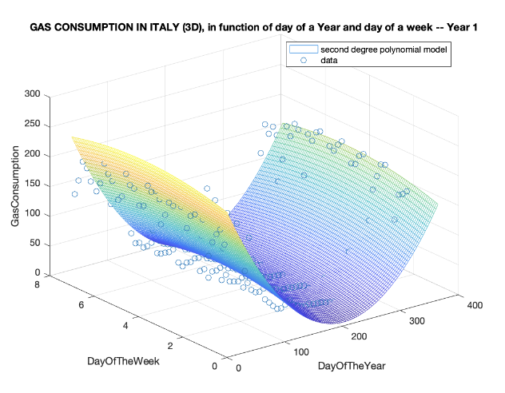
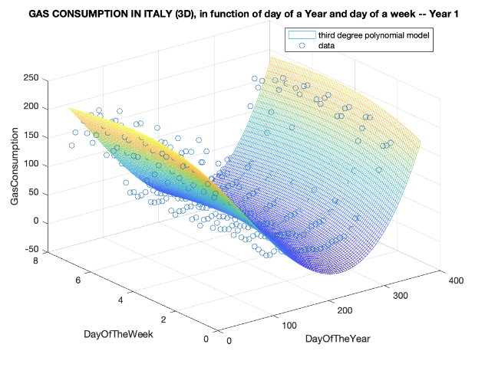
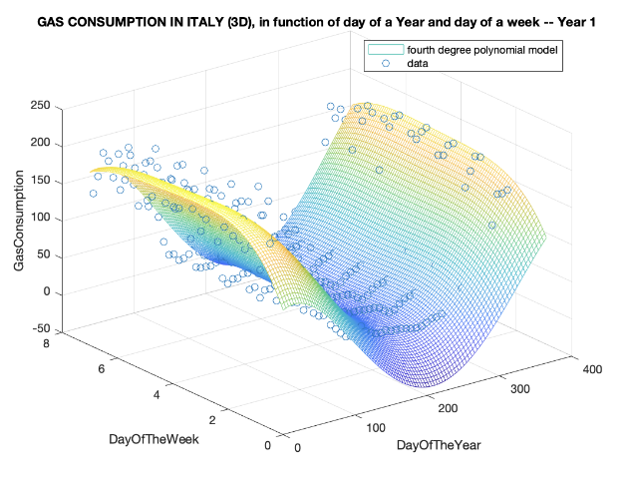
3.1 Polynomial regression
Plot (Different polynomial models)

Slide 13
3.1 Polynomial regression
Polynomial models results, identification
Cross-validation:
Polynomial models results, cross-validation:
Polynomial model degree: SSR_Identification TEST F AIC FPE MDL
2° 2.6444e⁵ 1.673e³ 12.52 2.733e⁵ 12.60
3° 2.1417e⁵ 83.09 12.33 2.262e⁵ 12.44
4° 1.8057e⁵ 64.84 12.18 1.960e⁵ 12.35
We considered the various polynomial models previously shown and saw which was the one that minimized the SSR (hence also the standard deviation) between validation data and expected data.
Polynomial model degree: SSR_Validation SD
2° 2.1648e⁵ 24.38
3° 1.9883e⁵ 23.37
4° 2.2411e⁵ 24.81

Slide 14
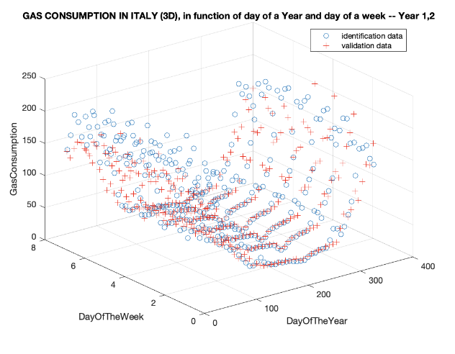
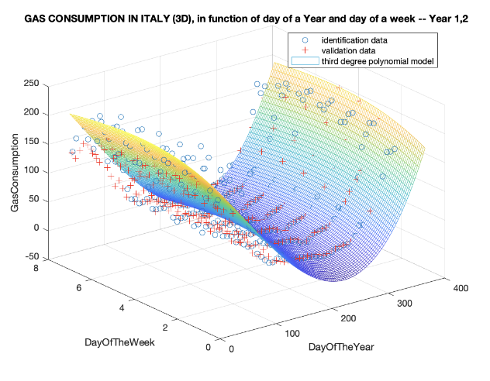
3.1 Polynomial regression
Identification and Validation data
Best model for cross-validation

Slide 15
3.2 Neural network
Multi-layer perceptron neural network characteristics:
2 layer MLP (1 hidden layer, 1 output layer)
Data division: 70% identification, 15% test, 15% validation (First year identification, second year cross-validation)
Activation function: tanh(z)
Training algorithm: Bayesian-Regularization
Performance: MSE minimization, consequently also SSR e SD
Here’s some results, in identification (left) and cross-validation (right), obtained modifying the neuron’s number in the hidden layer.
Number of Neurons SSR SD
3 9.2184e⁴ 15.89
5 6.5197e⁴ 13.36
8 5.4082e⁴ 12.17
10 3.1955e⁴ 9.35
12 2.9674e⁴ 9.10
Number of Neurons SSR SD
3 2.4047e⁵ 25.66
5 2.5286e⁵ 26.32
8 2.6414e⁵ 26.90
10 2.7289e⁵ 27.34
12 2.6331e⁵ 26.86
Identification results
Cross-validation results

Slide 16
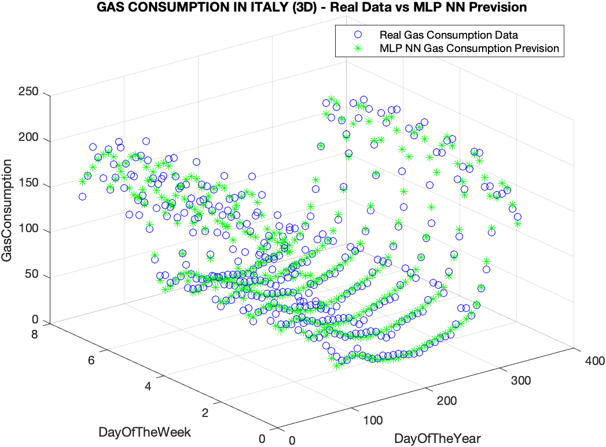
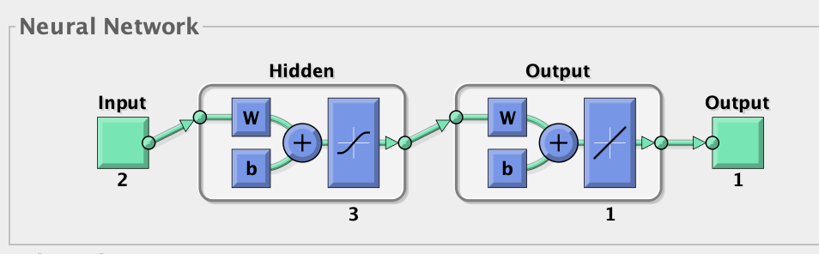
3.2 Neural network
Neural network architecture
Real gas consumption VS nn prediction

Slide 17
3.3 Harmonic regression
This identification method follows the same methodology of the polynomial regression (using harmonics instead of polynomials, according to Fourier series theory).
The division of the data and the initial observations are the same we discussed in polynomial regression (first year data identification, second year cross-validation).
We'll use another time:
SSR, objective/subjective criteria, to compare different identified models;
Cross-validation, to understand which is the best model.
We won’t start using constant model, but first degree harmonic, because gas consumption trend isn’t constant.

Slide 18
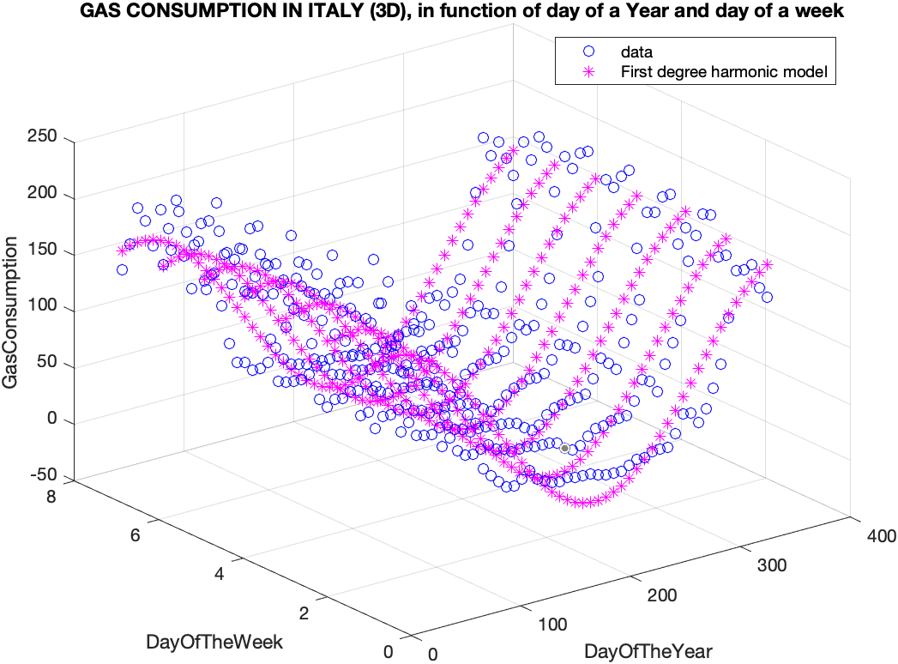
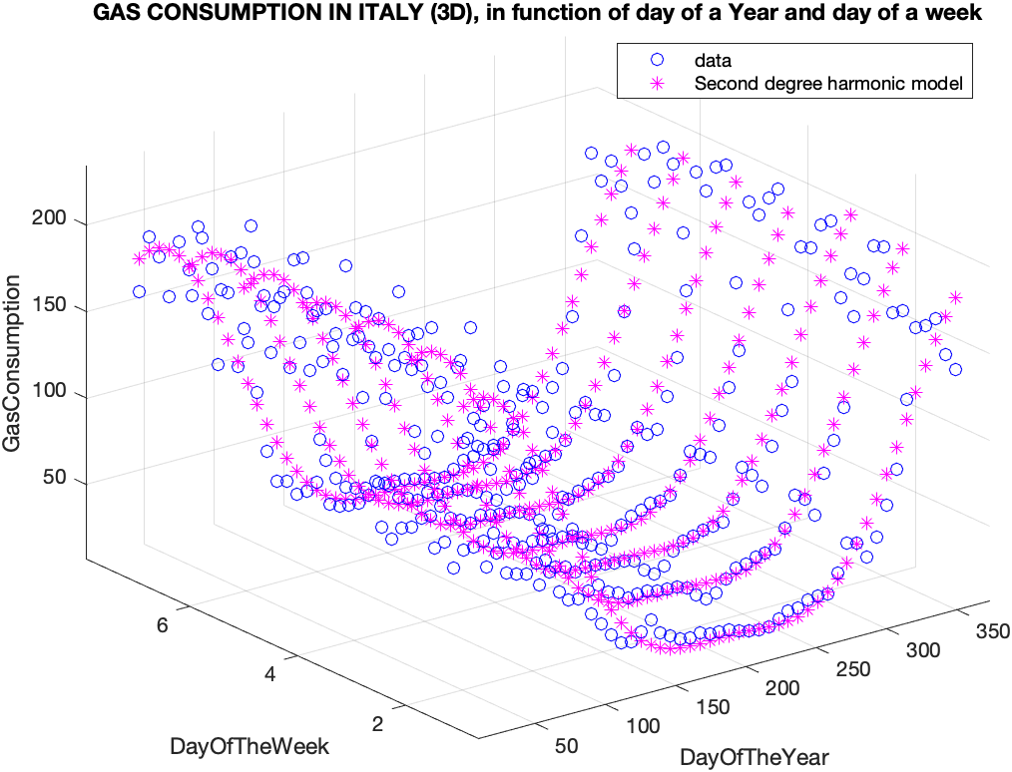
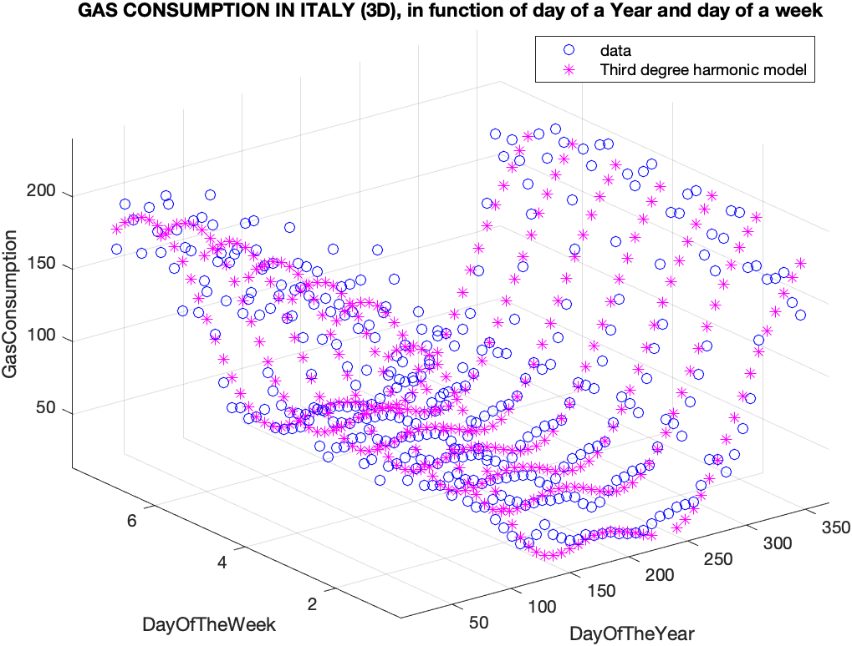
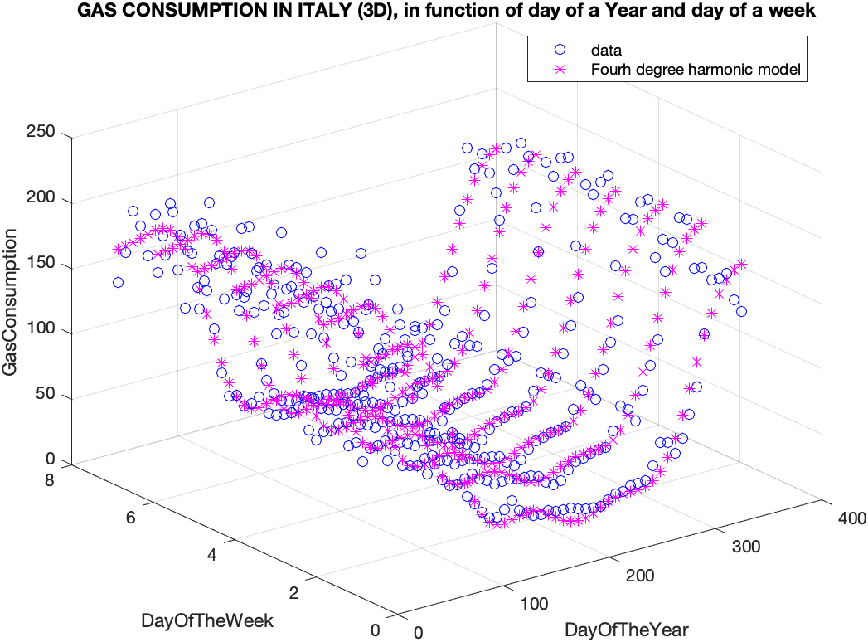
3.3 Harmonic regression
Plot (Different harmonic models)

Slide 19
3.3 Harmonic regression
Harmonic models results, identification
Cross-validation:
Harmonic models results, cross-validation:
Harmonic model degree: SSR_Identification TEST F AIC FPE MDL
1° 2.3475e⁵ / 12.39 2.4127e⁵ 12.45
2° 1.9969e⁵ 62.51 12.25 2.0979⁵ 12.35
3° 1.0416e⁵ 322.8 11.62 1.1185e⁵ 11.76
4° 8.8673e⁴ 60.78 11.49 9.7736e⁴ 11.67
We considered the various polynomial models previously shown and saw which was the one that minimized the SSR (hence also the standard deviation) between validation data and expected data.
Harmonic model degree: SSR_Validation SD
1° 2.8801e⁵ 28.09
2° 1.9169e⁵ 22.91
3° 2.0297e⁵ 23.58
4° 2.1635e⁵ 24.34

Slide 20
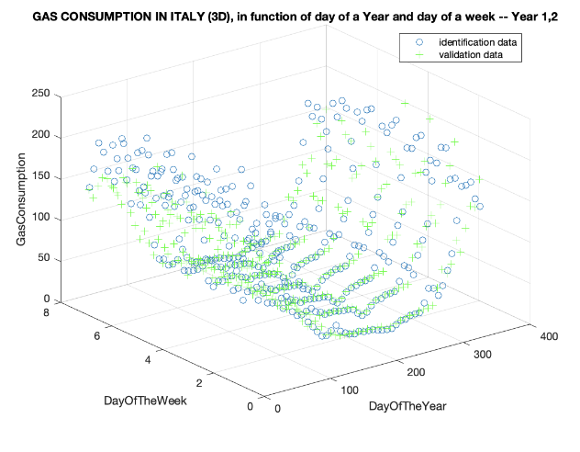
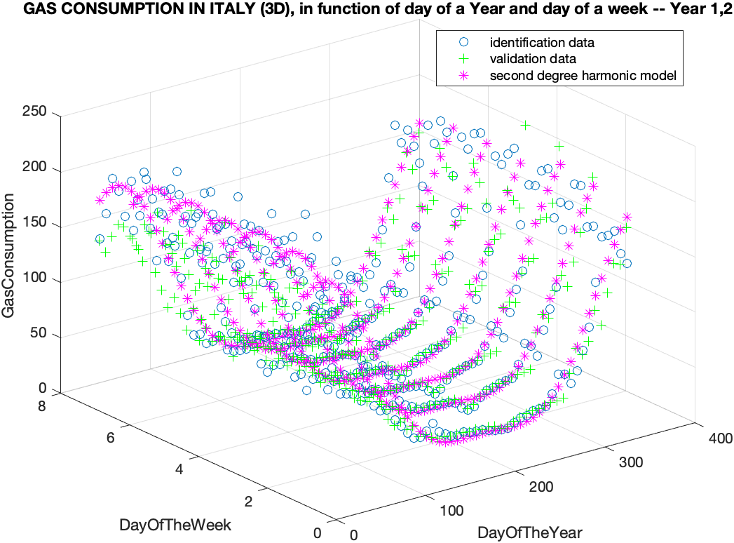
3.3 Harmonic regression
Identification and Validation data
Best model for cross-validation

Slide 21
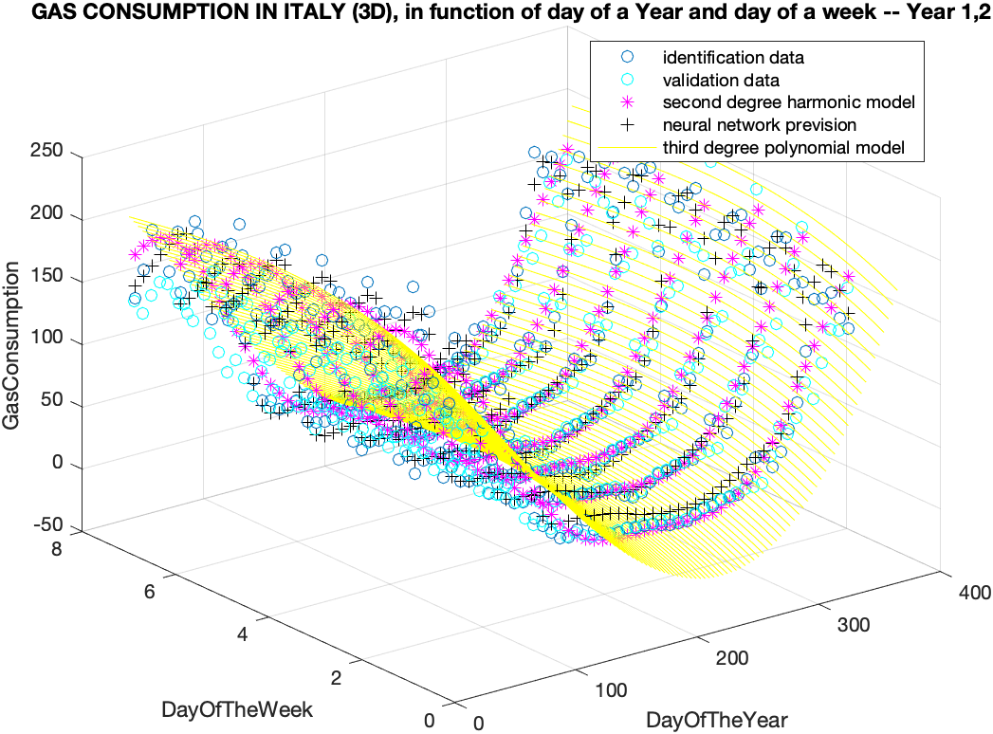
3.4 Compare different models
In order to decide which model is better we compare them using two figures of merit: SSR and standard deviation.
Comparison between different models
Identification Method SSR SD
Polynomial model 1.9883e⁵ 23.37
Neural network 2.4047e⁵ 25.66
Harmonic regression 1.9169e⁵ 22.91

Slide 22
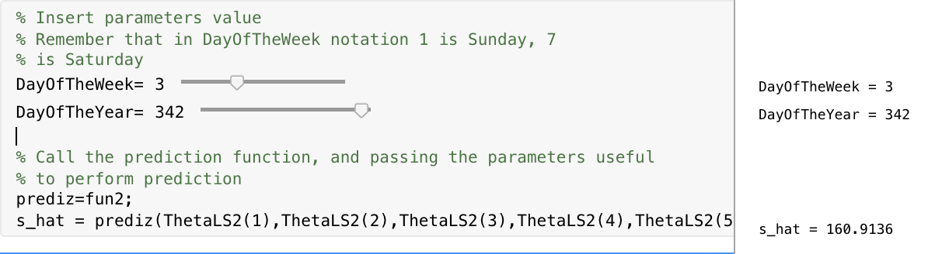
4. Prediction function
Once identified best model for our dataset, in our case the 2nd degree harmonic model, a prediction function which forecasts gas consumption depending on two parameters (days of the week and day of the year) has been written. You can also change manually, via numerical slider, the value of those parameters in order to see how the gas consumption prediction changes.

Slide 23
5. Link to our repository project (GitHub)
Here’s our full project repository: LINK
If you want to see only the live script, here’s the link: LINK

Slide 24
6. Conclusion
Note that the best model was built on the basis of the data in our possession. If you want to predict the gas consumption in an “abnormal situations”, you have to accept that the forecast might be very different from what actually happens.
The identification of models is a really useful “tool”, which allows you to make predictions built on data in possession of any process that you are considering.
Myriad of other applications of this theory.
Important component, among other things, in the "decision making" process.

Slide 25
Thanks for your time !

