Slide 1
BUSINESS INTELLIGENCE CAPSTONE PROJECT
Hospital Operational &
Financial Intelligence
Inpatient Analysis: January 2023 – December 2024
PREPARED BY
ZION TECH HUB COHORT 9.0
DATE
AmatulBaasit Ayomikun Ghazal
Healthcare Analytics
May 2026

Slide 2
PRESENTATION OUTLINE
Problem Understanding
Financial Findings
01
05
What challenges prompted this investigation?
Revenue trends, payment mix & dept performance
About the Data
Business Insights
02
06
Dataset overview, schema & methodology
What the data is really telling us
Operational Findings
Recommendations
03
07
Encounter Volume, ALOS trends, department workload & Top Procedures
7 prioritised actions for leadership
Clinical Findings
Conclusion
04
08
Top diagnoses, prolonged LOS & readmissions
Summary & next steps

Slide 3
PROBLEM UNDERSTANDING
03
A large tertiary hospital is under operational stress. Leadership commissioned a data-driven investigation to identify root causes and provide actionable solutions.
Prolonged Inpatient Stays
Bed Occupancy Pressure
Delayed Patient Turnover
Patients occupying beds longer than clinically expected, delaying incoming admissions and reducing throughput capacity.
Reduced capacity to accommodate new admissions due to slow patient turnover across departments.
Discharge processes misaligned with optimal clinical and operational timelines.
Rising Readmission Rates
Growing Financial Strain
Patients returning within 30 days of discharge — signalling gaps in care transition and post-discharge support.
Revenue not reflecting operational burden, with consistent declining trend despite sustained patient activity.

Slide 4
ABOUT THE DATA
Star Schema — PostgreSQL Database
Analytical Scope
fact_encounters
936,099
Analysis Window:
Central fact table — all hospital visits
Most recent 24 months
(Jan 2023 – Dec 2024)
Encounter Filter:
fact_patients
21,866
Inpatient class only
1,907 valid encounters
Patient demographics & history
LOS Definition:
stop_date – start_date
(non-null discharge dates only)
fact_payers
10
Insurance & payer information
Readmission Definition:
Any inpatient return within
30 days of prior discharge
fact_financial_summary
936,099
Tools Used:
Financial transactions per encounter
PostgreSQL + DBeaver + Tableau
fact_procedures
1,048,575
Procedures performed per encounter

Slide 5
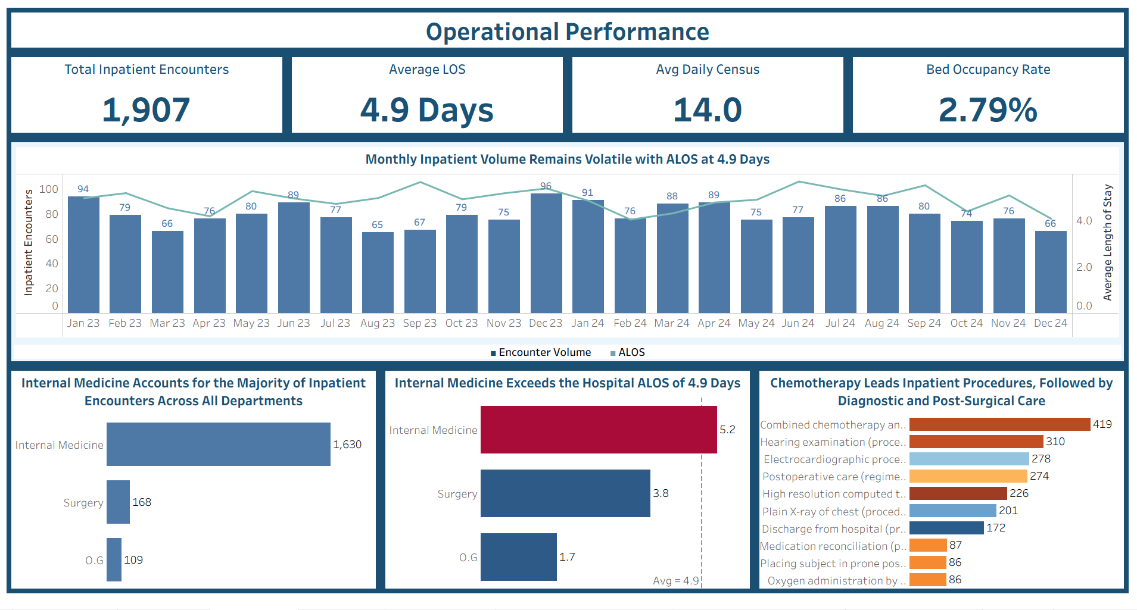
OPERATIONAL DASHBOARD
Encounter Volume, ALOS, Department Workload & Top Procedures

Slide 6
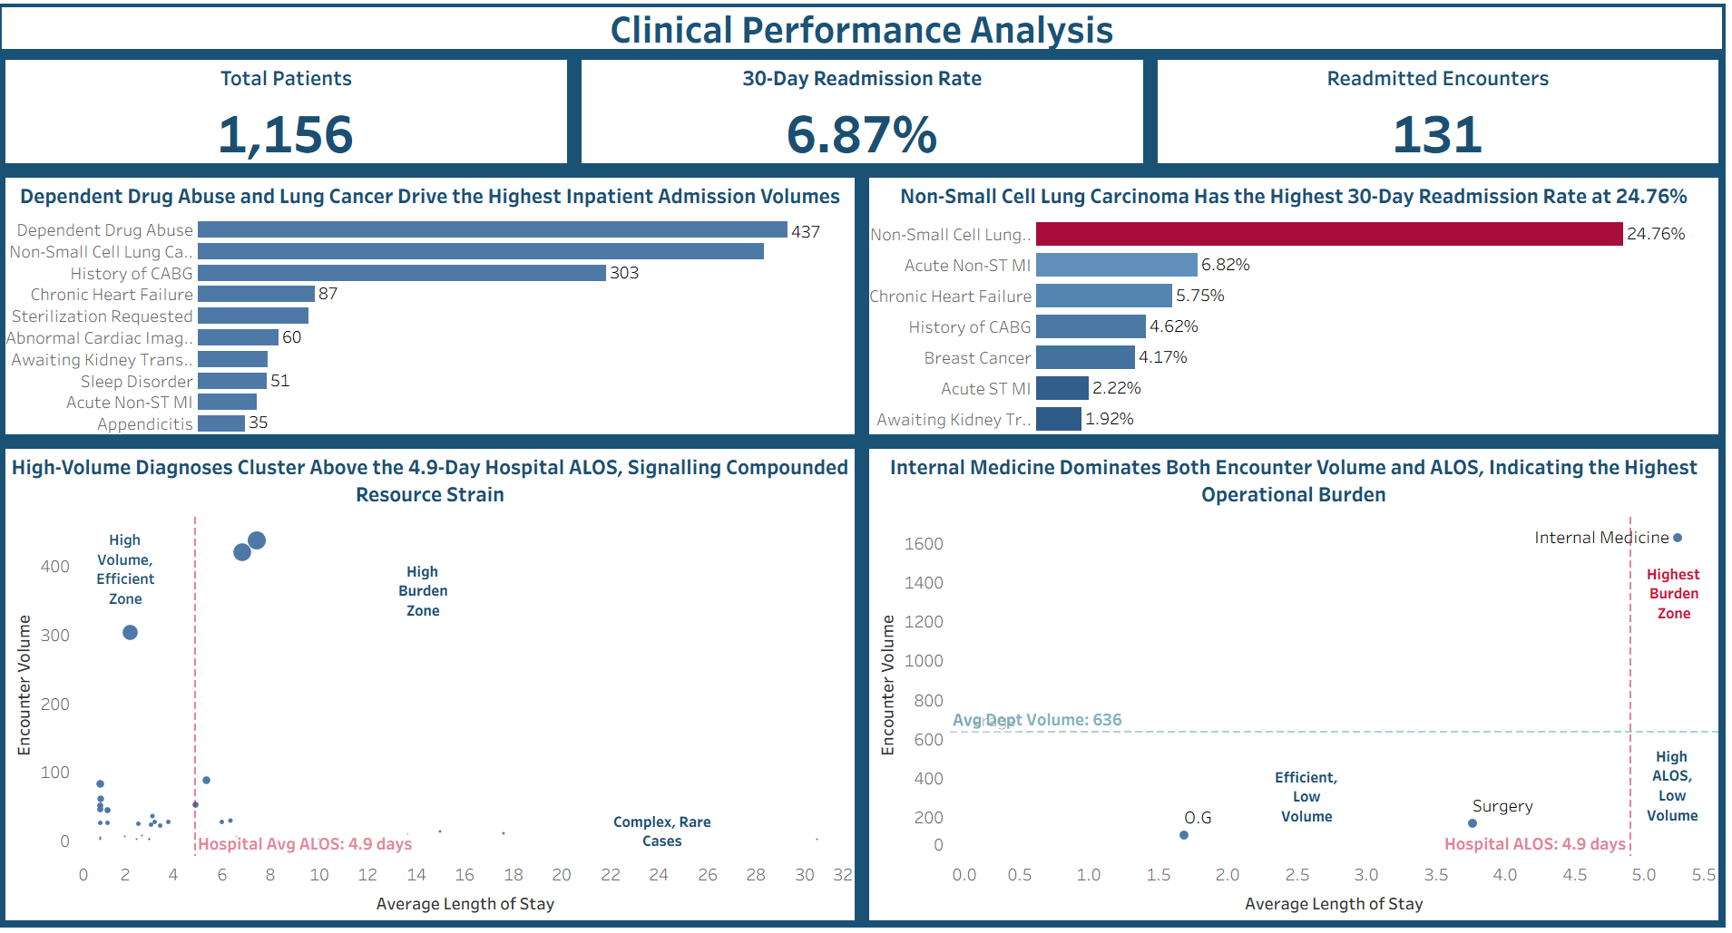
CLINICAL FINDINGS
What diagnoses are driving inpatient activity?

Slide 7
CLINICAL FINDINGS — 30-DAY READMISSIONS ANALYSIS
Which patients are returning within 30 days of discharge?
30-DAY
READMISSION
RATE
Readmission Rate by Diagnosis
6.87%
131 of 1,907 discharges
Readmission Definition:
Any inpatient encounter beginning within 30 days of a prior inpatient discharge for the same patient. Encounters with missing discharge dates were excluded per KPI rules.
Lung Cancer (NSCLC) has a 24.76% readmission rate across 420 encounters, the highest absolute readmission burden.

Slide 8
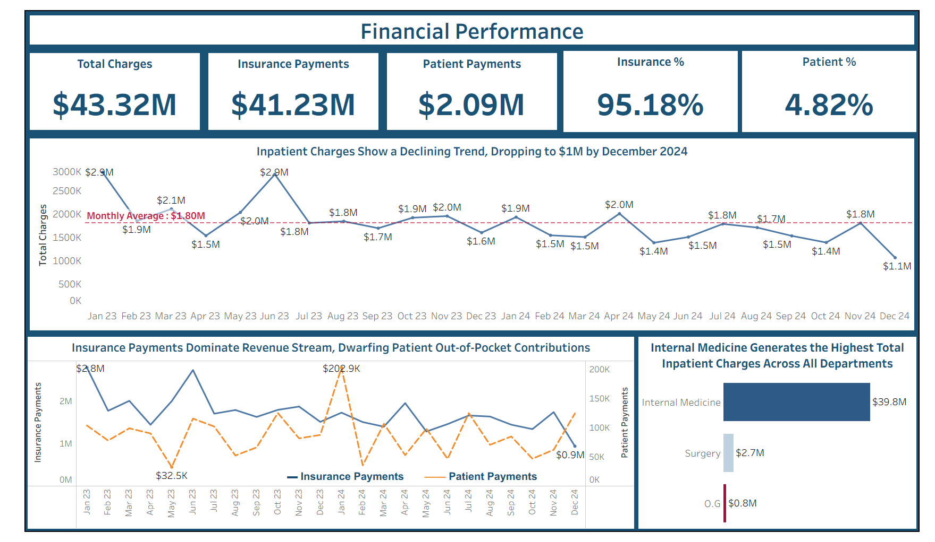
FINANCIAL FINDINGS
Revenue Trends, Payment Mix & Department Financial Performance

Slide 9
BUSINESS INSIGHTS
What the data is really telling hospital leadership
Internal Medicine Is the Operational Epicentre
Financial Performance Is Moving in the Opposite Direction of Operational Effort
01
The hospital's inpatient operations are overly dependent on Internal Medicine, which manages 85.5% of admissions while also exceeding the hospital’s ALOS benchmark.
While the hospital continues to manage a substantial inpatient workload, inpatient charges declined by 62% over the study period.
04
Throughput Inefficiency Is a Bigger Problem Than Demand
02
The hospital is not experiencing significant growth in patient volume, yet bed pressure remains high because patients are staying longer than necessary.
The Organization Faces System-Wide Concentration Risk
Hospital activity is concentrated around:
One department (Internal Medicine)
Two diagnoses (Drug Abuse and Lung Carcinoma)
One revenue source (Insurance)
A Single Diagnosis Is Driving Most Readmissions
05
03
Non-Small Cell Lung Carcinoma accounts for nearly 80% of all hospital readmissions despite representing only 22% of admissions.

Slide 10
RECOMMENDATIONS
8 Prioritised Actions for Hospital Leadership
Establish Internal Medicine Capacity Review Committee
HGH
1
5
Develop a Substance Abuse to Community Care Transition Pathway
HIGH
2
Implement Structured Discharge Planning Protocols
6
Establish Cardiac Readmission Prevention Protocols
HIGH
URGENT
3
Review Oncology Procedure Scheduling (Inpatient vs. Day-Case)
7
Investigate the Root Cause of Declining Inpatient Charges
Implement Lung Carcinoma Post-Discharge Surveillance Programme
4
8
Reduce Insurance Dependency Through Payer Diversification

Slide 11
CONCLUSION & NEXT STEPS
This investigation has surfaced a hospital system operating under concentrated, manageable, and addressable pressure. The findings do not indicate a systemic collapse but rather a set of identifiable bottlenecks that, if left unaddressed, will compound into more serious operational and financial challenges.
Three themes emerge consistently across the operational, clinical, and financial analyses:
• Concentration risk: A single department (Internal Medicine), two diagnoses (Lung Carcinoma and Drug Abuse), and one payer type (insurance) account for the disproportionate share of hospital activity and revenue. This concentration creates vulnerability.
• Throughput inefficiency: Elevated ALOS and high readmission rates in specific diagnoses suggest that patients are not transitioning efficiently through the care pathway, from admission, through treatment, to discharge and community support.
• Financial sustainability concern: The 62% decline in monthly inpatient charges over the analysis period, occurring alongside stable operational burdens, is not consistent with a financially healthy trajectory and requires urgent executive attention.
With the right interventions, this hospital can reduce ALOS and stabilise its financial performance. The data provides clear direction.

Slide 12
THANK YOU

