Slide 1

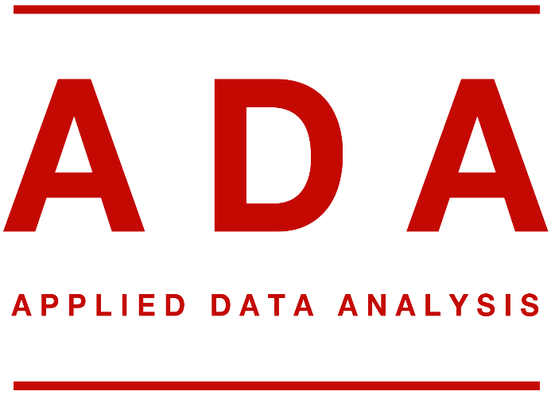
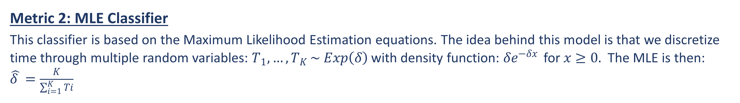
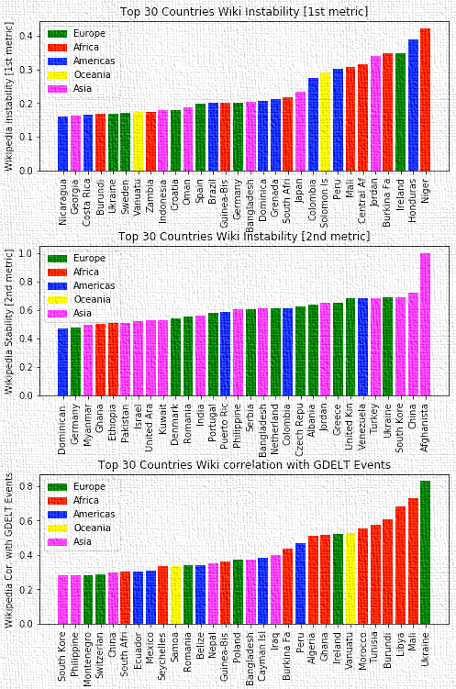
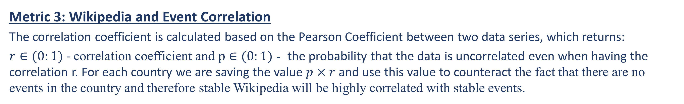
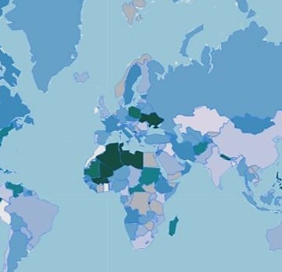
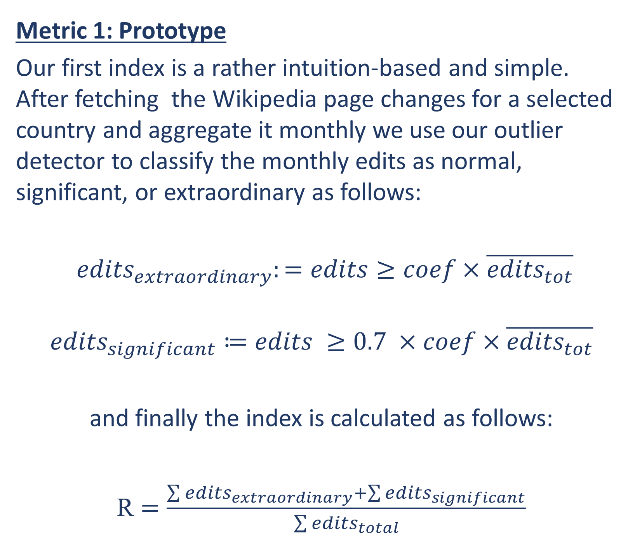
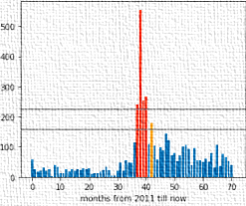

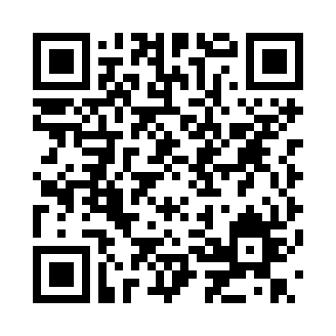
Wikipedia Changes and World Events WikipIndex
George Abi Younes, Amaury Combes, and Patryk Oleniuk
École Polytechnique Fédérale de Lausanne
Introduction
Main Results and Findings
Ever thought of how a country’s instability index is sized? Some people use Fragile States Index, others use Political Stability Indicator. We decided to disregard all of these fancy indicators and create our own using Wikipedia, literally.
We had an intuition towards the fact that the edits happening on a country’s Wikipedia page may contain an adequate amount of information to reflect on the country’s stability. Following that, resorting interchangeably to both Wikipedia and GDELT Event database, we started our journey of creating what we call the WikipIndex.
Figure 3: Wiki Instability [1st Metric] for Top 30 Countries
Methods
Figure 5: Wiki Instability [2nd Metric] for Top 30 Countries
Figure 6: Wiki Instability [3rd Metric] for Top 30 Countries
The above results show the three different metrics in action. We found the 3rd metric which uses the Wikipedia and Events correlation for classification, to be the best among the three, as it was the most consistent and had the least flagrant misclassifications.
Extraordinary
Significant
Figure 2: Final Instability Indicator Overlay on World Map
Figure 1: Metric 1 Outlier Detector in Action on Ukraine Wikipedia Page

