Slide 1
Corporate Research Dossier:
Stripe
Compiled autonomously via GravityAI Multi-Agent System.
Session ID: test-session-123 | Version: v1 | Date: 2026-07-10

Slide 2
Executive Summary & Quality Metrics
Key Findings Overview:
• Description: Not Available...
• Overall Research Quality: 55%
• Overall Confidence rating: 55%
• Source coverage: 5 Official | 9 Public Sources

Slide 3
Company Profile & Sitemap details
Company Overview for Stripe:
• HQ Location: Not Available
• Founded Year: None
• Key Leadership:
• Sitemap crawled: No

Slide 4
Business Model & Segments
Strategic business model parameters:
• Pricing Model: Pay-as-you-go transactional pricing (e.g. 2.9% + 30c)
• Revenue Streams: ['Transaction Fees', 'SaaS Subscriptions']
• Customer Segments: ['E-commerce Merchants', 'B2B SaaS Platforms']

Slide 5
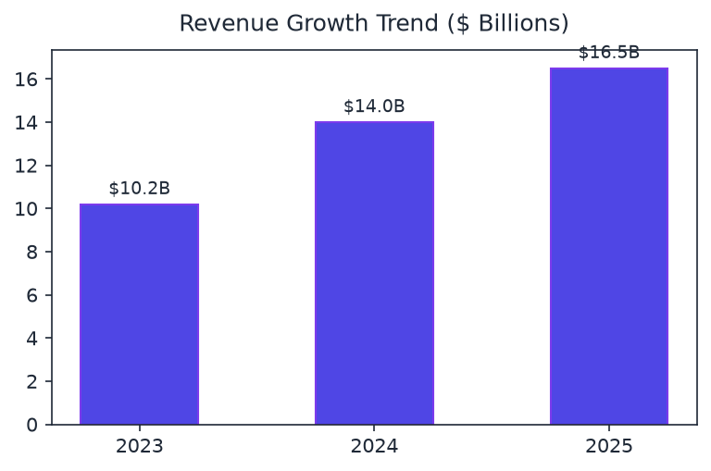
Financial Highlights & Revenue Growth
Corporate Valuation: $65 Billion
Revenue Trends: ['$10.2B (2023)', '$14.0B (2024)', '$16.5B (2025)']
Funding: ['Series H ($6.5B)', 'Secondary Sale ($1.0B)']

Slide 6
Technology Stack Profile
Identified technologies:
• Frontend: ['React', 'Next.js', 'TailwindCSS']
• Backend & Servers: ['Node.js', 'Go', 'Python (FastAPI)']
• Cloud Providers: ['Amazon Web Services (AWS)', 'Google Cloud Platform (GCP)']
• Databases: ['PostgreSQL', 'Redis', 'MongoDB']

Slide 7
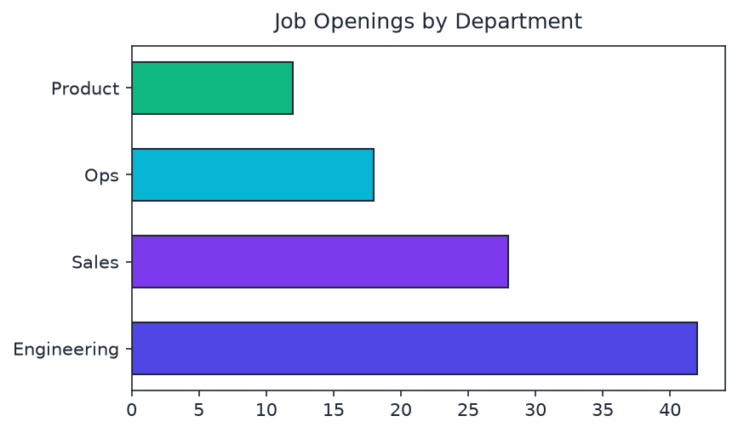
Hiring Trajectory & Open Positions
Hiring Velocity: Moderate hiring velocity. Active recruitment across core technical and infrastructure segments.
Open Roles: ['Staff Software Engineer (APIs)', 'Solutions Architect', 'Technical Program Manager']
Growing Areas: ['Engineering', 'Sales & Solutions', 'Operations']

Slide 8
Competitor Landscape Matrix
Positioning: Competes in global sector.
Competitor | Market Share | Advantages
Adyen | General Competitor | Alternative peer solution.
PayPal | General Competitor | Alternative peer solution.
Checkout.com | General Competitor | Alternative peer solution.

Slide 9
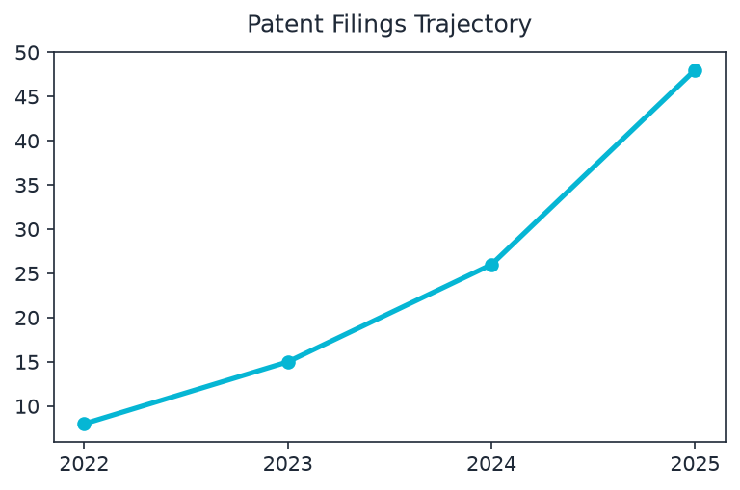
Patent Filings & Innovation
Patent Count: 48
Filing Trend: ['Accelerating filings in tokenization security (2023-2025)', 'Stable growth in database routing algorithms']
Themes: ['Distributed Transaction Processing', 'Tokenized Fraud Detection', 'Mobile API Security']

Slide 10
SWOT Matrix Evaluation
SWOT Highlights:
• Strengths: Strong industry footprint, Good product diversification
• Weaknesses: Geographic concentration
• Opportunities: Leverage semantic search models
• Threats: Evolving regulatory landscapes

Slide 11
Strategic Recommendations
Actionable corporate guidance items:
• Recommendation 1: Investigate alternative distribution API pipelines.

Slide 12
Thank You
GravityAI Enterprise Research Operating System
For inquiries contact research@gravityai.com

