Slide 1
NoSQL and Relational in the Modern Data Architecture

Slide 2
What We’ll Cover
CAP
ACID
NoSQL 101
Comparison to relational
Not Only SQL
Terminology
Categories
What they are
Why you use them
When you use them
A little of how to use them
BASE
Cloud
BIG
SCHEMA
Scale

Slide 3
Agenda
Intro
Hadoop
Column Families
Document Stores
Streaming
Search

Slide 4
4 Questions
Notes:
We collect and manage data for a reason. We want to answer questions. We find that almost all questions fall fit into four categories of questions.

Slide 5

What Happened?
Notes:
The first category of questions is “What Happened?” These are month-over-month, year-over-year, period-over-period types of questions. In the world of data platforms, we would consider these answers in the data warehouse.
The new world of data has presented new challenges and new opportunities. <click for build> We recognize that the Enterprise Data Warehouse – a single data warehouse to store all data – doesn’t exist. We have many data warehouses, data exists in other forms, some data sits on systems outside our organizations. In addition, new forms of data storage have been showing up - Hadoop.
We need to look across these systems

Slide 6


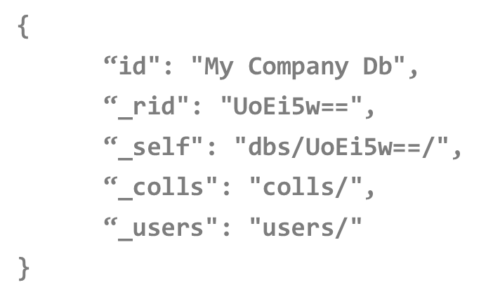



What’s Happening?

Slide 7

Why ?

Slide 8

What Will Happen?

Slide 9
The And
Polyglot persistence
Not all new
EAV
XML
Architecture paradigm: OLAP/DW and OLTP
Optimized for data
Optimized for workload

Slide 10
The Why
Polyschematic
Multiple schemas over the same data
Schema on read, not on write
Data integrity may be managed elsewhere
* ALL DATA HAS STRUCTURE!
** EMBRACE DENORMALIZATION

Slide 11
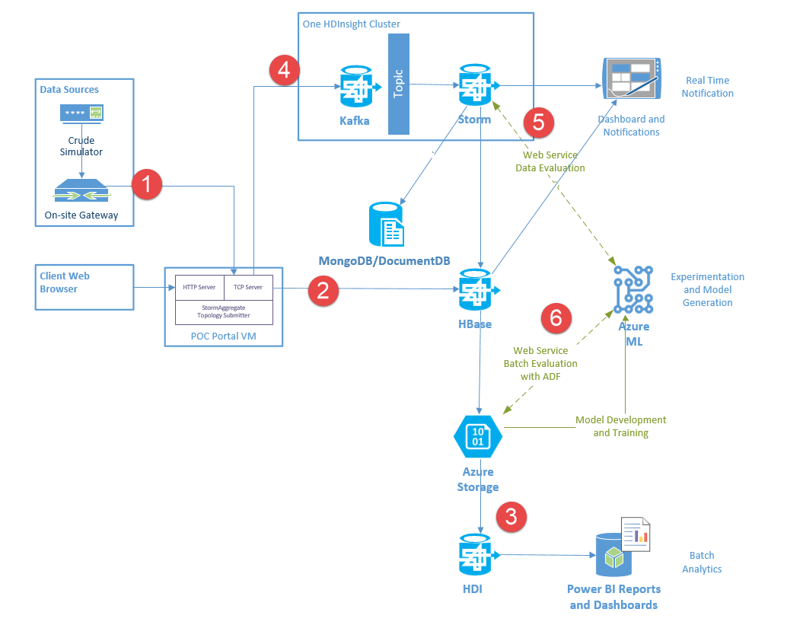

Slide 12

Kinect Telemetry Retail Application
Price Check
Key-Value
Product Catalog
Document Store
Sensor Data
Column Family
Reporting/Analysis
Hadoop Batch Processing
{ }

Slide 13
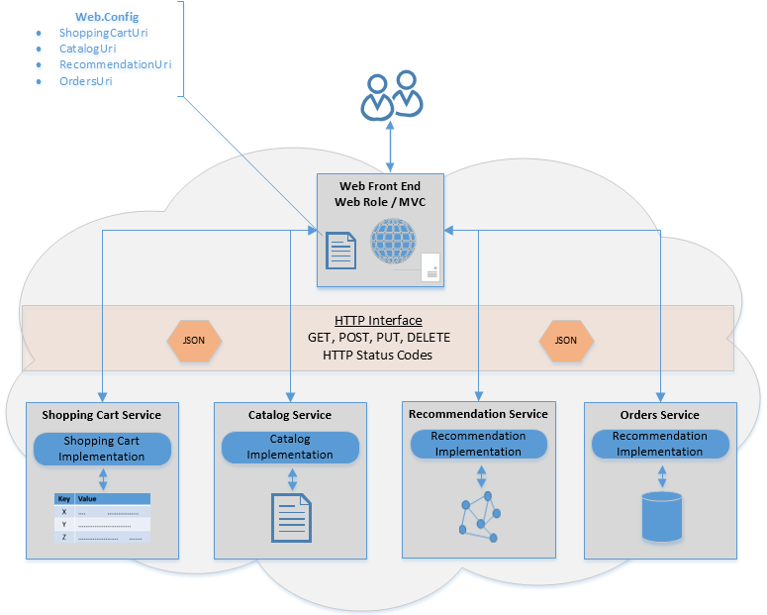
Polyglot Persistence Pattern
Cloud Ninja Polyglot Persistence Sample Application

Slide 14
Data-Intensive Applications in the Cloud Computing World

Slide 15




Event producers
Collection
Event Queuing System
Transformation
Long-term storage
Presentation and action
Apache Storm on HDInsight
Kafka /
RabbitMQ /
ActiveMQ
HBase
Web/thick client dashboards
Applications
HDFS
Azure DBs
Event Hubs
Azure Stream Analytics
Search and query
Cloud gateways (web APIs)
Stream processing
Devices
Azure storage
Live Dashboards
Data analytics (Excel)
Sensors
Field gateways
Storage adapters
Web and Social
Devices to take action
Notes:
Hadoop suits multiple data platform needs in a variety of workloads. In a canonical IoT scenario you will find Hadoop supporting streaming, realtime, and batch oriented workloads. Microsoft Azure will support all these workloads from a 1st party (Microsoft developed) service, as well as 3rd party (Partner developed) solutions.

Slide 17
Terminology Time
ACID
Cloud
CAP
BASE
SCHEMA
POLYGLOT
Consistency

Slide 18
Distributed Systems and the CAP Theorem
Consistency
Relational, Un-partitioned
Availability
Big Table-like:
HBase, MongoDB
Dynamo-like:
Cassandra, CouchDB
Eric Brewer’s CAP Theorem and even better
CAP Twelve Years Later
and even better yet
Myth: Eric Brewer On Why Banks Are BASE Not ACID - Availability Is Revenue
Partition Tolerant
Notes:
Drop Partition Tolerance
Put it on one machine and you are fine…. Except this imposes scale limitations.
Drop Availability
Just wait for the data to be consistent on all nodes in the cluster. No services may access nodes in the cluster until it is consistent.
Drop Consistency
Wait for things to be eventually consistent. Can you get “close enough” or feed stale data? Hm…

Slide 19
BASE - ACID
BASE
ACID
Basically Available
Soft State
Eventually Consistent
Atomic
Consistent
Isolated
Durable
Notes:
Atomic: Everything in a transaction succeeds or the entire transaction is rolled back.
Consistent: A transaction cannot leave the database in an inconsistent state.
Isolated: Transactions cannot interfere with each other.
Durable: Completed transactions persist, even when servers restart etc.

Slide 20
__aaS - Services
PaaS
IaaS
SaaS
Platform
Infrastructure
Service

Slide 21






How do we think about the different services?
SQL Server in a VM
SQL Database
DocumentDB
HBase
Tables/Blobs
fully featured RDBMS
rich query
transactional processing
managed as a service
elastic scale
schema-free data model
internet accessible http/rest
arbitrary data formats
Notes:
Presenter guidance:
Introduce the family portrait.
Slide talk track:
This is how we think about the core differences across the data services for capturing and managing data
On the left, you have more database imposed structure on the left and this loosens as you move to the right, ending in blobs which is just large containers of binary data.

Slide 22
Agenda
Intro
Hadoop
Column Families
Document Stores
Streaming
Search

Slide 23
HOL1 Explore the Portal(s)

Slide 24
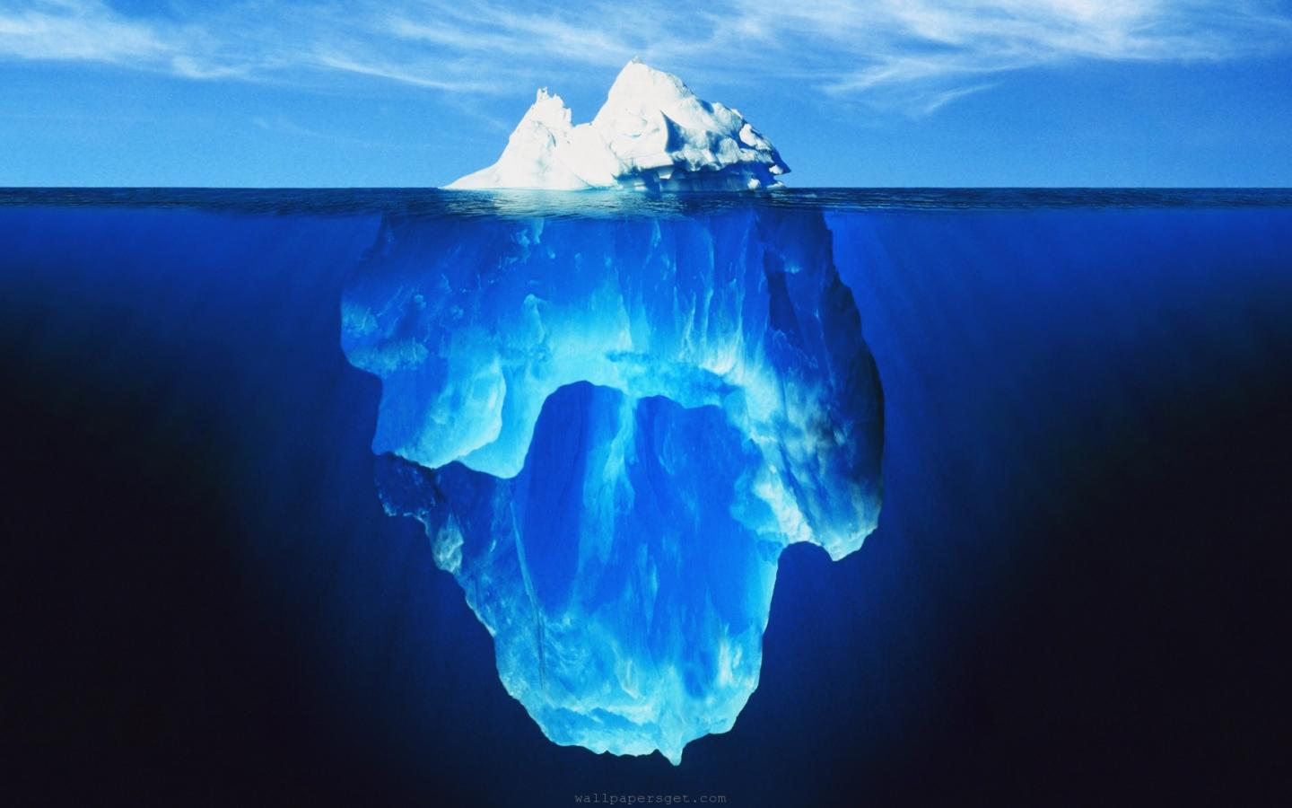
20%
Structured Data
80%
Unstructured Data
Big Data is about building new analytic applications
based on new types of data, in order to better serve your customers and drive a better competitive advantage
David McJannet, Hortonworks
http://www.informationweek.com/big-data/news/big-data-analytics/big-data-a-practical-definition/240160412#disqus_thread
Notes:
So – for the purposes of this presentation – let me set the context for what is meant by Big Data. When we refer to Big Data we are referring to data sets that have the following characteristics or attributes:
1. Large Data Volume (Size) >10TB
2. High Data Velocity (Growth) >25% YoY
3. Wide Data Variety (Form) >15% Unstructured Data (Text, E-Mail) Weblogs, Video, Images, Sound,
We traditionally look at Data through two lenses – traditional structured data – which accounts for 20% of all data and is what enterprises historically focused on – and unstructured data - which accounts for appx. 80% of all data, but nobody much cared about until recently – it’s often referred to as dark data and sits beneath the surface. Again – historically we did not have the tools to do much with unstructured data – so it was just noise.

