Slide 1
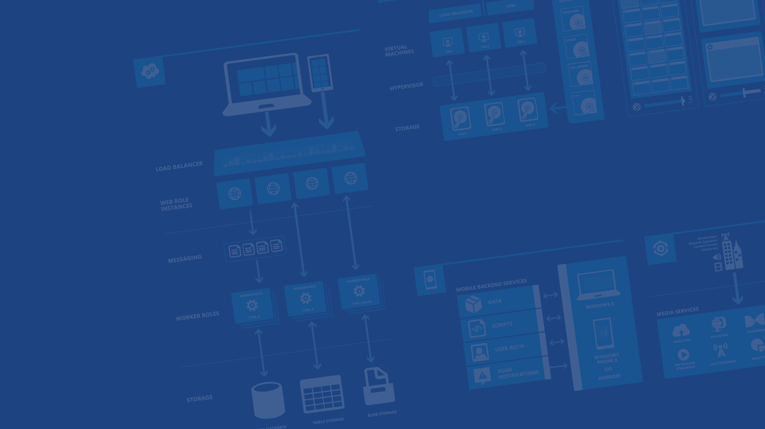
Building Cloud Solutions
Presenter Name
Position or role
Microsoft Azure

Slide 2
Agenda
→ Your services and Azure
→ Design for Cloud
→ Cloud Services
Notes:
Slide Objectives:
Explain the agenda of the session.
Speaker Notes:
Explain this presentation is a high-level overview, so not everything is covered in-depth.

Slide 3
Your service

Slide 4
→ Your application code
→ Your infrastructure code
→ Required resources

Slide 5
Automation
Innovation
Reduced cycle time
Elasticity
Versioning environments
Continuous Deployment
Speed to market
Feedback loop
Agility
Continuous
Improvements
QoS
Availability
Insights
Growth
TCO

Slide 6
You: Code (application, infrastructure)
Azure: Resources (IaaS, PaaS, SaaS)

Slide 7
Demo: code + resources
Deploying a Website to Azure
Notes:
Demo: Getting Started
Go to the portal
Create a new mobile service (Node backend works with most of deck)
Walk through Getting started screen
Choose platform
Download quick start
Run quick start
Save and update data
Show data in portal (Node)
Walk through client code that deals with Mobile Service

Slide 8
Cloud Services

Slide 9
Cloud Services
→ Focus on your application
→ Scalability, availability and reliability
→ Monitoring and diagnostics
Notes:
Slide Objectives:
Explain the agenda of the session.
Speaker Notes:
Explain this presentation is a high-level overview, so not everything is covered in-depth.

Slide 10
What is a Cloud Service?
A container of related service roles
Web Roles Worker Roles VMs
Notes:
Note: VM is separated out as IaaS offering.

Slide 11
How do roles communicate?
Public endpoints
Publicly accessible, load balanced
Internal endpoints
Private to cloud service, not load balanced
Instance Input endpoints
Address individual instance
Microsoft Azure

Slide 12
Web Role
All features of a worker role + IIS 7, 7.5 or IIS 8.0*
ASP.NET 3.5 SP1, 4.0 or 4.5* – 64bit
Hosts
Webforms or MVC
FastCGI applications (e.g. PHP)
Multiple Websites
Http(s)
Web/Worker Hybrid
Can optionally implement RoleEntryPoint *with Windows Server 2012
Notes:
Slide Objective
Understand how a Web Role extends the standard worker role
Speaker Notes
A web role takes all the capabilities and semantics of a worker role and adds the IIS Hostable Web Core
Web Roles run ASP.NET websites- they do this by using the IIS hostage web core.
pretty much anything that will work in a standard IIS ASP.NET Web Site should work in Windows Azure. At MIX09, we additionally added support for IIS7’s FastCGI capability. As a note, any files that are part of a asp.net project on windows azure are READ ONLY! If you need to be able to change the contents of files:
User Blob Storage
If its configuration, use the service model files – which can be changed at runtime.
Inbound protocols are http(s) – outbound protocols are any TCP connection but NOT UDP.
Notes
http://msdn.microsoft.com/en-us/library/dd179341.aspx
http://blogs.msdn.com/b/carlosag/archive/2008/04/14/hostyourownwebserverusingiis7.aspx
http://blogs.iis.net/ksingla/archive/2007/12/20/ins-amp-outs-of-hostable-web-core.aspx

Slide 13
Worker Role Patterns
Queue Polling Worker
Poll and Pop Messages within while(true) loop
E.g. Map/Reduce pattern, background image processing
Listening Worker Role
Create TcpListener or WCF Service Host
E.g. Run a .NET SMTP server or WCF Service
External Process Worker Role
OnStart or Run method executes Process.Start()
Startup Task installs or executes background/foreground process
Custom Role Entry Point (executable or .Net assembly)
E.g. Run a database server, web server, distributed cache
Notes:
Slide Objective
Understand the 3 common patterns of worker roles
Speaker Notes
Pattern 1 – Polling
Worker role polls a Queue
Pops message
Performs work
Polls queue again
Pattern 2
Worker listens for inbound TCP request Can implement with Raw TcpListeners or use WCF or use Hosted Web Core
Pattern 3
Run a 3rd party process When the role starts up or runs use a Process.Start() call to run a standard windows executable
E.g. Running a database server
Notes
http://blog.smarx.com/posts/build-your-own-web-role-running-hosted-web-core-in-windows-azure
http://blog.smarx.com/posts/making-songs-swing-with-windows-azure-python-and-the-echo-nest-api

Slide 14
Role Programming Model
Inherits RoleEntryPoint
OnStart() Method
Called by Fabric on startup, allows you to perform initialization tasks. Reports Busy status to load balancer until you return true.
Run() Method
Main logic is here – can do anything, typically infinite loop. Should never exit.
OnStop() Method
Called when role is to be shutdown, graceful exit.
30 Seconds to tidy up.
Notes:
Slide Objective
Understand the role programming model in overview
Speaker Notes
A role is similar to a windows service. It gets started once deployed, and will get stopped when required.
It could get stopped because
we are re-deploying you to a different server
You actioned the stop from the web-portal
It’s up to you to keep running and NEVER return from Start() unless you have been told to stop. Note: you do not need to handle the stop – you can simply “fail”
Notes
http://msdn.microsoft.com/en-us/library/ee848065.aspx
http://blogs.msdn.com/b/jnak/archive/2010/02/11/windows-azure-roleentrypoint-method-call-order.aspxes

Slide 15
Role Lifecycle
All roles may extend RoleEntryPoint
Roles report status via RoleEnvironment
Methods
Events
Status
Fabric Calls
OnStart
StatusCheck
Busy
Requests Routed
Run
StatusCheck
Ready
Role Lifetime
OnStop
StatusCheck
Busy
Stopping
Notes:
Slide Objective
Understand the lifecycle of a Windows Azure role
Understand the methods that can be overridden in RoleEntryPoint
Understand the events that are raised by role instances when their status is changing
Speaker Notes
Roles will typically extend RoleEntryPoint
The fabric calls RoleEntryPoint methods as it starts and stops a role
WaWorkerHost process is started.
Worker Role assembly is loaded and surfed for a class that derives from RoleEntryPoint. This class is instantiated.
RoleEntryPoint.OnStart() is called.
RoleEntryPoint.Run() is called.
If the RoleEntryPoint.Run() method exits, the RoleEntryPoint.OnStop() method is called .
WaWorkerHost process is stopped. The role will recycle and startup again.
As a role changes state it will raise the StatusCheck event.
A status of Busy will mean the load balancer will not route requests to the instance.
Note
http://blogs.msdn.com/b/jnak/archive/2010/02/11/windows-azure-roleentrypoint-method-call-order.aspx
http://msdn.microsoft.com/en-us/library/ee848065.aspx

Slide 16
Roles and Instances
Roles are defined in a Hosted Service
A role definition specifies:
VM size
Communication Endpoints
Local storage resources
etc.
At runtime each Role will execute on one or more instances
A role instance is a set of code, configuration, and local data, deployed in a dedicated VM
Notes:
Slide Objective
Understand the difference between Roles and Instances
Speaker Notes
The Service model defines the shape of a service-
the Roles it will have
endpoints it will listen on
Types of VMs that will be run
At runtime each Role will run at a given scale
Specifically each role will be deployed onto and executed on one or more VMs
A VM runs a single role
Notes
Notes on the various security roles involved in running a Windows Azure account
http://blog.toddysm.com/2010/01/subscription-and-service-administration-in-windows-azure.html

Slide 17
Roles and Instances
Hosted Service
Web Role
Worker Role
VM₁
VM₂
VM₃
VM₄
VM₁
VM₂
VM₃
VM₄
VM₅
VM₆
VM₇
VM₈
VM₅
VM_{n}
…
VM₉
VM_{n}
…

Slide 18
Demo: Cloud Service
TBD
Notes:
Demo: Getting Started
Go to the portal
Create a new mobile service (Node backend works with most of deck)
Walk through Getting started screen
Choose platform
Download quick start
Run quick start
Save and update data
Show data in portal (Node)
Walk through client code that deals with Mobile Service

Slide 19
Design for Cloud

Slide 20




Thanks!
We are done now.

Slide 21

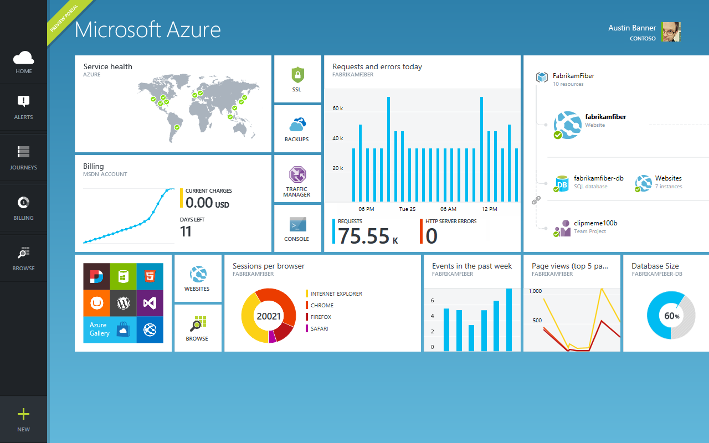
Get started
Visit azure.microsoft.com

