Slide 1
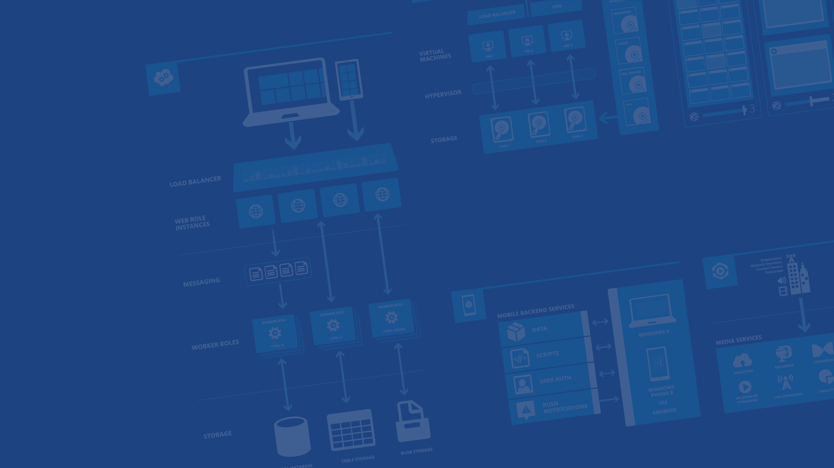
Azure Websites
Presenter Name
Position or role
Microsoft Azure

Slide 2
Agenda
Site creation
Language Support
Deployment
Source Control Integration
Scale
Web Jobs
Site Slots
Traffic Manager
Backup
Hybrid Connections
Redis Cache

Slide 3
Fastest way to build for the cloud

Slide 4
The three ways to host your applications on the Microsoft Azure Platform
Infrastructure as a Service
IaaS
Platform as a Service
PaaS
Notes:
Making the point that Virtual Machines is IaaS while both CloudServices and Websites are PaaS.

Slide 5
Demo
Azure Website Creation

Slide 6

Develop apps with…
.NET
Python
Node.js
Java
PHP

Slide 7
Demo
Language Support
Notes:
FTP files (ASP, Node, PHP, etc.) to new website created in demo 1

Slide 8
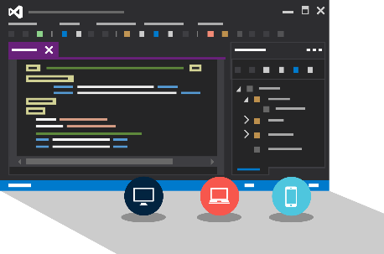
Visual Studio + Azure Websites
Create Azure Resources during File / New
Create Azure Website during deploy
Manage with Server Explorer

Slide 9
Demo
Visual Studio Support
Notes:
File / New Web Application
Show Host In The Cloud dialog
Select Empty web site (for quick create)
Right-click project, select Publish
Show Azure Website creation
Cancel publish
Show Azure Websites in Server Explorer
Right-click one Website and show settings

Slide 10

Source Control
Git
Visual Studio
Online
CodePlex
GitHub
BitBucket
DropBox
FTP
Choose your own adventure!
Notes:
Slide Objectives:
Objective #1
Transition:
Transition statement(s) to setup the slide
Speaking Points:
Speaking Point #1
Speaking Point #2
Notes:
Any notes go here

Slide 11
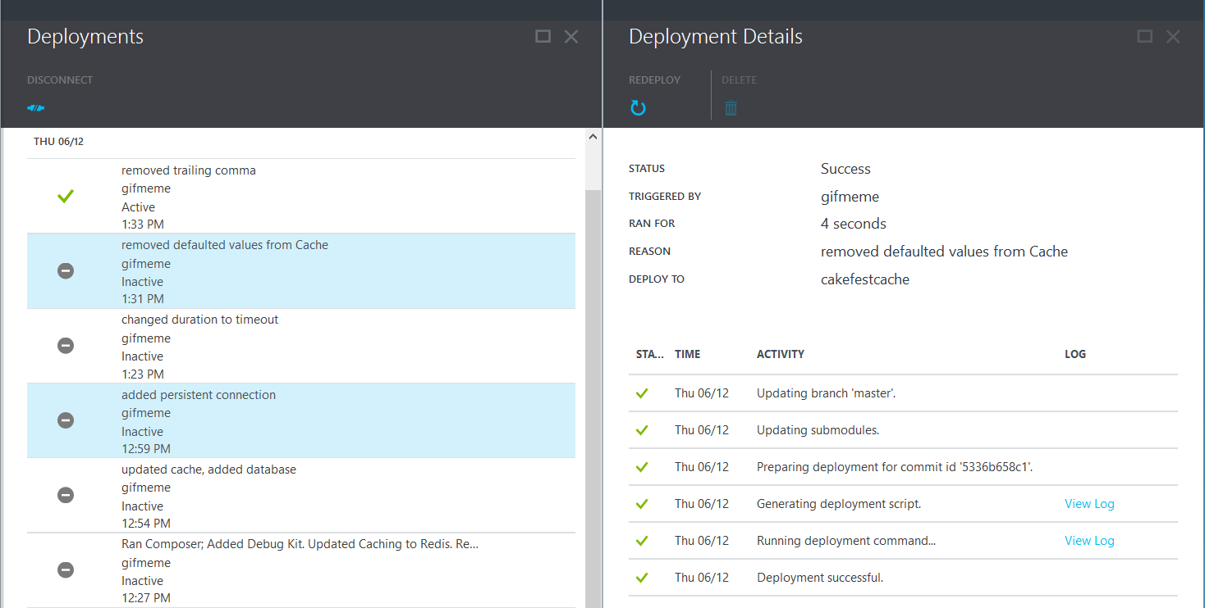
Deployments

Slide 12
Scale

Slide 13
Manual Scaling
Instance Count
1
6
Instances

Slide 14
AutoScale

Slide 15
AutoScale

Slide 16
AutoScale

Slide 17
Auto-Scaling (Metric)
Instance Count
2
6
Instances
[Metric]
60
80
Percent
CPU Percentage | Memory Percentage | Disk Queue Length | HTTP Queue Length | Data In | Data Out

Slide 18
Demo
Manual Scale
Auto Scale

Slide 19
Only Scales the Web Tier
Scale Up/Down is not instantaneous
Auto-Scale Considerations

Slide 20
Deployment Slots

Slide 21
Staging

Slide 22
Staging

Slide 23
Staging

Slide 24
Staging

Slide 25
Testing in Production

Slide 26
Demo
Testing in production

Slide 27
Web Jobs

Slide 28
WebJobs

Slide 29
WebJobs

Slide 30
Demo
WebJobs fundamentals

Slide 31
Demo
WebJobs in real scenarios #1: File Copy

Slide 32
Demo
WebJobs in real scenarios #2: Faster ASP.NET

Slide 33
Traffic Manager

Slide 34
14 regions worldwide in 2014
Azure
Websites footprint

Slide 35
Intelligent customer routing with Traffic Manager
www.yourapp.com

Slide 36
Intelligent customer routing with Traffic Manager
www.yourapp.com

Slide 37
Backup

Slide 38
Backups
Websites Files
Websites Settings Manifest
Database (Optional)

Slide 39
Hybrid Connections

Slide 40



Hybrid Connections
Corporate Network
Microsoft SQL Server
Web Sites
Hybrid Connection Manager
Other published resources
Hybrid Connection
Mobile Services

Slide 41
Redis Cache

Slide 42

Redis Cache Service
Full Functionality Redis Cache Cluster
Master/Slave Configuration
Up to 26GB
SSL Supported

Slide 43
Demo
Redis Cache

Slide 44
Stateless
Notes:
https://coderead.wordpress.com/2011/09/12/sticky-sessions-and-windows-azure
Although it is possible to use Sticky Sessions in Azure it’s not a great fit for cloud architecture, for these reasons:
1) When you provision new instances, only new sessions will be routed to them. Depending on your load balancing logic, new sessions may also still be provisioned on the old instances. This results in it taking a long time (depending on the average length of your session) for load to be evenly distributed across your instances.
2) Cloud solutions should be designed to fail. One of your instances may be removed at any time for patching, or hardware failure. With a sticky session scenario, the clients with a session on this instance will probably have to log in again, or may see an error page, depending on your load balancing logic.
3) Unless your load balancer shares state in some way, it’s likely that you’re load balancing with a single instance (single point of failure) and not eligible for the Microsoft SLA.

Slide 45
Demo
Redis Cache for ASP Session state
Notes:
http://azure.microsoft.com/en-us/documentation/articles/web-sites-dotnet-session-state-caching

Slide 46
Application Insights

Slide 47
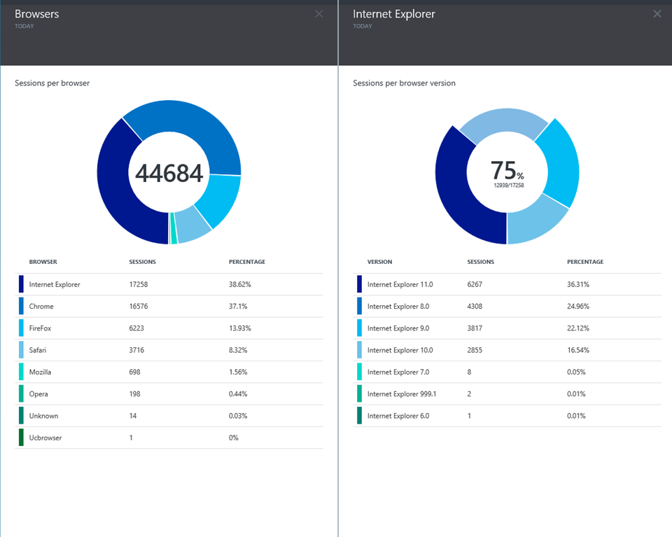
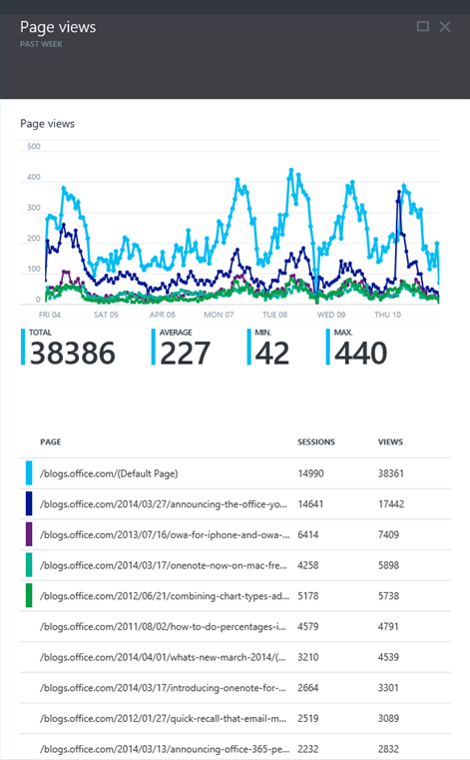
Application Insights

Slide 49

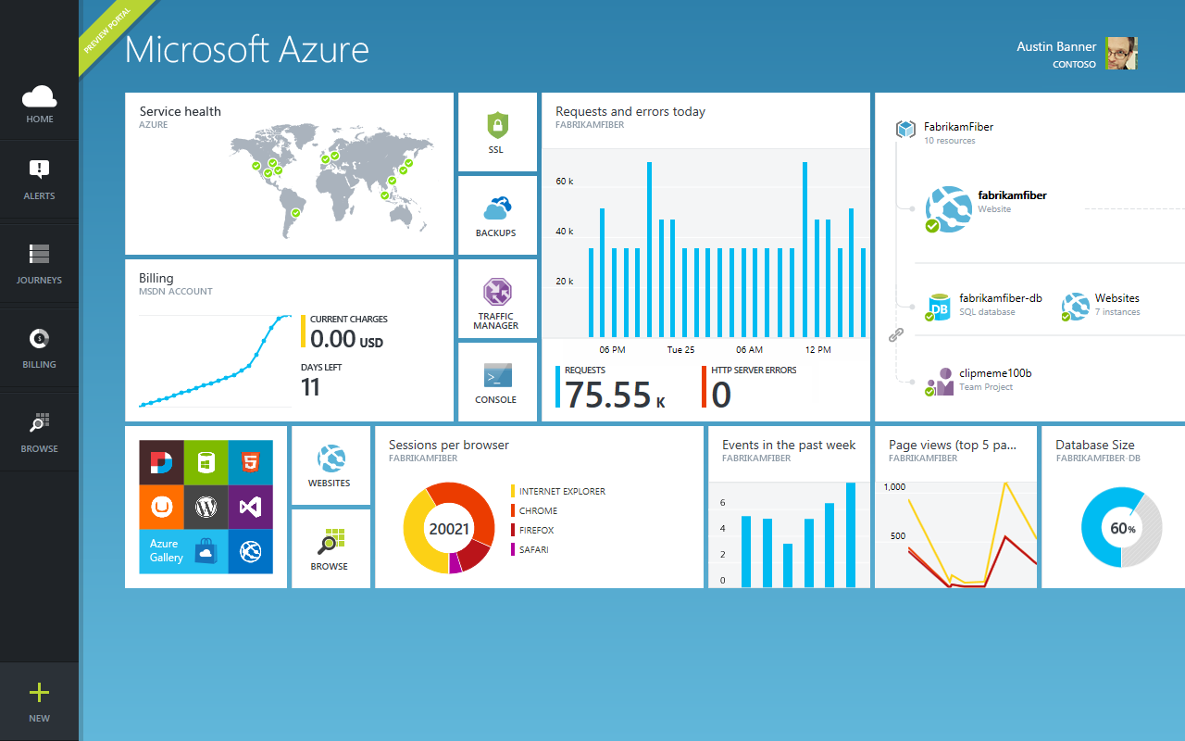
Get started
Visit azure.microsoft.com

Slide 50
Web Sites Service Architecture
Deployment
Server(s)
File Server
Publish Endpoint
Blob Storage
Application Database
Frontend (IIS ARR)
Microsoft Azure
Load Balancer
Metering
Runtime Database
API Endpoint

Slide 51
Debug Console (Kudu)
Environment
Debug Console
Diagnostics & Logs
Web Hooks
REST API
https://[website-name].scm.azurewebsites.net

Slide 52
Azure Websites
Web Site
Monaco
MSDeploy
Build/Upload Your Own
Kudu
Web Jobs
Gallery
Public Site Extensions
Private Site Extensions
Microsoft Azure Web Site

Slide 53
Customizing the Deployment
>: azure site deploymentscript –h
help:
help: Generate custom deployment script
help: Usage: site deploymentscript [options]
help:
help: Options:
help: --aspWAP <projectFilePath>
help: --aspWebSite
help: --node
help: --php
help: --python
help: --basic
xplat-cli: Microsoft Azure Cross Platform Command-Line Tools

Slide 55
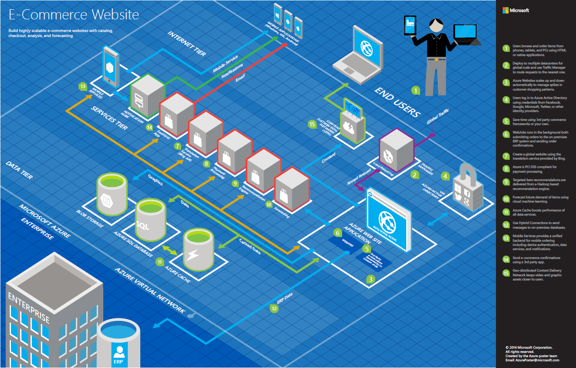

Slide 56
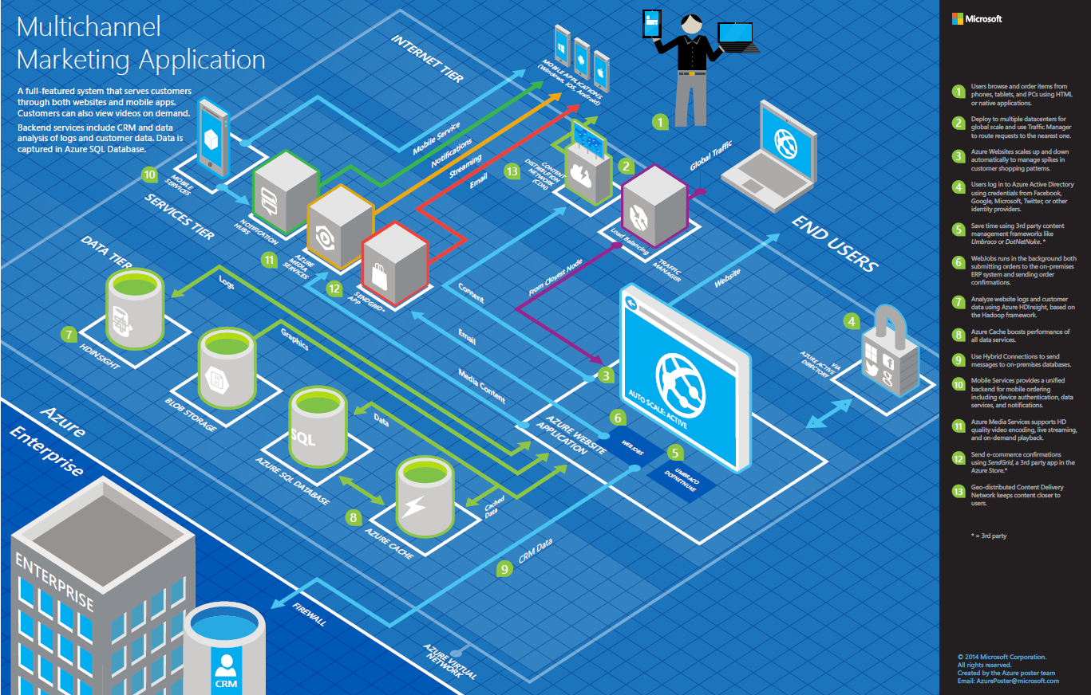

Slide 57
>57%
Greater than
1,000,000
>250k
Fortune 500 using Azure
Active websites
SQL Databases in Azure
>20
>1
TRILLION storage objects
>300
MILLION
AD users
MILLION
Developers registered with Visual Studio Online
>2
MILLION requests/sec
>13
BILLION
authentication/wk

Slide 58
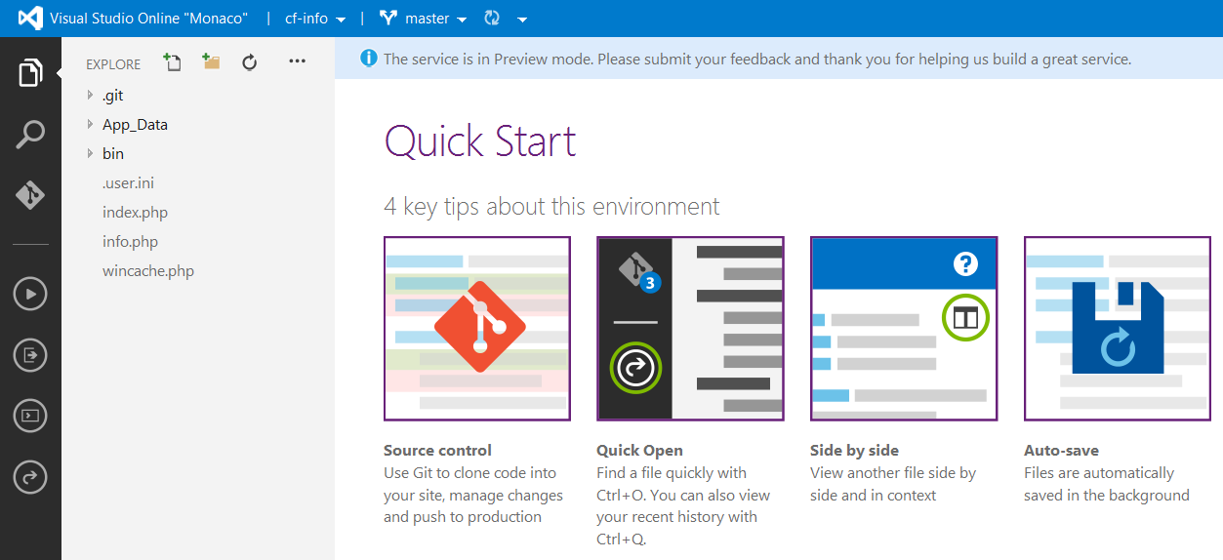
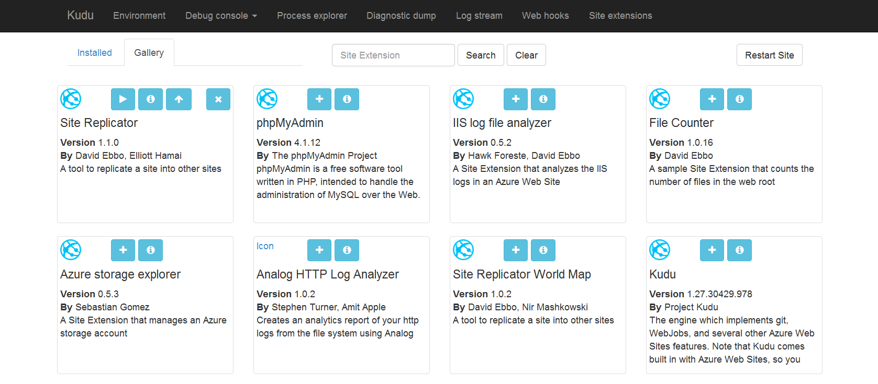
Site Extensions

Slide 59
WebSockets
Persistent Connection
Concurrent
Connections
5
35
350
Unlimited
Tier
Free
Shared
Basic / Standard
Premium

Slide 60


Web Hosting Plan
$
+
+
Azure Subscription
Pricing Tier
Geographic Region
Notes:
Web Hosting Plan is a scale unit for websites. It is comprised of a Geographic Region and a Pricing Tier within the same Azure Subscription. When you scale a site to either Basic or Standard all of the sites within the Web Hosting Plan will be placed on the same Virtual Machine.

