Slide 1
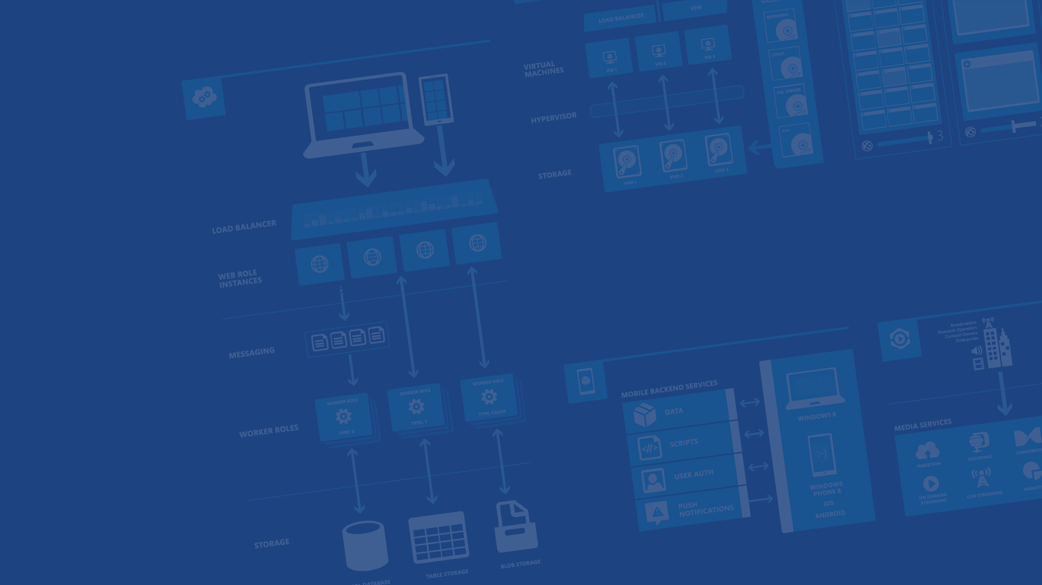
Hybrid Connections Building Amazing Hybrid Web Sites and Mobile Apps in Minutes
<Presenter Name>
<Position or role>
<Contact>
Microsoft Azure

Slide 2
Abstract: Hybrid connections is a new feature of Azure BizTalk Services that makes it easier than ever for application developers to build hybrid Azure Web Sites and Mobile Services. Build applications that connect to on-premises resources over TCP or HTTP, including Microsoft SQL Server, custom web services and more. Join us for a tour of this game changing capability and see how you can deploy a hybrid system in minutes.
See this video for a full walkthrough of this deck and demos http://channel9.msdn.com/Shows/Cloud+Cover/Episode-144-Hybrid-Connections-with-Santosh-Chandwani

Slide 3
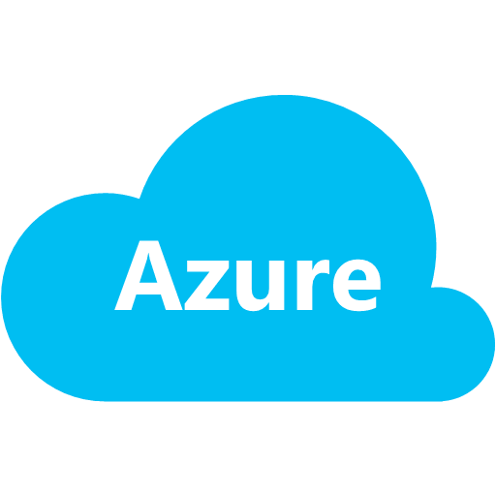


Evolving Enterprise Infrastructure
Corporate Network
Virtual Network

Slide 4

Motivation
Reinforce ability to rapidly create, test & deploy hybrid applications on Azure
Extend hybrid capabilities to all Azure services
Access existing on-premises resources without having to deploy custom code or infrastructure
Secure access without changing network configuration
Enterprise admins continue to have control and visibility

Slide 5
Introducing Hybrid Connections
Fast, easy way to build Hybrid Apps previews Today
Connect your Azure Websites & Mobile Services to on-premises resources
Secure access to resources with IT control
Included in Azure BizTalk Services

Slide 6
Key Features
Access to on-premises resources
Connect to SQL Server, Web Services or most other that use TCP or HTTP connectivity
Works with most frameworks
Support for .NET, PHP, Java, Python, Node.js for Websites and Node.js and .NET for Mobile Services*
No need to alter the network perimeter
Doesn’t require a VPN gateway or Firewall changes to allow incoming traffic
Applications have access only to the resource that they require
Maintains IT control over resources
Support for Group Policy and Event/Audit Logging providing Admins control and visibility

Slide 7
Introducing BizTalk Services FREE Edition
Makes it easy for developers to use Hybrid Connections at no charge
Hybrid Connections are now included with all BizTalk Services tiers

Slide 8

Hybrid Connections
Corporate Network
Microsoft SQL Server
Web Sites
Other published resources
Hybrid Connection
Hybrid Connection Manager
Mobile Services

Slide 9
Demo: Azure Website connecting to onpremises sql
Presenter title/role
Company (optional)
Notes:
NH Notes:
Do this: http://azure.microsoft.com/en-us/documentation/articles/web-sites-hybrid-connection-connect-on-premises-sql-server/
Then this: http://azure.microsoft.com/en-us/documentation/articles/web-sites-hybrid-connection-get-started/
Demo as shown here: http://azure.microsoft.com/en-us/documentation/videos/azure-friday/

Slide 10
Lift and Shift
You can move existing web workloads to Azure Websites whilst still connecting to on-premises data without changing any code.

Slide 11
Flow
Windows Azure
On Premises
Web Site
Hybrid Connection Manager
LOB App
Hybrid Connection
Mobile Service
Connects to ‘Hostname:Port’
Configuration: LOB App
Identified by Hostname:Port
Each Hybrid C
Multiple applications can share a Hybrid Connection to access
Applications on Azure access a resource the same way that they would if it was running on-premises

Slide 12
Cardinality
Each Hybrid Connection provides access to a single on-premises resource
Applications can use multiple Hybrid Connections to access on-premises resources
Multiple Applications can share a Hybrid Connection to access a resource
The on-premises Hybrid Connection Manager can be used as connector for multiple Hybrid Connections

Slide 13
Constraints
Supports resources using TCP and HTTP for connectivity
Only static TCP ports are supported
Currently, resources relying on dynamic port allocation cannot be used
Hybrid Connections don’t buffer or inspect traffic
TLS can be negotiated end-to-end between the application and the on-premises resource
Dynamic port redirection, as in case of FTP passive-mode or

Slide 14
Security
Uses Shared Access Signature Authorization
Application and On-Premises Hybrid Connection Manager connect with separate keys and rights
Separate roles defined for on-premises connector & application
Allows for credentials for each to be rolled independently
Seamless and secure distribution & update of credentials to applications & Hybrid Connection Manager
Application authorization is independent
You can use an authorization mechanism appropriate for the Hybrid Application
In practice, depends on end-to-end authorization mechanisms supported across cloud/on-premises

Slide 15
Deployment considerations
Applications and On-premises Resources can be scaled out as usual
Hybrid Connection Manager can be deployed on the resource server or in front of a load-balancer or cluster
Supports SQL Availability Groups and Clustering
Features using redirection not supported: MultiSubnetFailover=true and ApplicationIntent=ReadOnly
Multiple instances of Hybrid Connection Manager supported
Application connection requests are evenly distributed across the different instances

Slide 16
Enterprise IT in control
Manage resource access for Hybrid applications
Group Policy controls for allowing access
Administrators can designate resources to which Hybrid Applications have access
Event and Audit logging
IT has insight into resources being accessed
IT can use existing infrastructure investments for monitoring and control
Dashboard on Azure portal
Access to connection health, status
Will provide insights on usage and metrics

Slide 17
Included in BizTalk Services
 | Free | Developer | Basic | Standard | Premium
Price | $0 / month | ~$97 / month | ~$499 / month | ~$2,999 / month | ~$5,997 / month
Scale Limit | N/A | N/A | Up to 8 units | Up to 8 units | Up to 8 units
EAI Bridges per Unit | N/A | 25 | 25 | 125 | 500
EDI Agreements per Unit | N/A | 10 | 50 | 250 | 1000
Hybrid Connections per unit | 5 | 5 | 10 | 50 | 100
Hybrid Connection data transfer per unit | 5 GB | 5 GB | 50 GB | 250 GB | 500 GB
Archiving | N/A | Included | Not Included | Not Included | Included
High Availability | Not Included | Not Included | Included | Included | Included
Connection limits for each Hybrid Connection apply. Additional Hybrid data transfer billed at $1/GB.

Slide 18




Thanks!
We are done now.

Slide 20
16 regions worldwide in 2014
Azure footprint

Slide 21
>57%
Greater than
1,000,000
>250k
Fortune 500 using Azure
Active websites
SQL Databases in Azure
>20
>1
TRILLION storage objects
>300
MILLION
AD users
MILLION
Developers registered with Visual Studio Online
>2
MILLION requests/sec
>13
BILLION
authentication/wk

Slide 22
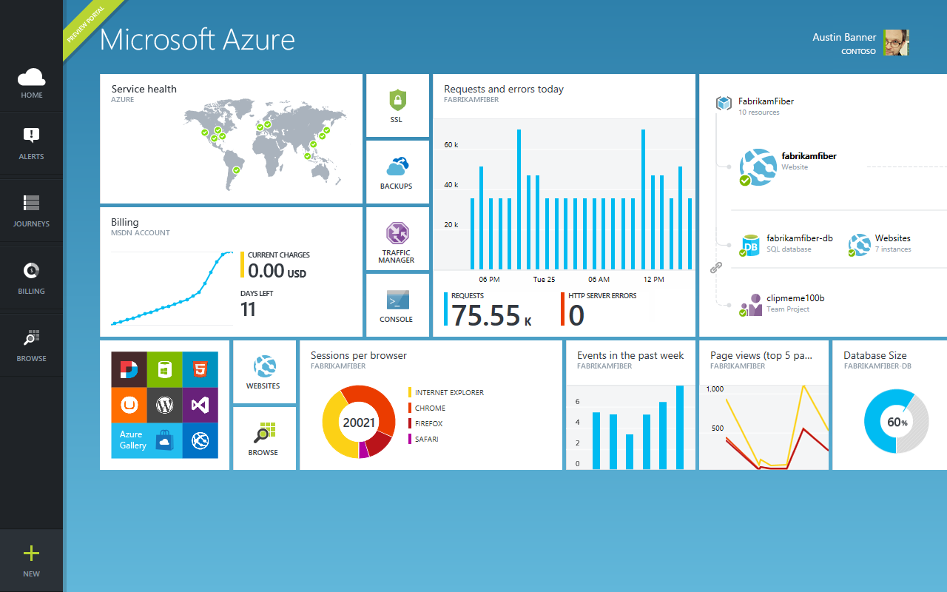

Slide 23

Get started
Visit azure.microsoft.com

