Slide 1
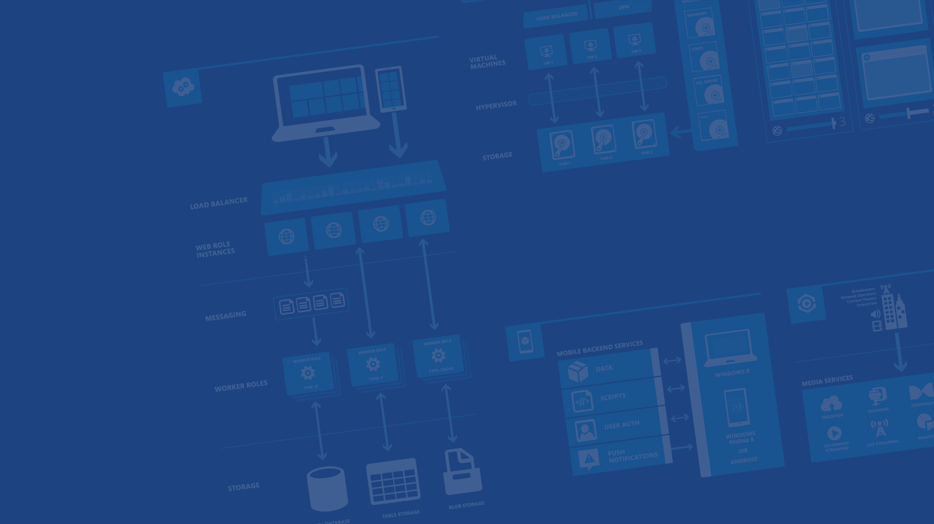
Azure PaaS
Presenter Name
Position or role
Microsoft Azure

Slide 2
Your service

Slide 3
→ Your application code
→ Required resources
→ Your infrastructure code

Slide 5
Azure Websites
→ Create new sites in seconds
→ Leverage familiar languages and frameworks
→ Built-in auto-scaling and load balancing
→ Continuous Deployment with Git, TFS, GitHub

Slide 6




Thanks!
We are done now.

Slide 8
16 regions worldwide in 2014
Azure footprint

Slide 9
>57%
Greater than
1,000,000
>250k
Fortune 500 using Azure
Active websites
SQL Databases in Azure
>20
>1
TRILLION storage objects
>300
MILLION
AD users
MILLION
Developers registered with Visual Studio Online
>2
MILLION requests/sec
>13
BILLION
authentication/wk

Slide 10
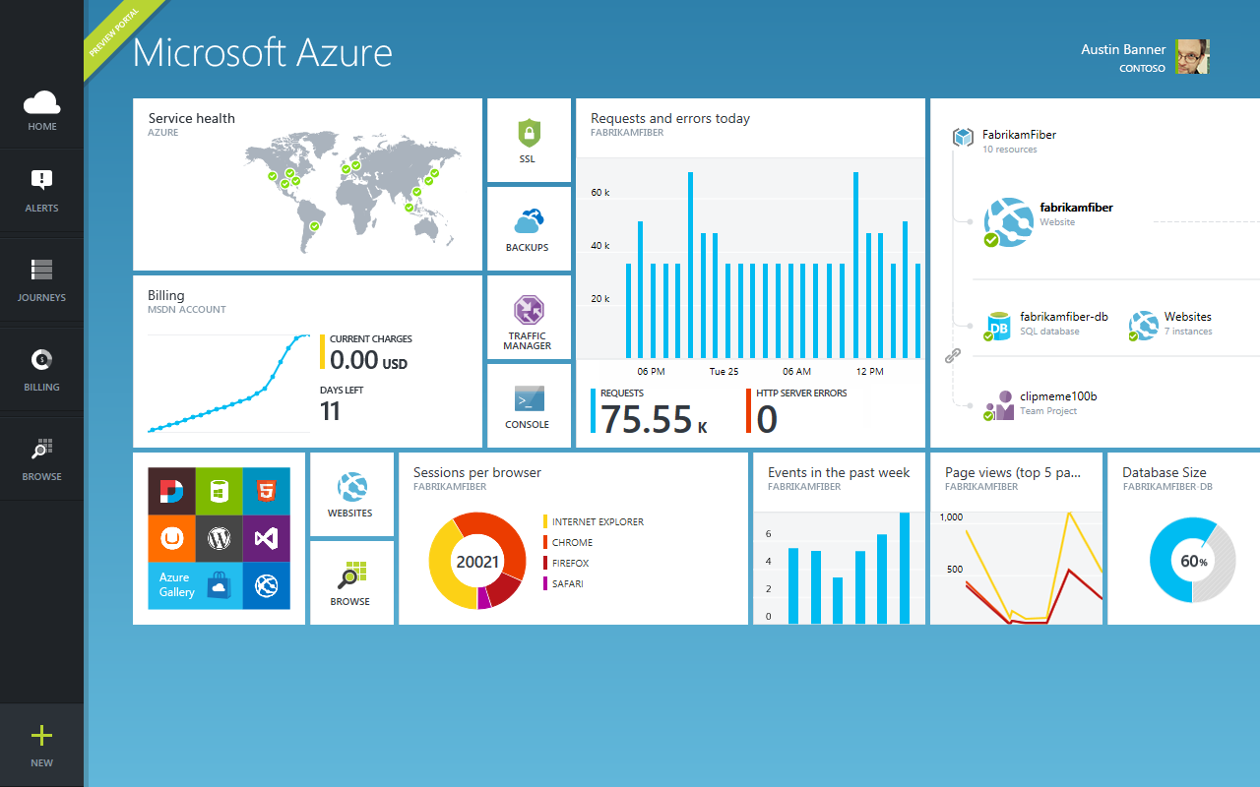

Slide 11

Get started
Visit azure.microsoft.com

