Slide 1
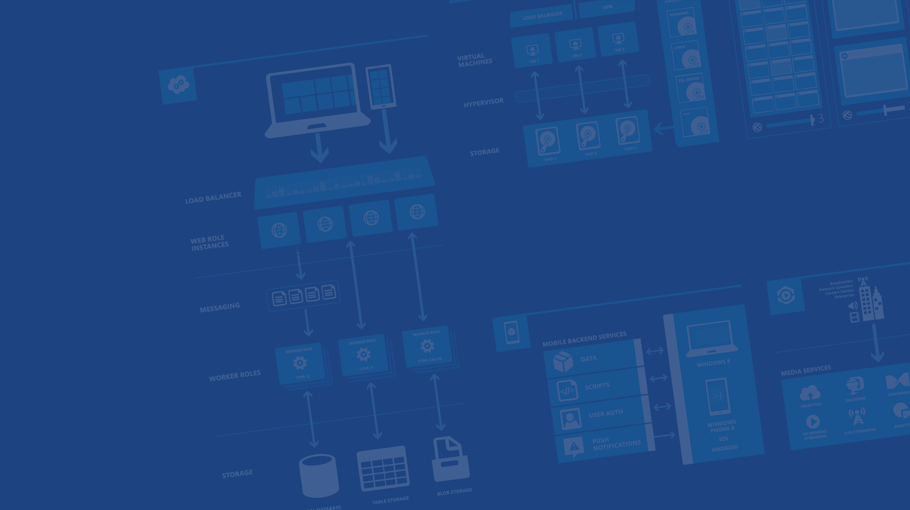
Azure Data Overview
Presenter Name
Position or role
Microsoft Azure

Slide 2
SQL Database
SQL on IaaS
DocumentDB

Slide 3
Microsoft Azure SQL Database

Slide 4

Microsoft Relational Storage Options
A Continuous offering
Physical
Virtual
IaaS
SaaS
From private to public Cloud
Notes:
Slide Objectives:
Show Microsoft’ continuous Private to Public Cloud Offering, but this presentation will focus on Microsoft’s relational database PaaS offering.
Transition:
Microsoft provides a continuous solution from private cloud to the public cloud. No matter where you are on your technology roadmap we have a solution to fit your needs.
We are a trusted advisor and platform in the traditional enterprise and ISV space with new IaaS offerings that making it easier to bring this same level of trust and ease of use to the public cloud. However, Microsoft Azure SQL Database extends SQL Server capabilities to the cloud by offering SQL Server as a relational database service.
Speaking Points:
SQL Database provides SQL Server as a relational service.

Slide 5
Microsoft Azure SQL Database
Architecture

Slide 6
A Server is not a machine
SQL Server
Machine
(Physical/VM)
Azure
SQL Database Server
TDS Endpoint
Notes:
Slide Objectives:
Understand that while there are physical SQL Server boxes behind the scenes, when connecting to SQL Database, you are not connecting to a physical server, but to a TDS endpoint.
Transition:
The key to understanding SQL Database is understanding while SQL Database is SQL Server, we do not interact with them in the same physical manner.
Speaking Points:
In an on-premises environment, we typically have physical access to the actual SQL Server server.
In Microsoft Azure, we do not have physical access to the actual server.
Notes:
It is important that the attendee understands that it IS INDEED SQL Server at the platform layer. There are physical boxes running SQL Server 2012 Enterprise Edition. However, due to the nature of the Azure environment to provide the high-availability and scalability necessary, access to the physical boxes is currently not supported.

Slide 7
Microsoft Azure SQL Database
Starting with the basics

Slide 8
SQL Server database technology “as a Service”
Fully Managed
Enterprise-ready with automatic support for HA, DR, Backups, replication and more
Can scale out elastically using ElasticScale
SQL Database – The Basics
Notes:
Slide Objectives:
Understand the overall concepts and benefits of SQL Database
Transition:
Let’s clear up any confusion and look at the basics of what SQL Database really is and some of its benefits.
Speaking Points:
The same great SQL Server database technology that you know, love, and use on-premises provided as a service
Enterprise-ready
Automatic support for High-Availability
Designed to scale on-demand to provide the same great elasticity
Notes:
High-availability – 3 copies of the database free for the cost of the one database. Always in sync. The cost to do this on-premises isn’t cheap. This is FREE in SQL Database.

Slide 9
How It Works – Architecture of the Service
Client Layer
PHP
SQL Server
Applications
and Tools
WCF Data Services
Applications communicate directly with SQL Database using TDS.
ODBC
ADO.NET
Tabular Data Stream (TDS)
Notes:
Slide Objectives:
To understand the actual architecture that provides the enterprise-ready SQL Database service.
Transition:
Developers have spent years working with their technology of choice, and Microsoft wanted to ensure that the technologies and tools you use today will continue to work with SQL Database without learning a whole new set of technologies.
Speaking Points:
Familiar technology and tools
Similar architecture as that of on-premises
Additional layer providing server and database partitioning, client connection routing, and billing.
Same great SQL Server technology on the backend.
Additional services (SQL Database Fabric) to ensure SLAs are met and to ensure optimum performance.
Notes:
Client - The client layer resides closest to your application, and is used by your application to communicate directly with SQL Database. The client layer can reside on-premise in your datacenter or be hosted in Microsoft Azure. Because SQL Database provides the same tabular data stream (TDS) interface as SQL Server, you can use familiar tools and libraries to build client applications for data that is in the cloud.
Services - The services layer functions as a gateway between the client layer and the platform layer, where the data resides. The services layer provides three functions: provisioning, billing and metering, and connection routing.
The services layer provisions the databases that you specify with your Microsoft Azure platform account. The billing and metering aspect of the services layer enables multi-tenant support by providing monitoring and billing for database usage based on individual Microsoft Azure platform accounts. SQL Database is built on a scalable platform involving numerous physical servers; this layer handles all the connections routing between your application and the physical servers where your data resides.
Platform - The platform layer includes the physical servers and services that support the services layer. The platform layer consists of many instances of SQL Server, each of which is managed by the SQL Database fabric.
The SQL Database fabric is a distributed computing system composed of tightly integrated networks, servers, and storage. It enables automatic failover, load balancing, and automatic replication between physical servers.
Management services monitor the health of individual servers and enable automated installation of service upgrades and software patches.
Infrastructure - The infrastructure layer represents the IT administration of the physical hardware and operating systems that support the services layer.

Slide 10
How It Works – Architecture of the Service
Client Layer
PHP
SQL Server
Applications
and Tools
WCF Data Services
ODBC
ADO.NET
Tabular Data Stream (TDS)
TDS+SSL
Gateway between Client layer and Platform layer.
Services Layer
Provisioning
Provisioning
Provisioning
…
Billing and Metering
Billing and Metering
Billing and Metering
…
Connection Routing
Connection Routing
Connection Routing
…
Notes:
Slide Objectives:
To understand the actual architecture that provides the enterprise-ready SQL Database service.
Transition:
Developers have spent years working with their technology of choice, and Microsoft wanted to ensure that the technologies and tools you use today will continue to work with SQL Database without learning a whole new set of technologies.
Speaking Points:
Familiar technology and tools
Similar architecture as that of on-premises
Additional layer providing server and database partitioning, client connection routing, and billing.
Same great SQL Server technology on the backend.
Additional services (SQL Database Fabric) to ensure SLAs are met and to ensure optimum performance.
Notes:
Client - The client layer resides closest to your application, and is used by your application to communicate directly with SQL Database. The client layer can reside on-premise in your datacenter or be hosted in Microsoft Azure. Because SQL Database provides the same tabular data stream (TDS) interface as SQL Server, you can use familiar tools and libraries to build client applications for data that is in the cloud.
Services - The services layer functions as a gateway between the client layer and the platform layer, where the data resides. The services layer provides three functions: provisioning, billing and metering, and connection routing.
The services layer provisions the databases that you specify with your Microsoft Azure platform account. The billing and metering aspect of the services layer enables multi-tenant support by providing monitoring and billing for database usage based on individual Microsoft Azure platform accounts. SQL Database is built on a scalable platform involving numerous physical servers; this layer handles all the connections routing between your application and the physical servers where your data resides.
Platform - The platform layer includes the physical servers and services that support the services layer. The platform layer consists of many instances of SQL Server, each of which is managed by the SQL Database fabric.
The SQL Database fabric is a distributed computing system composed of tightly integrated networks, servers, and storage. It enables automatic failover, load balancing, and automatic replication between physical servers.
Management services monitor the health of individual servers and enable automated installation of service upgrades and software patches.
Infrastructure - The infrastructure layer represents the IT administration of the physical hardware and operating systems that support the services layer.

Slide 11
How It Works – Architecture of the Service
Client Layer
PHP
SQL Server
Applications
and Tools
WCF Data Services
ODBC
ADO.NET
Tabular Data Stream (TDS)
TDS+SSL
Services Layer
Provisioning
Provisioning
Provisioning
…
Billing and Metering
Billing and Metering
Billing and Metering
…
Connection Routing
Connection Routing
Connection Routing
…
Includes physical servicers and services that support the Services layer.
Platform Layer
SQL Server
SQL Server
SQL Server
…
SQL Database Fabric
SQL Database Fabric
SQL Database Fabric
…
Management Services
Management Services
Management Services
…
Notes:
Slide Objectives:
To understand the actual architecture that provides the enterprise-ready SQL Database service.
Transition:
Developers have spent years working with their technology of choice, and Microsoft wanted to ensure that the technologies and tools you use today will continue to work with SQL Database without learning a whole new set of technologies.
Speaking Points:
Familiar technology and tools
Similar architecture as that of on-premises
Additional layer providing server and database partitioning, client connection routing, and billing.
Same great SQL Server technology on the backend.
Additional services (SQL Database Fabric) to ensure SLAs are met and to ensure optimum performance.
Notes:
Client - The client layer resides closest to your application, and is used by your application to communicate directly with SQL Database. The client layer can reside on-premise in your datacenter or be hosted in Microsoft Azure. Because SQL Database provides the same tabular data stream (TDS) interface as SQL Server, you can use familiar tools and libraries to build client applications for data that is in the cloud.
Services - The services layer functions as a gateway between the client layer and the platform layer, where the data resides. The services layer provides three functions: provisioning, billing and metering, and connection routing.
The services layer provisions the databases that you specify with your Microsoft Azure platform account. The billing and metering aspect of the services layer enables multi-tenant support by providing monitoring and billing for database usage based on individual Microsoft Azure platform accounts. SQL Database is built on a scalable platform involving numerous physical servers; this layer handles all the connections routing between your application and the physical servers where your data resides.
Platform - The platform layer includes the physical servers and services that support the services layer. The platform layer consists of many instances of SQL Server, each of which is managed by the SQL Database fabric.
The SQL Database fabric is a distributed computing system composed of tightly integrated networks, servers, and storage. It enables automatic failover, load balancing, and automatic replication between physical servers.
Management services monitor the health of individual servers and enable automated installation of service upgrades and software patches.
Infrastructure - The infrastructure layer represents the IT administration of the physical hardware and operating systems that support the services layer.

Slide 12
How It Works – Architecture of the Service
Client Layer
PHP
SQL Server
Applications
and Tools
WCF Data Services
ODBC
ADO.NET
Tabular Data Stream (TDS)
TDS+SSL
Services Layer
Provisioning
Provisioning
Provisioning
…
Billing and Metering
Billing and Metering
Billing and Metering
…
Connection Routing
Connection Routing
Connection Routing
…
Platform Layer
SQL Server
SQL Server
SQL Server
…
SQL Database Fabric
SQL Database Fabric
SQL Database Fabric
…
Administration of the physical HW and OS.
Management Services
Management Services
Management Services
…
Infrastructure Layer
Notes:
Slide Objectives:
To understand the actual architecture that provides the enterprise-ready SQL Database service.
Transition:
Developers have spent years working with their technology of choice, and Microsoft wanted to ensure that the technologies and tools you use today will continue to work with SQL Database without learning a whole new set of technologies.
Speaking Points:
Familiar technology and tools
Similar architecture as that of on-premises
Additional layer providing server and database partitioning, client connection routing, and billing.
Same great SQL Server technology on the backend.
Additional services (SQL Database Fabric) to ensure SLAs are met and to ensure optimum performance.
Notes:
Client - The client layer resides closest to your application, and is used by your application to communicate directly with SQL Database. The client layer can reside on-premise in your datacenter or be hosted in Microsoft Azure. Because SQL Database provides the same tabular data stream (TDS) interface as SQL Server, you can use familiar tools and libraries to build client applications for data that is in the cloud.
Services - The services layer functions as a gateway between the client layer and the platform layer, where the data resides. The services layer provides three functions: provisioning, billing and metering, and connection routing.
The services layer provisions the databases that you specify with your Microsoft Azure platform account. The billing and metering aspect of the services layer enables multi-tenant support by providing monitoring and billing for database usage based on individual Microsoft Azure platform accounts. SQL Database is built on a scalable platform involving numerous physical servers; this layer handles all the connections routing between your application and the physical servers where your data resides.
Platform - The platform layer includes the physical servers and services that support the services layer. The platform layer consists of many instances of SQL Server, each of which is managed by the SQL Database fabric.
The SQL Database fabric is a distributed computing system composed of tightly integrated networks, servers, and storage. It enables automatic failover, load balancing, and automatic replication between physical servers.
Management services monitor the health of individual servers and enable automated installation of service upgrades and software patches.
Infrastructure - The infrastructure layer represents the IT administration of the physical hardware and operating systems that support the services layer.

Slide 13
How It Works – Architecture of the Service
Client Layer
PHP
SQL Server
Applications
and Tools
WCF Data Services
ODBC
ADO.NET
Tabular Data Stream (TDS)
TDS+SSL
Services Layer
Provisioning
Provisioning
Provisioning
…
Billing and Metering
Billing and Metering
Billing and Metering
…
Microsoft Azure SQL Database
SaaS
Connection Routing
Connection Routing
Connection Routing
…
Platform Layer
SQL Server
SQL Server
SQL Server
…
SQL Database Fabric
SQL Database Fabric
SQL Database Fabric
…
Management Services
Management Services
Management Services
…
Infrastructure Layer
Notes:
Slide Objectives:
To understand the actual architecture that provides the enterprise-ready SQL Database service.
Transition:
Developers have spent years working with their technology of choice, and Microsoft wanted to ensure that the technologies and tools you use today will continue to work with SQL Database without learning a whole new set of technologies.
Speaking Points:
Familiar technology and tools
Similar architecture as that of on-premises
Additional layer providing server and database partitioning, client connection routing, and billing.
Same great SQL Server technology on the backend.
Additional services (SQL Database Fabric) to ensure SLAs are met and to ensure optimum performance.
Notes:
Client - The client layer resides closest to your application, and is used by your application to communicate directly with SQL Database. The client layer can reside on-premise in your datacenter or be hosted in Microsoft Azure. Because SQL Database provides the same tabular data stream (TDS) interface as SQL Server, you can use familiar tools and libraries to build client applications for data that is in the cloud.
Services - The services layer functions as a gateway between the client layer and the platform layer, where the data resides. The services layer provides three functions: provisioning, billing and metering, and connection routing.
The services layer provisions the databases that you specify with your Microsoft Azure platform account. The billing and metering aspect of the services layer enables multi-tenant support by providing monitoring and billing for database usage based on individual Microsoft Azure platform accounts. SQL Database is built on a scalable platform involving numerous physical servers; this layer handles all the connections routing between your application and the physical servers where your data resides.
Platform - The platform layer includes the physical servers and services that support the services layer. The platform layer consists of many instances of SQL Server, each of which is managed by the SQL Database fabric.
The SQL Database fabric is a distributed computing system composed of tightly integrated networks, servers, and storage. It enables automatic failover, load balancing, and automatic replication between physical servers.
Management services monitor the health of individual servers and enable automated installation of service upgrades and software patches.
Infrastructure - The infrastructure layer represents the IT administration of the physical hardware and operating systems that support the services layer.

Slide 14
SQL Database – Server Definition
The Service head contains databases
Connect via automatically generated FQDN: {name}.database.windows.net
Initially contains only a master database
Notes:
Slide Objectives:
Show the different methods of provisioning a SQL Database server along with how easy it is. Plus, help the attendees understand what a SQL Database “server” really is.
Transition:
Provisioning an on-premises SQL Server box can be time consuming, costly, and at times, a challenge. With SQL Database, provisioning a “server” is painless, quick, and provisioned in a matter of seconds.
Speaking Points:
Provision servers interactively using the Management Portal
Automate server provisioning using the Microsoft Azure Management API or PowerShell.
Notes:
While the “server” is technically a TDS endpoint, much of the SQL Server process is similar. Administration login credentials are still needed for security, and more importantly defining service access is essential, and required, for maintaining the integrity of your server through firewall rules.

Slide 15
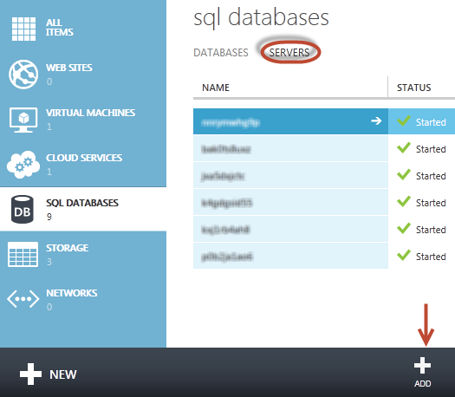
SQL Database – Provision Servers Interactively
Log on to Microsoft Azure Management Portal
Create a SQL Database server
Specify admin login credentials
Add firewall rules and enable service access
Notes:
Slide Objectives:
Show the different methods of provisioning a SQL Database server along with how easy it is. Plus, help the attendees understand what a SQL Database “server” really is.
Transition:
Provisioning an on-premises SQL Server box can be time consuming, costly, and at times, a challenge. With SQL Database, provisioning a “server” is painless, quick, and provisioned in a matter of seconds.
Speaking Points:
Provision servers interactively using the Management Portal
Automate server provisioning using the Microsoft Azure Management API or PowerShell.
Notes:
While the “server” is technically a TDS endpoint, much of the SQL Server process is similar. Administration login credentials are still needed for security, and more importantly defining service access is essential, and required, for maintaining the integrity of your server through firewall rules.

Slide 16
SQL Database – Provision Servers Interactively
Log on to Microsoft Azure Management Portal
Create a SQL Database server
Specify admin login credentials
Add firewall rules and enable service access
Same for Preview Portal?
Notes:
Slide Objectives:
Show the different methods of provisioning a SQL Database server along with how easy it is. Plus, help the attendees understand what a SQL Database “server” really is.
Transition:
Provisioning an on-premises SQL Server box can be time consuming, costly, and at times, a challenge. With SQL Database, provisioning a “server” is painless, quick, and provisioned in a matter of seconds.
Speaking Points:
Provision servers interactively using the Management Portal
Automate server provisioning using the Microsoft Azure Management API or PowerShell.
Notes:
While the “server” is technically a TDS endpoint, much of the SQL Server process is similar. Administration login credentials are still needed for security, and more importantly defining service access is essential, and required, for maintaining the integrity of your server through firewall rules.

Slide 17
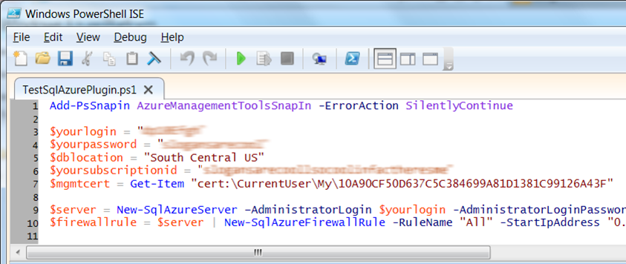
SQL Database – Automate Server Provisioning
Use Microsoft Azure Platform PowerShell cmdlets
http://azure.microsoft.com/en-us/services/automation
Make separate slides!
Or use the Azure Cross-Platform Command-Line Interface (xplat-cli)
Notes:
Slide Objectives:
Show the different methods of provisioning a SQL Database server along with how easy it is. Plus, help the attendees understand what a SQL Database “server” really is.
Transition:
Provisioning an on-premises SQL Server box can be time consuming, costly, and at times, a challenge. With SQL Database, provisioning a “server” is painless, quick, and provisioned in a matter of seconds.
Speaking Points:
Provision servers interactively using the Management Portal
Automate server provisioning using the Microsoft Azure Management API or PowerShell.
Notes:
While the “server” is technically a TDS endpoint, much of the SQL Server process is similar. Administration login credentials are still needed for security, and more importantly defining service access is essential, and required, for maintaining the integrity of your server through firewall rules.

Slide 18
Selecting the right SQL Database edition
Service Tier | Performance Level | Common App Pattern | Performance |  |  | Business Continuity
 |  |  | Max DB Size | Trans. Perf. Objective | DTU | PITR | DR / GEO-Rep
Basic | Basic | Small DB, SQL opp | 2 GB | Reliability / Hr. | 5 | 7 Days | DB Copy + Manual Export
Standard | S0 S1 S2 | Wrkgp/cloud app, multiple concurrent operations | 250 GB | Reliability / Min. | 10 20 50 | 14 Days | DB Copy + Manual Export
Premium | P1 P2 P3 | Mission Critical, High volume, Many concurrent Users | 500 GB | Reliability / sec. | 100 200 800 | 35 Days | Active Geo-replication
This information is subject to change over time.
Notes:
Slide Objectives:
Highlight what’s new in the latest SQL Database service update.
Transition:
In late September a service update was deployed to Microsoft Azure SQL Database that included new functionality.
Speaking Points:
Linked Server – This is a new component for database hybrid solutions spanning on-premises corporate networks and the Microsoft Azure cloud.
Recursive Trigger – Just like SQL Server 2012, the option can be configured via ALTER DATABASE dbname SET RECURSIVE_TRIGGERS ON|OFF
DBCC – The query optimizer uses statistics to estimate the cardinality or number of rows in the query result, which enables the query optimizer to create a high quality query plan.
Firewall Rules – different rules for different databases hosted on the same logical SQL Database server
Notes:

Slide 19
Creating A SQL Database Server
Demo
Notes:
Use Azure Portal (Ibiza) to create a new database server

Slide 20
Create and deploy your database
Demo
Notes:
Use Azure Portal (Ibiza) to create a new database server

Slide 21
Transact-SQL
Use Familiar Technologies
(obviously)
Notes:
Slide Objectives:
Point out that 1) The same great technologies that developers use today on-premises works with SQL Database 2) high-level differences between on-premises and SQL Database 3) SQL Database features currently unsupported
Transition:
Creating, managing, and deploying a database in Microsoft Azure SQL Database isn’t difficult. The key is understanding the features that are supported and how SQL Database compares to on-premises SQL Server and the technologies that can be used with SQL Database.
Speaking Points:
The same great technologies that developers use today on-premises works with SQL Database, including developer languages, Frameworks, and Tools. Nothing new to learn!
SQL Server Comparison -> highlight the physical vs. logical administration. Developers and DBAs can now focus on things they love to do and not worry about the physical aspect.
Features unsupported by SQL Database -> Many of the unsupported features are hardware based and thus don’t need to be in SQL Database. Other features, such as encryption, are server-based and become a challenge in solving in a shared-environment.
Notes:
CLR data types ARE supported, SQLCLR is not yet supported.
Backup/Restore: PIT Coming; Import/Export can be used for backup to BLOB storage. Third-party backup products available via RedGate and Enzo.
Data can be stored encrypted but the encryption must be done at the application level.
Native encryption is being looked at.
**Linked Servers and Distributed Queries are now supported, linking a SQL Database instance from an on-premises server. Linking two SQL Database instances is NOT supported.

Slide 22
.NET Framework (C#, Visual Basic, F#): ADO.NET
C / C++: ODBC
Java: Microsoft JDBC provider
PHP: Microsoft PHP provider
Use Familiar Technologies - Languages
Notes:
Slide Objectives:
Point out that 1) The same great technologies that developers use today on-premises works with SQL Database 2) high-level differences between on-premises and SQL Database 3) SQL Database features currently unsupported
Transition:
Creating, managing, and deploying a database in Microsoft Azure SQL Database isn’t difficult. The key is understanding the features that are supported and how SQL Database compares to on-premises SQL Server and the technologies that can be used with SQL Database.
Speaking Points:
The same great technologies that developers use today on-premises works with SQL Database, including developer languages, Frameworks, and Tools. Nothing new to learn!
SQL Server Comparison -> highlight the physical vs. logical administration. Developers and DBAs can now focus on things they love to do and not worry about the physical aspect.
Features unsupported by SQL Database -> Many of the unsupported features are hardware based and thus don’t need to be in SQL Database. Other features, such as encryption, are server-based and become a challenge in solving in a shared-environment.
Notes:
CLR data types ARE supported, SQLCLR is not yet supported.
Backup/Restore: PIT Coming; Import/Export can be used for backup to BLOB storage. Third-party backup products available via RedGate and Enzo.
Data can be stored encrypted but the encryption must be done at the application level.
Native encryption is being looked at.
**Linked Servers and Distributed Queries are now supported, linking a SQL Database instance from an on-premises server. Linking two SQL Database instances is NOT supported.

Slide 23
Odata
Entity Framework
WCF Data Services
Nhibernate (etc.)
Use Familiar Technologies - Frameworks
Notes:
Slide Objectives:
Point out that 1) The same great technologies that developers use today on-premises works with SQL Database 2) high-level differences between on-premises and SQL Database 3) SQL Database features currently unsupported
Transition:
Creating, managing, and deploying a database in Microsoft Azure SQL Database isn’t difficult. The key is understanding the features that are supported and how SQL Database compares to on-premises SQL Server and the technologies that can be used with SQL Database.
Speaking Points:
The same great technologies that developers use today on-premises works with SQL Database, including developer languages, Frameworks, and Tools. Nothing new to learn!
SQL Server Comparison -> highlight the physical vs. logical administration. Developers and DBAs can now focus on things they love to do and not worry about the physical aspect.
Features unsupported by SQL Database -> Many of the unsupported features are hardware based and thus don’t need to be in SQL Database. Other features, such as encryption, are server-based and become a challenge in solving in a shared-environment.
Notes:
CLR data types ARE supported, SQLCLR is not yet supported.
Backup/Restore: PIT Coming; Import/Export can be used for backup to BLOB storage. Third-party backup products available via RedGate and Enzo.
Data can be stored encrypted but the encryption must be done at the application level.
Native encryption is being looked at.
**Linked Servers and Distributed Queries are now supported, linking a SQL Database instance from an on-premises server. Linking two SQL Database instances is NOT supported.

Slide 24
SQL Server Management Studio (>=2008 R2)
SQL Server command-line utilities (SQLCMD, BCP)
CA Erwin® Data Modeler
Embarcadero Technologies DBArtisan®
Use Familiar Technologies - Tools
Why are there specific options here for other technologies?
Notes:
Slide Objectives:
Point out that 1) The same great technologies that developers use today on-premises works with SQL Database 2) high-level differences between on-premises and SQL Database 3) SQL Database features currently unsupported
Transition:
Creating, managing, and deploying a database in Microsoft Azure SQL Database isn’t difficult. The key is understanding the features that are supported and how SQL Database compares to on-premises SQL Server and the technologies that can be used with SQL Database.
Speaking Points:
The same great technologies that developers use today on-premises works with SQL Database, including developer languages, Frameworks, and Tools. Nothing new to learn!
SQL Server Comparison -> highlight the physical vs. logical administration. Developers and DBAs can now focus on things they love to do and not worry about the physical aspect.
Features unsupported by SQL Database -> Many of the unsupported features are hardware based and thus don’t need to be in SQL Database. Other features, such as encryption, are server-based and become a challenge in solving in a shared-environment.
Notes:
CLR data types ARE supported, SQLCLR is not yet supported.
Backup/Restore: PIT Coming; Import/Export can be used for backup to BLOB storage. Third-party backup products available via RedGate and Enzo.
Data can be stored encrypted but the encryption must be done at the application level.
Native encryption is being looked at.
**Linked Servers and Distributed Queries are now supported, linking a SQL Database instance from an on-premises server. Linking two SQL Database instances is NOT supported.

Slide 25
Focus on logical vs. physical administration
Database and log files automatically placed
Three high-availability replicas maintained for every database
Tables require a clustered index
Maximum database size is 500 GB
Azure SQL Database vs. SQL Server
Do you like this design that foucuses on one point at a time?
Notes:
Slide Objectives:
Point out that 1) The same great technologies that developers use today on-premises works with SQL Database 2) high-level differences between on-premises and SQL Database 3) SQL Database features currently unsupported
Transition:
Creating, managing, and deploying a database in Microsoft Azure SQL Database isn’t difficult. The key is understanding the features that are supported and how SQL Database compares to on-premises SQL Server and the technologies that can be used with SQL Database.
Speaking Points:
The same great technologies that developers use today on-premises works with SQL Database, including developer languages, Frameworks, and Tools. Nothing new to learn!
SQL Server Comparison -> highlight the physical vs. logical administration. Developers and DBAs can now focus on things they love to do and not worry about the physical aspect.
Features unsupported by SQL Database -> Many of the unsupported features are hardware based and thus don’t need to be in SQL Database. Other features, such as encryption, are server-based and become a challenge in solving in a shared-environment.
Notes:
CLR data types ARE supported, SQLCLR is not yet supported.
Backup/Restore: PIT Coming; Import/Export can be used for backup to BLOB storage. Third-party backup products available via RedGate and Enzo.
Data can be stored encrypted but the encryption must be done at the application level.
Native encryption is being looked at.
**Linked Servers and Distributed Queries are now supported, linking a SQL Database instance from an on-premises server. Linking two SQL Database instances is NOT supported.

Slide 26
Use command, distributed transactions, distributed views
Service Broker
Common Language Runtime (CLR)
SQL Agent
SQL Profiler
Native Encryption
Unsupported SQL Server Features
Notes:
Slide Objectives:
Point out that 1) The same great technologies that developers use today on-premises works with SQL Database 2) high-level differences between on-premises and SQL Database 3) SQL Database features currently unsupported
Transition:
Creating, managing, and deploying a database in Microsoft Azure SQL Database isn’t difficult. The key is understanding the features that are supported and how SQL Database compares to on-premises SQL Server and the technologies that can be used with SQL Database.
Speaking Points:
The same great technologies that developers use today on-premises works with SQL Database, including developer languages, Frameworks, and Tools. Nothing new to learn!
SQL Server Comparison -> highlight the physical vs. logical administration. Developers and DBAs can now focus on things they love to do and not worry about the physical aspect.
Features unsupported by SQL Database -> Many of the unsupported features are hardware based and thus don’t need to be in SQL Database. Other features, such as encryption, are server-based and become a challenge in solving in a shared-environment.
Notes:
CLR data types ARE supported, SQLCLR is not yet supported.
Backup/Restore: PIT Coming; Import/Export can be used for backup to BLOB storage. Third-party backup products available via RedGate and Enzo.
Data can be stored encrypted but the encryption must be done at the application level.
Native encryption is being looked at.
**Linked Servers and Distributed Queries are now supported, linking a SQL Database instance from an on-premises server. Linking two SQL Database instances is NOT supported.

Slide 27
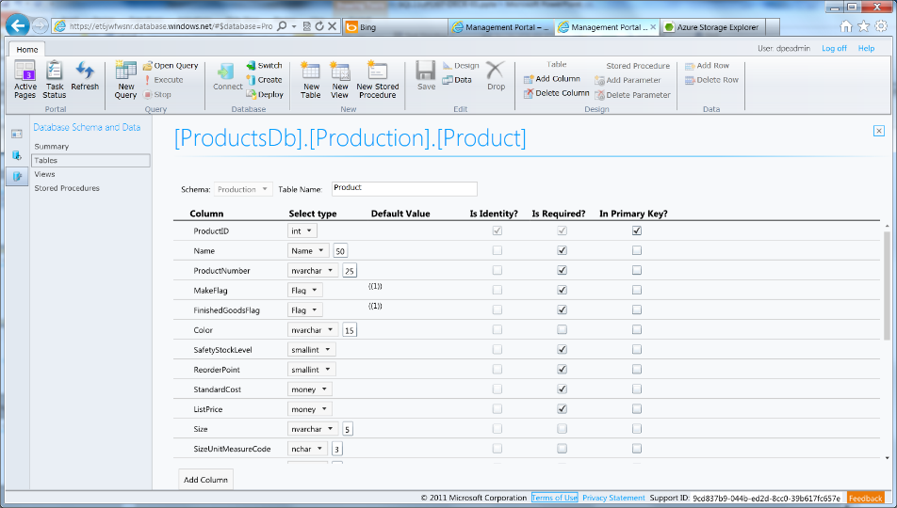
Azure SQL Database Management Portal
Web designers for tables, views, stored procs
Interactive query editing and execution
Notes:
Slide Objectives:
Highlight the set of tools for developers when interacting with Microsoft Azure SQL Database.
Transition:
Transition statement(s) to setup the slide
Speaking Points:
SQL Database Management Portal -> Cross Browser, Unified Management Experience
SQL Server Data Tools -> Integrated Database Design Environment, Table Designer, Debugging, T-SQL Editor
Notes:
IntelliSense in T-SQL Editor
SQL Server Data Tools
Strive to make it consistent as possible
Intersection with the cloud
Bridging you to the new cloud world
Consistency to the new developer experience
Consistency with the new cloud model

Slide 28
SQL Server Management Studio (SSMS)
SSMS picture
Notes:
Slide Objectives:
Highlight the set of tools for developers when interacting with Microsoft Azure SQL Database.
Transition:
Transition statement(s) to setup the slide
Speaking Points:
SQL Database Management Portal -> Cross Browser, Unified Management Experience
SQL Server Data Tools -> Integrated Database Design Environment, Table Designer, Debugging, T-SQL Editor
Notes:
IntelliSense in T-SQL Editor
SQL Server Data Tools
Strive to make it consistent as possible
Intersection with the cloud
Bridging you to the new cloud world
Consistency to the new developer experience
Consistency with the new cloud model

Slide 29
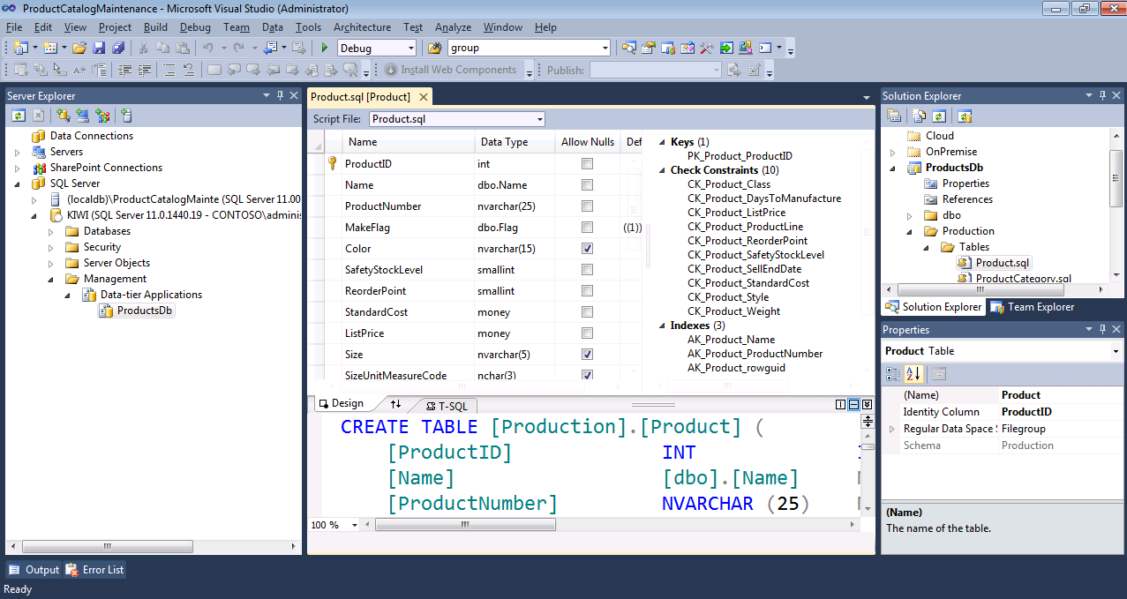
Includes modern designers and projects with declarative, model-driven development
Develop and test in both connected and disconnected states
Visual Studio IDE for database development
Notes:
Slide Objectives:
Highlight the set of tools for developers when interacting with Microsoft Azure SQL Database.
Transition:
Transition statement(s) to setup the slide
Speaking Points:
SQL Database Management Portal -> Cross Browser, Unified Management Experience
SQL Server Data Tools -> Integrated Database Design Environment, Table Designer, Debugging, T-SQL Editor
Notes:
IntelliSense in T-SQL Editor
SQL Server Data Tools
Strive to make it consistent as possible
Intersection with the cloud
Bridging you to the new cloud world
Consistency to the new developer experience
Consistency with the new cloud model

Slide 30
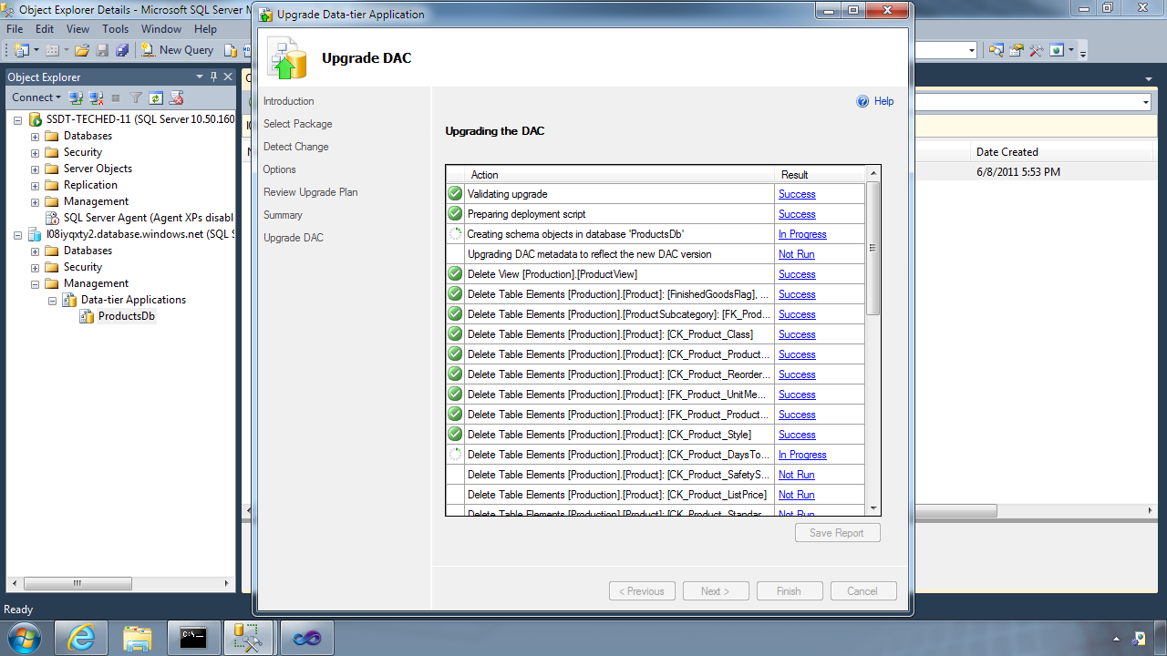
Database Deployment - Data-Tier Application Framework (DAC Fx)
Alternative to traditional script based approach
Dramatically simplifies deployment, migration and versioning of databases
Provides a single unit of deployment for schema (dacpac) or for schema + data (bacpac)
Supports automatic versioning of database schemas
Supports platform targeting for both SQL Server (2005 and above) and SQL Database
Build from scratch or extract from existing db
Notes:
Slide Objectives:
Discuss the deployment options for migrating your on-premises database to SQL Database.
Transition:
There are many ways to migrate your on-premises SQL Server database to Microsoft Azure SQL Database, but there have been great enhancements and improvements in both DAC and SSDT to dramatically improve and simplify deployment and migration options.
Speaking Points:
DAC Framework – A new unit of deployment called a bacpac which contains both schema AND data.
SQL Server Data Tools – Easily determine “Azure read” status. Provide single Publish capability.
Notes:
Both DAC and SSDT provide instant feedback as to the “azure-ready” status of your on-premises database. SSDT provides a single publish from source to destination, but DAC creates a deployment unit which can be stored in Azure storage or on-premises and used to create multiple SQL Database instances.

Slide 31
Database Deployment - How To Get The Latest DAC Fx
SQL Server Data Tools
SQL Server 2012/2014 Management Studio
SQL Database Import/Export Service
http://sqldacexamples.codeplex.com
Notes:
Slide Objectives:
Discuss the deployment options for migrating your on-premises database to SQL Database.
Transition:
There are many ways to migrate your on-premises SQL Server database to Microsoft Azure SQL Database, but there have been great enhancements and improvements in both DAC and SSDT to dramatically improve and simplify deployment and migration options.
Speaking Points:
DAC Framework – A new unit of deployment called a bacpac which contains both schema AND data.
SQL Server Data Tools – Easily determine “Azure read” status. Provide single Publish capability.
Notes:
Both DAC and SSDT provide instant feedback as to the “azure-ready” status of your on-premises database. SSDT provides a single publish from source to destination, but DAC creates a deployment unit which can be stored in Azure storage or on-premises and used to create multiple SQL Database instances.

Slide 32
DAC Deployment From SQL Server Management Studio
Demo
Notes:
Use SSMS to deploy DAC pack to previously provisioned database server

Slide 33
Secure your Database

Slide 34
There are two ways to Secure a database
On The Server
Within The Database
Notes:
Slide Objectives:
Highlight the two areas where Microsoft Azure SQL Database can be secured.
Transition:
Security is vitally important and has not be overlooked. Microsoft Azure SQL Database takes security seriously.
Speaking Points:
Set security options on the server itself
Security within the database
Notes:
This doesn’t leave the application free of any responsibility…some settings are required to be set within the application.

Slide 35
SQL Database Server Security
SQL authentication supported
(No Integrated authentication)
The Admin login is similar to sa
Notes:
Slide Objectives:
Highlight the important server security aspects and benefits of SQL Database security.
Transition:
From the server perspective, there are several things that should be things that should be considered when managing the security of your SQL Database.
Speaking Points:
No Integrated Authentication
Use Master to create and drop databases
The Admin login (which was created during server provisioning) is equivalent to sa. It has full rights on the server (and all databases) and should only be used for administration.
The loginmanager role is used for creating logins: membership in this role grants CREATE / ALTER / DROP Login privileges
The dbmanager role is used for creating databases: membership in this role grants CREATE / ALTER / DROP Database privileges
Manage logins with CREATE / ALTER / DROP LOGIN commands
Notes:
Although the server-level principal login is not a member of the two database roles dbmanager and loginmanager in the master database, it has all permissions granted to these two roles.

Slide 36
SQL Database Server Security
Connect to master to administer logins
loginmanager role: Server-Level security role for creating logins
dbmanager role: Server-Level security role for creating databases
Notes:
Slide Objectives:
Highlight the important server security aspects and benefits of SQL Database security.
Transition:
From the server perspective, there are several things that should be things that should be considered when managing the security of your SQL Database.
Speaking Points:
No Integrated Authentication
Use Master to create and drop databases
The Admin login (which was created during server provisioning) is equivalent to sa. It has full rights on the server (and all databases) and should only be used for administration.
The loginmanager role is used for creating logins: membership in this role grants CREATE / ALTER / DROP Login privileges
The dbmanager role is used for creating databases: membership in this role grants CREATE / ALTER / DROP Database privileges
Manage logins with CREATE / ALTER / DROP LOGIN commands
Notes:
Although the server-level principal login is not a member of the two database roles dbmanager and loginmanager in the master database, it has all permissions granted to these two roles.

Slide 37
SQL Database Security
Logins require an associated user account
The Admin login is automatically associated with dbo
The dbo has full rights in the database
Notes:
Slide Objectives:
Highlight the important server security aspects and benefits of SQL Database security.
Transition:
From the server perspective, there are several things that should be things that should be considered when managing the security of your SQL Database.
Speaking Points:
No Integrated Authentication
Use Master to create and drop databases
The Admin login (which was created during server provisioning) is equivalent to sa. It has full rights on the server (and all databases) and should only be used for administration.
The loginmanager role is used for creating logins: membership in this role grants CREATE / ALTER / DROP Login privileges
The dbmanager role is used for creating databases: membership in this role grants CREATE / ALTER / DROP Database privileges
Manage logins with CREATE / ALTER / DROP LOGIN commands
Notes:
Although the server-level principal login is not a member of the two database roles dbmanager and loginmanager in the master database, it has all permissions granted to these two roles.

Slide 38
SQL Database Security
Manage users with CREATE / ALTER / DROP USER commands
Add users to roles via sp_add_rolemember to grant privileges
Utilize schemas where appropriate
Notes:
Slide Objectives:
Highlight the important server security aspects and benefits of SQL Database security.
Transition:
From the server perspective, there are several things that should be things that should be considered when managing the security of your SQL Database.
Speaking Points:
No Integrated Authentication
Use Master to create and drop databases
The Admin login (which was created during server provisioning) is equivalent to sa. It has full rights on the server (and all databases) and should only be used for administration.
The loginmanager role is used for creating logins: membership in this role grants CREATE / ALTER / DROP Login privileges
The dbmanager role is used for creating databases: membership in this role grants CREATE / ALTER / DROP Database privileges
Manage logins with CREATE / ALTER / DROP LOGIN commands
Notes:
Although the server-level principal login is not a member of the two database roles dbmanager and loginmanager in the master database, it has all permissions granted to these two roles.

Slide 39
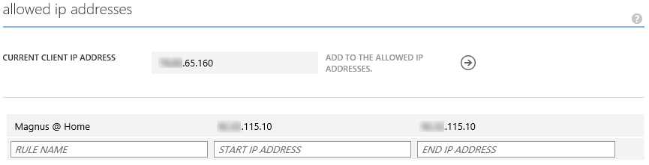
SQL Database Firewall
IP Address-based access control for SQL Database
Rules can be defined at the server and database
No IP authorized by default
Configurable using the SQL Database Portal and REST API
Option to disable/enable access from applications hosted in Microsoft Azure
Notes:
Slide Objectives:
Illustrate the how SQL Database Firewall
Transition:
Transition statement(s) to setup the slide
Speaking Points:
By default, no-one is allowed to access the database.
Server Rules enable clients to access your entire SQL Database server
Database rules enable clients to access individual databases within your SQL Database server
Rules are originating IP Address-based.
Notes:
Maximum of 128 Rules
Rather than using a REST API like the other Azure storage services, SQL Database is accessed via Tabular Data Stream (TDS), the same protocol used by Microsoft SQL Server (operating over port TCP/1433). To help protect the data, the SQL Database firewall prevents all access to your SQL Database server until you specify which computers have permission.
Initially, all access to your SQL Database server is blocked by the SQL Database firewall; connection attempts originating from the Internet or Microsoft Azure will not be able to reach your SQL Database server. In order to begin using your SQL Database server, you must go to the SQL Database Portal and specify one or more firewall settings that enable access to your SQL Database server. Use the firewall settings to specify which IP address ranges from the Internet are allowed, and whether or not Microsoft Azure applications can attempt to connect to your SQL Database server.

Slide 40
Connecting To SQL Database
Tabular Data Stream (TDS) protocol over TCP/IP
SSL required
<connectionStrings>
<addname="AdventureWorks"connectionString=
"Data Source=[server].database.windows.net;
Integrated Security=False;
Initial Catalog=ProductsDb;
User Id=[login]@[server];
Password=[password];
Trusted_Connection=False;
Encrypt=true;"
providerName="System.Data.SqlClient"/>
</connectionStrings>
Notes:
Slide Objectives:
Highlight application connectivity requirement, considerations and best practices to SQL Database.
Transition:
While connecting to SQL Database is fairly straight forward, there are some general considerations and recommended coding practices when developing Microsoft Azure SQL Database applications.
Speaking Points:
Login:
Idle connections terminated after 30 minutes
Long running transactions terminated after 24 hours
DoS guard terminates suspect connections with no error message
Failover events terminate connections
Throttling may generate errors…which leads to:
Implement Connection Pooling and Retry logic to handle transient failures
Latency introduced for updates due to HA replicas
No cross-database dependencies: resultsets from different database must be combined in the application tier (Fan out queries)
Notes:

Slide 41
SQL Database Considerations and Best Practices
login: [login]@[server]
Idle connections
Long running transactions
Notes:
Slide Objectives:
Highlight application connectivity requirement, considerations and best practices to SQL Database.
Transition:
While connecting to SQL Database is fairly straight forward, there are some general considerations and recommended coding practices when developing Microsoft Azure SQL Database applications.
Speaking Points:
Login:
Idle connections terminated after 30 minutes
Long running transactions terminated after 24 hours
DoS guard terminates suspect connections with no error message
Failover events terminate connections
Throttling may generate errors…which leads to:
Implement Connection Pooling and Retry logic to handle transient failures
Latency introduced for updates due to HA replicas
No cross-database dependencies: resultsets from different database must be combined in the application tier (Fan out queries)
Notes:

Slide 42
SQL Database Considerations and Best Practices
DoS guard
Failover events
Throttling
Notes:
Slide Objectives:
Highlight application connectivity requirement, considerations and best practices to SQL Database.
Transition:
While connecting to SQL Database is fairly straight forward, there are some general considerations and recommended coding practices when developing Microsoft Azure SQL Database applications.
Speaking Points:
Login:
Idle connections terminated after 30 minutes
Long running transactions terminated after 24 hours
DoS guard terminates suspect connections with no error message
Failover events terminate connections
Throttling may generate errors…which leads to:
Implement Connection Pooling and Retry logic to handle transient failures
Latency introduced for updates due to HA replicas
No cross-database dependencies: resultsets from different database must be combined in the application tier (Fan out queries)
Notes:

Slide 43
SQL Database Considerations and Best Practices
Connection pooling and Retry logic
Latency introduced for updates
No cross-database dependencies
Notes:
Slide Objectives:
Highlight application connectivity requirement, considerations and best practices to SQL Database.
Transition:
While connecting to SQL Database is fairly straight forward, there are some general considerations and recommended coding practices when developing Microsoft Azure SQL Database applications.
Speaking Points:
Login:
Idle connections terminated after 30 minutes
Long running transactions terminated after 24 hours
DoS guard terminates suspect connections with no error message
Failover events terminate connections
Throttling may generate errors…which leads to:
Implement Connection Pooling and Retry logic to handle transient failures
Latency introduced for updates due to HA replicas
No cross-database dependencies: resultsets from different database must be combined in the application tier (Fan out queries)
Notes:

Slide 44
Microsoft SQL Server on a Virtual Machine
SQL IaaS

Slide 45
Run SQL on VM
Run any SQL product on cloud VM
Support for SQL Server, Oracle, MySql
Ready to go VM images available in Gallery
Persistent storage using attached disk in blob storage

Slide 46
SQL Database
Fully managed “as a Service”
Enterprise-ready with automatic support for HA, DR, Backups, replication and more
Can scale out elastically using ElasticScale
…
SQL IaaS
Choice of a variety of DB engines (SQL Server, Oracle, MySql)
All the features of native DB
Windows authentication available (requires VM to be joined to on-premises domain)
Larger database sizes possible (16TB)
…

Slide 47
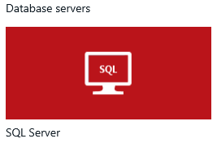
Standing up a SQL Server in Azure using Marketplace
Demo
Notes:
Use portal.azure.com.
Enter Marketplace.
Select Data -> SQL Server -> Any SQL VM you like.
Show Pricing tier options and settings.
Deploy it!

Slide 48
HDInsight

Slide 49
Why Big Data?

Slide 50
Key trends
Device Explosion
Social Networks
Cheap Storage
>5.5 billion (70+% of global population)
>2 billion
users
$100 gets you 3 million times more storage in 30 years)
Ubiquitous Connection
Sensor Networks
Inexpensive Computing
Web traffic
2010 130 exabyte (10 E18)
2015 1.6 zettabyte (10 E21)
>10 billion
1980 10 MIPS/$
2005 10 million MIPS/$

Slide 51

1.8 ZETTABYTES
Of Information will be created in 2011
Source: CenturyLink resource center, as reported in The readwriteweb, Nov 17, 2011

Slide 52
7.9 ZETTABYTES
By 2015
Source: CenturyLink resource center, as reported in The readwriteweb, Nov 17, 2011

Slide 53


Big Data analytics
Data
acquisition
& modeling
Collaboration
& visualization
Analysis & data mining
Dissemination, sharing, preservation
It takes more time to hand a project from the seismic guys to me to the engineers in production than it does to figure out the oil field plays.
Geologist, Major oil and gas company
Our weather model and resulting data sets should be accessible to universities and other institutions.
Aerospace Development Manager, U.S. Federal Government

Slide 54
What is Big Data?
Internet of Things
Social Sentiment
Exabytes
(10e18)
Click Stream
Sensors / RFID / Devices
Wikis / Blogs
Modern Web
Audio / Video
Mobile
Petabytes
(10e15)
Log Files
Advertising
eCommerce
Collaboration
Spatial & GPS Coordinates
Volume
ERP / CRM
Digital Marketing
Data Market Feeds
Terabytes
(10e12)
Search Marketing
Payables
Contacts
eGov Feeds
Payroll
Deal Tracking
Web Logs
Weather
Gigabytes
(10e9)
Inventory
Sales Pipeline
Recommendations
Text/Image
Velocity | Variety | Variability
ERP / CRM
Modern Web
Internet of Things

Slide 55
Example Scenario

Slide 56
Traditional E-Commerce Data Flow
OPERATIONAL DATA
NEW USER REGISTRY
NEW PURCHASE
NEW PRODUCT
Data Warehouse
ETL Some Data
Logs
Excess Data

Slide 57
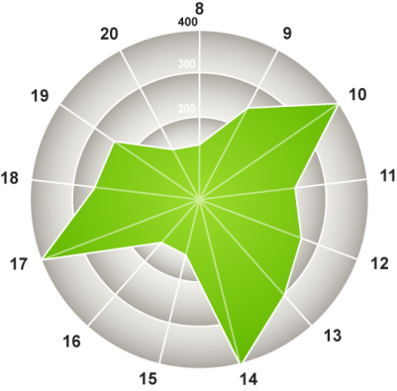
New E-Commerce Big Data Flow
OPERATIONAL DATA
NEW USER REGISTRY
NEW PURCHASE
NEW PRODUCT
Logs
Data Warehouse
Raw Data
“Store it All”
Cluster
Logs
How much do views for certain products increase when our TV ads run?
Raw Data
“Store it All”
Cluster

Slide 58
Understanding the Basics

Slide 59


Characteristics of Big Data
New Data Sources
Large Data Volumes
New Technologies
Non-traditional Data Types
New Economics
New Questions & New Insights

Slide 60

RDBMS vs. Hadoop
 | RDBMS | Hadoop
Data size | Gigabytes (Terabytes) | Petabytes (Hexabytes)
Access | Interactive and Batch | Batch
Updates | Read / Write many times | Write once, Read many times
Structure | Static Schema | Dynamic Schema
Integrity | High (ACID) | Low
Scaling | Nonlinear | Linear
Reference: Tom White’s Hadoop: The Definitive Guide

Slide 61
Programming HDInsight
Existing ecosystem
Hive, Pig, Mahout, Cascading, Scalding, Scoobi, Pegasus…
Microsoft .NET
C#, F# Map/Reduce, Microsoft .NET management clients
DevOps / IT Pros
PowerShell, cross-platform CLI tools

Slide 62
Building developer experiences
Authoring Jobs
App Integration
End-user tooling (IDEs, analyst tools, Command lines)
Extend breadth & depth
Enable new scenarios
Integrate with current tool chains
Lightweight
Low cost to extend
Scenario oriented
Breadth of clients (Java, JS, Microsoft .NET)
Consistent REST APIs
Connectivity
Programmability
Security
Loosely coupled
Innovation flows upward
New compute models
Performance enhancements
Core Hadoop
Authoring frameworks and languages

Slide 63
Demo - HDInsight
Notes:
Provision a cluster via Portal
Provision a cluster via Powershell

Slide 64

Hadoop Architecture
Task tracker
Task tracker
MapReduce Layer
Job tracker
Name node
HDFS Layer
Data node
Data node
Reference: http://en.wikipedia.org/wiki/File:Hadoop_1.png
Notes:
,

Slide 65

Hadoop ecosystem
Pipeline / workflow
(Oozie)
Graph
(Pegasus)
Stats processing
(RHadoop)
Machine Learning
(Mahout)
Data Integration
( ODBC / SQOOP/ REST)
Metadata
(HCatalog)
Legend
■ Core Hadoop
■ Data processing
■ Data Movement
■ Packages
NoSQL Database
(HBase)
Scripting
(Pig)
Query
(Hive)
Distributed Processing
(MapReduce)
Distributed Storage
(HDFS)

Slide 66
HDInsight and Hadoop
ODBC
C#, F#, .NET
Sqoop for SQL Server
PowerShell
Hadoop Core +
Hive, Pig, HBase
Office 365 Power BI (Excel, PowerQuery, PowerView,
BI Sites)
Azure Storage (WASB)
World's Data (Azure Data Marketplace)

Slide 67
Detailed Offerings
INSIGHTS
Integration with Microsoft Power BI stack
Hive ODBC Driver
ENTERPRISE
READY
Hadoop distribution for Microsoft Azure
Strategic Partnership with Hortonworks
BROADER
ACCESS
Integration with diverse sources of data

Slide 68
Deploying and Interacting With a Hadoop Cluster on Azure

Slide 69
MapReduce
Analogous to GROUP BY in SQL
Usually combiners can be an effective way to minimize network IO
Based on the dataset opportunity to use a custom partitioner to balance the reducers
Complete control of mappers and reducers
Non-trivial to write

Slide 70
Hive
SQL-Like query syntax – if you know SQL, you’ll be able to use Hive
Relational set algebra mixed with row-oriented manipulation
Declare tables (internal and external) and views
Query processor optimizes MapReduce job
Microsoft Azure

Slide 71
HiveQL Examples
Create an External Table
CREATE EXTERNAL TABLE iislogs(
sdate string, stime string, ssitename string, csmethod string, csuristem string, csuriquery string, sport int, scstatus int, scbytes int, sbytes int, timetaken int)
ROW FORMAT DELIMITED
FIELDS TERMINATED BY ' '
LOCATION
'wasb://iis-logs@myapp.blob.core.windows.net/'
Run a query to return data
select sdate, stime, csmethod, scuristem, query_params['api-version'] as api_version, query_params['search_value'] as search_value
from (select *, str_to_map(csuriquery, '&', '=') as query_params
from iislogs
) version_logs
where query_params['api-version'] is not null
Microsoft Azure

Slide 72
Pig
Script language for expressing MapReduce jobs
Script operations can be chained together
Compiler optimizes MapReduce job
Microsoft Azure

Slide 73
PigLatin Examples
Load and Transform Data
A = load 'passwd' using PigStorage(':'); -- load the passwd file
B = foreach A generate $0 as id; -- extract the user IDs
store B into ‘id.out’; -- write the results to a file name id.out
Run a query to return and process data
LOGS = LOAD 'wasb:///example/data/sample.log';
LEVELS = foreach LOGS generate REGEX_EXTRACT($0, '(TRACE|DEBUG|INFO|WARN|ERROR|FATAL)', 1) as LOGLEVEL;
FILTEREDLEVELS = FILTER LEVELS by LOGLEVEL is not null;
GROUPEDLEVELS = GROUP FILTEREDLEVELS by LOGLEVEL;
FREQUENCIES = foreach GROUPEDLEVELS generate group as LOGLEVEL, COUNT(FILTEREDLEVELS.LOGLEVEL) as COUNT;
RESULT = order FREQUENCIES by COUNT desc;
DUMP RESULT;
Microsoft Azure

Slide 74
Microsoft Big Data Roadmap
Microsoft is extending its leadership in business intelligence and data warehousing to provide insights to all users by activating new types of data of any size
To accelerate the delivery of Microsoft’s Hadoop based solution for Windows Server and service for Microsoft Azure, Microsoft is announcing a partnership with Hortonworks
Microsoft is announcing an end-to-end roadmap for Big Data that embraces Apache HadoopTM by distributing enterprise class Hadoop based solutions on both Windows Server and Microsoft Azure
Microsoft is committed to broadening accessibility and usage of Hadoop to end users, developers and IT professionals in organizations of all sizes

Slide 75
Resources
http://www.hadooponazure.com/
http://hadoop.apache.org/

Slide 76
NoSQL

Slide 77
Generally more scalable
The storage engines of NoSQL stores are designed to minimize contentions enabling higher throughput and therefore more scalable
Lower transaction capability in NoSQL results in less contention and therefore more scalable
Less complex query processor means that a single query can’t degrade service
Built-in replication capability means that store can scale out which better aligns to other application tiers (e.g. websites)
No fixed schema or lower schema requirements
Microsoft Azure

Slide 78
NoSQL on Azure
Azure Tables service is NoSQL row store
MongoDB is a document (JSON) store
Cassandra is a columnar store with excellent replication
HBase is a Big Data (Hadoop) NoSQL store available in HDInsight
Microsoft Azure

Slide 79
Microsoft Azure DocumentDB

Slide 81
16 regions worldwide in 2014
Azure footprint

Slide 82
>57%
Greater than
1,000,000
>250k
Fortune 500 using Azure
Active websites
SQL Databases in Azure
>20
>1
TRILLION storage objects
>300
MILLION
AD users
MILLION
Developers registered with Visual Studio Online
>2
MILLION requests/sec
>13
BILLION
authentication/wk

Slide 83
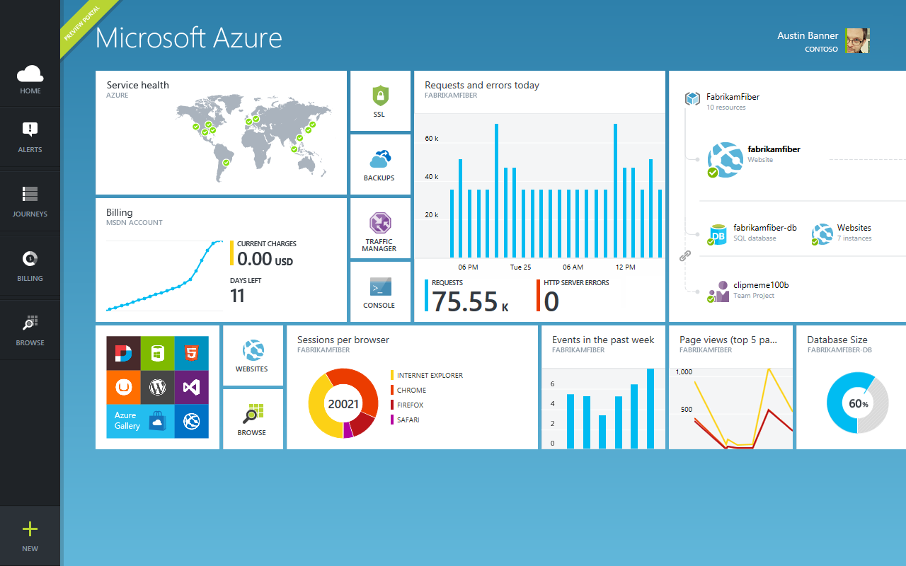

Slide 84

Get started
Visit azure.microsoft.com

Slide 85

SQL Database Billing Rates (As of February 2012)
Database Size | Price Per Database Per Month
0 to 100 MB | Flat $4.995
> 100 to 1 GB | Flat $9.99
> 1GB to 10 GB | $9.99 for first GB, $3.99 per additional GB
> 10 GB to 50 GB | $45.954 for first 10 GB, $1.998 for each additional GB
> 50 GB to 150 GB | $145.874 for first 50 GB, $0.999 for each additional GB
Based on graduated rate based on database size
Charged at monthly rate per database
Amortized over month -> calculated on daily basis
No Transaction Charges
Data Transfers
North America and Europe regions $0.05 - $0.12 per GB outbound
Asia Pacific region $0.12 - $0.19 per GB outbound
All inbound data transfers are at no charge.
Notes:
Slide Objectives:
Understand the SQL Database pricing
Transition:
Speaking Points:
Reduced database rates as of February 2012
Notes:
http://www.windowsazure.com/en-us/pricing/details/#data-management
http://www.windowsazure.com/en-us/pricing/details/#data-transfers

Slide 86
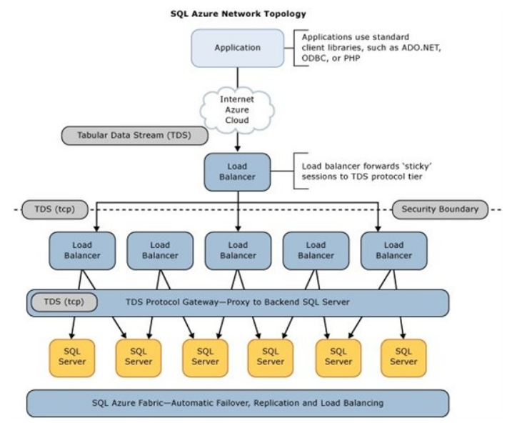
SQL Database Architecture

