Slide 1
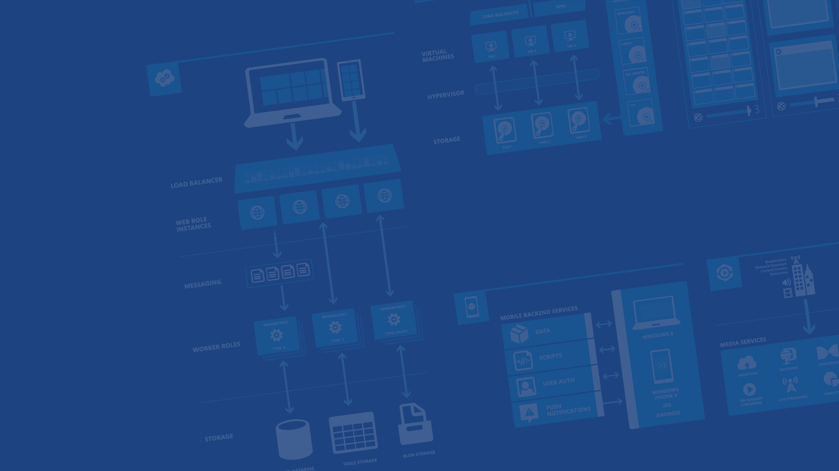
Cloud Powered Mobile Apps with Azure
<Presenter Name>
<Presenter Title>
<company / contact info>
Microsoft Azure

Slide 2
Agenda
Mobile Services
Features and Demos
Advanced Features
Scaling and Pricing
Questions
Notes:
Speaking Points:
Topics covered in the session include
What is Microsoft Azure
What is Mobile Services, a feature of Azure
Features and demos
Advanced features throughout the session
Scaling and pricing details
Questions at the end

Slide 3



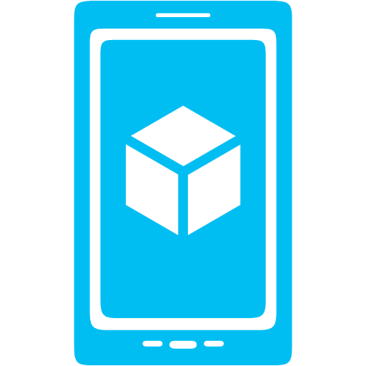



What is Mobile Services?
Storage
Authentication
Logic
Push
Scheduler
Notes:
Speaking Notes
Azure Mobile Services is a Backend-as-a-Service
Instead of you having to design, build, test, deploy, manage, and upgrade your whole backend, we do it for you
Features of Mobile Services
Storage – SQL DB
Authentication – built in support for social providers w/ ability to custom auth
Backend logic – data validation, logical flows, etc
Push Notifications – across all major mobile platforms
Scheduler – backend job processing

Slide 4
Demo: Getting Started
Your first Mobile Service
Notes:
Demo: Getting Started
Go to the portal
Create a new mobile service (Node backend works with most of deck)
Walk through Getting started screen
Choose platform
Download quick start
Run quick start
Save and update data
Show data in portal (Node)
Walk through client code that deals with Mobile Service

Slide 5
Structured Storage
Powered by SQL Database
Supports rich querying capabilities
Dynamic Schematization
Data management in:
Azure Portal
SQL Portal (Silverlight)
SQL Management Studio
REST API
Azure CLI Tools
SQL CLI
Microsoft Azure
Notes:
Speaking points
Mobile Service easily connects to SQL Database
SQL offers rich querying and indexing capabilities
Dynamic Schematization means you don’t have to be a DBA and manage schema
Data can be managed in:
Azure Portal (read and delete data)
SQL Portal (Silverlight)
SQL Management Studio (windows)
REST API (used by SDKs)
Azure CLI tools
SQL CLI (Node module)

Slide 6
The REST API
Base Endpoint: https://MobileService.azure-mobile.net/tables/*
Action | HTTP Method | URL Suffix
Create | POST | /TodoItem
Read | GET | /TodoItem?filter=id%3D42
Update | PATCH | /TodoItem/id
Delete | DELETE | /TodoItem/id
Microsoft Azure
Notes:
Speaking points
This is the mapping for the REST API exposed by table storage
Standard REST
Anything that can talk REST can connect to your Mobile Service

Slide 7
JSON to SQL Type Mappings
JSON Type | T-SQL Type
Numeric values (integer, decimal, floating point) | Float(53)
Boolean | bit
DateTime | DateTimeOffset(3)
String | Nvarchar(max)
Microsoft Azure
Notes:
Speaking points
JSON to SQL mapping
Whatever JSON data type on left is passed in generates column of SQL type on right

Slide 8
Auto-generated Columns
id – unique guid
__createdAt – date
__updatedAt – date
__version – timestamp
Helps with concurrency and offline
Microsoft Azure
Notes:
Speaking notes
Auto-generated columns
id – unique id used to handle querying, updating, and deleting specific rows
createdAt, updatedAt, version help with optimistic concurrency (first update wins)
Last three columns not pulled to client by default (Need to specify query parameter to get those back)

Slide 9
Backend Logic: JavaScript & .NET
Notes:
Speaking points
* Section change: Backend Logic

Slide 10
Server Side Table Scripts
Node.js scripts
.NET Web API
backend in
Visual Studio
Passes through to SQL by default
MongoDB, Table Storage, SQL out of the box
Intercept CRUD requests to tables
Fully customizable
Notes:
Speaking points
Node backend generates Node scripts for each table action
Scripts intercept CRUD requests
Pass to SQL by default
Custom logic added here
Edit in portal (NODE)
.NET Backend creates Visual Studio project

Slide 11
Node Modules
request
push.*
sendgrid
console
mssql
pusher
tables
azure
twilio
Notes:
Speaking points
Node backend comes with pre-included modules
Request – make web requests against other services
Push.* - perform push notifications
Console – log information
Mssql – call stored procedures / custom SQL
Tables – OO way of accessing tables in backend
Azure – access service bus, blob, table storage, notification hubs, etc
Partners
Sendgrid – send emails
Pusher – web socket style communications
Twilio – SMS and voice
Most have a free tier you can use

Slide 12
Demo: Customizing Logic
Adding Data Validation
Notes:
Demo: Customizing logic
If using quick start
Go into insert script and add validation to check length of item.text field
Run app and show validation catching
Show app still working if validation is fulfilled

Slide 13
.NET Backend
Web API based w/ additional functionality, developed in and deployed from Visual Studio
TableController data context can map to SQL, Table Storage, Mongo, etc
Pull in NuGet modules and other .NET libraries
Set permissions with attributes on classes
Local Debug
Microsoft Azure
Notes:
Speaking points
.NET backend is currently in preview
Bases off of Web API
Develop and deploy in VS (also create new Mobile Services with VS project template)
Debug locally
Can pull in NuGet and other .NET libs
TableController is base for accessing data, can be overridden to talk to Table Storage, Mongo, etc
Permissions handled as attributes on classes

Slide 14
Custom API
Non-table based endpoints
Accessible from
GET
POST
PUT
PATCH
DELETE
For node.js logic in scripts like table endpoints
For .NET delivered through a WebAPI
Expose any functionality you want
Microsoft Azure
Notes:
Speaking points
All scripts so far tied to a table action
Custom APIs are non-table based endpoints
Script functionality for normal HTTP methods

Slide 15
File Storage
Don’t store files in Mobile Services DB
Use Mobile Service to provide a Valet Key Pattern to Blob Storage, aka BLOB SAS
Create table / custom API script to talk to Blob Storage
Script generates Shared Access Signature (SAS) URL
Script returns SAS URL to client app
Client app uploads data to blob storage directly
Store file URL in Mobile Service DB as needed
Blob storage costs less and is built for redundant file storage
Resource Broker extension for .NET and Node backends
Microsoft Azure
Notes:
File storage
SQL DB for Mobile Services not ideal for file data storage
Best practice is to use Mobile Service as Proxy
Mobile Service script generates SAS URL
Client uploads file to SAS URL
Valet Key Pattern http://msdn.microsoft.com/en-us/library/dn568102.aspx

Slide 16
Push Notifications
Notes:
Speaking points
Section change: Push Notifications

Slide 17
Push Notification Flow
Client
Mobile Services
Register for push notifications with PNS
Send your identifier to Mobile Service
Send push from server scripts
PNS delivers notification to device
App
(2)
(3)
(4)
(1)
PNS
Microsoft Azure
Notes:
Speaking points
Push notifications work the same no matter which client you’re working with
Client talks to PNS to register for push
Client gets token, passes to Mobile Service
Mobile Service asks PNS to deliver payload to token / channel URI / registration ID
PNS delivers push to client app
PNS = Push Notification Service (i.e. MPNS, WNS, GCM, ADM, APNS)

Slide 18
Demo: Adding Push Notifications
Notes:
Demo: Adding Push
Configure server side for push (Apple Dev portal / Android portal / Win Portal)
Copy certificate / api key / etc to Azure portal
Set up push on client
Enable push from server to client

Slide 19
Notification Hubs
Separate from Mobile Services
Can be used regardless of whether you’re storing data in Azure
Extremely scalable push notifications
Cross platform support
Push to iOS, Android, Kindle, Windows Phone, Windows Store
Tags (i.e. tie my registration to this topic or user ID)
Templates (i.e. when I get a push, send it in this format)
Server SDKs for .NET, Java, and Node (also open as REST API)
Microsoft Azure
Notes:
Speaking points
Notification Hubs are a separate service from Mobile Services but also used by Mobile Services
Pushes to iOS, Android, Kindle, Windows Phone, Windows Store
Extremely scalable (millions of pushes in minutes)
Tags and templates
Server SDKs: .NET, Java (beta), Node, REST API

Slide 20
Authorization & Authentication
Notes:
Speaking points
Section change: Authorization and Authentication
Controlling who can access what

Slide 21
Data Authorization
Per HTTP method auth options:
App Key Required
Not ideal for production use
Everyone
Authenticated Users
Admins and other scripts
Requires Master Key as header
401 Unauthorized response if security check fails
Microsoft Azure
Notes:
Speaking points
Data auth – locking data down
Default is App Key Required, great for pre-release time period
Not production ready due to key’s accessibility in public apps
Authenticated users – requests must contain user ID and matching auth token
Admins and other scripts – only external requests with Master Key make it through
Otherwise 401 is returned

Slide 22
User Auth Flow (server)
GOOGLE
CREDENTIALS (via oAuth/WebView)
FACEBOOK
DEVICE
TWITTER
AUTH TOKEN
GRAPH ACCESS (LIMITED)
MICROSOFT ACCOUNT
IDENTITY
AAD
MOBILE SERVICE
Microsoft Azure
Notes:
Speaking Points
Server auth flow uses OAUTH
Mobile Service is registered with provider to allow auth
Client calls auth method and passes in provider name
User authenticates, Mobile Service and provider do OAUTH
User ID and token (for Mobile Service) returned to client
Provider token / secret accessible in Mobile Service

Slide 23

User Auth Flow (client)
GOOGLE
CREDENTIALS (via native SDKs)
FACEBOOK
AUTH CODE + TOKEN
DEVICE
GRAPH ACCESS
TWITTER
GRAPH ACCESS
MICROSOFT ACCOUNT
AUTH CODE
IDENTITY
AAD
MOBILE SERVICE
Microsoft Azure
Notes:
Speaking points
Client flow uses SDKs for provider / platform
User auths using SDK on client
Provider token / secret sent to Mobile Service
Mobile Service checks validity and hands back user ID and token

Slide 24
The User object
User.level
Admin
Authenticated
Anonymous
User.userId
Provider:id or undefined
User.getIdentities()
UserId
Provider Access Token / Secret
Basic user information (i.e. name, username, locale, picture, link)
Microsoft Azure
Notes:
Speaking points
User level indicates if they’ve logged in or came across with master key
User ID for user making the request
GetIdentities can be called to get provider token / secret and basic information from provider

Slide 25
Demo: Adding Auth
Lock Down and Login
Notes:
Demo: adding auth
Lock table operations down to authenticated users
Attempt to access and show 401 on client
Set up auth provider and mobile service in portal
Add auth code to client
Show auth working
Add logic to insert script to tie data to user
Add logic to read script to only fetch data user can access

Slide 26
Offline Sync
Notes:
Speaking notes
Subject change: Scheduler

Slide 27
Offline support
SQL Database
Conflict resolution
TableController
(with optimistic concurrency)
BYOD
SQLite
Explicit Push/Pull
Table Storage
Device
Mobile Service
MongoDB

Slide 28
Offline Sync: Potential Uses
Improve app responsiveness by caching server data locally on the device
Make apps resilient against intermittent network connectivity
Allow end-users to create and modify data even when there is no network access, supporting scenarios with little or no connectivity
Sync data across multiple devices and detect conflicts when the same record is modified by two devices

Slide 29
Scheduler
Notes:
Speaking notes
Subject change: Scheduler

Slide 30
Scheduled Jobs
Executes a script on defined schedule
Can be run on demand
Ideal for any backend data processing job
Length / frequency based of Mobile Service tier
Microsoft Azure
Notes:
Speaking points
Schedule jobs (scripts) can be run by the scheduler
Ideal for any backend job processing (regular push notification, remove old data, etc)
Length and how often you can run job based off tier of your mobile service

Slide 31
Script Source Control
Notes:
Speaking points
Subject change: Script source control

Slide 32
Script Source Control
Creates a Git repo in Azure
Node.js only, turned on by default
Access table, scheduler, custom API, shared scripts and permissions
Pushing changes triggers a redeploy of your Mobile Service
Enables installing NPM modules (for Node backends)
Shared Scripts
Create scripts that can be used from all other scripts in your Service
Microsoft Azure
Notes:
Speaking points
Script source control creates GIT repo for all scripts and permission JSON files
Enables you to pull scripts down and edit locally
Lets you create shared scripts to reuse code
Enables installing of NPM modules (Node)

Slide 33
Diagnostics Logging Scale
Notes:
Speaking points
Subject change: diagnostics, logging, scale

Slide 34
Diagnostics, Logging, Scale
API Calls, # of Devices, Data Out
Console Logging (auto error logging)
Scale Service Based off API Calls
Auto-scale to Save Money
Free Tier for Mobile
Free Tier for SQL
Notes:
Speaking points
Some default stats like # of api calls, # of devices connecting, amount of data out
Api calls are important because that’s how mobile services’ scale is baed
All console statements and errors go to logging area
Auto-scaling helps save money
Free tier for Mobile Services and SQL while developing

Slide 35
Mobile Service Scaling
→ Free: 500k calls / month / subscription
→ Basic: 1.5M calls / unit (6) / month
→ Standard: 15M calls / unit (10) / month
Microsoft Azure
Notes:
Speaking points
Scaling
Free 500k / month / sub (across entire subscription is important distinction)
Basic 1.5M / unit / month (up to 6 units)
Standard 15M / unit / month (up to 10 units)
More units available by contacting support

Slide 36
Demo: Scaling
Leaving Free Mode and Turning on AutoScale
Notes:
Demo: Scaling
Go to scaling tab
Go to Standard mode
Turn on auto-scaling
Explain that additional units will only be turned on / used if you need them based off daily API calls

Slide 37
Command Line Interface
Notes:
Speaking points
Section change: Command Line Interface

Slide 38
CLI
Create / Delete Services
Inspect / Delete Table Data
Create / Update / Delete Tables and Permissions
Create / Upload / Delete Scripts
Scale Up / Down Services
Much More Across Azure
Notes:
Speaking points
CLI allows you to do many different things within Azure
Create new Mobile Services, read table data, update permissions and scripts, change scale, turn on and off features, etc
Also allows you to do things outside Mobile Services (create VMs, read debug logs, etc)

Slide 39
Demo: Using the CLI
Notes:
Demo: Using the CLI
Open the CLI tools
Perform some commands
azure mobile list
azure mobile table list <service-name>
Reference: http://azure.microsoft.com/en-us/documentation/articles/mobile-services-manage-command-line-interface/

Slide 40
Mobile Service Tiers
usage & licensing
service level agreements
$
 | Free | Basic | Standard
Usage Restrictions | Up to 10 services, Up to 500 Active Devices* | N/A | N/A
API Calls | 500K (per subscription) | 1.5M (per unit) | 15M (per unit)
Scale | N/A | Up to 6 (in portal) | Up to 10 (in portal)
Scheduled Jobs | Limited | Included | Included
SQL Database (required) | 20MB free DB | 20MB free DB | 20MB free DB
General Availability 99.9%
*Active devices refers to the number of physical devices and emulators that make at least one call to or receive a push notification from your mobile service.
Notes:
Speaking points
Review different tiers
Mention that SQL database bills separately but is a full SQL DB and can be accessed from other resources (i.e. web sites, VMs)

Slide 41
Azure Mobile Services
Storage
Authentication
Logic
Push
Scheduler
Notes:
Speaking Notes
Summarize earlier slide
Azure Mobile Services is a Backend-as-a-Service
Instead of you having to design, build, test, deploy, manage, and upgrade your whole backend, we do it for you
Features of Mobile Services
Storage – SQL DB
Authentication – built in support for social providers w/ ability to custom auth
Backend logic – data validation, logical flows, etc
Push Notifications – across all major mobile platforms
Scheduler – backend job processing

Slide 42
Resources
Get a FREE Microsoft Azure Trial Account:
http://azure.microsoft.com
Videos, Tutorials, and More
http://azure.microsoft.com/mobile
SDK Source Code on GitHub
https://github.com/Azure/azure-mobile-services
Contact Details
<Contact Info>
Microsoft Azure
Notes:
Speaking points
Sign up for a free Azure trial
Mobile Services are free to develop with (to a point) on non-trial subscription
Additional videos, tutorials, samples available
SDK source code (for Mobile Services and Notification Hubs) available in GitHub

Slide 43

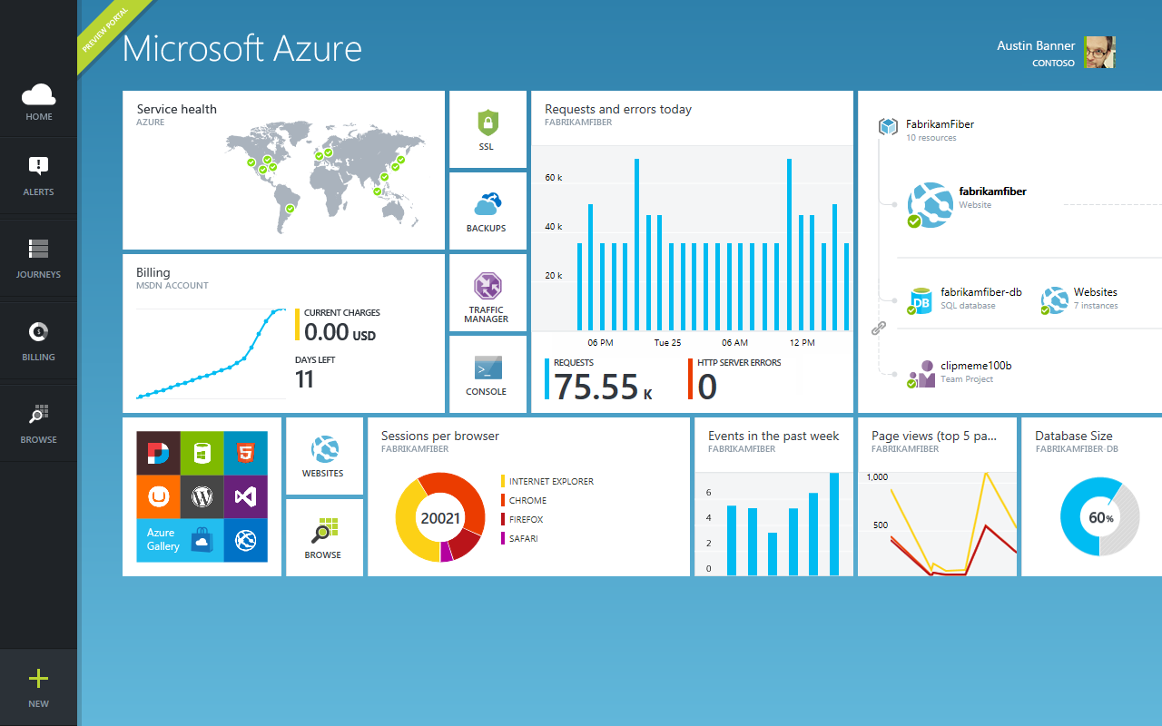
Get started
Visit azure.microsoft.com

Slide 45
16 regions worldwide in 2014
Azure footprint

Slide 46
>57%
Greater than
1,000,000
>250k
Fortune 500 using Azure
Active websites
SQL Databases in Azure
>20
>1
TRILLION storage objects
>300
MILLION
AD users
MILLION
Developers registered with Visual Studio Online
>2
MILLION requests/sec
>13
BILLION
authentication/wk

