Slide 1
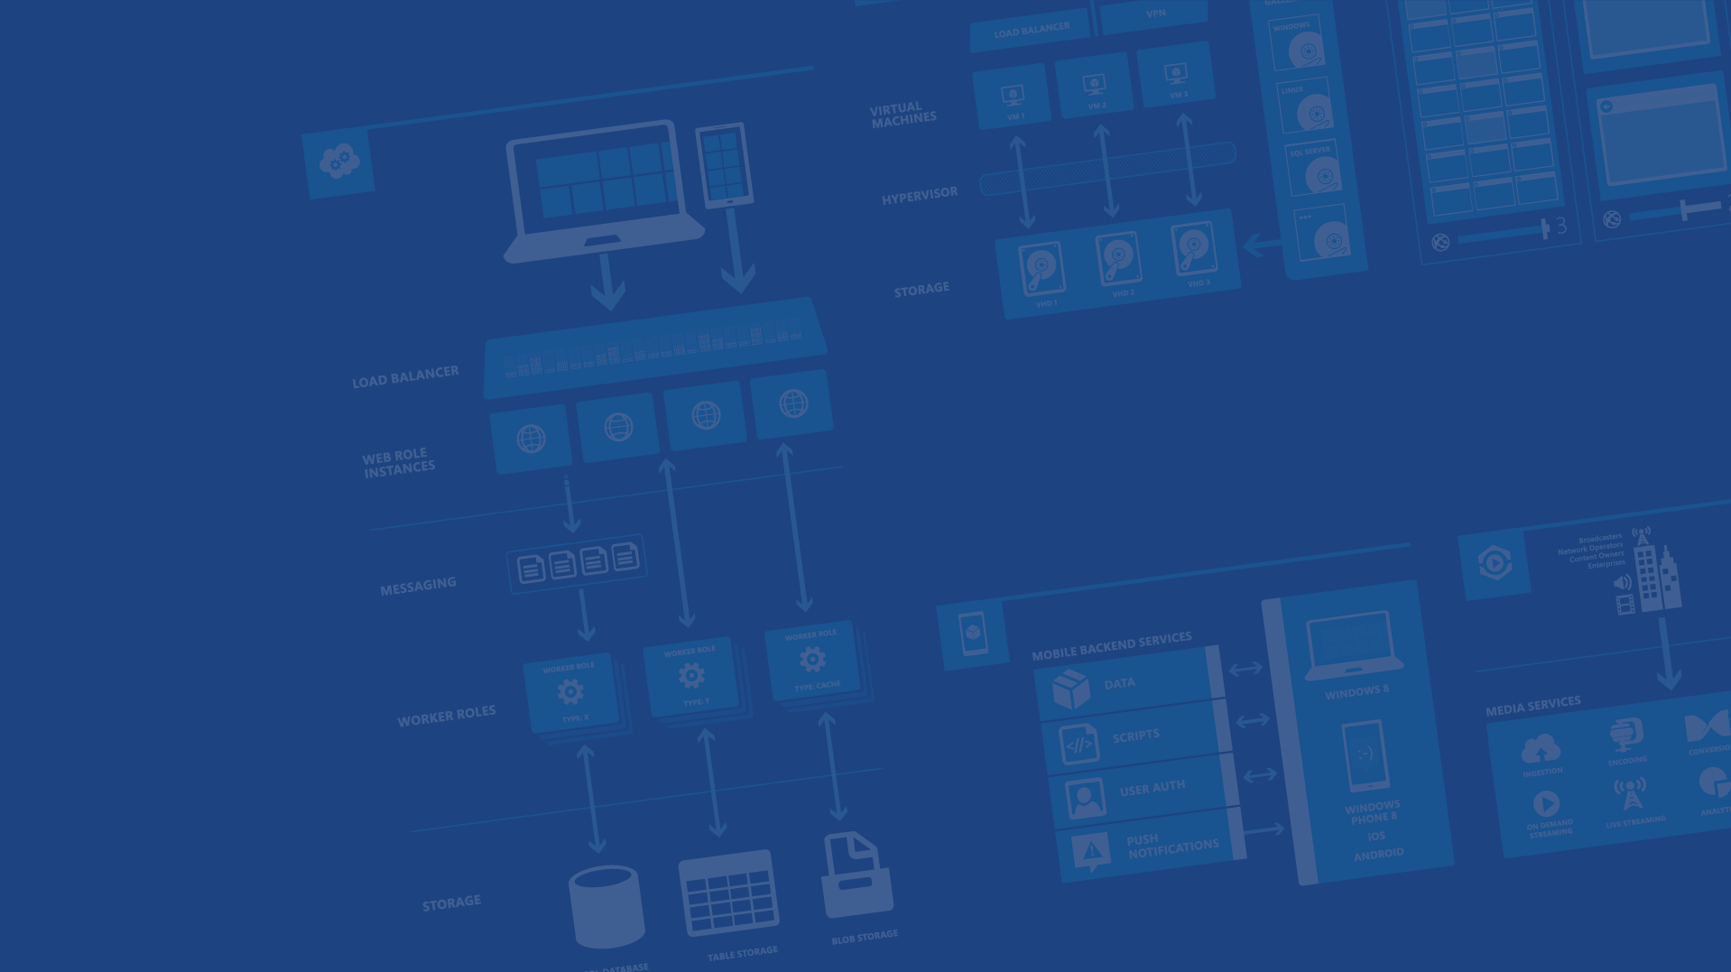
Azure Data Overview
Presenter Name
Position or role
Microsoft Azure

Slide 2
Agenda
SQL Database
SQL on IaaS
NoSQL
Blobs
Files
StorSimple
Queues
DocumentDB

Slide 3
Microsoft Azure SQL Database

Slide 4

Microsoft Relational Storage Options
A Continuous offering
Physical
Virtual
IaaS
SaaS
From private to public Cloud
Notes:
Slide Objectives:
Show Microsoft’ continuous Private to Public Cloud Offering, but this presentation will focus on Microsoft’s relational database PaaS offering.
Transition:
Microsoft provides a continuous solution from private cloud to the public cloud. No matter where you are on your technology roadmap we have a solution to fit your needs.
We are a trusted advisor and platform in the traditional enterprise and ISV space with new IaaS offerings that making it easier to bring this same level of trust and ease of use to the public cloud. However, Microsoft Azure SQL Database extends SQL Server capabilities to the cloud by offering SQL Server as a relational database service.
Speaking Points:
SQL Database provides SQL Server as a relational service.

Slide 5
Microsoft Azure SQL Database
Architecture

Slide 6
A Server is not a machine
SQL Server
Machine
(Physical/VM)
Azure
SQL Database Server
TDS Endpoint
Notes:
Slide Objectives:
Understand that while there are physical SQL Server boxes behind the scenes, when connecting to SQL Database, you are not connecting to a physical server, but to a TDS endpoint.
Transition:
The key to understanding SQL Database is understanding while SQL Database is SQL Server, we do not interact with them in the same physical manner.
Speaking Points:
In an on-premises environment, we typically have physical access to the actual SQL Server server.
In Microsoft Azure, we do not have physical access to the actual server.
Notes:
It is important that the attendee understands that it IS INDEED SQL Server at the platform layer. There are physical boxes running SQL Server 2012 Enterprise Edition. However, due to the nature of the Azure environment to provide the high-availability and scalability necessary, access to the physical boxes is currently not supported.

Slide 7
Microsoft Azure SQL Database
Starting with the basics

Slide 8
SQL Server database technology “as a Service”
Fully Managed
Enterprise-ready with automatic support for HA, DR, Backups, replication and more
Can scale out elastically using ElasticScale
SQL Database – The Basics
Notes:
Slide Objectives:
Understand the overall concepts and benefits of SQL Database
Transition:
Let’s clear up any confusion and look at the basics of what SQL Database really is and some of its benefits.
Speaking Points:
The same great SQL Server database technology that you know, love, and use on-premises provided as a service
Enterprise-ready
Automatic support for High-Availability
Designed to scale on-demand to provide the same great elasticity
Notes:
High-availability – 3 copies of the database free for the cost of the one database. Always in sync. The cost to do this on-premises isn’t cheap. This is FREE in SQL Database.

Slide 9
How It Works – Architecture of the Service
Client Layer
PHP
SQL Server
Applications
and Tools
WCF Data Services
Applications communicate directly with SQL Database using TDS.
ODBC
ADO.NET
Tabular Data Stream (TDS)
Notes:
Slide Objectives:
To understand the actual architecture that provides the enterprise-ready SQL Database service.
Transition:
Developers have spent years working with their technology of choice, and Microsoft wanted to ensure that the technologies and tools you use today will continue to work with SQL Database without learning a whole new set of technologies.
Speaking Points:
Familiar technology and tools
Similar architecture as that of on-premises
Additional layer providing server and database partitioning, client connection routing, and billing.
Same great SQL Server technology on the backend.
Additional services (SQL Database Fabric) to ensure SLAs are met and to ensure optimum performance.
Notes:
Client - The client layer resides closest to your application, and is used by your application to communicate directly with SQL Database. The client layer can reside on-premise in your datacenter or be hosted in Microsoft Azure. Because SQL Database provides the same tabular data stream (TDS) interface as SQL Server, you can use familiar tools and libraries to build client applications for data that is in the cloud.
Services - The services layer functions as a gateway between the client layer and the platform layer, where the data resides. The services layer provides three functions: provisioning, billing and metering, and connection routing.
The services layer provisions the databases that you specify with your Microsoft Azure platform account. The billing and metering aspect of the services layer enables multi-tenant support by providing monitoring and billing for database usage based on individual Microsoft Azure platform accounts. SQL Database is built on a scalable platform involving numerous physical servers; this layer handles all the connections routing between your application and the physical servers where your data resides.
Platform - The platform layer includes the physical servers and services that support the services layer. The platform layer consists of many instances of SQL Server, each of which is managed by the SQL Database fabric.
The SQL Database fabric is a distributed computing system composed of tightly integrated networks, servers, and storage. It enables automatic failover, load balancing, and automatic replication between physical servers.
Management services monitor the health of individual servers and enable automated installation of service upgrades and software patches.
Infrastructure - The infrastructure layer represents the IT administration of the physical hardware and operating systems that support the services layer.

Slide 10
How It Works – Architecture of the Service
Client Layer
PHP
SQL Server
Applications
and Tools
WCF Data Services
ODBC
ADO.NET
Tabular Data Stream (TDS)
TDS+SSL
Gateway between Client layer and Platform layer.
Services Layer
Provisioning
Provisioning
Provisioning
…
Billing and Metering
Billing and Metering
Billing and Metering
…
Connection Routing
Connection Routing
Connection Routing
…
Notes:
Slide Objectives:
To understand the actual architecture that provides the enterprise-ready SQL Database service.
Transition:
Developers have spent years working with their technology of choice, and Microsoft wanted to ensure that the technologies and tools you use today will continue to work with SQL Database without learning a whole new set of technologies.
Speaking Points:
Familiar technology and tools
Similar architecture as that of on-premises
Additional layer providing server and database partitioning, client connection routing, and billing.
Same great SQL Server technology on the backend.
Additional services (SQL Database Fabric) to ensure SLAs are met and to ensure optimum performance.
Notes:
Client - The client layer resides closest to your application, and is used by your application to communicate directly with SQL Database. The client layer can reside on-premise in your datacenter or be hosted in Microsoft Azure. Because SQL Database provides the same tabular data stream (TDS) interface as SQL Server, you can use familiar tools and libraries to build client applications for data that is in the cloud.
Services - The services layer functions as a gateway between the client layer and the platform layer, where the data resides. The services layer provides three functions: provisioning, billing and metering, and connection routing.
The services layer provisions the databases that you specify with your Microsoft Azure platform account. The billing and metering aspect of the services layer enables multi-tenant support by providing monitoring and billing for database usage based on individual Microsoft Azure platform accounts. SQL Database is built on a scalable platform involving numerous physical servers; this layer handles all the connections routing between your application and the physical servers where your data resides.
Platform - The platform layer includes the physical servers and services that support the services layer. The platform layer consists of many instances of SQL Server, each of which is managed by the SQL Database fabric.
The SQL Database fabric is a distributed computing system composed of tightly integrated networks, servers, and storage. It enables automatic failover, load balancing, and automatic replication between physical servers.
Management services monitor the health of individual servers and enable automated installation of service upgrades and software patches.
Infrastructure - The infrastructure layer represents the IT administration of the physical hardware and operating systems that support the services layer.

Slide 11
How It Works – Architecture of the Service
Client Layer
PHP
SQL Server
Applications
and Tools
WCF Data Services
ODBC
ADO.NET
Tabular Data Stream (TDS)
TDS+SSL
Services Layer
Provisioning
Provisioning
Provisioning
…
Billing and Metering
Billing and Metering
Billing and Metering
…
Connection Routing
Connection Routing
Connection Routing
…
Includes physical servicers and services that support the Services layer.
Platform Layer
SQL Server
SQL Server
SQL Server
…
SQL Database Fabric
SQL Database Fabric
SQL Database Fabric
…
Management Services
Management Services
Management Services
…
Notes:
Slide Objectives:
To understand the actual architecture that provides the enterprise-ready SQL Database service.
Transition:
Developers have spent years working with their technology of choice, and Microsoft wanted to ensure that the technologies and tools you use today will continue to work with SQL Database without learning a whole new set of technologies.
Speaking Points:
Familiar technology and tools
Similar architecture as that of on-premises
Additional layer providing server and database partitioning, client connection routing, and billing.
Same great SQL Server technology on the backend.
Additional services (SQL Database Fabric) to ensure SLAs are met and to ensure optimum performance.
Notes:
Client - The client layer resides closest to your application, and is used by your application to communicate directly with SQL Database. The client layer can reside on-premise in your datacenter or be hosted in Microsoft Azure. Because SQL Database provides the same tabular data stream (TDS) interface as SQL Server, you can use familiar tools and libraries to build client applications for data that is in the cloud.
Services - The services layer functions as a gateway between the client layer and the platform layer, where the data resides. The services layer provides three functions: provisioning, billing and metering, and connection routing.
The services layer provisions the databases that you specify with your Microsoft Azure platform account. The billing and metering aspect of the services layer enables multi-tenant support by providing monitoring and billing for database usage based on individual Microsoft Azure platform accounts. SQL Database is built on a scalable platform involving numerous physical servers; this layer handles all the connections routing between your application and the physical servers where your data resides.
Platform - The platform layer includes the physical servers and services that support the services layer. The platform layer consists of many instances of SQL Server, each of which is managed by the SQL Database fabric.
The SQL Database fabric is a distributed computing system composed of tightly integrated networks, servers, and storage. It enables automatic failover, load balancing, and automatic replication between physical servers.
Management services monitor the health of individual servers and enable automated installation of service upgrades and software patches.
Infrastructure - The infrastructure layer represents the IT administration of the physical hardware and operating systems that support the services layer.

Slide 12
How It Works – Architecture of the Service
Client Layer
PHP
SQL Server
Applications
and Tools
WCF Data Services
ODBC
ADO.NET
Tabular Data Stream (TDS)
TDS+SSL
Services Layer
Provisioning
Provisioning
Provisioning
…
Billing and Metering
Billing and Metering
Billing and Metering
…
Connection Routing
Connection Routing
Connection Routing
…
Platform Layer
SQL Server
SQL Server
SQL Server
…
SQL Database Fabric
SQL Database Fabric
SQL Database Fabric
…
Administration of the physical HW and OS.
Management Services
Management Services
Management Services
…
Infrastructure Layer
Notes:
Slide Objectives:
To understand the actual architecture that provides the enterprise-ready SQL Database service.
Transition:
Developers have spent years working with their technology of choice, and Microsoft wanted to ensure that the technologies and tools you use today will continue to work with SQL Database without learning a whole new set of technologies.
Speaking Points:
Familiar technology and tools
Similar architecture as that of on-premises
Additional layer providing server and database partitioning, client connection routing, and billing.
Same great SQL Server technology on the backend.
Additional services (SQL Database Fabric) to ensure SLAs are met and to ensure optimum performance.
Notes:
Client - The client layer resides closest to your application, and is used by your application to communicate directly with SQL Database. The client layer can reside on-premise in your datacenter or be hosted in Microsoft Azure. Because SQL Database provides the same tabular data stream (TDS) interface as SQL Server, you can use familiar tools and libraries to build client applications for data that is in the cloud.
Services - The services layer functions as a gateway between the client layer and the platform layer, where the data resides. The services layer provides three functions: provisioning, billing and metering, and connection routing.
The services layer provisions the databases that you specify with your Microsoft Azure platform account. The billing and metering aspect of the services layer enables multi-tenant support by providing monitoring and billing for database usage based on individual Microsoft Azure platform accounts. SQL Database is built on a scalable platform involving numerous physical servers; this layer handles all the connections routing between your application and the physical servers where your data resides.
Platform - The platform layer includes the physical servers and services that support the services layer. The platform layer consists of many instances of SQL Server, each of which is managed by the SQL Database fabric.
The SQL Database fabric is a distributed computing system composed of tightly integrated networks, servers, and storage. It enables automatic failover, load balancing, and automatic replication between physical servers.
Management services monitor the health of individual servers and enable automated installation of service upgrades and software patches.
Infrastructure - The infrastructure layer represents the IT administration of the physical hardware and operating systems that support the services layer.

Slide 13
How It Works – Architecture of the Service
Client Layer
PHP
SQL Server
Applications
and Tools
WCF Data Services
ODBC
ADO.NET
Tabular Data Stream (TDS)
TDS+SSL
Services Layer
Provisioning
Provisioning
Provisioning
…
Billing and Metering
Billing and Metering
Billing and Metering
…
Microsoft Azure SQL Database
SaaS
Connection Routing
Connection Routing
Connection Routing
…
Platform Layer
SQL Server
SQL Server
SQL Server
…
SQL Database Fabric
SQL Database Fabric
SQL Database Fabric
…
Management Services
Management Services
Management Services
…
Infrastructure Layer
Notes:
Slide Objectives:
To understand the actual architecture that provides the enterprise-ready SQL Database service.
Transition:
Developers have spent years working with their technology of choice, and Microsoft wanted to ensure that the technologies and tools you use today will continue to work with SQL Database without learning a whole new set of technologies.
Speaking Points:
Familiar technology and tools
Similar architecture as that of on-premises
Additional layer providing server and database partitioning, client connection routing, and billing.
Same great SQL Server technology on the backend.
Additional services (SQL Database Fabric) to ensure SLAs are met and to ensure optimum performance.
Notes:
Client - The client layer resides closest to your application, and is used by your application to communicate directly with SQL Database. The client layer can reside on-premise in your datacenter or be hosted in Microsoft Azure. Because SQL Database provides the same tabular data stream (TDS) interface as SQL Server, you can use familiar tools and libraries to build client applications for data that is in the cloud.
Services - The services layer functions as a gateway between the client layer and the platform layer, where the data resides. The services layer provides three functions: provisioning, billing and metering, and connection routing.
The services layer provisions the databases that you specify with your Microsoft Azure platform account. The billing and metering aspect of the services layer enables multi-tenant support by providing monitoring and billing for database usage based on individual Microsoft Azure platform accounts. SQL Database is built on a scalable platform involving numerous physical servers; this layer handles all the connections routing between your application and the physical servers where your data resides.
Platform - The platform layer includes the physical servers and services that support the services layer. The platform layer consists of many instances of SQL Server, each of which is managed by the SQL Database fabric.
The SQL Database fabric is a distributed computing system composed of tightly integrated networks, servers, and storage. It enables automatic failover, load balancing, and automatic replication between physical servers.
Management services monitor the health of individual servers and enable automated installation of service upgrades and software patches.
Infrastructure - The infrastructure layer represents the IT administration of the physical hardware and operating systems that support the services layer.

Slide 14
SQL Database – Server Definition
The Service head contains databases
Connect via automatically generated FQDN: {name}.database.windows.net
Initially contains only a master database
Notes:
Slide Objectives:
Show the different methods of provisioning a SQL Database server along with how easy it is. Plus, help the attendees understand what a SQL Database “server” really is.
Transition:
Provisioning an on-premises SQL Server box can be time consuming, costly, and at times, a challenge. With SQL Database, provisioning a “server” is painless, quick, and provisioned in a matter of seconds.
Speaking Points:
Provision servers interactively using the Management Portal
Automate server provisioning using the Microsoft Azure Management API or PowerShell.
Notes:
While the “server” is technically a TDS endpoint, much of the SQL Server process is similar. Administration login credentials are still needed for security, and more importantly defining service access is essential, and required, for maintaining the integrity of your server through firewall rules.

Slide 15
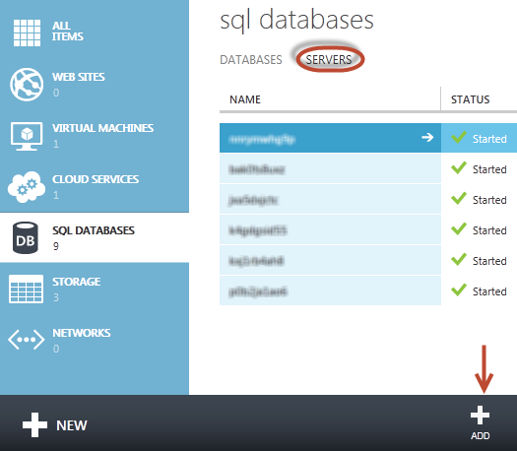
SQL Database – Provision Servers Interactively
Log on to Microsoft Azure Management Portal
Create a SQL Database server
Specify admin login credentials
Add firewall rules and enable service access
Notes:
Slide Objectives:
Show the different methods of provisioning a SQL Database server along with how easy it is. Plus, help the attendees understand what a SQL Database “server” really is.
Transition:
Provisioning an on-premises SQL Server box can be time consuming, costly, and at times, a challenge. With SQL Database, provisioning a “server” is painless, quick, and provisioned in a matter of seconds.
Speaking Points:
Provision servers interactively using the Management Portal
Automate server provisioning using the Microsoft Azure Management API or PowerShell.
Notes:
While the “server” is technically a TDS endpoint, much of the SQL Server process is similar. Administration login credentials are still needed for security, and more importantly defining service access is essential, and required, for maintaining the integrity of your server through firewall rules.

Slide 16
SQL Database – Provision Servers Interactively
Log on to Microsoft Azure Management Portal
Create a SQL Database server
Specify admin login credentials
Add firewall rules and enable service access
Same for Preview Portal?
Notes:
Slide Objectives:
Show the different methods of provisioning a SQL Database server along with how easy it is. Plus, help the attendees understand what a SQL Database “server” really is.
Transition:
Provisioning an on-premises SQL Server box can be time consuming, costly, and at times, a challenge. With SQL Database, provisioning a “server” is painless, quick, and provisioned in a matter of seconds.
Speaking Points:
Provision servers interactively using the Management Portal
Automate server provisioning using the Microsoft Azure Management API or PowerShell.
Notes:
While the “server” is technically a TDS endpoint, much of the SQL Server process is similar. Administration login credentials are still needed for security, and more importantly defining service access is essential, and required, for maintaining the integrity of your server through firewall rules.

Slide 17
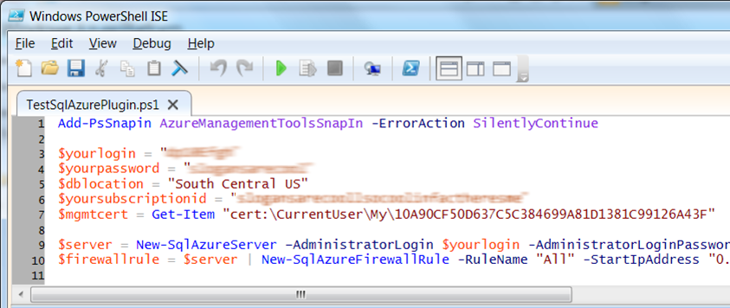
SQL Database – Automate Server Provisioning
Use Microsoft Azure Platform PowerShell cmdlets
http://azure.microsoft.com/en-us/services/automation
Make separate slides!
Or use the Azure Cross-Platform Command-Line Interface (xplat-cli)
Notes:
Slide Objectives:
Show the different methods of provisioning a SQL Database server along with how easy it is. Plus, help the attendees understand what a SQL Database “server” really is.
Transition:
Provisioning an on-premises SQL Server box can be time consuming, costly, and at times, a challenge. With SQL Database, provisioning a “server” is painless, quick, and provisioned in a matter of seconds.
Speaking Points:
Provision servers interactively using the Management Portal
Automate server provisioning using the Microsoft Azure Management API or PowerShell.
Notes:
While the “server” is technically a TDS endpoint, much of the SQL Server process is similar. Administration login credentials are still needed for security, and more importantly defining service access is essential, and required, for maintaining the integrity of your server through firewall rules.

Slide 18
Selecting the right SQL Database edition
Service Tier | Performance Level | Common App Pattern | Performance |  |  | Business Continuity
 |  |  | Max DB Size | Trans. Perf. Objective | DTU | PITR | DR / GEO-Rep
Basic | Basic | Small DB, SQL opp | 2 GB | Reliability / Hr. | 5 | 7 Days | DB Copy + Manual Export
Standard | S0 S1 S2 | Wrkgp/cloud app, multiple concurrent operations | 250 GB | Reliability / Min. | 10 20 50 | 14 Days | DB Copy + Manual Export
Premium | P1 P2 P3 | Mission Critical, High volume, Many concurrent Users | 500 GB | Reliability / sec. | 100 200 800 | 35 Days | Active Geo-replication
This information is subject to change over time.
Notes:
Slide Objectives:
Highlight what’s new in the latest SQL Database service update.
Transition:
In late September a service update was deployed to Microsoft Azure SQL Database that included new functionality.
Speaking Points:
Linked Server – This is a new component for database hybrid solutions spanning on-premises corporate networks and the Microsoft Azure cloud.
Recursive Trigger – Just like SQL Server 2012, the option can be configured via ALTER DATABASE dbname SET RECURSIVE_TRIGGERS ON|OFF
DBCC – The query optimizer uses statistics to estimate the cardinality or number of rows in the query result, which enables the query optimizer to create a high quality query plan.
Firewall Rules – different rules for different databases hosted on the same logical SQL Database server
Notes:

Slide 19
Creating A SQL Database Server
Demo
Notes:
Use Azure Portal (Ibiza) to create a new database server

Slide 20
Create and deploy your database
Demo
Notes:
Use Azure Portal (Ibiza) to create a new database server

Slide 21
Transact-SQL
Use Familiar Technologies
(obviously)
Notes:
Slide Objectives:
Point out that 1) The same great technologies that developers use today on-premises works with SQL Database 2) high-level differences between on-premises and SQL Database 3) SQL Database features currently unsupported
Transition:
Creating, managing, and deploying a database in Microsoft Azure SQL Database isn’t difficult. The key is understanding the features that are supported and how SQL Database compares to on-premises SQL Server and the technologies that can be used with SQL Database.
Speaking Points:
The same great technologies that developers use today on-premises works with SQL Database, including developer languages, Frameworks, and Tools. Nothing new to learn!
SQL Server Comparison -> highlight the physical vs. logical administration. Developers and DBAs can now focus on things they love to do and not worry about the physical aspect.
Features unsupported by SQL Database -> Many of the unsupported features are hardware based and thus don’t need to be in SQL Database. Other features, such as encryption, are server-based and become a challenge in solving in a shared-environment.
Notes:
CLR data types ARE supported, SQLCLR is not yet supported.
Backup/Restore: PIT Coming; Import/Export can be used for backup to BLOB storage. Third-party backup products available via RedGate and Enzo.
Data can be stored encrypted but the encryption must be done at the application level.
Native encryption is being looked at.
**Linked Servers and Distributed Queries are now supported, linking a SQL Database instance from an on-premises server. Linking two SQL Database instances is NOT supported.

Slide 22
.NET Framework (C#, Visual Basic, F#): ADO.NET
C / C++: ODBC
Java: Microsoft JDBC provider
PHP: Microsoft PHP provider
Use Familiar Technologies - Languages
Notes:
Slide Objectives:
Point out that 1) The same great technologies that developers use today on-premises works with SQL Database 2) high-level differences between on-premises and SQL Database 3) SQL Database features currently unsupported
Transition:
Creating, managing, and deploying a database in Microsoft Azure SQL Database isn’t difficult. The key is understanding the features that are supported and how SQL Database compares to on-premises SQL Server and the technologies that can be used with SQL Database.
Speaking Points:
The same great technologies that developers use today on-premises works with SQL Database, including developer languages, Frameworks, and Tools. Nothing new to learn!
SQL Server Comparison -> highlight the physical vs. logical administration. Developers and DBAs can now focus on things they love to do and not worry about the physical aspect.
Features unsupported by SQL Database -> Many of the unsupported features are hardware based and thus don’t need to be in SQL Database. Other features, such as encryption, are server-based and become a challenge in solving in a shared-environment.
Notes:
CLR data types ARE supported, SQLCLR is not yet supported.
Backup/Restore: PIT Coming; Import/Export can be used for backup to BLOB storage. Third-party backup products available via RedGate and Enzo.
Data can be stored encrypted but the encryption must be done at the application level.
Native encryption is being looked at.
**Linked Servers and Distributed Queries are now supported, linking a SQL Database instance from an on-premises server. Linking two SQL Database instances is NOT supported.

Slide 23
Odata
Entity Framework
WCF Data Services
Nhibernate (etc.)
Use Familiar Technologies - Frameworks
Notes:
Slide Objectives:
Point out that 1) The same great technologies that developers use today on-premises works with SQL Database 2) high-level differences between on-premises and SQL Database 3) SQL Database features currently unsupported
Transition:
Creating, managing, and deploying a database in Microsoft Azure SQL Database isn’t difficult. The key is understanding the features that are supported and how SQL Database compares to on-premises SQL Server and the technologies that can be used with SQL Database.
Speaking Points:
The same great technologies that developers use today on-premises works with SQL Database, including developer languages, Frameworks, and Tools. Nothing new to learn!
SQL Server Comparison -> highlight the physical vs. logical administration. Developers and DBAs can now focus on things they love to do and not worry about the physical aspect.
Features unsupported by SQL Database -> Many of the unsupported features are hardware based and thus don’t need to be in SQL Database. Other features, such as encryption, are server-based and become a challenge in solving in a shared-environment.
Notes:
CLR data types ARE supported, SQLCLR is not yet supported.
Backup/Restore: PIT Coming; Import/Export can be used for backup to BLOB storage. Third-party backup products available via RedGate and Enzo.
Data can be stored encrypted but the encryption must be done at the application level.
Native encryption is being looked at.
**Linked Servers and Distributed Queries are now supported, linking a SQL Database instance from an on-premises server. Linking two SQL Database instances is NOT supported.

Slide 24
SQL Server Management Studio (>=2008 R2)
SQL Server command-line utilities (SQLCMD, BCP)
CA Erwin® Data Modeler
Embarcadero Technologies DBArtisan®
Use Familiar Technologies - Tools
Why are there specific options here for other technologies?
Notes:
Slide Objectives:
Point out that 1) The same great technologies that developers use today on-premises works with SQL Database 2) high-level differences between on-premises and SQL Database 3) SQL Database features currently unsupported
Transition:
Creating, managing, and deploying a database in Microsoft Azure SQL Database isn’t difficult. The key is understanding the features that are supported and how SQL Database compares to on-premises SQL Server and the technologies that can be used with SQL Database.
Speaking Points:
The same great technologies that developers use today on-premises works with SQL Database, including developer languages, Frameworks, and Tools. Nothing new to learn!
SQL Server Comparison -> highlight the physical vs. logical administration. Developers and DBAs can now focus on things they love to do and not worry about the physical aspect.
Features unsupported by SQL Database -> Many of the unsupported features are hardware based and thus don’t need to be in SQL Database. Other features, such as encryption, are server-based and become a challenge in solving in a shared-environment.
Notes:
CLR data types ARE supported, SQLCLR is not yet supported.
Backup/Restore: PIT Coming; Import/Export can be used for backup to BLOB storage. Third-party backup products available via RedGate and Enzo.
Data can be stored encrypted but the encryption must be done at the application level.
Native encryption is being looked at.
**Linked Servers and Distributed Queries are now supported, linking a SQL Database instance from an on-premises server. Linking two SQL Database instances is NOT supported.

Slide 25
Focus on logical vs. physical administration
Database and log files automatically placed
Three high-availability replicas maintained for every database
Tables require a clustered index
Maximum database size is 500 GB
Azure SQL Database vs. SQL Server
Do you like this design that foucuses on one point at a time?
Notes:
Slide Objectives:
Point out that 1) The same great technologies that developers use today on-premises works with SQL Database 2) high-level differences between on-premises and SQL Database 3) SQL Database features currently unsupported
Transition:
Creating, managing, and deploying a database in Microsoft Azure SQL Database isn’t difficult. The key is understanding the features that are supported and how SQL Database compares to on-premises SQL Server and the technologies that can be used with SQL Database.
Speaking Points:
The same great technologies that developers use today on-premises works with SQL Database, including developer languages, Frameworks, and Tools. Nothing new to learn!
SQL Server Comparison -> highlight the physical vs. logical administration. Developers and DBAs can now focus on things they love to do and not worry about the physical aspect.
Features unsupported by SQL Database -> Many of the unsupported features are hardware based and thus don’t need to be in SQL Database. Other features, such as encryption, are server-based and become a challenge in solving in a shared-environment.
Notes:
CLR data types ARE supported, SQLCLR is not yet supported.
Backup/Restore: PIT Coming; Import/Export can be used for backup to BLOB storage. Third-party backup products available via RedGate and Enzo.
Data can be stored encrypted but the encryption must be done at the application level.
Native encryption is being looked at.
**Linked Servers and Distributed Queries are now supported, linking a SQL Database instance from an on-premises server. Linking two SQL Database instances is NOT supported.

Slide 26
Use command, distributed transactions, distributed views
Service Broker
Common Language Runtime (CLR)
SQL Agent
SQL Profiler
Native Encryption
Unsupported SQL Server Features
Notes:
Slide Objectives:
Point out that 1) The same great technologies that developers use today on-premises works with SQL Database 2) high-level differences between on-premises and SQL Database 3) SQL Database features currently unsupported
Transition:
Creating, managing, and deploying a database in Microsoft Azure SQL Database isn’t difficult. The key is understanding the features that are supported and how SQL Database compares to on-premises SQL Server and the technologies that can be used with SQL Database.
Speaking Points:
The same great technologies that developers use today on-premises works with SQL Database, including developer languages, Frameworks, and Tools. Nothing new to learn!
SQL Server Comparison -> highlight the physical vs. logical administration. Developers and DBAs can now focus on things they love to do and not worry about the physical aspect.
Features unsupported by SQL Database -> Many of the unsupported features are hardware based and thus don’t need to be in SQL Database. Other features, such as encryption, are server-based and become a challenge in solving in a shared-environment.
Notes:
CLR data types ARE supported, SQLCLR is not yet supported.
Backup/Restore: PIT Coming; Import/Export can be used for backup to BLOB storage. Third-party backup products available via RedGate and Enzo.
Data can be stored encrypted but the encryption must be done at the application level.
Native encryption is being looked at.
**Linked Servers and Distributed Queries are now supported, linking a SQL Database instance from an on-premises server. Linking two SQL Database instances is NOT supported.

Slide 27
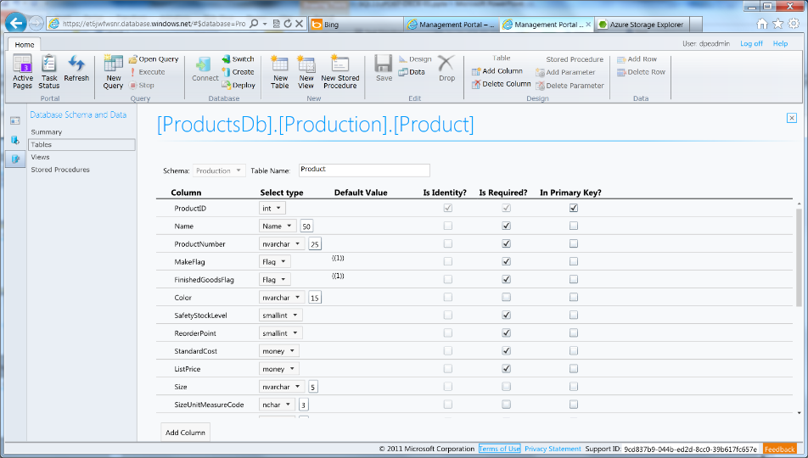
Azure SQL Database Management Portal
Web designers for tables, views, stored procs
Interactive query editing and execution
Notes:
Slide Objectives:
Highlight the set of tools for developers when interacting with Microsoft Azure SQL Database.
Transition:
Transition statement(s) to setup the slide
Speaking Points:
SQL Database Management Portal -> Cross Browser, Unified Management Experience
SQL Server Data Tools -> Integrated Database Design Environment, Table Designer, Debugging, T-SQL Editor
Notes:
IntelliSense in T-SQL Editor
SQL Server Data Tools
Strive to make it consistent as possible
Intersection with the cloud
Bridging you to the new cloud world
Consistency to the new developer experience
Consistency with the new cloud model

Slide 28
SQL Server Management Studio (SSMS)
SSMS picture
Notes:
Slide Objectives:
Highlight the set of tools for developers when interacting with Microsoft Azure SQL Database.
Transition:
Transition statement(s) to setup the slide
Speaking Points:
SQL Database Management Portal -> Cross Browser, Unified Management Experience
SQL Server Data Tools -> Integrated Database Design Environment, Table Designer, Debugging, T-SQL Editor
Notes:
IntelliSense in T-SQL Editor
SQL Server Data Tools
Strive to make it consistent as possible
Intersection with the cloud
Bridging you to the new cloud world
Consistency to the new developer experience
Consistency with the new cloud model

Slide 29
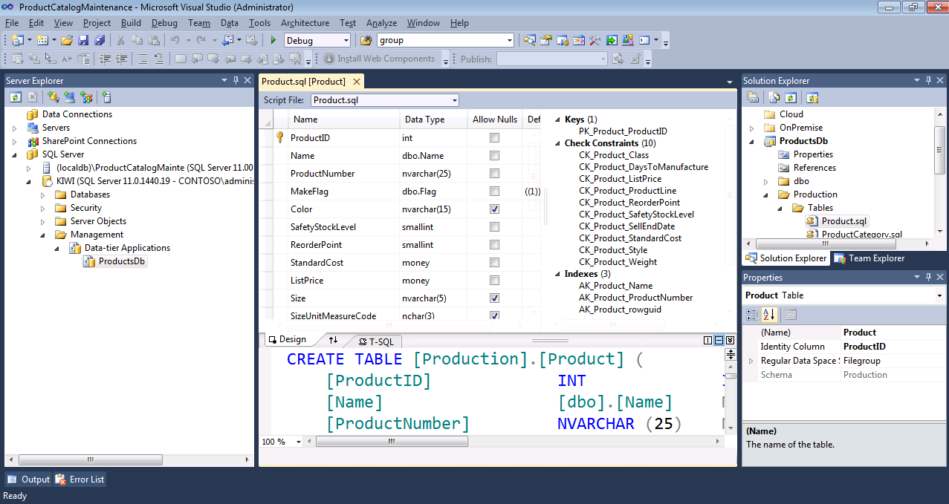
Includes modern designers and projects with declarative, model-driven development
Develop and test in both connected and disconnected states
Visual Studio IDE for database development
Notes:
Slide Objectives:
Highlight the set of tools for developers when interacting with Microsoft Azure SQL Database.
Transition:
Transition statement(s) to setup the slide
Speaking Points:
SQL Database Management Portal -> Cross Browser, Unified Management Experience
SQL Server Data Tools -> Integrated Database Design Environment, Table Designer, Debugging, T-SQL Editor
Notes:
IntelliSense in T-SQL Editor
SQL Server Data Tools
Strive to make it consistent as possible
Intersection with the cloud
Bridging you to the new cloud world
Consistency to the new developer experience
Consistency with the new cloud model

Slide 30
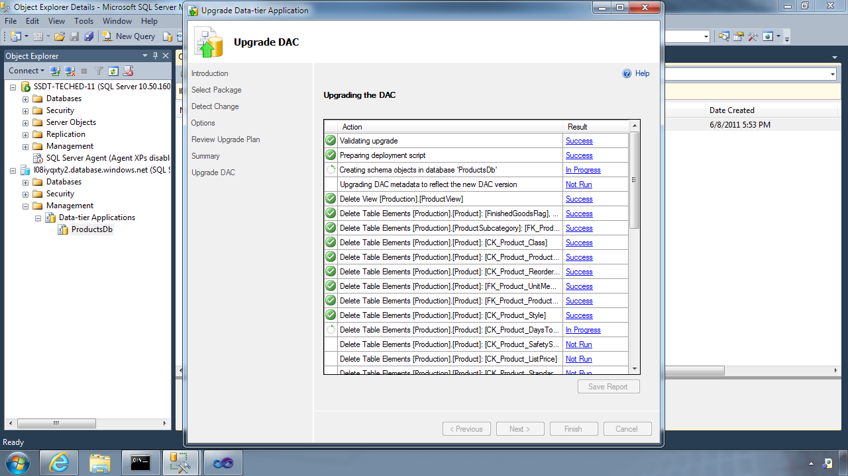
Database Deployment - Data-Tier Application Framework (DAC Fx)
Alternative to traditional script based approach
Dramatically simplifies deployment, migration and versioning of databases
Provides a single unit of deployment for schema (dacpac) or for schema + data (bacpac)
Supports automatic versioning of database schemas
Supports platform targeting for both SQL Server (2005 and above) and SQL Database
Build from scratch or extract from existing db
Notes:
Slide Objectives:
Discuss the deployment options for migrating your on-premises database to SQL Database.
Transition:
There are many ways to migrate your on-premises SQL Server database to Microsoft Azure SQL Database, but there have been great enhancements and improvements in both DAC and SSDT to dramatically improve and simplify deployment and migration options.
Speaking Points:
DAC Framework – A new unit of deployment called a bacpac which contains both schema AND data.
SQL Server Data Tools – Easily determine “Azure read” status. Provide single Publish capability.
Notes:
Both DAC and SSDT provide instant feedback as to the “azure-ready” status of your on-premises database. SSDT provides a single publish from source to destination, but DAC creates a deployment unit which can be stored in Azure storage or on-premises and used to create multiple SQL Database instances.

Slide 31
Database Deployment - How To Get The Latest DAC Fx
SQL Server Data Tools
SQL Server 2012/2014 Management Studio
SQL Database Import/Export Service
http://sqldacexamples.codeplex.com
Notes:
Slide Objectives:
Discuss the deployment options for migrating your on-premises database to SQL Database.
Transition:
There are many ways to migrate your on-premises SQL Server database to Microsoft Azure SQL Database, but there have been great enhancements and improvements in both DAC and SSDT to dramatically improve and simplify deployment and migration options.
Speaking Points:
DAC Framework – A new unit of deployment called a bacpac which contains both schema AND data.
SQL Server Data Tools – Easily determine “Azure read” status. Provide single Publish capability.
Notes:
Both DAC and SSDT provide instant feedback as to the “azure-ready” status of your on-premises database. SSDT provides a single publish from source to destination, but DAC creates a deployment unit which can be stored in Azure storage or on-premises and used to create multiple SQL Database instances.

Slide 32
DAC Deployment From SQL Server Management Studio
Demo
Notes:
Use SSMS to deploy DAC pack to previously provisioned database server

Slide 33
Secure your Database

Slide 34
There are two ways to Secure a database
On The Server
Within The Database
Notes:
Slide Objectives:
Highlight the two areas where Microsoft Azure SQL Database can be secured.
Transition:
Security is vitally important and has not be overlooked. Microsoft Azure SQL Database takes security seriously.
Speaking Points:
Set security options on the server itself
Security within the database
Notes:
This doesn’t leave the application free of any responsibility…some settings are required to be set within the application.

Slide 35
SQL Database Server Security
SQL authentication supported
(No Integrated authentication)
The Admin login is similar to sa
Notes:
Slide Objectives:
Highlight the important server security aspects and benefits of SQL Database security.
Transition:
From the server perspective, there are several things that should be things that should be considered when managing the security of your SQL Database.
Speaking Points:
No Integrated Authentication
Use Master to create and drop databases
The Admin login (which was created during server provisioning) is equivalent to sa. It has full rights on the server (and all databases) and should only be used for administration.
The loginmanager role is used for creating logins: membership in this role grants CREATE / ALTER / DROP Login privileges
The dbmanager role is used for creating databases: membership in this role grants CREATE / ALTER / DROP Database privileges
Manage logins with CREATE / ALTER / DROP LOGIN commands
Notes:
Although the server-level principal login is not a member of the two database roles dbmanager and loginmanager in the master database, it has all permissions granted to these two roles.

Slide 36
SQL Database Server Security
Connect to master to administer logins
loginmanager role: Server-Level security role for creating logins
dbmanager role: Server-Level security role for creating databases
Notes:
Slide Objectives:
Highlight the important server security aspects and benefits of SQL Database security.
Transition:
From the server perspective, there are several things that should be things that should be considered when managing the security of your SQL Database.
Speaking Points:
No Integrated Authentication
Use Master to create and drop databases
The Admin login (which was created during server provisioning) is equivalent to sa. It has full rights on the server (and all databases) and should only be used for administration.
The loginmanager role is used for creating logins: membership in this role grants CREATE / ALTER / DROP Login privileges
The dbmanager role is used for creating databases: membership in this role grants CREATE / ALTER / DROP Database privileges
Manage logins with CREATE / ALTER / DROP LOGIN commands
Notes:
Although the server-level principal login is not a member of the two database roles dbmanager and loginmanager in the master database, it has all permissions granted to these two roles.

Slide 37
SQL Database Security
Logins require an associated user account
The Admin login is automatically associated with dbo
The dbo has full rights in the database
Notes:
Slide Objectives:
Highlight the important server security aspects and benefits of SQL Database security.
Transition:
From the server perspective, there are several things that should be things that should be considered when managing the security of your SQL Database.
Speaking Points:
No Integrated Authentication
Use Master to create and drop databases
The Admin login (which was created during server provisioning) is equivalent to sa. It has full rights on the server (and all databases) and should only be used for administration.
The loginmanager role is used for creating logins: membership in this role grants CREATE / ALTER / DROP Login privileges
The dbmanager role is used for creating databases: membership in this role grants CREATE / ALTER / DROP Database privileges
Manage logins with CREATE / ALTER / DROP LOGIN commands
Notes:
Although the server-level principal login is not a member of the two database roles dbmanager and loginmanager in the master database, it has all permissions granted to these two roles.

Slide 38
SQL Database Security
Manage users with CREATE / ALTER / DROP USER commands
Add users to roles via sp_add_rolemember to grant privileges
Utilize schemas where appropriate
Notes:
Slide Objectives:
Highlight the important server security aspects and benefits of SQL Database security.
Transition:
From the server perspective, there are several things that should be things that should be considered when managing the security of your SQL Database.
Speaking Points:
No Integrated Authentication
Use Master to create and drop databases
The Admin login (which was created during server provisioning) is equivalent to sa. It has full rights on the server (and all databases) and should only be used for administration.
The loginmanager role is used for creating logins: membership in this role grants CREATE / ALTER / DROP Login privileges
The dbmanager role is used for creating databases: membership in this role grants CREATE / ALTER / DROP Database privileges
Manage logins with CREATE / ALTER / DROP LOGIN commands
Notes:
Although the server-level principal login is not a member of the two database roles dbmanager and loginmanager in the master database, it has all permissions granted to these two roles.

Slide 39
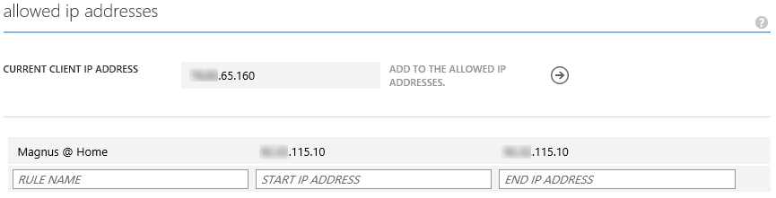
SQL Database Firewall
IP Address-based access control for SQL Database
Rules can be defined at the server and database
No IP authorized by default
Configurable using the SQL Database Portal and REST API
Option to disable/enable access from applications hosted in Microsoft Azure
Notes:
Slide Objectives:
Illustrate the how SQL Database Firewall
Transition:
Transition statement(s) to setup the slide
Speaking Points:
By default, no-one is allowed to access the database.
Server Rules enable clients to access your entire SQL Database server
Database rules enable clients to access individual databases within your SQL Database server
Rules are originating IP Address-based.
Notes:
Maximum of 128 Rules
Rather than using a REST API like the other Azure storage services, SQL Database is accessed via Tabular Data Stream (TDS), the same protocol used by Microsoft SQL Server (operating over port TCP/1433). To help protect the data, the SQL Database firewall prevents all access to your SQL Database server until you specify which computers have permission.
Initially, all access to your SQL Database server is blocked by the SQL Database firewall; connection attempts originating from the Internet or Microsoft Azure will not be able to reach your SQL Database server. In order to begin using your SQL Database server, you must go to the SQL Database Portal and specify one or more firewall settings that enable access to your SQL Database server. Use the firewall settings to specify which IP address ranges from the Internet are allowed, and whether or not Microsoft Azure applications can attempt to connect to your SQL Database server.

Slide 40
Connecting To SQL Database
Tabular Data Stream (TDS) protocol over TCP/IP
SSL required
<connectionStrings>
<addname="AdventureWorks"connectionString=
"Data Source=[server].database.windows.net;
Integrated Security=False;
Initial Catalog=ProductsDb;
User Id=[login]@[server];
Password=[password];
Trusted_Connection=False;
Encrypt=true;"
providerName="System.Data.SqlClient"/>
</connectionStrings>
Notes:
Slide Objectives:
Highlight application connectivity requirement, considerations and best practices to SQL Database.
Transition:
While connecting to SQL Database is fairly straight forward, there are some general considerations and recommended coding practices when developing Microsoft Azure SQL Database applications.
Speaking Points:
Login:
Idle connections terminated after 30 minutes
Long running transactions terminated after 24 hours
DoS guard terminates suspect connections with no error message
Failover events terminate connections
Throttling may generate errors…which leads to:
Implement Connection Pooling and Retry logic to handle transient failures
Latency introduced for updates due to HA replicas
No cross-database dependencies: resultsets from different database must be combined in the application tier (Fan out queries)
Notes:

Slide 41
SQL Database Considerations and Best Practices
login: [login]@[server]
Idle connections
Long running transactions
Notes:
Slide Objectives:
Highlight application connectivity requirement, considerations and best practices to SQL Database.
Transition:
While connecting to SQL Database is fairly straight forward, there are some general considerations and recommended coding practices when developing Microsoft Azure SQL Database applications.
Speaking Points:
Login:
Idle connections terminated after 30 minutes
Long running transactions terminated after 24 hours
DoS guard terminates suspect connections with no error message
Failover events terminate connections
Throttling may generate errors…which leads to:
Implement Connection Pooling and Retry logic to handle transient failures
Latency introduced for updates due to HA replicas
No cross-database dependencies: resultsets from different database must be combined in the application tier (Fan out queries)
Notes:

Slide 42
SQL Database Considerations and Best Practices
DoS guard
Failover events
Throttling
Notes:
Slide Objectives:
Highlight application connectivity requirement, considerations and best practices to SQL Database.
Transition:
While connecting to SQL Database is fairly straight forward, there are some general considerations and recommended coding practices when developing Microsoft Azure SQL Database applications.
Speaking Points:
Login:
Idle connections terminated after 30 minutes
Long running transactions terminated after 24 hours
DoS guard terminates suspect connections with no error message
Failover events terminate connections
Throttling may generate errors…which leads to:
Implement Connection Pooling and Retry logic to handle transient failures
Latency introduced for updates due to HA replicas
No cross-database dependencies: resultsets from different database must be combined in the application tier (Fan out queries)
Notes:

Slide 43
SQL Database Considerations and Best Practices
Connection pooling and Retry logic
Latency introduced for updates
No cross-database dependencies
Notes:
Slide Objectives:
Highlight application connectivity requirement, considerations and best practices to SQL Database.
Transition:
While connecting to SQL Database is fairly straight forward, there are some general considerations and recommended coding practices when developing Microsoft Azure SQL Database applications.
Speaking Points:
Login:
Idle connections terminated after 30 minutes
Long running transactions terminated after 24 hours
DoS guard terminates suspect connections with no error message
Failover events terminate connections
Throttling may generate errors…which leads to:
Implement Connection Pooling and Retry logic to handle transient failures
Latency introduced for updates due to HA replicas
No cross-database dependencies: resultsets from different database must be combined in the application tier (Fan out queries)
Notes:

Slide 44
SQL on IaaS

Slide 45
Run SQL on VM
Run any SQL product on cloud VM
Support for SQL Server, Oracle, MySql
Ready to go VM images available in Gallery
Persistent storage using attached disk in blob storage

Slide 46
SQL Database
Fully managed “as a Service”
Enterprise-ready with automatic support for HA, DR, Backups, replication and more
Can scale out elastically using ElasticScale
…
SQL IaaS
Choice of a variety of DB engines (SQL Server, Oracle, MySql)
All the features of native DB
Windows authentication available (requires VM to be joined to on-premises domain)
Larger database sizes possible (16TB)
…

Slide 47
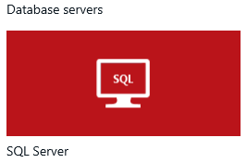
Standing up a SQL Server in Azure using Marketplace
Demo
Notes:
Use portal.azure.com.
Enter Marketplace.
Select Data -> SQL Server -> Any SQL VM you like.
Show Pricing tier options and settings.
Deploy it!

Slide 48
Azure Files

Slide 49
Azure Files – Customer Quotes
“I wish I could go to storage and provision a cloud drive, giving it a namespace, and that drive would then be UNC-addressable by the OSes.”
“I need two VM's running with a shared drive. One will write to the drive, the other will read [it].”
“Hi, I have two VM's in Microsoft Azure. All I want to do is set up a file share between them. Is this possible?”
“Is it possible to share a secondary disk between different VM instances?”

Slide 50
Sharing Files – The old way
Setup an IaaS VM to host a File Share backed by an IaaS Disk
Write code to find the IaaS File Share from the rest of the VMs in your service.
Write some code to provide high availability
Handle host upgrades, node failures
You can only access the File Share from other VMs
IaaS VM
IaaS VM
IaaS VM
PaaS VM
IaaS VM
(Sharing IaaS Disk)
Backup IaaS VMs (Mount/Share after failover)

Slide 51

Azure Files
Shared Network File Storage for Azure
Availability, durability, scalability are managed automatically
Supports two interfaces: SMB and REST
IaaS VM
IaaS VM
IaaS VM
PaaS VM
Azure File Share
(PaaS)

Slide 52
Azure Files - Scenarios
Share data across VMs and applications
Multiple writers, multiple readers using standard file system semantics.
Share settings throughout services
VMs can read settings and files from a common, shared location. These can be updated externally via REST.
Dev/Test/Debug
Very useful to have a shared location for installing applications, setting up VMs, running tools, and keeping notes while developing, testing, and debugging cloud services.

Slide 53
Azure Files - SMB 2.1 Protocol
Enables moving on-premises applications that rely on shared file storage to Azure
Azure VMs can “net use” to a share
Natively supported by OS APIs, libraries, and tools
Windows (CreateFile, ReadFile, WriteFile, …)
CRTs (fopen, fread, fwrite, …)
.Net (FileStream.Read, FileStream.Write, …)
Many more
Supports standard file system semantics
Move and rename files and directories
Read-only, write through, overlapped
Change notifications

Slide 54
Azure Files - File REST APIs
Allows internet access to the same shared file system
Build hybrid applications (on premises + cloud)
Supports a variety of common APIs:
Create/Delete Files and Directories
Write/Read Files
Get File and Directory properties
List Files

Slide 55
Demo: Azure Files – Part 1

Slide 56
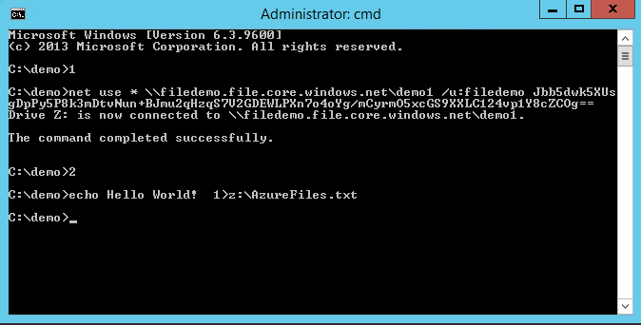
Azure Files

Slide 57
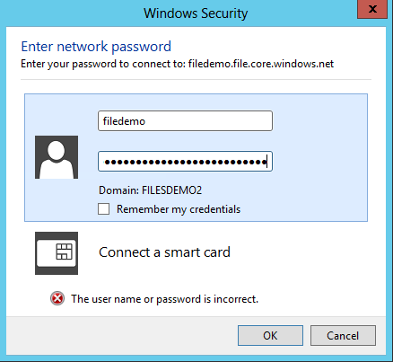
Azure Files

Slide 58
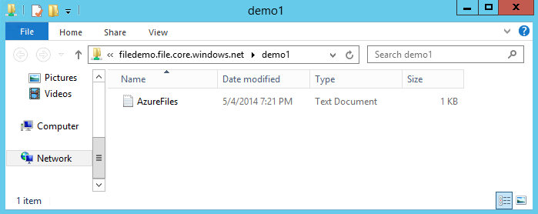
Azure Files

Slide 59
Azure Files vs Blobs
Description | Azure Blobs | Azure Files
Durability Options | LRS, ZRS, GRS (and RA-GRS for higher availability) | LRS, GRS
Accessibility | REST APIs | SMB 2.1 (standard file system APIs) REST APIs
Connectivity | REST – Worldwide | SMB 2.1 - Within region REST – Worldwide
Endpoints | http://myaccount.blob.core.windows.net/mycontainer/myblob | \\myaccount.file.core.windows.net\myshare\myfile.txt http://myaccount.file.core.windows.net/myshare/myfile.txt
Directories | Flat namespace however prefix listing can simulate virtual directories | True directory objects
Case Sensitivity of Names | Case sensitive | Case insensitive, but case preserving
Capacity | Up to 500TB containers | 5TB file shares
Throughput | Up to 60 MB/s per blob | Up to 60 MB/s per share
Object size | Up to 1 TB/blob | Up to 1 TB/file
Billed capacity | Based on bytes written | Based on file size

Slide 60
Azure Files vs Disks
Description | Disk | Azure Files
Relationship with Azure VMs | Required for booting (OS Disk)
Scope | Exclusive/Isolated to a single VM | Shared access across multiple VMs
Snapshots and Copy | Yes | No
Configuration | Configured via portal/Management APIs and available at boot time | Connect after boot (via net use on windows)
Built-in authentication | Built-in authentication | Set up authentication on net use
Cleanup | Resources can be cleaned up with VM if needed | Manually via standard file APIs or REST APIs
Access via REST | Can only access as fixed formatted VHD (single blob) via REST. Files stored in VHD cannot be accessed via REST. | Individual files stored in share are accessible via REST
Max Size | 1TB Disk | 5TB File Share 1TB file within share
Max 8KB IOps | 500 IOps | 1000 IOps
Throughput | Up to 60 MB/s per Disk | Up to 60 MB/s per File Share

Slide 61
Azure Files – Client OS Support
Windows Supported:
Windows Server 2008 R2
Windows Server 2012
Windows Server 2012 R2
Investigating Linux Support:
Ubuntu 13.10
Ubuntu 14.04 LTS

Slide 62
Azure Files: Getting Started
Request a token
Tokens will start to be granted in batches by end of May 2014
Redeem token
Create new storage account
Create share (using powershell)
Put files into share (azcopy)
Connect to share from VM

Slide 63
Demo: Azure Files – Part 2

Slide 64

Website Served From Azure File Share
…
Load Balancer
Azure VM
Azure VM
SMB 2.1
Azure File Share
REST APIs

Slide 65
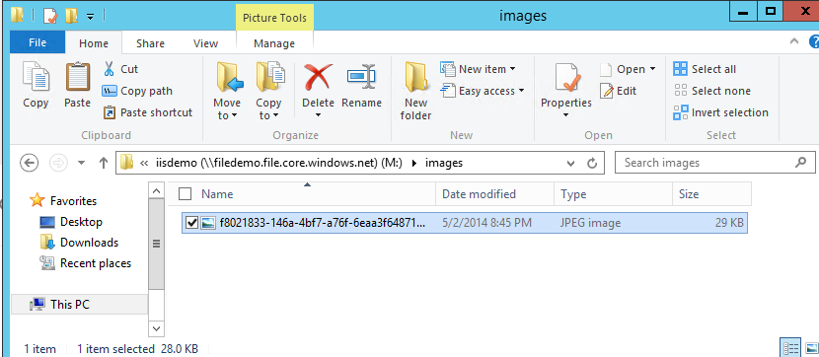
Azure Files

Slide 66
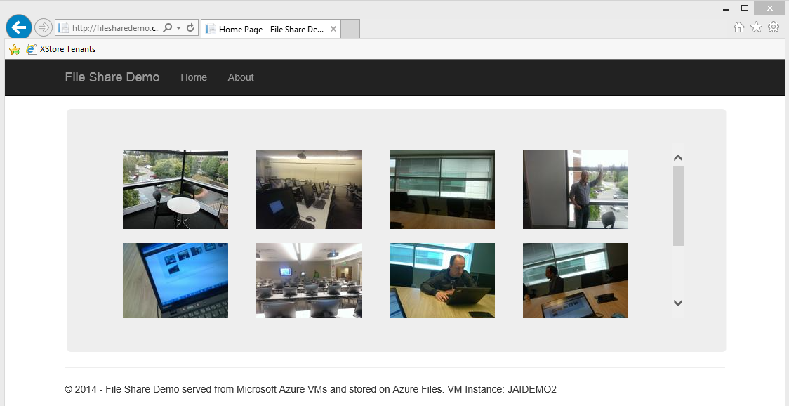
Azure Files

Slide 67
Blob Storage

Slide 68
Blob Storage Concepts
http://<account>.blob.core.windows.net/<container>/<blobname>
Account
Container
Blob
Pages/ Blocks
PIC01.JPG
images
Block/Page
PIC02.JPG
contoso
Block/Page
videos
VID1.AVI
Notes:
Slide Objectives
Understand the hierarchy of Blob storage
Speaker Notes
The Blob service provides storage for entities, such as binary files and text files.
The REST API for the Blob service exposes two resources:
Containers
Blobs.
A container is a set of blobs; every blob must belong to a container.
The Blob service defines two types of blobs:
Block blobs, which are optimized for streaming.
Page blobs, which are optimized for random read/write operations and which provide the ability to write to a range of bytes in a blob.
Blobs can be read by calling the Get Blob operation. A client may read the entire blob, or an arbitrary range of bytes.
Block blobs less than or equal to 64 MB in size can be uploaded by calling the Put Blob operation.
Block blobs larger than 64 MB must be uploaded as a set of blocks, each of which must be less than or equal to 4 MB in size.
Page blobs are created and initialized with a maximum size with a call to Put Blob.
To write content to a page blob, you call the Put Page operation. The maximum size currently supported for a page blob is 1 TB.
Notes
http://msdn.microsoft.com/en-us/library/dd573356.aspx
Using the REST API for the Blob service, developers can create a hierarchical namespace similar to a file system. Blob names may encode a hierarchy by using a configurable path separator. For example, the blob names MyGroup/MyBlob1 and MyGroup/MyBlob2 imply a virtual level of organization for blobs. The enumeration operation for blobs supports traversing the virtual hierarchy in a manner similar to that of a file system, so that you can return a set of blobs that are organized beneath a group. For example, you can enumerate all blobs organized under MyGroup/.

Slide 69
Blob Details
PutBlob
GetBlob
DeleteBlob
CopyBlob
SnapshotBlob
LeaseBlob
Main Web Service Operations
Notes:
Slide Objectives
Understand the hierarchy of Blob storage
Speaker Notes
Put Blob - Creates a new blob or replaces an existing blob within a container.
Get Blob - Reads or downloads a blob from the system, including its metadata and properties.
Delete Blob - Deletes a blob
Copy Blob - Copies a source blob to a destination blob within the same storage account.
SnapShot Blob - The Snapshot Blob operation creates a read-only snapshot of a blob.
Lease Blob - Establishes an exclusive one-minute write lock on a blob. To write to a locked blob, a client must provide a lease ID.
Using the REST API for the Blob service, developers can create a hierarchical namespace similar to a file system.
Blob names may encode a hierarchy by using a configurable path separator. For example, the blob names MyGroup/MyBlob1 and MyGroup/MyBlob2 imply a virtual level of organization for blobs.
The enumeration operation for blobs supports traversing the virtual hierarchy in a manner similar to that of a file system, so that you can return a set of blobs that are organized beneath a group.
For example, you can enumerate all blobs organized under MyGroup/.
Notes
The Blob service provides storage for entities, such as binary files and text files. The REST API for the Blob service exposes two resources: containers and blobs. A container is a set of blobs; every blob must belong to a container. The Blob service defines two types of blobs:
Block blobs, which are optimized for streaming. This type of blob is the only blob type available with versions prior to 2009-09-19.
Page blobs, which are optimized for random read/write operations and which provide the ability to write to a range of bytes in a blob. Page blobs are available only with version 2009-09-19.
Containers and blobs support user-defined metadata in the form of name-value pairs specified as headers on a request operation.
Using the REST API for the Blob service, developers can create a hierarchical namespace similar to a file system. Blob names may encode a hierarchy by using a configurable path separator. For example, the blob names MyGroup/MyBlob1 and MyGroup/MyBlob2 imply a virtual level of organization for blobs. The enumeration operation for blobs supports traversing the virtual hierarchy in a manner similar to that of a file system, so that you can return a set of blobs that are organized beneath a group. For example, you can enumerate all blobs organized under MyGroup/.
A block blob may be created in one of two ways. Block blobs less than or equal to 64 MB in size can be uploaded by calling the Put Blob operation. Block blobs larger than 64 MB must be uploaded as a set of blocks, each of which must be less than or equal to 4 MB in size. A set of successfully uploaded blocks can be assembled in a specified order into a single contiguous blob by calling Put Block List. The maximum size currently supported for a block blob is 200 GB.
Page blobs are created and initialized with a maximum size with a call to Put Blob. To write content to a page blob, you call the Put Page operation. The maximum size currently supported for a page blob is 1 TB.
Blobs support conditional update operations that may be useful for concurrency control and efficient uploading.
Blobs can be read by calling the Get Blob operation. A client may read the entire blob, or an arbitrary range of bytes.
For the Blob service API reference, see Blob Service API.

Slide 70
Blob Details
Standard HTTP metadata/headers (Cache-Control, Content-Encoding, Content-Type, etc)
Metadata is <name, value> pairs, up to 8KB per blob
Either as part of PutBlob or independently
Associate Metadata with Blob
Notes:
Slide Objectives
Understand the hierarchy of Blob storage
Speaker Notes
Put Blob - Creates a new blob or replaces an existing blob within a container.
Get Blob - Reads or downloads a blob from the system, including its metadata and properties.
Delete Blob - Deletes a blob
Copy Blob - Copies a source blob to a destination blob within the same storage account.
SnapShot Blob - The Snapshot Blob operation creates a read-only snapshot of a blob.
Lease Blob - Establishes an exclusive one-minute write lock on a blob. To write to a locked blob, a client must provide a lease ID.
Using the REST API for the Blob service, developers can create a hierarchical namespace similar to a file system.
Blob names may encode a hierarchy by using a configurable path separator. For example, the blob names MyGroup/MyBlob1 and MyGroup/MyBlob2 imply a virtual level of organization for blobs.
The enumeration operation for blobs supports traversing the virtual hierarchy in a manner similar to that of a file system, so that you can return a set of blobs that are organized beneath a group.
For example, you can enumerate all blobs organized under MyGroup/.
Notes
The Blob service provides storage for entities, such as binary files and text files. The REST API for the Blob service exposes two resources: containers and blobs. A container is a set of blobs; every blob must belong to a container. The Blob service defines two types of blobs:
Block blobs, which are optimized for streaming. This type of blob is the only blob type available with versions prior to 2009-09-19.
Page blobs, which are optimized for random read/write operations and which provide the ability to write to a range of bytes in a blob. Page blobs are available only with version 2009-09-19.
Containers and blobs support user-defined metadata in the form of name-value pairs specified as headers on a request operation.
Using the REST API for the Blob service, developers can create a hierarchical namespace similar to a file system. Blob names may encode a hierarchy by using a configurable path separator. For example, the blob names MyGroup/MyBlob1 and MyGroup/MyBlob2 imply a virtual level of organization for blobs. The enumeration operation for blobs supports traversing the virtual hierarchy in a manner similar to that of a file system, so that you can return a set of blobs that are organized beneath a group. For example, you can enumerate all blobs organized under MyGroup/.
A block blob may be created in one of two ways. Block blobs less than or equal to 64 MB in size can be uploaded by calling the Put Blob operation. Block blobs larger than 64 MB must be uploaded as a set of blocks, each of which must be less than or equal to 4 MB in size. A set of successfully uploaded blocks can be assembled in a specified order into a single contiguous blob by calling Put Block List. The maximum size currently supported for a block blob is 200 GB.
Page blobs are created and initialized with a maximum size with a call to Put Blob. To write content to a page blob, you call the Put Page operation. The maximum size currently supported for a page blob is 1 TB.
Blobs support conditional update operations that may be useful for concurrency control and efficient uploading.
Blobs can be read by calling the Get Blob operation. A client may read the entire blob, or an arbitrary range of bytes.
For the Blob service API reference, see Blob Service API.

Slide 71
Blob Details
Can include ‘/‘ or other delimeter in name e.g. /<container>/myblobs/blob.jpg
Blob always accessed by name
Notes:
Slide Objectives
Understand the hierarchy of Blob storage
Speaker Notes
Put Blob - Creates a new blob or replaces an existing blob within a container.
Get Blob - Reads or downloads a blob from the system, including its metadata and properties.
Delete Blob - Deletes a blob
Copy Blob - Copies a source blob to a destination blob within the same storage account.
SnapShot Blob - The Snapshot Blob operation creates a read-only snapshot of a blob.
Lease Blob - Establishes an exclusive one-minute write lock on a blob. To write to a locked blob, a client must provide a lease ID.
Using the REST API for the Blob service, developers can create a hierarchical namespace similar to a file system.
Blob names may encode a hierarchy by using a configurable path separator. For example, the blob names MyGroup/MyBlob1 and MyGroup/MyBlob2 imply a virtual level of organization for blobs.
The enumeration operation for blobs supports traversing the virtual hierarchy in a manner similar to that of a file system, so that you can return a set of blobs that are organized beneath a group.
For example, you can enumerate all blobs organized under MyGroup/.
Notes
The Blob service provides storage for entities, such as binary files and text files. The REST API for the Blob service exposes two resources: containers and blobs. A container is a set of blobs; every blob must belong to a container. The Blob service defines two types of blobs:
Block blobs, which are optimized for streaming. This type of blob is the only blob type available with versions prior to 2009-09-19.
Page blobs, which are optimized for random read/write operations and which provide the ability to write to a range of bytes in a blob. Page blobs are available only with version 2009-09-19.
Containers and blobs support user-defined metadata in the form of name-value pairs specified as headers on a request operation.
Using the REST API for the Blob service, developers can create a hierarchical namespace similar to a file system. Blob names may encode a hierarchy by using a configurable path separator. For example, the blob names MyGroup/MyBlob1 and MyGroup/MyBlob2 imply a virtual level of organization for blobs. The enumeration operation for blobs supports traversing the virtual hierarchy in a manner similar to that of a file system, so that you can return a set of blobs that are organized beneath a group. For example, you can enumerate all blobs organized under MyGroup/.
A block blob may be created in one of two ways. Block blobs less than or equal to 64 MB in size can be uploaded by calling the Put Blob operation. Block blobs larger than 64 MB must be uploaded as a set of blocks, each of which must be less than or equal to 4 MB in size. A set of successfully uploaded blocks can be assembled in a specified order into a single contiguous blob by calling Put Block List. The maximum size currently supported for a block blob is 200 GB.
Page blobs are created and initialized with a maximum size with a call to Put Blob. To write content to a page blob, you call the Put Page operation. The maximum size currently supported for a page blob is 1 TB.
Blobs support conditional update operations that may be useful for concurrency control and efficient uploading.
Blobs can be read by calling the Get Blob operation. A client may read the entire blob, or an arbitrary range of bytes.
For the Blob service API reference, see Blob Service API.

Slide 72
Blob Containers
Multiple Containers per Account
Special $root container
Blob Container
A container holds a set of blobs
Set access policies at the container level
Associate Metadata with Container
List the blobs in a container
Including Blob Metadata and MD5
NO search/query. i.e. no WHERE MetadataValue = ?
Blobs Throughput
Effectively in Partition of 1
Target of 60MB/s per Blob
Notes:
Slide Objective
Understand containers
Speaker Notes
Account can contain unlimited number of containers
Root container useful when serving Silverlight and flash out of Blob storage. May need to store Cross domain access policy files in root of the domain
Metadata is up to 8KB of name value pairs per container
Notes
http://msdn.microsoft.com/en-us/library/dd179361.aspx
http://msdn.microsoft.com/en-us/library/ee395424.aspx
A root container serves as a default container for your storage account. A storage account may have one root container. The root container must be explicitly created and must be named $root.
A blob stored in the root container may be addressed without referencing the root container name, so that a blob can be addressed at the top level of the storage account hierarchy. For example, you can now reference a blob that resides in the root container in the following manner:

Slide 73
Enumerating Blobs
GET Blob operation takes parameters
Prefix
Delimiter
Include= (snapshots, metadata etc…)
http://adventureworks.blob.core.windows.net/
Products/Bikes/SuperDuperCycle.jpg
Products/Bikes/FastBike.jpg
Products/Canoes/Whitewater.jpg
Products/Canoes/Flatwater.jpg
Products/Canoes/Hybrid.jpg
Products/Tents/PalaceTent.jpg
Products/Tents/ShedTent.jpg
GET http://.../products?comp=list&prefix=Tents&delimiter=/
<Blob>Tents/PalaceTent.wmv</Blob>
<Blob>Tents/ShedTent.wmv</Blob>
Notes:
Slide Objective
Understand basics of listing blobs in a container
Speaker Notes
The List Blobs operation enumerates the list of blobs under the specified container.
Can include uncommitted Blobs- see discussion on Blocks and Block Lists
Can include snapshots
Notes
http://msdn.microsoft.com/en-us/library/dd135734.aspx

Slide 74
Pagination
Large lists of Blobs can be paginated
Either set maxresults or;
Exceed default value for maxresults (5000)
http://.../products?comp=list&prefix=Canoes&maxresults=2
<Blob>Canoes/Whitewater.jpg</Blob>
<Blob>Canoes/Flatwater.jpg</Blob>
<NextMarker>MarkerValue</NextMarker>
http://.../products?comp=list&prefix=Canoes&maxresults=2 &marker=MarkerValue
<Blob>Canoes/Hybrid.jpg</Blob>
Notes:
Slide Objective
Understand pagination when listing blobs
Speaker Notes
Reponses over multiple pages return a marker value
This marker is sent to get subsequent page
Notes
http://msdn.microsoft.com/en-us/library/dd135734.aspx

Slide 75
Tour of the Blob Service
demo
Notes:
No specific demo identified. Use the MMC or MyAzureStorage.com or Visual Studio to interact with blob storage.

Slide 76
Two Types of Blobs Under the Hood
Block Blob
Targeted at streaming workloads
Each blob consists of a sequence of blocks
Each block is identified by a Block ID
Size limit 200GB per blob
Optimistic Concurrency via Etags
Page Blob
Targeted at random read/write workloads
Each blob consists of an array of pages
Each page is identified by its offset from the start of the blob
Size limit 1TB per blob
Optimistic or Pessimistic (locking) concurrency via leases
Notes:
Slide Objective
Understand different blob types
Speaker Notes
Block blobs are comprised of blocks, each of which is identified by a block ID.
You create or modify a block blob by uploading a set of blocks and committing them by their block IDs.
If you are uploading a block blob that is no more than 64 MB in size, you can also upload it in its entirety with a single Put Blob operation.
When you upload a block to Microsoft Azure using the Put Block operation, it is associated with the specified block blob, but it does not become part of the blob until you call the Put Block List operation and include the block's ID.
The block remains in an uncommitted state until it is specifically committed. Writing to a block blob is thus always a two-step process.
Each block can be a maximum of 4 MB in size. The maximum size for a block blob in version 2009-09-19 is 200 GB, or up to 50,000 blocks.
Page blobs are a collection of pages.
A page is a range of data that is identified by its offset from the start of the blob.
To create a page blob, you initialize the page blob by calling Put Blob and specifying its maximum size.
To add content to or update a page blob, you call the Put Page operation to modify a page or range of pages by specifying an offset and range. All pages must align 512-byte page boundaries.
Unlike writes to block blobs, writes to page blobs happen in-place and are immediately committed to the blob.
The maximum size for a page blob is 1 TB.
A page written to a page blob may be up to 1 TB in size but will typically be much smaller
Notes
http://msdn.microsoft.com/en-us/library/dd135734.aspx

Slide 77

Uploading a Block Blob
blobName = “TheBlob.wmv”;
PutBlock(blobName, blockId1, block1Bits);
PutBlock(blobName, blockId2, block2Bits);
…………
PutBlock(blobName, blockIdN, blockNBits);
PutBlockList(blobName,
blockId1,…,blockIdN);
Uploading a large blob
THE BLOB
10 GB Movie
Block Id 1
Block Id 2
Block Id 3
Block Id N
Benefit
Efficient continuation and retry
Parallel and out of order upload of blocks
TheBlob.wmv
Microsoft Azure Storage
TheBlob.wmv
Notes:
Slide Objective
Understand uploading a block blob
VALUE PROP
Block blobs let you upload large blobs efficiently. Block blobs are comprised of blocks, each of which is identified by a block ID.
Speaking notes
When you upload a block to a blob in your storage account, it is associated with the specified block blob, but it does not become part of the blob until you commit a list of blocks that includes the new block's ID.
New blocks remain in an uncommitted state until they are specifically committed or discarded.
Writing a block does not update the last modified time of an existing blob.
With a block blob, you can upload multiple blocks in parallel to decrease upload time.
Each block can include an MD5 hash to verify the transfer, so you can track upload progress and re-send blocks as needed.
You can upload blocks in any order, and determine their sequence in the final block list commitment step.
Notes

Slide 78


Page Blob – Random Read/Write
Create MyBlob
Specify Blob Size = 10 Gbytes
Sparse storage - Only charged for pages with data stored in them
Fixed Page Size = 512 bytes
Random Access Operations
PutPage[512, 2048)
PutPage[0, 1024)
ClearPage[512, 1536)
PutPage[2048,2560)
GetPageRange[0, 4096) returns valid data ranges:
[0,512) , [1536,2560)
GetBlob[1000, 2048) returns
All 0 for first 536 bytes
Next 512 bytes are data stored in [1536,2048)
0
512
1024
1536
2048
2560
10 GB Address Space
10 GB
Notes:
Slide Objective
Understand page blob
VALUE PROP
Page blobs are a collection of 512-byte pages optimized for random read and write operations.
Speaking notes
The maximum size for a page blob is 1 TB.
To create a page blob, you initialize the page blob and specify the maximum size the page blob will grow.
To add or update the contents of a page blob, you write a page or pages by specifying an offset and a range that align to 512-byte page boundaries.
A write to a page blob can overwrite just one page, some pages, or up to 4 MB of the page blob.
Writes to page blobs happen in-place and are immediately committed to the blob.
Notes

Slide 79
Shared Access Signatures
Fine grain access rights to blobs and containers
Sign URL with storage key – permit elevated rights
Revocation
Use short time periods and re-issue
Use container level policy that can be deleted
Two broad approaches
Ad-hoc
Policy based
Notes:
Slide Objective
Introduce Shared Access Signatures
Speaker Notes
Shared Access Signatures provide access rights to containers and blobs at a more granular level than by simply setting a container’s permissions
Grant users access to a specific blob or to any blob within a specified container for a specified period of time.
Specify what operations a user may perform on a blob that's accessible via a Shared Access Signature.
Use HTTPS to protect the signature (it is like a short dated password)
Two approaches
Ad-hoc Use for very short dated single use scenarios
Policy based Use for longer dated revocable permission sets
Always endeavour to use Least Permission set possible
Notes
http://msdn.microsoft.com/en-us/library/ee395415.aspx

Slide 80
Ad Hoc Signatures
Create Short Dated Shared Access Signature
Signedresource Blob or Container
AccessPolicy Start, Expiry and Permissions
Signature HMAC-SHA256 of above fields
Use case
Single use URLs
E.g. Provide URL to mobile client to upload to container
http://...blob.../pics/image.jpg? sr=c&st=2009-02-09T08:20Z&se=2009-02-10T08:30Z&sp=w &sig= dD80ihBh5jfNpymO5Hg1IdiJIEvHcJpCMiCMnN%2fRnbI%3d
Notes:
Slide Objective
Understand Ad-Hoc Shared Access signatures
Speaker Notes
Ad-hoc Use for very short dated single use scenarios
Include all permissions and expiry in the signed URL
Can only revoke by deleting the blob or waiting for expiry
Use very short dated URLs
Notes
http://msdn.microsoft.com/en-us/library/ee395415.aspx

Slide 81
Policy Based Signatures
Create Container Level Policy
Specify StartTime, ExpiryTime, Permissions
Create Shared Access Signature URL
Signedresource Blob or Container
Signedidentifier Optional pointer to container policy
Signature HMAC-SHA256 of above fields
Use case
Providing revocable permissions to certain users/groups
To revoke: Delete or update container policy
http://...blob.../pics/image.jpg? sr=c&si=MyUploadPolicyForUserID12345 &sig=dD80ihBh5jfNpymO5Hg1IdiJIEvHcJpCMiCMnN%2fRnbI%3d
Notes:
Slide Objective
Understand Ad-Hoc Shared Access signatures
Speaker Notes
Policy Based
Points to a Container level policy
User where want a longer dated permission with ability to revoke
Include all permissions and expiry in the signed URL
Can only revoke by deleting the blob or waiting for expiry
Use very short dated URLs
Notes
http://msdn.microsoft.com/en-us/library/ee395415.aspx

Slide 82
NoSQL

Slide 83
Generally more scalable
The storage engines of NoSQL stores are designed to minimize contentions enabling higher throughput and therefore more scalable
Lower transaction capability in NoSQL results in less contention and therefore more scalable
Less complex query processor means that a single query can’t degrade service
Built-in replication capability means that store can scale out which better aligns to other application tiers (e.g. websites)
No fixed schema or lower schema requirements
Microsoft Azure

Slide 84
NoSQL on Azure
Azure Tables service is NoSQL row store
MongoDB is a document (JSON) store
Cassandra is a columnar store with excellent replication
HBase is a Big Data (Hadoop) NoSQL store available in HDInsight
Microsoft Azure

Slide 85
Queues

Slide 86
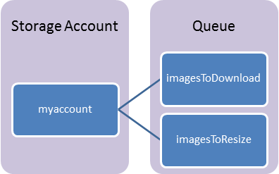
Components
Storage Account: All access to Azure Storage is done through a storage account.
Queue: A queue contains a set of messages. All messages must be in a queue.
Message: A message, in any format, of up to 64KB.

Slide 87
URL Format
Queues are addressable using the following URL format:
http://<storage account>.queue.core.windows.net/<queue>
The following URL addresses one of the queues in the diagram:
http://myaccount.queue.core.windows.net/imagesToDownload

Slide 88
Queue Considerations
Messages are not ordered
Message
Will be processed at least once
Maybe returned more than once
Failover
In case of failure, the message will be reprocessed by another node
Message size<= 8KB
Stored up to 7 days

Slide 89
Queue
Producers
Consumers
P₂
C₁
4
3
2
1
3
2
2
1
1
C₂
P₁

Slide 90
Why use Queue?
The queue length directly reflects how well the backend processing nodes are catching up with the overall workload.
Decouples different parts of the application.
Allows the flexibility of efficient resource usage within an application
Buffering to absorb traffic bursts and reduce the impact of individual component failures.
Notes:
First of all, the queue length directly reflects how well the backend processing nodes are catching up with the overall workload.
Second, the use of queues decouples different parts of the application, making it easier to scale different parts of the application independently.
Third, the use of queues allows the flexibility of efficient resource usage within an application, allowing the application to scale more efficiently. That is, separate queues can be used for work items of different priorities and/or different weights, and separate pools of backend servers can process these different queues.
Queues provide buffering to absorb traffic bursts and reduce the impact of individual component failures.

Slide 91
Azure Storage Architecture
REST
REST
REST
REST
SMB
Blob/Disk
Head
Table
Head
Queue
Head
File Share
Head
Massive Scale Out & Auto Load Balancing Index Layer
Distributed Replication Layer
“Microsoft Azure Storage: A Highly Available Cloud Storage Service with Strong Consistency”, ACM Symposium on Operating System Principals (SOSP), Oct. 2011

Slide 92
Tables

Slide 93
Table Storage Concepts
Account
Table
Entity
Name =…
Email = …
customers
Name =…
EMailAdd=
contoso
Photo ID =…
Date =…
photos
Photo ID =…
Date =…
Notes:
Slide Objectives
Understand Tables
Speaker Notes
The Table service provides structured storage in the form of tables.
The Table service supports a REST API that is compliant with the ADO.NET Data Services REST API.
Developers may also use the .NET Client Library for ADO.NET Data Services to access the Table service.
Notes
http://msdn.microsoft.com/en-us/library/dd573356.aspx

Slide 94

Table Details
Create, Query, Delete
Tables can have metadata
Not an RDBMS! Table
Insert
Update
Merge – Partial update
Replace – Update entire entity
Upsert
Delete
Query
Entity Group Transactions
Multiple CUD Operations in a single atomic transaction
Entities
Notes:
Slide Objectives
Understand Tables
Speaker Notes
Within a storage account, a developer may create named tables.
Tables store data as entities.
An entity is a collection of named properties and their values, similar to a row.
Tables are partitioned to support load balancing across storage nodes.
Each table has as its first property a partition key that specifies the partition an entity belongs to.
The second property is a row key that identifies an entity within a given partition.
The combination of the partition key and the row key forms a primary key that identifies each entity uniquely within the table.
The Table service does not enforce any schema.
A developer may choose to implement and enforce a schema on the client side
Notes
http://msdn.microsoft.com/en-us/library/dd573356.aspx

Slide 95
Entity Properties
Entity can have up to 255 properties
Up to 1MB per entity
Mandatory Properties for every entity
PartitionKey & RowKey (only indexed properties)
Uniquely identifies an entity
Defines the sort order
Timestamp
Optimistic Concurrency
Exposed as an HTTP Etag
No fixed schema for other properties
Each property is stored as a <name, typed value> pair
No schema stored for a table
Properties can be the standard .NET types
String, binary, bool, DateTime, GUID, int, int64, and double
Notes:
Slide Objectives
Understand Tables and Entities
Speaker Notes
Tables store data as entities.
An entity is a collection of named properties and their values, similar to a row- not an RDBMS though
Tables are partitioned to support load balancing across storage nodes.
Each table has as its first property a partition key that specifies the partition an entity belongs to.
The second property is a row key that identifies an entity within a given partition.
The combination of the partition key and the row key forms a primary key that identifies each entity uniquely within the table.
The Table service does not enforce any schema.
A developer may choose to implement and enforce a schema on the client side
Notes
http://msdn.microsoft.com/en-us/library/dd573356.aspx
http://msdn.microsoft.com/en-us/library/dd179338.aspx

Slide 96
No Fixed Schema
 | FIRST | LAST | BIRTHDATE
 | Wade | Wegner | 2/2/1981
 | Nathan | Totten | 3/15/1965
 | Nick | Harris | May 1, 1976
FAV SPORT
Canoeing
Notes:
Slide Objectives
Understand Flexible Entities
Speaker Notes
Tables store data as entities.
A table can contain entities of any shape
There is no fixed schema
There is no schema checking
There is no strong typing- not that Birthdate is stored as both a datetime value and as a string
Not that we can add additional columns
Notes
http://msdn.microsoft.com/en-us/library/dd573356.aspx

Slide 97
Querying
?$filter=Last eq ‘Wegner’
 | FIRST | LAST | BIRTHDATE
 | Wade | Wegner | 2/2/1981
 | Nathan | Totten | 3/15/1965
 | Nick | Harris | May 1, 1976
Notes:
Slide Objectives
Understand The Basic Query Syntax
Speaker Notes
Tables store data as entities.
Querying is per the ADO.NET Data Services spec http://msdn.microsoft.com/en-us/library/cc668784.aspx
Should endeavour to always include the Partition key to limit scope of query- partitions always served by a single storage node
Notes
http://msdn.microsoft.com/en-us/library/dd573356.aspx

Slide 98
Purpose of the PartitionKey
Entity Locality
Entities in the same partition will be stored together
Efficient querying and cache locality
Endeavour to include partition key in all queries
Entity Group Transactions
Atomic multiple Insert/Update/Delete in same partition in a single transaction
Table Scalability
Target throughput – 500 tps/partition, several thousand tps/account
Microsoft Azure monitors the usage patterns of partitions
Automatically load balance partitions
Each partition can be served by a different storage node
Scale to meet the traffic needs of your table
Notes:
Slide Objectives
Understand The Partition Key
Speaker Notes
Tables are partitioned to support load balancing across storage nodes.
A table's entities are organized by partition.
A partition is a consecutive range of entities possessing the same partition key value.
The partition key is a unique identifier for the partition within a given table, specified by the PartitionKey property.
The partition key forms the first part of an entity's unique identifier within the table.
The partition key may be a string value up to 1 KB in size.
You must include the PartitionKey property in every insert, update, and delete operation.
Notes
http://msdn.microsoft.com/en-us/library/dd573356.aspx
http://blogs.msdn.com/b/windowsazurestorage/archive/2010/05/07/understanding-the-scalability-availability-durability-and-billing-of-windows-azure-storage.aspx
http://blogs.msdn.com/b/windowsazurestorage/archive/2010/05/10/windows-azure-storage-abstractions-and-their-scalability-targets.aspx

Slide 99
Partitions and Partition Ranges
PartitionKey (Category) | RowKey (Title) | Timestamp | MODELYEAR
Bikes | Super Duper Cycle | … | 2009
Bikes | Quick Cycle 200 Deluxe | … | 2007
… | … | … | …
Canoes | Whitewater | … | 2009
Canoes | Flatwater | … | 2006
PartitionKey (Category) | RowKey (Title) | Timestamp | MODELYEAR
Bikes | Super Duper Cycle | … | 2009
Bikes | Quick Cycle 200 Deluxe | … | 2007
… | … | … | …
Canoes | Whitewater | … | 2009
Canoes | Flatwater | … | 2006
Rafts | 14ft Super Tourer | … | 1999
… | … | … | …
Skis | Fabrikam Back Trackers | … | 2009
… | … | … | …
Tents | Super Palace | … | 2008
Server A
Table = Products
[MinKey - Canoes)
Server A
Table = Products
PartitionKey (Category) | RowKey (Title) | Timestamp | MODELYEAR
Rafts | 14ft Super Tourer | … | 1999
… | … | … | …
Skis | Fabrikam Back Trackers | … | 2009
… | … | … | …
Tents | Super Palace | … | 2008
Server B
Table = Products
[Canoes - MaxKey)
Notes:
Slide Objectives
Understand Partition Ranges
Speaker Notes
DON’T use unique PartionKey values for your entities – each entity will then belong to its own partition
Range partitions group entities that have sequentially, unique PartitionKey values to improve the performance of range queries.
Without range partitions, a range query will need to cross partition boundaries or server boundaries, which can decrease the performance of the query.
Notes

Slide 101
16 regions worldwide in 2014
Azure footprint

Slide 102
>57%
Greater than
1,000,000
>250k
Fortune 500 using Azure
Active websites
SQL Databases in Azure
>20
>1
TRILLION storage objects
>300
MILLION
AD users
MILLION
Developers registered with Visual Studio Online
>2
MILLION requests/sec
>13
BILLION
authentication/wk

Slide 103
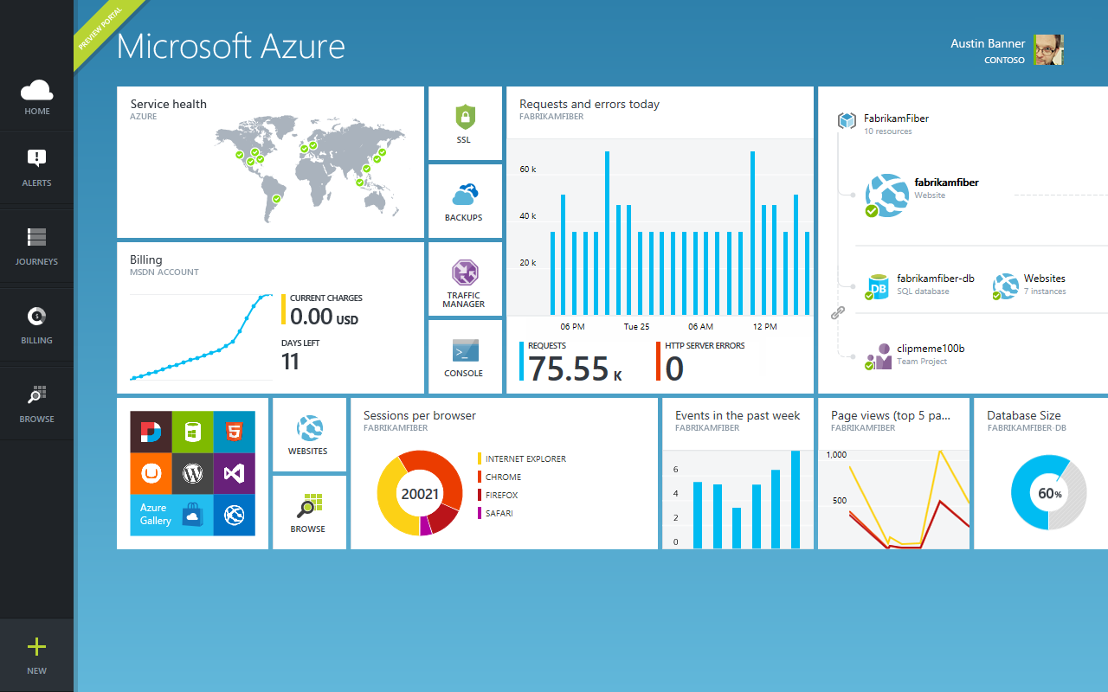

Slide 104

Get started
Visit azure.microsoft.com

Slide 105

SQL Database Billing Rates (As of February 2012)
Database Size | Price Per Database Per Month
0 to 100 MB | Flat $4.995
> 100 to 1 GB | Flat $9.99
> 1GB to 10 GB | $9.99 for first GB, $3.99 per additional GB
> 10 GB to 50 GB | $45.954 for first 10 GB, $1.998 for each additional GB
> 50 GB to 150 GB | $145.874 for first 50 GB, $0.999 for each additional GB
Based on graduated rate based on database size
Charged at monthly rate per database
Amortized over month -> calculated on daily basis
No Transaction Charges
Data Transfers
North America and Europe regions $0.05 - $0.12 per GB outbound
Asia Pacific region $0.12 - $0.19 per GB outbound
All inbound data transfers are at no charge.
Notes:
Slide Objectives:
Understand the SQL Database pricing
Transition:
Speaking Points:
Reduced database rates as of February 2012
Notes:
http://www.windowsazure.com/en-us/pricing/details/#data-management
http://www.windowsazure.com/en-us/pricing/details/#data-transfers

Slide 106
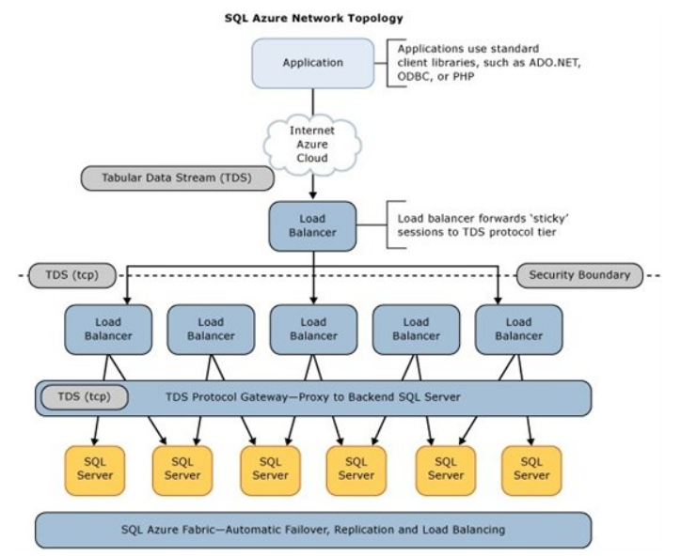
SQL Database Architecture

