Slide 1
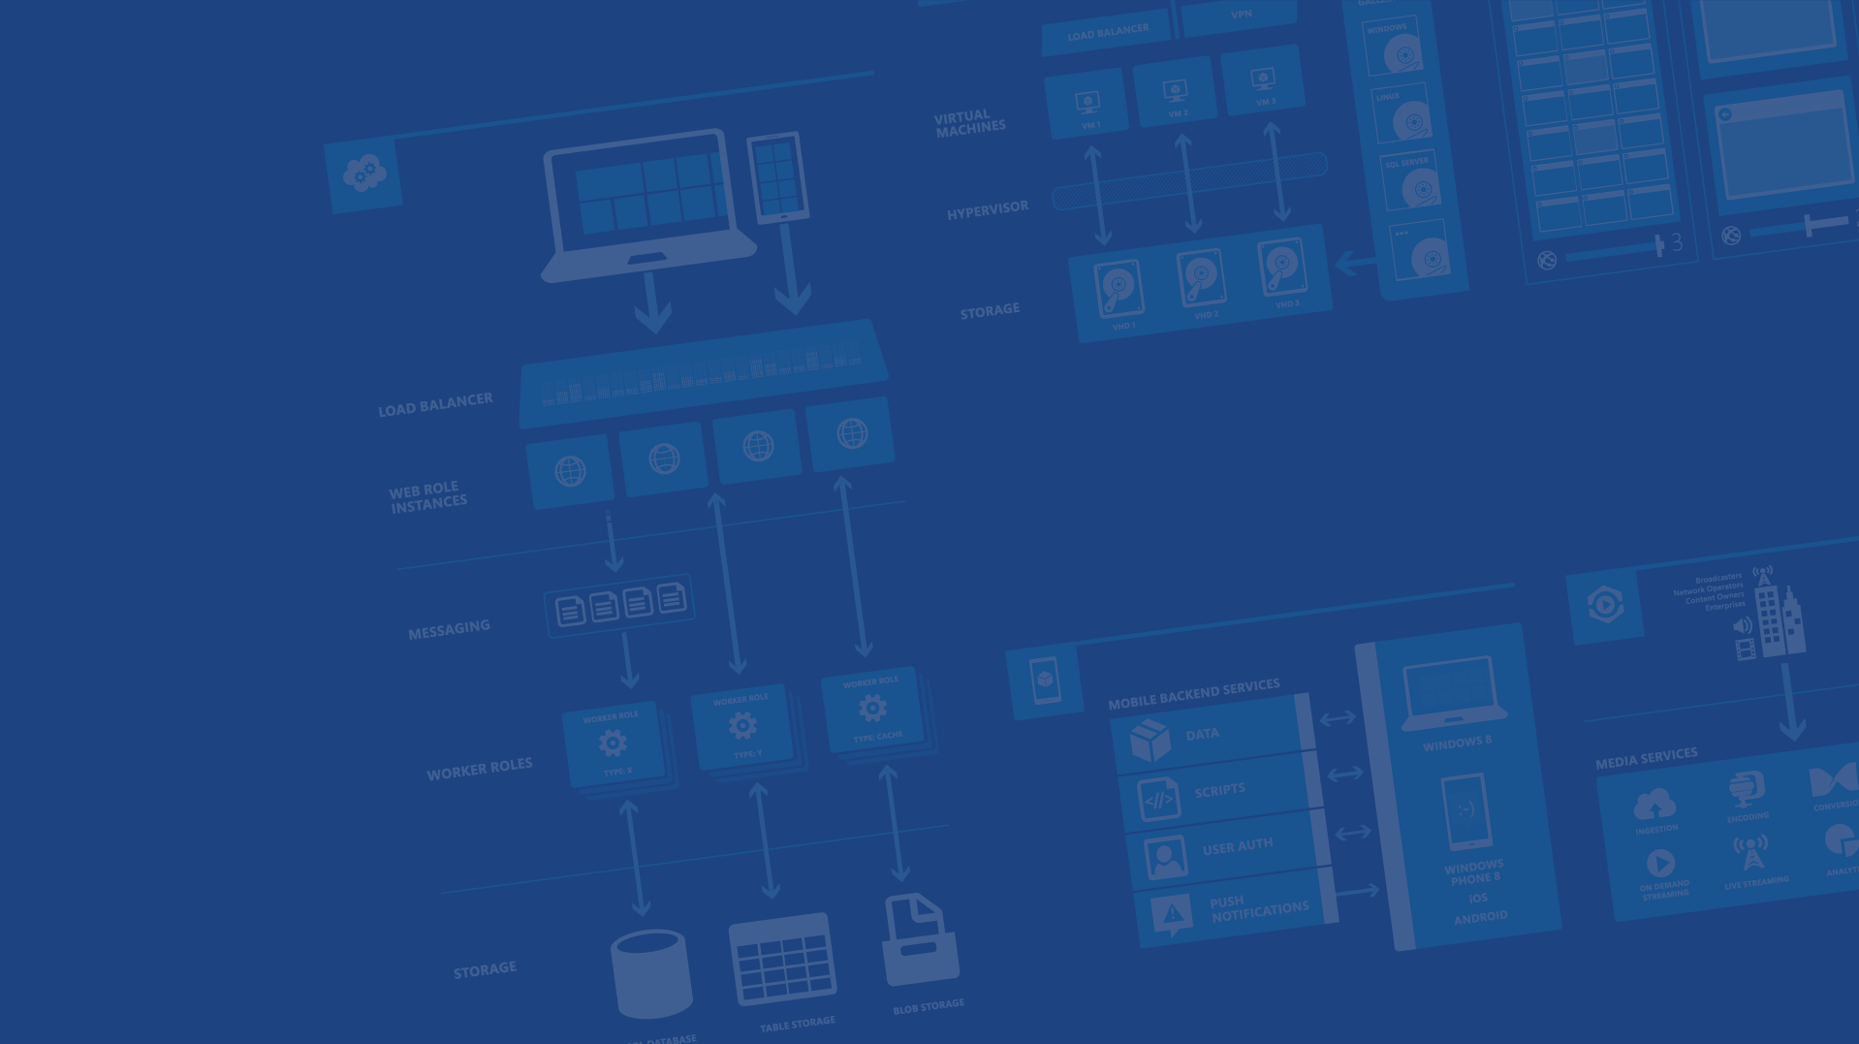
Azure IaaS
Presenter Name
Position or role
Microsoft Azure

Slide 2
Your service

Slide 3
→ Your application code
→ Required resources
→ Your infrastructure code

Slide 5
Azure Virtual Machines
→ Launch Windows Server and Linux in minutes
→ Scale from 1 to 1000s of VM Instances
→ Save money with per-minute billing
→ Open and extensible

Slide 6


Provisioning VM
Getting Started
Select Image and VM Size
New Disk Persisted in Storage
Windows Server
Management Portal
Boot VM from New Disk
Linux
>_
Extra Small
Small
Medium
Large
X-Large
Scripting
(Windows, Linux and Mac)
Cloud
REST API
Notes:
Slide Objective:
Explain workflow for provisioning VMs in the cloud
Notes:
Cloud First Provisioning means exactly what is says. Building a VM in the cloud first.
You have three methods of starting this process: Build a VM from the portal, from the command line OR programmatically calling the REST API.
Once your choice of provisioning is made you will need to select the image and instance size to start from.
The newly created disk will be stored in blob storage and your machine will boot.

Slide 7

















VM Gallery
A collection of prebuilt images for various workloads
Windows Serve 2012 R2
Ubuntu Server 14.04 LTS
CentOS 6.5
SUSE Linux
Enterprise Server
openSUSE 13.1
Oracle Linux 6.4.0.0.0
SQL Server 2014 Standard
Oracle Database 11g R2
SharePoint Server Farm
Microsoft Dynamics
GP 2013
Zulu 8
BizTalk Server 2013
SAP HANA
Developer Edition
Puppet Enterprise 3.2.3
Barracuda Web Application
Oracle WebLogic
Server 12.1.2
Visual Studio Ultimate 2013
Windows 8.1 Enterprise
Microsoft Azure

Slide 8
Virtual Machine Sizes
VM Size | CPU Cores | Memory | Bandwidth | # (1TB) Data Disks
Extra Small (A0) | Shared | 768 MB | 5 (Mbps) | 1
Small (A1) | 1 | 1.75 GB | 100 (Mbps) | 2
Medium (A2) | 2 | 3.5 GB | 200 (Mbps) | 4
Large (A3) | 4 | 7 GB | 400 (Mbps) | 8
Extra Large (A4) | 8 | 14 GB | 800 (Mbps) | 16
A5 | 2 | 14 GB | 200 (Mbps) | 4
A6 | 4 | 28 GB | 1000 (Mbps) | 8
A7 | 8 | 56 GB | 2000 (Mbps) | 16
A8 | 8 | 56 GB | 40 Gbit/s InfiniBand | 16
A9 | 16 | 112 GB | 40 Gbit/s InfiniBand | 16
Notes:
Slide Objective:
VM sizes

Slide 9






VM Extensions
Installable components to customize VM instances
Enable various DevOps scenarios
Can be added, updated, disabled or removed at any time
Managed via portal, PowerShell and Management APIs
Microsoft Azure

Slide 10
Demo: Provisioning VM
Provision VMs using Azure portal
Notes:
Demo: Getting Started
Go to the portal
Create a new mobile service (Node backend works with most of deck)
Walk through Getting started screen
Choose platform
Download quick start
Run quick start
Save and update data
Show data in portal (Node)
Walk through client code that deals with Mobile Service

Slide 11
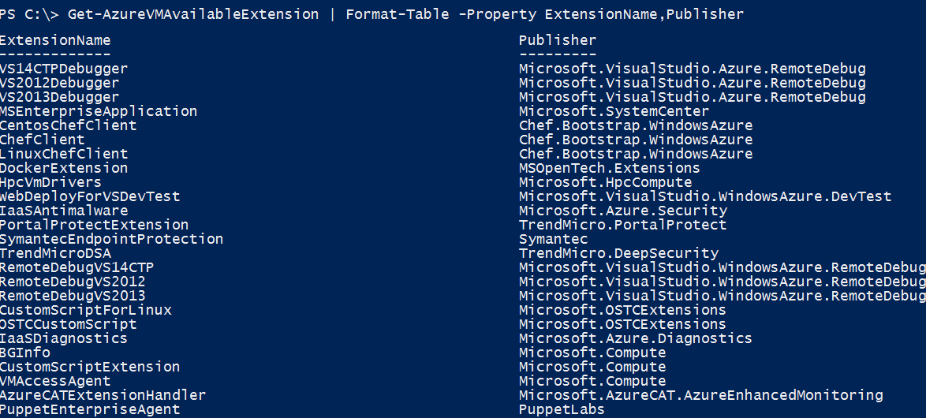
VM Extensions
Microsoft Azure

Slide 12
Azure Virtual Networks
→ A protected private virtual network in cloud
→ Extend enterprise networks into Azure
→ Cross-premises connectivity

Slide 13
Virtual Network Scenarios
Hybrid Public/Private Cloud
Enterprise app in Windows Azure requiring connectivity to on-premise resources
Enterprise Identity and Access Control
Manage identity and access control with on-premise resources (on-premises Active Directory)
Monitoring and Management
Remote monitoring and trouble-shooting of resources running in Azure
Advanced Connectivity Requirements
Cloud deployments requiring IP addresses and direct connectivity across services
Microsoft Azure

Slide 14






Cross-premises Connectivity
Site-to-site
Create a secure connection between your on-premises site and your virtual network
Point-to-site
Create a secure connection via VPN to your virtual network
ExpressRouteTM
Create a private connection between Azure data centers and infrastructures on your premises or in a co-location environment.
Connect at an ExpressRoute location (Exchange Provider facility)
Direct connect via a Network Service Provider
Microsoft Azure

Slide 15
Demo: Virtual Network
TBD
Notes:
Demo: Getting Started
Go to the portal
Create a new mobile service (Node backend works with most of deck)
Walk through Getting started screen
Choose platform
Download quick start
Run quick start
Save and update data
Show data in portal (Node)
Walk through client code that deals with Mobile Service

Slide 16




Thanks!
We are done now.

Slide 18
16 regions worldwide in 2014
Azure footprint

Slide 19
>57%
Greater than
1,000,000
>250k
Fortune 500 using Azure
Active websites
SQL Databases in Azure
>20
>1
TRILLION storage objects
>300
MILLION
AD users
MILLION
Developers registered with Visual Studio Online
>2
MILLION requests/sec
>13
BILLION
authentication/wk

Slide 20
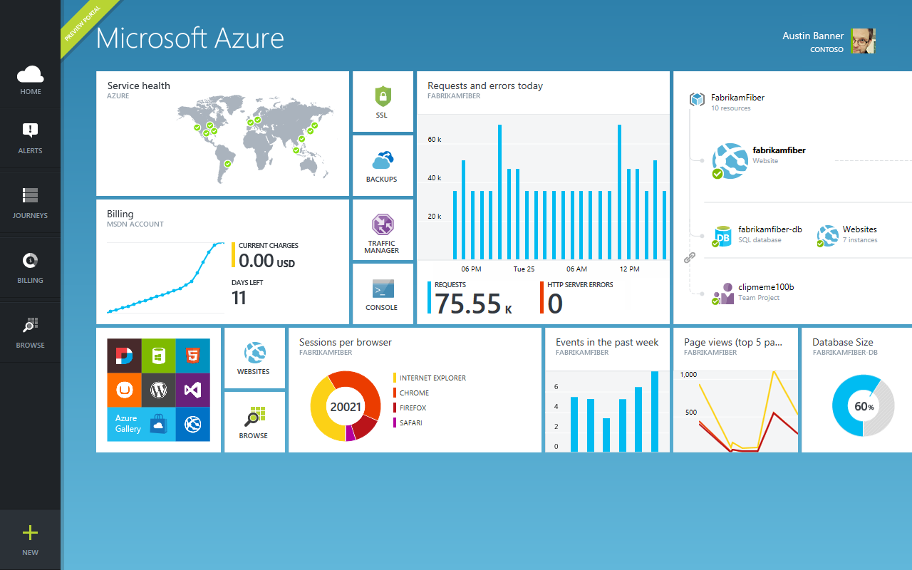

Slide 21

Get started
Visit azure.microsoft.com

