Slide 1


Modification in Friction Stir Welding Work Table
Presented By
Kailas Dumane - (214103206)
Amay B. Gholpe - (214103205)
MTech – Manufacturing Science and Engineering
Department of Mechanical Engineering
Indian Institute of Technology Guwahati
2021-22

Slide 2
Introduction
Friction stir welding, patented by The Welding Institute in 1991, presents a new technique for material joining and processing. Friction stir welding has enjoyed worldwide interest since its inception because of its advantages over traditional joining techniques. This technology boost reduction of distortion and elimination of cracking. Due to the combined effects of the tooling Friction stir welding (FSW) is a promising welding process and is being extensively studied because it can produce high quality joints.

Slide 3
Literature Review
It is evident that friction stir welding has more potential in the fabrication of similar and dissimilar aluminium alloys when compared with other conventional welding methods.
Most of the literature studies are limited only to the effect analysis of similar materials. However, FSW of dissimilar joint not been analyzed in all FSW parameters.
Many researchers have studied that the effect of one parameters at a time. However, the combined effects of the process parameters had not been studied extensively.

Slide 4
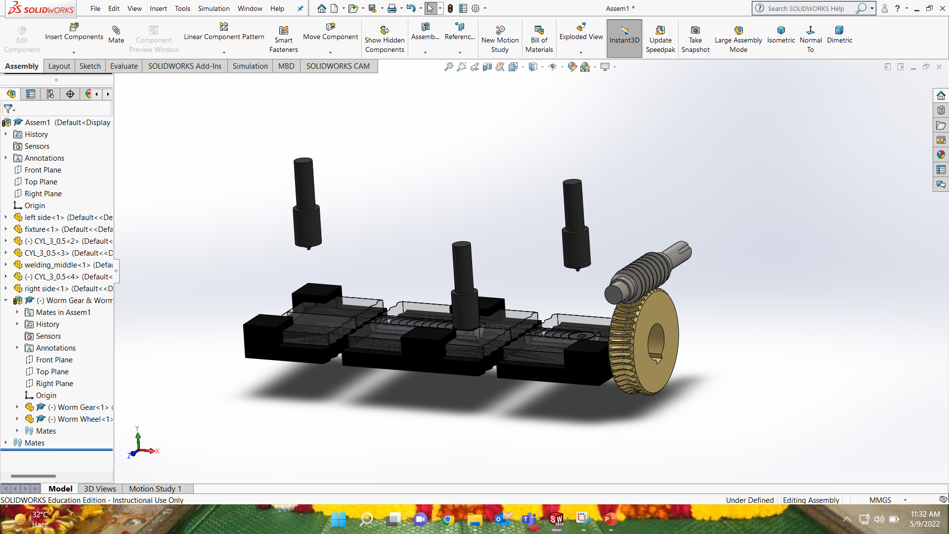
Designed Product
Bed
Worm Gear and Wheel
Power Source
Computer Control

Slide 5
Novelty
The rotation of work table is done in order to get ease in operation. Before this modification the tool was not able do operations on all the sides of workpiece in same arrangement.
After this modification, work table can be easily rotated by 180⁰, thus tool can do operation on every side of workpiece.

Slide 6
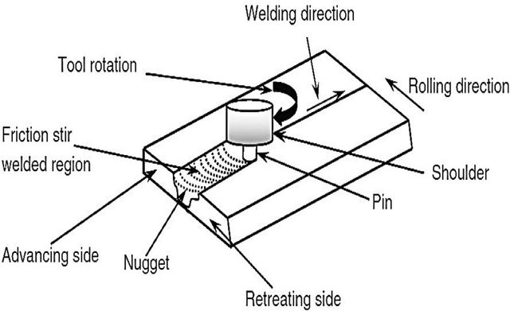
Methodology
Friction stir welding process uses a cylindrical tool which is shouldered with a profile & is rotated and slowly moves into the joint between two pieces joined together.
In this setup, the work table is rotated by 180⁰ using arrangement of worm gear and wheel.
The heat produced by friction between workpiece and tool allows traversing of the tool along the weld line without reaching the melting point

Slide 7
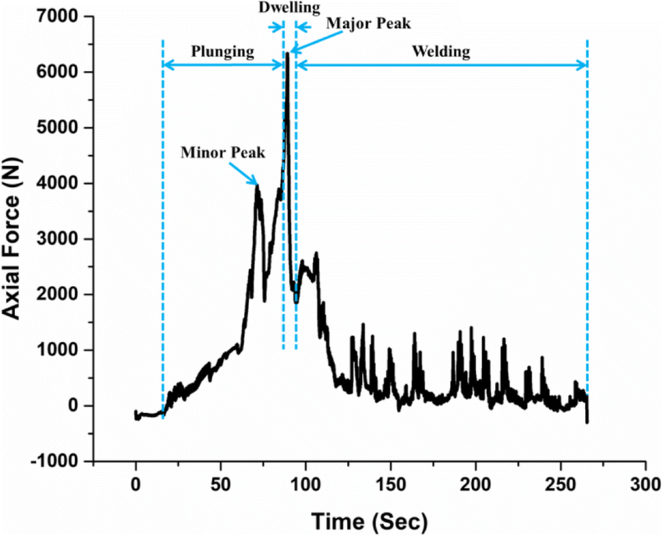
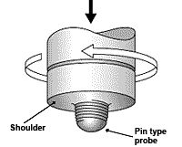
Process Parameter
Tool design
Tool rotation speed
Welding feed speed
Axial force
Tool tilt angle
Tool

Slide 8
Future Scope
The future work will also be focused on the investigation of the thermo-mechanical phenomenon, leading to the uncharacteristic force and torque behavior.
As this model is suggested upto friction weld but while we move upside down it might cause deform while loosing the fixture.
Production rate will rapidly increase, since no need to removing and placing it again.

Slide 9
Conclusion
This paper is aimed to explain the Principle of Friction stir welding process & also tells the various parameters associated with it.
It also helps in explaining the various Zones apart from it, helps in explaining the environmental aspects of Friction Stir Welding (FSW) & the various advantages of friction stir welding.

Slide 10
References
S. Senthil Kumaran& S. Muthu kumaran& S. Vinodh. Optimization of friction welding of tube-to-tube plate using an external tool by Taguchi method and genetic algorithm.
K. Elangovan, V. Bala subramanian. Influences of tool pin profile and welding speed on the formation of friction stir processing zone in AA2219 aluminium alloy. Journal of materials processing technology 2 0 0 ( 2 0 0 8 ) 163–175.
Diogo Mariano Neto& Pedro Neto. Numerical modellings of friction stir welding process: a literature review. 2012

