Slide 1
CS 343: Artificial Intelligence
Machine Learning
Raymond J. Mooney
University of Texas at Austin

Slide 2
What is Learning?
Herbert Simon: “Learning is any process by which a system improves performance from experience.”
What is the task?
  Classification
  Problem solving / planning / control

Slide 3
Classification
Assign object/event to one of a given finite set of categories.
  Medical diagnosis
  Credit card applications or transactions
  Fraud detection in e-commerce
  Worm detection in network packets
  Spam filtering in email
  Recommended articles in a newspaper
  Recommended books, movies, music, or jokes
  Financial investments
  DNA sequences
  Spoken words
  Handwritten letters
  Astronomical images

Slide 4
Problem Solving / Planning / Control
Performing actions in an environment in order to achieve a goal.
  Solving calculus problems
  Playing checkers, chess, or backgammon
  Balancing a pole
  Driving a car or a jeep
  Flying a plane, helicopter, or rocket
  Controlling an elevator
  Controlling a character in a video game
  Controlling a mobile robot

Slide 5
Sample Category Learning Problem
Instance language: <size, color, shape>
  size ∈ {small, medium, large}
  color ∈ {red, blue, green}
  shape ∈ {square, circle, triangle}
C = {positive, negative}
D:
Example | Size | Color | Shape | Category
1 | small | red | circle | positive
2 | large | red | circle | positive
3 | small | red | triangle | negative
4 | large | blue | circle | negative

Slide 6
Hypothesis Selection
Many hypotheses are usually consistent with the training data.
  red & circle
  (small & circle) or (large & red)
  (small & red & circle) or (large & red & circle)
  not [ ( red & triangle) or (blue & circle) ]
  not [ ( small & red & triangle) or (large & blue & circle) ]
Bias
  Any criteria other than consistency with the training data that is used to select a hypothesis.

Slide 7
Generalization
Hypotheses must generalize to correctly classify instances not in the training data.
Simply memorizing training examples is a consistent hypothesis that does not generalize.
Occam’s razor:
  Finding a simple hypothesis helps ensure generalization.

Slide 8
Hypothesis Space
Restrict learned functions a priori to a given hypothesis space, H, of functions h(x) that can be considered as definitions of c(x).
For learning concepts on instances described by n discrete-valued features, consider the space of conjunctive hypotheses represented by a vector of n constraints
<c₁, c₂, … c_{n}> where each c_{i} is either:
  ?, a wild card indicating no constraint on the ith feature
  A specific value from the domain of the ith feature
  Ø indicating no value is acceptable
Sample conjunctive hypotheses are
  <big, red, ?>
  <?, ?, ?> (most general hypothesis)
  < Ø, Ø, Ø> (most specific hypothesis)

Slide 9
Inductive Learning Hypothesis
Any function that is found to approximate the target concept well on a sufficiently large set of training examples will also approximate the target function well on unobserved examples.
Assumes that the training and test examples are drawn independently from the same underlying distribution.
This is a fundamentally unprovable hypothesis unless additional assumptions are made about the target concept and the notion of “approximating the target function well on unobserved examples” is defined appropriately (cf. computational learning theory).

Slide 10
Evaluation of Classification Learning
Classification accuracy (% of instances classified correctly).
  Measured on an independent test data.
Training time (efficiency of training algorithm).
Testing time (efficiency of subsequent classification).

Slide 11
Category Learning as Search
Category learning can be viewed as searching the hypothesis space for one (or more) hypotheses that are consistent with the training data.
Consider an instance space consisting of n binary features which therefore has 2^{n} instances.
For conjunctive hypotheses, there are 4 choices for each feature: Ø, T, F, ?, so there are 4^{n} syntactically distinct hypotheses.
However, all hypotheses with 1 or more Øs are equivalent, so there are 3^{n}+1 semantically distinct hypotheses.
The target binary categorization function in principle could be any of the possible 2^{2^n} functions on n input bits.
Therefore, conjunctive hypotheses are a small subset of the space of possible functions, but both are intractably large.
All reasonable hypothesis spaces are intractably large or even infinite.

Slide 12
Learning by Enumeration
For any finite or countably infinite hypothesis space, one can simply enumerate and test hypotheses one at a time until a consistent one is found.
For each h in H do:
If h is consistent with the training data D,
then terminate and return h.
This algorithm is guaranteed to terminate with a consistent hypothesis if one exists; however, it is obviously computationally intractable for almost any practical problem.

Slide 13
Efficient Learning
Is there a way to learn conjunctive concepts without enumerating them?
How do human subjects learn conjunctive concepts?
Is there a way to efficiently find an unconstrained boolean function consistent with a set of discrete-valued training instances?
If so, is it a useful/practical algorithm?

Slide 14
Conjunctive Rule Learning
Conjunctive descriptions are easily learned by finding all commonalities shared by all positive examples.
Must check consistency with negative examples. If inconsistent, no conjunctive rule exists.
Example | Size | Color | Shape | Category
1 | small | red | circle | positive
2 | large | red | circle | positive
3 | small | red | triangle | negative
4 | large | blue | circle | negative
Learned rule: red & circle → positive

Slide 15
Limitations of Conjunctive Rules
If a concept does not have a single set of necessary and sufficient conditions, conjunctive learning fails.
Example | Size | Color | Shape | Category
1 | small | red | circle | positive
2 | large | red | circle | positive
3 | small | red | triangle | negative
4 | large | blue | circle | negative
5 | medium | red | circle | negative
Learned rule: red & circle → positive
Inconsistent with negative example #5!

Slide 16
Decision Trees
Tree-based classifiers for instances represented as feature-vectors. Nodes test features, there is one branch for each value of the feature, and leaves specify the category.
Can represent arbitrary conjunction and disjunction. Can represent any classification function over discrete feature vectors.
Can be rewritten as a set of rules, i.e. disjunctive normal form (DNF).
  red ∧ circle → pos
  red ∧ circle → A
  blue → B; red ∧ square → B
  green → C; red ∧ triangle → C
color
color
red
green
red
blue
green
blue
shape
shape
C
neg
pos
B
circle
square
triangle
circle
square
triangle
pos
neg
neg
A
B
C

Slide 17
Properties of Decision Tree Learning
Continuous (real-valued) features can be handled by allowing nodes to split a real valued feature into two ranges based on a threshold (e.g. length < 3 and length ≥3)
Classification trees have discrete class labels at the leaves, regression trees allow real-valued outputs at the leaves.
Algorithms for finding consistent trees are efficient for processing large amounts of training data for data mining tasks.
Methods developed for handling noisy training data (both class and feature noise).
Methods developed for handling missing feature values.

Slide 18
Top-Down Decision Tree Induction
Recursively build a tree top-down by divide and conquer.
<big, red, circle>: + <small, red, circle>: +
<small, red, square>: − <big, blue, circle>: −
color
red
blue
green
<big, red, circle>: +
<small, red, circle>: +
<small, red, square>: −

Slide 19
Top-Down Decision Tree Induction
Recursively build a tree top-down by divide and conquer.
<big, red, circle>: + <small, red, circle>: +
<small, red, square>: − <big, blue, circle>: −
color
red
blue
green
<big, red, circle>: +
<small, red, circle>: +
<small, red, square>: −
shape
neg
neg
circle
<big, blue, circle>: −
square
triangle
pos
neg
pos
<big, red, circle>: +
<small, red, circle>: +
<small, red, square>: −

Slide 20
Decision Tree Induction Pseudocode
DTree(examples, features) returns a tree
If all examples are in one category, return a leaf node with that category label.
Else if the set of features is empty, return a leaf node with the category label that
is the most common in examples.
Else pick a feature F and create a node R for it
For each possible value v_{i} of F:
Let examples_{i} be the subset of examples that have value v_{i} for F
Add an out-going edge E to node R labeled with the value v_{i.}
If examples_{i} is empty
then attach a leaf node to edge E labeled with the category that
is the most common in examples.
else call DTree(examples_{i} , features – {F}) and attach the resulting
tree as the subtree under edge E.
Return the subtree rooted at R.

Slide 21
Picking a Good Split Feature
Goal is to have the resulting tree be as small as possible, per Occam’s razor.
Finding a minimal decision tree (nodes, leaves, or depth) is an NP-hard optimization problem.
Top-down divide-and-conquer method does a greedy search for a simple tree but does not guarantee to find the smallest.
  General lesson in ML: “Greed is good.”
Want to pick a feature that creates subsets of examples that are relatively “pure” in a single class so they are “closer” to being leaf nodes.
There are a variety of heuristics for picking a good test, a popular one is based on information gain that originated with the ID3 system of Quinlan (1979).

Slide 22
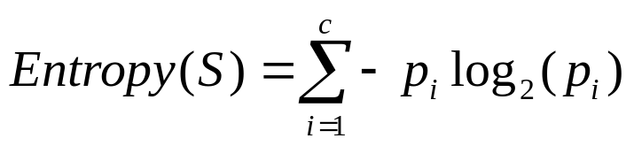
Entropy
Entropy (disorder, impurity) of a set of examples, S, relative to a binary classification is:
where p₁ is the fraction of positive examples in S and p₀ is the fraction of negatives.
If all examples are in one category, entropy is zero (we define 0⋅log(0)=0)
If examples are equally mixed (p₁=p₀=0.5), entropy is a maximum of 1.
Entropy can be viewed as the number of bits required on average to encode the class of an example in S where data compression (e.g. Huffman coding) is used to give shorter codes to more likely cases.
For multi-class problems with c categories, entropy generalizes to:

Slide 23
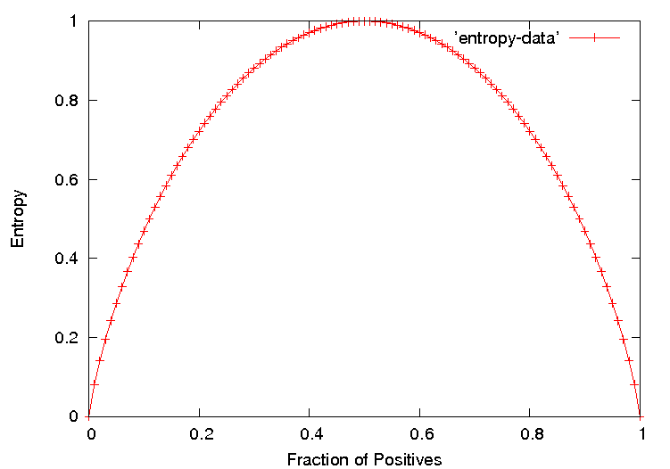
Entropy Plot for Binary Classification

Slide 24
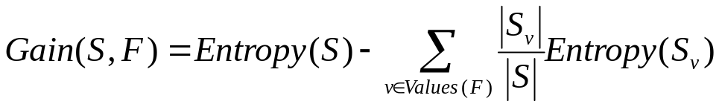
Information Gain
The information gain of a feature F is the expected reduction in entropy resulting from splitting on this feature.
where S_{v} is the subset of S having value v for feature F.
Entropy of each resulting subset weighted by its relative size.
Example:
  <big, red, circle>: + <small, red, circle>: +
  <small, red, square>: − <big, blue, circle>: −
2+, 2 −: E=1
size
2+, 2 − : E=1
color
2+, 2 − : E=1
shape
big small
1+,1− 1+,1−
E=1 E=1
red blue
2+,1− 0+,1−
E=0.918 E=0
circle square
2+,1− 0+,1−
E=0.918 E=0
Gain=1−(0.5⋅1 + 0.5⋅1) = 0
Gain=1−(0.75⋅0.918 +
0.25⋅0) = 0.311
Gain=1−(0.75⋅0.918 +
0.25⋅0) = 0.311

Slide 25
Hypothesis Space Search
Performs batch learning that processes all training instances at once rather than incremental learning that updates a hypothesis after each example.
Performs hill-climbing (greedy search) that may only find a locally-optimal solution. Guaranteed to find a tree consistent with any conflict-free training set (i.e. identical feature vectors always assigned the same class), but not necessarily the simplest tree.
Finds a single discrete hypothesis, so there is no way to provide confidences or create useful queries.

Slide 26
Another Red-Circle Data Set
Example | Size | Color | Shape | Category
1 | small | red | circle | positive
2 | large | red | circle | positive
3 | small | red | square | negative
4 | large | blue | circle | negative

Slide 27
Weka J48 Trace 1
data> java weka.classifiers.trees.J48 -t figure.arff -T figure.arff -U -M 1
Options: -U -M 1
J48 unpruned tree
------------------
color = blue: negative (1.0)
color = red
| shape = circle: positive (2.0)
| shape = square: negative (1.0)
| shape = triangle: positive (0.0)
color = green: positive (0.0)
Number of Leaves : 5
Size of the tree : 7
Time taken to build model: 0.03 seconds
Time taken to test model on training data: 0 seconds

Slide 28
A Data Set Requiring Disjunction
Example | Size | Color | Shape | Category
1 | small | red | circle | positive
2 | large | red | circle | positive
3 | small | red | triangle | negative
4 | large | blue | circle | negative
5 | small | green | circle | positive

Slide 29
Weka J48 Trace 2
data> java weka.classifiers.trees.J48 -t figure3.arff -T figure3.arff -U -M 1
Options: -U -M 1
J48 unpruned tree
------------------
shape = circle
| color = blue: negative (1.0)
| color = red: positive (2.0)
| color = green: positive (1.0)
shape = square: positive (0.0)
shape = triangle: negative (1.0)
Number of Leaves : 5
Size of the tree : 7
Time taken to build model: 0.02 seconds
Time taken to test model on training data: 0 seconds

Slide 30
Weka J48 Trace 3
data> java weka.classifiers.trees.J48 -t contact-lenses.arff
J48 pruned tree
------------------
tear-prod-rate = reduced: none (12.0)
tear-prod-rate = normal
| astigmatism = no: soft (6.0/1.0)
| astigmatism = yes
| | spectacle-prescrip = myope: hard (3.0)
| | spectacle-prescrip = hypermetrope: none (3.0/1.0)
Number of Leaves : 4
Size of the tree : 7
Time taken to build model: 0.03 seconds
Time taken to test model on training data: 0 seconds
=== Error on training data ===
Correctly Classified Instances 22 91.6667 %
Incorrectly Classified Instances 2 8.3333 %
Kappa statistic 0.8447
Mean absolute error 0.0833
Root mean squared error 0.2041
Relative absolute error 22.6257 %
Root relative squared error 48.1223 %
Total Number of Instances 24
=== Confusion Matrix ===
a b c <-- classified as
5 0 0 | a = soft
0 3 1 | b = hard
1 0 14 | c = none
=== Stratified cross-validation ===
Correctly Classified Instances 20 83.3333 %
Incorrectly Classified Instances 4 16.6667 %
Kappa statistic 0.71
Mean absolute error 0.15
Root mean squared error 0.3249
Relative absolute error 39.7059 %
Root relative squared error 74.3898 %
Total Number of Instances 24
=== Confusion Matrix ===
a b c <-- classified as
5 0 0 | a = soft
0 3 1 | b = hard
1 2 12 | c = none

Slide 31
Evaluating Inductive Hypotheses
Accuracy of hypotheses on training data is obviously biased since the hypothesis was constructed to fit this data.
Accuracy must be evaluated on an independent (usually disjoint) test set.
Average over multiple train/test splits to get accurate measure of accuracy.
K-fold cross validation averages over K trials using each example exactly once as a test case.

Slide 32
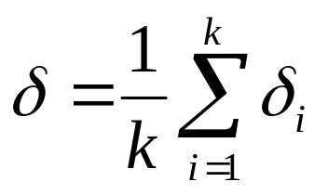
K-Fold Cross Validation
Randomly partition data D into k disjoint equal-sized
subsets P₁…P_{k}
For i from 1 to k do:
Use P_{i} for the test set and remaining data for training
S_{i} = (D – P_{i})
h_{A} = L_{A}(S_{i})
h_{B} = L_{B}(S_{i})
δ_{i} = error_{Pi}(h_{A}) – error_{Pi}(h_{B})
Return the average difference in error:

Slide 33
K-Fold Cross Validation Comments
Every example gets used as a test example once and as a training example k–1 times.
All test sets are independent; however, training sets overlap significantly.
Measures accuracy of hypothesis generated for [(k–1)/k]⋅|D| training examples.
Standard method is 10-fold.
If k is low, not sufficient number of train/test trials; if k is high, test set is small and test variance is high and run time is increased.
If k=|D|, method is called leave-one-out cross validation.

Slide 34
Learning Curves
Plots accuracy vs. size of training set.
Has maximum accuracy (Bayes optimal) nearly been reached or will more examples help?
Is one system better when training data is limited?
Most learners eventually converge to Bayes optimal given sufficient training examples.
100%
Bayes optimal
Test Accuracy
Random guessing
# Training examples

Slide 35
Cross Validation Learning Curves
Split data into k equal partitions
For trial i = 1 to k do:
Use partition i for testing and the union of all other partitions for training.
For each desired point p on the learning curve do:
For each learning system L
Train L on the first p examples of the training set and record
training time, training accuracy, and learned concept complexity.
Test L on the test set, recording testing time and test accuracy.
Compute average for each performance statistic across k trials.
Plot curves for any desired performance statistic versus training set size.

