Slide 1
Markov Logic
Parag Singla
Dept. of Computer Science
University of Texas, Austin

Slide 2
Overview
Motivation
Background
Markov logic
Inference
Learning
Applications

Slide 3
The Interface Layer
Applications
Interface Layer
Infrastructure

Slide 4
Networking
WWW
Applications
Email
Interface Layer
Internet
Protocols
Infrastructure
Routers

Slide 5
Databases
ERP
CRM
Applications
OLTP
Interface Layer
Relational Model
Transaction
Management
Infrastructure
Query
Optimization

Slide 6
Artificial Intelligence
Planning
Robotics
Applications
NLP
Multi-Agent
Systems
Vision
Interface Layer
Representation
Infrastructure
Inference
Learning

Slide 7
Artificial Intelligence
Planning
Robotics
Applications
NLP
Multi-Agent
Systems
Vision
Interface Layer
First-Order Logic?
Representation
Infrastructure
Inference
Learning

Slide 8
Artificial Intelligence
Planning
Robotics
Applications
NLP
Multi-Agent
Systems
Vision
Interface Layer
Graphical Models?
Representation
Infrastructure
Inference
Learning

Slide 9
Artificial Intelligence
Planning
Robotics
Applications
NLP
Multi-Agent
Systems
Vision
Interface Layer
Statistical + Logical AI
Representation
Infrastructure
Inference
Learning

Slide 10
Artificial Intelligence
Planning
Robotics
Applications
NLP
Multi-Agent
Systems
Vision
Interface Layer
Markov Logic
Representation
Infrastructure
Inference
Learning

Slide 11
Overview
Motivation
Background
Markov logic
Inference
Learning
Applications

Slide 12
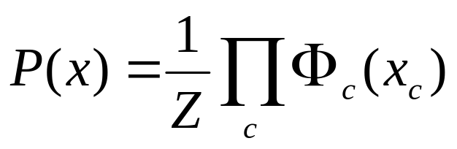
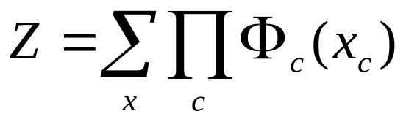
Markov Networks
Undirected graphical models
Smoking
Cancer
Asthma
Cough
Potential functions defined over cliques
Smoking | Cancer | Ф(S,C)
False | False | 4.5
False | True | 4.5
True | False | 2.7
True | True | 4.5

Slide 13
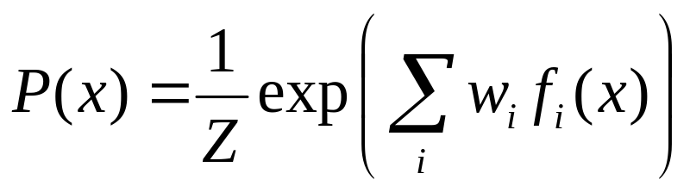
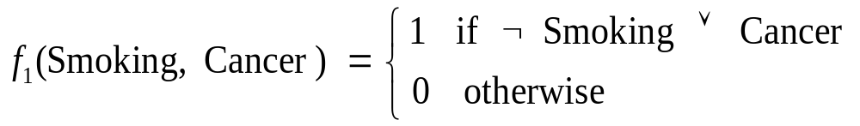

Markov Networks
Undirected graphical models
Smoking
Cancer
Asthma
Cough
Log-linear model:
Weight of Feature i
Feature i

Slide 14
First-Order Logic
Constants, variables, functions, predicates
  Anna, x, MotherOf(x), Friends(x,y)
Grounding: Replace all variables by constants
  Friends (Anna, Bob)
Formula: Predicates connected by operators
  Smokes(x) ⇒ Cancer(x)
Knowledge Base (KB): A set of formulas
  Can be equivalently converted into a clausal form
World: Assignment of truth values to all ground predicates

Slide 15
Overview
Motivation
Background
Markov logic
Inference
Learning
Applications

Slide 16
Markov Logic
A logical KB is a set of hard constraints
on the set of possible worlds
Let’s make them soft constraints:
When a world violates a formula,
It becomes less probable, not impossible
Give each formula a weight
(Higher weight ⇒ Stronger constraint)

Slide 17
Definition
A Markov Logic Network (MLN) is a set of pairs (F, w) where
  F is a formula in first-order logic
  w is a real number
Together with a finite set of constants,
it defines a Markov network with
  One node for each grounding of each predicate in the MLN
  One feature for each grounding of each formula F in the MLN, with the corresponding weight w

Slide 18
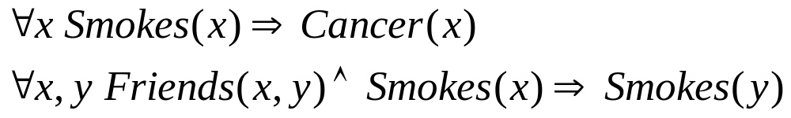
Example: Friends & Smokers

Slide 19

Example: Friends & Smokers

Slide 20
Example: Friends & Smokers
Two constants: Ana (A) and Bob (B)

Slide 21
Example: Friends & Smokers
Two constants: Ana (A) and Bob (B)
Smokes(A)
Smokes(B)
Cancer(A)
Cancer(B)

Slide 22
Example: Friends & Smokers
Two constants: Ana (A) and Bob (B)
Friends(A,B)
Friends(A,A)
Smokes(A)
Smokes(B)
Friends(B,B)
Cancer(A)
Cancer(B)
Friends(B,A)

Slide 23
Example: Friends & Smokers
Two constants: Ana (A) and Bob (B)
Friends(A,B)
Friends(A,A)
Smokes(A)
Smokes(B)
Friends(B,B)
Cancer(A)
Cancer(B)
Friends(B,A)

Slide 24
Example: Friends & Smokers
Two constants: Ana (A) and Bob (B)
Friends(A,B)
Friends(A,A)
Smokes(A)
Smokes(B)
Friends(B,B)
Cancer(A)
Cancer(B)
Friends(B,A)

Slide 25
Example: Friends & Smokers
Two constants: Ana (A) and Bob (B)
Friends(A,B)
Friends(A,A)
Smokes(A)
Smokes(B)
Friends(B,B)
Cancer(A)
Cancer(B)
Friends(B,A)
State of the World ≡ {0,1} Assignment to the nodes

Slide 26
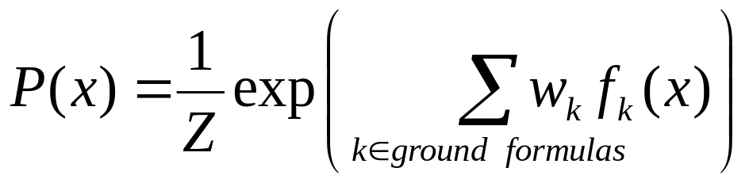
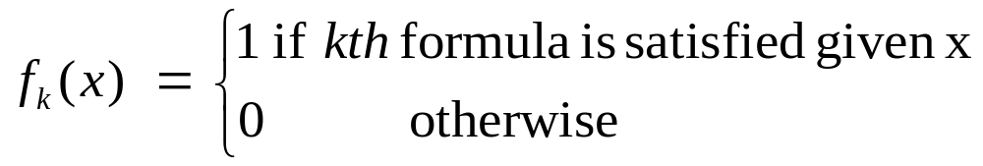
Markov Logic Networks
MLN is template for ground Markov networks
Probability of a world x:
One feature for each ground formula

Slide 27
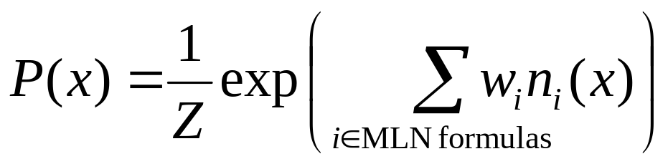
Markov Logic Networks
MLN is template for ground Markov nets
Probability of a world x:
Weight of formula i
No. of true groundings of formula i in x

Slide 28
Relation to Statistical Models
Special cases:
  Markov networks
  Markov random fields
  Bayesian networks
  Log-linear models
  Exponential models
  Max. entropy models
  Gibbs distributions
  Boltzmann machines
  Logistic regression
  Hidden Markov models
  Conditional random fields
Obtained by making all predicates zero-arity
Markov logic allows objects to be interdependent
(non-i.i.d.)

Slide 29
Relation to First-Order Logic
Infinite weights ⇒ First-order logic
Satisfiable KB, positive weights ⇒
Satisfying assignments = Modes of distribution
Markov logic allows contradictions between formulas
Markov logic in infinite domains

Slide 30
Overview
Motivation
Background
Markov logic
Inference
Learning
Applications

Slide 31
Inference
Friends(A,B)
Friends(A,A)
Smokes(A)?
Smokes(B)?
Friends(B,B)
Cancer(A)
Cancer(B)?
Friends(B,A)

Slide 32
Most Probable Explanation (MPE)
Inference
Friends(A,B)
Friends(A,A)
Smokes(A)?
Smokes(B)?
Friends(B,B)
Cancer(A)
Cancer(B)?
Friends(B,A)
What is the most likely state of Smokes(A), Smokes(B), Cancer(B)?

Slide 33
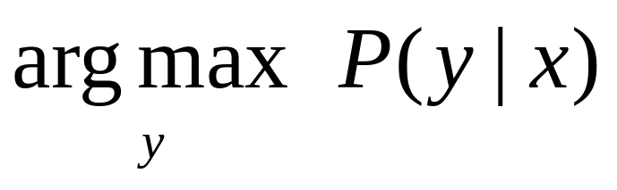
MPE Inference
Problem: Find most likely state of world given evidence
Query
Evidence

Slide 34
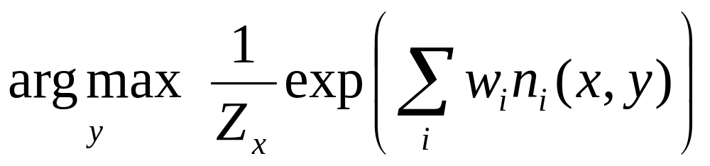
MPE Inference
Problem: Find most likely state of world given evidence

Slide 35
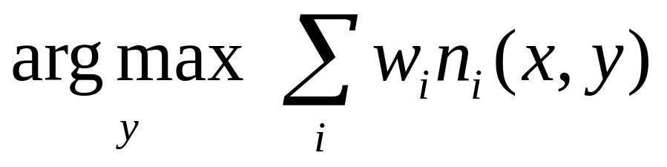
MPE Inference
Problem: Find most likely state of world given evidence

Slide 36
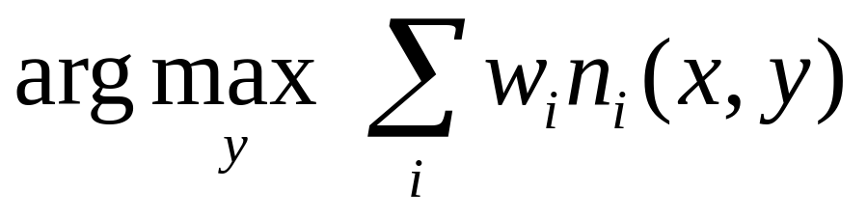
MPE Inference
Problem: Find most likely state of world given evidence
This is just the weighted MaxSAT problem
Use weighted SAT solver
(e.g., MaxWalkSAT [Kautz et al. 97] )

Slide 37
Computing Probabilities: Marginal Inference
Friends(A,B)
Friends(A,A)
Smokes(A)?
Smokes(B)?
Friends(B,B)
Cancer(A)
Cancer(B)?
Friends(B,A)
What is the probability Smokes(B) = 1?

Slide 38
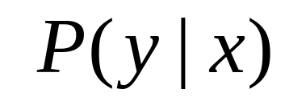
Marginal Inference
Problem: Find the probability of query atoms given evidence
Query
Evidence

Slide 39
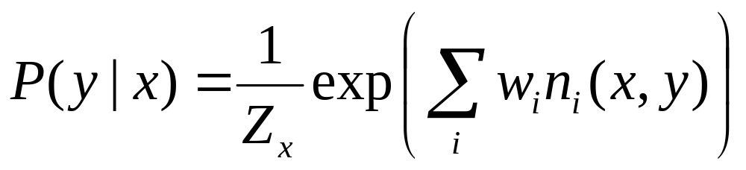
Marginal Inference
Problem: Find the probability of query atoms given evidence
Computing Z_{x} takes exponential time!

Slide 40
Belief Propagation
Bipartite network of nodes (variables)
and features
In Markov logic:
  Nodes = Ground atoms
  Features = Ground clauses
Exchange messages until convergence
Messages
  Current approximation to node marginals

Slide 41
Belief Propagation
Smokes(Ana)
Smokes(Ana) ∧ Friends(Ana, Bob)
⇒ Smokes(Bob)
Nodes (x)
Features (f)

Slide 42
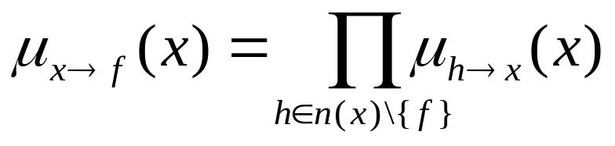
Belief Propagation
Nodes (x)
Features (f)

Slide 43
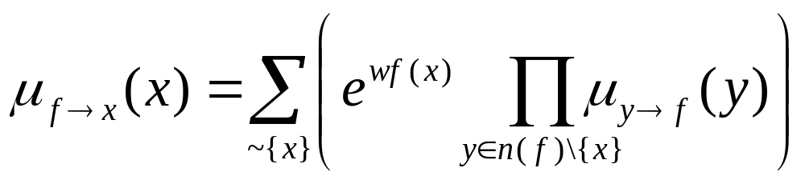
Belief Propagation
Nodes (x)
Features (f)

Slide 44
Lifted Belief Propagation
Nodes (x)
Features (f)

Slide 45
Lifted Belief Propagation
Nodes (x)
Features (f)

Slide 46
Lifted Belief Propagation
α,β :
Functions of edge counts
α
β
Nodes (x)
Features (f)

Slide 47
Overview
Motivation
Background
Markov logic
Inference
Learning
Applications

Slide 48
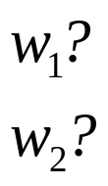
Learning Parameters
Three constants: Ana, Bob, John

Slide 49
Learning Parameters
Three constants: Ana, Bob, John
Smokes
Smokes(Ana)
Smokes(Bob)

Slide 50
Learning Parameters
Three constants: Ana, Bob, John
Smokes
Smokes(Ana)
Smokes(Bob)
Closed World Assumption:
Anything not in the database is assumed false.

Slide 51
Learning Parameters
Three constants: Ana, Bob, John
Smokes
Smokes(Ana)
Smokes(Bob)
Cancer
Cancer(Ana)
Cancer(Bob)
Closed World Assumption:
Anything not in the database is assumed false.

Slide 52
Learning Parameters
Three constants: Ana, Bob, John
Smokes
Smokes(Ana)
Smokes(Bob)
Cancer
Cancer(Ana)
Cancer(Bob)
Friends
Friends(Ana, Bob)
Friends(Bob, Ana)
Friends(Ana, John)
Friends(John, Ana)
Closed World Assumption:
Anything not in the database is assumed false.

Slide 53
Learning Parameters
Data is a relational database
Closed world assumption (if not: EM)
Learning parameters (weights)
  Generatively
  Discriminatively

Slide 54
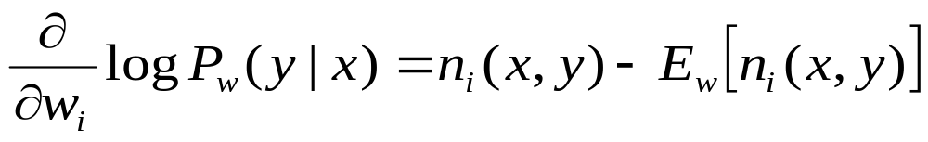
Learning Parameters (Discriminative)
Given training data
Maximize conditional likelihood of query (y) given evidence (x)
Use gradient ascent
No local maxima
No. of true groundings of clause i in data
Expected no. true groundings according to model

Slide 55
Learning Parameters (Discriminative)
Requires inference at each step (slow!)
Approximate expected counts by counts in MAP state of y given x
No. of true groundings of clause i in data
Expected no. true groundings according to model

Slide 56
Learning Structure
Three constants: Ana, Bob, John
Smokes
Smokes(Ana)
Smokes(Bob)
Cancer
Cancer(Ana)
Cancer(Bob)
Friends
Friends(Ana, Bob)
Friends(Bob, Ana)
Friends(Ana, John)
Friends(John, Ana)
Can we learn the set of the formulas in the MLN?

Slide 57
Learning Structure
Three constants: Ana, Bob, John
Smokes
Smokes(Ana)
Smokes(Bob)
Cancer
Cancer(Ana)
Cancer(Bob)
Friends
Friends(Ana, Bob)
Friends(Bob, Ana)
Friends(Ana, John)
Friends(John, Ana)
Can we refine the set of the formulas in the MLN?

Slide 58

Learning Structure
Three constants: Ana, Bob, John
Smokes
Smokes(Ana)
Smokes(Bob)
Cancer
Cancer(Ana)
Cancer(Bob)
Friends
Friends(Ana, Bob)
Friends(Bob, Ana)
Friends(Ana, John)
Friends(John, Ana)

Slide 59
Learning Structure
Learn the MLN formulas given data
Search in the space of possible formulas
  Exhaustive search not possible!
  Need to guide the search
Initial state: Unit clauses or hand-coded KB
Operators: Add/remove literal, flip sign
Evaluation function:
likelihood + structure prior
Search: top-down, bottom-up, structural motifs

Slide 60
Overview
Motivation
Markov logic
Inference
Learning
Applications
Conclusion & Future Work

Slide 61
Applications
Web-mining
Collective Classification
Link Prediction
Information retrieval
Entity resolution
Activity Recognition
Image Segmentation & De-noising
Social Network Analysis
Computational Biology
Natural Language Processing
Robot mapping
Planning and MDPs
More..

Slide 62
Entity Resolution
Data Cleaning and Integration – first step in the data-mining process
Merging of data from multiple sources results in duplicates
Entity Resolution: Problem of identifying which of the records/fields refer to the same underlying entity

Slide 63
Entity Resolution
Author
Title
Venue
Parag Singla and Pedro Domingos, “Memory-Efficient
Inference in Relational Domains” (AAAI-06).
Singla, P., & Domingos, P. (2006). Memory-efficent
inference in relatonal domains. In Proceedings of the
Twenty-First National Conference on Artificial Intelligence
(pp. 500-505). Boston, MA: AAAI Press.
H. Poon & P. Domingos, Sound and Efficient Inference
with Probabilistic and Deterministic Dependencies”, in
Proc. AAAI-06, Boston, MA, 2006.
Poon H. (2006). Efficent inference. In Proceedings of the
Twenty-First National Conference on Artificial Intelligence.

Slide 64
Entity Resolution
Author
Title
Venue
Parag Singla and Pedro Domingos, “Memory-Efficient
Inference in Relational Domains” (AAAI-06).
Singla, P., & Domingos, P. (2006). Memory-efficent
inference in relatonal domains. In Proceedings of the
Twenty-First National Conference on Artificial Intelligence
(pp. 500-505). Boston, MA: AAAI Press.
H. Poon & P. Domingos, Sound and Efficient Inference
with Probabilistic and Deterministic Dependencies”, in
Proc. AAAI-06, Boston, MA, 2006.
Poon H. (2006). Efficent inference. In Proceedings of the
Twenty-First National Conference on Artificial Intelligence.

Slide 65
Entity Resolution
Author
Title
Venue
Parag Singla and Pedro Domingos, “Memory-Efficient
Inference in Relational Domains” (AAAI-06).
Singla, P., & Domingos, P. (2006). Memory-efficent
inference in relatonal domains. In Proceedings of the
Twenty-First National Conference on Artificial Intelligence
(pp. 500-505). Boston, MA: AAAI Press.
H. Poon & P. Domingos, Sound and Efficient Inference
with Probabilistic and Deterministic Dependencies”, in
Proc. AAAI-06, Boston, MA, 2006.
Poon H. (2006). Efficent inference. In Proceedings of the
Twenty-First National Conference on Artificial Intelligence.

Slide 66
Predicates
HasToken(field,token)
HasField(record,field)
SameField(field,field)
SameRecord(record,record)

Slide 67
Predicates & Formulas
HasToken(field,token)
HasField(record,field)
SameField(field,field)
SameRecord(record,record)
HasToken(f₁,t) ∧ HasToken(f₂,t) ⇒ SameField(f₁,f₂)
(Similarity of fields based on shared tokens)

Slide 68
Predicates & Formulas
HasToken(field,token)
HasField(record,field)
SameField(field,field)
SameRecord(record,record)
HasToken(f₁,t) ∧ HasToken(f₂,t) ⇒ SameField(f₁,f₂)
(Similarity of fields based on shared tokens)
HasField(r₁,f₁) ∧ HasField(r₂,f₂) ∧ SameField(f₁,f₂)
⇔ SameRecord(r₁,r₂)
(Similarity of records based on similarity of fields and vice-versa)

Slide 69
Predicates & Formulas
HasToken(field,token)
HasField(record,field)
SameField(field,field)
SameRecord(record,record)
HasToken(f₁,t) ∧ HasToken(f₂,t) ⇒ SameField(f₁,f₂)
(Similarity of fields based on shared tokens)
HasField(r₁,f₁) ∧ HasField(r₂,f₂) ∧ SameField(f₁,f₂)
⇔ SameRecord(r₁,r₂)
(Similarity of records based on similarity of fields and vice-versa)
SameRecord(r₁,r₂) ^ SameRecord(r₂,r₃) ⇒ SameRecord(r₁,r₃) (Transitivity)

Slide 70
Predicates & Formulas
HasToken(field,token)
HasField(record,field)
SameField(field,field)
SameRecord(record,record)
HasToken(f₁,t) ∧ HasToken(f₂,t) ⇒ SameField(f₁,f₂)
(Similarity of fields based on shared tokens)
HasField(r₁,f₁) ∧ HasField(r₂,f₂) ∧ SameField(f₁,f₂)
⇔ SameRecord(r₁,r₂)
(Similarity of records based on similarity of fields and vice-versa)
SameRecord(r₁,r₂) ^ SameRecord(r₂,r₃) ⇒ SameRecord(r₁,r₃) (Transitivity)
Winner of Best Paper Award!

Slide 71

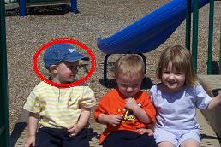
Discovery of Social Relationships in Consumer Photo Collections
Find out all the photos of my child’s friends!

Slide 72
MLN Rules
Hard Rules
  Two people share a unique relationship
  Parents are older than their children
  …
Soft Rules
  Children’s friends are of similar age
  Young adult appearing with a child shares a parent-child relationship
  Friends and relatives are clustered together
  …

Slide 73
Models Compared
Model | Description
Random | Random prediction (uniform)
Prior | Prediction based on priors
Hard | Hard constraints only
Hard-prior | Combination of hard and prior
MLN | Hand constructed MLN

Slide 74
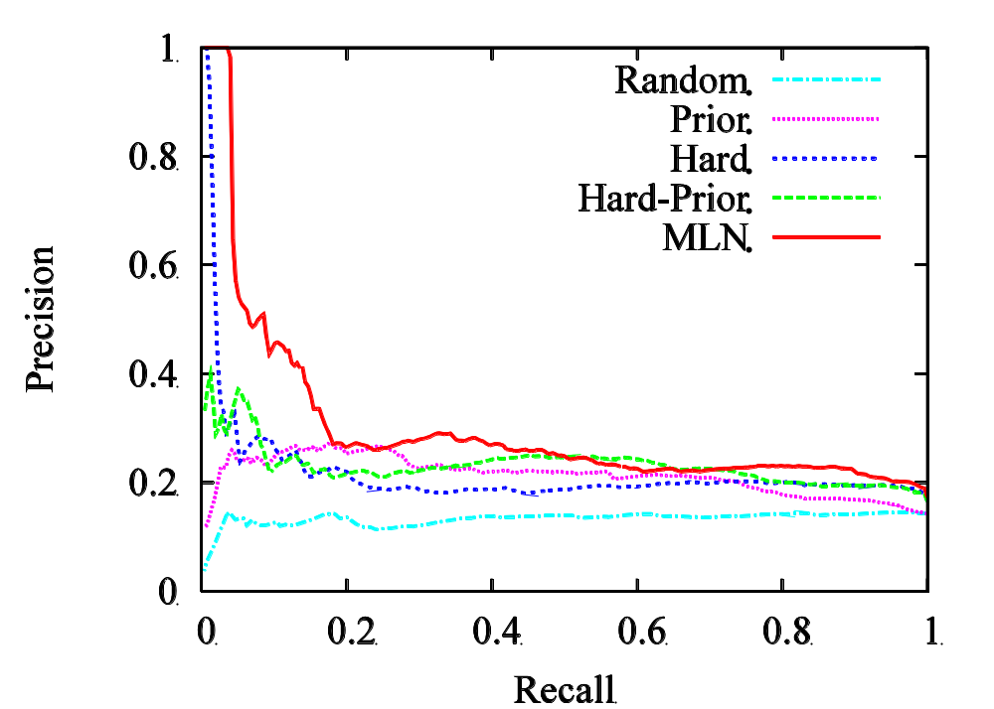
Results (7 Different Relationships)

Slide 75
Alchemy
Open-source software including:
Full first-order logic syntax
MPE inference, marginal inference
Generative & discriminative weight learning
Structure learning
Programming language features
alchemy.cs.washington.edu

