Slide 1
CS 343: Artificial Intelligence
Neural Networks
Raymond J. Mooney
University of Texas at Austin

Slide 2
Neural Networks
Analogy to biological neural systems, the most robust learning systems we know.
Attempt to understand natural biological systems through computational modeling.
Massive parallelism allows for computational efficiency.
Help understand “distributed” nature of neural representations (rather than “localist” representation) that allow robustness and graceful degradation.
Intelligent behavior as an “emergent” property of large number of simple units rather than from explicitly encoded symbolic rules and algorithms.

Slide 3
Neural Speed Constraints
Neurons have a “switching time” on the order of a few milliseconds, compared to nanoseconds for current computing hardware.
However, neural systems can perform complex cognitive tasks (vision, speech understanding) in tenths of a second.
Only time for performing 100 serial steps in this time frame, compared to orders of magnitude more for current computers.
Must be exploiting “massive parallelism.”
Human brain has about 10¹¹ neurons with an average of 10⁴ connections each.

Slide 4
Neural Network Learning
Learning approach based on modeling adaptation in biological neural systems.
Perceptron: Initial algorithm for learning simple neural networks (single layer) developed in the 1950’s.
Backpropagation: More complex algorithm for learning multi-layer neural networks developed in the 1980’s.

Slide 5
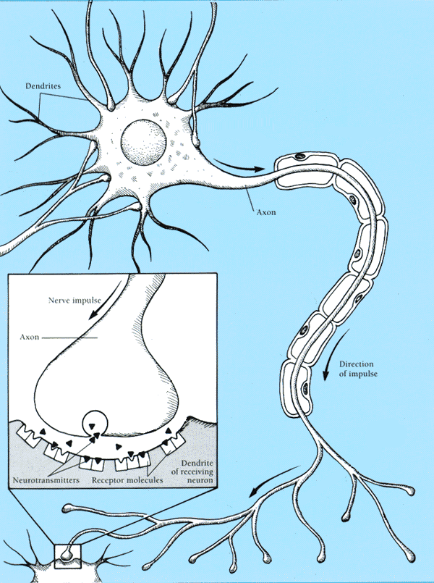
Real Neurons
Cell structures
  Cell body
  Dendrites
  Axon
  Synaptic terminals

Slide 6
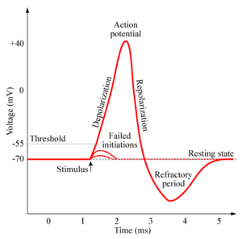
Neural Communication
Electrical potential across cell membrane exhibits spikes called action potentials.
Spike originates in cell body, travels down
axon, and causes synaptic terminals to
release neurotransmitters.
Chemical diffuses across synapse to
dendrites of other neurons.
Neurotransmitters can be excititory or
inhibitory.
If net input of neurotransmitters to a neuron from other neurons is excititory and exceeds some threshold, it fires an action potential.

Slide 7
Real Neural Learning
Synapses change size and strength with experience.
Hebbian learning: When two connected neurons are firing at the same time, the strength of the synapse between them increases.
“Neurons that fire together, wire together.”

Slide 8
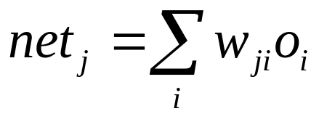
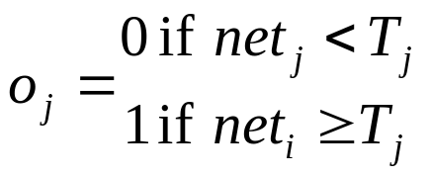
Artificial Neuron Model
Model network as a graph with cells as nodes and synaptic connections as weighted edges from node i to node j, w_{ji}
Model net input to cell as
Cell output is:
1
w₁₂
w₁₅
w₁₆
w₁₃
w₁₄
2
3
4
5
6
o_{j}
1
(T_{j} is threshold for unit j)
0
T_{j}
net_{j}

Slide 9
Neural Computation
McCollough and Pitts (1943) showed how such model neurons could compute logical functions and be used to construct finite-state machines.
Can be used to simulate logic gates:
  AND: Let all w_{ji} be T_{j}/n, where n is the number of inputs.
  OR: Let all w_{ji} be T_{j}
  NOT: Let threshold be 0, single input with a negative weight.
Can build arbitrary logic circuits, sequential machines, and computers with such gates.
Given negated inputs, two layer network can compute any boolean function using a two level AND-OR network.

Slide 10
Perceptron Training
Assume supervised training examples giving the desired output for a unit given a set of known input activations.
Learn synaptic weights so that unit produces the correct output for each example.
Perceptron uses iterative update algorithm to learn a correct set of weights.

Slide 11
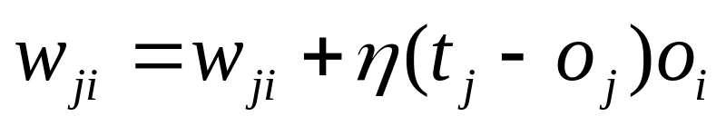
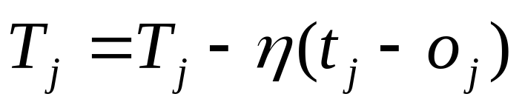
Perceptron Learning Rule
Update weights by:
where η is the “learning rate”
t_{j} is the teacher specified output for unit j.
Equivalent to rules:
  If output is correct do nothing.
  If output is high, lower weights on active inputs
  If output is low, increase weights on active inputs
Also adjust threshold to compensate:

Slide 12
Perceptron Learning Algorithm
Iteratively update weights until convergence.
Each execution of the outer loop is typically called an epoch.
Initialize weights to random values
Until outputs of all training examples are correct
For each training pair, E, do:
Compute current output o_{j} for E given its inputs
Compare current output to target value, t_{j ,} for E
Update synaptic weights and threshold using learning rule

Slide 13
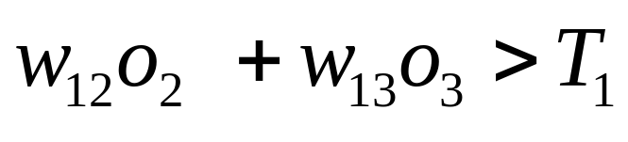
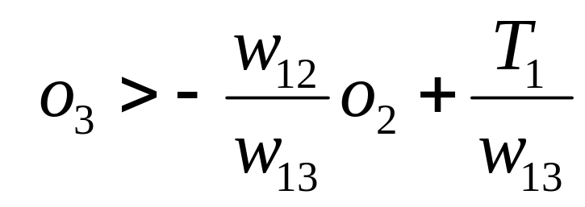
Perceptron as a Linear Separator
Since perceptron uses linear threshold function, it is searching for a linear separator that discriminates the classes.
o₃
??
Or hyperplane in
n-dimensional space
o₂

Slide 14
Concept Perceptron Cannot Learn
Cannot learn exclusive-or, or parity function in general.
o₃
1
+
–
??
–
+
0
o₂
1

Slide 15
Perceptron Limits
System obviously cannot learn concepts it cannot represent.
Minksy and Papert (1969) wrote a book analyzing the perceptron and demonstrating many functions it could not learn.
These results discouraged further research on neural nets; and symbolic AI became the dominate paradigm.

Slide 16
Perceptron Convergence and Cycling Theorems
Perceptron convergence theorem: If the data is linearly separable and therefore a set of weights exist that are consistent with the data, then the Perceptron algorithm will eventually converge to a consistent set of weights.
Perceptron cycling theorem: If the data is not linearly separable, the Perceptron algorithm will eventually repeat a set of weights and threshold at the end of some epoch and therefore enter an infinite loop.
  By checking for repeated weights+threshold, one can guarantee termination with either a positive or negative result.

Slide 17
Perceptron as Hill Climbing
The hypothesis space being search is a set of weights and a threshold.
Objective is to minimize classification error on the training set.
Perceptron effectively does hill-climbing (gradient descent) in this space, changing the weights a small amount at each point to decrease training set error.
For a single model neuron, the space is well behaved with a single minima.
training
error
0
weights

Slide 18
Perceptron Performance
Linear threshold functions are restrictive (high bias) but still reasonably expressive; more general than:
  Pure conjunctive
  Pure disjunctive
  M-of-N (at least M of a specified set of N features must be present)
In practice, converges fairly quickly for linearly separable data.
Can effectively use even incompletely converged results when only a few outliers are misclassified.
Experimentally, Perceptron does quite well on many benchmark data sets.

Slide 19
Multi-Layer Networks
Multi-layer networks can represent arbitrary functions, but an effective learning algorithm for such networks was thought to be difficult.
A typical multi-layer network consists of an input, hidden and output layer, each fully connected to the next, with activation feeding forward.
The weights determine the function computed. Given an arbitrary number of hidden units, any boolean function can be computed with a single hidden layer.
output
hidden
activation
input

Slide 20
Hill-Climbing in Multi-Layer Nets
Since “greed is good” perhaps hill-climbing can be used to learn multi-layer networks in practice although its theoretical limits are clear.
However, to do gradient descent, we need the output of a unit to be a differentiable function of its input and weights.
Standard linear threshold function is not differentiable at the threshold.
o_{i}
1
0
T_{j}
net_{j}

Slide 21
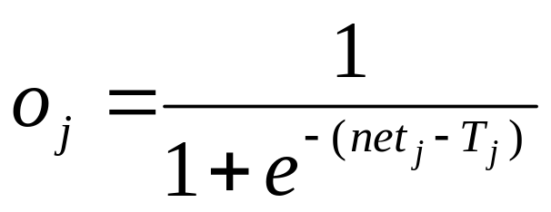
Differentiable Output Function
Need non-linear output function to move beyond linear functions.
  A multi-layer linear network is still linear.
Standard solution is to use the non-linear, differentiable sigmoidal “logistic” function:
1
0
T_{j}
net_{j}
Can also use tanh or Gaussian output function

Slide 22
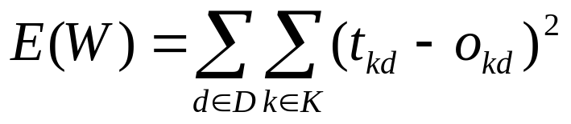
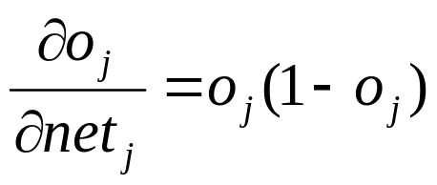
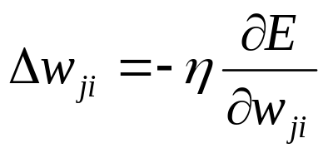
Gradient Descent
Define objective to minimize error:
where D is the set of training examples, K is the set of output units, t_{kd} and o_{kd} are, respectively, the teacher and current output for unit k for example d.
The derivative of a sigmoid unit with respect to net input is:
Learning rule to change weights to minimize error is:

Slide 23
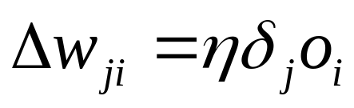
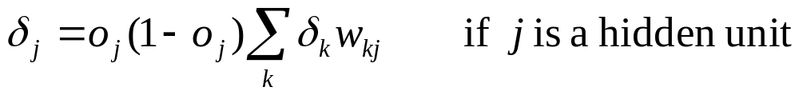
Backpropagation Learning Rule
Each weight changed by:
where η is a constant called the learning rate
t_{j} is the correct teacher output for unit j
δ_{j} is the error measure for unit j

Slide 24
Error Backpropagation
First calculate error of output units and use this to change the top layer of weights.
Current output: o_{j}=0.2
Correct output: t_{j}=1.0
Error δ_{j} = o_{j}(1–o_{j})(t_{j}–o_{j})
0.2(1–0.2)(1–0.2)=0.128
output
Update weights into j
hidden
input

Slide 25
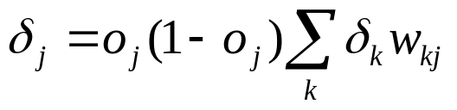
Error Backpropagation
Next calculate error for hidden units based on errors on the output units it feeds into.
output
hidden
input

Slide 26
Error Backpropagation
Finally update bottom layer of weights based on errors calculated for hidden units.
output
hidden
Update weights into j
input

Slide 27
Backpropagation Training Algorithm
Create the 3-layer network with H hidden units with full connectivity
between layers. Set weights to small random real values.
Until all training examples produce the correct value (within ε), or
mean squared error ceases to decrease, or other termination criteria:
Begin epoch
For each training example, d, do:
Calculate network output for d’s input values
Compute error between current output and correct output for d
Update weights by backpropagating error and using learning rule
End epoch

Slide 28
Comments on Training Algorithm
Not guaranteed to converge to zero training error, may converge to local optima or oscillate indefinitely.
However, in practice, does converge to low error for many large networks on real data.
Many epochs (thousands) may be required, hours or days of training for large networks.
To avoid local-minima problems, run several trials starting with different random weights (random restarts).
  Take results of trial with lowest training set error.
  Build a committee of results from multiple trials (possibly weighting votes by training set accuracy).

Slide 29
Representational Power
Boolean functions: Any boolean function can be represented by a two-layer network with sufficient hidden units.
Continuous functions: Any bounded continuous function can be approximated with arbitrarily small error by a two-layer network.
  Sigmoid functions can act as a set of basis functions for composing more complex functions, like sine waves in Fourier analysis.
Arbitrary function: Any function can be approximated to arbitrary accuracy by a three-layer network.

Slide 30
Sample Learned XOR Network
O
3.11
6.96
−7.38
−5.24
A
B
−2.03
−3.58
−3.6
−5.57
X
−5.74
Y
Hidden Unit A represents: ¬(X ∧ Y)
Hidden Unit B represents: ¬(X ∨ Y)
Output O represents: A ∧ ¬B = ¬(X ∧ Y) ∧ (X ∨ Y)
= X ⊕ Y

Slide 31
Hidden Unit Representations
Trained hidden units can be seen as newly constructed features that make the target concept linearly separable in the transformed space.
On many real domains, hidden units can be interpreted as representing meaningful features such as vowel detectors or edge detectors, etc..
However, the hidden layer can also become a distributed representation of the input in which each individual unit is not easily interpretable as a meaningful feature.

Slide 32
Successful Applications
Text to Speech (NetTalk)
Fraud detection
Financial Applications
  HNC (eventually bought by Fair Isaac)
Chemical Plant Control
  Pavillion Technologies
Automated Vehicles
Game Playing
  Neurogammon
Handwriting recognition

