Slide 1
Android Adapters
Mobile (Android)
Application Development

Slide 2


List View & Grid View
The content for “List View” & “Grid View” is dynamic.
These are populated with views at runtime.

Slide 3
List View & Grid View
In order to implement functionality:
Add each view item inside the List or Grid.
Populate each view item with content.
Since we can have many items inside List or Grid, we may need to implement scrolling & pagination.
We also have to write additional code to identify the click event on a particular item.
Notes:
All items are of the same type

Slide 4
List View & Grid View
Note that items in both the List & Grid:
Are of same type. i.e., TextView, ImageView, etc.
Need to be accessed and added at runtime from some data source for example, array, database, etc.

Slide 5
What We Need?
We need Android Framework to provide us with:
An object that can:
  Provide access to the data items.
  Be responsible for making a View for each item in the data set.
A ViewGroup:
  Whose children are determined by the above object.
  That provides mechanism to handle click event on particular list items.
  That takes care of scrolling & pagination.
Notes:
Values in form get from user and contained in data object to be send to database layer

Slide 6
Good News!
Android Framework provides us with:
Adapter Class:
  Provides access to the data items.
  Responsible for making a View for each item in the data set.
AdapterView Class:
  Whose children are determined by an Adapter.
  Provide mechanism to handle click event on particular list items.
  Takes care of scrolling & pagination.
  ListView & GridView are subclasses of AdapterView.
Notes:
Adapter talks to data, gets/fetches data

Slide 7
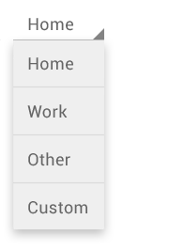
Spinner
Spinner and Gallery (Gallery has been deprecated since API 16) are also commonly used subclasses of AdapterView.
Spinners provide a quick way to select one value from a set. In the default state, a spinner shows its currently selected value. Touching the spinner displays a dropdown menu with all other available values, from which the user can select a new one.
Notes:
Spinner is an adapter view – it talks to adapter and adapter talks to source

Slide 8
Adapter
An Adapter object acts as a bridge between an AdapterView and the underlying data for that view.
The Adapter provides access to the data items.
The Adapter is also responsible for making a View for each item in the data set.

Slide 9
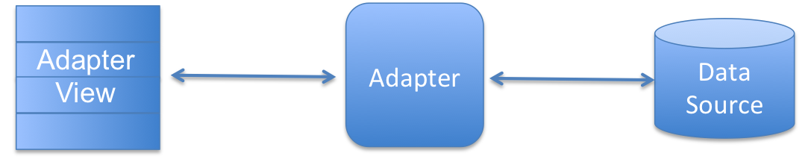
Adapter (Conceptual Diagram)
List View
Grid View
Spinner
ArrayAdapter
SimpleCursorAdapter
Array
Database
Notes:
ArrayAdapter
You can use this adapter when your data source is an array. By default, ArrayAdapter creates a view for each array item by calling toString() on each item and placing the contents in a TextView. Consider you have an array of strings you want to display in a ListView, initialize a new ArrayAdapter using a constructor to specify the layout for each string and the string array −
ArrayAdapter adapter = new ArrayAdapter<String>(this, R.layout.ListView, StringArray);

Slide 10
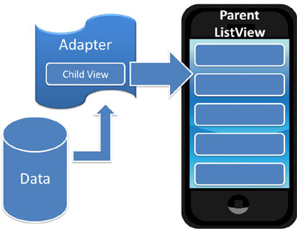
Adapter (Conceptual Diagram)

Slide 11
Using Adapter & AdapterView
Add AdapterView to Activity (i.e., Add in XML Layout) – list, grid, spinner
Define Date Source (e.g. Array in Code or in XML “string-array”)
Create Adapter (e.g., ArrayAdapter)
  Specify context, layout to be used for each view, and the string array
Get reference to AdapterView (use findViewById() method)
Set Adapter on Adapter View (use setAdapter() method)
Set Event Listener (if needed. e.g., onItemClick())
Notes:
Inflater convert the XML resource into a programmable object

Slide 12
ArrayAdapter
Consider you have an array of strings you want to display in a ListView, initialize a new ArrayAdapter using a constructor to specify the layout for each string and the string array −
ArrayAdapter adapter = new ArrayAdapter<String>(this, R.layout.ListView, StringArray);
Parameters of Array Adapter
this is the application context.
R.layout.ListView is defined in XML file and having TextView for each string in the array.
StringArray is an array of strings which will be populated in the text view.
Notes:
Once you have array adapter created, then simply call setAdapter() on your ListView object as follows −
ListView listView = (ListView) findViewById(R.id.listview);
listView.setAdapter(adapter);

Slide 13
ArrayAdapter Examples
List View
Grid View
Spinner

Slide 14
Example:
List View With Array Adapter

Slide 15
1. Add AdapterView
<RelativeLayout
... >
<ListView
android:id="@+id/listView1"
android:layout_width="match_parent"
android:layout_height="wrap_content"
android:layout_alignParentLeft="true"
android:layout_alignParentTop="true" >
</ListView>
</RelativeLayout>

Slide 16
2. Define Date Source
String[] months = {"January", "February", "March", "April", "May", "June", "July", "August", "September", "October", "November", "December"};

Slide 17
3. Create Adapter
ArrayAdapter<String> adapter = new ArrayAdapter<String>(this, android.R.layout.simple_list_item_1, months);
Notes:
Sspecifying String to the generic adapter.
Android.R.layout.simple_list_item_1 . Android keyword here means we are using android default resource

Slide 18
4. Get reference to AdapterView
ListView listview = (ListView) findViewById(R.id.listView1);

Slide 19
5. Set Adapter on Adapter View
listview.setAdapter(adapter);

Slide 20
6. Set Event Listener
listview.setOnItemClickListener(new OnItemClickListener()
{
public void onItemClick(AdapterView<?> parent, View v, int position, long id) {
Toast.makeText(getApplicationContext(), months[position], Toast.LENGTH_SHORT).show();
}
});
Notes:
Study generics wild cards - * and ?
TOAST vs. Snake bar

Slide 21
ListView with ChoiceMode
<ListView
android:id="@+id/listView1"
android:layout_width="match_parent"
android:layout_height="wrap_content"
android:layout_alignParentLeft="true"
android:layout_alignParentTop="true"
android:divider="@color/colorAccent"
android:dividerHeight="1dp“
android:choiceMode="multipleChoice>
</ListView>

Slide 22
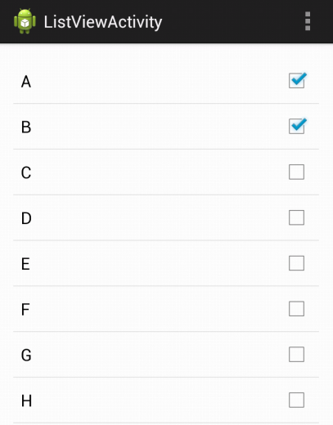
ListView with ChoiceMode
ArrayAdapter<String> adapter = new ArrayAdapter<String>(this, android.R.layout.simple_list_item_multiple_choice, data);

Slide 23
Example:
Grid View With Array Adapter

Slide 24
1. Add AdapterView
<RelativeLayout
... >
<GridView
android:id="@+id/gridView1"
android:layout_width="match_parent"
android:layout_height="wrap_content"
android:layout_alignParentLeft="true"
android:layout_alignParentTop="true"
android:numColumns="3" >
</GridView>
</RelativeLayout>

Slide 25
2. Define Date Source
In “strings.xml” File:
<string-array name="alphabets_array">
<item>A</item>
<item>B</item>
<item>C</item>
. . .
<item>Z</item>
</string-array>

Slide 26
2. Define Date Source
In Activity’s “.java” File:
// You can declare outside (onCreate) method, But don’t initialize
String[] alphabets;
// Get values from XML resource file
alphabets = getResources().getStringArray(R.array.alphabets_array);

Slide 27
3. Create Adapter
ArrayAdapter<String> adapter = new ArrayAdapter<String>(this, android.R.layout.simple_list_item_1, alphabets);

Slide 28
4. Get reference to AdapterView
GridView gridview = (GridView) findViewById(R.id.gridView1);

Slide 29
5. Set Adapter on Adapter View
gridview.setAdapter(adapter);

Slide 30
6. Set Event Listener
gridview.setOnItemClickListener(new OnItemClickListener()
{
public void onItemClick(AdapterView<?> parent, View v, int position, long id)
{
Toast.makeText(getApplicationContext(), "You Clicked: " + alphabets[position], Toast.LENGTH_SHORT).show();
}
});

Slide 31
Example:
Spinner With Array Adapter

