Slide 1
Customer Churn Prediction

Slide 2
Why Churn prediction ?
According to customer intelligence leader CallMiner, U.S. companies lose $35.3 billion annually due to unplanned consumer switching, known as customer churn in the industry.

Slide 3
Problem Statement:
You have been hired by a telecom company, a leading telecommunications company with a vast customer base and a competitive market. The company is facing a significant challenge in retaining its customers and wishes to develop an effective strategy to predict and prevent customer churn(leave the service). To address this, the company is seeking to build a Customer Churn Prediction system and implement MLOps practices to ensure the seamless deployment and maintenance of the model in a real-world business environment.
Project Description:
The company is seeking to leverage its extensive customer data, including call records, service plans, customer support interactions, and billing information, to predict which customers are most likely to churn (leave the service). The goal is to develop a machine learning model that can identify potential churners well in advance and enable the company to take proactive measures to retain them.

Slide 4
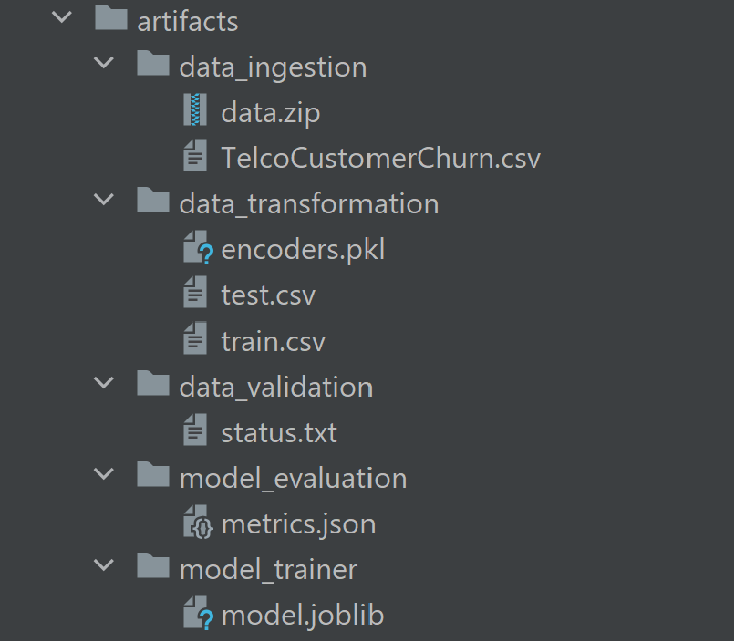
Data Pipeline

Slide 5
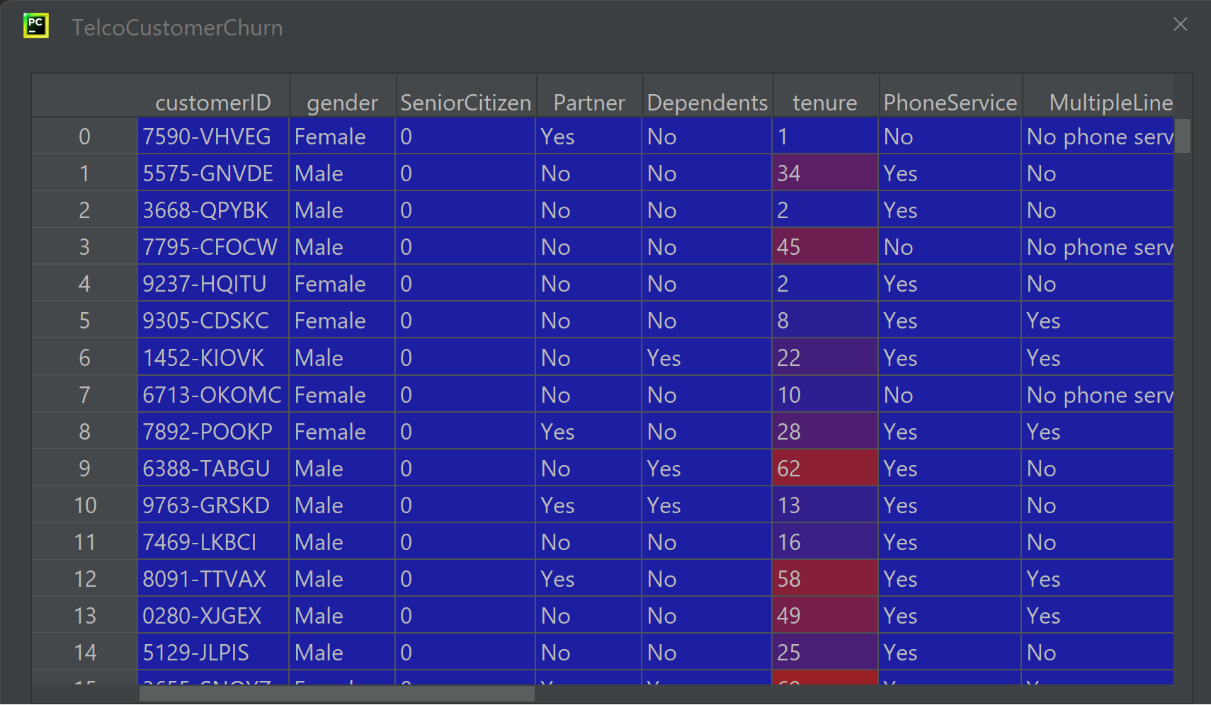
Data Pipeline
(1) Data ingestion:
Reads the input raw data that is not processed or cleaned as a zip file using its (url).
It unzips the data into a csv file.

Slide 6
Data Pipeline
(2) Data validation:
It makes sure that the loaded data comply with the schema according to schema.yaml file.

Slide 7
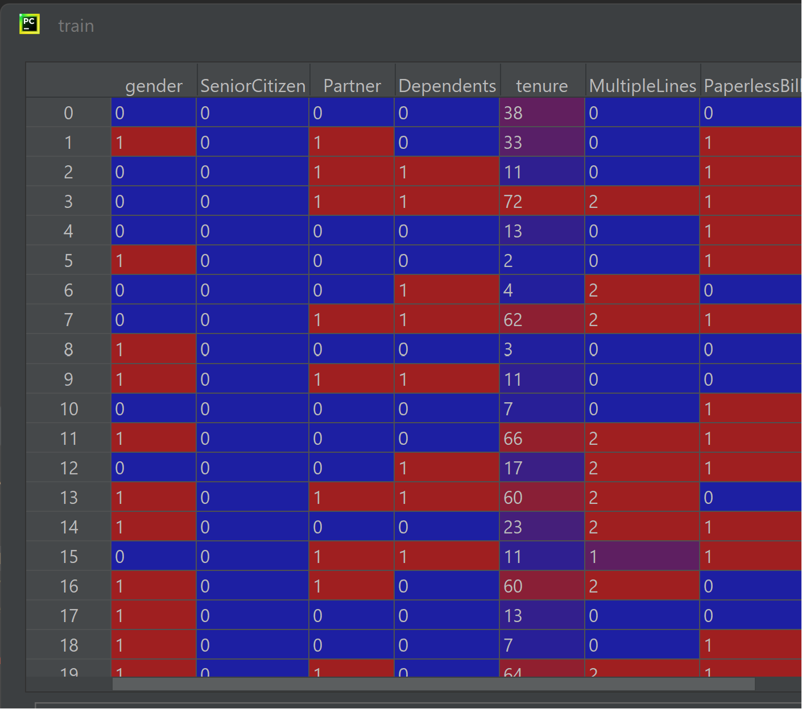
Data Pipeline
(3) Data transformation:
It applies some processing on the data including transforming and normalizing data.
Generates the file encoders.pkl that encodes the categorical values (i.e: Male=0, Female=1)
Generates two splits of the data:
• Train.csv, to be used to train the data
• Test.csv, to be used to evaluate the data.
(4) Model Trainer:
It’s intended to train the mode using a selected machine learning algorithm
Generates the trained model to be used in the evaluation phase

Slide 8
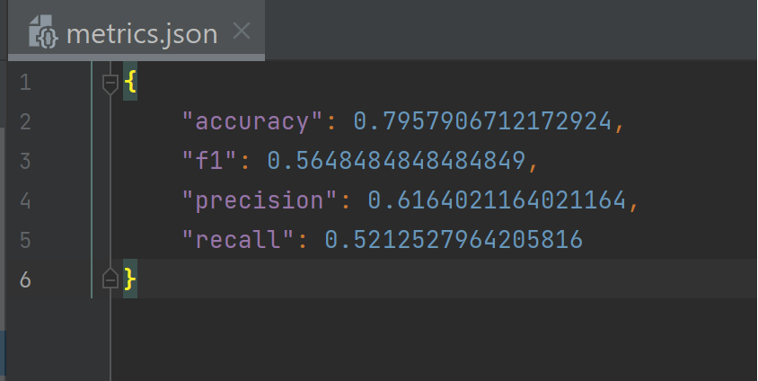
Data Pipeline
(5) Model evaluation:
Evaluates the model on the test.csv file using the resulted trained model from the previous phase.
The result is the file: metrics.json that contains some evaluation criteria used to measure the accuracy and the performance of the model.

Slide 9
Prediction
Using Flask RESTfull API we can predict new data records real time

