Slide 1
Huaxia Zhao Leibniz Universität Hannover 03.2022
Profit Maximisation of Deforestation based
on Reinforcement Learning
Huaxia Zhao

Slide 2
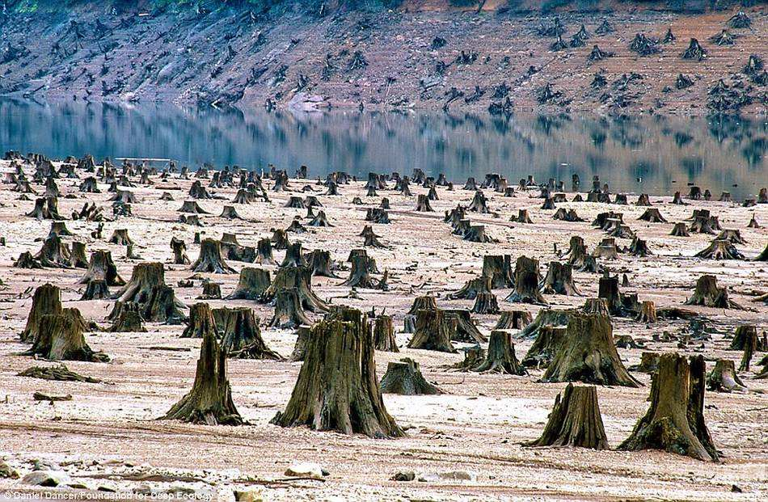
Problem caused by Deforestation

Slide 3




A Balance Solution
Interests of landowners
Environmental protection
Land condition
(fertility)
Influence between plants

Slide 4
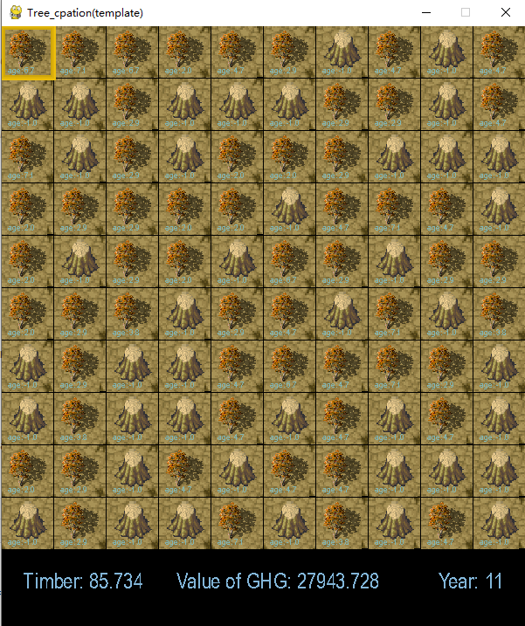
Available in RL?
Action_space
Observation_space
The complexity
Reward_Timber
Reward_GHG
Fertility

Slide 5
Reward function
reward(weighted)=
reward_timber * WEIGHT_TIMBER + Reward_greenhouse_gas *WEIGHT_GREENHOUSE_GAS
WEIGHT_TIMBER=0.5
WEIGHT_GREENHOUSE_GAS=0.01
value_of_tree_fn = lambda x: 0 if x == -1 else math.pi*((0.5*x) ** 2) value_of_greenhouse_gas_uptake_fn = lambda x: 0 if x == -1 else (x * 5)
age | timber | greenhouse gas | weighted Timber | weighted Greenhouse gas | sum reward
1 | 0.785 | 5 | 0.785 | 0.5 | 1.285
2 | 3.14 | 10 | 3.14 | 1 | 4.14
3 | 7.065 | 15 | 7.065 | 1.5 | 8.565
4 | 12.56 | 20 | 12.56 | 2 | 14.56
5 | 19.625 | 25 | 19.625 | 2.5 | 22.125
6 | 28.26 | 30 | 28.26 | 3 | 31.26
7 | 38.465 | 35 | 38.465 | 3.5 | 41.965

Slide 6
Value Fuction of fertility
MAX_FERTILITY = 3
tree_growth_fn = lambda x: x / MAX_FERTILITY absorb_fertility_ability_fn = lambda x: 0.05 *x
fertility | age | consume | grow | timeline
3 | 1 | 0.05 | 0.983333 | 1
2.95 | 1.983333 | 0.099167 | 0.950278 | 2
2.850833 | 2.933611 | 0.146681 | 0.901384 | 3
2.704153 | 3.834995 | 0.19175 | 0.837468 | 4
2.512403 | 4.672463 | 0.233623 | 0.759593 | 5
2.27878 | 5.432056 | 0.271603 | 0.669059 | 6
2.007177 | 6.101115 | 0.305056 | 0.567374 | 7
1.702121 | 6.668489 | 0.333424 | 0.456232 | 8
1.368697 | 7.124721 | 0.356236 | 0.337487 | 9

Slide 7
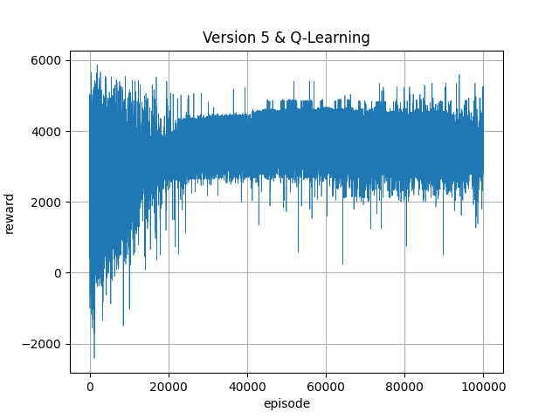
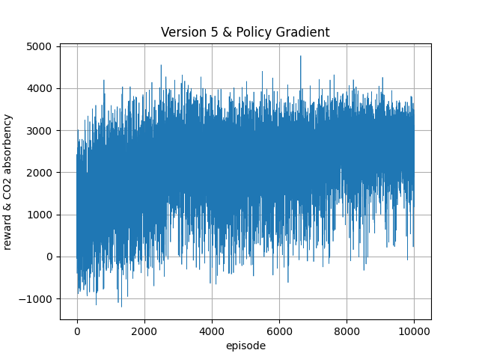
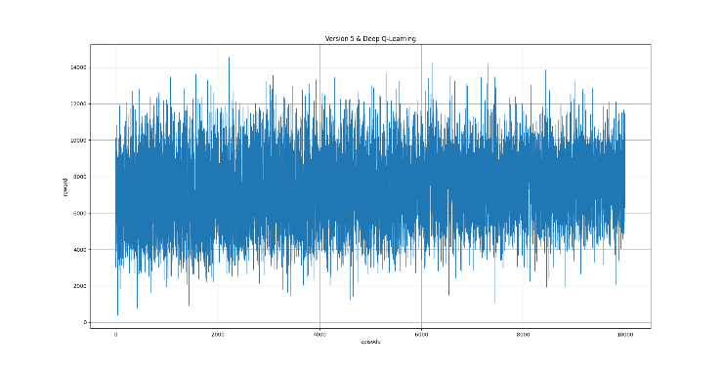
Learning Algorithm
Random test
Q-Learning
DQN
Policy Gradient
Q-learning
Policy Gradient
DQN

Slide 8
Thank you for attention!

