Slide 1

Established 2417 – Created By Gabriel Tobing

Slide 2



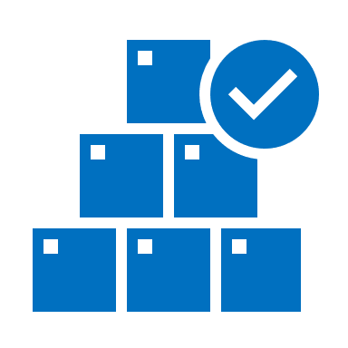
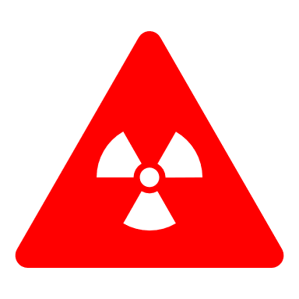
Purpose

Slide 3
Parties Involved
Countries – Anybody from dictatorships to democratic government.
People in General – Anybody with the money has the service available.
United States Government
The American People

Slide 4
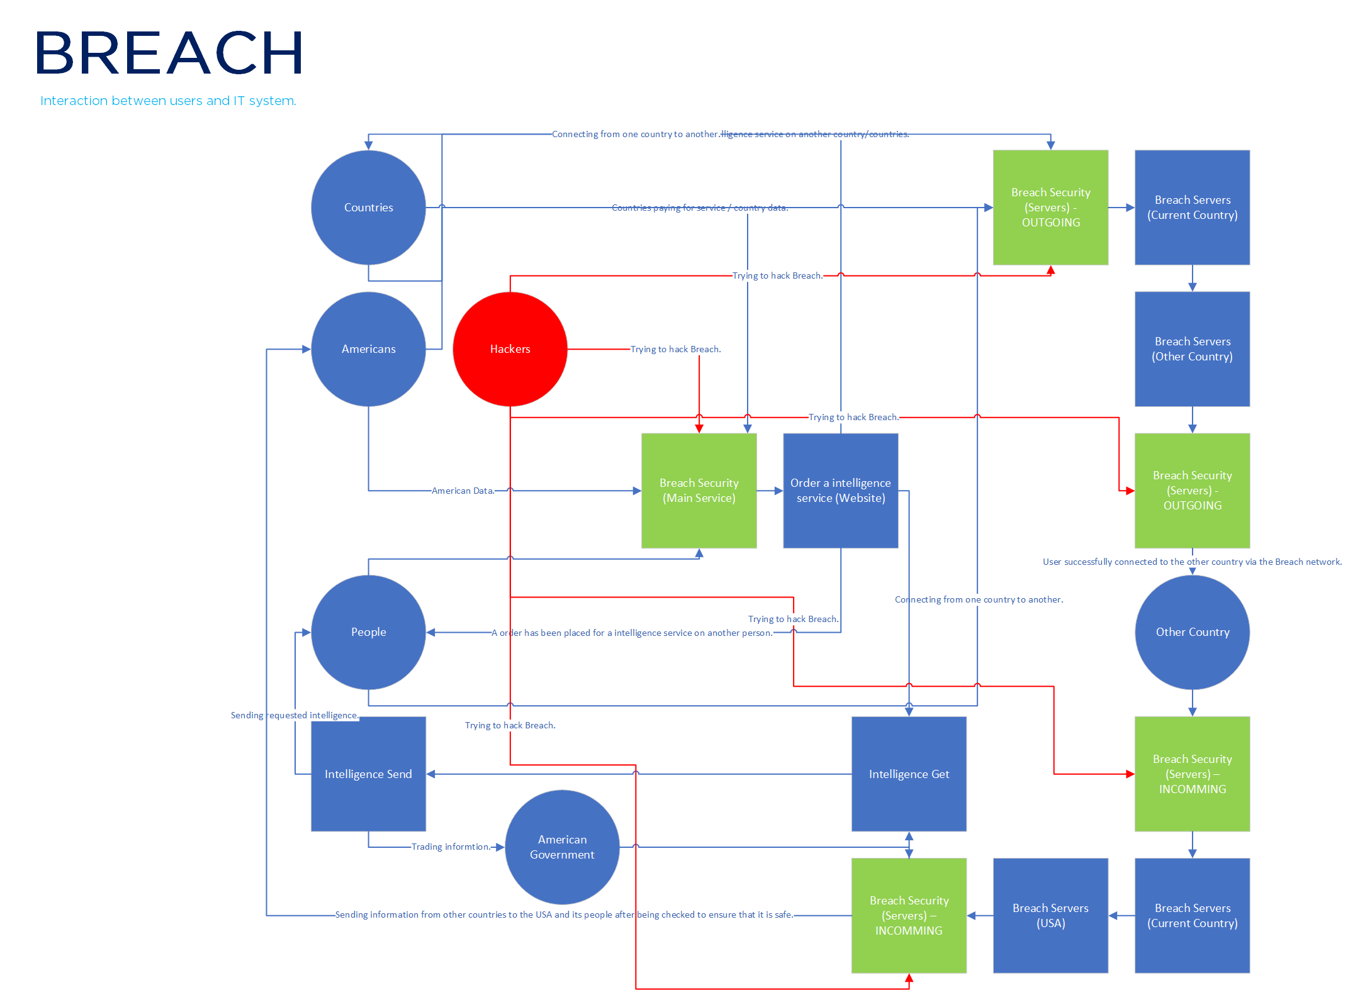
Interaction

Slide 5
Assets
The American People
Website
Servers
Staff
Offices
Data in transit
Illegally obtained highly confidential intelligence
International reputation
Legal standing
American trust
International trust of countries involved

Slide 6
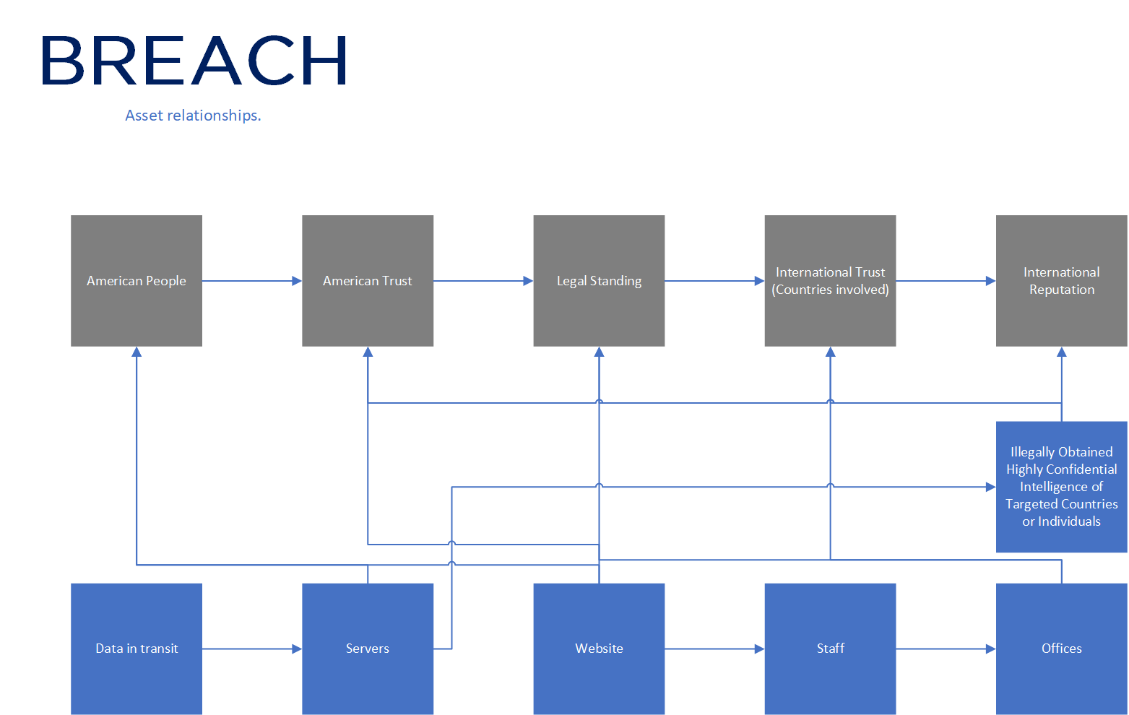
Assets
Parties Involved

Slide 7
Threats
The concept of Freedom
Nuclear blast
Hackers
Country intervention
Engineering mistakes
Politics
Natural disasters
Terrorist attacks
Death of the Director of Breach.

Slide 8
Threat Frequency
Frequency | Threat
Certain - Rare | The death of the Director of Breach can be caused by natural causes which is once every lifetime, however it can also be certain and happen at least annually depending on how much people want the Director of Breach dead, resulting in his murder.
Rare | Nuclear blast is rare as nuclear safety is usually almost always extremely high. If the nuclear blast is caused from war, than it is likely to still be rare as war will result in many loss of life and there are usually many ways a conflict can be resolved without the going into war.
Certain | A terrorist attack can happen multiple times a year, with many already on record thanks to terrorist trackers online.
Rare | The concept of Freedom would be rare as it is rarely that people would not have the sense of freedom which would then lead to action.
Certain | Politics are certain as they are always present in society, politicians can determine the ways of a country.
Certain – Possible | Natural disasters are unpredictable and can hence happen multiple times a year for multiple years.
Possible | Engineering mistakes may happen and due to the increase and the size of Breach with new infrastructure, may happen around once every 5 years.
Likely | Countries often want control and hence it is likely that they would interfere with Breach and its operations as Breach is also responsible for potentially attacking that country themselves for other countries that have paid for their services.
Certain | Hackers are always certain as people always want information for many reasons. There are already reports of hacking happening more than several times a year as technology progresses.

Slide 9
Consequences
Consequences | Description
Catastrophic (Complete loss of system functionality) | Power going out on all servers and fully draining the emergency power supply which will result in a fraction of United States cities being disconnected from the outside world via the internet. Director of Breach dead. Director of Breach or their family being held hostage and ransomed for intelligence on the United States and its people. Director of Breach blackmailed into revealing intelligence on intelligence on the United States and its people. Nuclear explosion which goes into the area of a Breach office or server which will result in complete data transmission lost, internet blackout for regions connected to the outside world via that Breach server and significant loss of life which may or may not include people of importance and power within Breach.
Serious (Major functionality loss of the system) | Being raided authorities of another country to gain the information of the United States. Breach employees being targeted and killed at a higher rate than usual that is at least 1.5 times higher. Lack of security at a Breach office or server leading to enemies getting physical access to information while in transit. The service downtime or services effected due varying reasons making the service fall under a 99.95% minimum uptime requirement within the period of 1 year for the protection the United States and its people.
Moderate (Some functionality loss of the system) | A Breach office being bombed. A Breach server being bombed. Breach employees being targeted and killed. Malicious staff. Lack of clear process. Engineering mistakes or ageing resulting a weakened structure integrity of Breach offices or servers. Website down (Website is cached using Cloudflare)
Minor (Easily fixable) | Flooding of Breach offices or servers. Earthquake of Breach offices or servers. Lack of clear training.
Insignificant (A small inconvenience) | Hardware failure due to wear and tear. Electrical or magnetic interference. (Low exposure)

Slide 10
Risk and function evaluation

Slide 11
Risk and function evaluation

Slide 12
Visit us for more information
BREACH.UNO

Slide 13
Created by
Gabriel Tobing of the year 2020.
Intelligence is the future

