Slide 1
MFC Programming 1
(SDI)
Seoul HRD Institute of KCCI
PhD. Kang, Won-Chan

Slide 2
Make MFC Project
(Visual studio 2019)

Slide 3
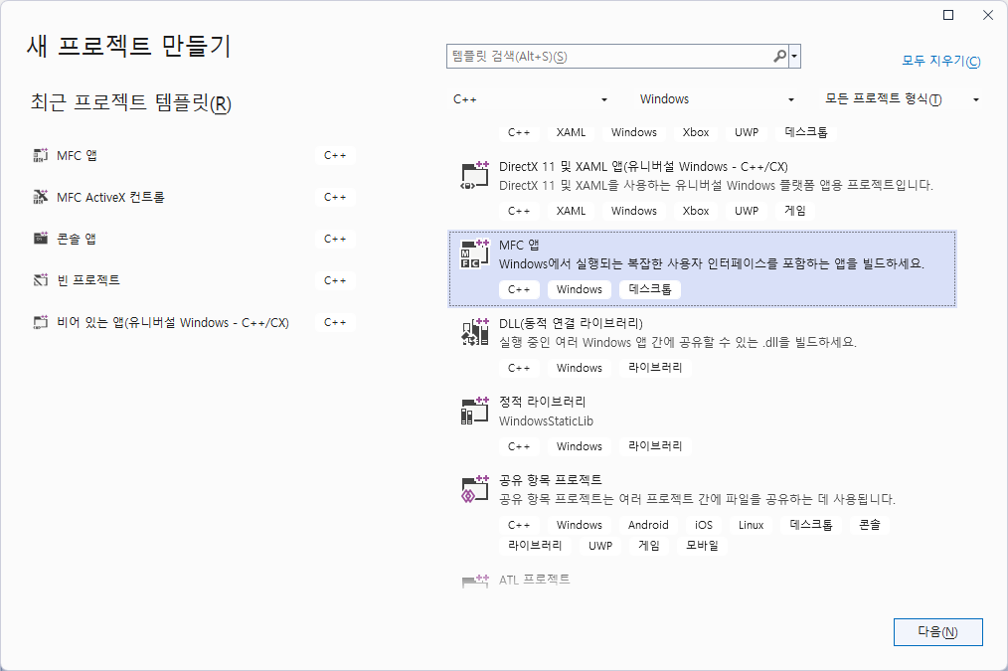

Slide 4
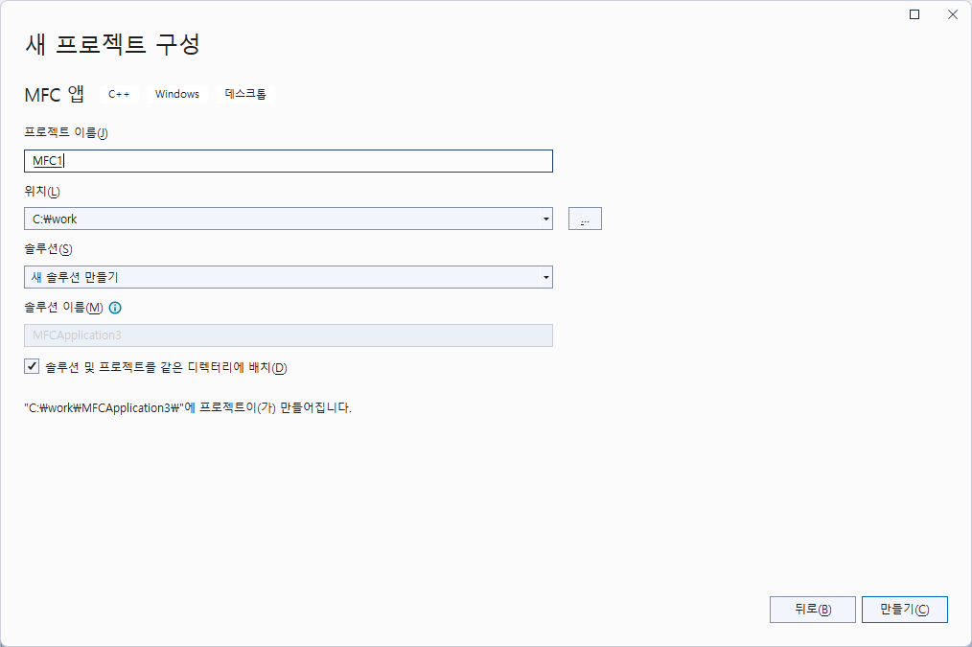

Slide 5
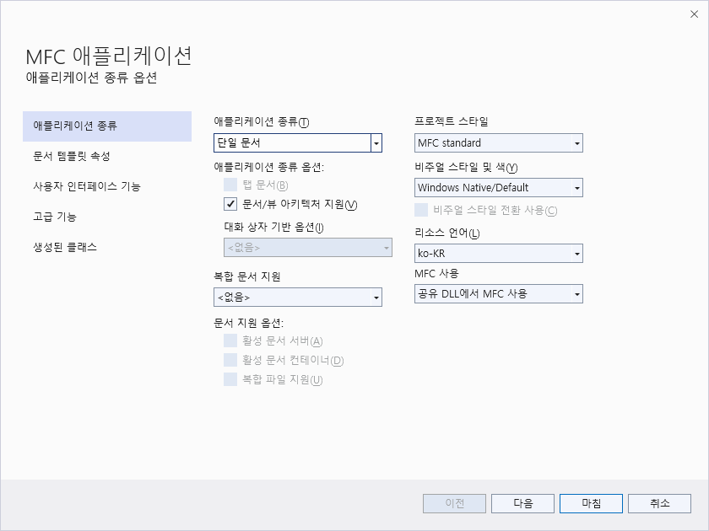

Slide 6
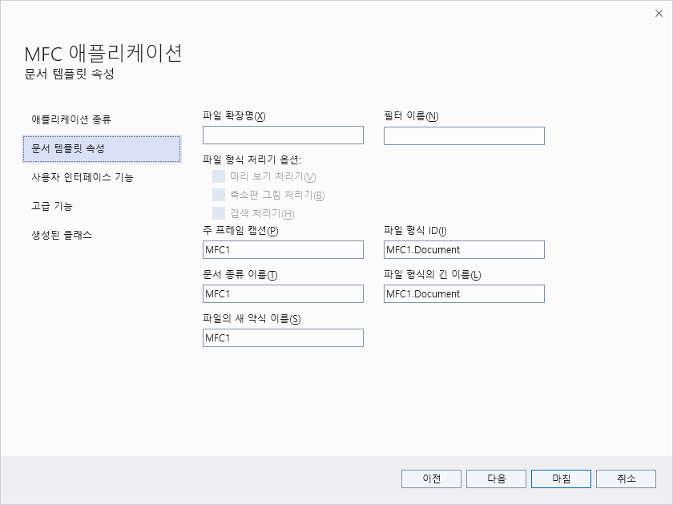
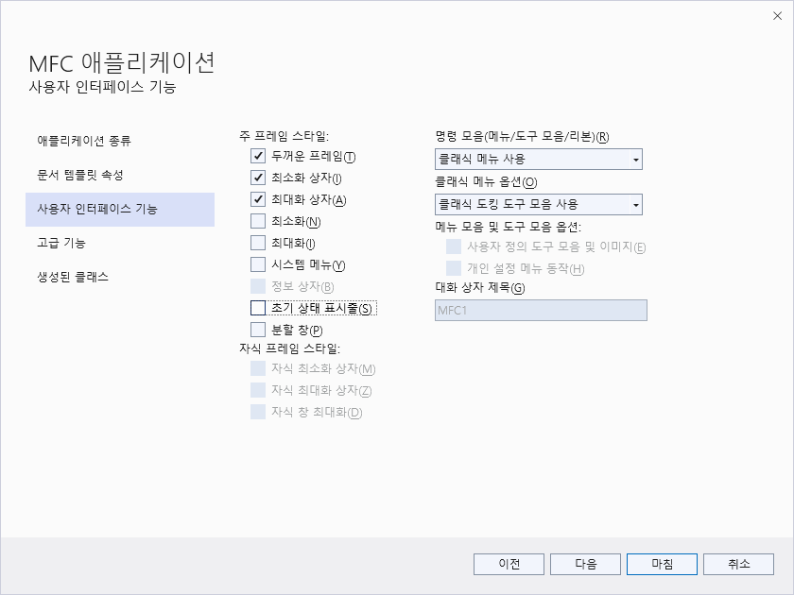

Slide 7
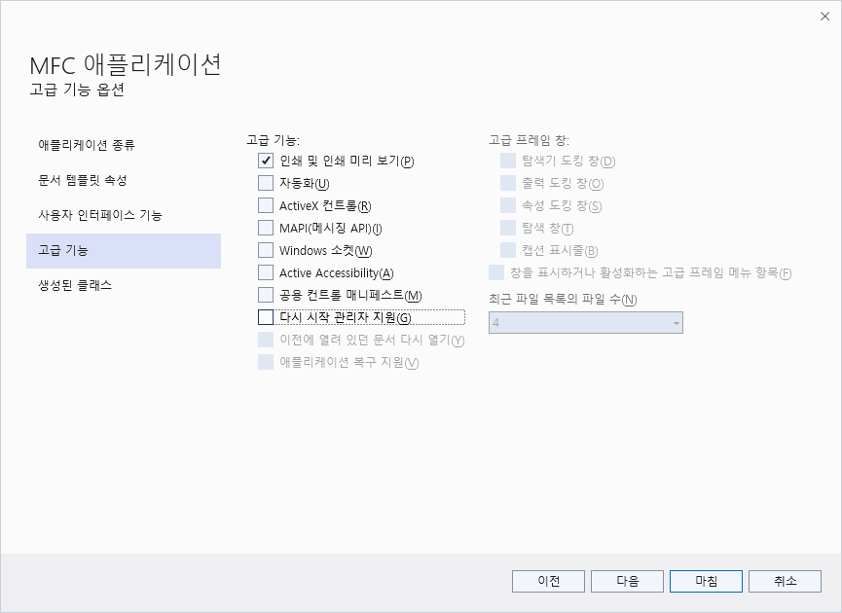
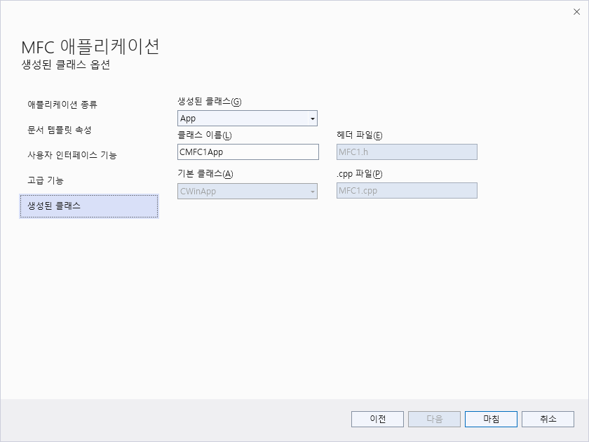

Slide 8
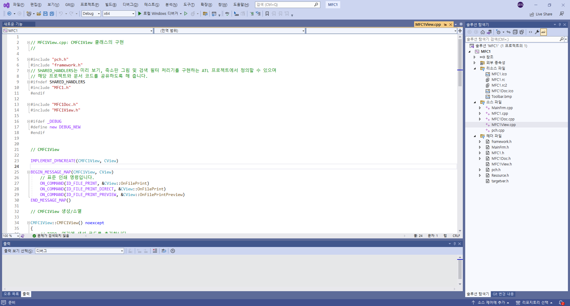
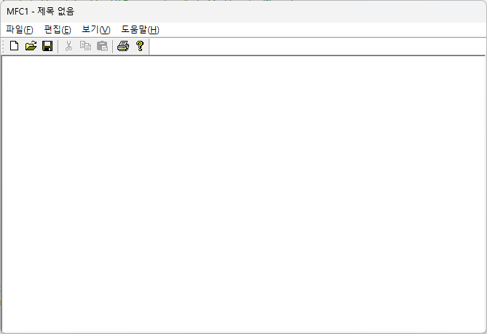

Slide 9
Compile & Execution
CMain Frame
CsdiView

Slide 10
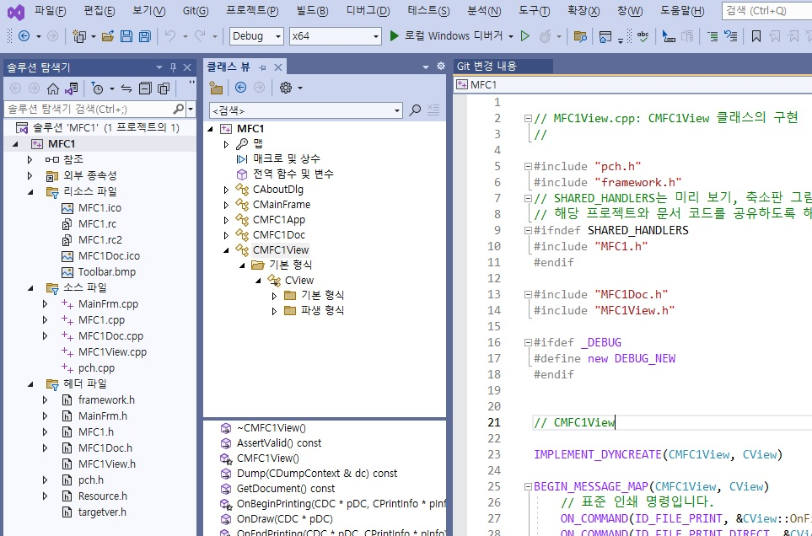

Slide 11
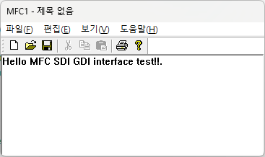
void CMFC1View::OnDraw(CDC* pDC)
{
CMFC1Doc* pDoc = GetDocument();
ASSERT_VALID(pDoc);
if (!pDoc)
return;
// TODO: 여기에 원시 데이터에 대한 그리기 코드를 추가합니다.
CString test = _T("Hello MFC SDI GDI interface test!!.");
pDC->TextOut(0, 0, test);
}
ADD & Modify

Slide 12
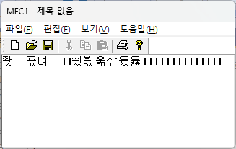
배열을 이용한 문자열 처리문제
SDK: HDC Handle
MFC: CDC Handle (including HDC)
void CSdiView::OnDraw(CDC* pDC)
{
CSdiDoc* pDoc = GetDocument();
ASSERT_VALID(pDoc);
// TODO: add draw code for native data here
char temp[80];
sprintf_s(temp, "안녕하세요 MFC 테스트입니다.");
pDC->TextOut(0, 0, temp, strlen(temp)); // 구버전 O.K. 현재X
pDC->TextOut(0, 0, (LPCWSTR)temp, strlen(temp));
//실행은 되나 글자는 깨짐
}
오류발생

Slide 13
CString
함수 | 내용
GetLength | Returns the number of characters in a CString object. For multibyte characters, counts each 8-bit character; that is, a lead and trail byte in one multibyte character are counted as two characters.
IsEmpty | Tests whether a CString object contains no characters.
Empty | Forces a string to have 0 length.
GetAt | Returns the character at a given position.
SetAt | Sets a character at a given position.
Compare | Compares two strings (case sensitive).
Mid,Left,Right | Extracts the middle part of a string (like the Basic MID$ function).
MakeUpper | Converts all the characters in this string to uppercase characters.
MakeLower | Converts all the characters in this string to lowercase characters.
Format | Format the string as sprintf does.
Find | Finds a character or substring inside a larger string.

Slide 14
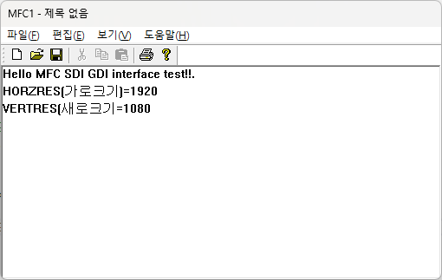
void CSdiView::OnDraw(CDC* pDC)
{
CSdiDoc* pDoc = GetDocument();
ASSERT_VALID(pDoc);
// TODO: add draw code for native data here
CString test=_T("Hello MFC SDI GDI interface test!!.“);
pDC->TextOut(0,0,test);
test.Format(_T("HORZRES(가로크기)=%d“),
pDC->GetDeviceCaps(HORZRES));
pDC->TextOut(0,20,test);
test.Format(_T("VERTRES(새로크기=%d“),
pDC->GetDeviceCaps(VERTRES));
pDC->TextOut(0,40,test);
}

Slide 15
virtual int DrawText( LPCTSTR lpszString, int nCount, LPRECT lpRect, UINT nFormat );
int DrawText( const CString& str, LPRECT lpRect, UINT nFormat );
값 | 내용
DT_TOP DT_BOTTOM DT_LEFT DT_RIGHT | 설정된 lpRect영역에 상단으로(DT_TOP) 하단으로(DT_BOTTOM) 좌측으로(DT_LEFt)우측으로(DT_RIGHT) 문자를 출력 한다. DT_SINGLELINE가 함께 지정되어 있어야 한다.
DT_CENTER | 설정된 영역의 가로중앙에 정렬시킨다
DT_VCENTER | 설정된 영역의 세로 중앙에 정렬 시킨다.
 | DT_
DT_EXPANDTABS | 문자열에 탭이 포함되어 있을 때 공백으로 띄어 준다. 기본폭은 8이다.
DT_CALCRECT | 텍스트가 출력할 사각형의 영역을 계산한다. 이때 문자는 출력되지 않는다.
DT_EXTERNALLEADING | 문자의 높이를 계산할 때 extenal leading sapce를 호함시킨다.
DT_SINGLELINE | 행바꿈과 라인 피드를 무지하고 한줄로 출력한다.
DT_NOCLIP | 클리핑 없이 문자를 출력한다.
DT_NOPREFIX | &문자를 표식어로 상용하지 않는다. 일반적으로& 코드는 출력하지 않고 다음 문자에 밑줄을 그린다.
DT_TABSTOP | Flat 상위 8비트에 값을 넣어서 탭간격을 변화시킨다.
DT_WORDBREAK | 문자열이 영역밖으로 출력되면 개행하여 출력한다.

Slide 16
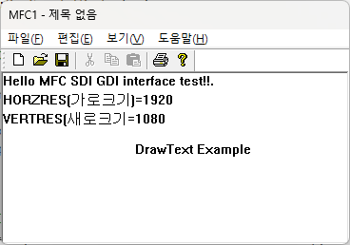
void CSdiView::OnDraw(CDC* pDC)
{
CSdiDoc* pDoc = GetDocument();
ASSERT_VALID(pDoc);
// TODO: add draw code for native data here
CString test="Hello MFC SDI GDI interface test!!.";
pDC->TextOut(0,0,test);
test.Format("HORZRES(가로크기)=%d",
pDC->GetDeviceCaps(HORZRES));
pDC->TextOut(0,20,test);
test.Format("VERTRES(새로크기=%d",
pDC->GetDeviceCaps(VERTRES));
pDC->TextOut(0,40,test);
test=_T("DrawText Example“);
//set box area
CRect rect= CRect(0,60,400,100);
//call DrawText function
pDC->DrawText(test,rect,DT_SINGLELINE | DT_CENTER | DT_VCENTER);
}

Slide 17
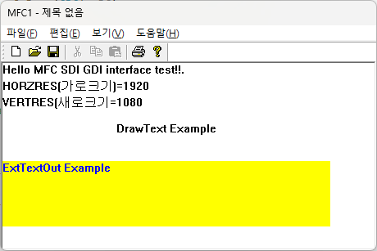
Color control
virtual COLORREF SetTextColor( COLORREF crColor );
virtual COLORREF SetBkColor( COLORREF crColor );
pDC->SetTextColor(RGB(0,0,255)); // blue
pDC->SetBkColor(RGB(255,255,0)); // yellow
void CSdiView::OnDraw(CDC* pDC)
{
CSdiDoc* pDoc = GetDocument();
ASSERT_VALID(pDoc);
CString test="Hello MFC SDI GDI interface test!!.";
pDC->TextOut(0,0,test);
test.Format("HORZRES(가로크기)=%d",
pDC->GetDeviceCaps(HORZRES));
pDC->TextOut(0,20,test);
test.Format("VERTRES(새로크기=%d",
pDC->GetDeviceCaps(VERTRES));
pDC->TextOut(0,40,test);
test="DrawText Example";
CRect rect= CRect(0,60,400,100);
pDC->DrawText(test,rect,DT_SINGLELINE | DT_CENTER | DT_VCENTER);
test="ExtTextOut Example"; //foreground color is blue
pDC->SetTextColor(RGB(0,0,255));
pDC->SetBkColor(RGB(255,255,0)); // background color is yellow
pDC->ExtTextOut(0,120,ETO_CLIPPED | ETO_OPAQUE,CRect(0,120,400,200), test,NULL);
}
Fill the box area setting background color
Ignore x,y position, lpRect area select

Slide 18
CString test = _T("안녕하세요 MFC 테스트입니다.");
pDC->TextOut(0, 0, test);
test.Format(_T("HORZRES(가로크기)=%d"), pDC->GetDeviceCaps(HORZRES));
pDC->TextOut(0, 20, test);
test.Format(_T("VERTRES(새로크기=%d"), pDC->GetDeviceCaps(VERTRES));
pDC->TextOut(0, 40, test);
test = _T("DrawText함수를 이용한 문자출력");
//박스 영역을 설정하고
CRect rect = CRect(0, 60, 400, 100);
//DrawText함수를 호출
pDC->DrawText(test, rect, DT_SINGLELINE | DT_CENTER | DT_VCENTER);
//탭크기 배열
int tabstop[4] = { 8,16,24,32 };
test =_T("TabbedTextOut\t를\t이용한\t출력");
//TabbedTextOut함수 사용
pDC->TabbedTextOut(0, 100, test, 4, tabstop, 0);
test = _T("ExtTextOut를 이용한 출력");
//문자 출력색을 청색으로
pDC->SetTextColor(RGB(0, 0, 255));
//배경색을 노랑색으로
pDC->SetBkColor(RGB(255, 255, 0));
//ExtTextOut함수사용
pDC->ExtTextOut(0, 120, ETO_CLIPPED | ETO_OPAQUE, CRect(0, 120, 400, 200),
test, NULL);
//oldFont를 다시 설정한다.
pDC->SelectObject(oldFont); // restore oldFont
//delete current font
cFont.DeleteObject();
}
void CSdiView::OnDraw(CDC* pDC)
{
CSdiDoc* pDoc = GetDocument();
ASSERT_VALID(pDoc);
// TODO: add draw code for native data here
CFont cFont, * oldFont;
//폰트를 만든다.
cFont.CreateFont(10, 10,//v,h size
0, 0,//angle
FW_DONTCARE,//bold
FALSE,//italic
FALSE,//under line
FALSE,//STRIKEOUT pulg
DEFAULT_CHARSET,//CHAR SET
OUT_DEFAULT_PRECIS,
CLIP_DEFAULT_PRECIS,
DEFAULT_QUALITY,
DEFAULT_PITCH,_T("바탕체"));
//oldFont backup
oldFont = pDC->SelectObject(&cFont);

Slide 19
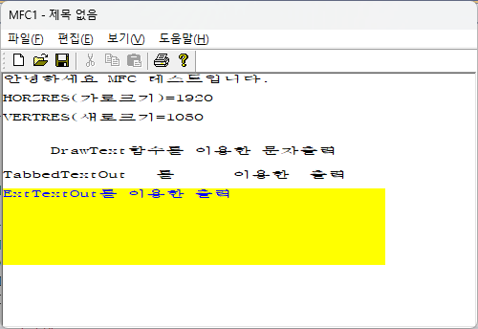

Slide 20
etc
pDC->SetBkMode(TRANSPARENT);
pDC->SetTextAlign(TA_BOTTOM|TA_RIGHT);
BOOL Rectangle( int x1, int y1, int x2, int y2 );
BOOL Rectangle( LPCRECT lpRect );

Slide 21
SDI Program(1)
(Text Graphic)

Slide 22
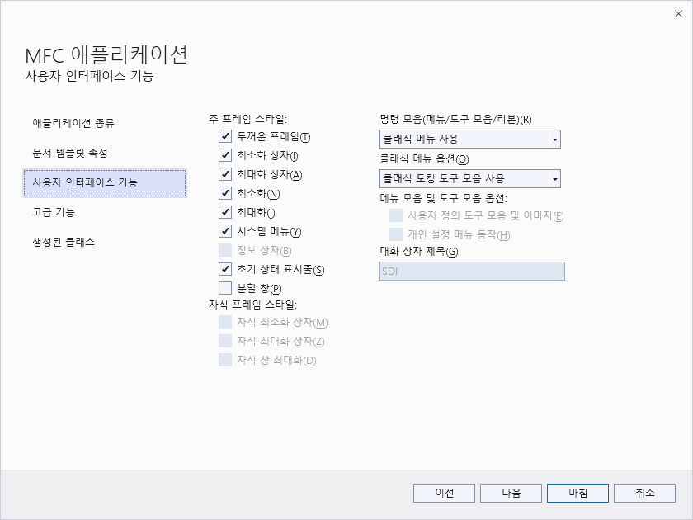

Slide 23
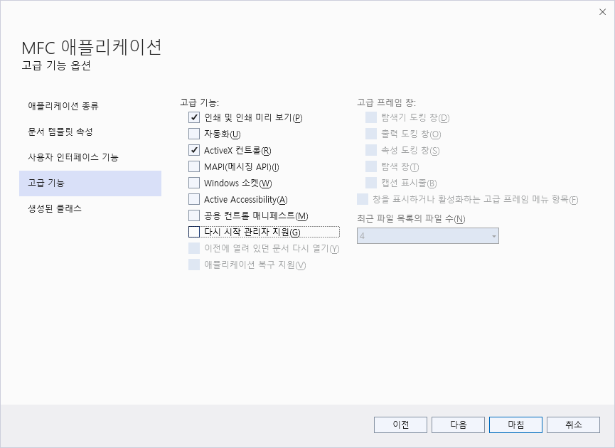

Slide 24
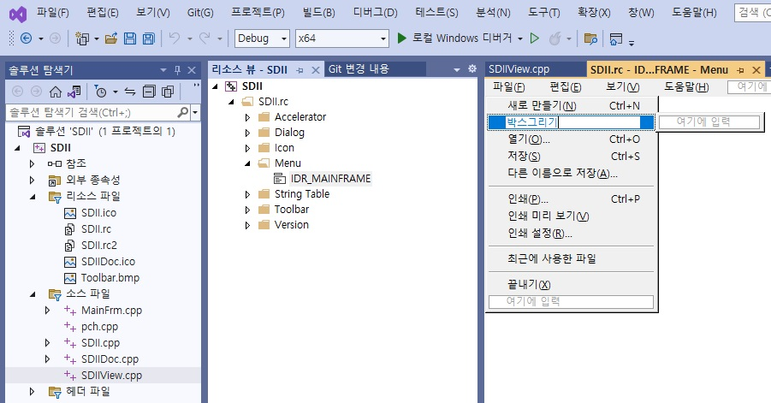
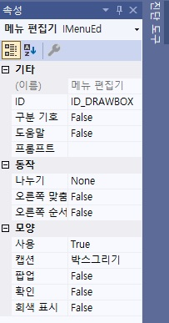

Slide 25
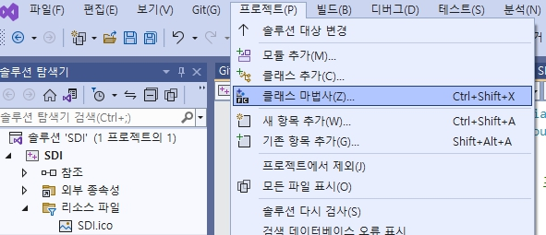
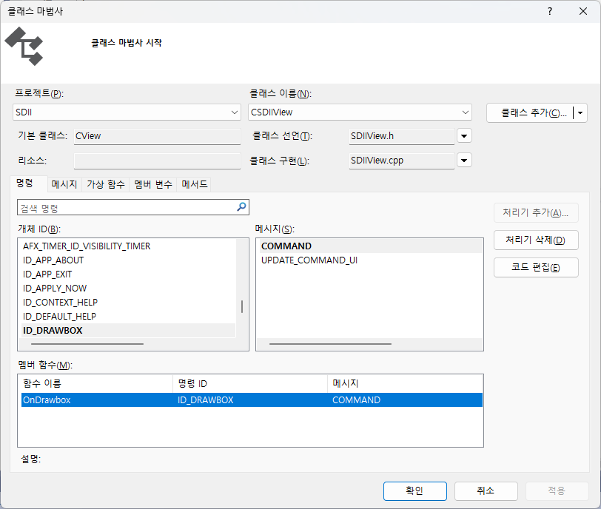

Slide 26
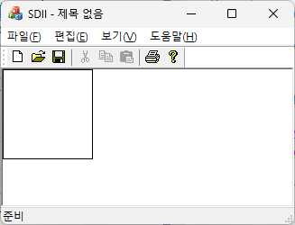
void CSDIIView::OnDrawbox()
{
// TODO: 여기에 명령 처리기 코드를 추가합니다.
CDC* pDC = GetDC();//DC를 얻고
pDC->Rectangle(CRect(0, 0, 100, 100));//박스를 그린다음
ReleaseDC(pDC);//DC해제
}

Slide 27
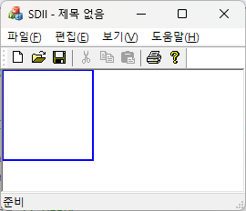
void CSdiView::OnDrawbox()
{
// TODO: Add your command handler code here
  CPen cPen, *oldPen;
  cPen.CreatePen(PS_SOLID, 2, RGB(0, 0, 255));
  CDC* pDC = GetDC();
  oldPen = pDC->SelectObject(&cPen);
  pDC->Rectangle(CRect(0, 0, 100, 100));
  pDC->SelectObject(oldPen);
  cPen.DeleteObject();
  ReleaseDC(pDC);
}

Slide 28
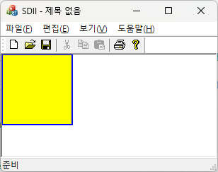
void CSdiView::OnDrawbox()
{
CPen cPen,*oldPen;
cPen.CreatePen(PS_SOLID,2,RGB(0,0,255));
CBrush cBrush,*oldBrush;
cBrush.CreateSolidBrush(RGB(255,255,0));
CDC *pDC=GetDC();//DC를 얻고
oldPen=pDC->SelectObject(&cPen);
oldBrush=pDC->SelectObject(&cBrush);
pDC->Rectangle(CRect(0,0,100,100));//박스를 그린다음
pDC->SelectObject(oldBrush);
cBrush.DeleteObject();
pDC->SelectObject(oldPen);
cPen.DeleteObject();
ReleaseDC(pDC);//DC해제
}

Slide 29
Draw function
CPoint MoveTo( int x, int y );
CPoint MoveTo( POINT point );
BOOL LineTo( int x, int y );
BOOL LineTo( POINT point );
BOOL RoundRect( int x1, int y1, int x2, int y2, int x3, int y3 )
BOOL RoundRect( LPCRECT lpRect, POINT point );
BOOL Ellipse( int x1, int y1, int x2, int y2 );
BOOL Ellipse( LPCRECT lpRect );
BOOL Polyline( LPPOINT lpPoints, int nCount );
BOOL PolyBezier( const POINT* lpPoints, int nCount );
pDC->MoveTo(0,0);
pDC->LineTo(0,0);

Slide 30
void CSdiView::OnDraw(CDC* pDC)
{
CSdiDoc* pDoc = GetDocument();
ASSERT_VALID(pDoc);
//Polyline와 PolyBezier에 사용할 POINT배열
POINT pline[6]={50,133,146,99,246,133,247,212,58,216,50,133};
//다각형 칠하기에 사용할 POINT배열
POINT pgon[4]={308,120,440,118,380,212,308,120};
RECT rect;
CBrush cBrush,*oldBrush;
//RoundRect에 사용할 모서리 둥근원의 x,y지름
POINT round={50,50};
//브러쉬를 노랑색 브러쉬로 만든다
cBrush.CreateSolidBrush(RGB(255,255,0));
//클라이언트 영역을 얻는다.
GetClientRect(&rect);
//라운드 박스를 그린다.
CDC* pDC = GetDC();//DC를 얻고
pDC->RoundRect(&rect,round);
//윈을 그린다.
pDC->Ellipse(rect.left+30,rect.top+30,
rect.right-30,rect.bottom-30);
//0,0좌표에서 화면 전체에 대각선을 그린다.
pDC->MoveTo(0,0);
pDC->LineTo(rect.right,rect.bottom);
//다각형 외곽선을 그린다.
pDC->Polyline(pline,6);
//베지어 곡선을 그린다.
pDC->PolyBezier(pline,4);
//브러쉬를 설정하고
oldBrush=pDC->SelectObject(&cBrush);
//내부를 칠하는 다각형을 그린다.
pDC->Polygon(pgon,4);
//이전 브러쉬를 설정하고
pDC->SelectObject(oldBrush);
//브러쉬를 삭제한다.
cBrush.DeleteObject();
}

Slide 31
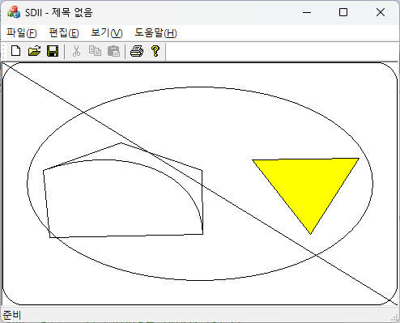
Reference by sdi.dsw

Slide 32
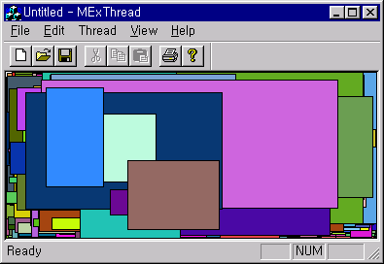
Exercise
Make this program!!

Slide 33
SDI example (2)
(Thread Application)

Slide 34
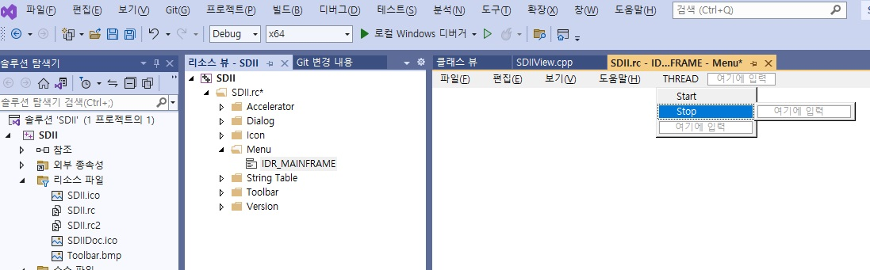
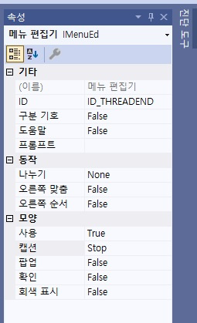
ID_THREADBEGIN
ID_THREADEND

Slide 35
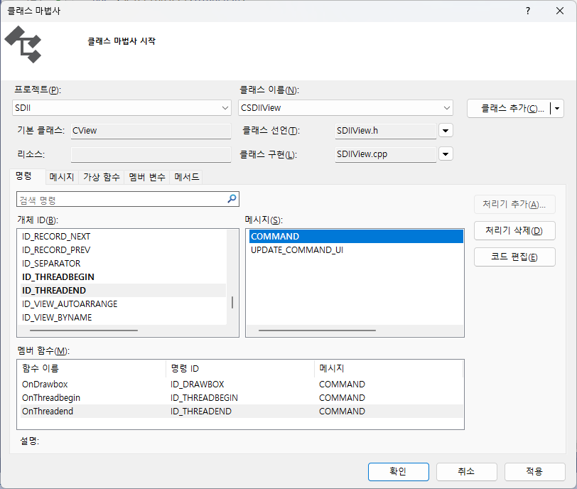

Slide 36
CSDIIApp::CSDIIApp() noexcept
{
// TODO: add construction code here,
}
// The one and only CThreadApp object
CSDIIApp theApp;
Thread.cpp
class CSDIIView : public CView
{public:
// 생성된 메시지 맵 함수
protected:
DECLARE_MESSAGE_MAP()
public:
afx_msg void OnDrawbox();
afx_msg void OnThreadbegin();
afx_msg void OnThreadend();
afx_msg void OnUpdateThreadbegin(CCmdUI* pCmdUI);
afx_msg void OnUpdateThreadend(CCmdUI* pCmdUI);
};
ThreadView.h

Slide 37
/////////////////////////////////////////////////////////////////////////////
BEGIN_MESSAGE_MAP(CSDIIView, CView)
// 표준 인쇄 명령입니다.
ON_COMMAND(ID_FILE_PRINT, &CView::OnFilePrint)
ON_COMMAND(ID_FILE_PRINT_DIRECT, &CView::OnFilePrint)
ON_COMMAND(ID_FILE_PRINT_PREVIEW, &CView::OnFilePrintPreview)
ON_COMMAND(ID_DRAWBOX, &CSDIIView::OnDrawbox)
ON_COMMAND(ID_THREADBEGIN, &CSDIIView::OnThreadbegin)
ON_COMMAND(ID_THREADEND, &CSDIIView::OnThreadend)
ON_UPDATE_COMMAND_UI(ID_THREADBEGIN, &CSDIIView::OnUpdateThreadbegin)
ON_UPDATE_COMMAND_UI(ID_THREADEND, &CSDIIView::OnUpdateThreadend)
END_MESSAGE_MAP()

Slide 38
void CSDIIView::OnThreadbegin()
{
  exitFlag = FALSE;
  AfxBeginThread(ThreadProc, (LPVOID)this);
}
void CSDIIView::OnThreadend()
{
exitFlag = TRUE;
}
void CSDIIView::OnUpdateThreadbegin(CCmdUI* pCmdUI)
{
  if (exitFlag)pCmdUI->Enable(TRUE);
  elsepCmdUI->Enable(FALSE);
}
void CSDIIView::OnUpdateThreadend(CCmdUI* pCmdUI)
{
  if (!exitFlag)pCmdUI->Enable(TRUE);
  elsepCmdUI->Enable(FALSE);
}

Slide 39
BOOL exitFlag=TRUE; //SDIIView.cpp의 맨 앞부분에 복사
UINT ThreadProc(LPVOID lParam)
{
CBrush cBrush ,*oldBrush;
CDC *pDC;
RECT rect;
int xLeft, xRight, yTop, yBottom, iRed, iGreen, iBlue ;
CSDIIView* pView;
pView = (CSDIIView*)lParam;
pView->GetClientRect(&rect);
pDC = pView->GetDC();
while (TRUE)
{
xLeft = rand () % rect.right ;
xRight = rand () % rect.right ;
yTop = rand () % rect.bottom ;
yBottom = rand () % rect.bottom;
iRed = rand () & 255 ;
iGreen = rand () & 255 ;
iBlue = rand () & 255 ;
cBrush.CreateSolidBrush (RGB (iRed, iGreen, iBlue)) ;
oldBrush=pDC->SelectObject (&cBrush) ;
pDC->Rectangle ( min (xLeft, xRight), min (yTop, yBottom),
max (xLeft, xRight), max (yTop, yBottom)) ;
pDC->SelectObject(oldBrush);
cBrush.DeleteObject();
if(exitFlag) break;
}
pView->ReleaseDC (pDC) ;
return 0;
}

Slide 40
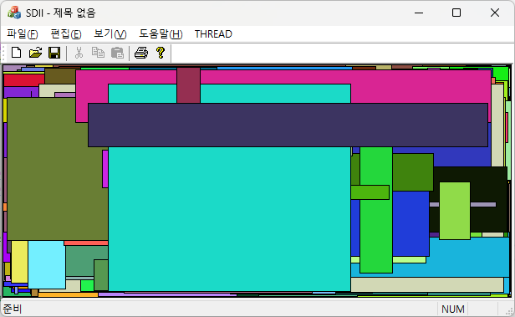
Home work answer

Slide 41
END

