Slide 1
Dialog Example(1)
[SDI based]
Seoul HRD Institute of KCCI
PhD. Kang, Won-Chan

Slide 2
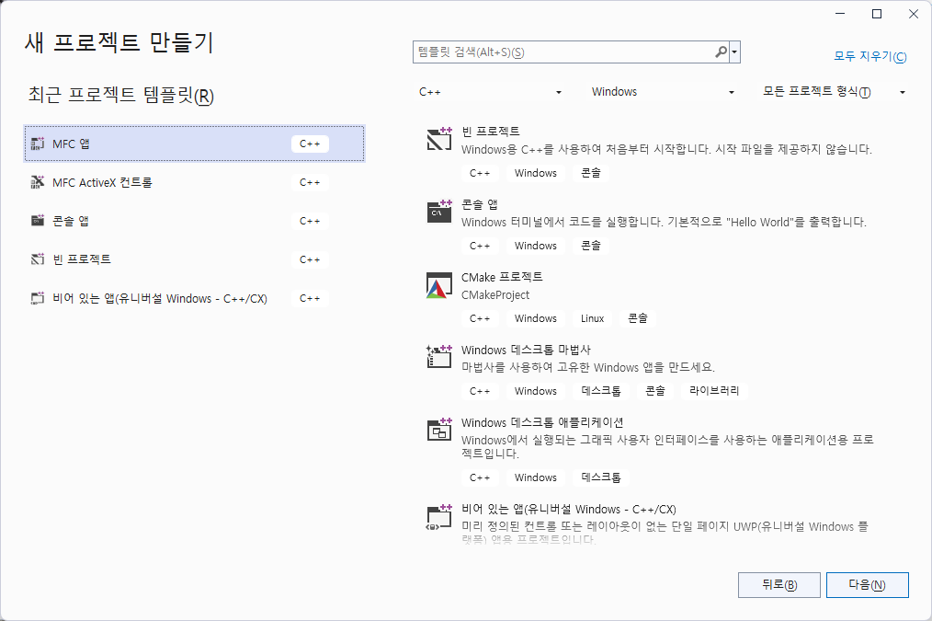

Slide 3
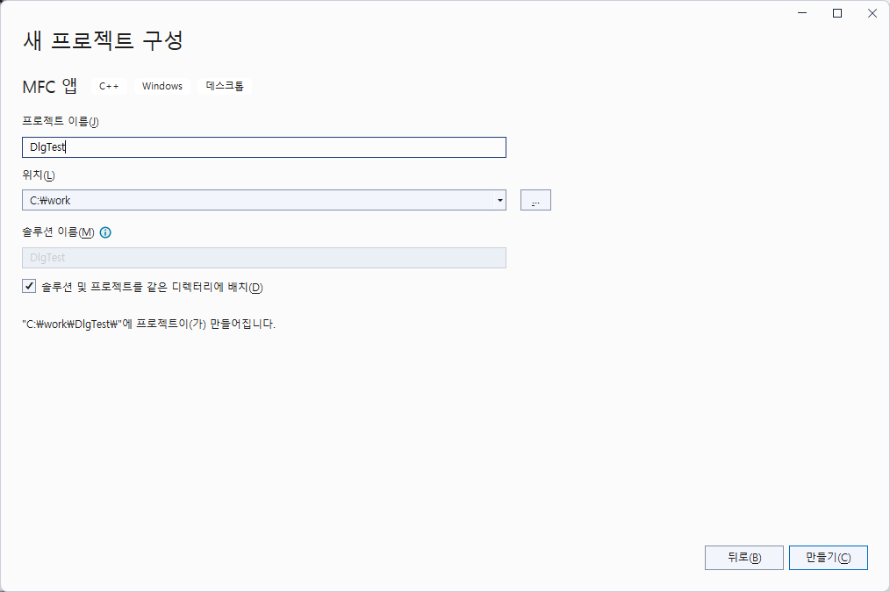
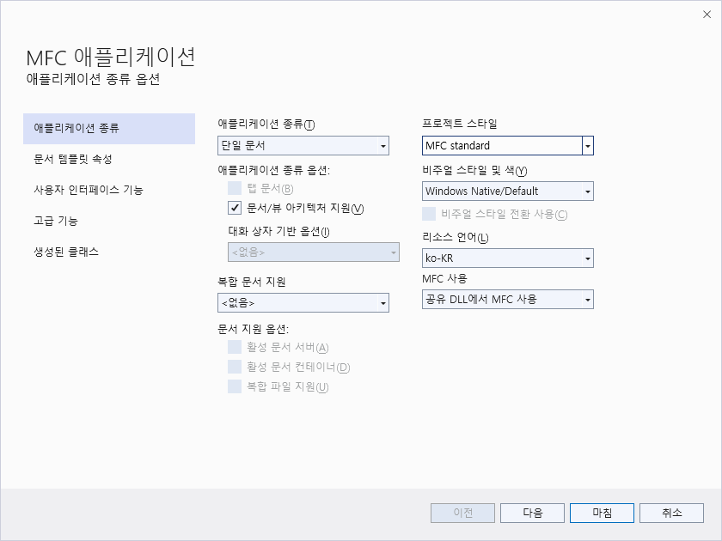

Slide 4
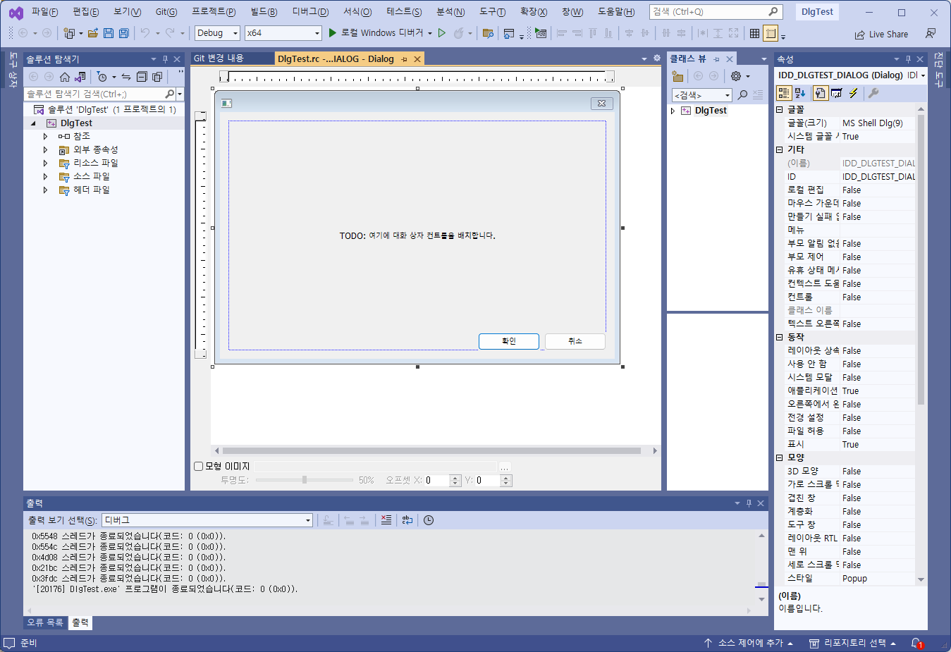

Slide 5
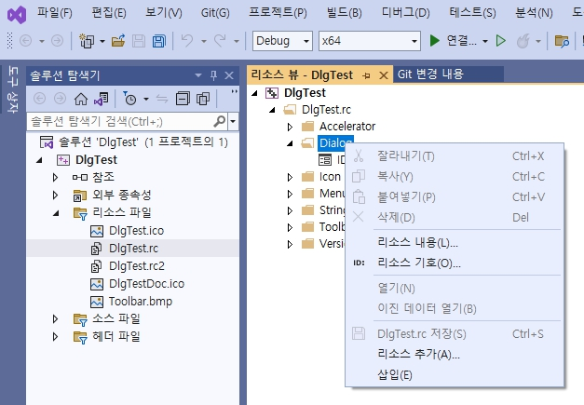

Slide 6
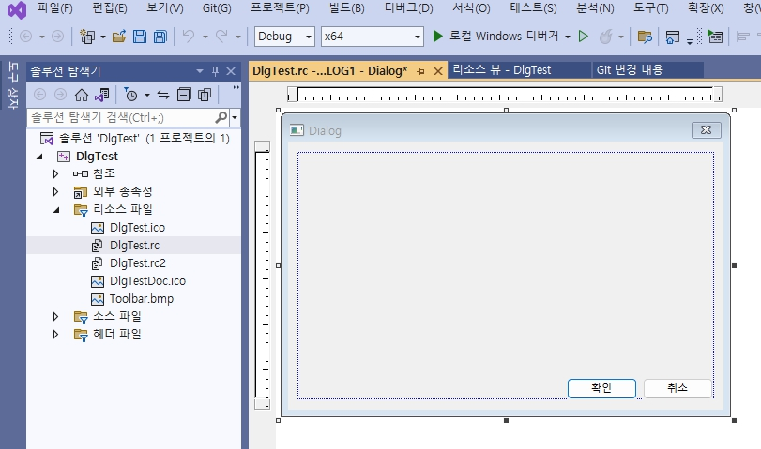
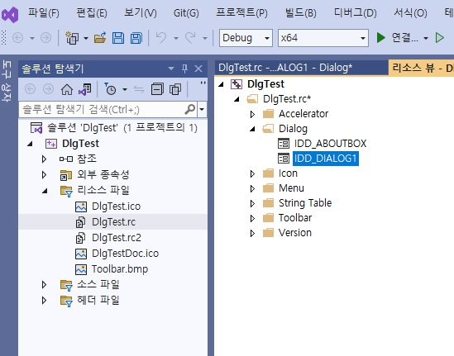
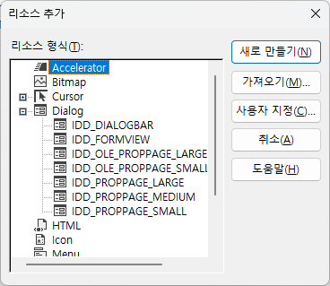
Mouse Right
Button Click
SELECT
SELECT
SELECT
SELECT

Slide 7
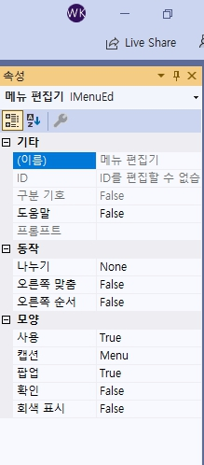
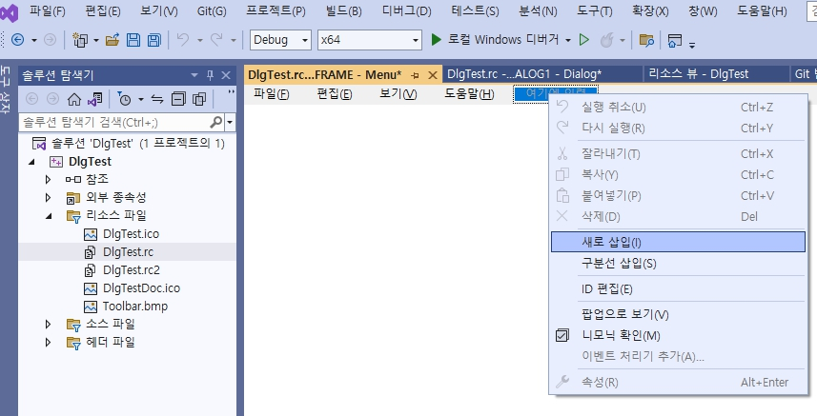

Slide 8
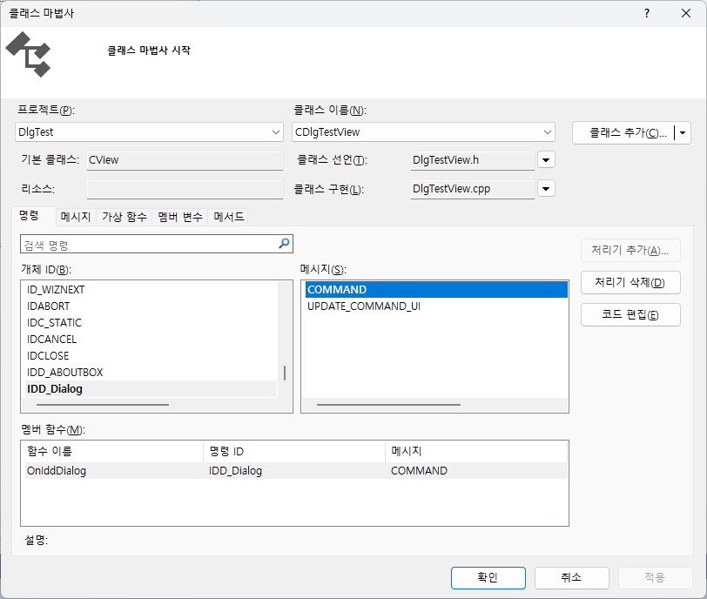
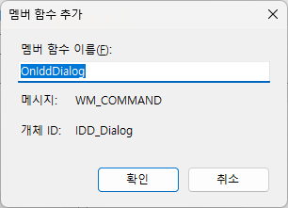

Slide 9
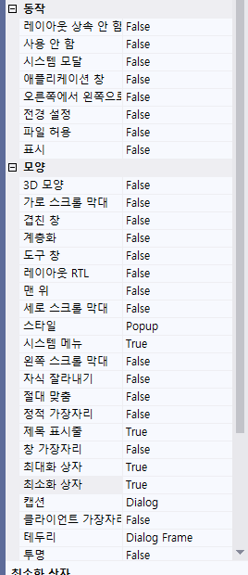

Slide 10
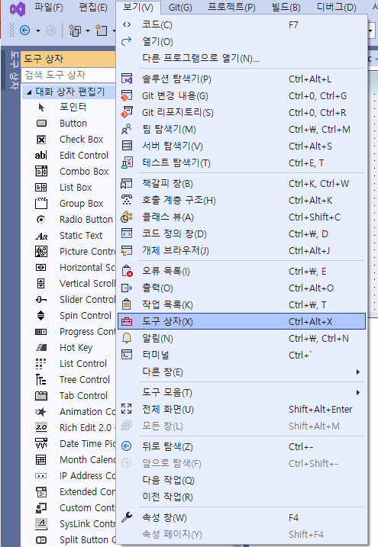
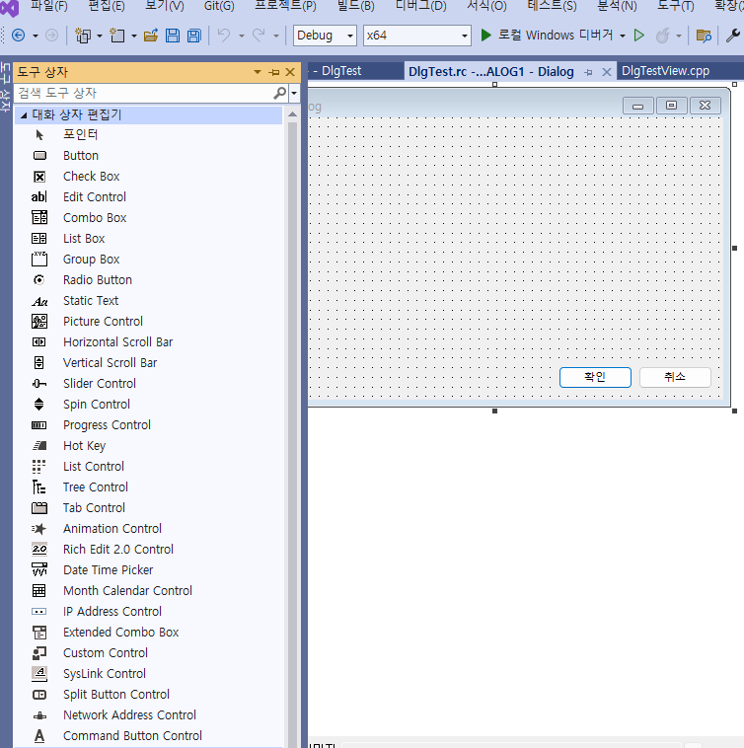

Slide 11
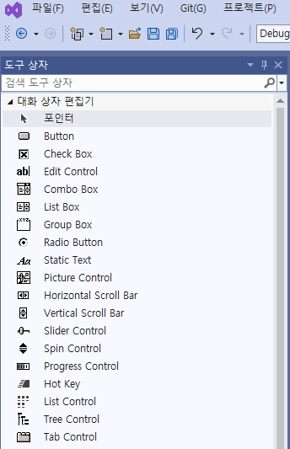
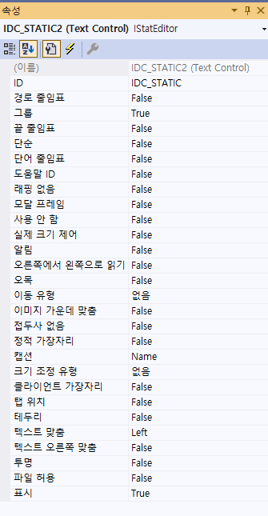
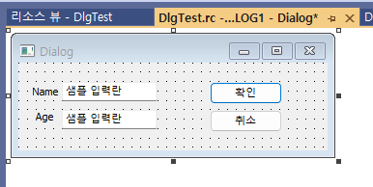
IDC_EDIT1
IDC_EDIT2

Slide 12
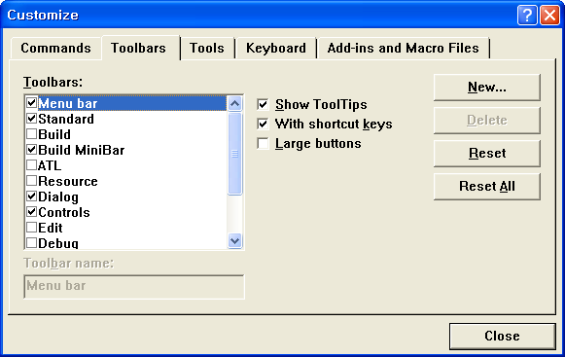
Mouse right button click -> Customize menu click

Slide 13
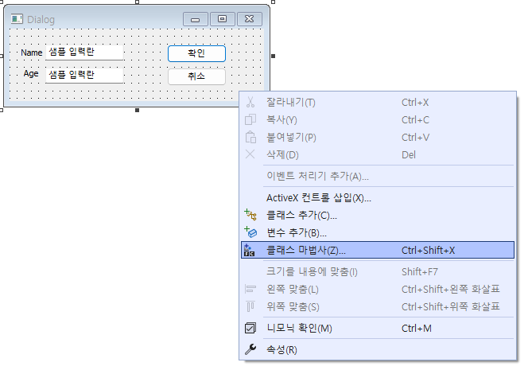

Slide 14
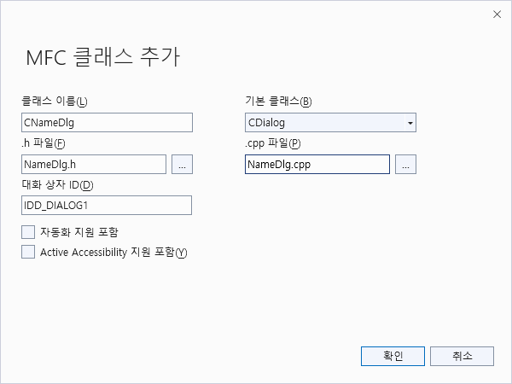
class CNameDlg : public CDialog
{
// Construction
public:
CNameDlg(CWnd* pParent = NULL); // standard constructor
// Dialog Data
//{{AFX_DATA(CNameDlg)
enum { IDD = IDD_DIALOG1 };
//}}AFX_DATA
// Overrides
// ClassWizard generated virtual function overrides
//{{AFX_VIRTUAL(CNameDlg)
protected:
virtual void DoDataExchange(CDataExchange* pDX); //}}AFX_VIRTUAL
// Implementation
protected:
// Generated message map functions
//{{AFX_MSG(CNameDlg)
// NOTE: the ClassWizard will add member functions here
//}}AFX_MSG
DECLARE_MESSAGE_MAP()
};
SELECT

Slide 15
DlgTestView.cpp에서
#include "NameDlg.h“ //추가
void CDlgTestView::OnIddDialog()
{
// TODO: 여기에 명령 처리기 코드를 추가합니다.
CNameDlg dlg;
dlg.DoModal();
}

Slide 16
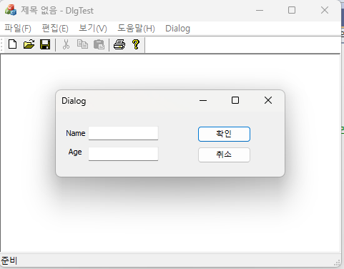

Slide 17
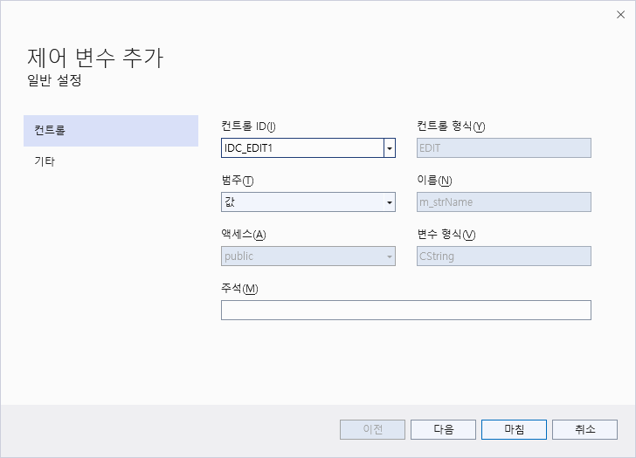
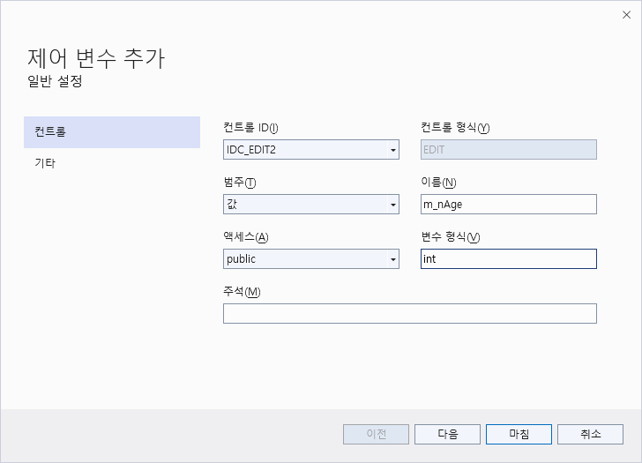


Slide 18
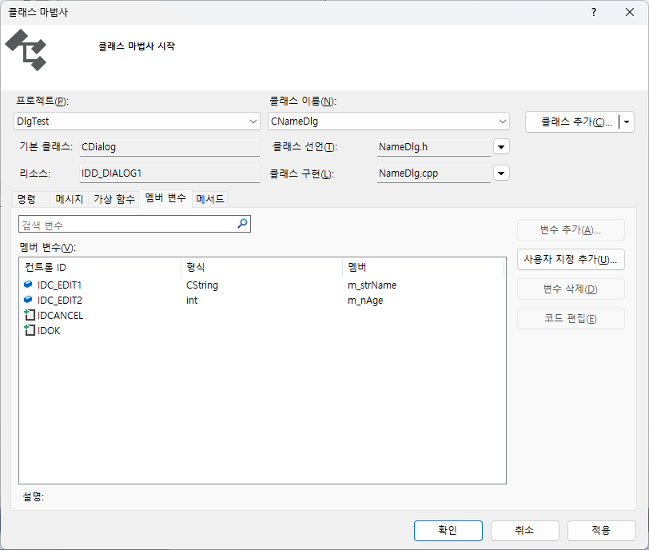

Slide 19
class CNameDlg : public CDialog
{
// Construction
public:
CNameDlg(CWnd* pParent = NULL);
// standard constructor
// Dialog Data
//{{AFX_DATA(CNameDlg)
enum { IDD = IDD_DIALOG1 };
CString m_strName;
int m_nAge;
//}}AFX_DATA
CNameDlg::CNameDlg(CWnd* pParent /*=NULL*/)
: CDialog(CNameDlg::IDD, pParent)
{
//{{AFX_DATA_INIT(CNameDlg)
m_strName = _T("");
m_nAge = 0;
//}}AFX_DATA_INIT
}
void CNameDlg::DoDataExchange(CDataExchange* pDX)
{
CDialog::DoDataExchange(pDX);
//{{AFX_DATA_MAP(CNameDlg)
DDX_Text(pDX, IDC_EDIT1, m_strName);
DDX_Text(pDX, IDC_EDIT2, m_nAge);
//}}AFX_DATA_MAP
}

Slide 20
범위 제한
  글자수 제한
  숫자범위 제한
void CNameDlg::DoDataExchange(CDataExchange* pDX)
{
CDialog::DoDataExchange(pDX);
//{{AFX_DATA_MAP(CNameDlg)
DDX_Text(pDX, IDC_EDIT1, m_strName);
DDV_MaxChars(pDX, m_strName, 10);
DDX_Text(pDX, IDC_EDIT2, m_nAge);
DDV_MinMaxInt(pDX, m_nAge, 0, 100);
//}}AFX_DATA_MAP
}

Slide 21
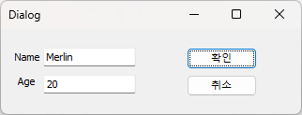
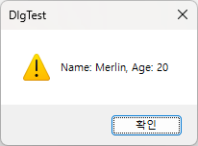
void CDlgTestView::OnDialog()
{
CNameDlg dlg;
dlg.m_strName = _T("Merlin“);
dlg.m_nAge = 20;
if( dlg.DoModal( ) == IDOK)
{
CString strOutText;
strOutText.Format(_T("Name: %s, Age: %d“), dlg.m_strName, dlg.m_nAge);
AfxMessageBox(strOutText);
}
}

Slide 22
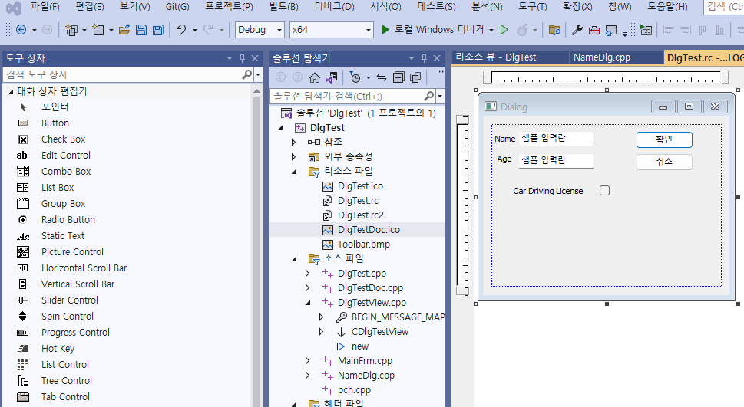

Slide 23
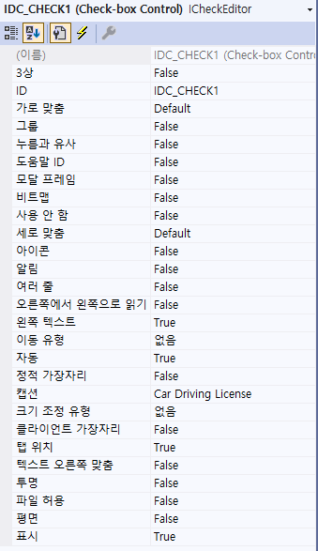
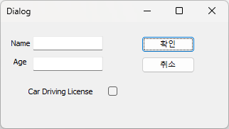
Check box control

Slide 24
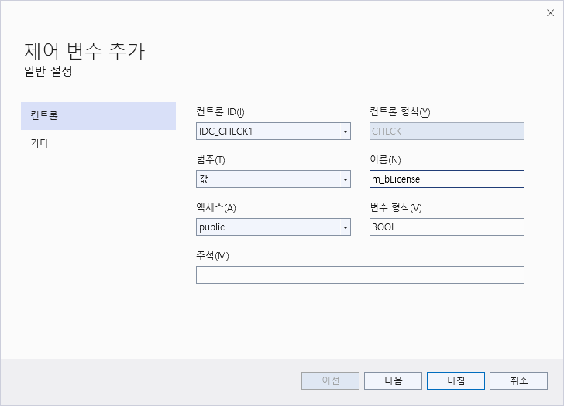

Slide 25
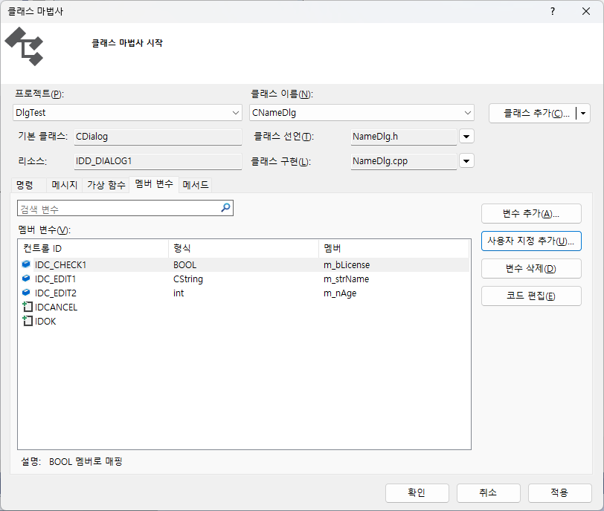

Slide 26
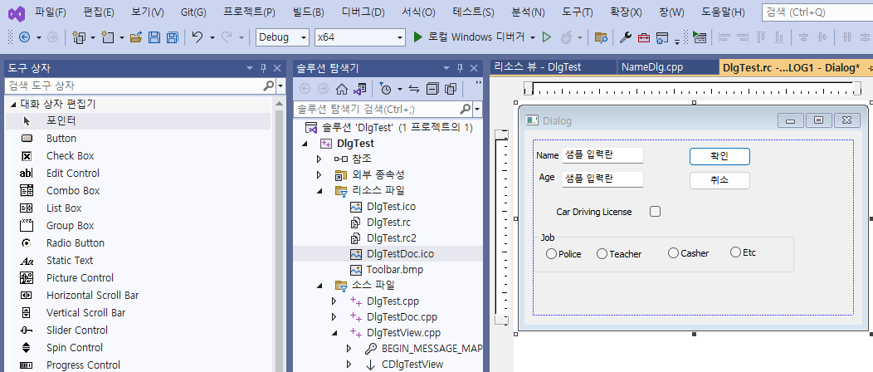

Slide 27
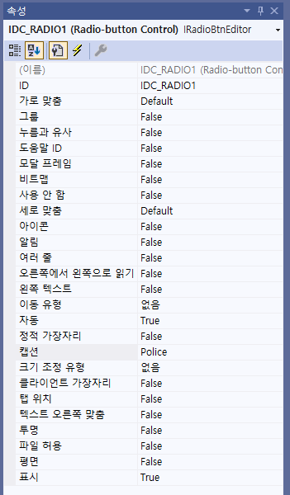

Slide 28
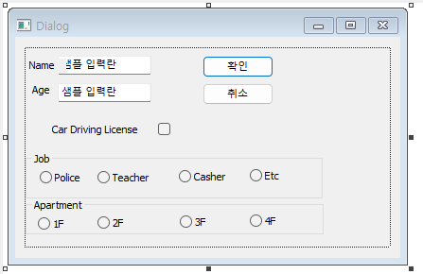
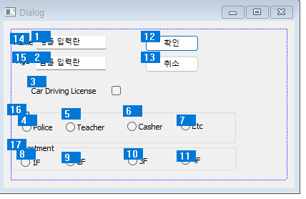
Layout=>Tab order
Or CTRL+D

Slide 29
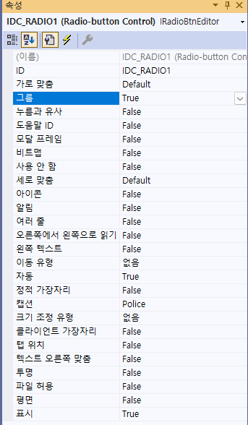
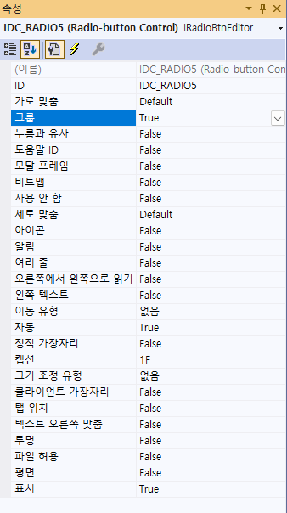
Group
Check the first member click

Slide 30
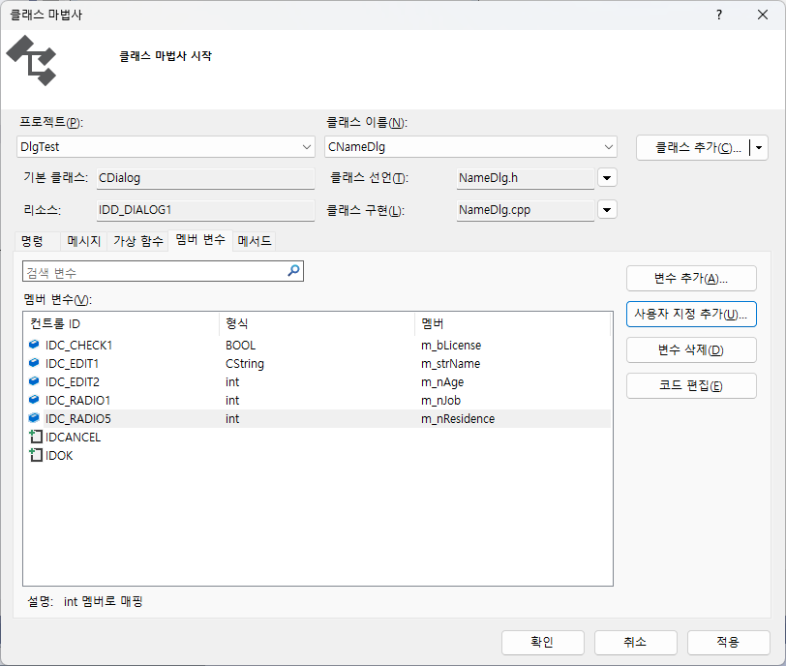

Slide 31
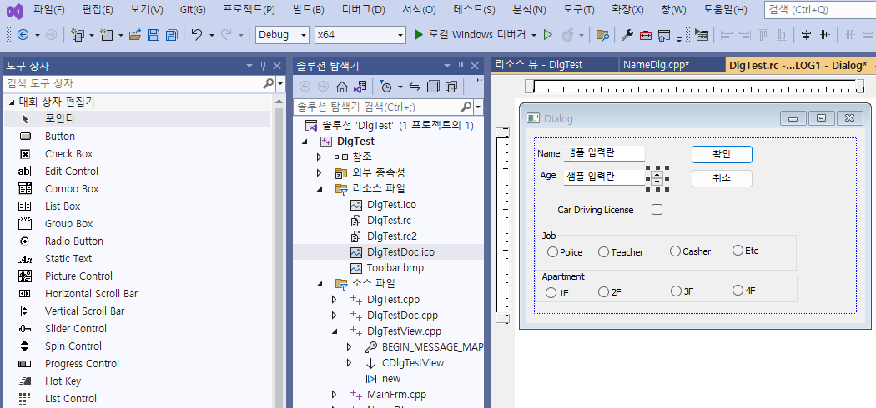

Slide 32
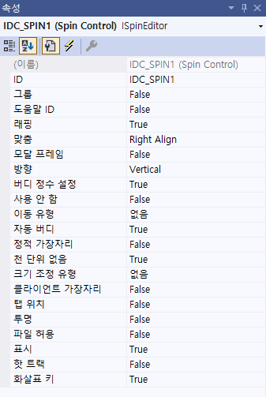

Slide 33
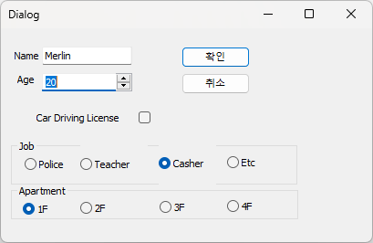

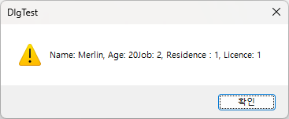
void CDlgTestView::OnDialog()
{
CString temp;
CNameDlg dlg;
dlg.m_strName = "Merlin";
dlg.m_nAge = 20;
if( dlg.DoModal( ) == IDOK)
{
CString strOutText,strOutText2;
strOutText.Format(_T("Name: %s, Age: %d\n“), dlg.m_strName, dlg.m_nAge);
strOutText2.Format(_T("Job: %d, Residence : %d, Licence: %d “), dlg.m_nJob, dlg.m_nResidence, dlg.m_bLicense);
temp=strOutText+strOutText2;
AfxMessageBox(temp);
}
}

Slide 34
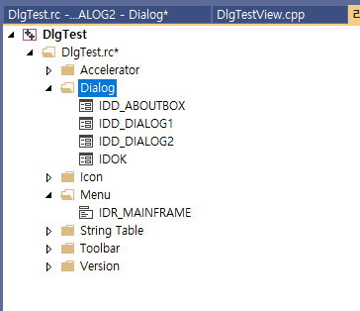
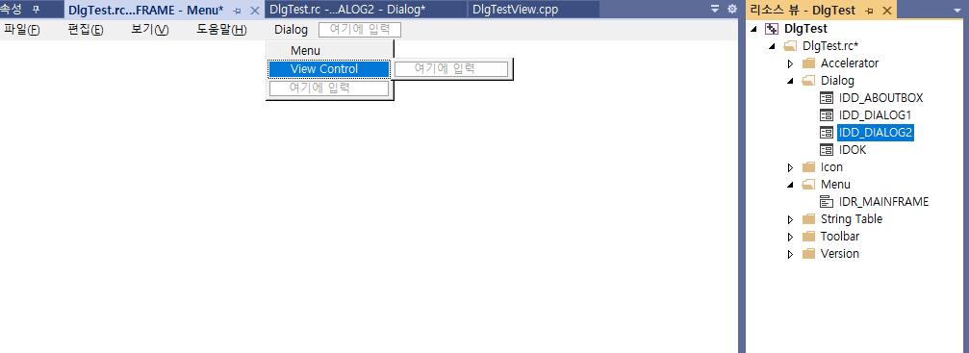

Slide 35
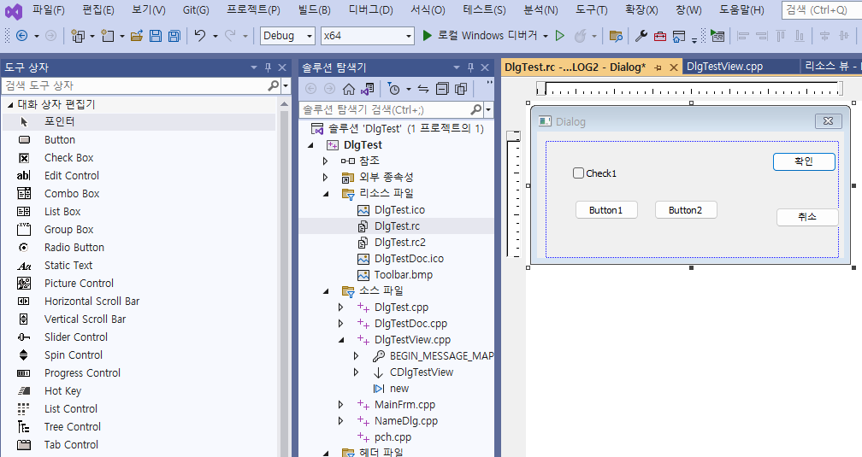

Slide 36
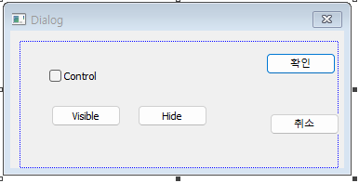
Add New Dialog

Slide 37
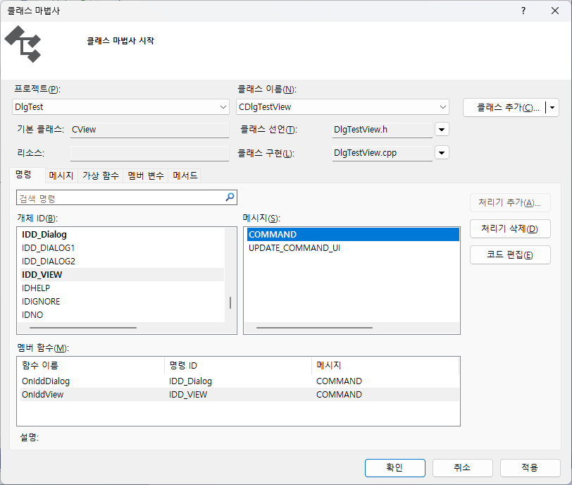
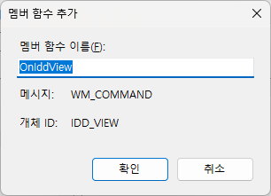

Slide 38


Slide 39
DlgTestView.cpp에서
#include "NameDlg2.h“ //추가
void CDlgTestView::OnIddDialog()
{
// TODO: 여기에 명령 처리기 코드를 추가합니다.
CNameDlg2 dlg2;
dlg2.DoModal();
}

Slide 40
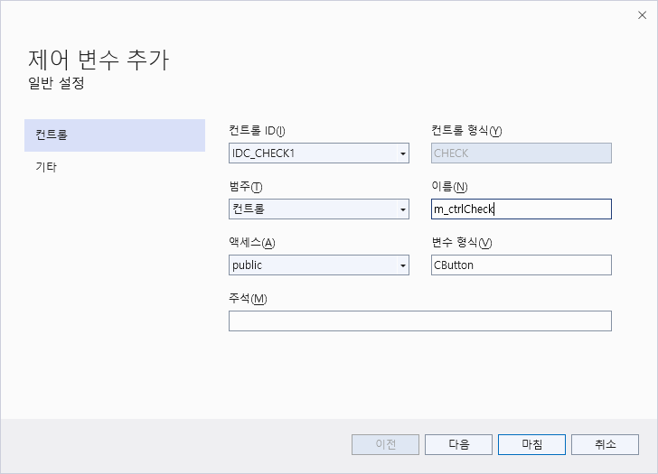
class CNameDlg2 : public CDialog
{
// Construction
public:
CNameDlg2(CWnd* pParent = NULL); // standard constructor
// Dialog Data
//{{AFX_DATA(CNameDlg2)
enum { IDD = IDD_DIALOG2 };
CButton m_ctrlCheck;
//}}AFX_DATA
void CNameDlg2::DoDataExchange(CDataExchange* pDX)
{
CDialog::DoDataExchange(pDX);
//{{AFX_DATA_MAP(CNameDlg2)
DDX_Control(pDX, IDC_CHECK1, m_ctrlCheck);
//}}AFX_DATA_MAP
}

Slide 41


void CNameDlg2::OnBnClickedButton1()
{
m_ctrlCheck.ShowWindow(SW_SHOW);
}
void CNameDlg2::OnBnClickedButton2()
{
m_ctrlCheck.ShowWindow(SW_HIDE);
}

Slide 42




Homework
** Make a Dialog Design

Slide 43
Dialog Example(1)
[Dialog based]

Slide 44


Slide 45


Slide 46


Slide 47
void CTimerDlg::OnBnClickedButton1()
{
// TODO: 여기에 컨트롤 알림 처리기 코드를 추가합니다.
}
void CTimerDlg::OnBnClickedButton2()
{
// TODO: 여기에 컨트롤 알림 처리기 코드를 추가합니다.
}
void CTimerDlg::OnBnClickedButton3()
{
// TODO: 여기에 컨트롤 알림 처리기 코드를 추가합니다.
}
void CTimerDlg::OnBnClickedButton4()
{
// TODO: 여기에 컨트롤 알림 처리기 코드를 추가합니다.
}

Slide 48


Slide 49
void CTimerDlg::OnTimer(UINT_PTR nIDEvent)
{
// TODO: 여기에 메시지 처리기 코드를 추가 및/또는 기본값을 호출합니다.
if (nIDEvent == 0) AfxMessageBox(_T("Timer1 3sec!!"));
if (nIDEvent == 1) AfxMessageBox(_T("Timer2 5sec!!"));
CDialogEx::OnTimer(nIDEvent);
}

Slide 50

bool m_bTimer;
bool m_bTimer1;

Slide 51
CTimerDlg::CTimerDlg(CWnd* pParent /*=nullptr*/)
: CDialogEx(IDD_TIMER_DIALOG, pParent)
{
m_hIcon = AfxGetApp()->LoadIcon(IDR_MAINFRAME);
m_bTimer = 1;
m_bTimer1 = 1;
}

Slide 52
void CTimerDlg::OnBnClickedButton1()
{
if (m_bTimer == 1)
{
SetTimer(0, 3000, NULL); // 타이머 설정
}
}
void CTimerDlg::OnBnClickedButton2()
{
if (m_bTimer1 == 1)
{
SetTimer(1, 5000, NULL); // 타이머 설정
}
}

Slide 53
void CTimerDlg::OnBnClickedButton3()
{
if (m_bTimer == 1) m_bTimer = 0;
KillTimer(0);
AfxMessageBox(_T("Timer0이 중지되었습니다!!"));
}
void CTimerDlg::OnBnClickedButton4()
{
if (m_bTimer1 == 1) m_bTimer1 = 0;
KillTimer(1);
AfxMessageBox(_T("Timer1이 중지되었습니다!!"));
}

Slide 54




Slide 55
END

