Slide 1
Dialog Example(2)
(Resource Control)
Seoul HRD Institute of KCCI
PhD. Kang, Won-Chan

Slide 2
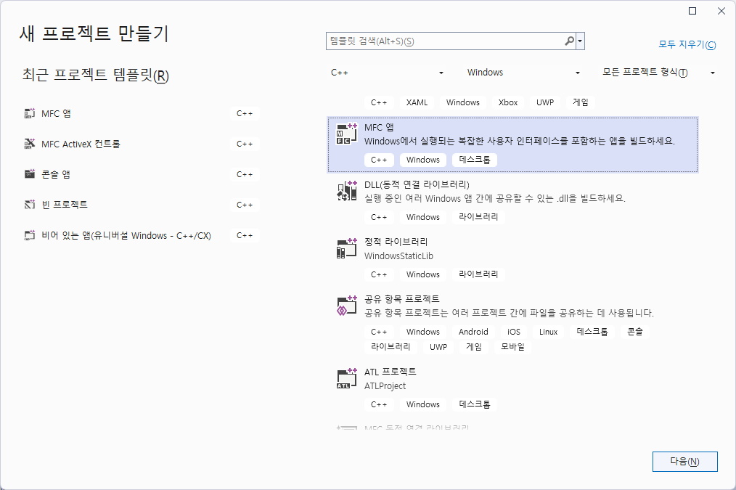

Slide 3
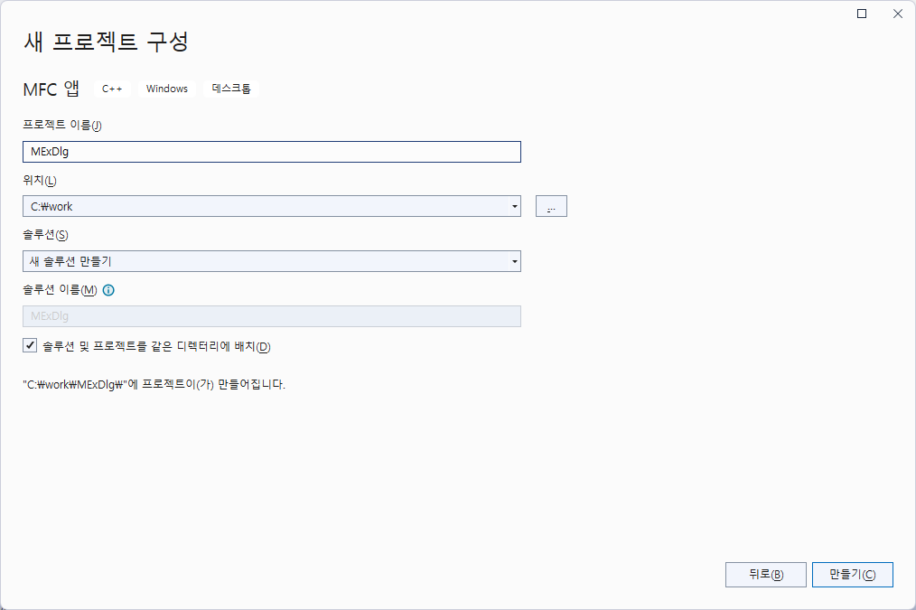
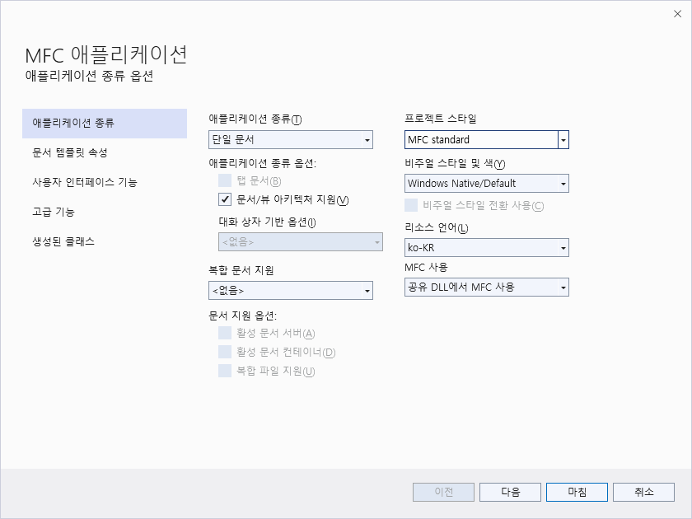
Make a SDI project

Slide 4
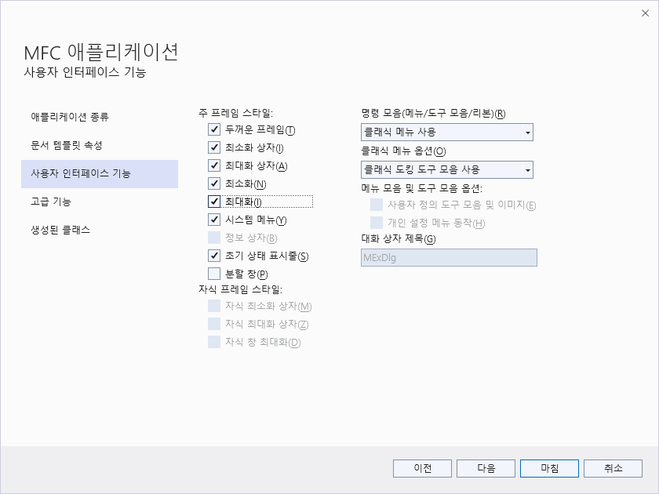

Slide 5
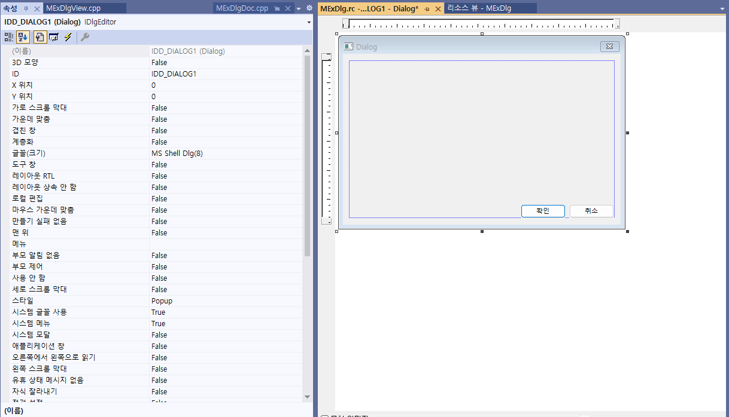

Slide 6
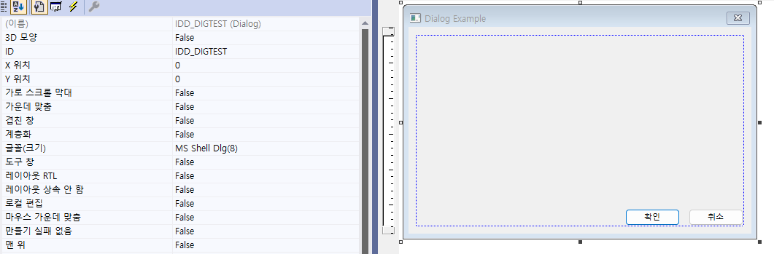
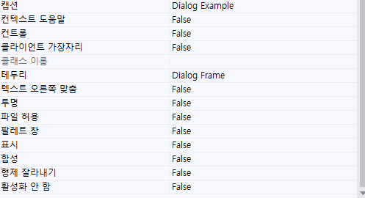
ID : IDD_DIGTEST
캡션: Dialog Example

Slide 7
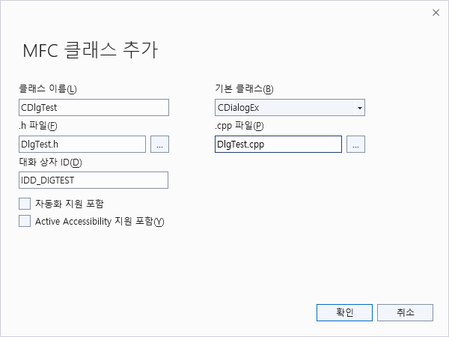

Slide 8
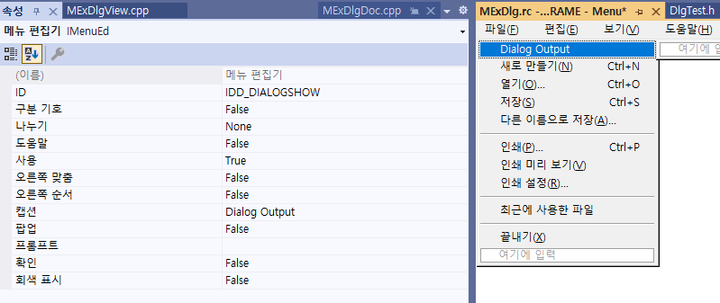

Slide 9
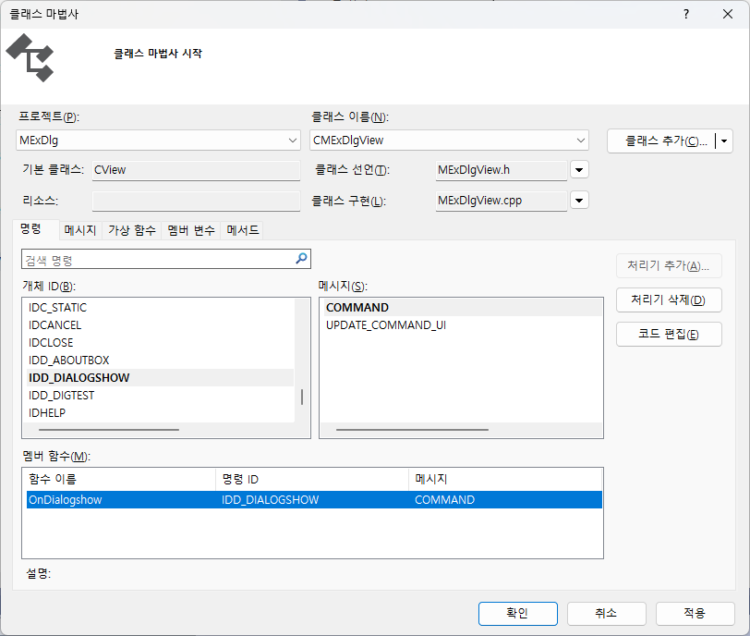

Slide 10
void CMexDlgView::OnDialogshow()
{
// TODO: Add your command handler code here
CDlgTest *pDlg = new CDlgTest;
pDlg->DoModal();
delete pDlg;
}
// CMexDlgView.cpp : implementation of the CMexDlgView class
//
#include "stdafx.h"
#include "MExDlg.h"
#include "DlgTest.h"
#include "MainFrm.h"

Slide 11
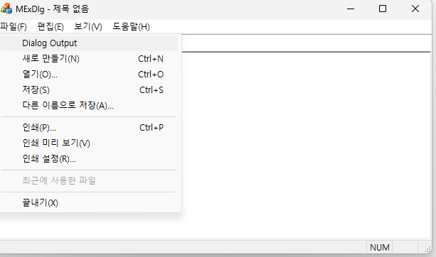
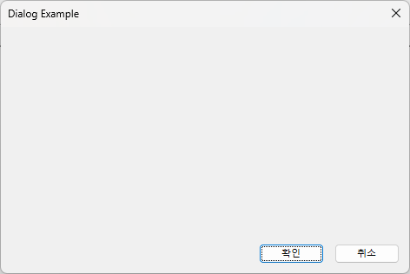

Slide 12
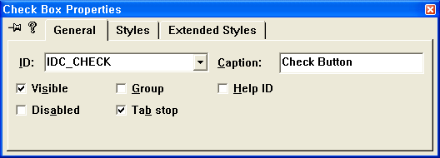
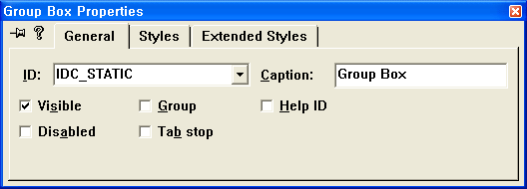
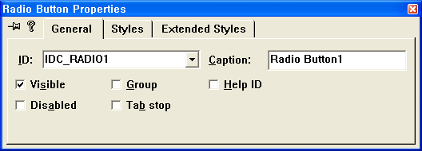
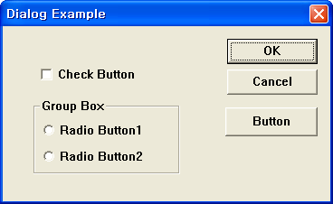
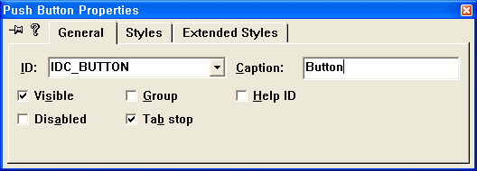

Slide 13
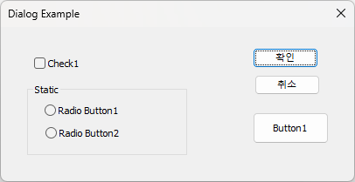
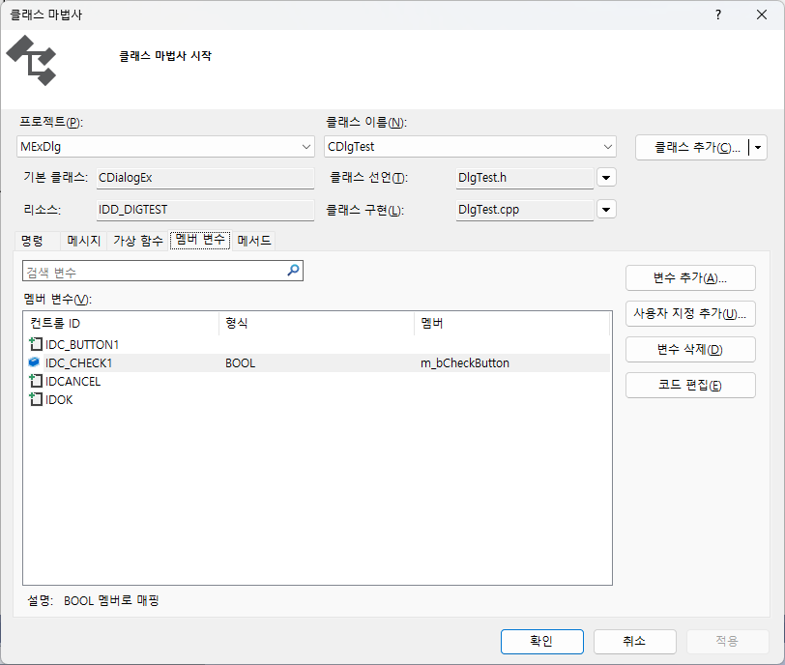
CTRL + Double Click

Slide 14
// CDlgTest dialog
class CDlgTest : public CDialog
{
// Construction
public:
CDlgTest(CWnd* pParent = NULL); // standard constructor
// Dialog Data
//{{AFX_DATA(CDlgTest)
enum { IDD = IDD_DIGTEST };
BOOL m_bCheckButton;
//}}AFX_DATA
void CDlgTest::DoDataExchange(CDataExchange* pDX)
{
CDialog::DoDataExchange(pDX);
//{{AFX_DATA_MAP(CDlgTest)
DDX_Check(pDX, IDC_CHECK, m_bCheckButton);
//}}AFX_DATA_MAP
}
CDlgTest::CDlgTest(CWnd* pParent /*=NULL*/)
: CDialog(CDlgTest::IDD, pParent)
{
//{{AFX_DATA_INIT(CDlgTest)
m_bCheckButton = FALSE;
//}}AFX_DATA_INIT
}

Slide 15
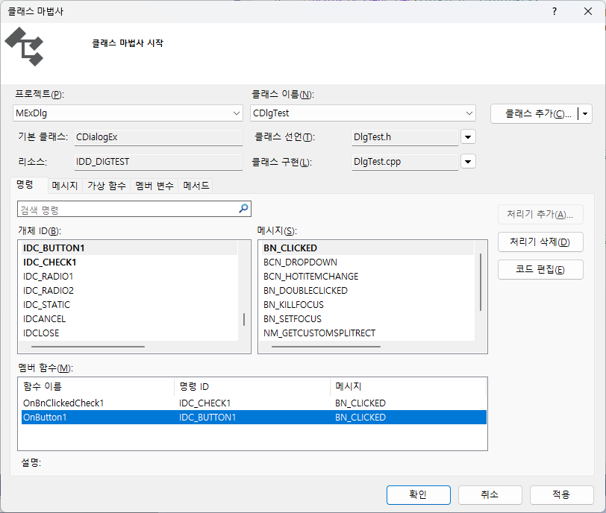
Or, Button Menu double click

Slide 16
void CDlgTest::OnButton1()
{
AfxMessageBox(_T("Button 1 Press"));
}
void CDlgTest::OnRadio1()
{
AfxMessageBox(_T( "Radio Button 1 Press“));
}
void CDlgTest::OnRadio2()
{
AfxMessageBox(_T( "Radio Button 2 Press"));
}
void CDlgTest::OnCheck()
{
UpdateData(TRUE);
CString message;
message.Format(_T( "Check button press value:%d“),m_bCheckButton);
AfxMessageBox(message);
}

Slide 17
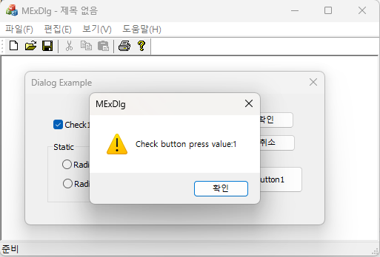

Slide 18
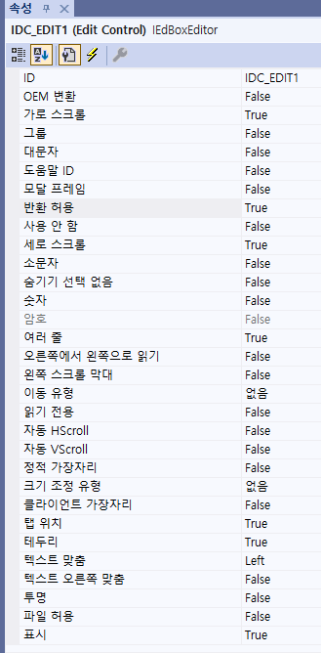
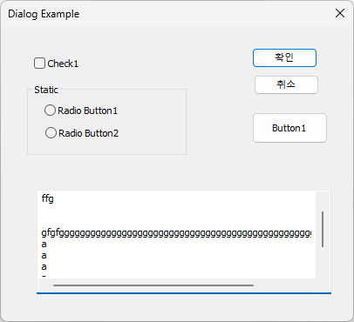
Editor Box Control

Slide 19
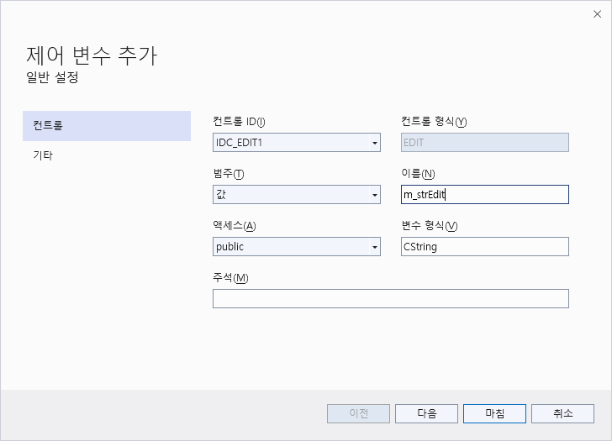
CDlgTest::CDlgTest(CWnd* pParent /*=NULL*/)
: CDialog(CDlgTest::IDD, pParent)
{
//{{AFX_DATA_INIT(CDlgTest)
m_bCheckButton = FALSE;
m_strEdit = _T(""); //Initialize Vaiable
//}}AFX_DATA_INIT
}
void CDlgTest::DoDataExchange(CDataExchange* pDX)
{
CDialog::DoDataExchange(pDX);
//{{AFX_DATA_MAP(CDlgTest)
DDX_Check(pDX, IDC_CHECK, m_bCheckButton);
DDX_Text(pDX, IDC_EDIT1, m_strEdit);//DDX_Text connect
//}}AFX_DATA_MAP
}

Slide 20
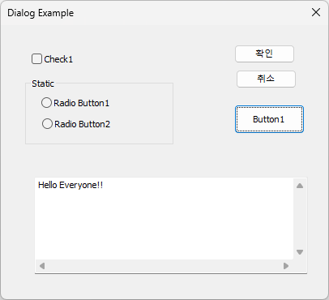
Change source code
// Dlgtest.h에서
class CDlgTest : public CDialogEx
{
DECLARE_DYNAMIC(CDlgTest)
public:
CDlgTest(CWnd* pParent = nullptr); // 표준 생성자입니다.
BOOL OnInitDialog(); //추가
virtual ~CDlgTest();
~~~~중략~~~
//Dlgtest.cpp에서
BOOL CDlgTest::OnInitDialog()
{
CDialog::OnInitDialog();
m_strEdit = _T("Hello Everyone!!“);
UpdateData(FALSE);
return TRUE;
}

Slide 21
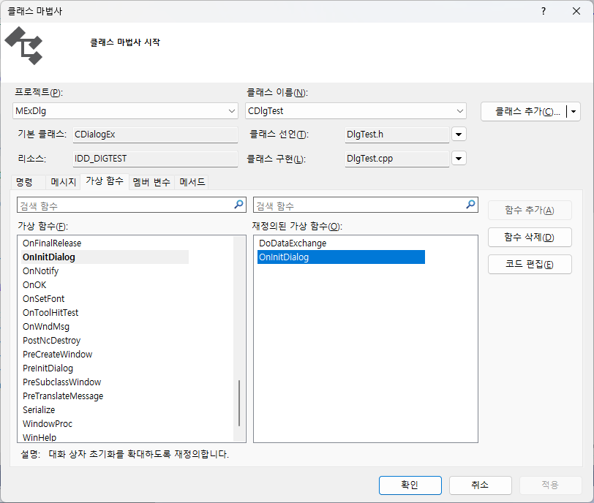
OnInitDialog()함수에서 에러발생
따라서 수작업으로 함수를 추가하세요.

Slide 22
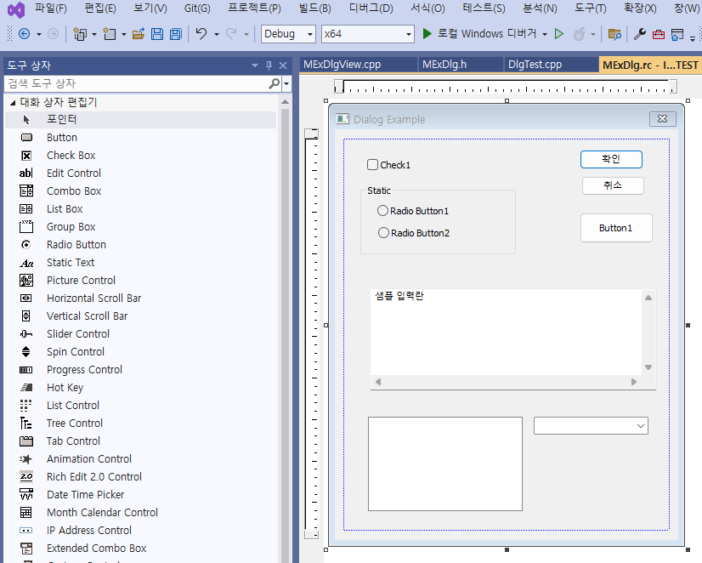

List Box
Combo Box

Slide 23
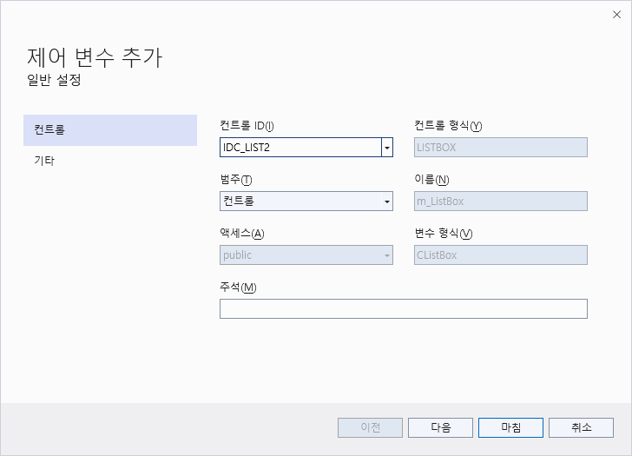
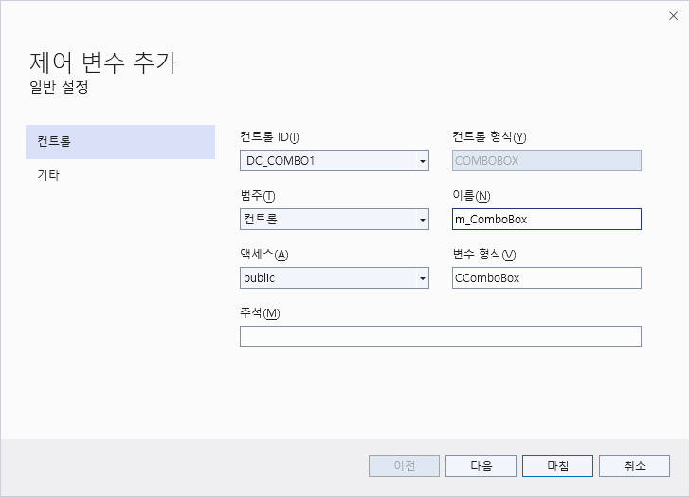
CListBox m_ListBox;
CComboBox m_comboBox;
DDX_Control(pDX, IDC_LIST1, m_lLstBox);
DDX_Control(pDX, IDC_COMBO1, m_comboBox);

Slide 24
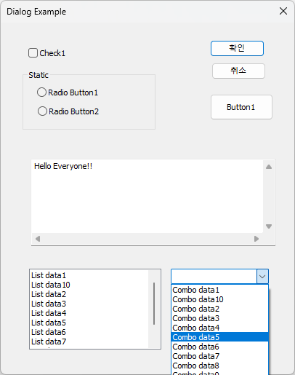
BOOL CDlgTest::OnInitDialog()
{
CDialog::OnInitDialog();
m_strEdit = _T("Hello Everyone!!");
UpdateData(FALSE);
CString data;
for (int i = 1; i < 11; i++)
{
      data.Format(_T("List data%d"), i);
      m_ListBox.AddString(data);
      data.Format(_T("Combo data%d"), i);
      m_ComboBox.AddString(data);
}
return TRUE;
}

Slide 25
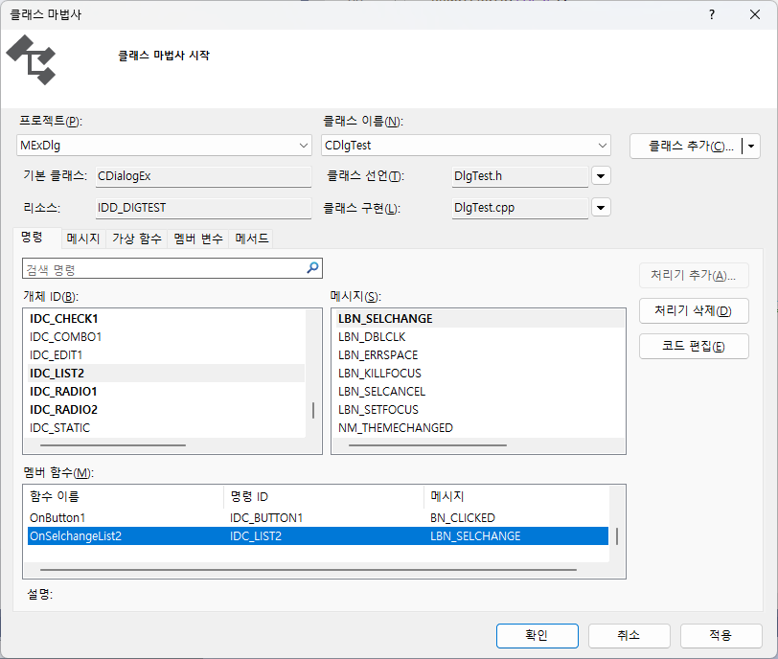

Slide 26
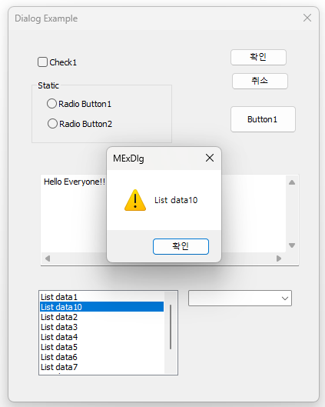
void CDlgTest::OnSelcancelList1()
{
// TODO: Add your control notification handler code here
int num = m_ListBox.GetCurSel();//Search the current position
CString data;
m_ListBox.GetText(num, data);//get character at select position
AfxMessageBox(data);//output message box
}

Slide 27
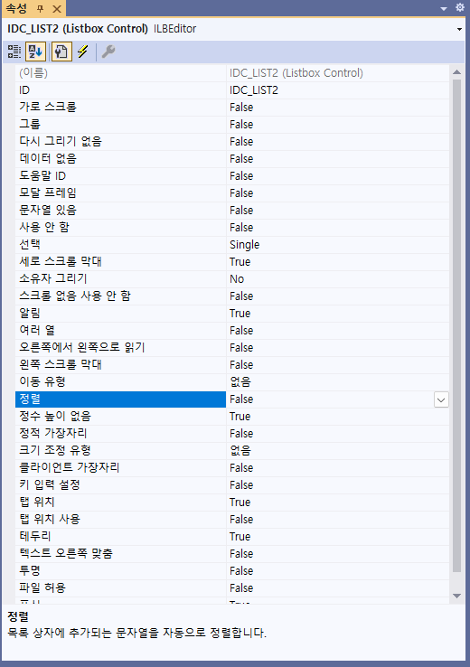

Slide 28
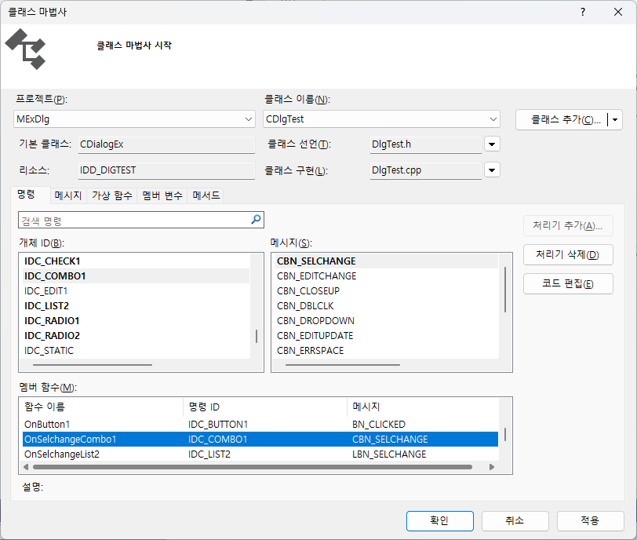

Slide 29
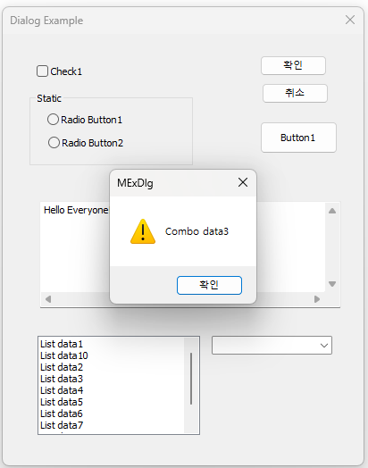
void CDlgTest::OnSelchangeCombo1()
{
// TODO: Add your control notification handler code here
int num = m_ComboBox.GetCurSel();
CString data;
m_ComboBox.GetLBText(num, data);
AfxMessageBox(data);
}

Slide 30
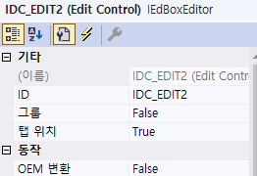
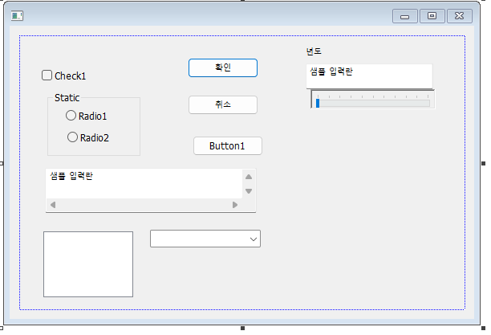
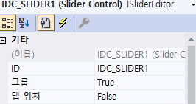
Slide CTRL 추가

Slide 31
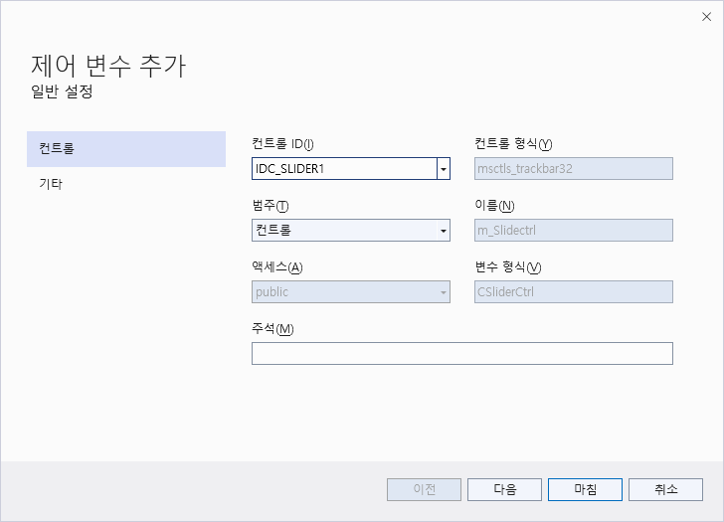

Slide 32
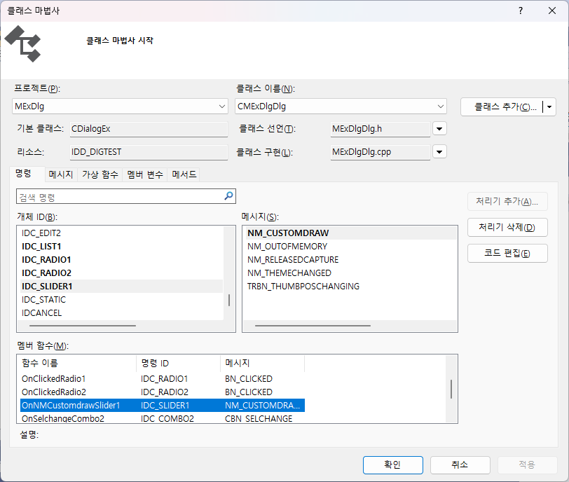

Slide 33
// TODO: 여기에 추가 초기화 작업을 추가합니다.
m_strEdit = _T("Hello Everyone!!");
UpdateData(FALSE);
CString data;
for (int i = 1; i < 11; i++)
{
data.Format(_T("List data%d"), i);
m_ListBox.AddString(data);
data.Format(_T("Combo data%d"), i);
m_ComboBox.AddString(data);
}
m_Slidectrl.SetRange(2000, 2300, TRUE);
m_Slidectrl.SetPos(2023);
return TRUE; // 포커스를 컨트롤에 설정하지 않으면 TRUE를 반환합니다.
}

Slide 34
void CMExDlgDlg::OnNMCustomdrawSlider1(NMHDR* pNMHDR, LRESULT* pResult)
{
LPNMCUSTOMDRAW pNMCD = reinterpret_cast<LPNMCUSTOMDRAW>(pNMHDR);
// TODO: 여기에 컨트롤 알림 처리기 코드를 추가합니다.
int position;
position = m_Slidectrl.GetPos();
SetDlgItemInt(IDC_EDIT2,position);
*pResult = 0;
}

Slide 35
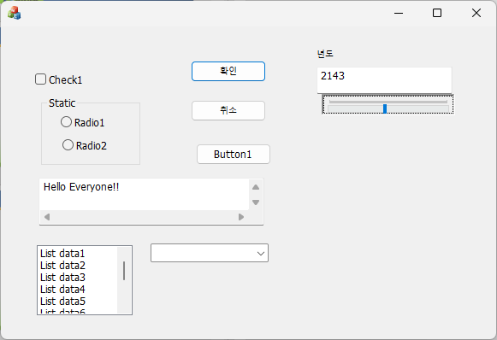

Slide 36
END

