Slide 1
Dialog Example(3)
(Resource Control based Dialog)
Seoul HRD Institute of KCCI
PhD. Kang, Won-Chan

Slide 2
List Control

Slide 3
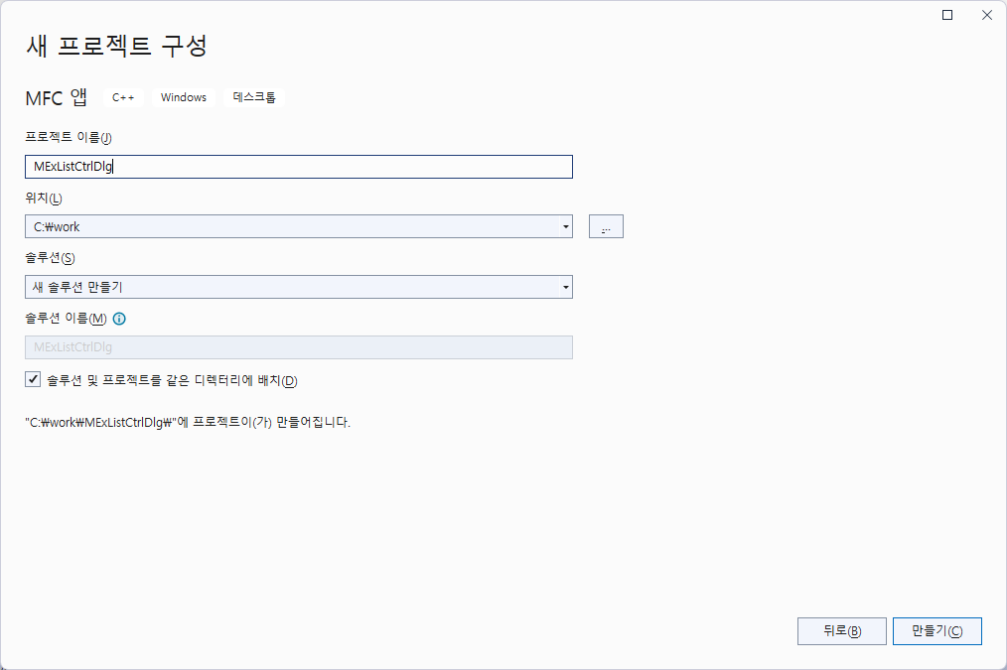

Slide 4
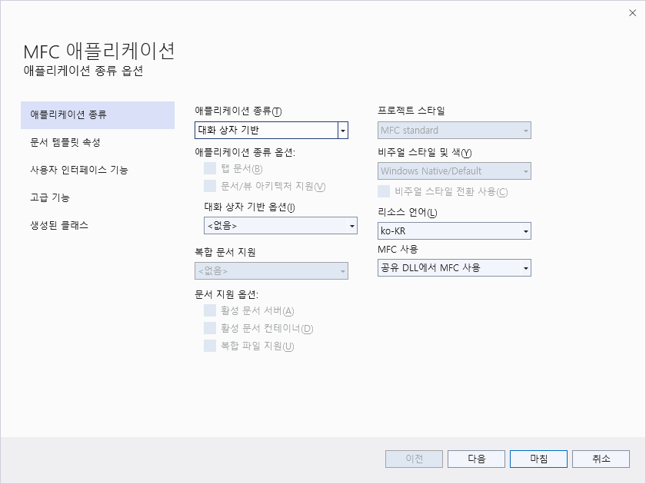

Slide 5
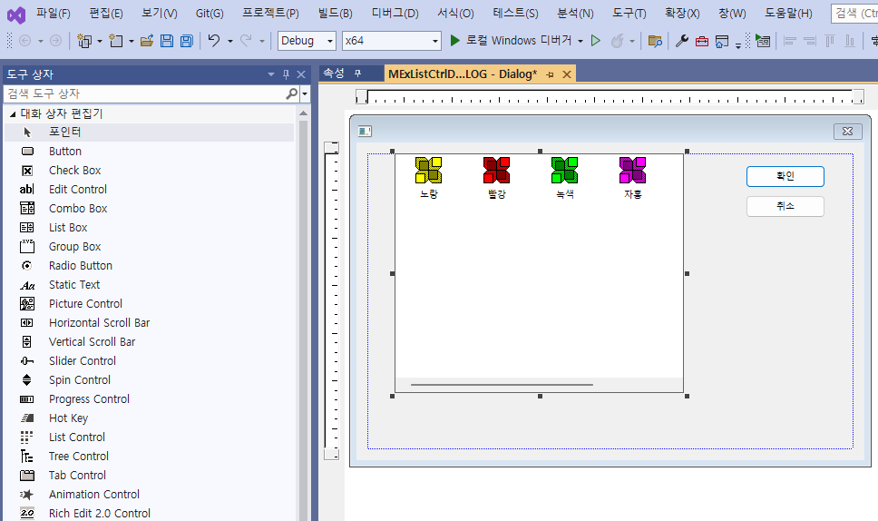

Slide 6
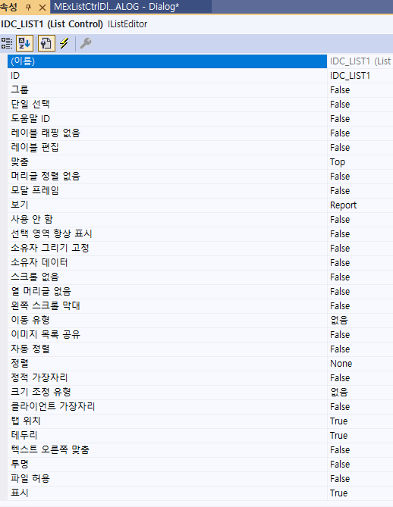
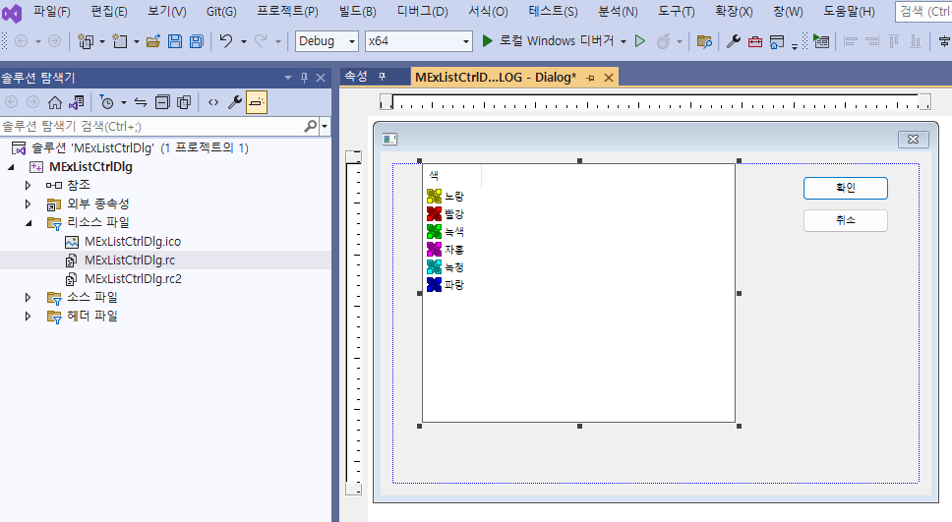

Slide 7
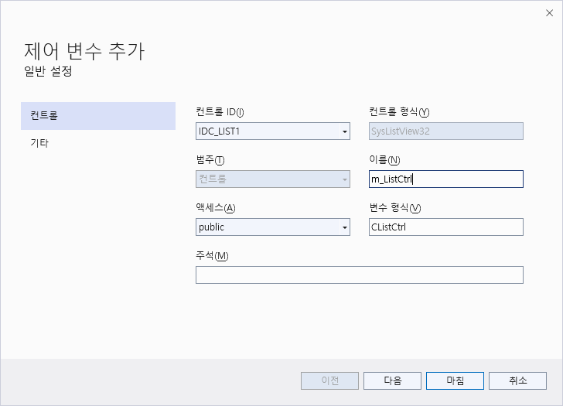
// Dialog Data
//{{AFX_DATA(CMExListCtrlDlg)
enum { IDD = IDD_MEXLISTCTRL_DIALOG };
CListCtrl m_listCtrl;
//}}AFX_DATA
void CMExListCtrlDlg::DoDataExchange(CDataExchange* pDX)
{
CDialog::DoDataExchange(pDX);
//{{AFX_DATA_MAP(CMExListCtrlDlg)
DDX_Control(pDX, IDC_LIST1, m_listCtrl);
//}}AFX_DATA_MAP
}

Slide 8
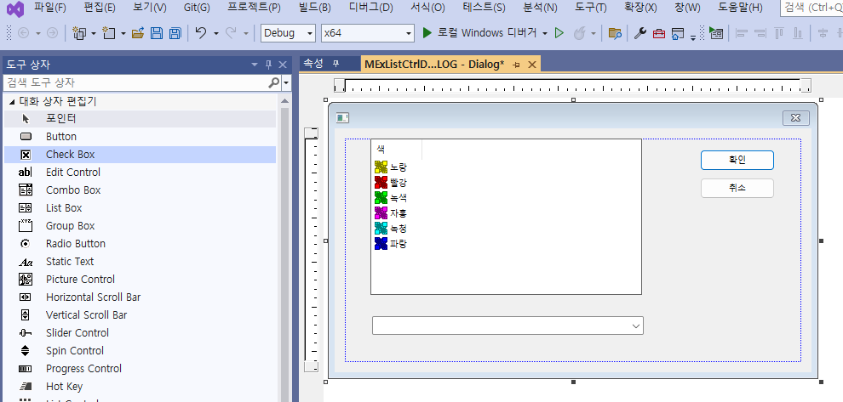

Slide 9
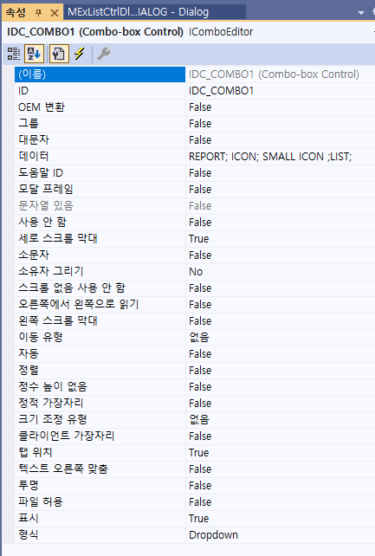

Slide 10
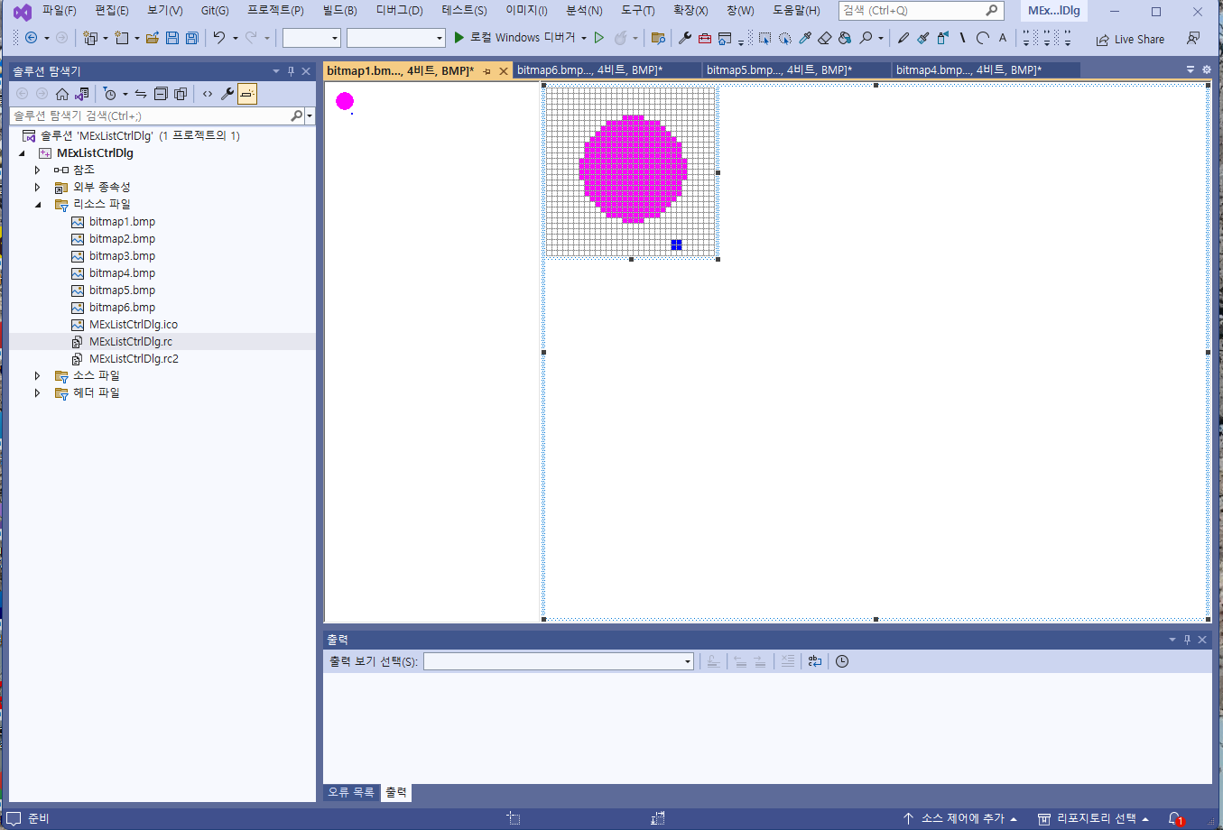
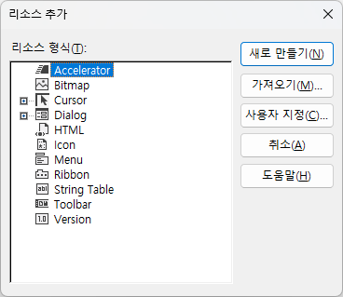
Bitmap 1-3: 32*32
Bitmap 4-6: 16*16

Slide 11
Make a Image data
class CMExListCtrlDlgDlg : public CDialog
{
// Construction
public:
CMExListCtrlDlgDlg(CWnd* pParent = NULL); // standard constructor
CImageList *m_largeImage; //for Big Icon
CImageList *m_smallImage; //for small Icon
BOOL CMExListCtrlDlgDlg::OnInitDialog()
{ :
:
// TODO: Add extra initialization here
// Prepare to memory allocation
m_largeImage= new CImageList;
m_smallImage= new CImageList;
:

Slide 12
// TODO: Add extra initialization here
// Prepare to memory allocation
m_largeImage= new CImageList;
m_smallImage= new CImageList;
m_largeImage->Create(32,32,ILC_COLOR4,3,3);
m_smallImage->Create(16,16,ILC_COLOR4,3,3);
// add a picture for Image list
CBitmap cBit;
cBit.LoadBitmap(IDB_BITMAP1);
m_largeImage->Add(&cBit,RGB(255,255,255));
cBit.DeleteObject();
cBit.LoadBitmap(IDB_BITMAP2);
m_largeImage->Add(&cBit,RGB(255,255,255));
cBit.DeleteObject();
cBit.LoadBitmap(IDB_BITMAP3);
m_largeImage->Add(&cBit,RGB(255,255,255));
cBit.DeleteObject();
cBit.LoadBitmap(IDB_BITMAP4);
m_smallImage->Add(&cBit,RGB(255,255,255));
cBit.DeleteObject();
cBit.LoadBitmap(IDB_BITMAP5);
m_smallImage->Add(&cBit,RGB(255,255,255));
cBit.DeleteObject();
cBit.LoadBitmap(IDB_BITMAP6);
m_smallImage->Add(&cBit,RGB(255,255,255));
cBit.DeleteObject();
m_ListCtrl.SetImageList(m_largeImage,LVSIL_NORMAL);
m_ListCtrl.SetImageList(m_smallImage,LVSIL_SMALL);
//Make a column
LV_COLUMN lvcolumn;
lvcolumn.mask=LVCF_FMT|LVCF_SUBITEM|LVCF_TEXT |LVCF_WIDTH;
lvcolumn.fmt=LVCFMT_LEFT;
lvcolumn.iSubItem=0;
lvcolumn.cx=80;
lvcolumn.pszText=_T("Robert");
m_ListCtrl.InsertColumn(0,&lvcolumn);
lvcolumn.mask=LVCF_FMT|LVCF_SUBITEM|LVCF_TEXT |LVCF_WIDTH;
lvcolumn.fmt=LVCFMT_LEFT;
lvcolumn.iSubItem=1;
lvcolumn.cx=280;
lvcolumn.pszText=_T("Comments");
m_ListCtrl.InsertColumn(1,&lvcolumn);
return TRUE;
}
Image size

Slide 13
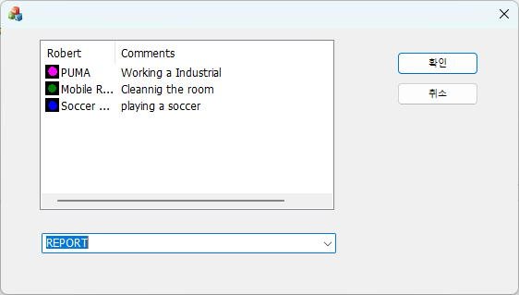
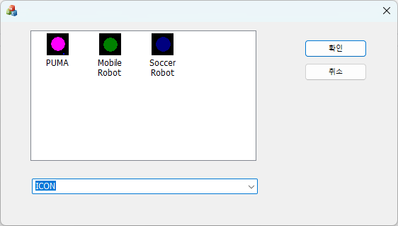

Slide 14
Data insert
// Insert Data
LV_ITEM lvitem;
lvitem.mask=LVIF_TEXT | LVIF_IMAGE;
lvitem.iItem=0;
lvitem.iSubItem=0;
lvitem.pszText=_T("PUMA");
lvitem.iImage=0;
m_ListCtrl.InsertItem(&lvitem);
lvitem.mask=LVIF_TEXT;
lvitem.iItem=0;
lvitem.iSubItem=1;
lvitem.pszText=_T("Working a Industrial");
m_ListCtrl.SetItem(&lvitem);
lvitem.mask=LVIF_TEXT | LVIF_IMAGE;
lvitem.iSubItem=0;
lvitem.iItem=1;
lvitem.pszText=_T("Mobile Robot");
lvitem.iImage=1;
m_ListCtrl.InsertItem(&lvitem);
lvitem.mask=LVIF_TEXT;
lvitem.iItem=1;
lvitem.iSubItem=1;
lvitem.pszText=_T("Cleannig the room");
m_ListCtrl.SetItem(&lvitem);
lvitem.mask=LVIF_TEXT | LVIF_IMAGE;
lvitem.iItem=2;
lvitem.iSubItem=0;
lvitem.pszText=_T("Soccer Robot");
lvitem.iImage=2;
m_ListCtrl.InsertItem(&lvitem);
lvitem.mask=LVIF_TEXT;
lvitem.iItem=2;
lvitem.iSubItem=1;
lvitem.pszText=_T("playing a soccer");
m_ListCtrl.SetItem(&lvitem);
return TRUE;
}

Slide 15
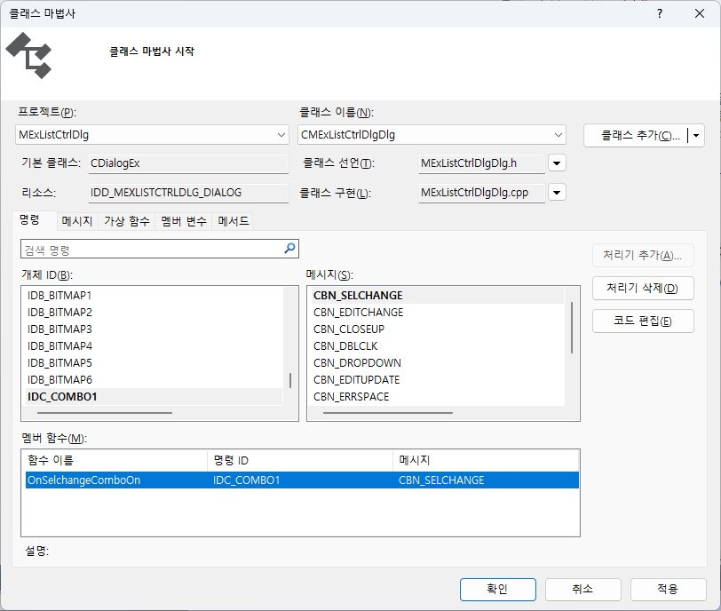
SELECT
SELECT
SELECT

Slide 16
void CMExListCtrlDlgDlg::OnSelchangeCombo1()
{
// TODO: Add your control notification handler code here
CComboBox *pcombo=(CComboBox *)GetDlgItem(IDC_COMBO1);
int num=pcombo->GetCurSel();
DWORD style=::GetWindowLong(m_ListCtrl.m_hWnd,GWL_STYLE);
style &=~(LVS_TYPEMASK);
switch(num)
{
case 0: style|=LVS_REPORT;
break;
case 1: style|=LVS_ICON;
break;
case 2: style|=LVS_SMALLICON;
break;
default: style|=LVS_LIST;
break;
}
::SetWindowLong(m_ListCtrl.m_hWnd,GWL_STYLE,(LONG)style);
}

Slide 17

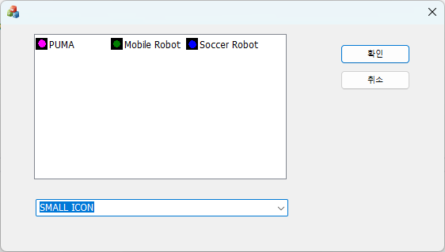
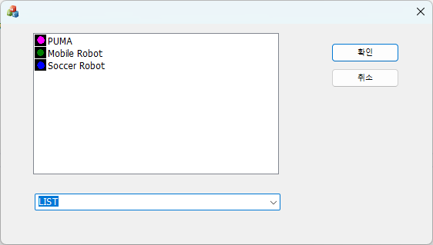

SELECT
SELECT
SELECT
SELECT

Slide 18
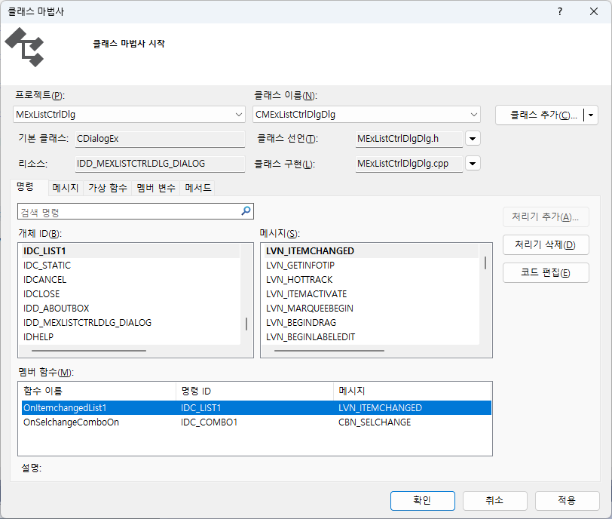
Event interrupt
SELECT
SELECT
SELECT

Slide 19
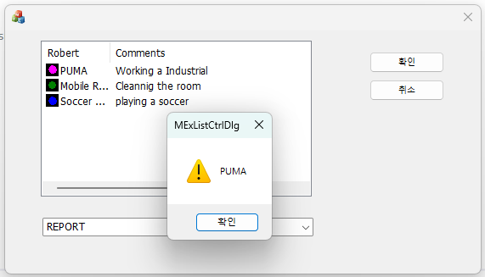
void CMExListCtrlDlgDlg::OnItemchangedList1(NMHDR* pNMHDR, LRESULT* pResult)
{
  LPNMLISTVIEW pNMLV = reinterpret_cast<LPNMLISTVIEW>(pNMHDR);
  // TODO: 여기에 컨트롤 알림 처리기 코드를 추가합니다.
  CString message;
  int num = pNMLV->iItem;
  static int oldnum = 0;
  if (num > -1 && oldnum != num)
  {
  message = m_ListCtrl.GetItemText(num, 0);
  AfxMessageBox(message);
  oldnum = num;
  }
*pResult = 0;
}

Slide 20
Tree control

Slide 21
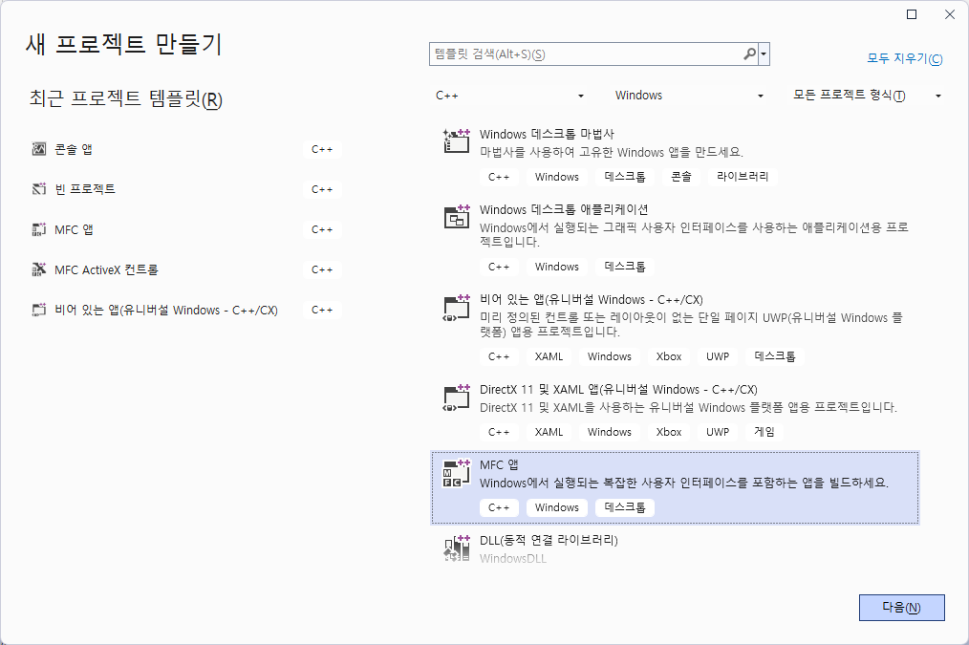

Slide 22


Slide 23
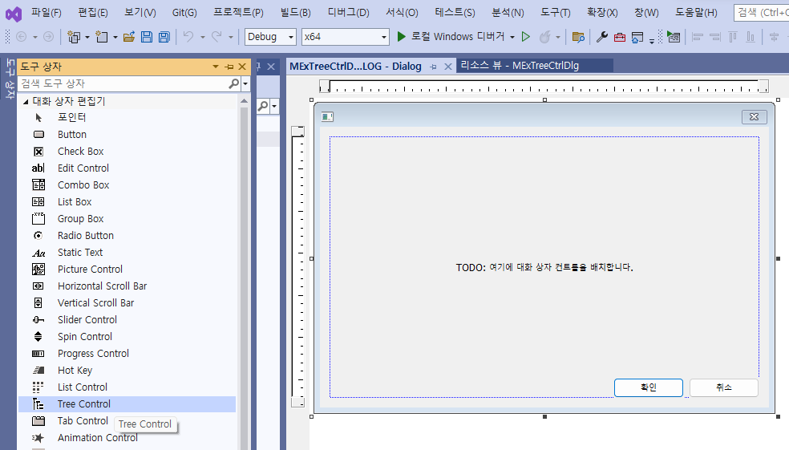
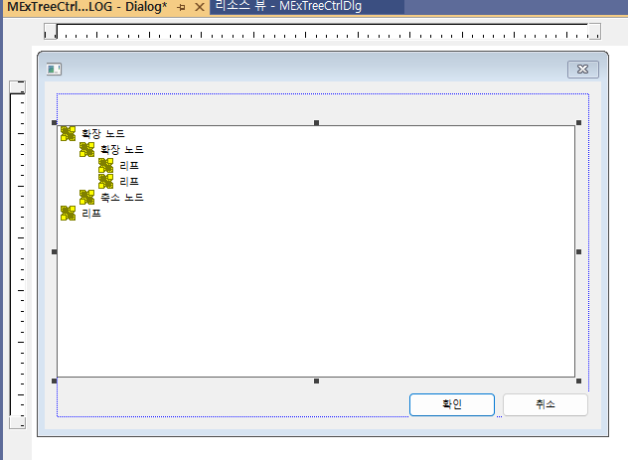

Slide 24
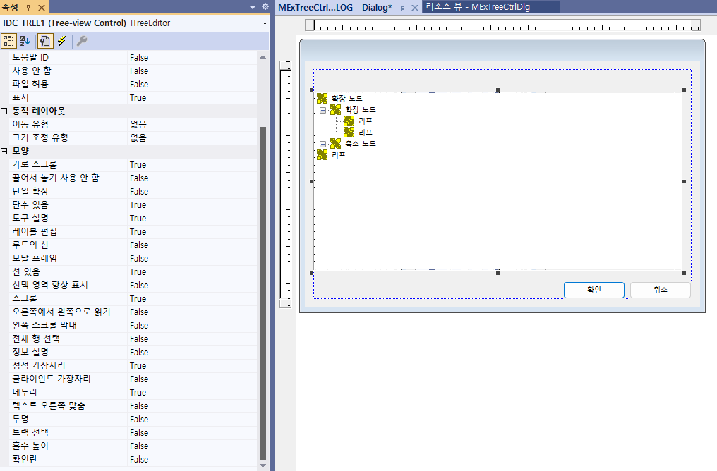

Slide 25
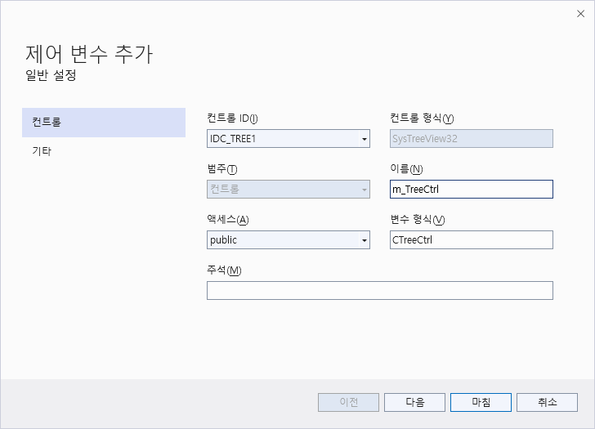
SELECT

Slide 26
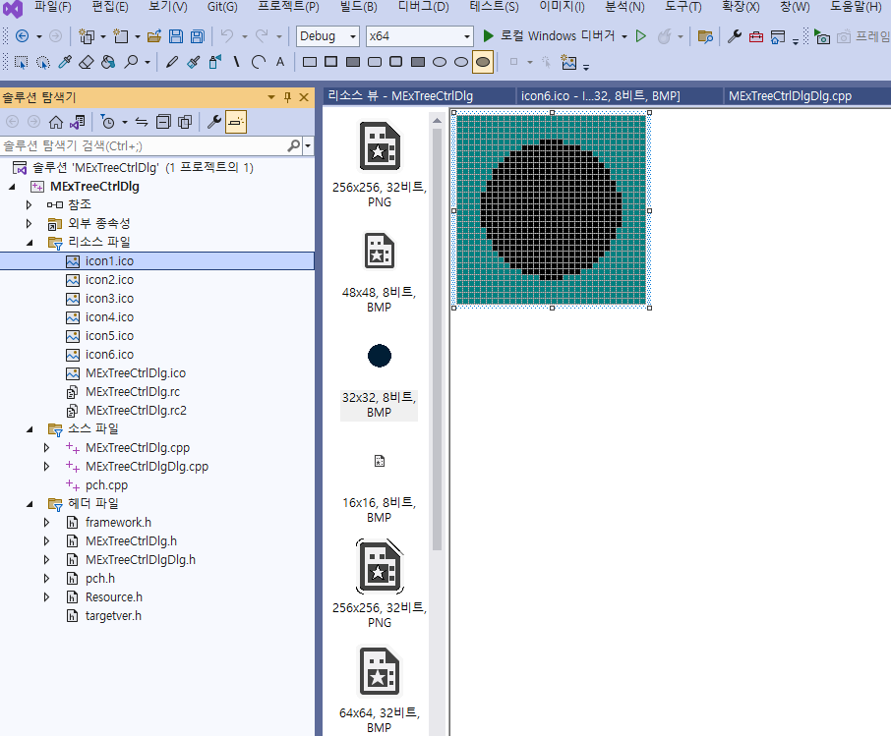
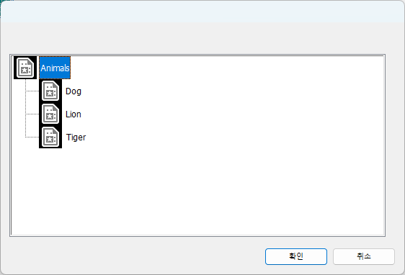
class CMExTreeCtrlDlgDlg : public CDialog
{
// Construction
public:
CImageList *pimagelist;
CMExTreeCtrlDlgDlg(CWnd* pParent = NULL);
:
:
Header file
SELECT

Slide 27
BOOL CMExTreeCtrlDlgDlg::OnInitDialog()
{
// TODO: Add extra initialization here
//Image list setup
pimagelist= new CImageList;
pimagelist->Create(32,32,ILC_COLOR4,3,3);
pimagelist->Add(AfxGetApp()->LoadIcon(IDI_ICON1));
pimagelist->Add(AfxGetApp()->LoadIcon(IDI_ICON2));
pimagelist->Add(AfxGetApp()->LoadIcon(IDI_ICON3));
pimagelist->Add(AfxGetApp()->LoadIcon(IDI_ICON4));
pimagelist->Add(AfxGetApp()->LoadIcon(IDI_ICON5));
pimagelist->Add(AfxGetApp()->LoadIcon(IDI_ICON6));
//tree setting
m_treeCtrl.SetImageList(pimagelist,TVSIL_NORMAL);
TV_INSERTSTRUCT tvstruct;
HTREEITEM item;
// insert root data
tvstruct.hParent=0;
tvstruct.hInsertAfter=TVI_LAST;
tvstruct.item.pszText="Animals";
tvstruct.item.mask=TVIF_TEXT | TVIF_IMAGE |TVIF_SELECTEDIMAGE ;
tvstruct.item.iImage =0;
tvstruct.item.iSelectedImage=3;
item=m_treeCtrl.InsertItem(&tvstruct);

Slide 28
// insert child data
tvstruct.hParent=item;
tvstruct.hInsertAfter=TVI_LAST;
tvstruct.item.pszText="Dog";
tvstruct.item.mask=TVIF_TEXT | TVIF_IMAGE |TVIF_SELECTEDIMAGE ;
tvstruct.item.iImage =0;
tvstruct.item.iSelectedImage=3;
m_treeCtrl.InsertItem(&tvstruct);
tvstruct.hParent=item;
tvstruct.hInsertAfter=TVI_LAST;
tvstruct.item.pszText="Lion";
tvstruct.item.mask=TVIF_TEXT |TVIF_IMAGE|TVIF_SELECTEDIMAGE ;
tvstruct.item.iImage =0;
tvstruct.item.iSelectedImage=3;
m_treeCtrl.InsertItem(&tvstruct);
tvstruct.hParent=item;
tvstruct.hInsertAfter=TVI_LAST;
tvstruct.item.pszText="Tiger";
tvstruct.item.mask=TVIF_TEXT | TVIF_IMAGE|TVIF_SELECTEDIMAGE ;
tvstruct.item.iImage =0;
tvstruct.item.iSelectedImage=3;
m_treeCtrl.InsertItem(&tvstruct);
return TRUE;
}

Slide 29
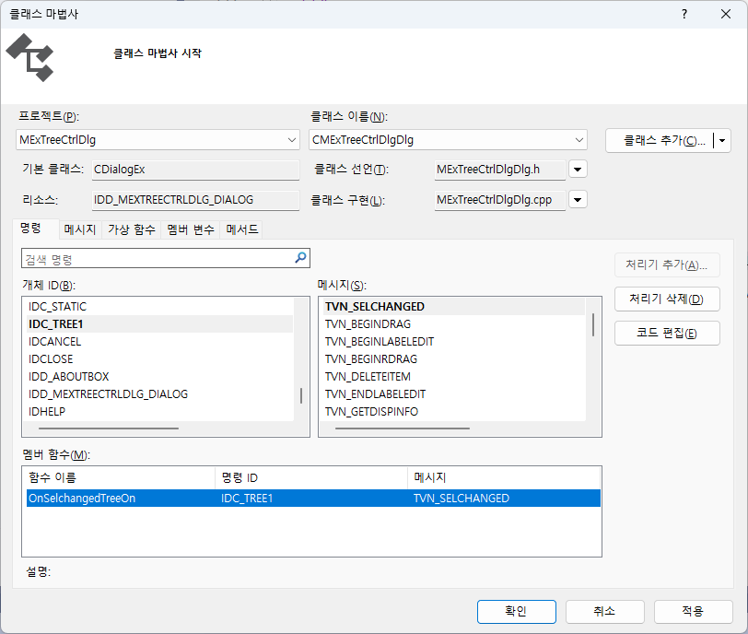
Get tree control event
SELECT

Slide 30
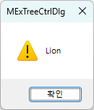
void CMExTreeCtrlDlgDlg::OnSelchangedTree1(NMHDR* pNMHDR, LRESULT* pResult)
{
NM_TREEVIEW* pNMTreeView = (NM_TREEVIEW*)pNMHDR;
// TODO: Add your control notification handler code here
UINT flags;
CPoint point;
CString message;
//Get mouse position
GetCursorPos(&point);
//position mapping the client region
m_treeCtrl.ScreenToClient(&point);
//get item using HitTest function
HTREEITEM nitem=m_treeCtrl.HitTest(point,&flags);
//get string item’s string
message=m_treeCtrl.GetItemText(nitem);
if(message.GetLength()>0)
AfxMessageBox(message);
*pResult = 0;
}

Slide 31
END

