Slide 1






Scotiabank
New Chat
We are a large bank. How can we leverage LLMs to process customer feedback?
Introduction
Team Alpha
Easter Eggs
For a large bank, using commercial LLMs poses challenges that can be mitigated by using open source LLMs.
Security: all data is offline, inference is done on-premise.
Bias: model can be fine-tuned to minimize bias.
Hallucination: quality prompting and “best of 5” can minimize hallucinations, running sequences of prompts is cheaper than with commercial LLMs.
Compute: quantized models run on laptops, Google Colab (16 GB RAM).
Cost: cheap compared to commercial LLMs.
Although commercial LLMs like GPT-4 are good at what they do, open source LLMs with the right prompts and data pipeline can reach the same quality level for a given task.
Topic Ranks
User Needs
Improvements
Suggestions
Conclusion
Clear conversations
Light Mode
OpenAI Discord
Regenerate response
Updates and FAQ
Log out
ChatGPT Jan 9 Version. Free Research Preview. Our goal is to make AI systems more natural and safe to interact with. Your feedback will help us improve.

Slide 2
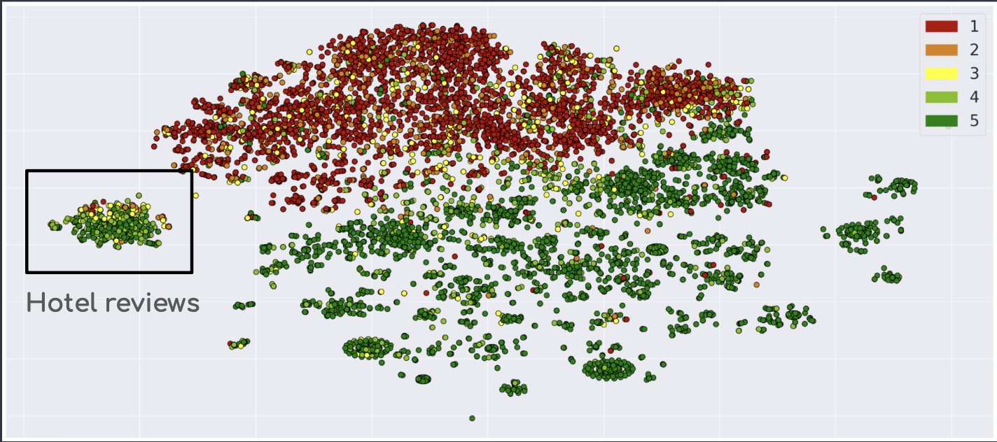
Scotiabank
New Chat
How do we find Easter Eggs in our dataset?
Introduction
Team Alpha
Easter Eggs
You can embed the reviews using a text embedding model like Instructor-xl, and visualize clusters using t-SNE. You will find one cluster which only contains reviews of hotels and its services.
Also, you can use a Few-Shot Learning model like SetFit. You can fine-tune it on a small dataset of hotel reviews, and then apply it on the main dataset.
Topic Ranks
User Needs
Improvements
Suggestions
Conclusion
Clear conversations
Light Mode
OpenAI Discord
Regenerate response
Updates and FAQ
Log out
ChatGPT Jan 9 Version. Free Research Preview. Our goal is to make AI systems more natural and safe to interact with. Your feedback will help us improve.

Slide 3
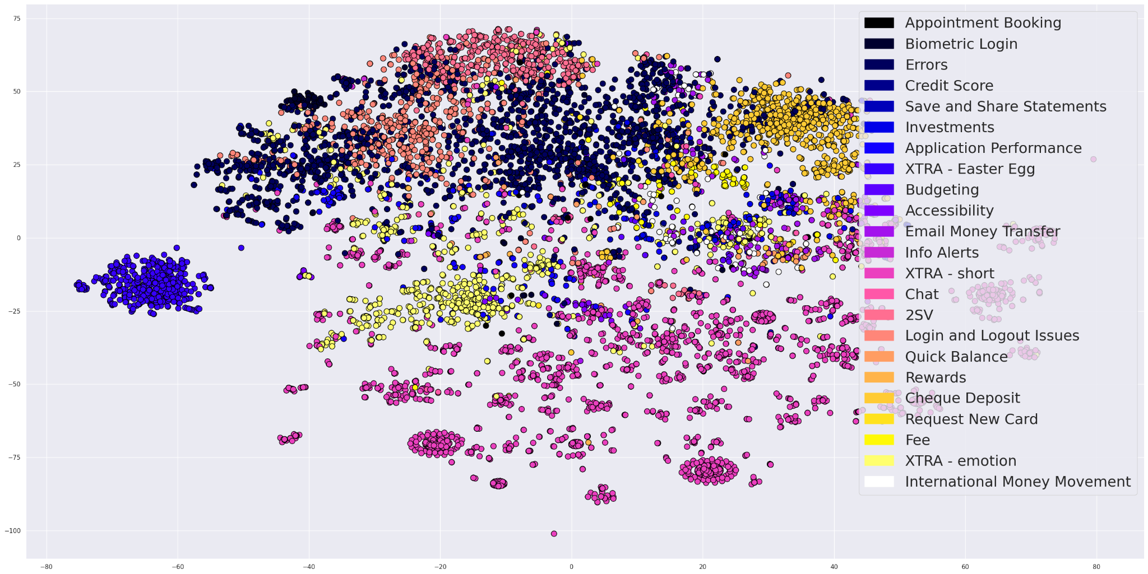
Scotiabank
New Chat
How can we rank the reviews by topic?
Introduction
Team Alpha
Easter Eggs
You can embed the topic, and then compare it to the review’s embedding. The higher the similarity score, the more likely the review is of that topic. To obtain labeled training data, you can generate sample reviews by giving ChatGPT the topic description from the data dictionary.
Topic Ranks
User Needs
Improvements
Suggestions
Conclusion
Clear conversations
Light Mode
OpenAI Discord
Regenerate response
Updates and FAQ
Log out
ChatGPT Jan 9 Version. Free Research Preview. Our goal is to make AI systems more natural and safe to interact with. Your feedback will help us improve.

Slide 4
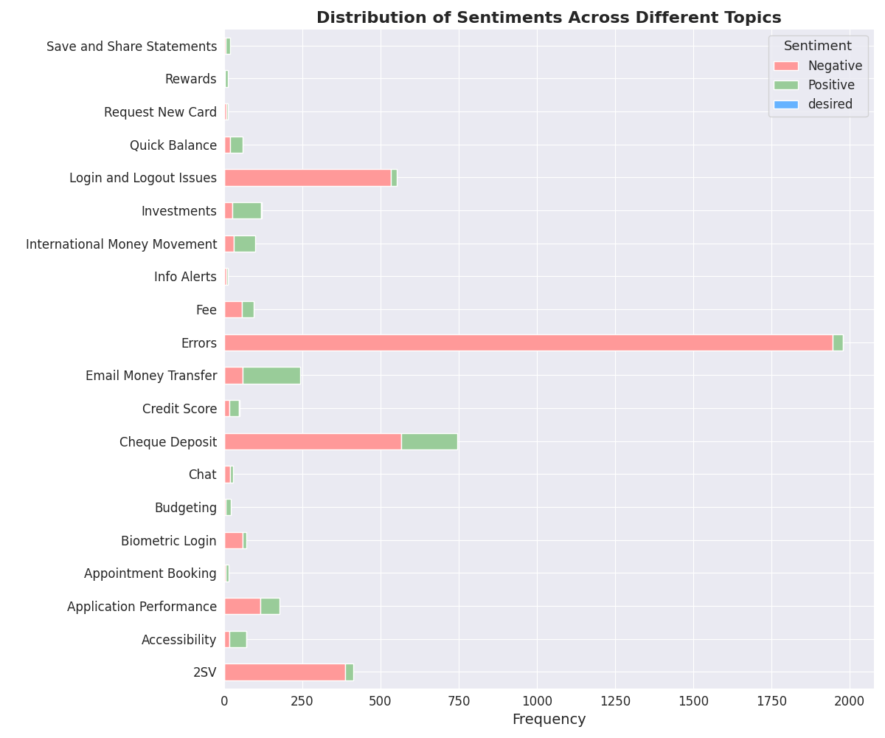
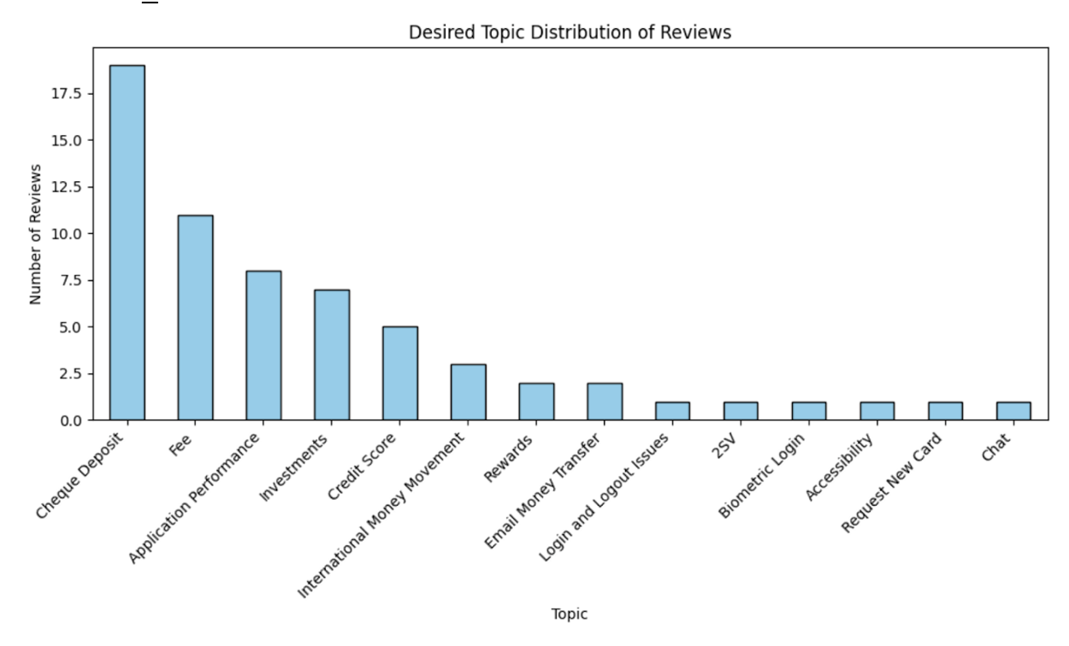
Scotiabank
New Chat
We want to understand the sentiment and desires of our customers.
Introduction
Team Alpha
Easter Eggs
You can obtain the reviews’ sentiment by processing them through SetFit, or an open source LLM like Mixtral8x7B. Then you can plot the positive to negative ratio per category. To understand the desires, you can use few-shot learning method along with SetFit to find reviews where customers mentioned their needs and desires and then select topics sorted by likes.
Topic Ranks
User Needs
Improvements
Suggestions
Conclusion
Clear conversations
Light Mode
OpenAI Discord
Updates and FAQ
Log out
ChatGPT Jan 9 Version. Free Research Preview. Our goal is to make AI systems more natural and safe to interact with. Your feedback will help us improve.

Slide 5
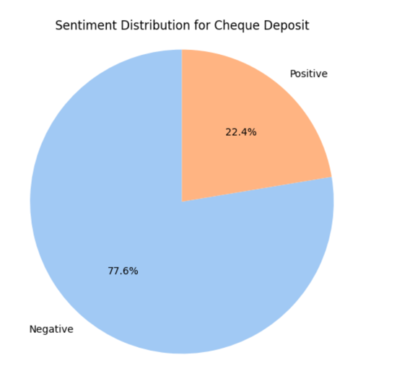
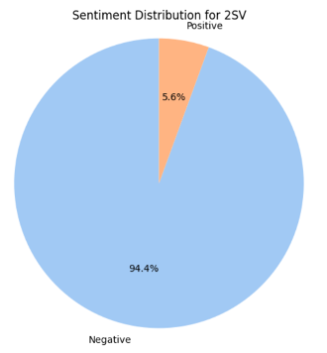
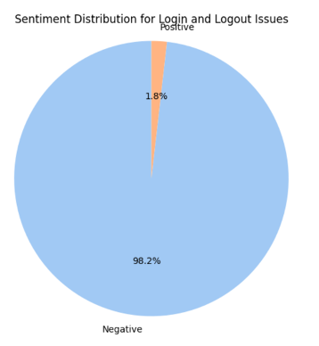
Scotiabank
New Chat
Ok whatever, just show me the results already!
Introduction
Team Alpha
Easter Eggs
For each category, you can rank the reviews by sentiment and number of likes to see which category the largest number of dissatisfied customers comes from.
It turns out these problems are app errors, cheque deposits, login issues, and Two Factor Authentication. Together these issues make up over 90% of the negative reviews, so focusing on fixing them would clear away a majority of customer complaints.
Topic Ranks
User Needs
Improvements
Suggestions
Conclusion
Clear conversations
Light Mode
OpenAI Discord
Regenerate response
Updates and FAQ
Log out
ChatGPT Jan 9 Version. Free Research Preview. Our goal is to make AI systems more natural and safe to interact with. Your feedback will help us improve.

Slide 6
Scotiabank
New Chat
What suggestions can you make to improve the client experience?
Introduction
Team Alpha
Easter Eggs
One option would be to implement a Voice Assistance feature. This will allow customers who have trouble navigating the app to do so with their voice, overcoming accessibility issues.
Additionally, a team focusing on system implementation to make sure that cheques are processed quickly will be another major achievement. Since “Error” is the most common category complaint, investing in a strong software development and testing team will quickly provide return on investment when customers do not have to face a struggle to accomplish their banking tasks.
Topic Ranks
User Needs
Improvements
Suggestions
Conclusion
Clear conversations
Light Mode
OpenAI Discord
Regenerate response
Updates and FAQ
Log out
ChatGPT Jan 9 Version. Free Research Preview. Our goal is to make AI systems more natural and safe to interact with. Your feedback will help us improve.

Slide 7
Scotiabank
New Chat
Thank you for your input!
Introduction
Team Alpha
Easter Eggs
No problem, if you have any more questions, please let me know!
Topic Ranks
User Needs
Improvements
Suggestions
Conclusion
Clear conversations
Light Mode
OpenAI Discord
Regenerate response
Updates and FAQ
Log out
ChatGPT Jan 9 Version. Free Research Preview. Our goal is to make AI systems more natural and safe to interact with. Your feedback will help us improve.

