Slide 1
Data Mining andMachine Learning Linear Regression
Dr. Edgar Acuña
http://academic.uprm.edu/eacuna
UNIVERSIDAD DE PUERTO RICO
RECINTO UNIVERSITARIO DE MAYAGUEZ

Slide 2
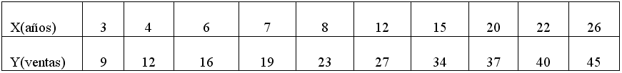
Example 1
A car dealer wants to predict car sales according to the year of experience of his salesmen. The following data represent years of experience of ten salesman (X) and the number of cars per year sold for them (Y).
Solution:
First, we draw a scatterplot to check linearity.

Slide 3
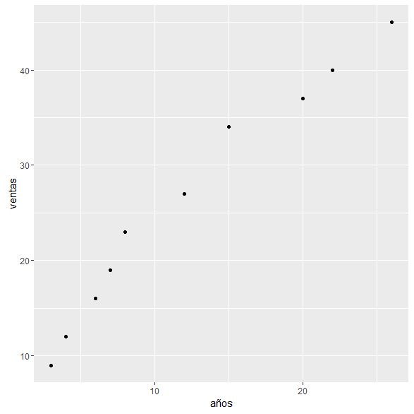
We can notice that there is a very good linear trend to represent the relationship between the two variables. Furthermore, when years of experience increases the sales tends to increase

Slide 4
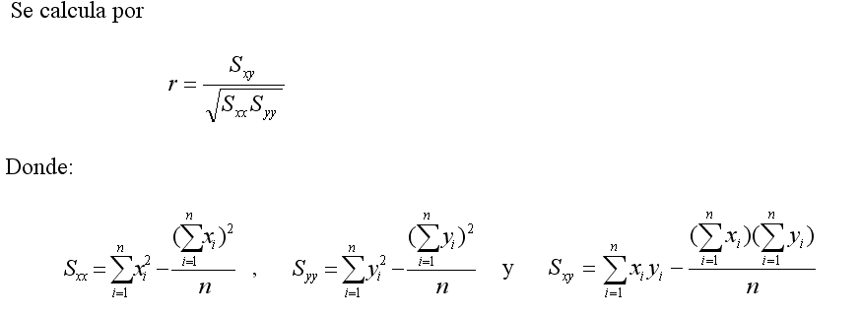
2 The Correlation coefficient
Also, it is known as the Pearson correlation coeffcient. It is represented by r and it measures the degree of linera association between two continuous atributes X and Y . It is computed as:
Both, S_{xx} and S_{yy} can not be negative, but S_{xy} could be either negative or positive.

Slide 5
The correlation assumes values between -1 and 1.
In most cases, a correlation greater than .75 or less than -.75 is considered good enough. On the other hand a correlation value between -.3 y .3 is considered low.
If the correlation is positive then when X increases also Y tends to increase.
If the correlation is negative the when X increases it is expected that Y decreases.

Slide 6
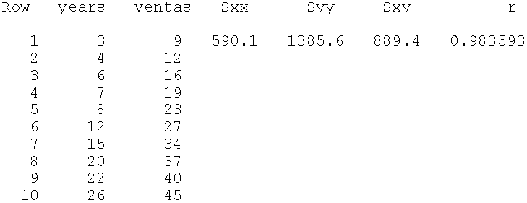
Example (cont)
En Python, the correlation coefficient can be found using several modules.
stats.pearsonr(years,ventas) #scipy
df.corr()["years"]["ventas"] #Pandas
np.corcoeff(years,ventas) #numpy
.983593
Interpretation: There is a very good linear relationship between years of experience of the salesman and the number of cars sold by him. Furthermore, to more year of experience of the salesman more cars he will sell. Years of experience can be used to predict sales through a linear equation.

Slide 7
Correlation values for several scatterplots

Slide 8
Effect of outliers in the correlation coefficient

Slide 9
Example 2 http://academic.uprm.edu/eacuna/casas.txt
Casa área(pies²) precio
1 3060 179000
2 1600 126500
3 2000 134500
4 1300 125000
5 2000 142000
6 1956 164000
7 2400 146000
8 1200 129000
9 1800 135000
10 1248 118500
11 2025 160000
12 1800 152000
13 1100 122500
14 3000 220000
15 2000 141000

Slide 10
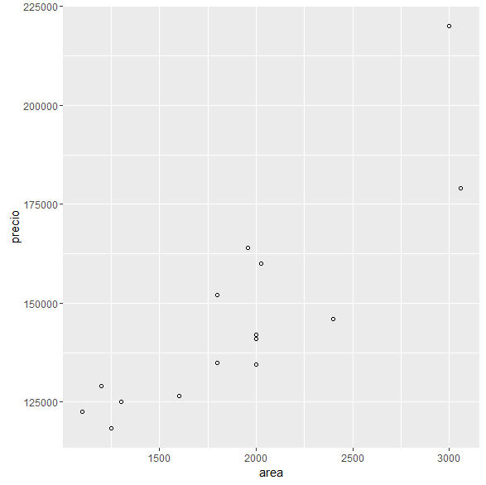
cor(area,precio)
[1] 0.8581799

Slide 11
Simple Linear Regression
The simple lineal regression model is given by:
where, Y is the dependent or response variable,
X is the independent or predictor variable,
α is the y-intercept of the regression line,
β is the slope of the regression line, and
ε is a random error, which it is supposed to have mean 0 and constant variancete σ².

Slide 12
Estimation of the Regression Line
The linear regression model is estimated by solving the equation
The estimate of α and the estimate of β are found using the least squares technique, which is based on minimizing the error sum of squares.
Q(α,β) =
and it is obtained

Slide 13
Estimated linear regression for example 1
result = sm.ols(formula="ventas ~ years", data=df).fit()
print result.params
print result.summary()
Intercept 7.661413
years 1.507202
OLS Regression Results ============================================================================== Dep. Variable: ventas R-squared: 0.967
Model: OLS Adj. R-squared: 0.963
Method: Least Squares F-statistic: 237.8
Date: Wed, 24 Oct 2018 Prob (F-statistic): 3.11e-07
Time: 21:07:51 Log-Likelihood: -21.720
No. Observations: 10 AIC: 47.44
Df Residuals: 8 BIC: 48.05
============================================================================== coef std err t P>|t| [0.025 0.975] ------------------------------------------------------------
Intercept 7.6614 1.417 5.405 0.001 4.393 10.930
years 1.5072 0.098 15.421 0.000 1.282 1.733

Slide 14
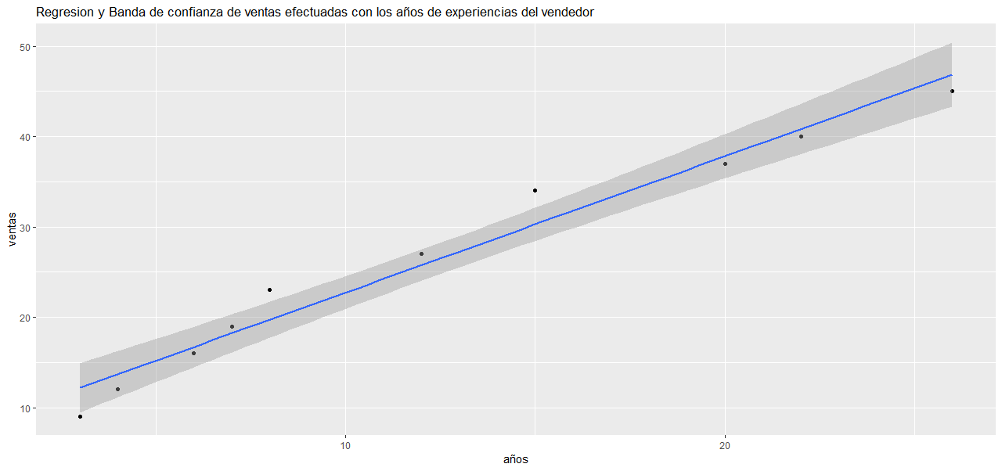
This plot can be obtained with plotnine or seaborn

Slide 15
Estimated linear regression for example 2
result = sm.ols(formula="precio ~ area", data=df).fit()
print result.params
print result.summary()
Intercept 73167.748381
area 38.523071
OLS Regression Results ==============================================================================
Dep. Variable: precio R-squared: 0.736
Model: OLS Adj. R-squared: 0.716
Method: Least Squares F-statistic: 36.33
Date: Wed, 24 Oct 2018 Prob (F-statistic): 4.25e-05
Time: 21:09:58 Log-Likelihood: -163.54 No.
Observations: 15 AIC: 331.1
Df Residuals: 13 BIC: 332.5
========================================================================
coef std err t P>|t| [0.025 0.975] ---
Intercept 7.317e+04 1.27e+04 5.773 0.000 4.58e+04 1.01e+05
area 38.5231 6.391 6.028 0.000 24.716 52.330

Slide 16
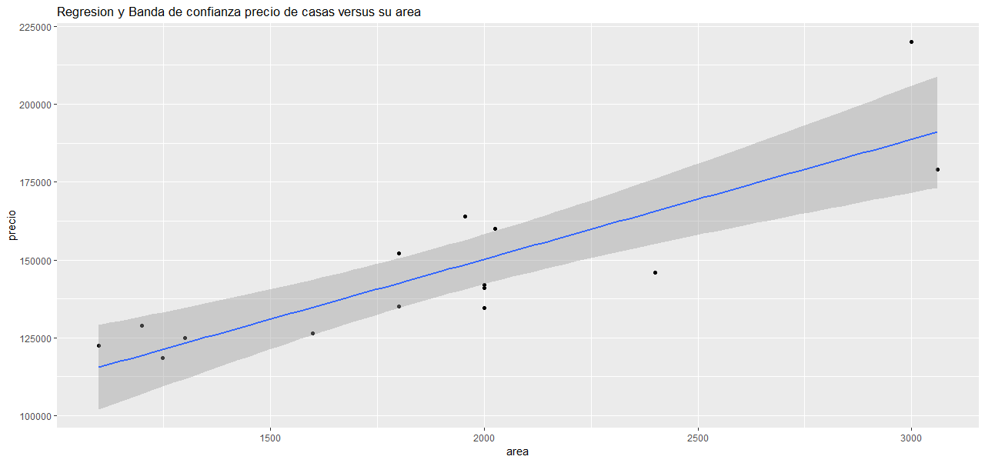

Slide 17
Interpretation of the regression coefficients
Interpretation of intercept :
It means the average value of the response variable Y when X is zero. If one knows for sure that the predictor X can not assume a 0 value then it does not make sense to interpret the intercept.
In example 2, = 73,168 would mean that the average price of houses without is 73,158, something really unreasonable.
Interpretation of slope :
It means the expected change in the response variable Y when the predictor X increases in one unit.
In example 2, = 38.5 means that for each additional feet square of área the price of the house it is expected to increase in 38.5 dollars.

Slide 18
Inference in lineal Regression
Inference about the regression coefficients
The most frequent hypothesis testing are, Ho: α = 0 versus Ha: α ≠ 0 and
Ho: β = 0 versus Ha: β ≠ 0.
The statistical test for the slope is given by:
y
This test has a t distribution with n-2 degrees of freedom.

Slide 19
The module statsmodels gives the value of the statistical t-test and its respective p-value. A p-value near to 0, say less than 0.05, leads us to reject the null hypothesis.
If the null hypothesis is rejected it means that somehow the variable X is important to predict the value of Y using a regression line. But, if the null hypothesis si not rejected then one concludes that the variable X can not be used to predict Y using a regression line.
In the example 2 the value of the statistical t test for the slope is 6.028 and its P-value = .0000 then the conclusion is to reject the null hypotesis. There is sufficient statistical evidence to conclude that the variable area of the house can be used to predict its price.

Slide 20
The Determination Coefficient
It is measure of goodness of fit for the estimated regression model.
where,
SSR represents the sum of squares due to regression
SST represents the total sum of squares.
Notice that the Determination coefficient is the square of the correlation coefficient.
The Determination coefficient varies between 0 and 1, although is very common to express it in percentage. A R² greater than 70 % indicates a good linear association between the two variables, and the X variable can be used to predict Y. Also, R² indicates which percentage of the total variation of the response variable Y is explained by its linear relationship with X.
In the example 2, R²=73.6, this means that 73.6% of the variability of the home prices is explained by its linear relationship with the its área. The variable área may be used to predict the predict the Price of a house.

Slide 21
Multiple Linear Regression
The multiple linear regression model with p predictor variables X₁,…X_{p}, is given by
The constants β_{o}, β₁ β₂…. β_{p} , are called regression coefficients and they are estimated by the least squares method using a training dataset of n observations of the form:
, for . The term ε_{i} is a random variable with mean 0 and variance .
Among the Python’ modules for linear regression are: Statsmodels, el submodule linear_model from sklearn includes Linear regression and tensorflow includes linear regression using the Gradient Descent method to minimize the Sum of Squares Error.

Slide 22
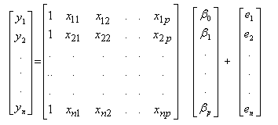
The multiple linear regression model
In matrix form :

Slide 23
Interpretación del coeficiente de regresión estimado β_{j}
The estimated of the poblacional regression coefficient, b_{j}, for is represented by β_{j}. This estimated indicates the expected change in the response variable Y when the predictor variable X_{j} changes in one additional unit assuming that the other predictors remain constant.

Slide 24
Example
Consider the millaje dataset, where the response variable is
Y= (MPG) miles per galon of a car, and the predictor variables are:
X₁=(VOL): volume,
X₂=(HP): horsepower,
X₃= (SP) :maximum speed and,
X₄=(WT): weight.
The data is available at academic.uprm.edu/eacuna/millaje.txt.

Slide 25
Matrix plot

Slide 26
Least Squares estimation of the parameter vector β
The error sum of squares must be minimized
Derivating Q with respect to β and equating to zero, the following system of normal equations is obtained
Solving for β the following vector of estimated coefficients is obtained

Slide 27
Least Squares estimation of the parameter vector β (2)
regall=smf.ols(formula='mpg~sp+wt+vol+hp',data=data1).fit()
print regall.summary()
==================================================
Dep. Variable: mpg R-squared: 0.873
Model: OLS Adj. R-squared: 0.867
Method: Least Squares F-statistic: 132.7
Date: Mon, 19 Mar 2018 Prob (F-statistic): 9.98e-34
Time: 12:57:26 Log-Likelihood: -220.00
No.Observations: 82 AIC: 450.0
Df Residuals: 77 BIC: 462.0
==============================================================================
coef std err t P>|t| [0.025 0.975]
Intercept 192.4378 23.532 8.178 0.000 145.580 239.295
Sp -1.2948 0.245 -5.290 0.000 -1.782 -0.807
wt -1.8598 0.213 -8.717 0.000 -2.285 -1.435
vol -0.0156 0.023 -0.685 0.495 -0.061 0.030
hp 0.3922 0.081 4.818 0.000 0.230 0.554

Slide 28
Interpretation of the estimated vector of parameters β
The estimated regression model for the mpg data is the following:
MPG = 192 - 1.29 SP - 1.85 WT -0.01 VOL + 0.39 HP
Interpretation of the coefficients:
B1=-1.29 means that if the máximum speed increases in one m/h then it is expected that the mpg decreases in 1.29, assuming that the other variables remain constant.
B2=-1.85 means that if the car’s weight invreases in one unit (100 lb) then it is expected that the mpg decreases in 1.85, assuming that the other variables remain constant.
B3=-.01 means that if the interior volumen of the car increases in one feet cubic then it is expected that the mpg decreases in 1.85 assuming that the other variables remain constant.
B4=0.39 means that if the horsepower increases in one unit then it is expected that the mpg increases in 0.39, assuming that the other variables remain constant.

Slide 29
Prediction
#Predicting the mpg for a car with sp=100, wt=20, vol=100 and hp=50
pred=regall.predict(pd.DataFrame({'sp': [100], 'wt':[20], 'vol': [100], 'hp': [50]}))
print “The predicted mpg is:",pred[0]
The predicted mpg is: 43.8059456465

Slide 30
Inference in multiple linear Regression
It includes:
Hypothesis testing and confidence intervals about the coefficients of the population regression model.
Confidence Interval for predictions made with the model

Slide 31
Hypothesis testing about regression coefficients
Ho: β_{i} = 0 ( i=1,2,..,p),
Ha: β_{i} ≠ 0;
The statistical test is a t test:
which has a t distribution with (n-p-1) df.
where, C_{ii} is the i-th element in the diagonal of (X’X)⁻¹.
Statmodels gives the “P-value” for the t-test. When the P-value is <0.05 Ho is rejected.

Slide 32
Hypotesis for millaje
coef std err t P>|t| [0.025 0.975]
Intercept 192.4378 23.532 8.178 0.000 145.580 239.295
Sp -1.2948 0.245 -5.290 0.000 -1.782 -0.807
wt -1.8598 0.213 -8.717 0.000 -2.285 -1.435
vol -0.0156 0.023 -0.685 0.495 -0.061 0.030
hp 0.3922 0.081 4.818 0.000 0.230 0.554
According to the above table all the predictors but vol are significant since their p-value is 0.000 less than .05

Slide 33
Feature selection in Multiple Linear Regression
Backward Elimination
Forward Selection
Stepwise

Slide 34
Backward Elimination method
At the initial step all the predictors are included in the model, and in each step the variable less important is eliminated from the model. The importance of the variable is determined according to several criteria. For instance, the variable which p-value is the highest is the less important one. Also, one can look at the value of the t-tests.
A variable which is eliminated from the model can not be considered anymore.
The process ends when all the variables have p-values less than .05. This is the same that to have all the t-tests greater than 2 in absolute value.
Statmodels uses instead of the t-test the Akaike’s Information criterion (AIC).

Slide 35
The AIC criterion
Akaike’s Information Criterion (Akaike, 1973) uses concepts of information theory. It is based on the minimization of the Kullback-Leibler distance between the distribution of the response variable Y under the reduced model and under the full model.
The AIC is calculated as:
AIC= n*log[SSE_{p}/n]+2p (1)
where n, is the number of observations, p is the number of parameters in the model, and SSE is the error sum of sqaures of the regression model.
There are other versions of the formula (1).
The best model is the one with the lowest AIC.

Slide 36
Example. The dataset grasa contains 13 variables to predict the percentage of body fat
Columna Nombre
v1 grasa (% de grasa )
v2 edad (en años)
v3 peso (en libras)
v4 altura (en pulgadas)
v5 cuello (en cms)
v6 pecho (en cms)
v7 abdomen (en cms)
v8 cadera (en cms)
v9 muslo (en cms)
v10 rodilla (en cms)
v11 tobillo (en cms)
v12 biceps (en cms)
v13 antebrazo (en cms)
v14 muñeca (en cms)
The measurements were taken in 252 subjects
The data is available at http://academic.uprm.edu/eacuna/grasa.txt

Slide 37
model=backward_elimination(data2,"grasa")
print model
AIC including all the features
1464.50237446
Feature considered for elimination in this step: rodilla
AIC 1462.50659712
Feature considered for elimination in this step: pecho
AIC= 1460.57130604
Feature considered for elimination in this step: altura
AIC= 1459.06626108
Feature considered for elimination in this step: tobillo
AIC= 1457.82217075
Feature considered for elimination in this step: biceps
AIC= 1456.99638198
Feature considered for elimination in this step: cadera
best AIC: 1456.99638198
Best Features: ['edad', 'peso', 'cuello', 'abdomen', 'cadera', 'muslo', 'antebrazo', 'muneca'] grasa ~ edad + peso + cuello + abdomen + cadera + muslo + antebrazo + muneca + 1

Slide 38
Interpretation: The best model is:
backbest=smf.ols(formula='grasa ~ edad + peso + cuello + abdomen + cadera + muslo + antebrazo + muneca',data=data2).fit()
print backbest.params
Intercept -22.656373 edad 0.065780 peso -0.089853 cuello -0.466558 abdomen 0.944815 cadera -0.195435 muslo 0.302392 antebrazo 0.515721 muneca -1.536652
print ‘R2= ', backbest.rsquared
R2= 0.746554022383
The best nodel has a R² equals to 74.66,whereas the full model using the 13 predictors has a R² = 74.90%. A 0.24% of prediction power has been lost, however the best model has only 8 predictors. Therefore the second model is more convenient.

Slide 39
Forward Selection
At the initial step, the single best variable is the one having the highest correlation with the response variable.
At the second step, it is included the variable that along with the first one improves a metric such as the R-saquared or the AIC. The process continues until the metric can not to be improved.
Notice that one variable that is elected can not be excluded from the model in a later step.

Slide 40
Example (cont). En el primer paso se halla la regresión simple con la variable predictora más altamente correlacionada con la variable de respuesta. En este caso, es abdomen que tiene correlación 0.803 con grasa.
La segunda variable que entra al modelo es peso porque es aquella con el valor de t más grande en valor absoluto entre las doce variables que aún no estaban incluidas.

Slide 41
model=forward_aic_selection(data2,"grasa")
print model.model.formula
print model.aic
1515.79033747 abdomen
1471.18477769 peso
1465.04121338 muneca
1460.219691 antebrazo
1459.44186161 cuello
1458.80625316 edad
1457.05383331 muslo
1456.99638198 cadera
1457.82217075 biceps
grasa ~ abdomen + peso + muneca + antebrazo + cuello + edad + muslo + cadera + 1 1456.99638198

Slide 42
Stepwise
Es una modificación del método “Forward”, donde una variable que ha sido incluida en el modelo en un paso previo puede ser eliminada posteriormente.
En cada paso se cotejan si todas las variables que están en el modelo deben permanecer alli. La mayoría de las veces, pero no siempre, los tres métodos dan el mismo resultado para el mejor modelo de regresión.

