Slide 1

Sanghvi Institute of Management and Science Rau , Indore(M.P.)
Department of Computer Science and Engineering
Presentation on : Socializer
Submitted To:
Mr. Jaynam Sanghvi
Lecturer, CSE Dept.
Submitted By:
Amber Pandit 0837CS111006
Amesh Karodiya 0837CS111007
Juzar Ali 0837CS111026
Mohammad Hussain 0837CS111031

Slide 2
Let’s roll back to history

Slide 3


Slide 4

Facemash was not a success because of Legal problems, that’s how Facebook was created in 2004
On January 2008, Facebook was ranked as the most used social networking service.

Slide 5
23% of Facebook user’s check their account more than 5 times a day
1 out of every 7 minutes spent online is on Facebook

Slide 6


Slide 7

Twitter was created in March 2006 by Jack Dorsey, Evan Williams, Biz Stone and Noah Glass and by July 2006, the site was launched.
Twitter is now one of the ten most-visited websites, and has been described as "the SMS of the Internet.

Slide 8
Barack Obama’s victory was the most re tweeted tweet
Number of Lady Gaga follower on Twitter is equal to the population of four New York Cities
60% of Twitter users access it from mobile.

Slide 9


Slide 10

Goggle plus is a social networking and identity services. On September 20, 2011
There is a 5000 maximum friend limit on every Google+ profile.
On average users spend 12 minutes a day in the stream

Slide 11
The Google+ Hangouts work with Google Translate to make multi-language communication possible instantly.
29% Google+ users are engineers by profession.

Slide 12

How many of you are on Facebook ,
Twitter, and Google plus?

Slide 13
Have you installed all of these apps?

Slide 14

How many of you have a
SMARTPHONE?

Slide 15
Main problem of old Smartphone's
less storage memory
Low RAM
Low processor
Get hanged frequently
Can Install limited no. of apps

Slide 16
Most of the users don’t install these apps .
Reasons are:

Slide 17
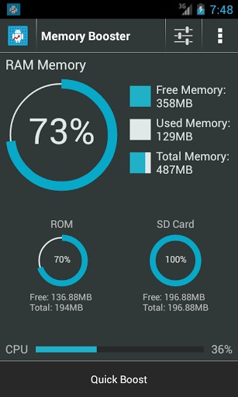
User can't install these applications because of the low memory of their device.

Slide 18
What if you have sufficient memory????
You may install but
Require more RAM
It will consume more resources.
Waste of time.
frequently Switching between apps.
May result in slow performance of device.

Slide 19
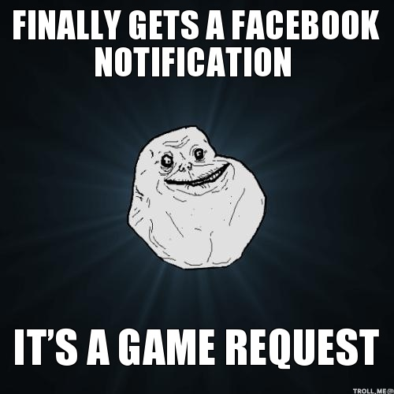

Slide 20

Secondly many users don’t want to use other facilities such as chatting, unwanted notifications, and game request etc.

Slide 21

and Just feel like to……

Slide 22
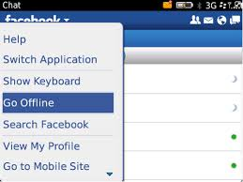
Only option they have to do is….

Slide 23
Problem domain:
The main problem that persists for a user who wish to check only the newsfeeds of these sites ,User have to install all these apps.
laid to wastage of the memory ,resources ,tremendous waste of time & slower the phone performance .
User have to switch over these app to get news feed from these social networks.

Slide 24
Why only
Facebook,
Twitter
& Google+?

Slide 25
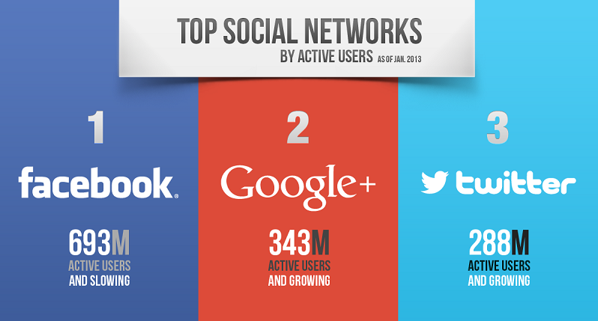
There are millions of users who use this sites.

Slide 26
Major points of variations
Sharing Data
Shared Content Visibility
Social graph

Slide 27
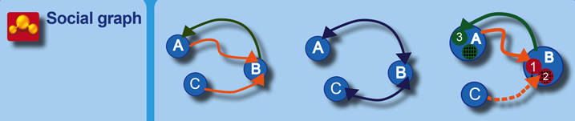

Slide 28
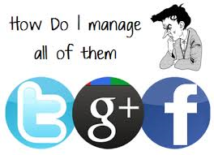

Slide 29
Solution is Here

Slide 30
socializer

Slide 31
What is socializer?
Socializer is an android application

Slide 32
What it will do?
Integrates
Facebook, Twitter
& Google plus

Slide 33
& There is No
annoying Candy crush saga requests
Unwanted notifications
Chat Pop-up
No need to switch among apps

Slide 34
Solution Domain
- In this project we have collected all the social network site’s news feed through a procedure called API
We will feed all these social feed in one platform
User have to once install the app & provide account log in information related to his/her accounts.

Slide 35
And all your social feeds
are Here

Slide 36
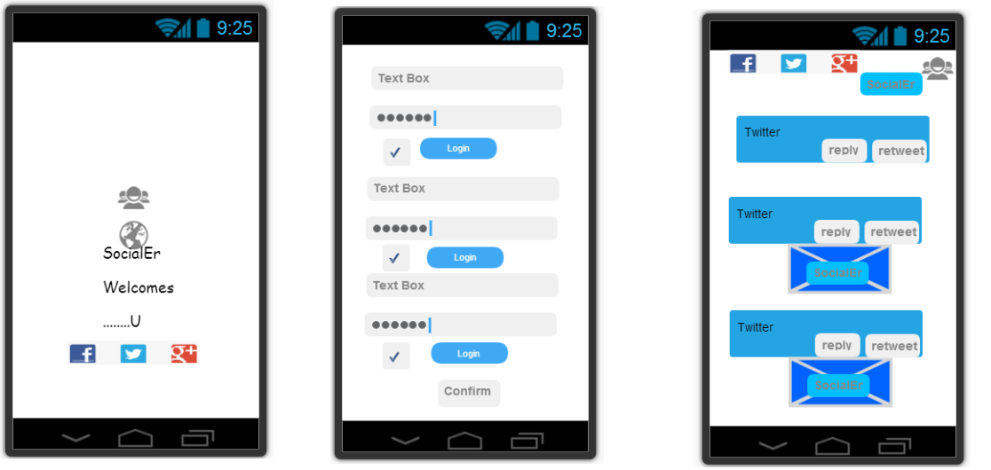
Expected outcomes
In this app we have brought all main social networking sites at one place.

Slide 37
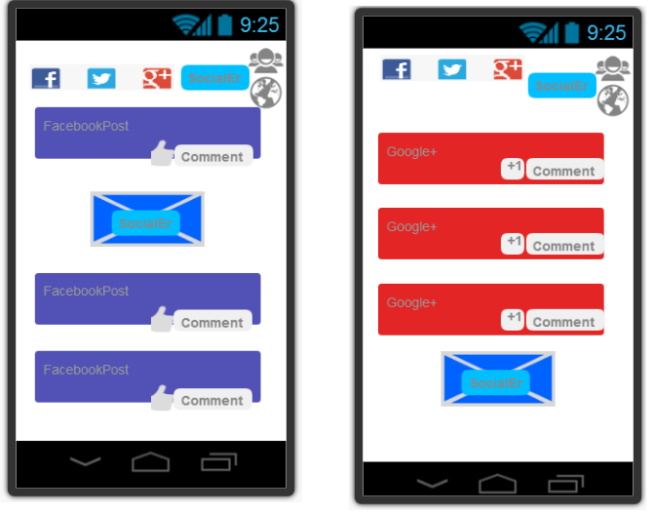
Expected outcomes

Slide 38
Queries
or
suggestions…

Slide 39
Credits:
team socializer

