Slide 1

Sanghvi Institute of Management and Science Rau , Indore(M.P.)
Department of Computer Science and Engineering
Presentation on : Socializer
Submitted To:
Mr. Jaynam Sanghvi
Lecturer, CSE Dept.
Submitted By:
Amber Pandit 0837CS111006
Amesh Karodiya 0837CS111007
Juzar Ali 0837CS111026
Mohammad Hussain 0837CS111031

Slide 2
Evolution of idea
Researched to find a unique idea
How we got the idea
Selection of platform to implement

Slide 3
General Overview
General talks
Explanation of UML diagram

Slide 4
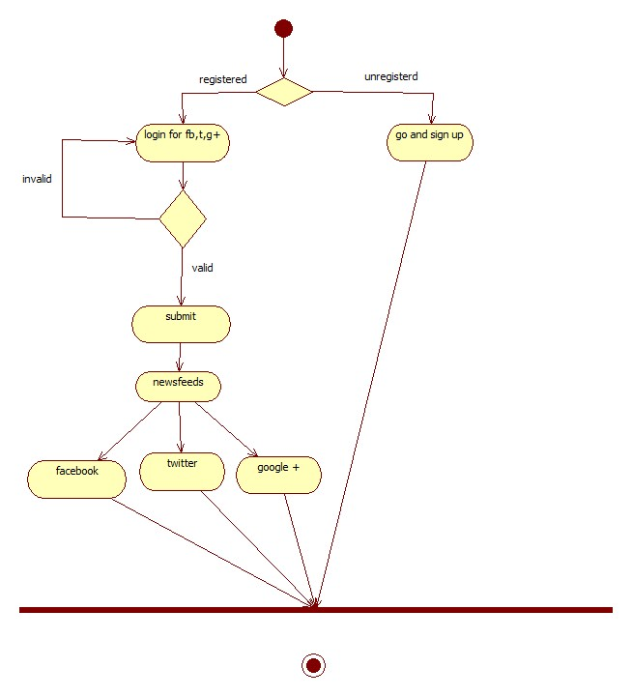

Slide 5
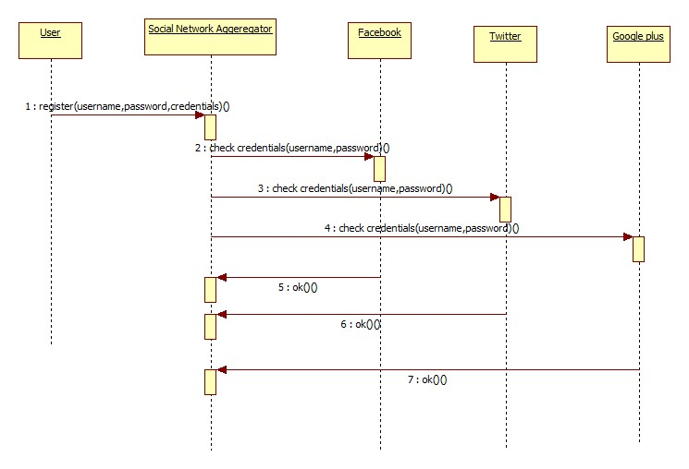

Slide 6
Implementation
Main mechanism
User Interface

Slide 7
Main mechanism
Main Activity
Three fragment activities corresponding to Facebook ,Twitter, Google+.

Slide 8
Main mechanism
In Main Activity broadcast receiver is Used .

Slide 9
Fragment Activities
Each fragment Contains functions to handle Various states of program .
Implementing methods
Setting layout in OnCreate().
OnKeyListener() (“back ”, “Setting” buttons).

Slide 10
Implementing methods
OnPageStarted().
OnRecievedError().
Methods for network state changed(On receive of broadcast receiver ) .

Slide 11
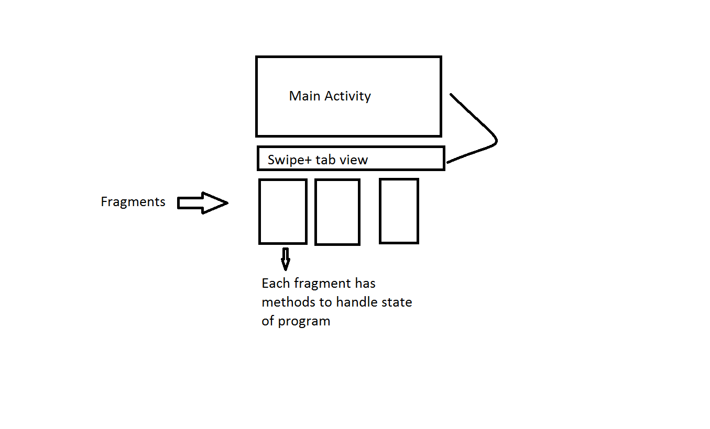

Slide 12
User Interface
Splash Screen Activity
Swipe + tab view(root element)
Initializing the fragment views.
Each fragment loads a https request.

Slide 13
User Interface
If saved state is null loads the login page of corresponding fragment .
Else reload .
Setting button for individual logout.
Progress Bar on fetching user data.

Slide 14
User Interface
Managed Toast notifications.

Slide 15
Survey
Testing

Slide 16
Live Demonstration

Slide 17
Queries??

Slide 18

Thank You
Credits
Team-Socializer

