Slide 1
Efficient Memory Disaggregation with Infiniswap
Juncheng Gu, Youngmoon Lee, Yiwen Zhang,
Mosharaf Chowdhury, Kang G. Shin
University of Michigan
Presented by Eric Newberry, University of Michigan

Slide 2
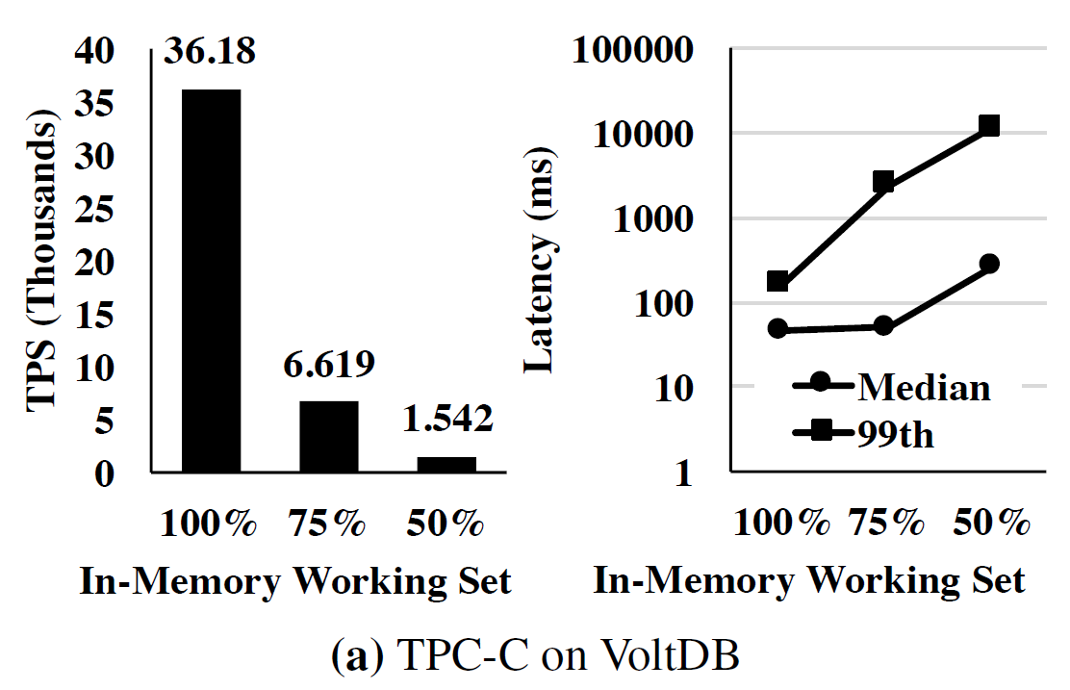
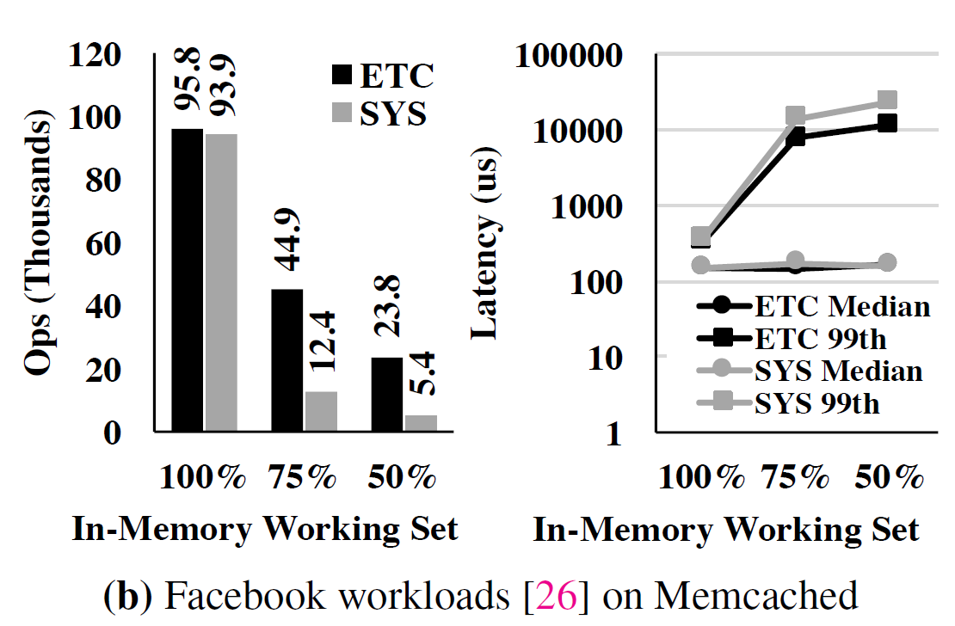
Motivation
Not able to store all pages in physical memory => swap space
However:
Higher tail latencies
Reduced application throughput
J. Gu et al, “Efficient Memory Disaggregation with Infiniswap”
J. Gu et al, “Efficient Memory Disaggregation with Infiniswap”
Notes:
ETC and SYS are two separate benchmarks for Memcached

Slide 3
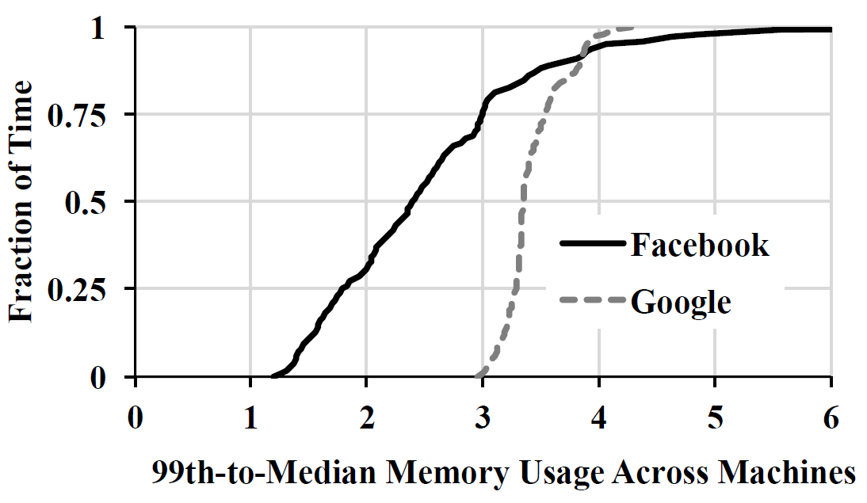
Motivation
Significant memory imbalance present on real clusters
Some machines w/ high memory utilization, some w/ comparatively little
J. Gu et al, “Efficient Memory Disaggregation with Infiniswap”
Notes:
“Causes of imbalance include placement and scheduling constraints [28, 44] and resource fragmentation during packing [47, 76], among others.”
Because average is over 2, this indicates that more often than not, over half of the memory in the cluster was unused

Slide 4
Motivation
Traditional swap devices (e.g, HDDs) are costly
Significant imbalance in memory usage between machines
What if we could use free memory in other machines as swap?

Slide 5
Background: RDMA
Specialized network designed for remote memory applications
Memory accessed directly by NIC, bypassing CPU and OS on both ends
High throughput: 56 Gbps
Low latency: 10 microseconds

Slide 6
Background: Related Work
Remote paging (e.g., Anderson et al, 1994)
Require central coordinator
Require CPU involvement to transfer pages (vs. RDMA)
Resource disaggregation (e.g., Li et al, 2016)
Global address space for cluster (e.g., Carter et al, 1991)
High communication overhead
Solutions to overhead require significant modifications to applications (e.g., Chamberlain et al, 2007)

Slide 7
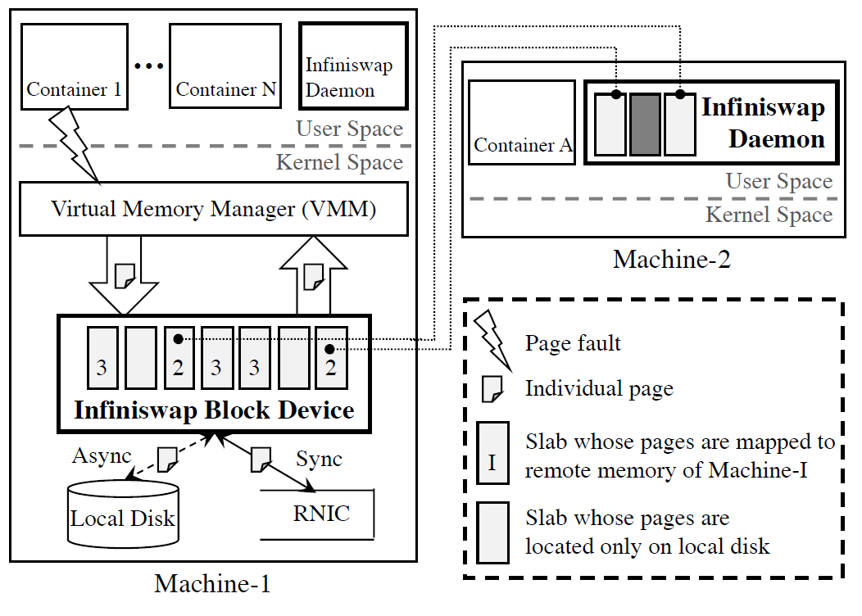
Design: Overview
J. Gu et al, “Efficient Memory Disaggregation with Infiniswap”
Notes:
Entirely decentralized system
Swap space split into slabs of equal size containing pages
All pages in the same slab are paged in/out from/to the same machine
Paged out pages are written synchronously to a remote location and asynchronously to disk

Slide 8
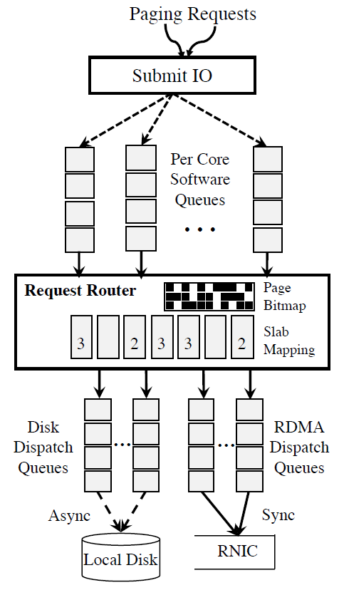
Design: Paging In (Reading)
Requests queued on per-core basis
Requests routed based upon whether mapped/unmapped
If mapped, put in RDMA dispatch queue
Otherwise, put in disk dispatch queue
J. Gu et al, “Efficient Memory Disaggregation with Infiniswap”

Slide 9
Design: Paging Out (Writing)
Requests queued on per-core basis
Requests routed based upon whether mapped/unmapped
If mapped, put in disk and RDMA queues
Otherwise, only put in disk queue
Done (to OS) when RDMA WRITE done
J. Gu et al, “Efficient Memory Disaggregation with Infiniswap”

Slide 10
Design: Batching
VMM often batches page requests => can span multiple slabs
If one slab hot and other cold, wait for all to complete before returning

Slide 11
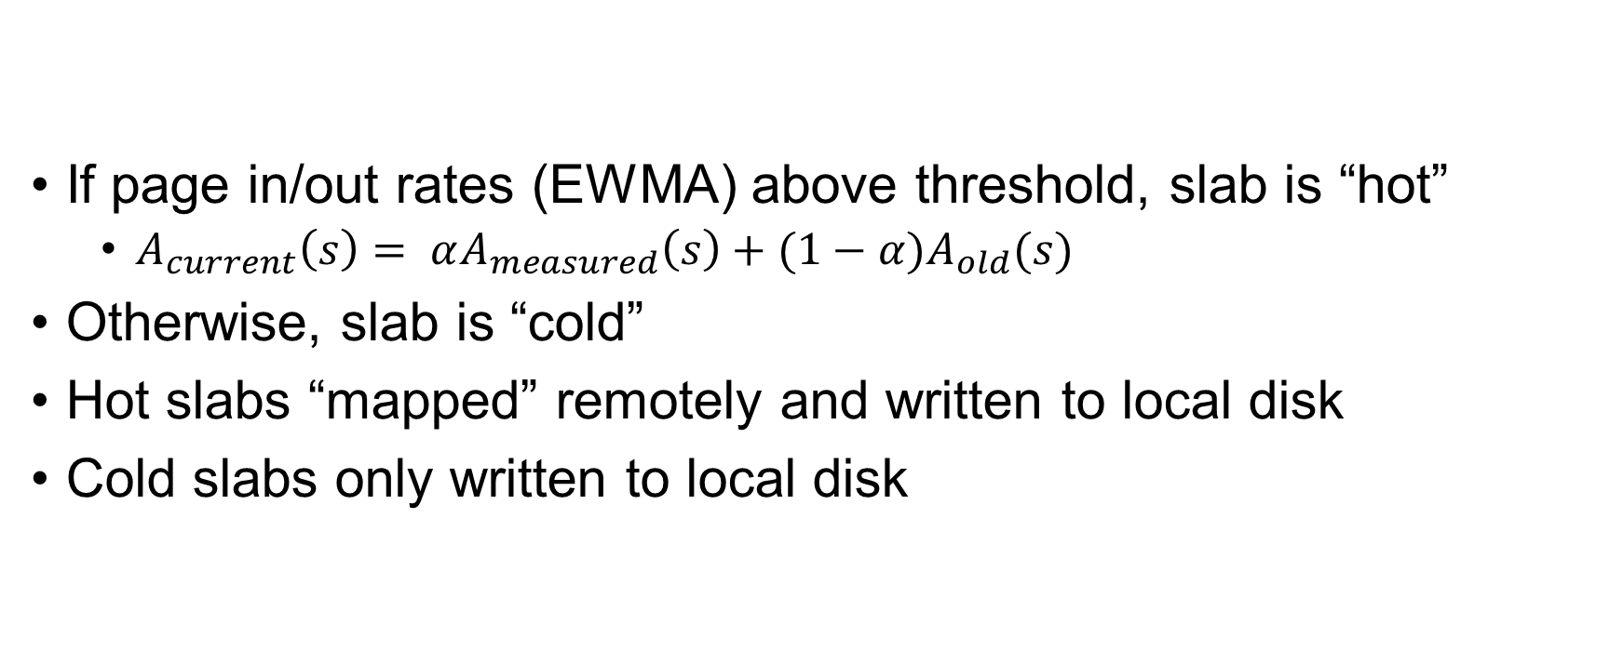
Design: Hot and Cold Slabs
If page in/out rates (EWMA) above threshold, slab is “hot”
$A_{current}\left(s\right)= αA_{measured}\left(s\right)+(1−α)A_{old}(s)$
Otherwise, slab is “cold”
Hot slabs “mapped” remotely and written to local disk
Cold slabs only written to local disk
Notes:
A(s) means total page-in and page-out activities for slab s
Alpha is “smoothing factor” (default 0.2)
Default threshold is 20 page I/Os per second

Slide 12
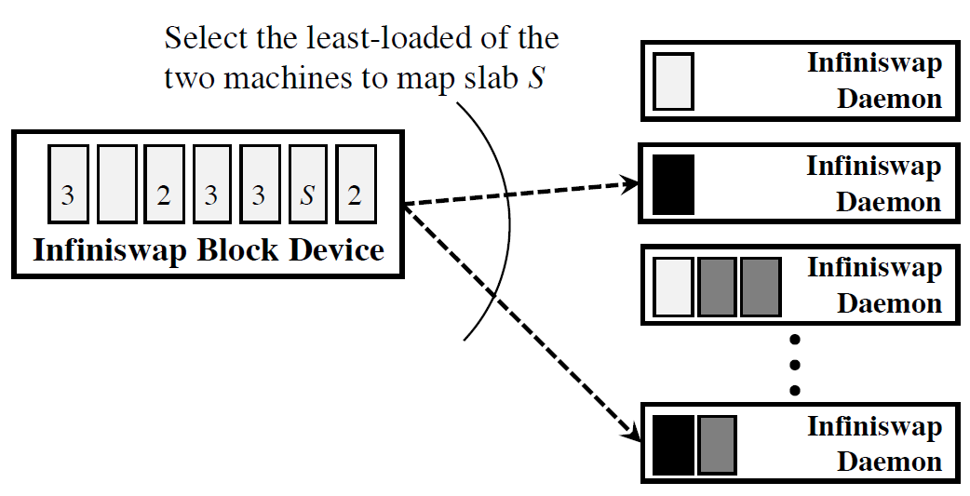
Design: Slab Placement (Mapping)
J. Gu et al, “Efficient Memory Disaggregation with Infiniswap”
Notes:
Goal is to split slabs from same machine across as many remote machines as possible
Pick two machines at random from two sets: those with slab from us and those without, with the latter being preferred. Go with whichever machine has lower memory usage

Slide 13
Design: Managing Local Memory
Keep some “head room” of memory free on local machine
If free memory above head room, claim for remote slabs
When less free than head room, evict remote mapped slabs

Slide 14
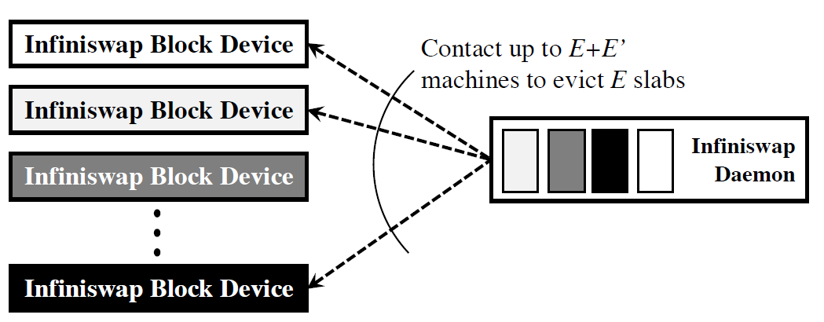
Design: Evicting From Local Memory
J. Gu et al, “Efficient Memory Disaggregation with Infiniswap”
Notes:
Need to evict E slabs. Pick E + E’ machines to contact and evict the slabs with E lowest access frequencies. Send EVICT message to chosen machines and received acknowledgement before actually removing block.
Goal is to evict slabs with low activity when possible

Slide 15
Design: Handling Remote Eviction
Receive EVICT message from remote host
Unmap evicted slab (sending future request to local disk)
After in-flight requests completed, send DONE to remote host
If still above hot threshold, remap slab to new remote host
If now cold, will remain on local disk only

Slide 16
Design: Fault Tolerance
Disconnected machines considered failed
Blocks on disconnected machine unmapped and remapped (if still above hot threshold)
In-progress requests to partially written page handled locally from disk dispatch queue
No current mechanism to treat transient failures differently

Slide 17
Design: Scalability
Entirely decentralized
No need for coordination at a centralized entity
“Power-of-choices” technique used to get good, but not necessarily best, resolution
Without requiring contact with central entity or every other machine in cluster

Slide 18
Implementation
Linux kernel module (version 3.13.0+), ~3500 lines
Block device
Daemon runs in user space
Message passing used for communication b/w components
RDMA READ and WRITE operations used for data plane
Connects are per-device, not per-slab
Both block device and daemon

Slide 19
Evaluation: Experimental Setup
32 node cluster (CloudLab)
32 virtual cores and 64 GB of RAM per machine
RDMA: 56 Gbps Infiniband network
Slab size: 1 GB (32k x 32KB pages)
Hot threshold: 20 paging activities/second
Head room: 8 GB on each machine
Applications run in containers with memory limits set (% of working memory set)

Slide 20
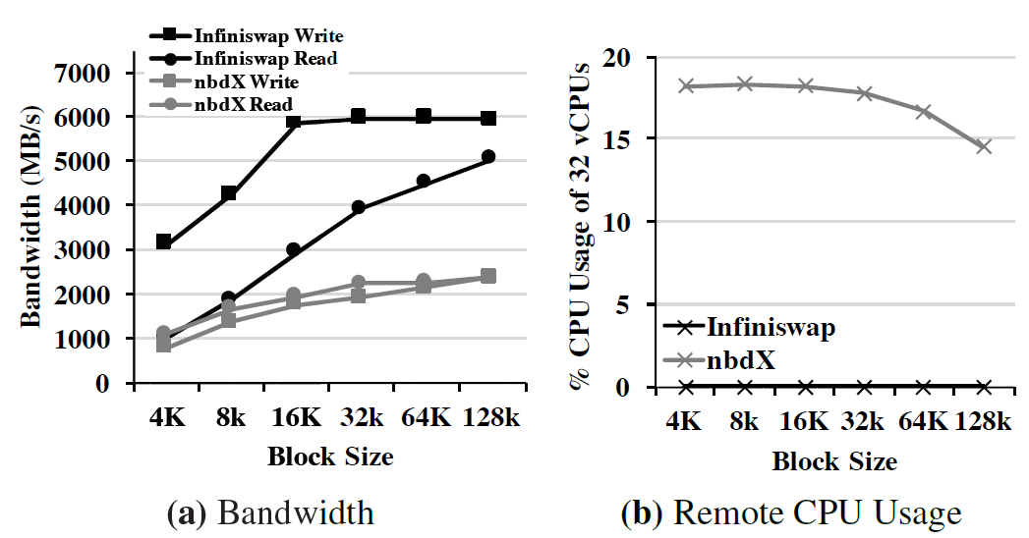
Evaluation: Block Device Performance
J. Gu et al, “Efficient Memory Disaggregation with Infiniswap”
Notes:
When compared with nbdX, another network block device developed by Mellanox, Infiniswap has significantly higher bandwidth at larger block sizes (2 to 4 times) and almost no CPU overhead on remote machines, while nbdX has high CPU usage, often completely utilizing 6 virtual cores. This CPU usage is caused by nbdX’s copying of data to and from RAMdisk, while Infiniswap bypasses the remote CPUs when performing data plane operations.
Because this evaluation is focused on network performance, these results exclude the disk component of Infiniswap.

Slide 21
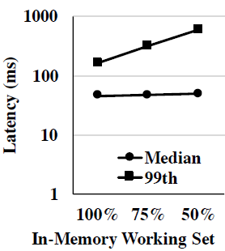
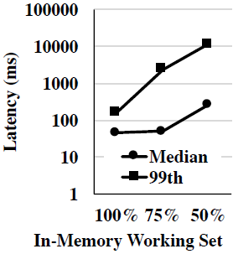
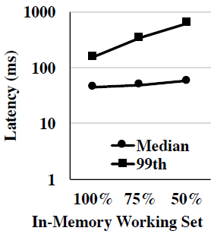
Evaluation: VoltDB
Infiniswap
Disk
nbdX
J. Gu et al, “Efficient Memory Disaggregation with Infiniswap”
Notes:
Single machine performance
In-memory, transactional database (TPC-C used to create transactional workloads)
“Performance […] drops linearly instead of super-linearly” as the percentage of the workload that can fit in memory decreases.
Infiniswap performance still drops significantly because VoltDB is more CPU bound than other applications, leading to more overhead due to context switches and other paging-associated overhead
nbdX performance is similar to Infiniswap for this application

Slide 22
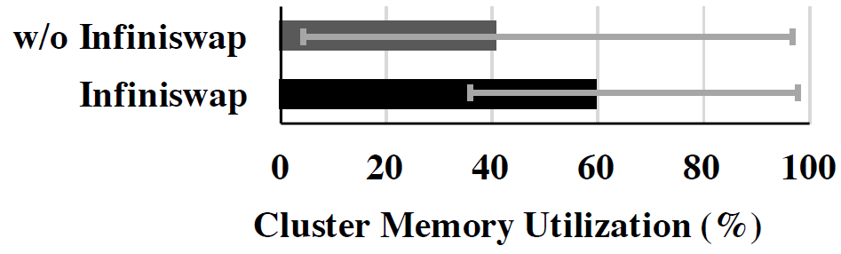
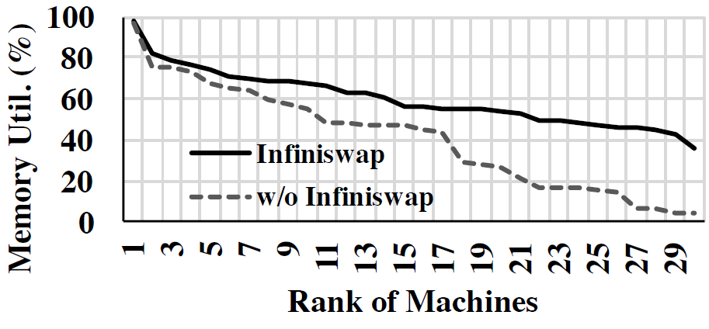
Evaluation: Concurrent Applications
J. Gu et al, “Efficient Memory Disaggregation with Infiniswap”
Notes:
Approx 90 containers running combinations of VoltDB, Memcached, PowerGraph, and GraphX
~50% with 100% config, ~30% with 75% config, remainder at 50% config
Created memory imbalance by placing randomly across machines
Increased cluster memory utilization and balanced memory utilization across machines

Slide 23
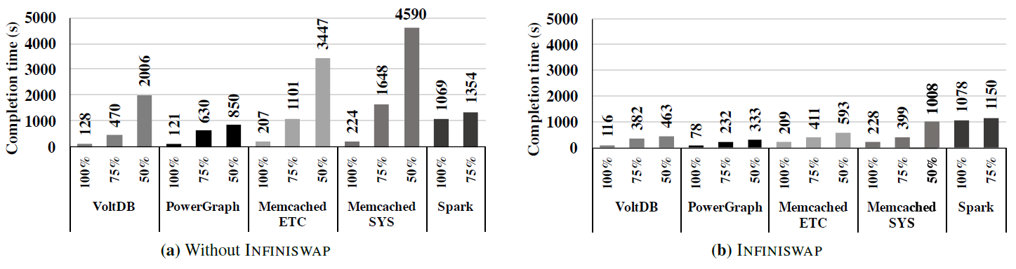
Evaluation: Concurrent Applications
J. Gu et al, “Efficient Memory Disaggregation with Infiniswap”
Notes:
Infiniswap significantly decreased the average completion time of applications running in containers (3-6x in 50% configuration)

Slide 24
Future Work
Determine optimal slab size (overhead vs granularity)
Application-aware designs (e.g., hot and cold database tables)
Limiting to certain applications that require higher performance
Consider performance when combined with other RDMA applications

Slide 25
Conclusion
Infiniswap increases application performance significantly compared to paging to local disk
Can achieve comparable or better results to nbdX
Requires no modifications to applications and is entirely decentralized
Can increase memory utilization of cluster and balance this better between nodes

Slide 26
Accelerating Relational Databases by Leveraging Remote Memory and RDMA
Feng Li, Sudipto Das, Manoj Syamala, Vivek R. Narasayya
Microsoft Research
Presented by Eric Newberry, University of Michigan

Slide 27
Motivation
Memory imbalance between database servers in a cluster
RDMA lets us access and modify memory on remote machines
Can relational databases (RDBMSes) make use of remote memory to improve their workload performance?
Can we do this without requiring significant modifications to existing RDBMSes?

Slide 28
Background: Related Work
Compute to storage transfers via RDMA (e.g., Teradata Aster Big Analytics Appliance)
Network file systems via RDMA (e.g., SMB Direct)
RDMA to transfer shared database pages (e.g., DB2 Purescale by IBM)
RDMA-based key-value (KV) stores (e.g., Jose et al, 2011)

Slide 29
Application: Cache Extension
Cache evicted entries in remote memory
Allows for a second tier of cache

Slide 30
Application: Temporary Data Storage
Queries can generate lots of intermediate data
Existing systems: If can’t fit in memory, spill to file (slow)
Instead, use remote memory (faster)

Slide 31
Application: Semantic Caching
Cache query input and results for use with future queries
Normally part of applications, but abstracting into RDBMS can simplify use of this feature

Slide 32
Application: Buffer Pool Priming
Large clusters provide multiple copies of database to provide high availability
Primary database updates secondary database(s) with transactions
If primary and secondary switch roles, new primary will start off with empty buffer pool => reduced performance
Some types of replication allow transfer of buffer cache between replicas
RDMA can speed up this transfer

Slide 33
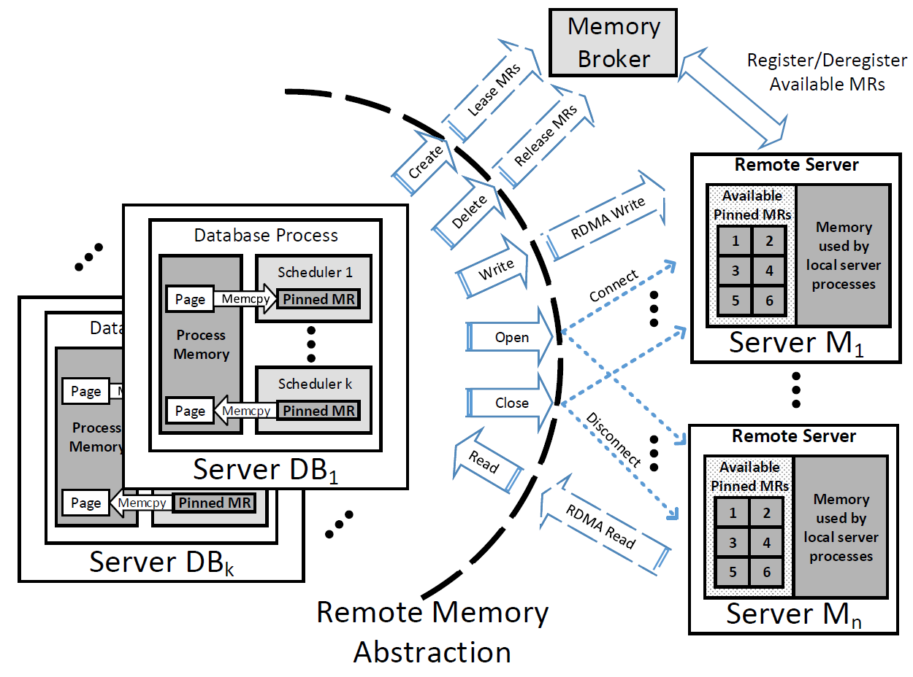
Design: Overview
RDBMSes require control over which data resident in memory
Centralized “memory broker” to track + “lease” remote memory
Remote memory organized into blocks accessed via a file API
Register remote memory regions with RDMA NIC upon initialization
F. Li et al, “Accelerating Relational Databases by Leveraging Remote Memory and RDMA”
Notes:
Broker “leases” remote regions of memory based upon requests. Zookeeper is used to provide fault tolerance and high availability of region metadata. These leases must be renewed on a regular basis.
Memory broker proxies on each server used to store remote memory will claim memory not assigned to any process, pin it as one or more available memory regions, and register these regions with the NIC and with the memory broker. These regions cannot be used by local processes once claimed. However, if a local process needs more memory than is available (after subtracting the reserved memory regions), one or more memory regions will be unregistered to avoid paging.
Registering remote memory regions with the NIC upon initialization avoids the overhead associated with doing this on an on-demand basis, which is on the order of the time needed to actually transfer the 8K page across the network

Slide 34
Design: Memory Abstraction
In-block memory abstraction
Similar to existing abstraction used by databases to manage memory
Fixed-sized blocks, read/written w/ block ID, offset, size of data
Allows for selective operations (saves bandwidth)
Blocks accessed via a simple file API “shim”

Slide 35
Design: Synchronous vs. Asynchronous
Existing databases use asynchronous ops for disk I/O
Masks latency of using disk
Context switching and other latencies become more pronounced with lower network I/O latencies
Therefore, use synchronous I/O for RDMA ops

Slide 36
Design: Scalability
Centralized controller
Not involved in data plane (RDMA READs and WRITEs)

Slide 37
Design: Fault Tolerance and Availability
Centralized controller
Because state is kept in Zookeeper, recovered or newly elected controller can seamlessly take over
Possible for remote memory to be implemented in redundant and highly available manner
However, this is complicated to implement
Therefore, this memory should only be used to improve performance

Slide 38
Implementation
Microsoft SQL Server
RDMA ops performed using Network Direct Service Provider Interface (NDSPI) – Windows specific
Memory regions treated as simple file system w/ “shim” layer

Slide 39
Evaluation: Experimental Setup
10-node cluster using Infiniband (56 Gbps)
384 GBs of RAM on each node
Windows Server 2012 R2
Microsoft SQL Server (custom un-optimized build)

Slide 40
Evaluation: Evaluated Designs
HDD – excess memory satisfied by HDD
HDD+SSD – excess memory satisfied by SSD and/or HDD
SMB+RamDrive – remote memory over SMB (TCP/IP) and RamDrive
SMBDirect+RamDrive – remote memory over SMBDirect (RDMA) and RamDrive
“Custom” – file API over NDSPI (RDMA)
Local Memory – all necessary memory can be used locally (“optimal” result)

Slide 41
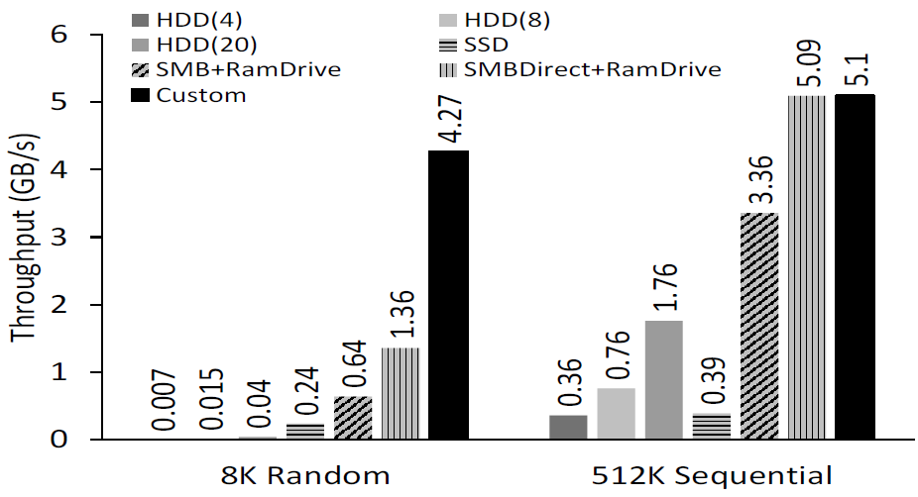
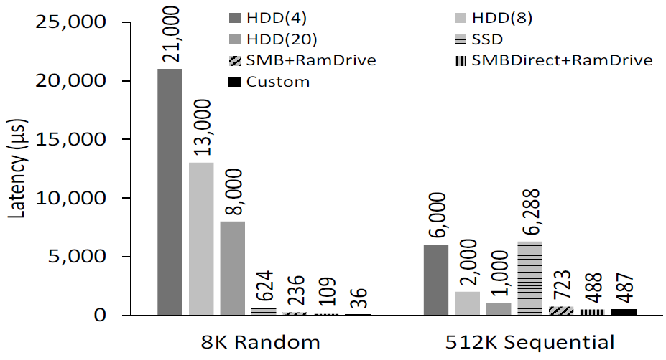
Evaluation: I/O Throughput and Latency
F. Li et al, “Accelerating Relational Databases by Leveraging Remote Memory and RDMA”
F. Li et al, “Accelerating Relational Databases by Leveraging Remote Memory and RDMA”
Notes:
Evaluations conducted with one DB server and one memory server
HDD uses RAID 0 with 4, 8, and 20 spindles
Random read and sequential read using SQLIO
HDD significantly higher due to RAID 0

Slide 42
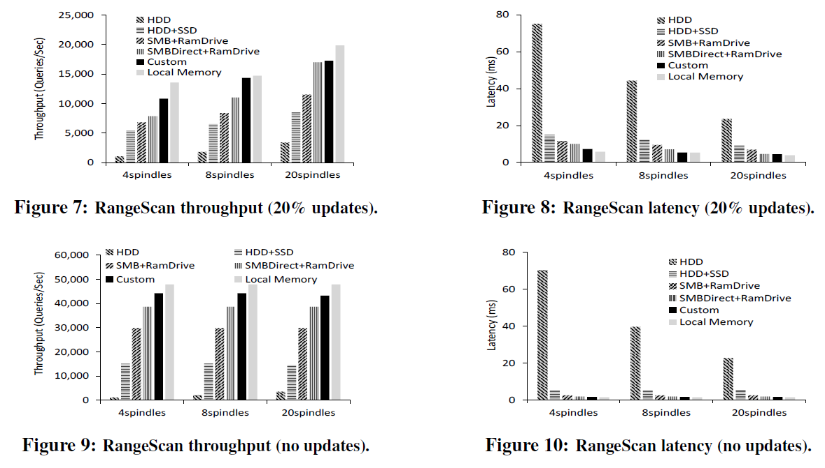
Evaluation: Cache Extension
F. Li et al, “Accelerating Relational Databases by Leveraging Remote Memory and RDMA”
Notes:
RangeScan is a benchmark that “generates queries that scan a range in a synthetically-generated Customer table”
Shows that RDMA is significantly more effective than other mechanisms when not enough memory is available locally
Updates must be stored to disk, reducing throughput and increasing latency

Slide 43
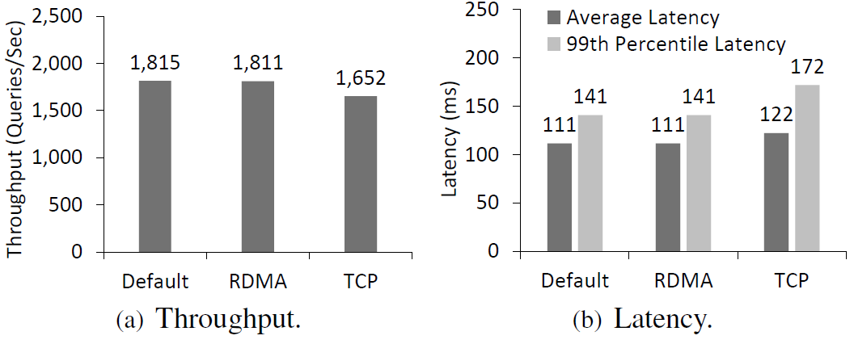
Evaluation: Remote Performance
F. Li et al, “Accelerating Relational Databases by Leveraging Remote Memory and RDMA”
Notes:
The performance of the remote (memory) server is almost completely unaffected by RDMA because RDMA bypasses the CPU. Meanwhile, TCP has a significant negative effect on performance.
Both machines running RangeScan benchmark (database servers)

Slide 44
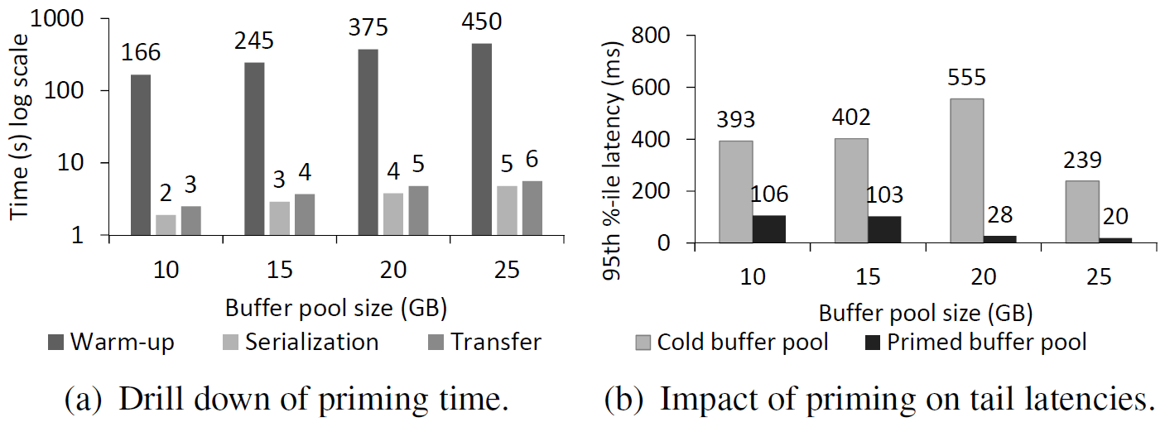
Evaluation: Buffer Pool Priming
F. Li et al, “Accelerating Relational Databases by Leveraging Remote Memory and RDMA”
Notes:
RangeScan workload
First plot contains time required to warm up buffer pool vs. scan and serialize and then transfer the buffer pool to new primary
Second plot shows workload latency with cold vs primed buffer pool – significantly reduced tail latencies
Time to warm up buffer pool is order of magnitude greater than time required to prime (via transfer) the new buffer pool

Slide 45
Future Work
Memory brokering policies
Inter-workload fairness
Security
Effects of virtualization

Slide 46
Conclusion
Allows RDBMSes to make use of memory on remote machines via RDMA
Applications manage memory because they know semantics of data
Only ensure best-effort availability – no tolerance for failure of memory node

Slide 47
Comparison with Infiniswap
RDMA-DB
Infiniswap
App-specific knowledge / Modifications
App-agnostic / No modifications
Centralized memory manager
Entirely decentralized system
Memory accessible on demand
Swaps pages on page fault
Single copy (Best-effort reliability)
Local and remote copies
Avoids context switches
Page faults cause context switches
DB performs better than Infiniswap
DB performs worse than RDMA-DB
Notes:
Comparison of relative DB app performance is based upon looking at how VoltDB Infiniswap 75% vs 100% local paging compared with modified Microsoft SQL Server “Custom” compared with local memory

Slide 48
App-specific vs. App-agnostic Design
App-specific Design
App-agnostic Design
Can use app knowledge to optimize
Generally no opt. possible (w/o app hints)
Specialized only for specific app
Can be used for (most) any application
Might require app modifications to use
Can likely be used w/o app modifications
Can decide what mem needs better perf.
Must treat all mem regions the same
More engineering and less research (?)
More interesting research results(?)
Notes:
Not all memory regions may be important
Database servers require a *lot* of memory

Slide 49
Performance Comparison
Infiniswap (VoltDB)
RDMA-DB (MS SQL Server)

Slide 50
Discussion Points
Do approaches rely upon application-specific knowledge (e.g., RDMA-DB) always work better than app-agnostic approaches (e.g., Infiniswap)?
Is this gap big enough to necessitate app-specific solutions or is a general solution “good enough”?
Do general solutions produce more interesting research results than app-specific solutions?

Slide 51
Backup Slides

Slide 52
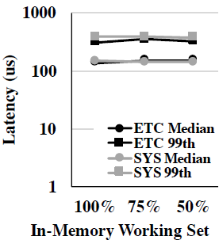
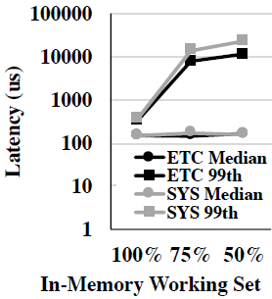
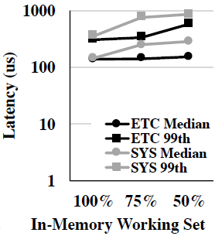
Evaluation: Memcached
Infiniswap
Disk
nbdX
J. Gu et al, “Efficient Memory Disaggregation with Infiniswap”
Notes:
Single machine performance
“In-memory object caching system” (workloads generated by and application benchmarked by memaslap)
ETC and SYS are different workloads published by Facebook with “different rates of SET operations” (5% SET ops vs 25% set ops)
With Infiniswap, performance remains almost steady as the working set percentage decreases. At the same time, ndbX suffers notable performance drops over the same interval, as it has become CPU-bound on the remote machine.

Slide 53
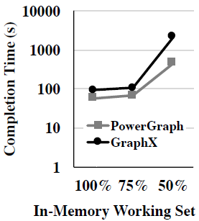
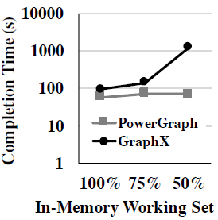
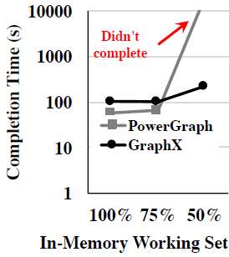
Evaluation: PowerGraph and GraphX
Disk
Infiniswap
ndbX
J. Gu et al, “Efficient Memory Disaggregation with Infiniswap”
Notes:
PowerGraph: “framework for large-scale machine learning and graph computation”
GraphX: “specialized graph processing system built on top of the Apache Spark in-memory analytics engine”
TunkRank used as benchmark (Twitter data)
PowerGraph: With Infiniswap, performance remains steady, while nbdX was not even able to complete the benchmark.
GraphX: Infiniswap has 2x improvement over disk for 50% configuration

Slide 54
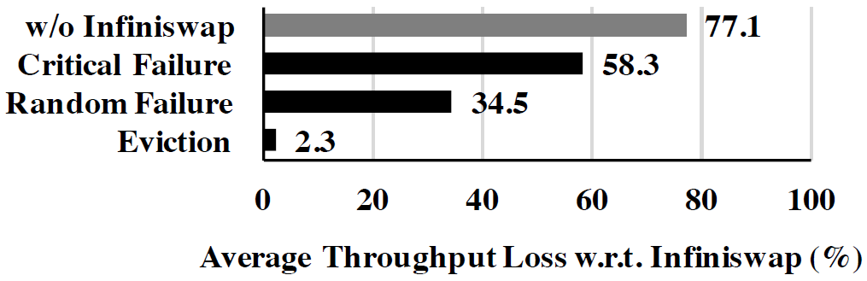
Evaluation: Evictions and Failures
J. Gu et al, “Efficient Memory Disaggregation with Infiniswap”
Notes:
For VoltDB 75% config
Random failure – turn off one of 6 machines in cluster. Timing of failure had large effect (e.g., high paging or low paging activity at given time)
Critical failure – turn off highest activity machine during peak period
Eviction – evicted 1 slab from a remote machine once a second. Fairly low average impact on performance, but influenced by activity level of that slab
However, even wit hthese failures, Infiniswap still performed better that paging to disk

Slide 55
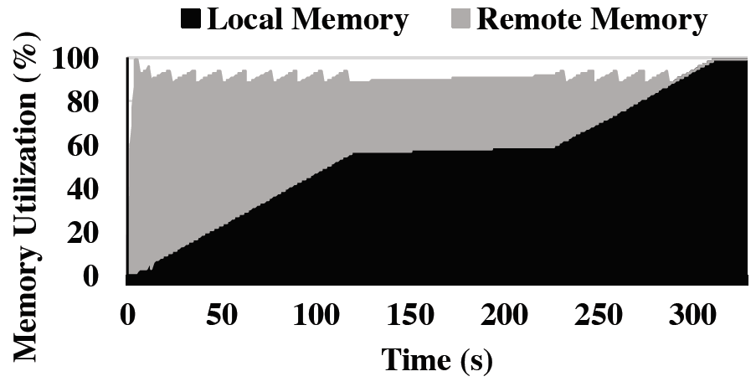
Evaluation: Local Memory Reclamation
J. Gu et al, “Efficient Memory Disaggregation with Infiniswap”
Notes:
Set head room to 1 GB and started running a Memcached server to see how local applications impacted by reclamation process. Found that throughput of app only reduced by 2-4%
At 120s, Memcached temporarily stopped allocating memory, resulting in mostly flat line for a while

Slide 57
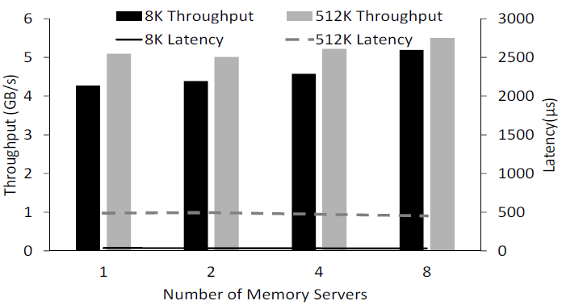
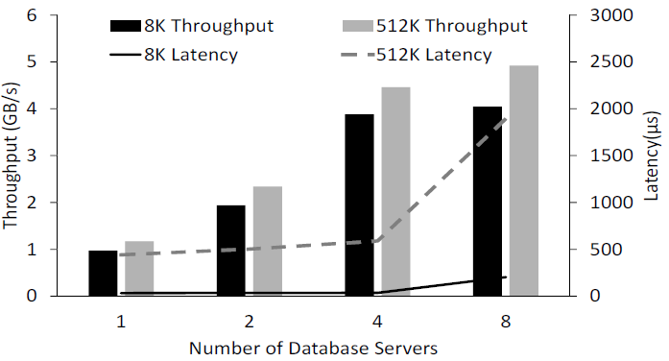
Evaluation: I/O Throughput and Latency
F. Li et al, “Accelerating Relational Databases by Leveraging Remote Memory and RDMA”
F. Li et al, “Accelerating Relational Databases by Leveraging Remote Memory and RDMA”
Notes:
One DB server paired with multiple memory servers/one memory server paired with multiple DB servers
When DB server network B/W saturated, negligible impact on throughput and latency as number of memory servers varies (random I/O latencies lower with higher number of memory servers due to parallelism) – can effectively use memory across multiple servers
Memory server bandwidth saturated with four DB servers – before saturation, throughput scales linearly with latency as # of DB servers increases – latency increases rapidly after saturation

Slide 58
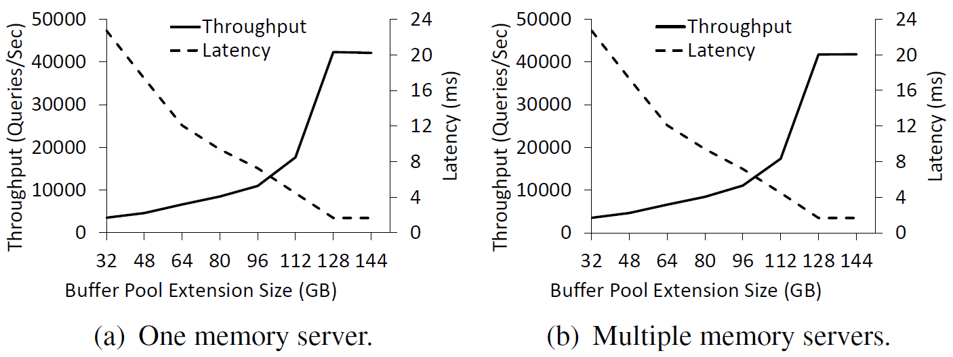
Evaluation: Cache Ext. – Memory Size
F. Li et al, “Accelerating Relational Databases by Leveraging Remote Memory and RDMA”
Notes:
“remote memory continues to be equally beneficial even when it is pooled from multiple servers”

Slide 59
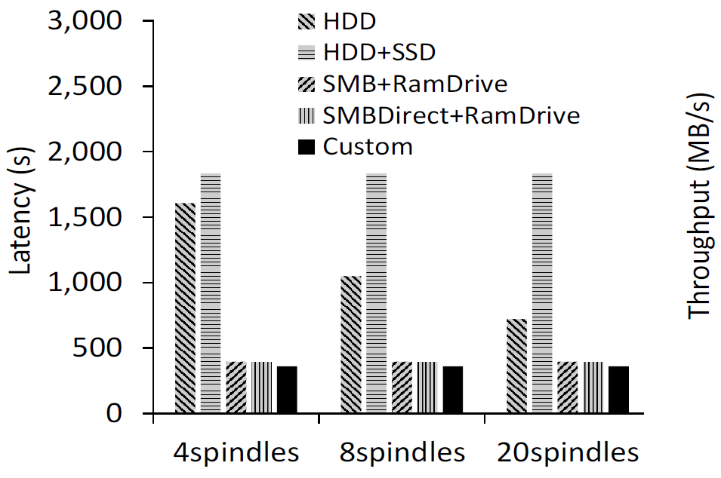
Evaluation: Temporary Data Storage
F. Li et al, “Accelerating Relational Databases by Leveraging Remote Memory and RDMA”
Notes:
Hash+Sort microbenchmark
Long-running query, so only completion time measured
Sequential reads in Hash+Sort cause SMBDirect+RamDrive to perform almost as well as “Custom”

Slide 60
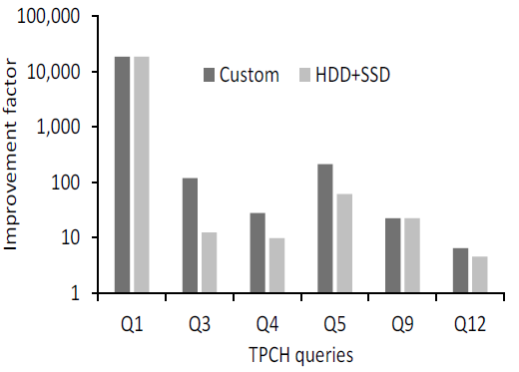
Evaluation: Semantic Caching
F. Li et al, “Accelerating Relational Databases by Leveraging Remote Memory and RDMA”
Notes:
Opportunistically building semantic cache
TPC-H workload
Semantic cache broker to access materialized views in remote memory
“plots the multiplicative factor improvement of the seven TPC-H queries compared to when they were executed without MVs using indexes tuned for the queries”
4 or 5 orders of magnitude improvement when using HDD+SSD over baseline, while “custom” can produce another order of magnitude improvement

