Slide 1
TVM: An Automated End-to-End Optimizing Compiler for Deep Learning
An Intermediate Representation for Optimizing Machine Learning Pipelines
Tianqi Chen et al.
Andreas Kunft et al.

Slide 2
TVM: An Automated End-to-End Optimizing Compiler for Deep Learning
Tianqi Chen et al.

Slide 3
Overview
Motivation
Implementation (Optimization)
Graph operation
Tensor operation
Optimization automation
Evaluation

Slide 4
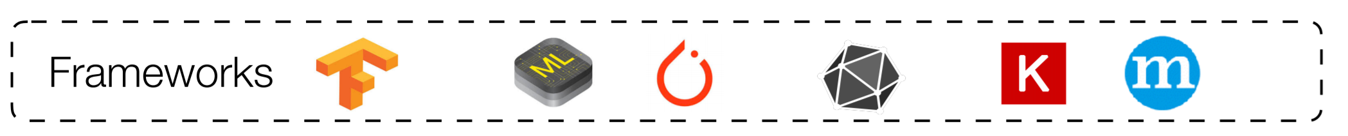
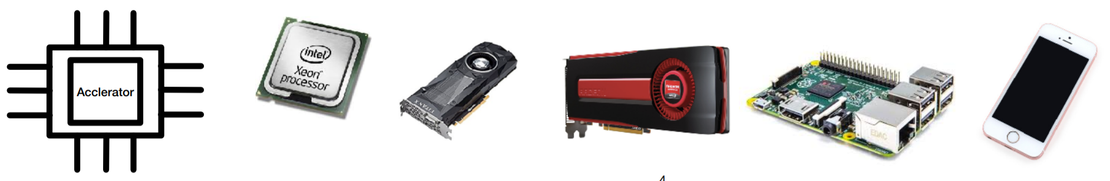
Motivation: What is TVM?
Automated End to End Compiler

Slide 5
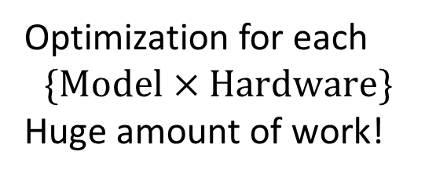
Motivation: Why TVM?
High-level computational graph optimization
openblas/cublas/mkl
cuDNN
LLVM
CUDA
Accelerator Backend

Slide 6
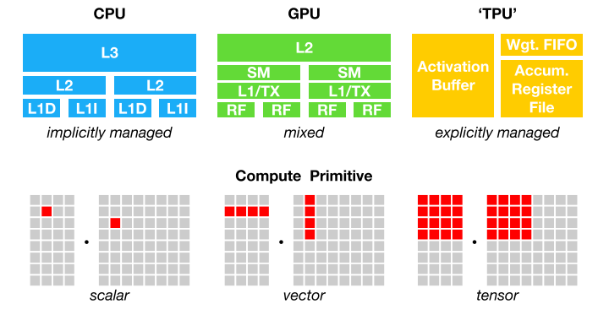
Motivation: Challenges to automation
Leveraging specific hardware features and abstractions
Large search space for optimization
Memory access, threading pattern, new HW primitives, etc…
Loop transformation, thread cooperation, etc…
Without human craft

Slide 7
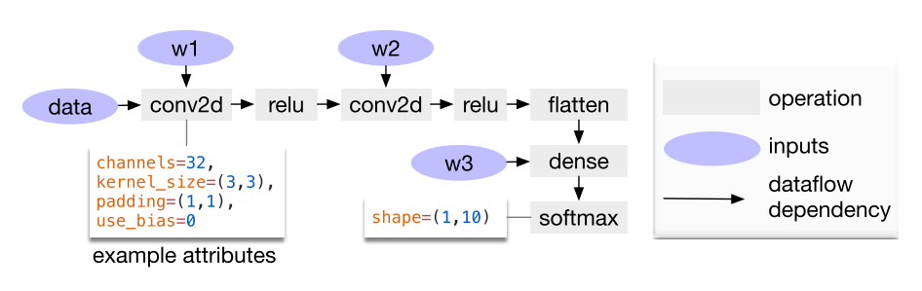
Optimization: Computation Graph
Common representation for operation flows
Avoid implementation of each details
Can be optimized on the high-level
Operator Fusion
Data layout transformation
Constant-folding, Static memory planning pass, etc…

Slide 8
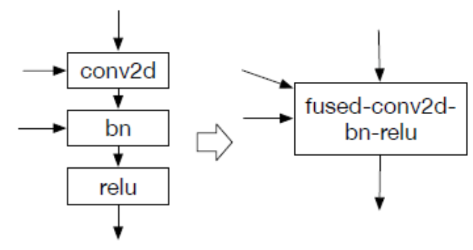
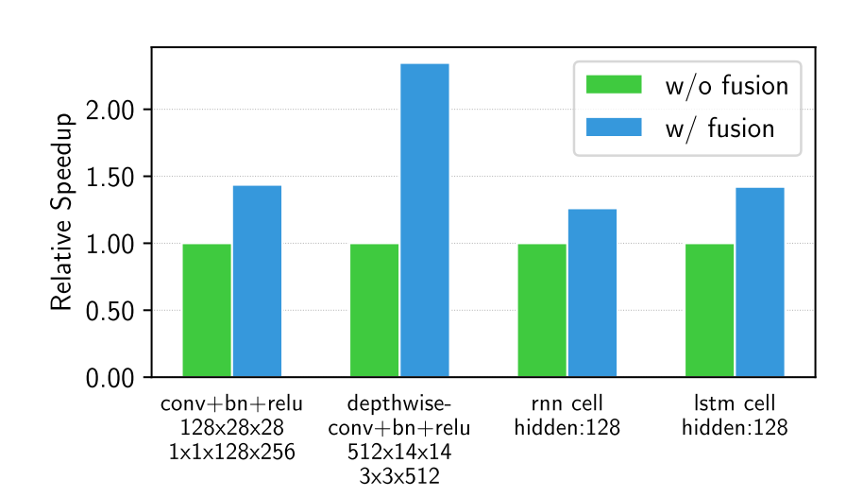
Optimization: Operation Fusion
Combine multiple operations into a single kernel
Saving the intermediate results in memory
Greatly save the execution time

Slide 9
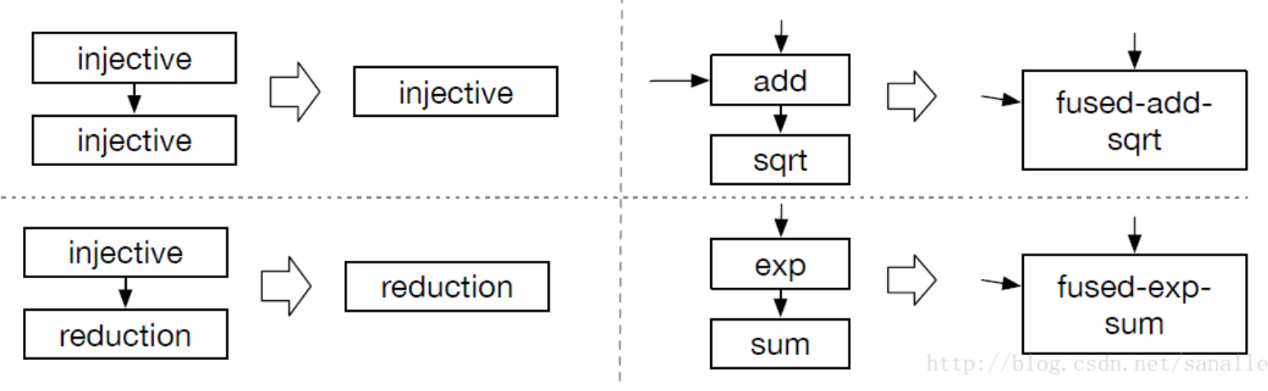
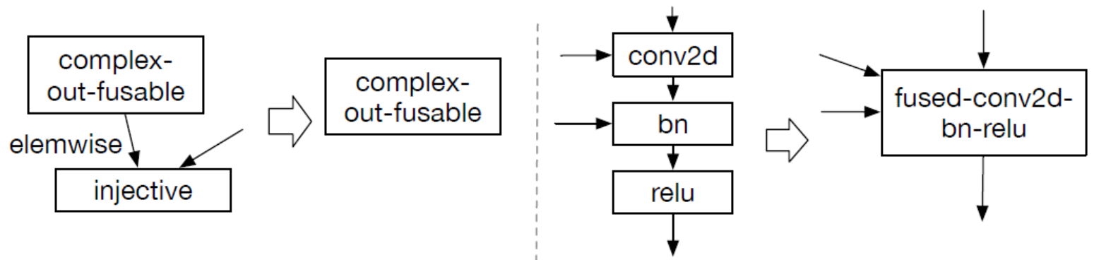
Optimization: Operation Fusion
Rules for fusion
Injective ( 1 to 1 map, e.g. add)
Reduction (e.g. sum)
Complex-out-fusable (e.g. conv2d)
Opaque (not fusable)

Slide 10
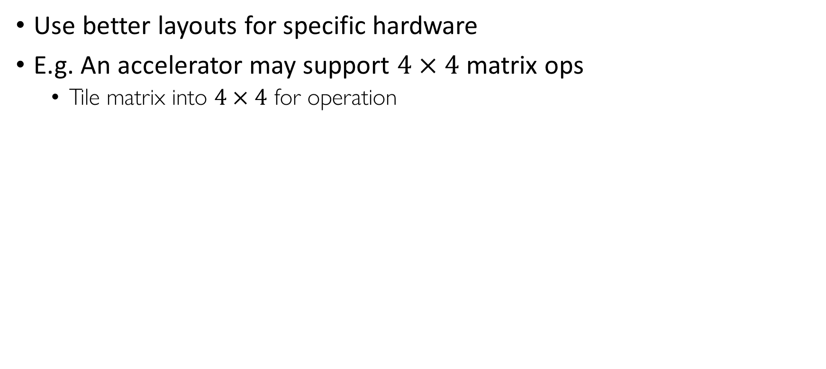
Optimization: Data Layout Transformation

Slide 11
Optimization: Tensor Operations
Current DL frameworks requires ops lib to provide fused ops implementation
Unfeasible to write each combination
TVM helps generating optimized operators for each hardware
Tensor Expression
Nested Parallelism with Cooperation
Tensorization
Explicit Memory Latency Hiding

Slide 12
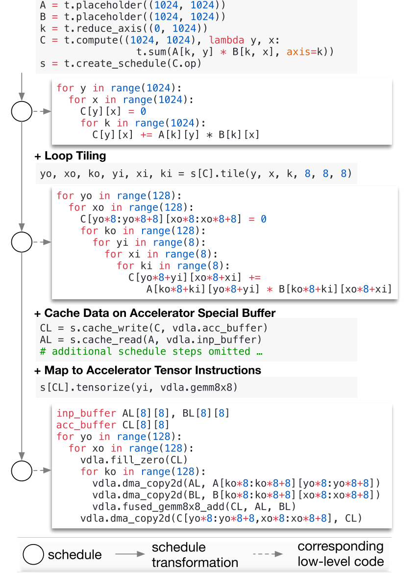
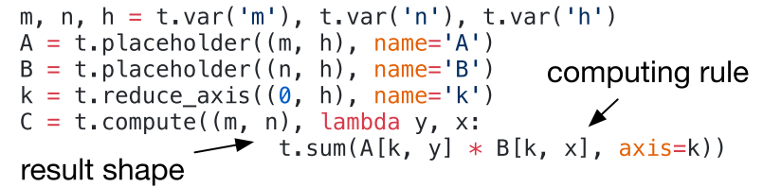
Optimization: Tensor Expression
Defines computing rules,
instead of execution details
Decouples compute/schedule
Many schedule primitives can be applied

Slide 13
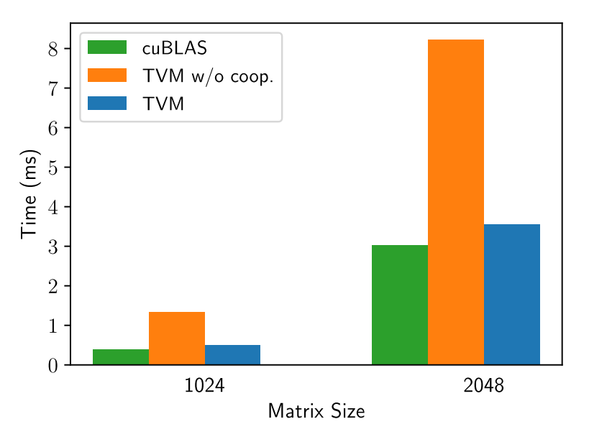
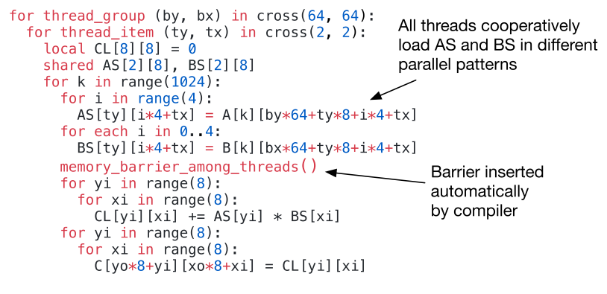
Optimization: Nested Parallelism with Coop
Many exists parallel solutions use shared-noting nested parallelism
Working thread cannot look at sibling’s data
TVM uses schedule to fetch data cooperatively
Enable data reuse across threads

Slide 14
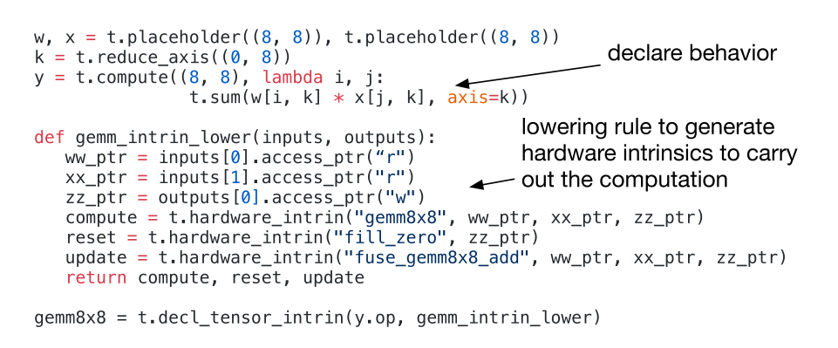
Optimization: Tensorization
Emerging new accelerators with their own instructions
Make tensorization extendible
Tensor-intrinsic declaration
Using same Tensor expression language to declare hardware intrinsic and lowering rules
Replace computation unit with intrinsic

Slide 15
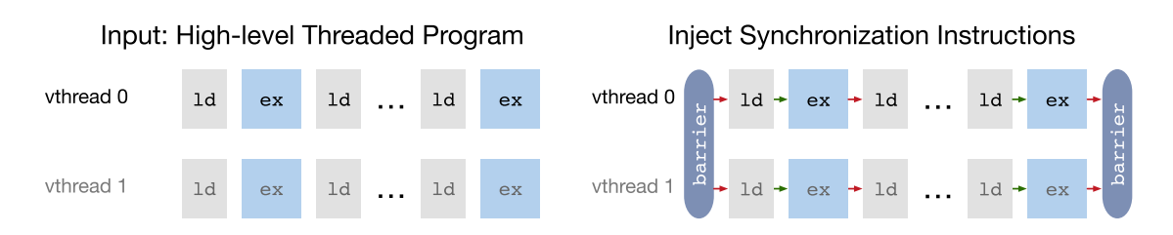
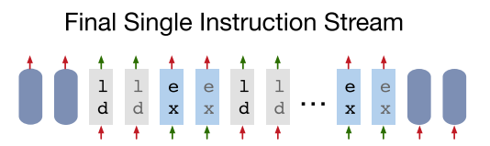
Optimization: Memory Latency Hiding
Overlap memory access with computation
Requires fine-grained sync to enforce dependencies
TVM uses virtual threading schedule primitives
Programmers specify a high-level data parallel program
TVM automatically lowers the program

Slide 16
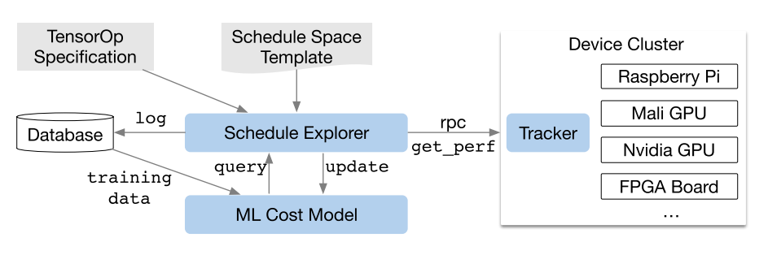
Optimization: Automation
So many schedule primitives, as well as params
Mem hierarchy, tiling size, unrolling factor, etc…
Automatically find optimizer using …. ML!

Slide 17
Optimization: Schedule Space Specification
Let developers declare knobs
Take advantage of experts’ knowledge

Slide 18
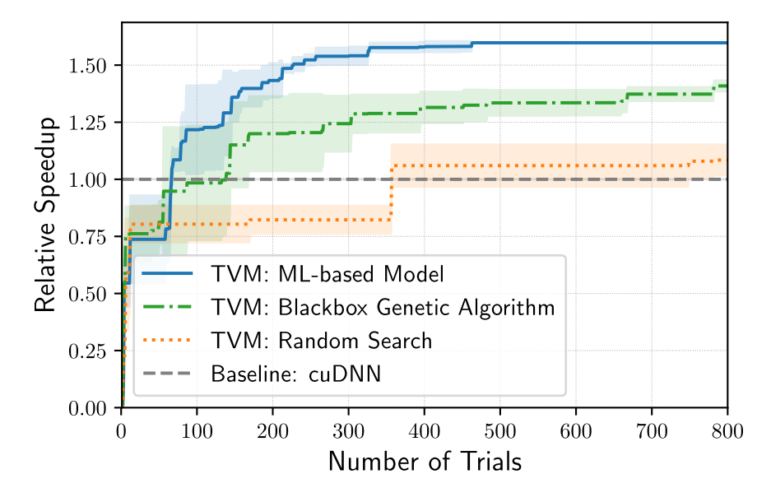
Optimization: ML-based cost model
Lowered loop program 🡪 Running time prediction
Better than auto-tuning / pre-defined model as in:
Less data requirements & experiments
Less bias under complex factors
Predict relative order instead of absolute value for faster inference

Slide 19
Optimization: Schedule Exploration
Run parallel annealing algorithm for search
Feasible compared with enumeration

Slide 20
Optimization: Distributed device Pool
Customized RPC-based distributed device pool to run program
Host machine cross-compiles and uploads program
Critical for embedded devices with low-power

Slide 21
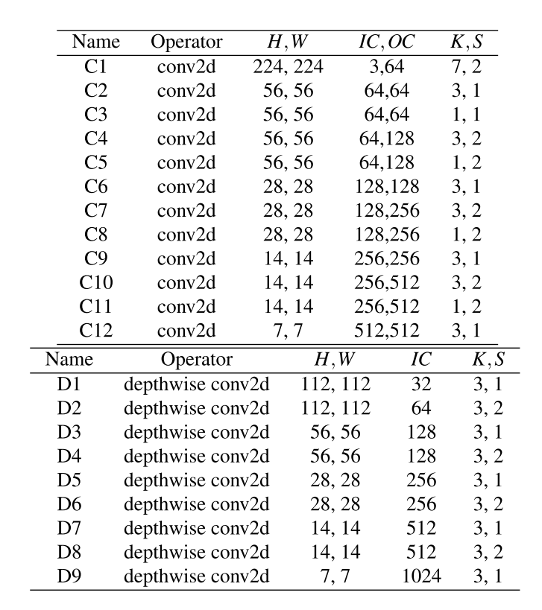
Evaluation
Comparison with existing heavily optimized frameworks
Support for new emerging DL operation
Support for new accelerators
Evaluate on 4 types of platforms
Server-class GPU
Embedded GPU/CPU
DL accelerator

Slide 22
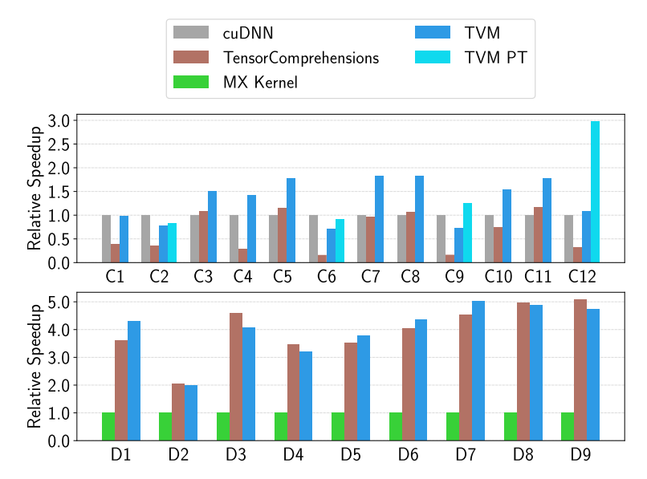
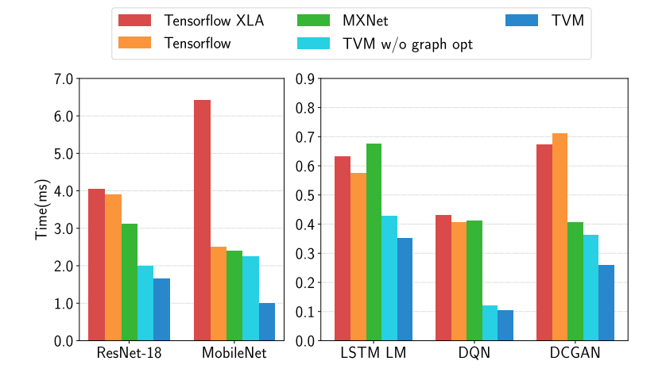
Evaluation: Server-Class GPU

Slide 23
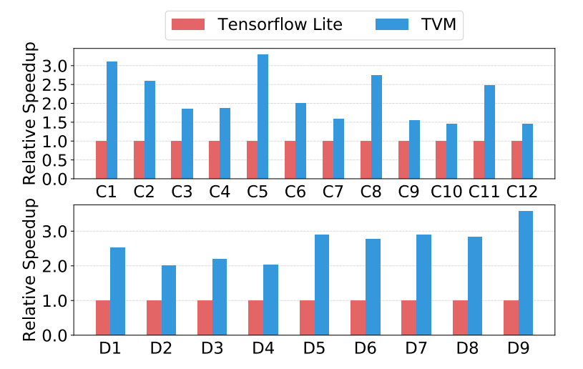
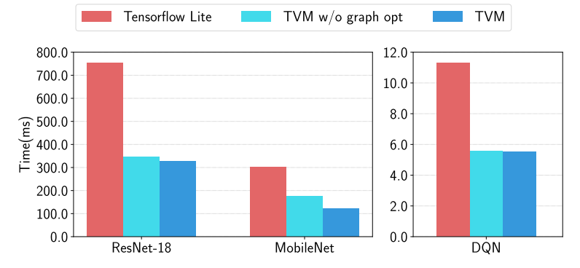
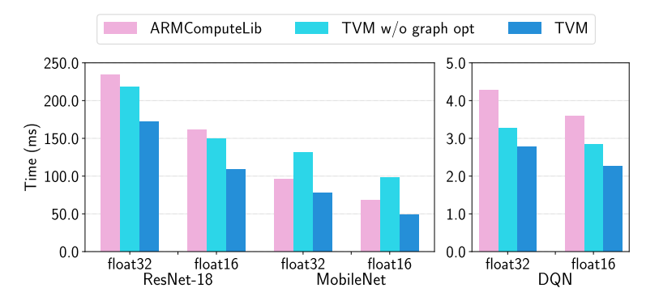
Evaluation: Embedded CPU/GPU
CPU
GPU

Slide 24
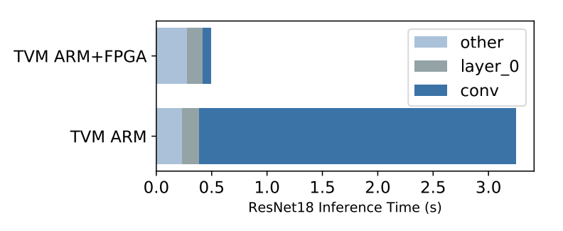
Evaluation: FPGA Accelerator
Provide 40x speed up for accelerable operation (conv)

Slide 25
Related Work Comparison
TensorFlow XLA
Focus on high level optimization
Specialized for TensorFlow
Halide
Introduce the idea of separating computing and scheduling
Intermediate representation of computation adopted by TVM
Tensor Comprehension
Use polyhedral model instead of schedule space search for automated optimization

Slide 26
Conclusion
TVM is an End to End compiler focusing on automatic optimization from framework to hardware.
TVM optimizes program from graph level and operation level
TVM uses ML-based cost model to automatically search optimal schedule.
TVM achieves similar performance on hand-crafted operation & popular hw, while provides much better performance on new operations and emerging accelerators.

Slide 27
An Intermediate Representation for Optimizing Machine Learning Pipelines
Andreas Kunft et al.

Slide 28
Motivation
Machine Learning involves more than model training
Data acquisition
Data cleaning + transformation
Feature engineering …….
Data preprocessing vs. model training
relational algebra + UDF VS iterations + linear algebra
Notes:
ML in real life involves more than model training. You first have to get data from somewhere. And often time your data is not as clean as you expected and contains all kinds of errors. And then you have to transform data into a certain format before feature engineering.
These parts are usually considered as data preprocessing. After these steps, you can actually begin to pick ML models and train them.
The workload and methods of data preprocessing is quite different from that of model training. Data preprocessing usually combines relational algebra and UDFs, while model training uses iterations and linear algebra.

Slide 29
Motivation
Current systems are tailored for either of the two
Preprocessing and ML steps are often executed in different systems in practice
Preprocessing and ML steps are optimized in isolation

Slide 30
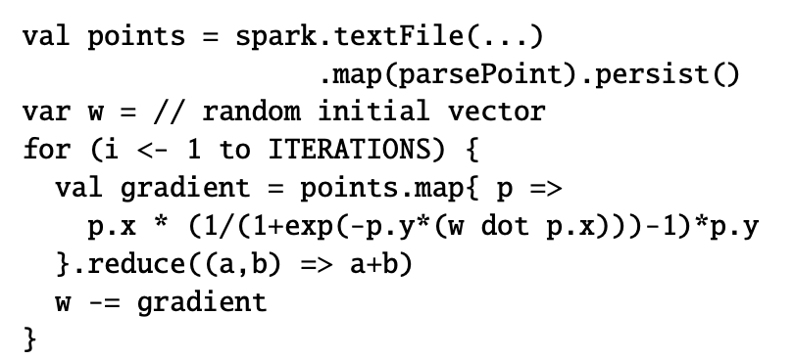
Current Solutions
Shallow-Embedded Libraries
Pandas
Scikit-learn
Type-Based DSLs
RDD in Spark
UDFs are generally treated as black-boxes; invisible control flow
Notes:
I’ll take a step further about current solutions and why they are not good enough. People tend to propose DSL to alleviate the problem.
For example, there are dedicated libraries for collection processing and ML, such as pandas, and …. These libraries are shallow embedded in the host language and executed as is without inter-library optimizations.
Type-based DSL use the operations defined on a type, such as …, to construct an operation graph rather than directly executing the operations. The problem with these types of DSL is that ….

Slide 31
Solution
Lara
Declarative domain-specific language (DSL) in Scala
Quotation-based
Old: DataBag (Emma)
New: Matrix, Vector
Optimized for both data preprocessing and ML steps
Control flow
White-box UDFs
...
Notes:
Lara is a DSL implemented in Scala as a library, It’s quotation-based, which means Lara reuses the syntax and type system of Scala. Lara also takes advantage of an existing data type call DataBag, which is proposed in a previous DSL called Emma.
Lara also proposes two new Data types Matrix and vector that are tailored for ML steps.
The high level idea is that Lara has good data types that are very easy to use for both data preprocessing and ML steps. Writing codes and functions using these data types enable Lara to reason about your control flow and UDFs are no longer black boxes. As a result, Lara can do different types of optimizations automatically.

Slide 32
Background
Monads
For-Comprehension
Syntactic sugar for map/FlatMap in Scala
for(x <- List(1,2,3) if x > 1) yield x*x
List(2,3).map(x => x*x)
Intermediate Representation (IR)
AST
3 IRs to figure out what optimizations can be applied
Notes:
One fact about the paper is that it kinda assumes you know a lot about Scala already, and because Lara is built based on a previous DSL called Emma, the paper also assumes you are familiar with Emma. I think it’s not necessarily true here, so I plan to introduce some basics first.
Monads are structures that represent sequential computations. In Monads, the output of a calculation at any step is the input to other calculations.
An intermediate representation is a the data structure or code used internally by a compiler or VM to represent the source code. Basically, an IR helps the compiler or VM to reason about the source code. For each source code, you could have several different … Lara build 3 IRs for each source program.

Slide 33
Optimization: Operator Pushdown
Push operations on a Matrix to DataBag
A DataBag of dense features, a DataBag of sparse features
Dense
Sparse
Dense
Sparse
Notes:
Convert second-order functions on a Matrix type to a DataBag type.
People usually use different format to represent sparse vectors to improve the look-up speed of non-zero values in the sparse vector. However, once dense features and sparse features are concatenated into a single matrix, there could be only one uniform representation left. This will slow down the look-up speed on the dense features if the Matrix is treating dense features the same way as sparse features.
If you apply a UDF onto the Matrix that involves element look up, the speed is not optimal.
Lara tracks
So both DataBags can keep their optimal element look-up speed.

Slide 34
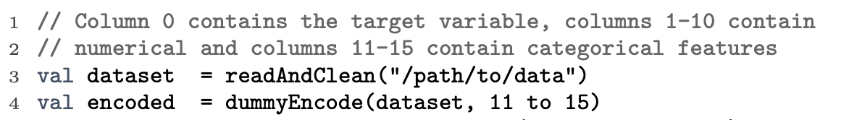
Optimization: Operator Fusion
Combine several operators in a way that reduces overhead
Notes:
Again, let’s look at a concrete example from the paper.

Slide 35
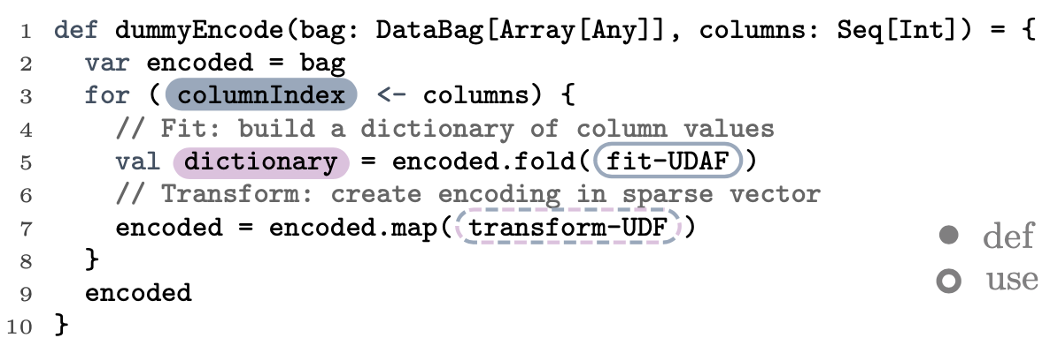
Optimization: Operator Fusion
2*n passes ⇒ 2 passes
Notes:
Data dependencies are indicated by colored boxes.
A naive execution of the code is suboptimal, as it requires two passes over the dataset per column. For each column index in the for loop, fold and map would have 1 pass over the entire DataBag respectively.
What Lara offers is that if each iteration reads and writes on disjoint columns, several folds are combined into a single fold, and several maps are also combined into one single map as they operate on the same dataset.

Slide 36
Optimization: K-fold Cross Validation
K-fold Cross Validation
Shuffle the dataset randomly
Split the dataset into k groups
For each unique group
Take the group as a test data set
Take the remaining groups as a training data set
Fit a model on the training set and evaluate it on the test set
Notes:
The authors also discuss the extensibility of their approach by introducing a high-level operator: k…..
Cross-validation is a resampling procedure used to evaluate machine learning models on a limited data sample.

Slide 37
Optimization: Cross Validation
3-fold Cross Validation
[0.1, 0.2, 0.3, 0.4, 0.5, 0.6]
Fold 1: [0.1, 0.2]
Fold 2: [0.3, 0.4]
Fold 3: [0.5, 0.6]

Slide 38
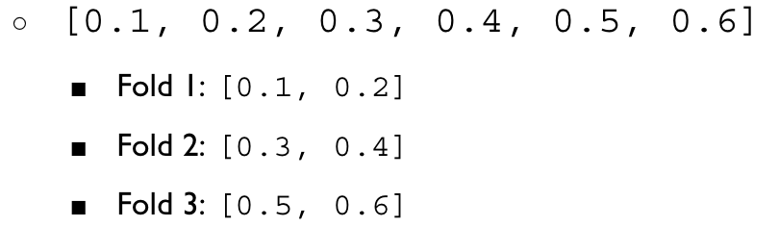
Optimization: Cross Validation
Each fold is used k − 1 times as part of the training set
The training algorithm is executed k − 1 times on each split.

Slide 39
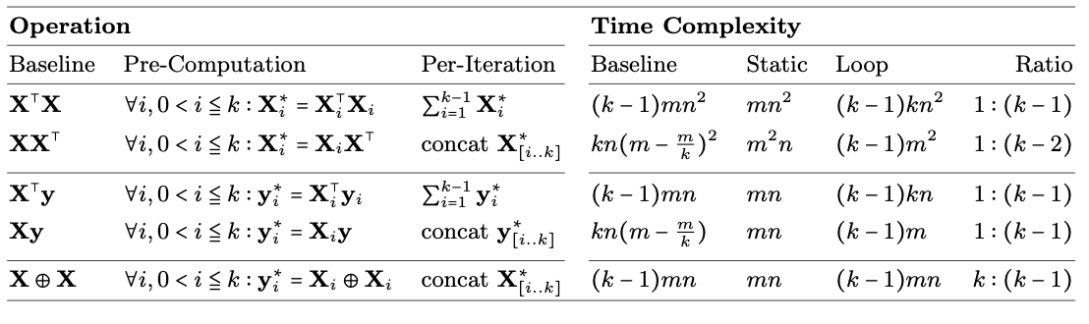
Optimization: Cross Validation
Lara: pre-computes the algorithm on the individual splits outside of the validation loop once

Slide 40
Evaluation
Setup
One server node with an Intel E5530 processor (8 cores, 48 GB mem)
JAVA 8 VM + Scala
One synthetic dataset + 2 real datasets

Slide 41
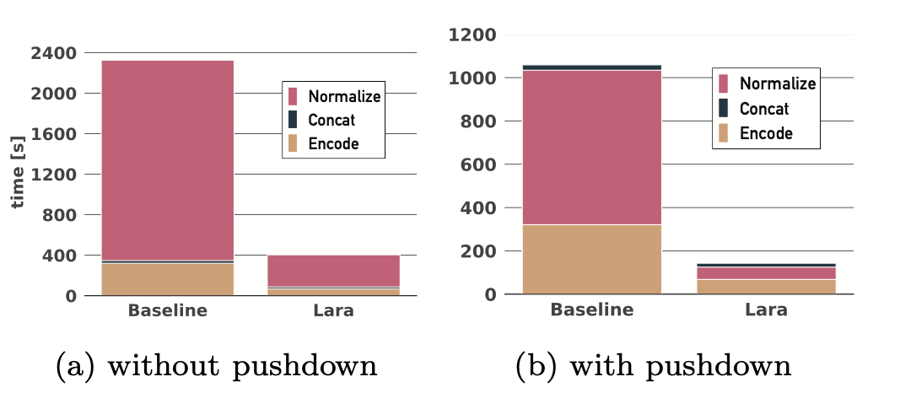
Evaluation: Data Preprocessing
Workload: a program containing data reading, feature encoding, concatenation, normalization, written by the authors
Notes:
Baseline means the program is executed without any optimization.
The baseline without pushdown of takes 5.75× longer than Lara without pushdown and 16.1× than the completely optimized version of Lara.

Slide 42
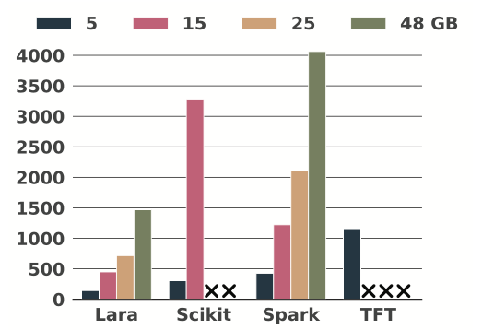
Evaluation: Data Preprocessing
Same program as in the previous experiment
On different systems and different data sizes
Notes:
Lara and Spark scale linear with the increasing data size. Both execute in a streaming fashion and thus, are not affected by growing data sizes. Scikit- learn loads the whole dataset in memory, which leads to degrading performance for larger datasets.
TFT simply failed for realloc error.

Slide 43
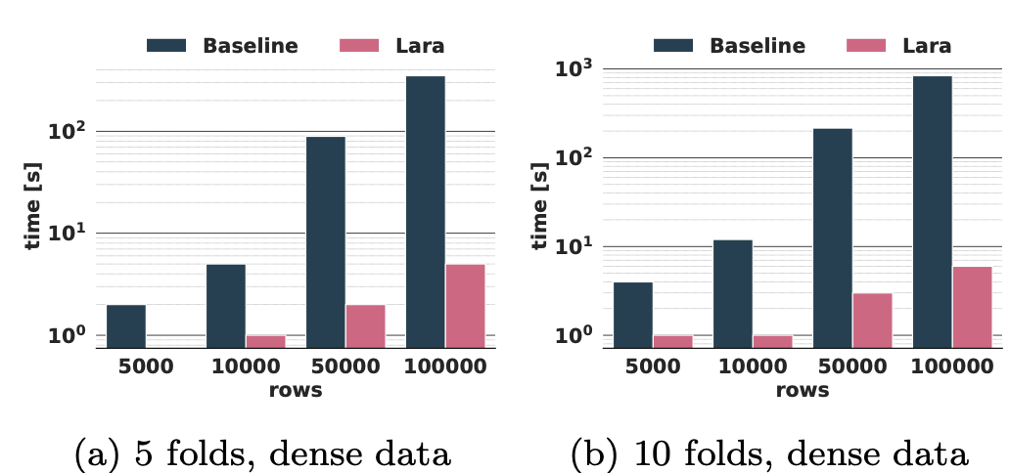
Evaluation: Cross-Validation
Ridge Regression on synthetic dataset
Notes:
The Baseline implementation executes the algorithm without the proposed optimizations for cross-validation.
Lara is up to 65× faster than the Baseline for five folds and up 136× faster for ten folds.
We relate this to the very small intermediate result for the Pre-Computation of X⊺X. (n*n)

Slide 44
Related Work Comparison
ML Libraries & Engines
SystemML
ML Specific Optimizations
Tensorflow
Execution Engines
Foreign function interface
Notes:
There are some … that support data preprocessing to some extent.
SystemML provides a transform function to apply pre-defined feature engineering methods to row datasets. But users cannot specify their own transformation functions.
There are systems that provide excellent ML specific Optimizations such as Tensorflow. But they either don’t consider relational algebra optimizations or do not perform control flow analysis and treat UDFs as black boxes.
There are also some people working on applying scalable linear algebra onto a relational database system. But it relies on the foreign function interface of DBMS to execute UDFs, which prohibits holistic optimizations.

Slide 45
Conclusion
Lara provides API and dedicated types for both ML training and data preprocessing
Lara exposes the complete ML pipeline to its optimizer, including UDF and control flow and etc.
Lara is able to achieve diverse optimizations due to its 3 IRs that provide different levels of abstractions

Slide 46
Discussion
TVM
What’s the difference between DL framework compiler like TVM and traditional compiler? (e.g. LLVM IR)
Auto-tuning vs. Manually tuning ? In terms of common ops & hw vs. new hw?
Lara
The experiments are run on one computer with one processor. Is it a fair comparison with systems that tailored for a cluster setting like Spark? Can be Lara used in the cluster setting?
Is it okay to do experiments on a program written by the authors? Cherry pick?
ML models need to be rewritten in Lara?

