Slide 1
TensorFlow A system for large-scale machine learning
PyTorch An Imperative Style, High-Performance Deep Learning Library
Mart´ın Abadi, Paul Barham, Jianmin Chen, Zhifeng Chen, Andy Davis, Jeffrey Dean, Matthieu Devin, Sanjay Ghemawat, Geoffrey Irving, Michael Isard, Manjunath Kudlur, Josh Levenberg, Rajat Monga, Sherry Moore, Derek G. Murray, Benoit Steiner, Paul Tucker, Vijay Vasudevan, Pete Warden, Martin Wicke, Yuan Yu, and Xiaoqiang Zheng
Adam Paszke, Sam Gross, Francisco Massa, Adam Lerer, James Bradbury, Gregory Chanan, Trevor Killeen, Zeming Lin, Natalia Gimelshein, Luca Antiga, Alban Desmaison, Andreas Kopf, Edward Yang, Zach DeVito, Martin Raison, Alykhan Tejani, Sasank Chilamkurthy, Benoit Steiner, Lu Fang, Jujie Bai, Soumith Chintala
Presenter: Hengjia Zhang, Jiaqing Ni, Yide Gu

Slide 2
TensorFlow
A system for large-scale machine learning

Slide 3
Background & Motivation
Previous system: DistBelief
The first scalable deep learning system, not flexible enough
TensorFlow is the successor of DistBelief
parameter server architecture
worker process
parameter server

Slide 4
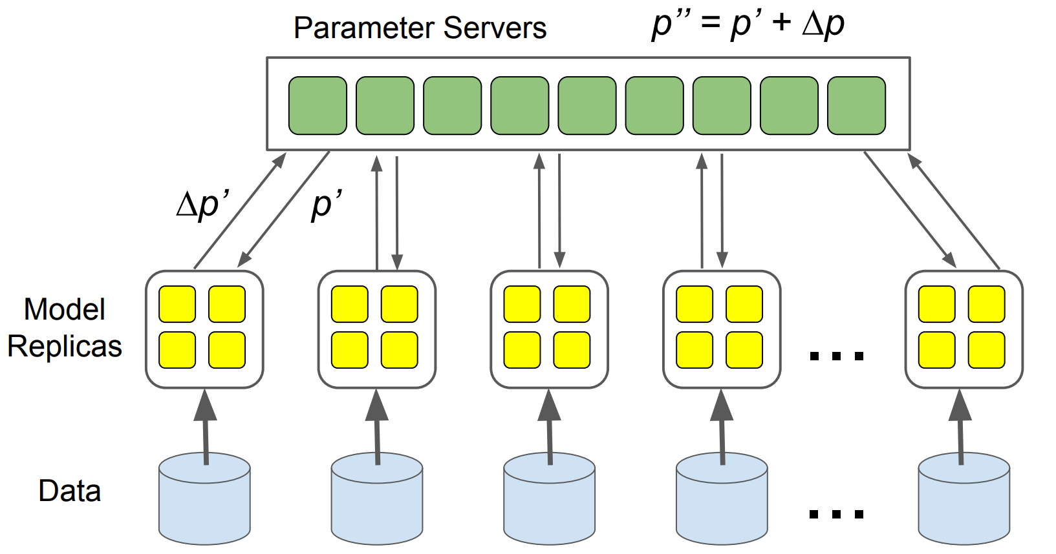
Parameter server architecture
https://www.matroid.com/scaledml/slides/jeff.pdf

Slide 5
Limitations of DistBlief
Defining new Layers:
DistBlief layers are implemented as C++ classes
Refining the training algorithm:
Good for SGD
Parameter server implementation needs to be modified for new optimization methods (Momentum, Adam, etc.)
Defining new training algorithms:
Good for simple feed-forward NN
Fails for advanced models(RNN, adversarial networks, RL models, etc.)

Slide 6
Design Principles of TensorFlow
Dataflow graphs of primitive operators
DistBelief uses complex Layers
TensorFlow represents math ops as nodes in the dataflow graph
Deferred execution
1st Phase: define a symbolic dataflow graph
2nd Phase: execute an optimized version of program on the set of available devices
Common abstraction for heterogeneous accelerators
CPU, GPU, TPU
Each operator can have multiple implementations for difference devices
Notes:
Deferred execution: tf can optimize the execution phase by using global info about the computation

Slide 7
Consequence of the design principles
There’s no such thing as a parameter server!
Deploy TensorFlow as a set of tasks (named process)
PS tasks (assumes the parameter server role)
Worker tasks
Key difference: PS task can run arbitrary TensorFlow graphs, users can program it with the same scripting interface that they use to define models.

Slide 8
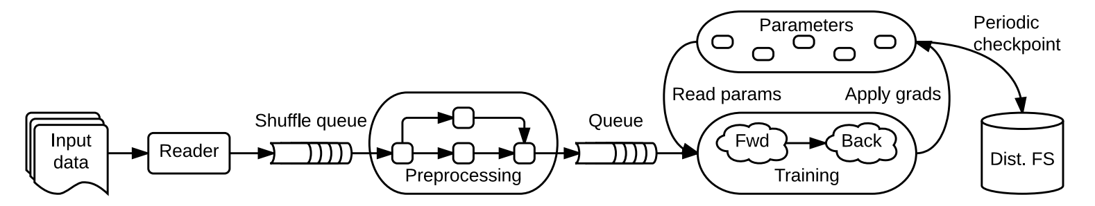
TensorFlow Execution Model
TensorFlow uses a single dataflow graph to represent all computation and state in a ML algorithm
the individual mathematical operations
the parameters
update rules
input preprocessing
Notes:
express the communication between subcomputations: parallel independent computation execution & partition computations across different devices

Slide 9
Key difference from batch dataflow system (Spark, etc.)
The model supports multiple concurrent executions on overlapping subgraphs of the overall graph.
Individual vertices may have mutable state that can be shared between different executions of the graph.
Make in-place updates to very large parameters
Propagate those updates to parallel training steps as quickly as possible
Enable experiments with different optimization/consistency schemes/parallelization strategies
Notes:
mutable state: enables tf to mimic the functionality of a parameter server with additional flexibility, because it becomes possible to execute arbitrary data flow subgraph on the machine that host the shared model parameters.

Slide 10
Key difference from batch dataflow system (Spark, etc.)
The model supports multiple concurrent executions on overlapping subgraphs of the overall graph.
Individual vertices may have mutable state that can be shared between different executions of the graph.
Make in-place updates to very large parameters
Propagate those updates to parallel training steps as quickly as possible
Enable experiments with different optimization/consistency schemes/parallelization strategies
Notes:
mutable state: enables tf to mimic the functionality of a parameter server with additional flexibility, because it becomes possible to execute arbitrary data flow subgraph on the machine that host the shared model parameters.

Slide 11
Dataflow graph elements
Tensors
n-dimensional arrays with the elements having primitive type
represent the inputs/result of the common mathematical operations
all tensors are dense at the lowest level
Operations
takes m ≥ 0 tensors as input & produces n ≥ 0 tensors as output
an operation can be polymorphic and variadic at compile-time
Stateful operations: Variable, Queue
Notes:
dense at the lowest level: the lowest levels of the system have simple implementations for memory allocation and serialization, thus reducing the framework overhead

Slide 12
Partial and concurrent execution
The API for executing a graph allows the client to specify the subgraph that should be executed.
A step: an invocation of the API
TensorFlow supports multiple concurrent steps on the same graph.
Notes:
the client selects zero or more edges to feed input tensors into the data flow, and one or more edges to fetch output tensors from the dataflow

Slide 13
Partial and concurrent execution
The API for executing a graph allows the client to specify the subgraph that should be executed.
A step: an invocation of the API
TensorFlow supports multiple concurrent steps on the same graph.
Notes:
different subgraphs are updated in concurrent steps, based on different input batch, to implement data-parallel training

Slide 14
Distributed execution
Each operation resides on a particular device (CPU / GPU).
TensorFlow allows multiple kernels registered for single operations, with different implementations for different devices/data type.
TensorFlow places operations on devices at runtime.
Each stateful operation and its state must be placed on the same device.

Slide 15
Dynamic control flow
Why?
To support advanced machine learning algorithms that contain conditional (if statement) and iterative (while loop) control flow
e.g. In RNN, dynamic control flow enables iteration over sequences that have variable lengths

Slide 16
Dynamic control flow
E.g. Conditional Statement
Use Switch(demultiplexer) and Merge(multiplexer)
Output 0
Data Input
Switch
Merge
Output 0
Output 1(Dead)
Control Input

Slide 17
Extensibility case study
Automatic Differentiation
Add nodes to record the control flow decisions for conditional/iterative subcomputations in the forward pass, replay the decision in reverse pass
Optimization
Advanced optimization (Momentum, Adam, etc.) can be built by using Variable and other primitive mathematical operations

Slide 18
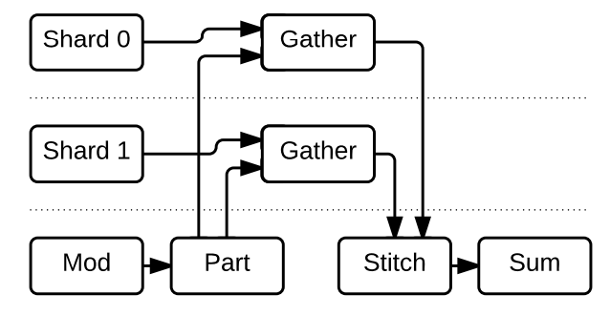
Extensibility case study
Training very large models (large sparse matrix)
Gather: extracts a sparse set of rows from a tensor
Part: divides the incoming variable-sized tensors that contain the indices destined for each shard
Stitch: reassembles the partial results from each shard into a single result tensor

Slide 19
Fault tolerance
User-level checkpointing using Save and Restore
Run Save periodically to produce a new checkpoint
When the client starts up, it attempts to Restore the latest checkpoint
Users can customize the checkpoint retention scheme

Slide 20
Synchronous replica coordination
TensorFlow provides both asynchronous parameter updates and synchronous parameter updates

Slide 21
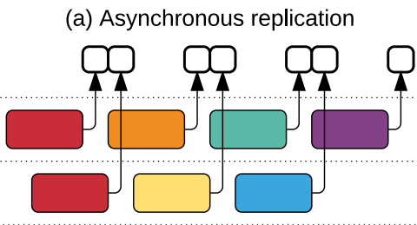
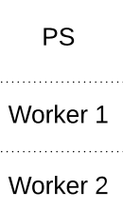
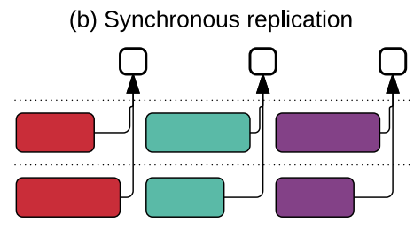
Synchronous replica coordination
Asynchronous:
Pro: ensure high utilization
Con: Use stale parameter values, making each step less effective
Synchronous:
Pro: Accumulates updates from all workers before applying them
Con: Slow

Slide 22
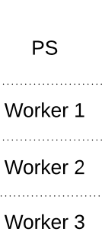
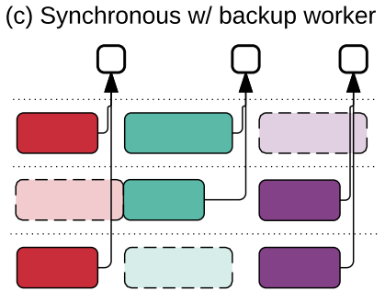
Synchronous replica coordination
To mitigate stragglers, TensorFlow implements backup workers.
Run proactively

Slide 23
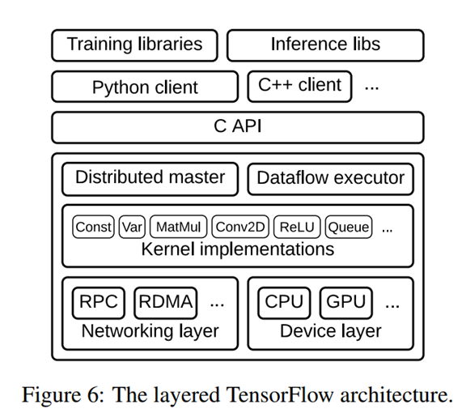
Implementation overview
User level code
C API
Core Tensorflow library

Slide 24
Implementation Core Runtime
Distributed master
Translates user request into execution
Prunes and partitions graph to obtain subgraphs
Caches and reuses subgraphs
Dataflow executor
Handles requests and schedules execution of kernels
Dispatches kernels to local devices
Runs kernels in parallel

Slide 25
Implementation Core Runtime
Distributed master
Translates user request into execution
Prunes and partitions graph to obtain subgraphs
Caches and reuses subgraphs
Dataflow executor
Handles requests and schedules execution of kernels
Dispatches kernels to local devices
Runs kernels in parallel

Slide 26
Implementation details
User level code features described previously
User composes higher standard operations to build higher-level abstractions
Neural network layers, optimization algorithms
Sharded embedding computations
Supports multiple client languages
Key: port established features to C++ to optimize implementation from all client languages
Can register additional efficient kernels in C++
Most of the operation kernels are implemented using Eigen: Tensor, which uses C++ templates to to generate efficient parallel code for multi core CPU and GPUs

Slide 27
Difference with related work
Mainly developed from DistBelief
Implemented layers in C++
Ability to design and test new training method
Refine algorithms to accelerate training process
Similarities and differences with other models
Express model as dataflow (As Theano, Cafe, unlike Torch)
Offers a powerful imperative programming model (Torch)
Uses parameter server architecture (Similar to MXNet)
Less costs in batch dataflow (SparkNet )

Slide 28
Commonly compared model: keras
TensorFlow
Easy Model Building
Robust ML Production Anywhere
Powerful Experimentation For Research
Keras
Modular and Composable
Can easily write custom building blocks
Offers consistent & simple APIs which helps in minimizing the number of user actions required

Slide 29
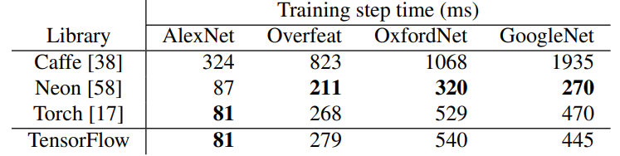
Evaluation
Single-machine benchmarks
Scalability doesn’t mask poor performance at small scales

Slide 30
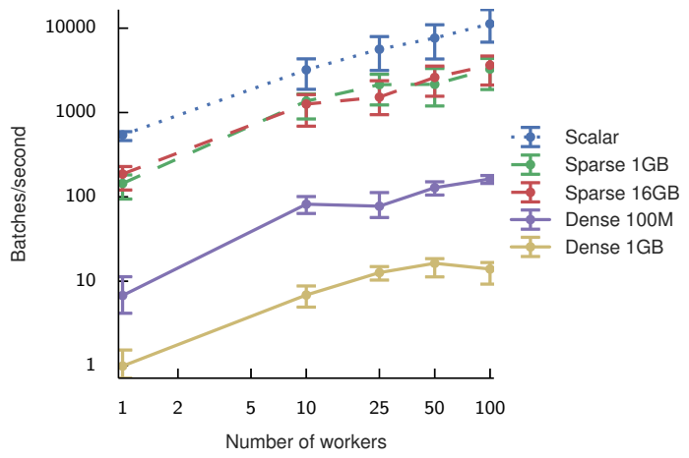
Evaluation
Synchronous replica microbenchmark

Slide 31
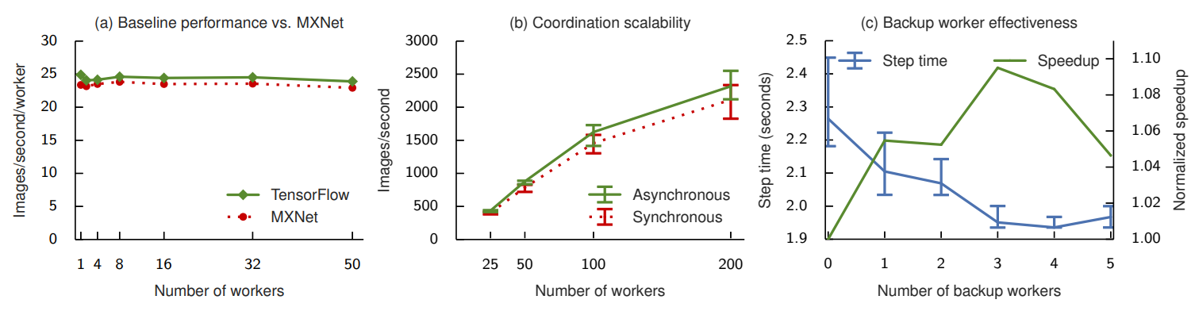
Evaluation
Performance evaluation on Inception-v3 model

Slide 32
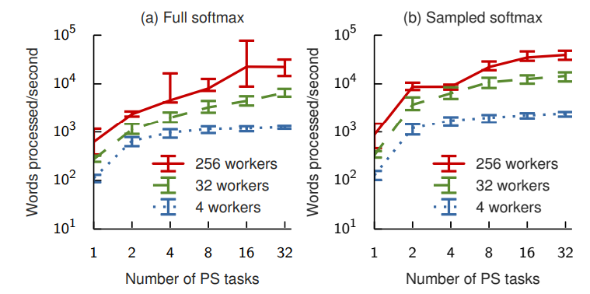
Evaluation
Performance of training a RNN on One Billion Word Benchmark

Slide 33
PyTorch
An Imperative Style, High-Performance Deep Learning Library

Slide 34
Background & Motivation
Deep learning frameworks trade off usability for speed
Caffe, CNTK, TensorFlow, Theano: construct static dataflow graph for computation and repeatedly apply to batches of data
Theoretically improves performance and scalability
Introduces usability & flexibility problem
Notes:
-builds static dataflow graph ahead of runtime
Performance: compiler visibility into the whole computation ahead of time
-Unfortunately, limit the types of computation that can be represented
Usability: the cost of ease of use, ease of debugging

Slide 35
Background & Motivation
Deep learning frameworks trade off speed for usability
Dynamic eager execution:define-by-run, operations return concrete values instead of constructing a computational graph to run later
Fast debugging, easy to use
Sacrifices performance or applicability
Notes:
More recently, TensorFlow
Less expressive faster language (Torch, DyNet) limits applicability

Slide 36
Background & Motivation
Recent trends:
Array-based programming involving tensors & operators
Automatic differentiation
Convergence to the open-source Python ecosystem
Hardware accelerators driven by deep learning kernals
PyTorch: Dynamic eager execution library with automatic differentiation and GPU acceleration
Maintains performance and achieves usability
Notes:
High productivity
Technique improves usability and enables efficient gradiant based optimization
Benefits being in this network
Performance-wise

Slide 37
Design Principles
Be Pythonic
Put researchers first
Provide pragmatic performance
Worse is better
Notes:
Maximize usability
Deliver compelling performance
Stay simple, easy to maintain, features can be incomplete

Slide 38
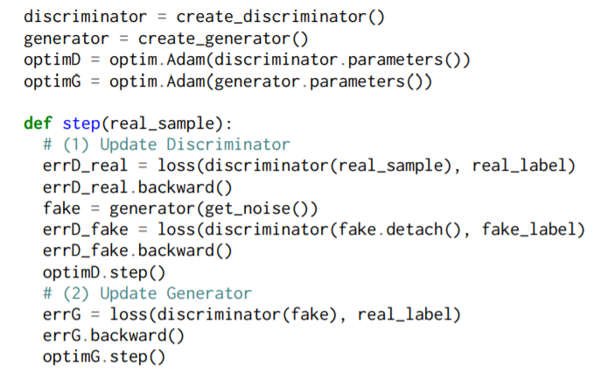
Usability centric design
To support the growing complexity of neural networks, PyTorch builds models, optimizers and data loaders by imperative Python without graph-metaprogramming.
Benefit: easy implementation for new potential neural network architecture
E.g. layers: stateful functions with implicit parameters
= Python class constructors create & init. param., forward methods process an input activation
E.g. Adversarial Neural Network
Notes:
- Give up the potential benefits of data flow graphs, in order to preserve the imperative programming model of Python
- Users observe any intermediate results
- Adversarial: Discriminator & Generator

Slide 39
Usability centric design
Easy and efficient interoperability: PyTorch supports bidirectional data-exchange with external libraries
Benefits: shared memory region, small/no cost of copy
E.g.
.numpy
Memory
PyTorch
Numpy
torch.from_numpy()
Notes:
Ensures inter-operability and extensibility by
For example, PyTorch tensor can be transformed into Numpy array and vice versa.
An amazing feature is PyTorch uses shared memory space rather than copying over data.
Both PyTorch and Numpy describe how to interpret a memory region.
This means no matter how large the tensor is, data copying will not drag down performance.

Slide 40
Automatic differentiation
Goal: automatically compute gradients of random Python programs
Problem: Python is dynamic, source-to-source differentiation not applicable
Operator overloading
Builds up a representation of the computed function every time it is executed
Feature: differentiate code employing mutation on tensors
Tradeoff: not supporting copy-on-write, to avoid subtle performance cliffs
Notes:
Gradient based optimization is vital
Currently: Reverse-mode automatic differentiation: computes the gradient of a scalar output w.r.t. a multivariate input
Basic building blocks of imperative programs

Slide 41
Performance focused implementation
Python global interpreter lock limits only one thread runs at a time.
C++ core for tensor data structure, GPU and CPU operators and basic parallel primitives
automatic differentiation system, gradient formulas for most built-in functions included → evaluator won’t hold GIL
Notes:
Despite integrated into Python ecosystem, the core of PyTorch is implemented in C++.
This includes ...

Slide 42
Separated control and data flow
PyTorch separates control flow and data flow.
Control flow
handled by Python and C++ executed on the host CPU
Data flow
CUDA stream mechanism
asynchronously fed CUDA kernal queue invocations to GPUs
Control flow
Host CPU
GPUs
CUDA kernal queue
Overlap the execution of Python code on CPU with tensor operators on GPU → saturates GPU and maximize performance

Slide 43
Custom caching tensor allocator
Optimize speed of the dynamic memory allocator
GPU cudafree routine tends to block GPU for queued work.
PyTorch: One-pool-per-stream
Incrementally builds up a cache of CUDA memory without using CUDA APIs
Tuning for specific memory usage patterns of DL and maintaining distinct pool of memory for every CUDA stream (work queue)
Benefits: skip synchronization by serialized CPU-GPU execution
Limitation: fragmented allocation by stream (uncommon in practice)
Notes:
-CPU runs ahead of GPU, frees memory ahead of GPU, the allocator reallocates memory immediately as long as same stream uses the memory region
-Multiple streams uncommon, CUDA kernels can’t easily share GPU

Slide 44
Multiprocessing
Python multiprocessing
A workaround for GIL: module spawns child processes and implement basic inter-process communication primitives.
Problem: inefficient serialization with large arrays.
PyTorch torch.multiprocessing
Drop-in extension for Python multiprocessing
Tensor uses shared memory space to avoid communication cost.
Benefits: User can easily implement heavily parallel programs that operate on independent GPUs
CUDA tensor sharing transparency
Notes:
-Weaken global interpreter lock process isolation
-Programming model close to regular threaded programs

Slide 45
Reference counting
Goal: Users increase batch sizes to speed up process, we allocate memory resource reasonably.
Automated garbage collection
Pro: good amortized performance.
Con: deferred deallocation leaves unacceptable memory overhead
PyTorch: Reference counting
Track num. uses of each tensor, deallocates once count reaches 0
Pro: release memory ASAP
Limitation: language counting support required
Notes:
-Garbage collection: the runtime periodically investigates the states of the system, enumerates used objects and frees everything else
-Tracks count internal to the libtorch library and external references
-Relies on a reference counting scheme, or languages that allow for user-defined behavior for assignment, copies and moves

Slide 46
Discussion
What do you think is the limitation of parameter server architecture?
not flexible for new optimization methods

Slide 47

Discussion
Tradeoff of including Dynamic Control Flow
TensorFlow: Include Dynamic Control Flow
Pytorch: Handle by PyTorch
TensorFlow vs. Pytorch?

