Slide 1
Towards Federated Learning at Scale: System Design
Presented by: Xiangfeng Zhu, Jiachen Liu, Chris Chen

Slide 2
What is Federal Learning ？
“
Federal Learning is a distributed machine learning approach which enables training on a large decentralized data residing on devices like mobile phones.
”

Slide 3
Introduction - System
This paper report a system design for federal learning algorithm in the domain of mobile phones (Android)
Platform: TensorFlow framework, Android mobile phones
Data: Data distributed on device
Training: Weight combined in the Cloud with Federal Average
Users’ privacy is ensured by Secure Aggregation
Inference: Mobile device pulls global model for inference
Application: Has been applied in large scale applications

Slide 4
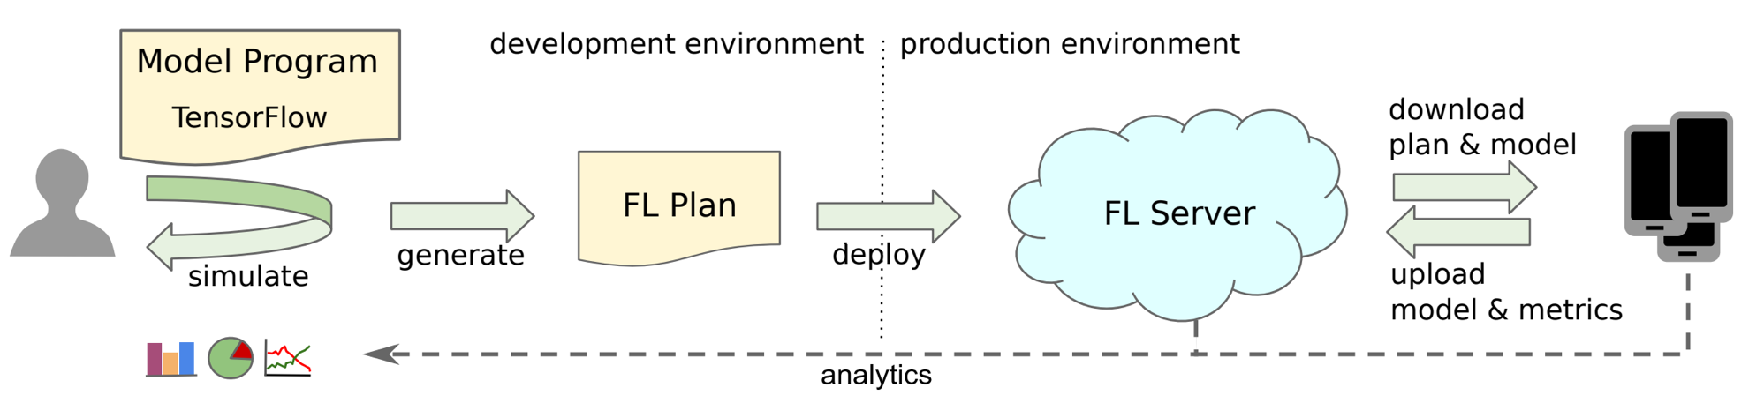
Protocol - Definition
Participants:
Devices: run FL tasks
FL server: coordinates their activities
FL population: A learning problem or application
FL plan: Instruction on what computation to run on a device assigned by the server.
TensorFlow graph and execution instruction

Slide 5
Protocol - Definition
FL task: A specific computation for a FL population
FL checkpoint: global model state
Round: A rendezvous between device and server

Slide 6
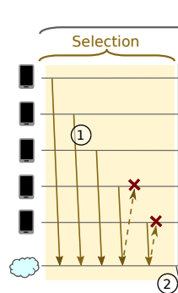
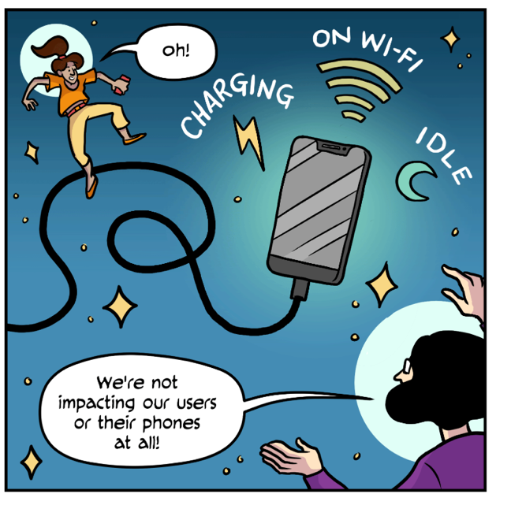
Selection
The server selects a subset of typically a few hundred which are invited to work on a specific FL task.
https://federated.withgoogle.com/
Notes:
\

Slide 7
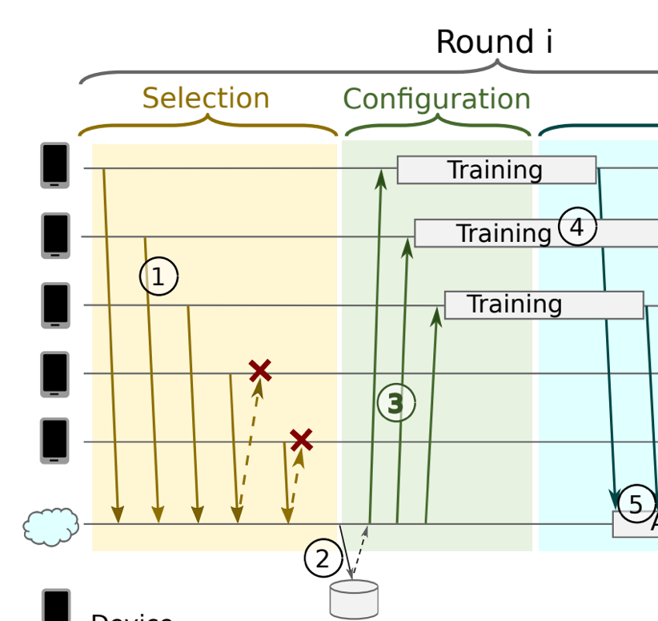
Configuration
The server sends the current global model parameters and any other necessary state to the devices as an FL checkpoint.
The devices perform their local computation and send an update back in FL checkpoint form.

Slide 8
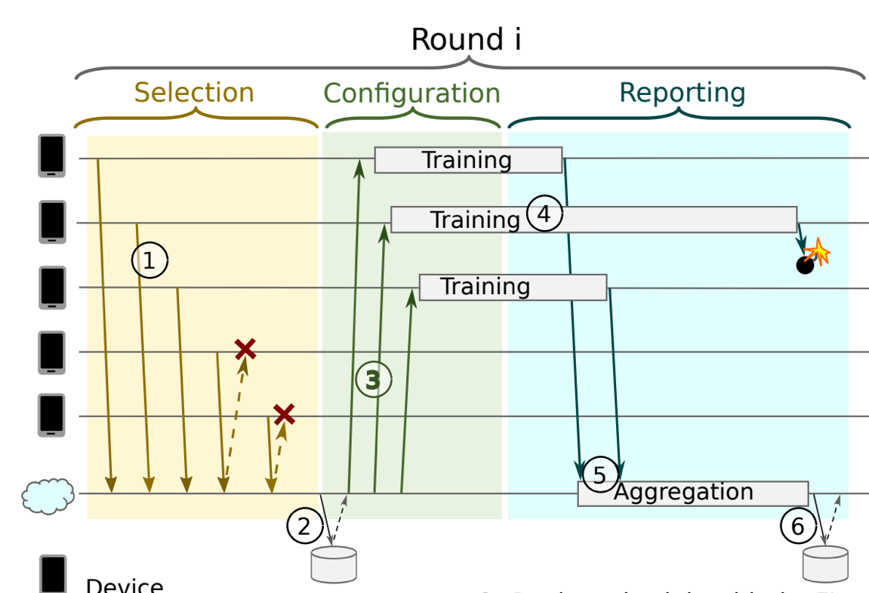
Reporting
When a device is ready, it reports an encrypted model update back to the server
Server aggregates updates as they arrive
Server closes round once seen enough reports

Slide 9
Protocol – Pace steering
A flow control mechanism regulating the pattern of device connections
It enables FL server to scale to varying FL populations
Small FL population: ensure sufficient devices to connect to the server simultaneously
Large population : randomize device check-in times to stabilize the flow

Slide 10
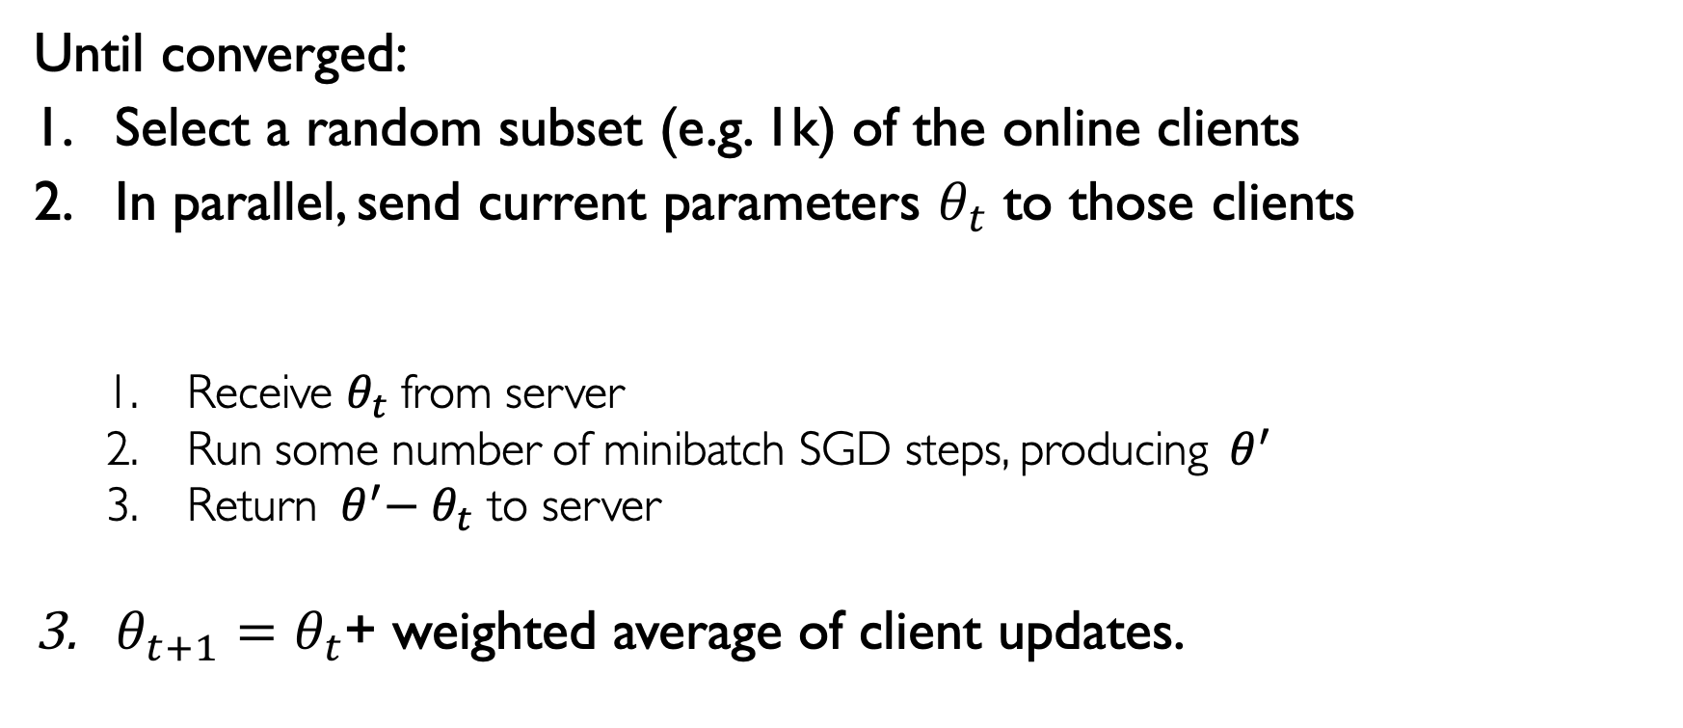
FedAvg
Server
Until converged:
Select a random subset (e.g. 1k) of the online clients
In parallel, send current parameters $θ_{t}$ to those clients
Receive $θ_{t}$from server
Run some number of minibatch SGD steps, producing${ θ}^{′}$
Return ${ θ}^{′}− θ_{t}$ to server
$θ_{t+1}=θ_{t}$+ weighted average of client updates.
Selected Clients

Slide 11
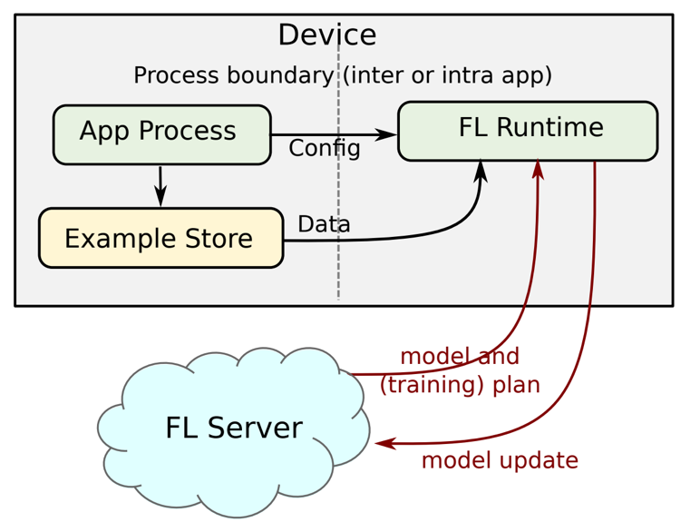
Device (Android)
Application collects and stores on device training data
Training is scheduled as a background job
Avoid negative impact on user experience

Slide 12
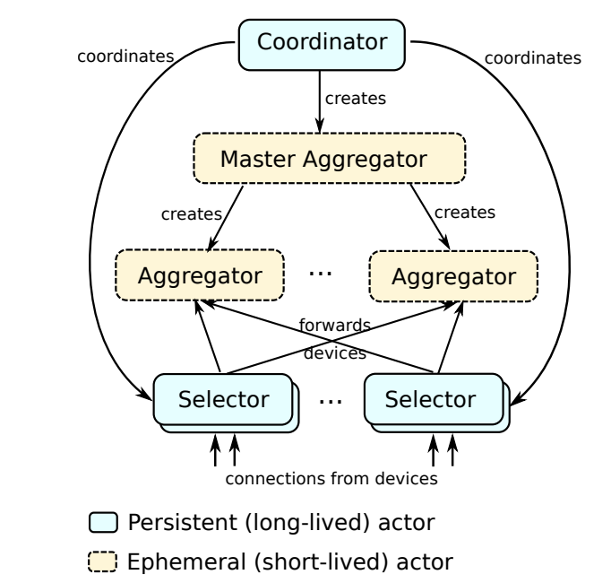
Server
Coordinator manages a training population
Selectors accept and forward device connections
(Master) Aggregators process device reports

Slide 13
Some numbers
Advances and Open Problems in Federated Learning by Kairouz et al (2019)

Slide 14
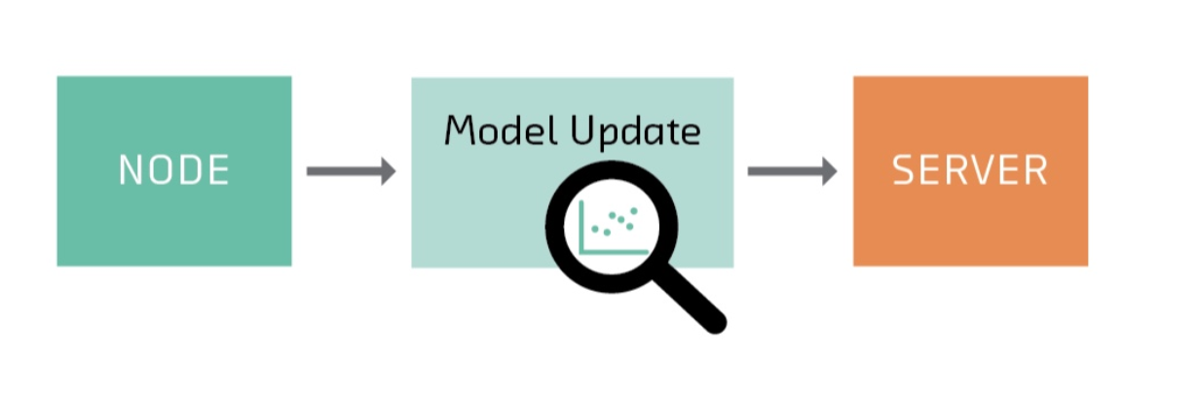
Security and Privacy

Slide 15
Deep Models under GAN by Hitaj et al. (2017)

Slide 16
Homomorphic encryption and secure aggregation – nodes encrypt the model updates such that the average can still be computed.
Differential privacy- nodes perturb the model updates such that the average can still be computed.

Slide 17
Applications of FL
What makes a good application?
On-device data is more relevant than server side proxy data
On-device data is privacy sensitive or large
Labels can be inferred naturally from user interaction
Example application
Language Modeling(e.g., next word prediction) for mobile keyboards
Image classification
Browser search query suggestions
…

Slide 18
Questions?

Slide 19
Scaling Video Analytics on Constrained Edge Nodes
Presented by: Xiangfeng Zhu, Jiachen Liu, Chris Chen

Slide 20
Motivation
In smart cities, cameras are ubiquitous
More deployments, and importantly, more applications

Slide 21
Target environment
Relevant events are rare
Data center applications require high-quality videos

Slide 22
Summary
Limited bandwidth
Infeasible for real-time streaming
Solution: filtering on edge nodes
Real-world video streams
High-quality videos with fine-grained details from wide-angle cameras
Solution: novel NN architectures
Scalable multi-tenancy
High computational costs
Solution: reuse shared computation

Slide 23
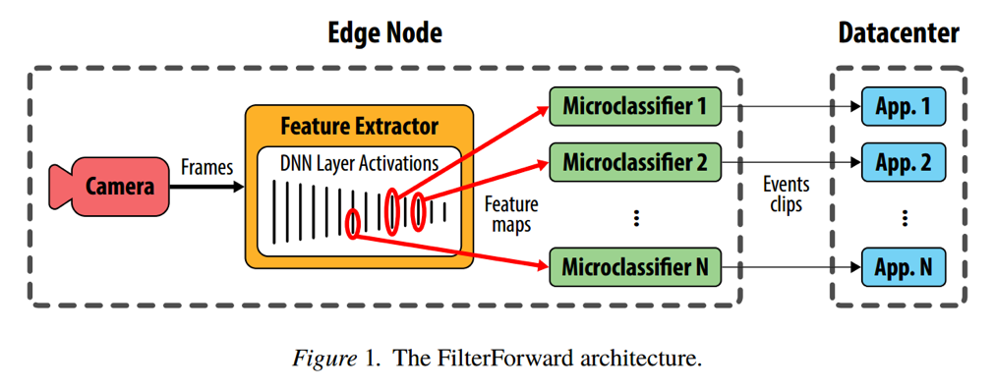
FilterForward
Filter
Identifies the most relevant video sequences
Forward
Offloads only the relevant data to datacenters for further processing

Slide 24
Filter
Goal
Identify frames of interest, e.g. frames containing dogs/cats.
Naïve approach
For each application, run a DNN for classification.
Though we can run DNNs in parallel, it’s too computationally expensive.
New approach by FilterForward
Base DNN + Microclassifiers(MCs).
Reuse shared computations.
High upfront costs but scale well.

Slide 25
Filter – Feature Engineering
Base DNN processes every frame.
Feature extractors take intermediate results (activations) and produce feature maps.
Feature maps are reused/shared by the MCs.

Slide 26
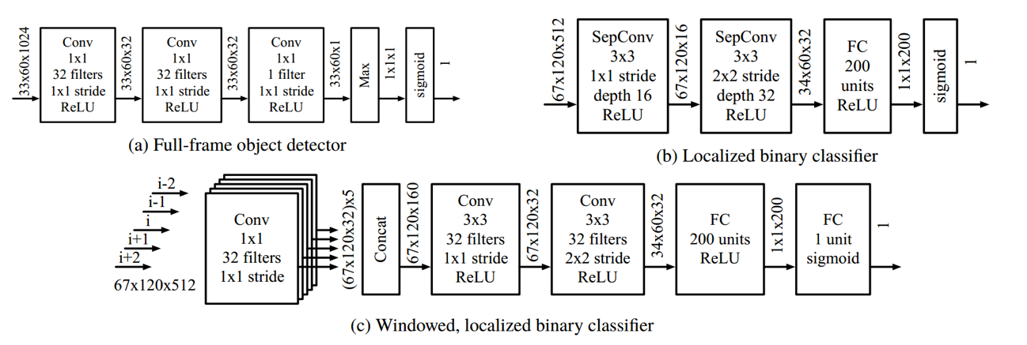
Filter - Microclassifiers
MCs (lightweight binary classification NNs) take feature maps and perform binary classification specific to each analytic application.

Slide 27
Filter – Detection of events
Per-frame classifications → events
Window: each MC’s results for N consecutive frames
Apply K-Voting to a window: at least K of the N frames are positive
False negatives are tolerable while false positives are detrimental
N = 5, K = 2

Slide 28
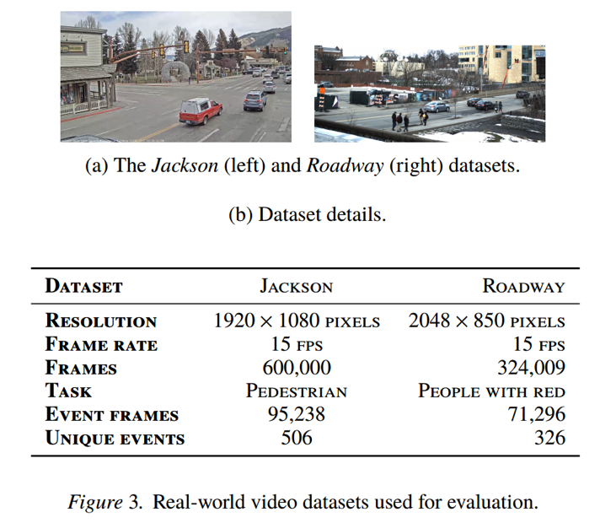
Evaluation - Setup
Hardware
Desktop computer with a quad-core Intel Core i7-6700K CPU and 32 GB of RAM to simulate an edge node.
Datasets
Video captured from a traffic camera deployment in Jackson Hole, Wyoming. Detect pedestrian appearance.
Video from a higher-quality camera deployed on a city street. Detect “people with red.”

Slide 29
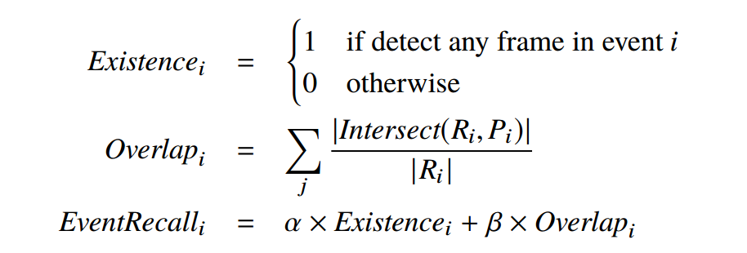
Evaluation - Metric
Event F1 Score: EventRecall
Existencei –detecting at least one frame from an event
Overlapi –detecting an increasing fraction of the frames from an event
Ri – ground truth event range
Pi – predicted event range
α = 0.9, β = 0.1: prioritize detecting a single frame in each event

Slide 30
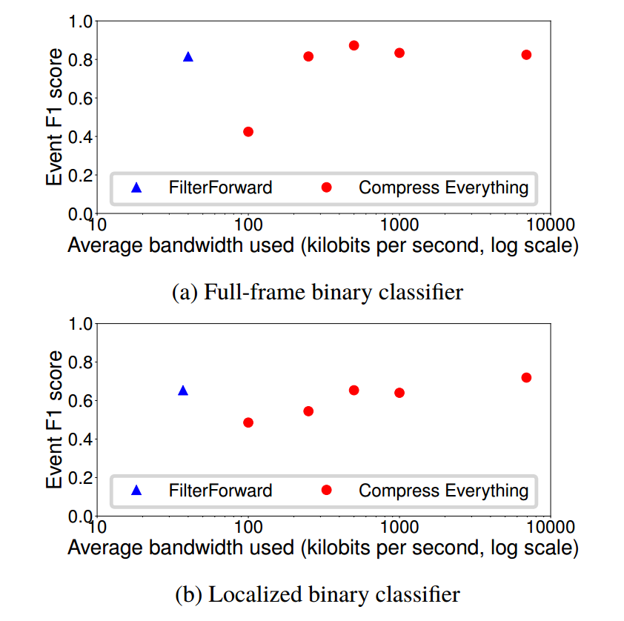
Evaluation – Accuracy VS Bandwidth
1.0 - all bandwidth is spent sending useful true positive frames

Slide 31
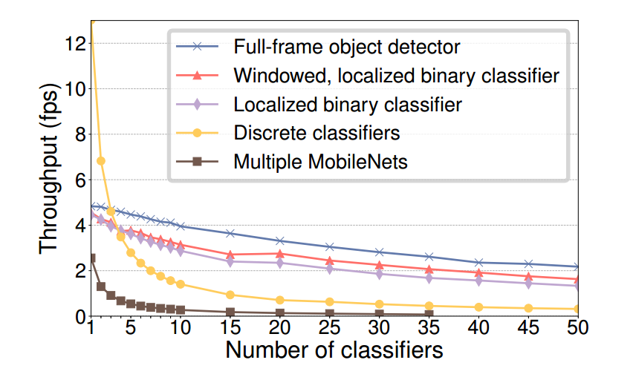
Evaluation - Scalability

Slide 32
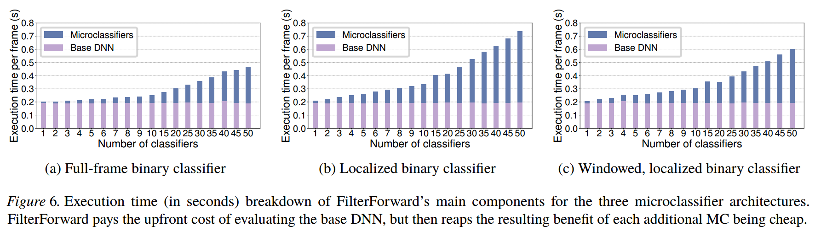
Evaluation - Scalability

Slide 33
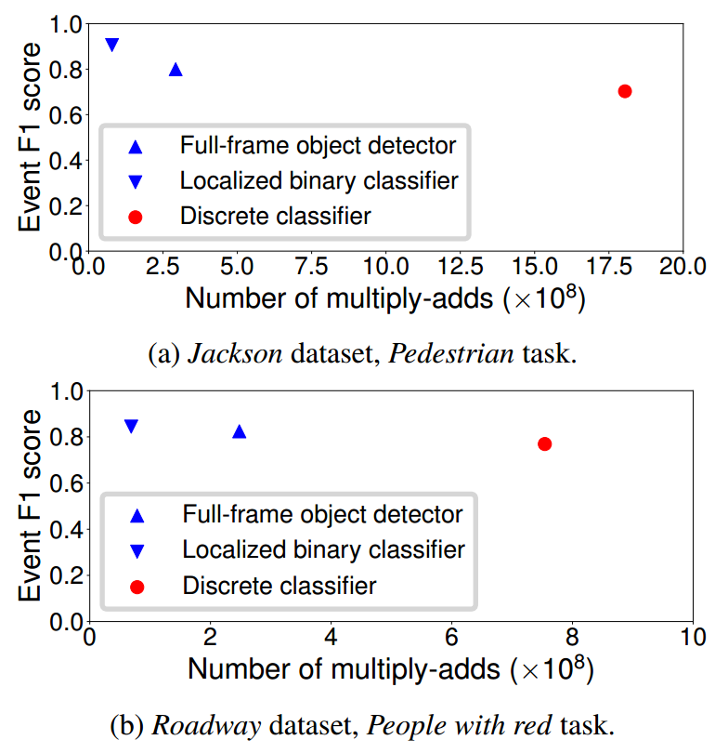
Evaluation – Computational Cost

Slide 34
Conclusion
Hybrid edge-to-cloud design
Reduce bandwidth use without sacrificing accuracy
Good for bandwidth-limited, compute-constrained edge deployment.

Slide 35
Discussion
More appropriate base DNNs?
Ensemble methods?
Dynamic architecture?

