Slide 1
Accelerators: TPU & FPGA

Slide 2
In-Datacenter Performance Analysis of a Tensor Processing Unit

Slide 3
Training vs. Inference
Typically, floating point is used for model training
GPUs are popular for floating point matrix operations
Throughput is the primary requirement
Inference often takes place on quantized models
Transform floating points to integer
Energy- and space-efficient from a hardware design perspective
User-facing; hence, latency is king
GPUs (at least K80) are inefficient for most Google workloads

Slide 4
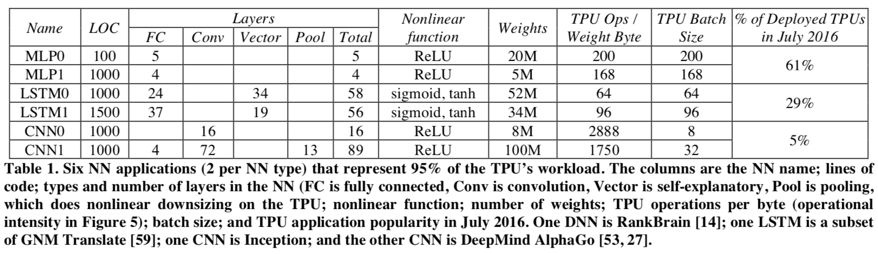
Google NN Workloads

Slide 5
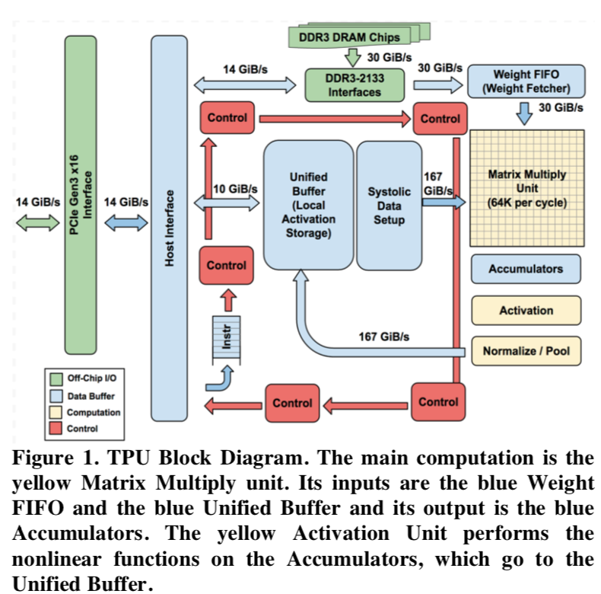
Architecture
To reduce the delay of deployment, the TPU was designed to be a coprocessor on the PCIe I/O bus
The TPU instructions are sent from the host over the PCIe Gen3 x16 bus into an instruction buffer
Internal blocks are connected together by 256-byte-wide paths

Slide 6
Compute: Matrix Multiply Unit(MMU)
Contains 256x256 MACs (Multiply Accumulate Unit)
Performing 8-bit multiply and adds on signed or unsigned integers
Output is 16-bit data
The matrix unit produces one 256-element partial sum per clock cycle
Can work when using a mix of 8-bit weights and 16-bit activations (or vice versa)
Half and quarter speeds respectively

Slide 7
IO Bandwidth
External
14 GiB/s to PCIe interface
30GiB/s to DDR3 interface
Internal
10 GiB/s for control plane
167 GiB/s for data plane

Slide 8
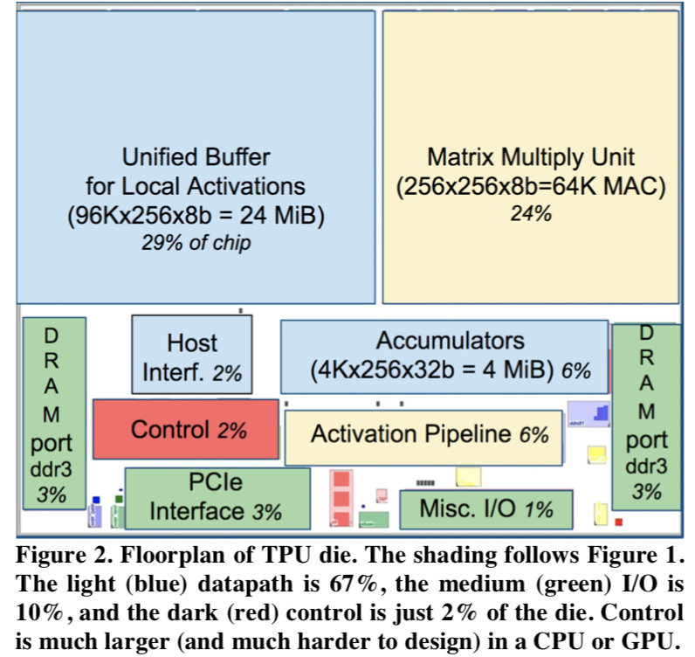
Space Management
Unified Buffer is almost a third (29%) of the die
MMU is a quarter (24%)
Interfaces take up about 10%

Slide 9
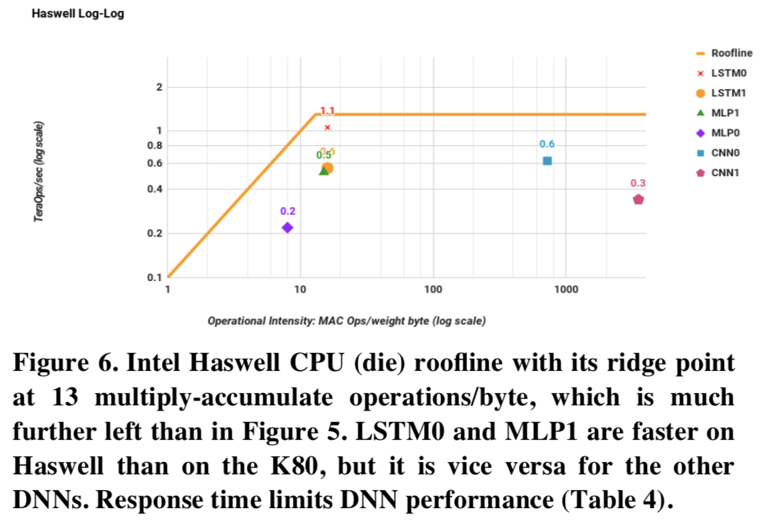
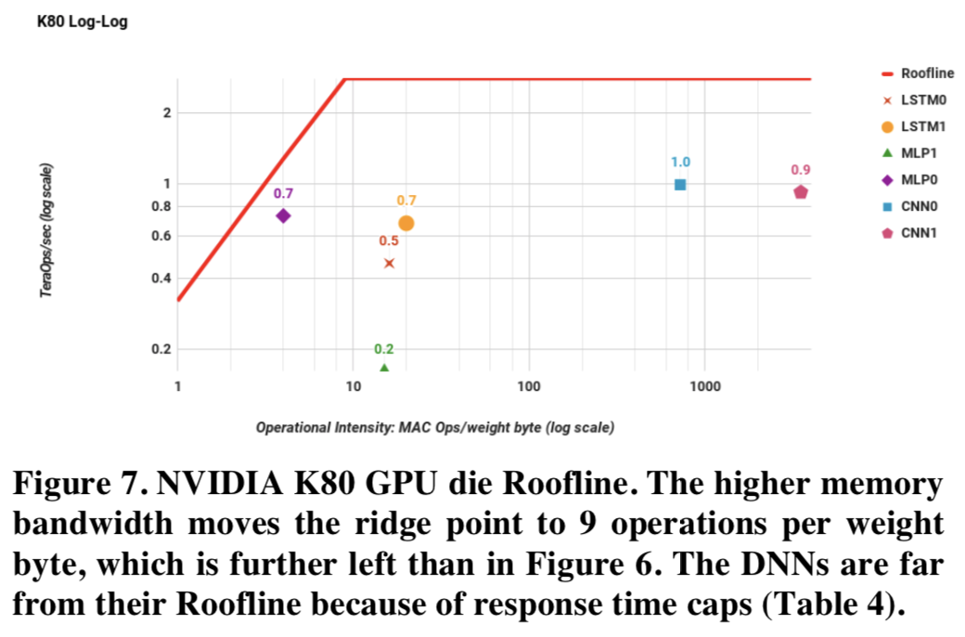
Performance
Intel Haswell
NVIDIA K80

Slide 10
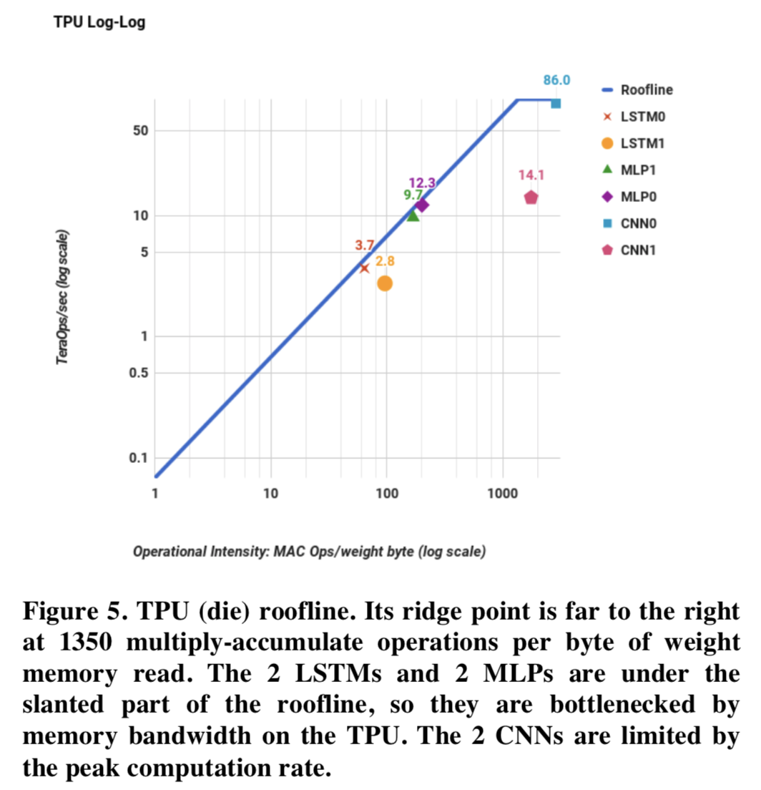
Performance: TPU
Performance is limited by memory bandwidth rather than by peak compute for most

Slide 11
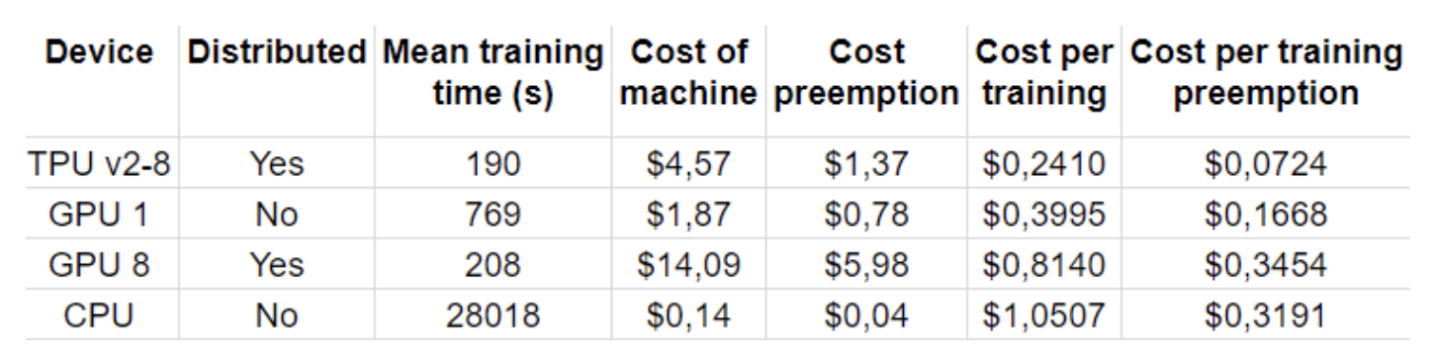
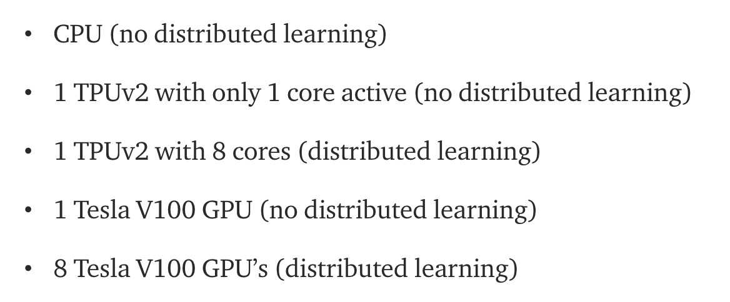
TPUv2
Fashion-MNIST Dataset
More memory
More bandwidth
Cluster configuration
Can do both inference and training
GPUs are catching up
Tensor Core in V100 GPUs
T4 for inference
https://medium.com/bigdatarepublic/cost-comparison-of-deep-learning-hardware-google-tpuv2-vs-nvidia-tesla-v100-3c63fe56c20f

Slide 12
Discussion
How to design an ASIC?
What’s the most important resource?
How to measure performance?
ASIC vs. FPGA?
Google abandoned due to performance and power concerns

Slide 13
Direct Universal Access: Making Data Center Resources Available to FPGA

Slide 14
FPGA are Flexible
Computation
Web search ranking
Deep neural networks
Big data analytics
Networking
Network processing
Database/Storage
SQL
Key-value store

Slide 15
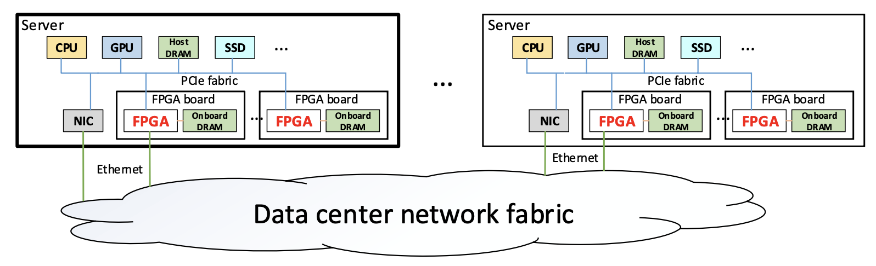
Typical FPGA Deployment in Datacenters

Slide 16
Typical FPGA Deployment in Datacenters
Problems
Too many interfaces
Too many namespaces
Difficult to share
Security issues

Slide 17
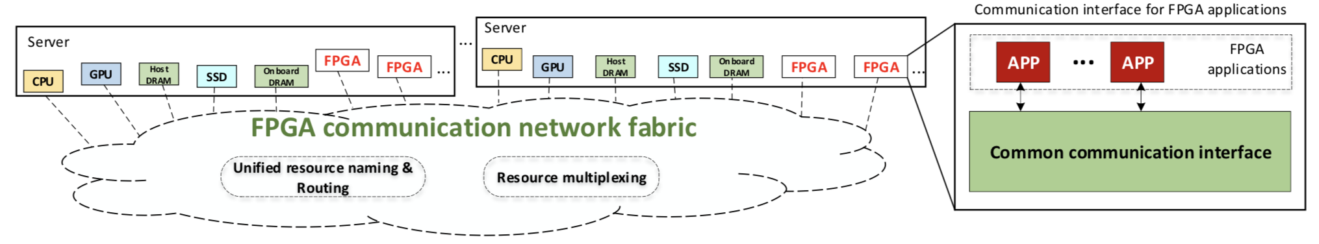
Ideal Solution
Global names
Common communication interface
Transparent routing and resource sharing

Slide 18
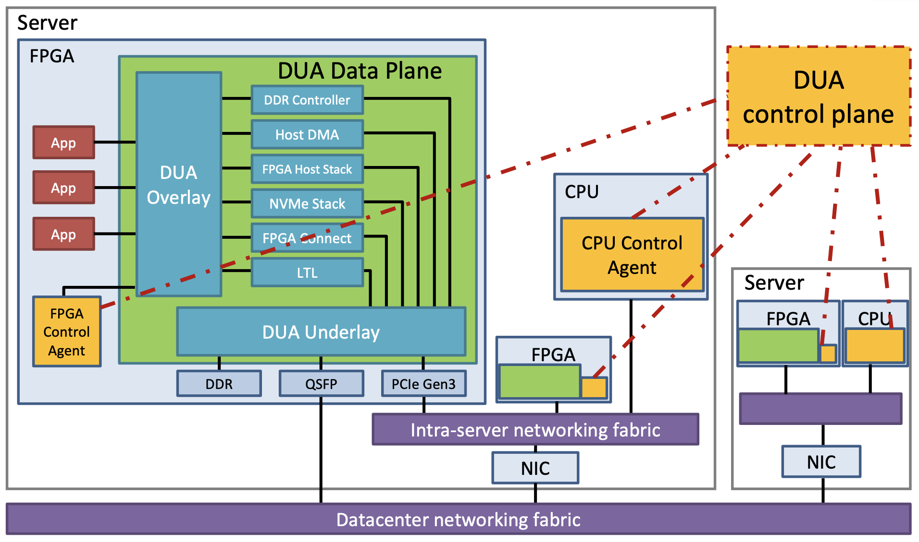
DUA Control Plane
Resource management
Route calculation
Policies
Source: DUA NSDI’19 presentation slides

Slide 19
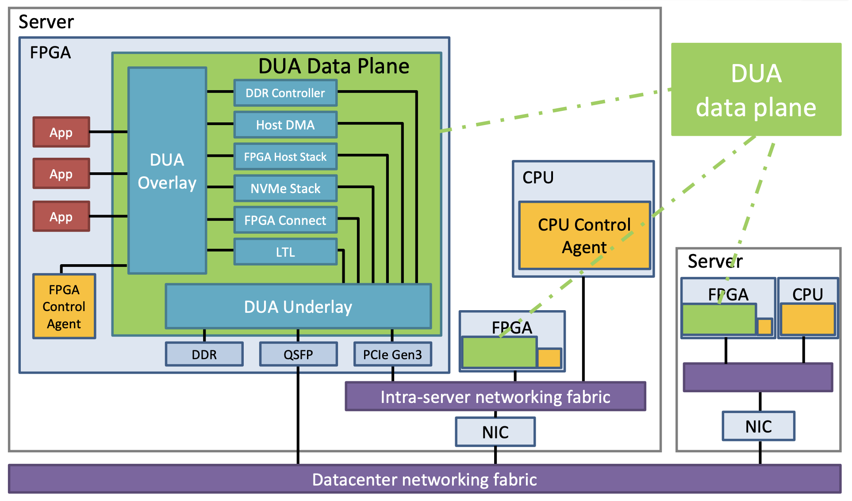
DUA Data Plane
Overlay
Unified interface
Routing
Underlay
Multiplexing
Security
Source: DUA NSDI’19 presentation slides

Slide 20
How to Scale?
Hierarchies
Naming/Addressing
Routing
Decentralization

Slide 21
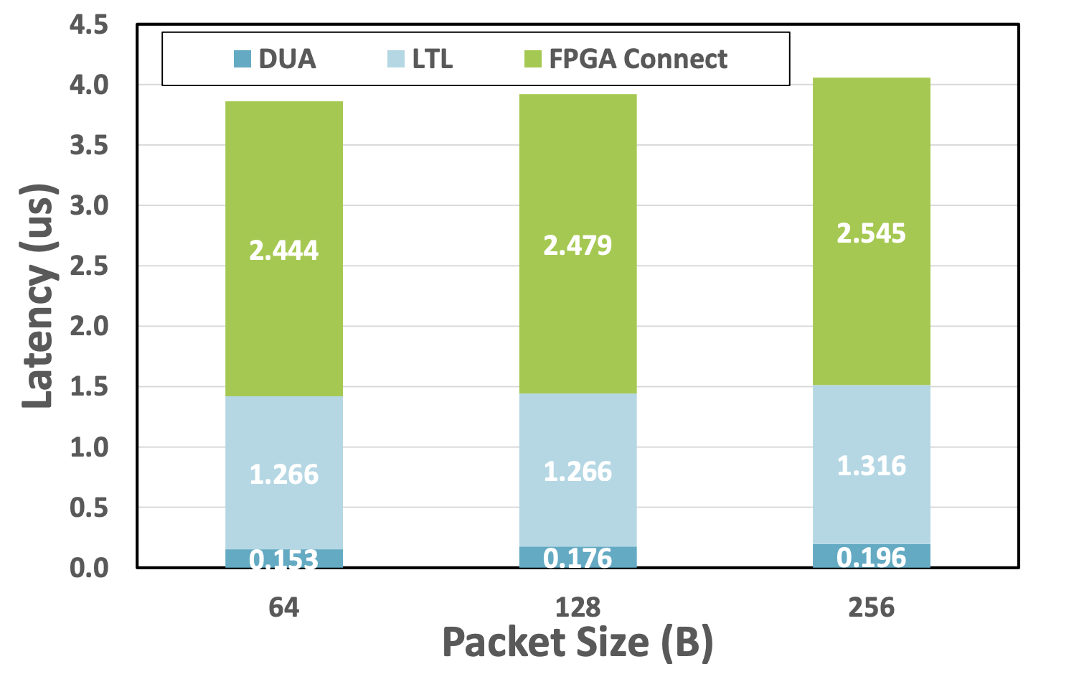
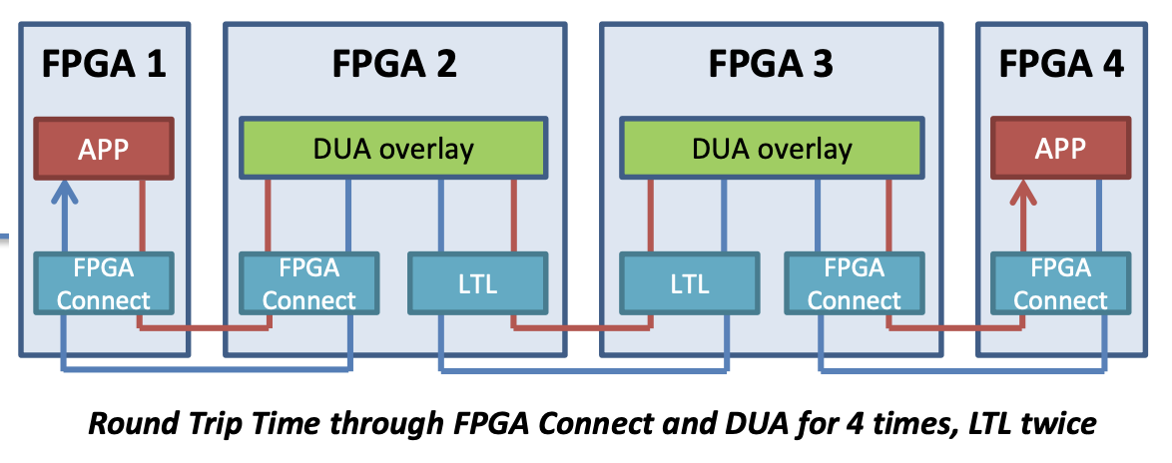
Latency
Source: DUA NSDI’19 presentation slides

Slide 22
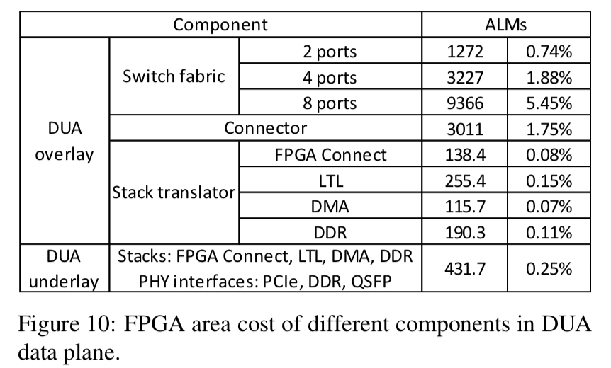
Area
Altera Stratix V D5, with 172.6K ALMs of programmable logic
10% total overhead
Notes:
Adaptive Logic Module (ALM)

Slide 23
Discussion

