Slide 1

Tiresias & Optimus
GPU Cluster Manager
for Distributed Deep Learning
EECS 598
By Juncheng Gu
Notes:
Tiresias /taɪˈriːsiəs/
Efficient and Information agnostic GPU cluster manager for DDL
This is a work done by Umich and researchers from xxxxx

Slide 2



GPU Cluster for Deep Learning Training
Deep learning (DL) is popular
10.5× increase of DL training jobs in Microsoft
DL training requires hardware accelerator (GPU)
GPU cluster for DL training
5× increase of GPU cluster scale in Microsoft _{[1]}
Leverage multiple GPUs
Distributed deep learning (DDL) training
How to efficiently manage a GPU cluster for DL training jobs ?
[1]. Analysis of Large-Scale Multi-Tenant GPU Clusters for DNN Training Workloads, https://arxiv.org/abs/1901.05758
Notes:
DL tech has been widely used in many domains, such as OD, Speech recog,….
With the increase of applications, more jobs need to be trained
In MS, the amount of DL training jobs has a 10.5 increa
Normally, DL training job are computing intensive, and require GPU to accelerate
With the increase of demands, many companies have built their own GPU cluster
GPU cluster to train their DL models
…
In this work, we will see what are the challeges faced by DL training jobs, and how to ….
The general question we try to answer is
How different from GPU cluster to the traditional cluster for big data applications in terms of resource management
Can we rely on the existing cluster manager for big data applications?

Slide 3
Tiresias
Information-agnostic
GPU cluster manager for Distributed Deep Learning
Schedule DL training jobs with unpredictable execution time
Place jobs with relaxed consolidation scheme

Slide 4
GPU Cluster Manager
Job Queue
Scheduler
Design Objectives
2
4
1
2
Placement Scheme
1
Minimize
Cluster-Wide Average
Job Completion Time (JCT)
1
N
N-GPU DL job
Free GPU
Achieve
High Resource (GPU) Utilization
Occupied GPU
4-GPU server
GPU Cluster
Notes:
Let’s firstly get the overview of a GPU cluster manager
Assuming we have a GPU cluster
4-GPU in a single server
Users submit their jobs in an online fashion to the system.
There is a job queue of CM holding the submitted jobs
The job scheduler in CM should schedule jobs based on the cluster status and requirements from jobs.
After that, the job will be in the placing stage. The placement scheme will alocate the requireds resource for the job, and forward it into the cluster to execute.
For a good CM, its scheduler should be designed for minimizing,…;
And its placement scheme should
A good CM should be able to minimize …. And also maximize …
GPU requirement is a user input
Howver, as a new kind of workload, DL training jobs bring some unique challenges to the cluster manager

Slide 5

Challenge Ⅰ: Unpredictable Training Time
Unknown execution time of DL training jobs
Jobs’ execution time is useful when minimizing JCT
Shortest-job-first (SJF), shortest-remaining-time-first (SRTF)
Predict job’s execution time
Use the smooth loss curve of DL training jobs (Optimus _{[1]})
It’s hard to predict training time of DL jobs in real cases
1.0
⎯ DSSM
⎯ ResNext
⎯ Seq2Seq
1.0
0.5
0.5
Norm. Train. Loss
Norm. Train. Loss
⎯ Job₁
⎯ Job₂
0.0
0.0
Progress
Progress
[1]. Optimus: An Efficient Dynamic Resource Scheduler for Deep Learning Clusters, EuroSys’18
Notes:
Time-based scheduling algorithms are often applied for minimzing the ave. JCT Such as xxxxxx,
Those algorithm require xxxx which is unaware for DL training jobs
Fortunately, for well-defined models, they often have smooth loss cruve which is easy to learn.
Using this feature, people can estimate the remaining execution time of the training jobs, and using in job scheduling.
However this method is not always valid in real cases.
DL models are explored in a trial-and-error manner. Many jobs are trials. Their models can have errors and bad configurations.
Because of these, their loss curve are non-smooth and unable to learn
Moreover, Because of the same reason, many jobs are killed by their users at early stage. Only a small portion of jobs can run to completion.
Therefore, for DL jobs, it’s hard (if not possible) estimate the execution time.
Deep Semantic Similarity Model (DSSM)

Slide 6
Challenge ⅠⅠ: Over-Aggressive Job Consolidation
Network overhead in DDL training
Consolidated placement for good training performance
Fragmented free GPUs in the cluster
Long queuing delay
4
4
N
N-GPU Job
Job Queue
Free GPU
Occupied GPU
Machine 2
Machine 1
Machine 2
Machine 2
Machine 3
Machine 4
Notes:
For cost effectiveness, the GPU cluster manager should achieve high GPU untilizaition
However, there can be fragmented free GPUs on individual servers
In this example, each server have one free GPU.
Sometimes, it’s hard to utilize those fragrmented GPU resource if the next job is a multi-GPU one.
If the GPU resource in a D T job are from different servers. There will
It’s been believed that the network overhead in training will greatly slow down the training process

Slide 7
Prior Solutions
I. Unpredictable Training Time
(Scheduling)
II. Over-Aggressive Job Consolidation
(Job Placement)
Optimus_{[1]}
None
None
YARN-CS
FIFO
None
Gandiva_{[2]}
Time-sharing
Trial-and-error
Tiresias
Information-agnostic
Model profile-based
[1]. Optimus: An Efficient Dynamic Resource Scheduler for Deep Learning Clusters, EuroSys’18
[2]. Gandiva: Introspective Cluster Scheduling for Deep Learning, OSDI’18
Notes:
The design of GPUCM for DL training, has received many a
There have been several designs proposed .
In Industy, companies are using the traditional DL applications, such as YARN-CS.
In
Among current approaches, YANR-CS is production, it uses FIFO scheduling and consolidation placement.
Optimus and Gandiva are two state-of-the-art soultions from academia.
The first one relies on the smooth loss curve for prediction.
The second schedules job in time-sharing manner.
However, none of them can solve the problem
Here, we propose our new solution: Tiresias,
it can schedule jobs without full job information.
And make the placement decision based on the information from its model profiler.
Both of them require no additional inputs from users.

Slide 8
Challenge I
How To Schedule DL Training Jobs
Without Complete Job Information?

Slide 9
Temporal and Spatial Co-scheduling
Characteristics of DL Training Jobs
Variations in both temporal and spatial aspects
128
64
# of GPUs
Scheduler should consider both
temporal and spatial aspects of DL training jobs
32
Job execution time
16
Number of GPUs
8
4
2
1
10
10²
10³
10⁴
10⁵
Job execution time (min)
Notes:
Before moving to the scheduler design,
Let’s firstly see the charac of DL training jobs.
The same situation for Spatial aspect of DL jobs.
Some jobs need just one GPU, there are jobs who need even 128 GPUs.
The center of the circle represent the
10-week job trace from MS
The scheduler we design should consider both of
If we look at this bubble graph, it shows the T&S characteristics of 10-week trace from MS in 2017.
The x-axis shows job execution time and the y-axis is the GPU requirement of training jobs.
The resource demands are heterogeneous.

Slide 10
Available Job Information
What’s the available information from each job?
Spatial: # of GPUs
Temporal: executed time
Executed time
G₃
G₂
# of GPUs
?
…
G₁
0
1
2
3
4
5
6
7
8
9
10
11
Time
Notes:
If we want to design a 2D scheduler, we have to get the information in both
The Gittins index policy can decrease the average JCT as long as the job duration distribution is given
$G_{J}$ is how likely the job can complete within the next service quantum
Higher Gittins Index means higher priority
Jobs with more received service should have lower priority
All jobs start with the highest priority
Job’s priority is inverse to its attained service

Slide 11
Age-Based Schedulers
Schedulers using jobs’ age (executed time)
Least-Attained Service_{[1]} (LAS)
Prioritize job that has the shortest executed time
Gittins Index policy_{[2]}
Need the distribution of job execution time
Prioritize job that has the highest probability to complete in the near future
Age (executed time)
G₃
G₂
# of GPUs
?
…
G₁
# of GPUs
0
1
2
3
4
5
6
7
8
9
10
11
Time
[1]. Feedback queueing models for time-shared systems. JACM, 1968
[2]. Multi-armed bandit allocation indices. Wiley, Chichester, 1989
Notes:
If we want to design a 2D scheduler, we have to get the information in both
The Gittins index policy can decrease the average JCT as long as the job duration distribution is given
$G_{J}$ is how likely the job can complete within the next service quantum
Higher Gittins Index means higher priority
Jobs with more received service should have lower priority
All jobs start with the highest priority
Job’s priority is inverse to its attained service

Slide 12
Two-Dimensional and Information-Agnostic Scheduler
Two dimensional attained service
Job’s total executed GPU time (# of GPUs × executed time)
2DAS (Two-Dimensional Attained Service based scheduler)
Schemes for different available information
No prior information
2D-LAS
With partial information: distribution of job GPU time.
2D-Gittins Index
Notes:
If we want to design a 2D scheduler, we have to get the information in both
The Gittins index policy can decrease the average JCT as long as the job duration distribution is given
$G_{J}$ is how likely the job can complete within the next service quantum
Higher Gittins Index means higher priority
Jobs with more received service should have lower priority
All jobs start with the highest priority
Job’s priority is inverse to its attained service

Slide 13
2D-Gittins Index — Partial Information
Higher probability to complete, higher priority
 | # of GPUs | Duration | Attained Service | Gittins Index
J₁ | 2 | 2 | 0 | 0.25
J₂ | 1 | 8 | 0 | 0.25
J₃ | 2 | 6 | 0 | 0.25
 | # of GPUs | Duration | Attained Service | Gittins Index
J₁ | 2 | 2 | 4 | 0.2
J₂ | 1 | 8 | 0 | 0.25
J₃ | 2 | 6 | 0 | 0.25
 | # of GPUs | Duration | Attained Service | Gittins Index
J₁ | 2 | 2 | 4 | 0.2
J₂ | 1 | 8 | 4 | 0.2
J₃ | 2 | 6 | 0 | 0.25
 | # of GPUs | Duration | Attained Service | Gittins Index
J₁ | 2 | 2 | 4 | 0.2
J₂ | 1 | 8 | 8 | 0.125
J₃ | 2 | 6 | 4 | 0.2
 | # of GPUs | Duration | Attained Service | Gittins Index
J₁ | 2 | 2 | 4 | 0.2
J₂ | 1 | 8 | 8 | 0.125
J₃ | 2 | 6 | 12 | N/A
 | # of GPUs | Duration | Attained Service | Gittins Index
J₁ | 2 | 2 | 4 | 0.2
J₂ | 1 | 8 | 4 | 0.2
J₃ | 2 | 6 | 4 | 0.2
Distribution
(4, 8,12)
J₁ end
Job switch
Job switch
J₂ end
J₃ end
 | Extra Information | Avg. JCT
2D-Gittins Index | GPU time distribution | 10.0
2D-LAS | None | 11.7
G₂
G₁
0
1
2
3
4
5
6
7
8
9
10
11
12
13
14
15
16
Time
2D-Gittins Index

Slide 14
Two-Dimensional and Information-Agnostic Scheduler
Two dimensional attained service
Job’s total executed GPU time (# of GPUs × executed time)
2DAS (Two-Dimensional Attained Service based scheduler)
Schemes for different available information
No prior information
2D-LAS
With partial information: distribution of job GPU time.
2D-Gittins Index
Priority discretization – Discretized-2DAS
Less job switches (preemptions / resumptions)
Notes:
If we want to design a 2D scheduler, we have to get the information in both
The Gittins index policy can decrease the average JCT as long as the job duration distribution is given
$G_{J}$ is how likely the job can complete within the next service quantum
Higher Gittins Index means higher priority
Jobs with more received service should have lower priority
All jobs start with the highest priority
Job’s priority is inverse to its attained service

Slide 15
Less Job Switches
Priority Discretization with Multi-level Feedback Queue_{[1]} (MLFQ)
Q₁
Highest-Priority
Queue
DL Job
Q₂
…
Discretized-2DAS
Priority across queues
A Job will be demoted when its attained service exceeds the queue threshold
Q_{K}
Lowest-Priority
Queue
[1]. Scheduling: The multi-level feedback queue. Operating Systems: Three Easy Pieces

Slide 16
Prior Solutions
I. Unpredictable Training Time
(Scheduling)
II. Over-Aggressive Job Consolidation
(Job Placement)
Optimus_{[1]}
None
None
YARN-CS
FIFO
None
Gandiva_{[2]}
Time-sharing
Trial-and-error
Tiresias
Information-agnostic
LAS
Gittins Index
Model profile-based
[1]. Optimus: An Efficient Dynamic Resource Scheduler for Deep Learning Clusters, EuroSys’18
[2]. Gandiva: Introspective Cluster Scheduling for Deep Learning, OSDI’18
Notes:
There have been several designs proposed .
In Industy, companies are using the traditional DL applications, such as YARN-CS.
In
Among current approaches, YANR-CS is production, it uses FIFO scheduling and consolidation placement.
Optimus and Gandiva are two state-of-the-art soultions from academia.
The first one relies on the smooth loss curve for prediction.
The second schedules job in time-sharing manner.
However, none of them can solve the problem
Here, we propose our new solution: Tiresias,
it can schedule jobs without full job information.
And make the placement decision based on the information from its model profiler.
Both of them require no additional inputs from users.

Slide 17
Challenge II
How to Place DL Jobs
Without Hurting Training Performance

Slide 18
Placement – Relax Job Consolidation
Consolidated placement is not always needed
Huge tensors in model make network congested
Model profile-based placement
Capture tensor size information
Relax consolidation constraint when not needed
 | Model size (MB) | Largest tensor (MB) | Perf. of distributed placement (w.r.t. consolidated placement)
AlexNet | 236 | 144 | 50%
ResNet152 | 230 | 9 | 97%
Model Profiler
4
4
4
4
4
N
N-GPU Job
Job Queue
Free GPU
Occupied GPU
Machine 1
Machine 2
Machine 3
Machine 4
Notes:
Consolidation is important, but not
Because of many optimizations, network overhead is not always significant.
Some time

Slide 19
Discretized-2DAS
Central Master
Placement scheme
DL Job
(model, resource)
Model profiler
Tiresias
Evaluation
Placement
Preemption
60-GPU
Testbed Experiment
Central Master
Network-Level Model Profiler
Large-scale &
Trace-driven Simulation
GPU Cluster
Notes:
To verify the scability

Slide 20
Testbed Experiments
Testbed – Michigan ConFlux cluster
15 servers (4 GPUs each)
100 Gbps RDMA network
Avg. JCT improvement (w.r.t. YARN-CS): 5.5×
JCT improvements
Comparable performance to SRTF
10
10²
10³
10⁴
10⁵
19

Slide 21
Trace-Driven Simulation
Discrete-time simulator
10-week production trace from Microsoft
2000-GPU cluster
JCT improvements
Avg. JCT improvement (w.r.t. Gandiva): 2×
10²
10³
10⁴
10⁵
10⁶
10⁷
JCT(second)

Slide 22

Tiresias
Information-agnostic
GPU cluster manager for Distributed Deep Learning
Optimize the average JCT with none or partial job information
Relax placement constraint without hurting training performance
Simple, practical, and with large performance improvements
https://github.com/SymbioticLab/Tiresias

Slide 23
Optimus
GPU cluster manager with dynamic resource allocation for Distributed Deep Learning
Curve-fitting model to estimate the remaining steps
Resource-speed model for better resource efficiency
Dynamic resource allocation (scheduling) to minimize JCT

Slide 24
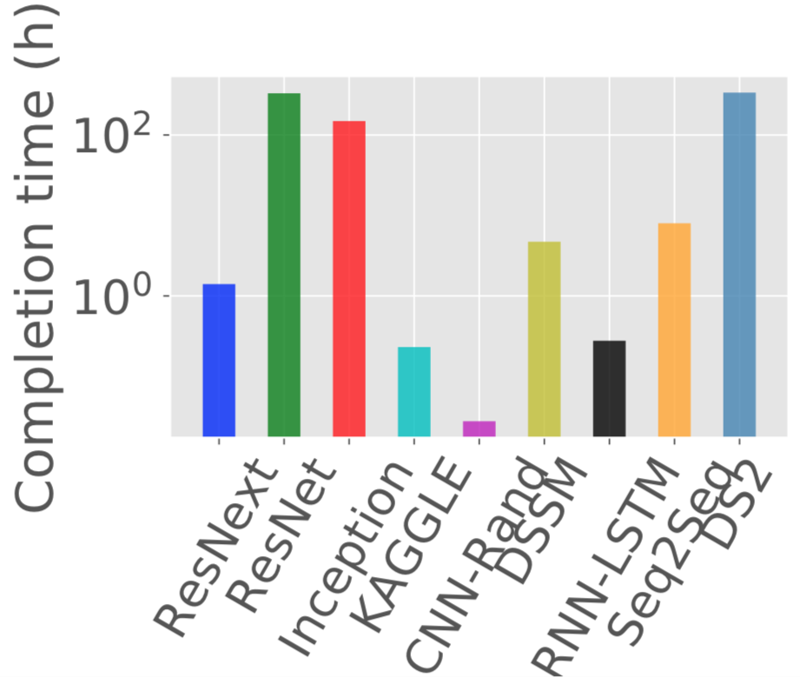
Challenge I
Job execution time unawareness
Notes:
HOL blocking

Slide 25
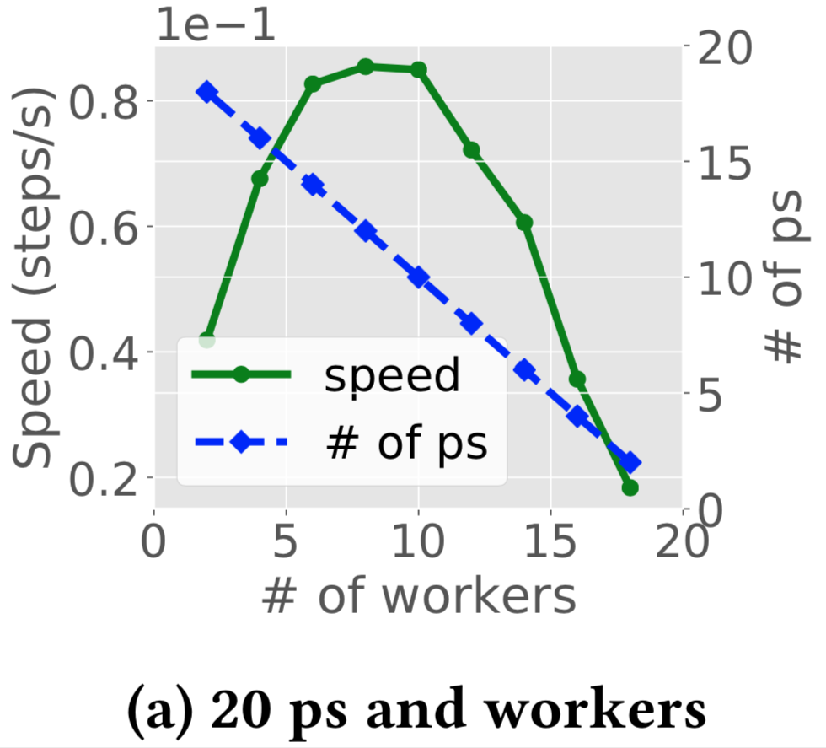
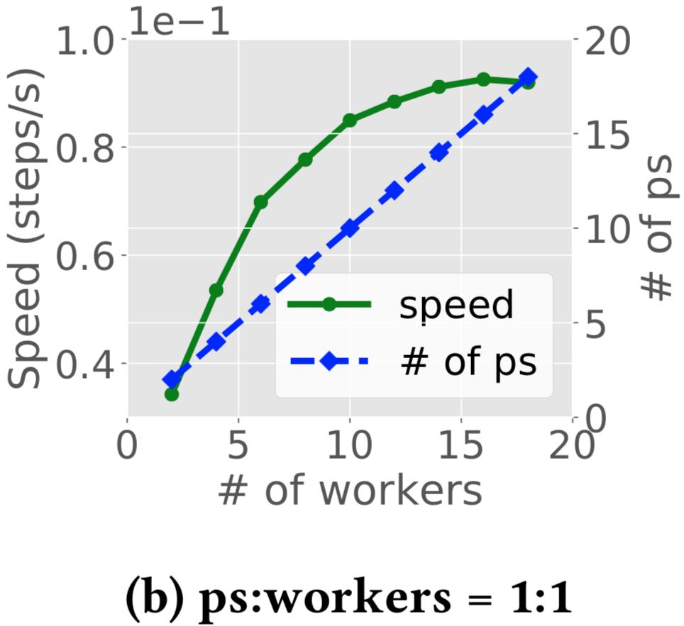
Challenge II
Static and manually-specified resource configuration
Maximal speed at 8 workers and 12 PSs
Non-linear speed improvement, even slower
Notes:
HOL blocking

Slide 26
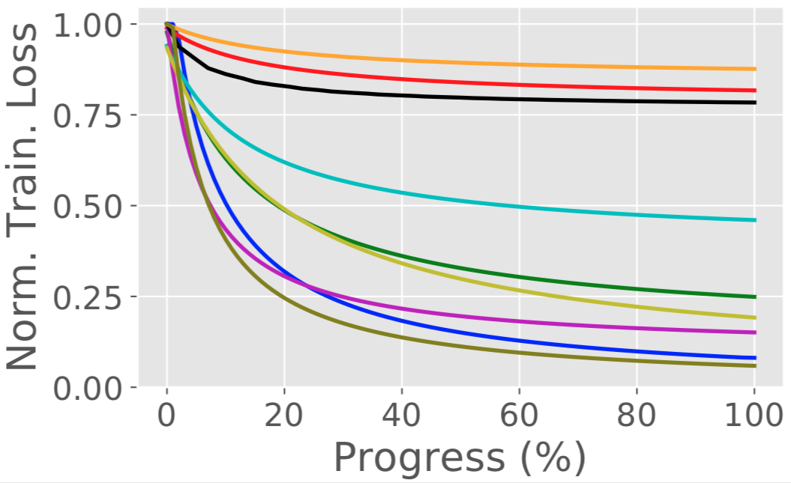
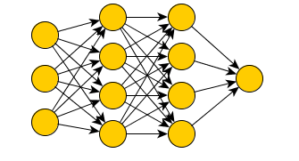
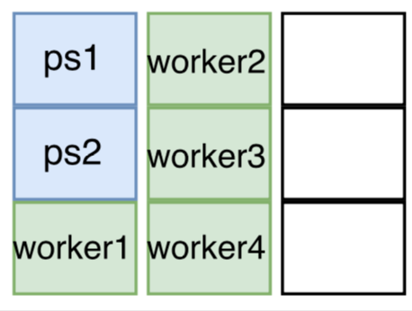
Overview of Optimus
Training loss
Remaining steps
Learning loss curve
Minimize JCT
Job resource
DL training jobs
Resource allocation
Training speed
Task placement
Speed function
Resource-Speed Model
Notes:
DL tech has been widely used in many domains, such as OD, Speech recog,….
With the increase of applications, more jobs need to be trained
In MS, the amount of DL training jobs has a 10.5 increa
Normally, DL training job are computing intensive, and require GPU to accelerate
With the increase of demands, many companies have built their own GPU cluster
GPU cluster to train their DL models
…
In this work, we will see what are the challeges faced by DL training jobs, and how to ….
The general question we try to answer is
How different from GPU cluster to the traditional cluster for big data applications in terms of resource management
Can we rely on the existing cluster manager for big data applications?

Slide 27
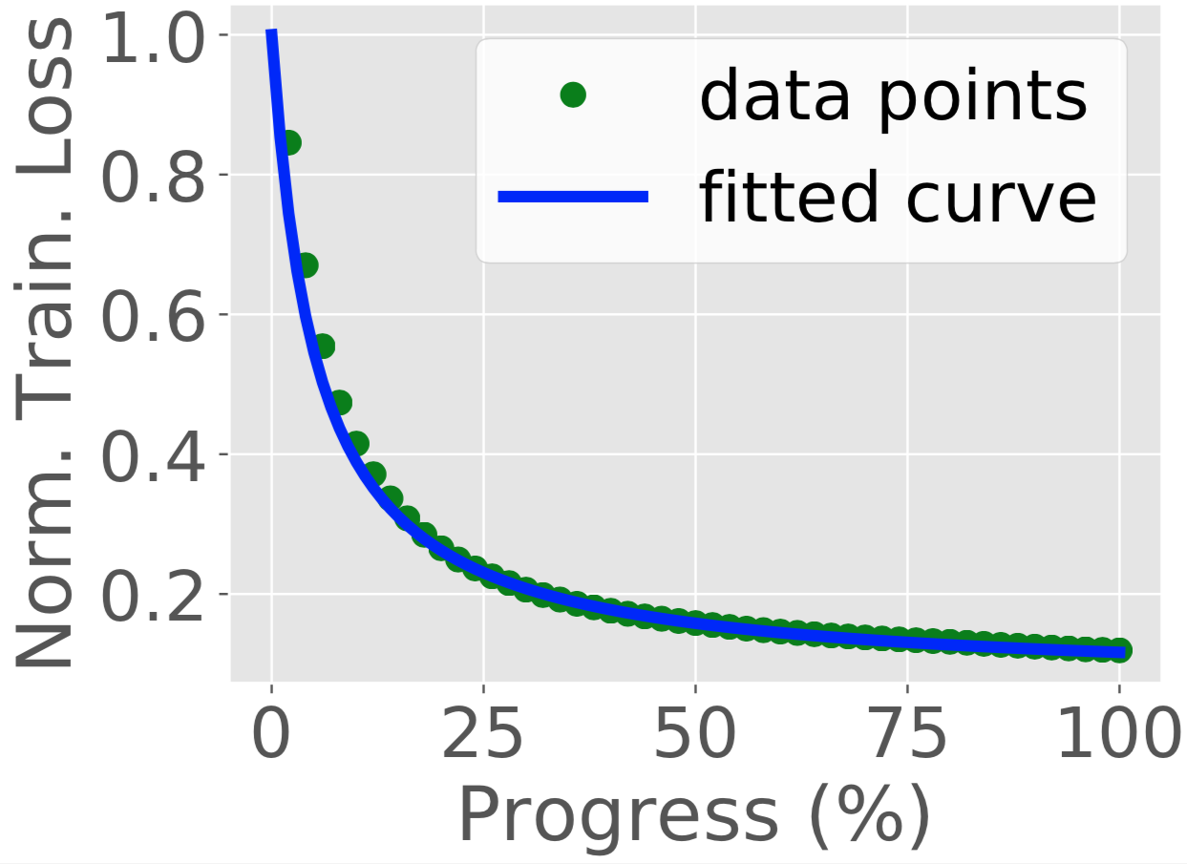
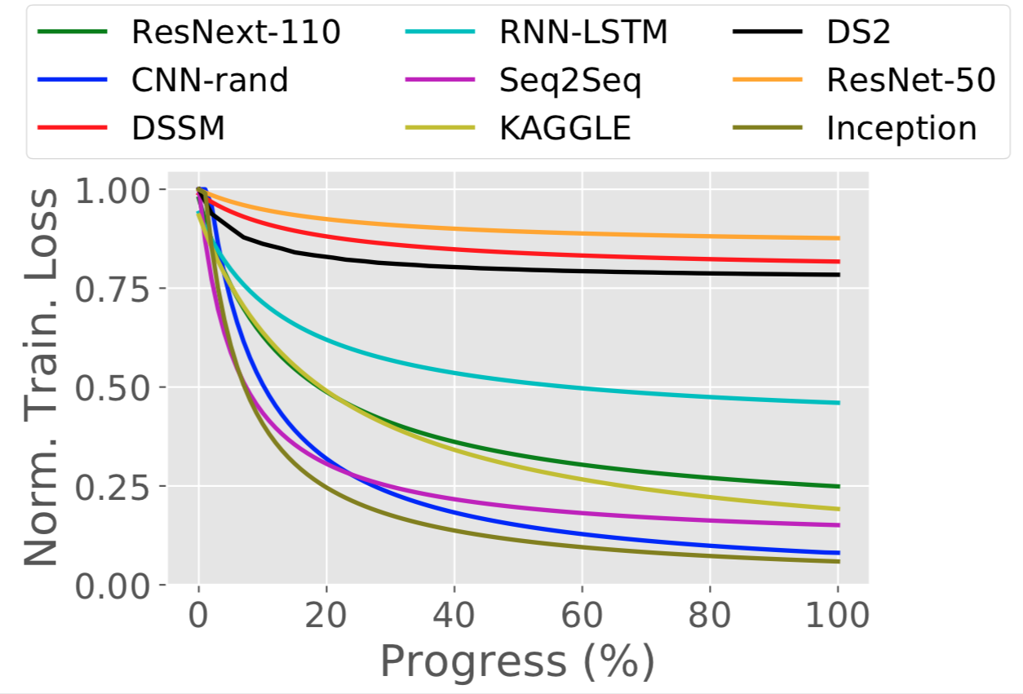
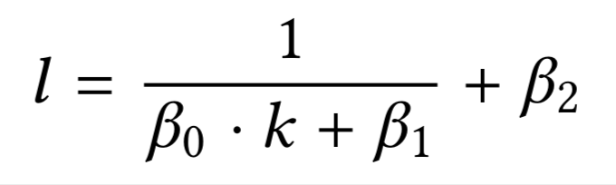
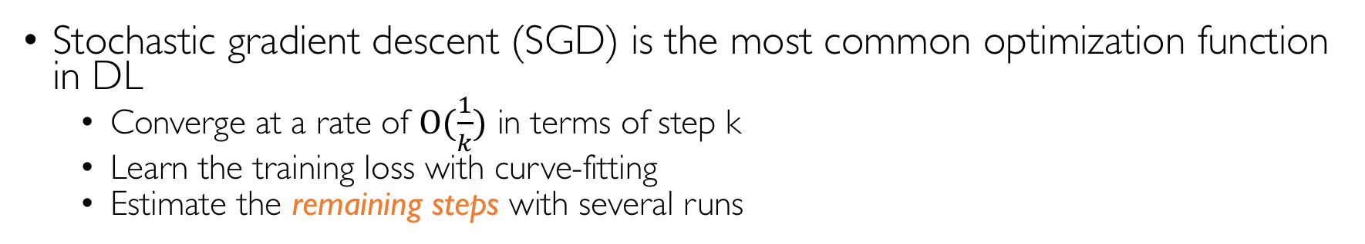
Learning the Loss curve
Stochastic gradient descent (SGD) is the most common optimization function in DL
Converge at a rate of $Ο(\frac{1}{k})$ in terms of step k
Learn the training loss with curve-fitting
Estimate the remaining steps with several runs
loss
step
coefficient

Slide 28
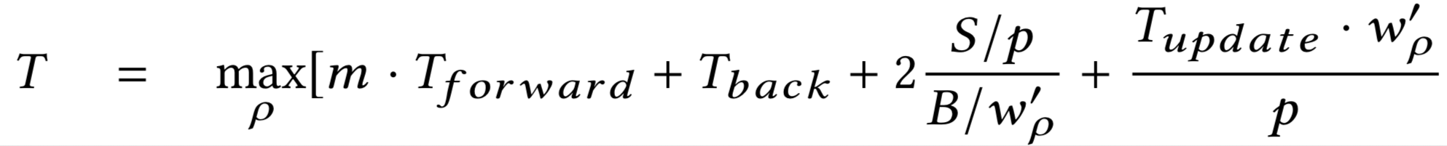
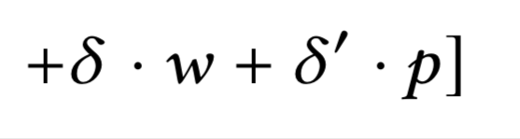
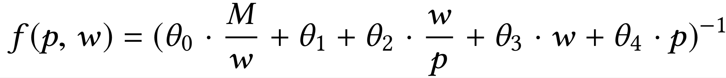
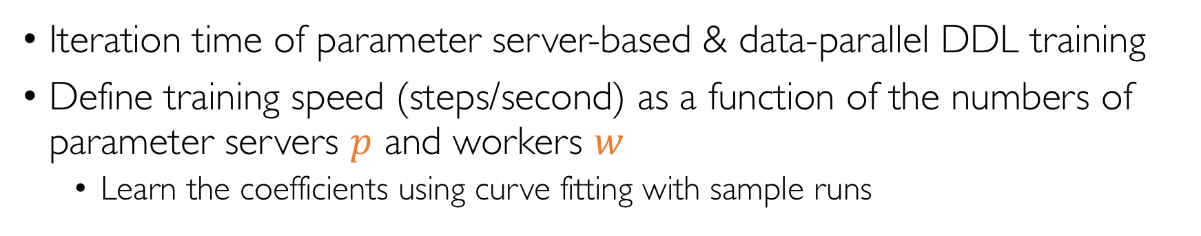
Resource-Speed Model of DL Training
Iteration time of parameter server-based & data-parallel DDL training
Define training speed (steps/second) as a function of the numbers of parameter servers $p$ and workers $w$
Learn the coefficients using curve fitting with sample runs
Forward
Backward
Push / pull
Model update
Control overhead
coefficient
Notes:
DL tech has been widely used in many domains, such as OD, Speech recog,….
With the increase of applications, more jobs need to be trained
In MS, the amount of DL training jobs has a 10.5 increa
Normally, DL training job are computing intensive, and require GPU to accelerate
With the increase of demands, many companies have built their own GPU cluster
GPU cluster to train their DL models
…
In this work, we will see what are the challeges faced by DL training jobs, and how to ….
The general question we try to answer is
How different from GPU cluster to the traditional cluster for big data applications in terms of resource management
Can we rely on the existing cluster manager for big data applications?

Slide 29
Overview of Optimus
Training loss
Remaining steps
Learning loss curve
Minimize JCT
Job resource
DL training jobs
Resource allocation
Training speed
Task placement
Speed function
Resource-Speed Model
Notes:
DL tech has been widely used in many domains, such as OD, Speech recog,….
With the increase of applications, more jobs need to be trained
In MS, the amount of DL training jobs has a 10.5 increa
Normally, DL training job are computing intensive, and require GPU to accelerate
With the increase of demands, many companies have built their own GPU cluster
GPU cluster to train their DL models
…
In this work, we will see what are the challeges faced by DL training jobs, and how to ….
The general question we try to answer is
How different from GPU cluster to the traditional cluster for big data applications in terms of resource management
Can we rely on the existing cluster manager for big data applications?

Slide 30
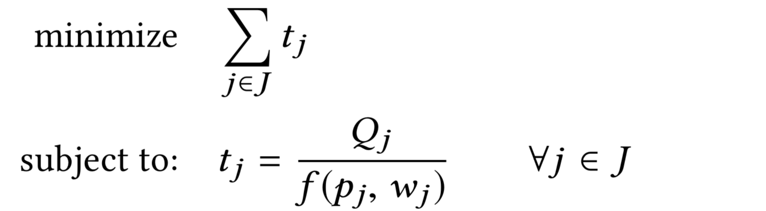
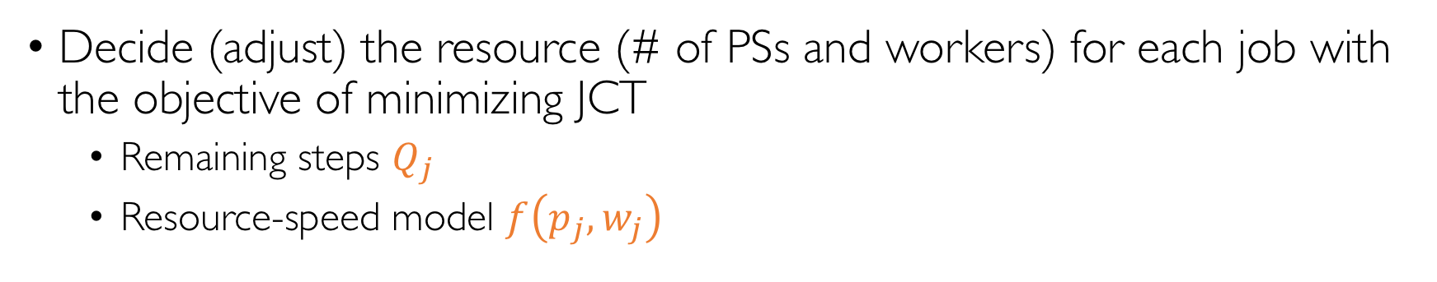
Resource Allocation
Decide (adjust) the resource (# of PSs and workers) for each job with the objective of minimizing JCT
Remaining steps $Q_{j}$
Resource-speed model $f\left(p_{j}, w_{j}\right)$
Problem formula

Slide 31
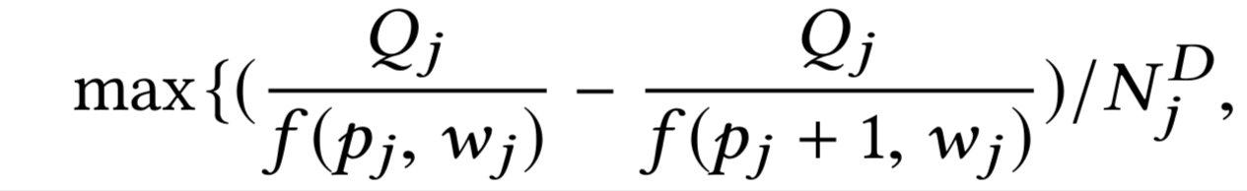
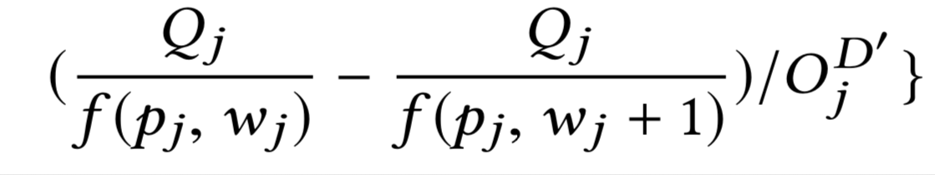
Resource Allocation
Decide (adjust) the resource (# of PSs and workers) for each job with the objective of minimizing JCT
Remaining steps $Q_{j}$
Resource-speed model $f\left(p_{j}, w_{j}\right)$
Marginal gain: reduced JCT per unit of resource (PS or worker)
marginal gain of PS
marginal gain of worker
Notes:
Margianl gain: with more resource, what’s (gain in time)

Slide 32
Greedy Resource Allocation
Prioritize job with the highest marginal gain
In each scheduling iteration
Allocate one PS and one worker for each active job
Sort jobs based on their marginal gain
Add one PS (or worker) to the job with the highest marginal gain
Repeat until running out of resource, or having non-positive marginal gain
Notes:
Margianl gain: with more resource, what’s (gain in time)
the reduction in job completion time when one worker (parameter server) is added to job i; dividing
it by the amount of dominate resource that a worker occupies

Slide 33
Overview of Optimus
Training loss
Remaining steps
Learning loss curve
Minimize JCT
Job resource
DL training jobs
Resource allocation
Training speed
Task placement
Speed function
Resource-Speed Model
Notes:
Consolidation: the minimum number of servers.

Slide 34
Implementation
Load balancing on parameter servers
Elastic training on MXNet
Checkpoint and resume model
Scheduling on Kubernetes
Notes:
Consolidation: the minimum number of servers.

Slide 35
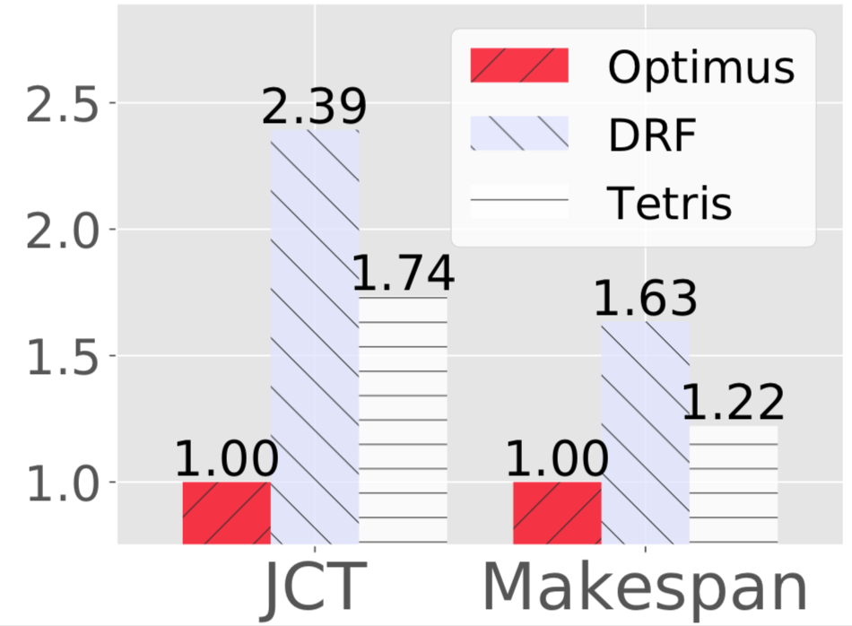
Evaluation
Optimus reduces the average JCT and makespan by 2.39× and 1.63× (w.r.t. DRF)
Notes:
Consolidation: the minimum number of servers.

Slide 36
Optimus
GPU cluster manager with dynamic resource allocation for Distributed Deep Learning
Curve-fitting model to estimate the remaining steps
Resource-speed model for better resource efficiency
Dynamic resource allocation (scheduling) to minimize JCT

Slide 37
Discussion
Learning the loss curve of DL training job
Ignore trial-and-error model exploration
Resource-speed model
Homogeneous hardware
Workers communicate with PSs concurrently
Explicit computing stage and communication stage in training
Stable and congestion-free network links
Dynamic resource allocation
Overhead in elastic training (adding / deleting PSs and workers)
Notes:
Consolidation: the minimum number of servers.
Slow down the jobs who are completing and have flat loss curve

Slide 38
Discussion
Who should and how to decide the resource configuration of DL training jobs?
Tiresias: user-specified input
Users’ experience and requirements
Optimus: dynamic allocation by cluster manager
Infrastructure-aware
Optimize JCT and resource efficiency
AutoML (model-exploration framework)
Users’ can specify the hard requirements or priority
Interact with the cluster manager
Allocate resource following its model-search algorithm and jobs’ quality
Notes:
Consolidation: the minimum number of servers.

Slide 39
Thank You
Notes:
Consolidation: the minimum number of servers.

